Slide 1
Central New Mexico Community College School of Business & Information Technology
CSCI 2251
Intermediate Programming

Slide 2

Basic Counting Systems
Decimal Counting
0 1 2 3 4 5 6 7 8 9
10 11 12 13 14 15 16 17 18 19
20 21 22 23 24 25 26 27 28 29
. . .
90 91 92 93 94 95 96 97 98 99
100 101 102 103 . . .
Binary Counting
0 1
10 11
100 101
110 111
1000 1001

Slide 3
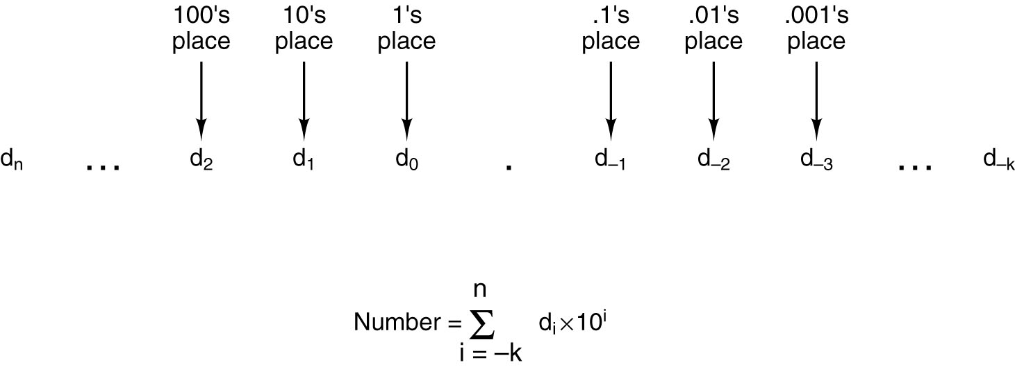
Radix Number Systems The Choice of 10 as Radix
The general form of a decimal number.
Which item in the above formula need to be changed for binary numbers?
Why?

Slide 4
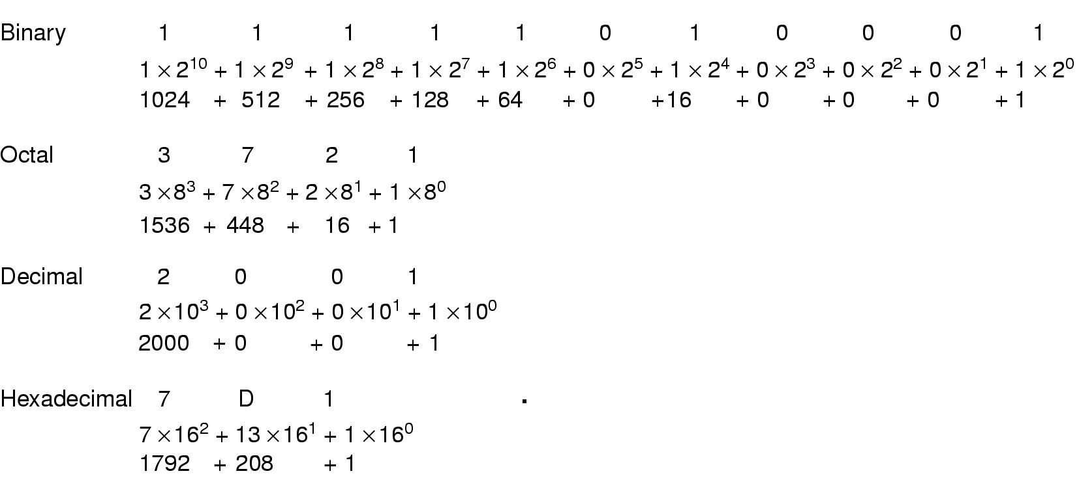
Radix Numbers Different Representation of The 2001₁₀
Decimal numbers and their binary, octal, and hexadecimal equivalents.

Slide 5
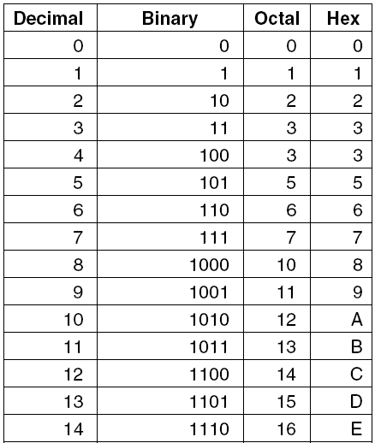
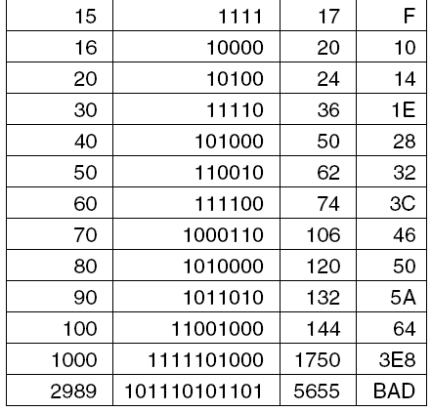
Conversion Between Radixes
Decimal numbers and their binary, octal, and hexadecimal equivalents.

Slide 6


Slide 7
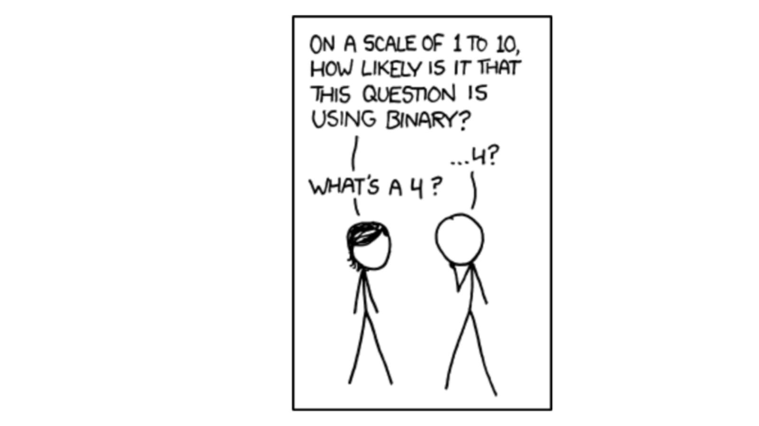
If you get an 11/100 on a CS test, but you claim it should be counted as a “C”, they’ll probably decide you deserve the upgrade.
https://xkcd.com/953/

Slide 8
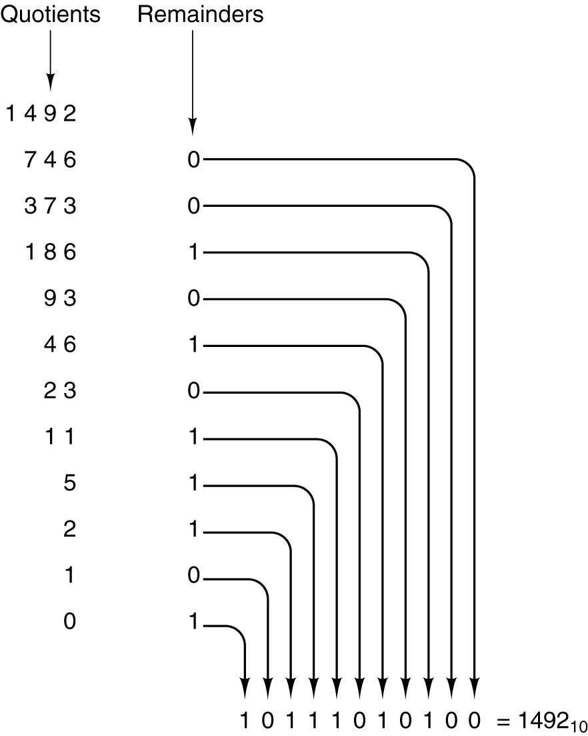
Conversion – Decimal to Binary
Conversion of the decimal number 1492 to binary by successive halving, starting at the top and working downward. For example, 93 divided by 2 yields a quotient of 46 and a remainder of 1, written on the line below

Slide 9
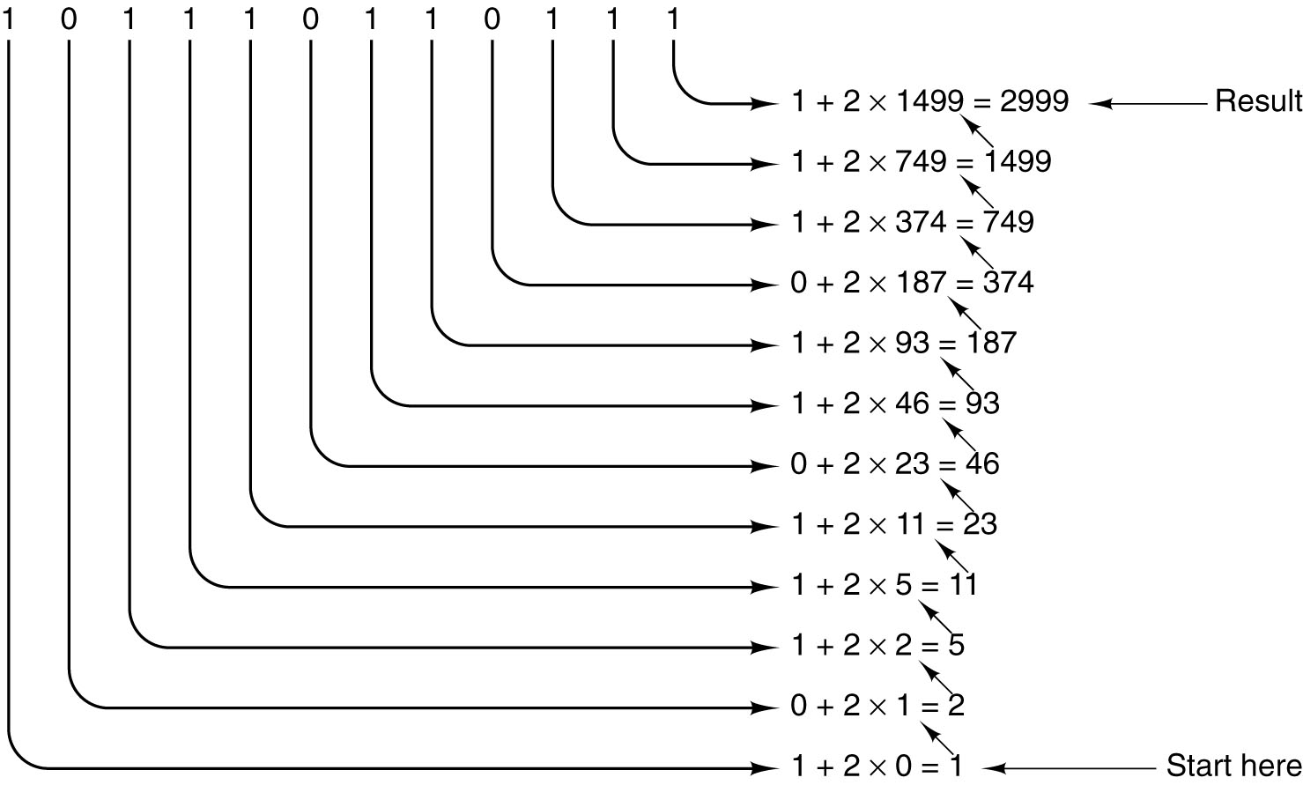
Conversion – Binary to Decimal
Conversion of the binary number 101110110111 to decimal by successive doubling, starting at the bottom. Each line is formed by doubling the one below it and adding the corresponding bit. For example, 749 is twice 374 plus the 1 bit on the same line as 749.

Slide 10

Supplemental Material Floating Point Numbers
Fenton Lake
Jemez Mountain
(2019)

Slide 11
Supplemental Material Binary Numbers
Computers use Finite Precision Numbers – Assuming a computer only can present three digits decimals, what will happen?
Numbers larger than 999
Negative numbers
Fractions
Irrational numbers
Complex numbers
Problems are: Too Large/Small, Not a Number

Slide 12
Floating-Point Numbers
exponent
fraction, or mantissa
radix

Slide 13
Floating-Point Numbers
3.14 = 0.314 × 10¹ = 3.14 × 10⁰
0.000001 = 0.1 × 10⁻⁵ = 1.0 × 10⁻⁶
1941 = 0.1941 × 10⁴ = 1.941 × 10³
Consider a number representation consisting of:
A signed decimal in the range from 0.1 to 1
and a signed two-digit exponent
The negative number range is -0.100 × 10⁻⁹⁹ to -0.999 × 10⁺⁹⁹
The positive number range is +0.100 × 10⁻⁹⁹ to +0.999 × 10⁺⁹⁹.
A span of nearly 199 order of magnitude.

Slide 14
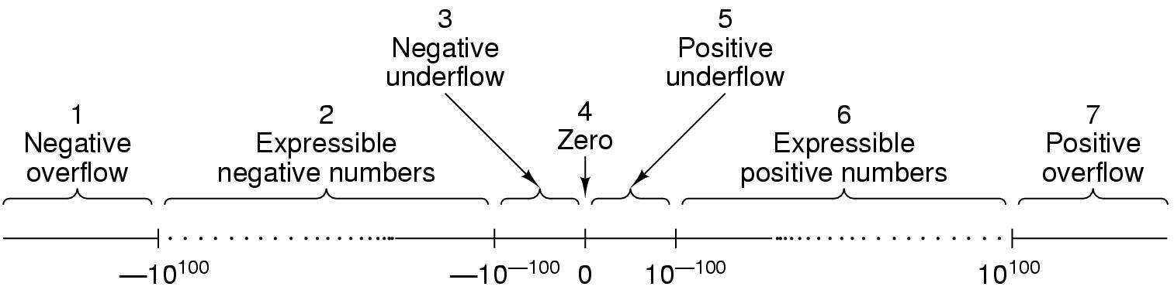
Floating-Point Numbers
Large negative number less than -0.999 × 10⁹⁹
Negative number between -0.999 × 10⁹⁹ and -0.100 × 10⁻⁹⁹
Small negative number with magnitudes less than 0.100 × 10⁻⁹⁹
Zero
Small positive number with magnitudes less than 0.100 × 10⁻⁹⁹
Positive numbers between 0.100 × 10⁻⁹⁹ and 0.999 × 10⁹⁹
Large positive numbers greater than 0.999 × 10⁺⁹⁹
Total of 358,201 distinct numbers (179,100 positive, 179,100 negative, and one 0) over the range between -0.999×10⁹⁹ to 0.999×10⁹⁹

Slide 15
Floating-Point Numbers
Overflow – the magnitude is too large to be represented by it’s positive exponent value (for both + and - numbers)
Underflow – the magnitude is too small to be represented by it’s negative exponent value (for both + and - numbers)
In many cases the underflow error is less serious than the overflow error.
Fraction (mantissa) represent the density between two real numbers. Increasing the fraction increases the accuracy.
Exponent represent the size (scope) of the number. Increasing the exponent increase the size of regions 2 and 6.
The spacing between adjacent expressible numbers is not constant but the relative error introduced by rounding is the same for small number as large ones.

Slide 16
Floating-Point Normalization
Binary floating point example
0 1 0 1 0 1 0 0. 0 0 0 0 0 0 0 0 0 0 0 1 1 0 1 1
Normalized means that a fraction with a non zero left most digit
Exponent
Excess 64
84-64 = 20
Fraction
Sign
+
16

Slide 17
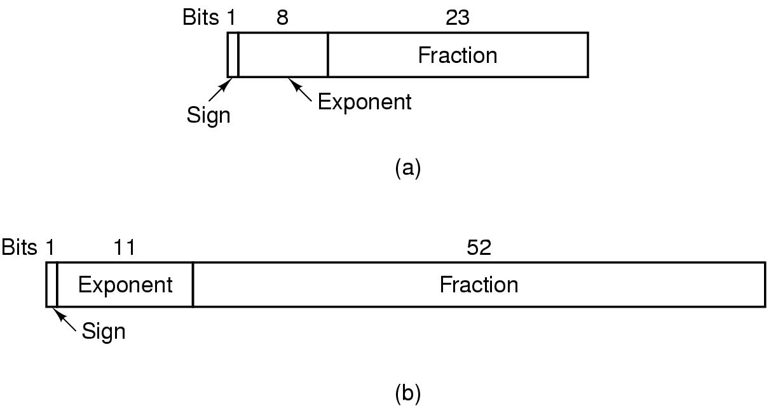
IEEE Floating-Point Standard 754
Single precision – 32 bits
Double precision – 64 bits
Extended precision – 80 bits
Starting from the leftmost bits
Sign; Exponent, 8 for single (excess 127) and 11 for double (excess 1023); Fraction, 23 for single and 52 for double.
Fraction – implied 1 followed by 23 or 52 explicit bits
17

Slide 18
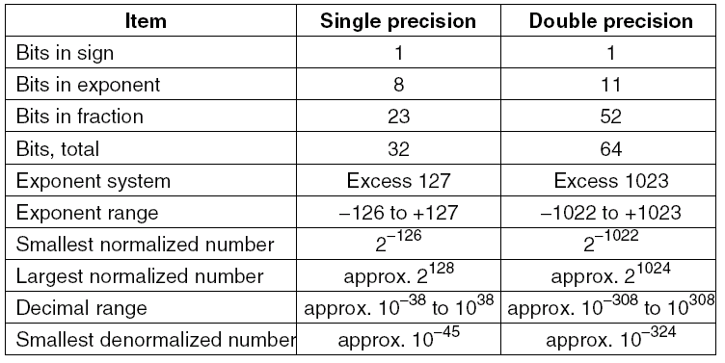
IEEE Floating-Point Standard 754

