Slide 1
Chapter 23 Concurrency

Slide 2

Processes and Threads
Processes – Programs in Execution
At any instance of time one CPU only runs one program.

Slide 3
Process Creation
Principal events that cause process creation:
System initialization
Background processes
Execution of a process creation system call by a running process
Compiler for example
User request to create a new process
User Command from command interpreter, double click

Slide 4
Process Termination
Conditions which terminate processes
Normal exit (voluntary)
exit() in Unix/Linux, ExitProcess() in windows
Error exit (voluntary)
Compiler cannot find source code
Fatal error (involuntary)
Program bugs – invalid memory access, divide by 0
Killed by another process (involuntary)
kill() in Unix/Linux, TerminateProcess() in Windows

Slide 5
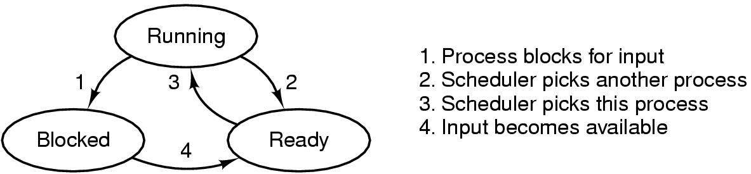
The Three Major Process States
Possible process states
Running
Blocked
Ready

Slide 6
Information about a Process
To implement the process model, the OS maintains a table, called the process table with one entry per process
The entry contains information about the process’s state, that includes
PC – Program Counter
SP – Stack Pointer
memory allocation,
status of open files,
accounting and scheduling information
context switch information.

Slide 7
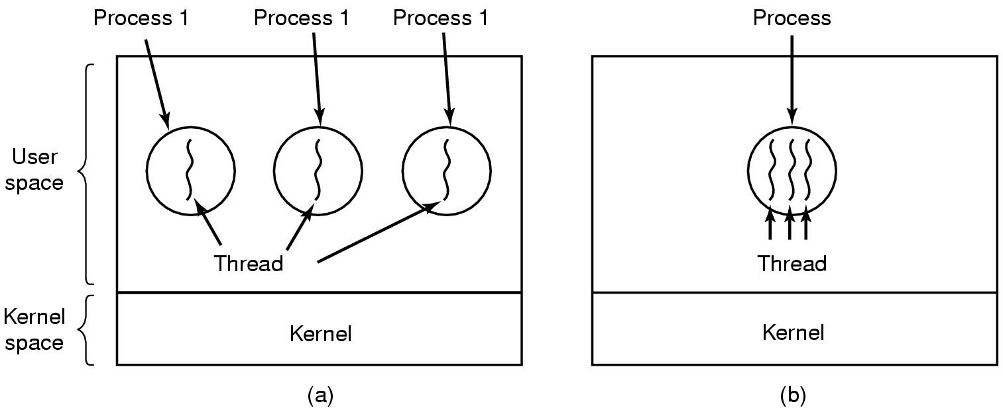
Threads Threads are execution sequences
2
3
Traditionally, each process has an address space and a single thread of control. In (a) three processes each with one thread.
Threads have PC, registers, stack. They do not have dedicated text and data and they share global variables. Threads are called lightweight processes. In (b) one process with three threads.

Slide 8
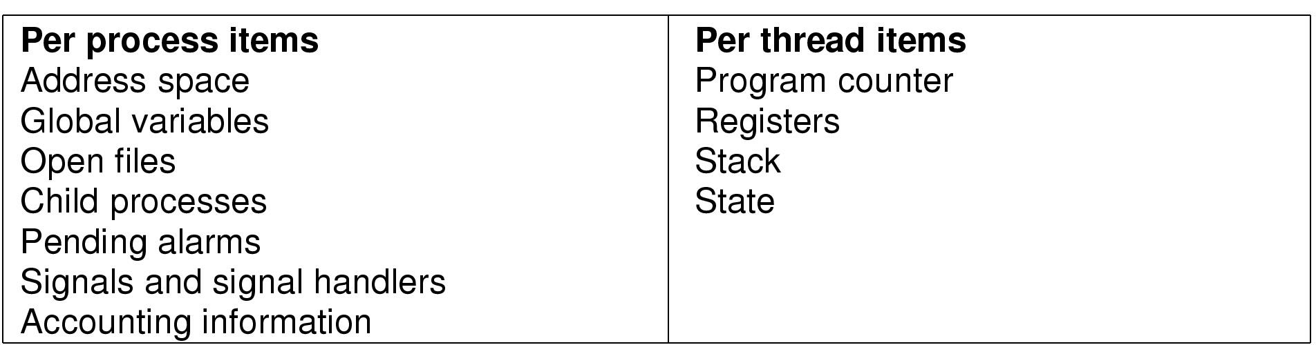
Threads Differences between Process and Thread
No protection between threads.
It is impossible (they are using the same address space).
It is not necessary (they all belong to a single process).
They share the same open file, child processes, alarms, and signals, etc.
First column: items shared by all threads in a process; second column: items private to each thread.

Slide 9
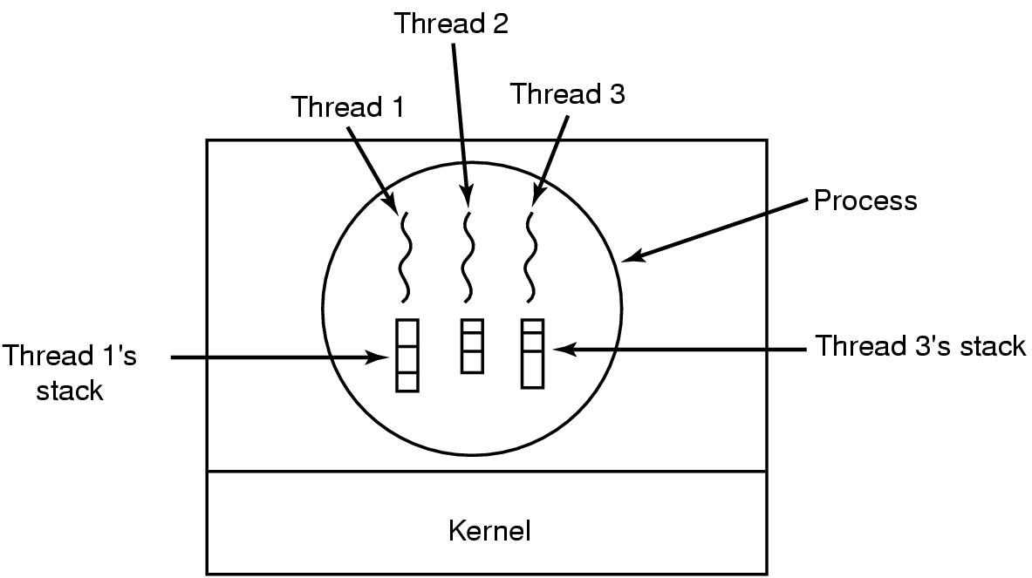
Threads The Characteristic of Thread
A thread can be in one of the states:
Running, blocked, ready, or terminated.
Each thread has its own stack
Contains one frame for each procedure called but not yet returned.
A single process (thread) starts, it then create new threads.
thread_create, thread_exit, thread_wait, and thread_yield are normal thread control operations.
Threads can be hierarchical, but normally not.

Slide 10
Threads Thread Usage – Why Thread?
The ability for the parallel entities to share an address space and all of its data among themselves.
Minimal resources attached to threads. They are easier to create and destroy than processes.
Threads gain a lot of performance on I/O bound tasks.
Threads are useful on systems with multiple CPUs.

Slide 11
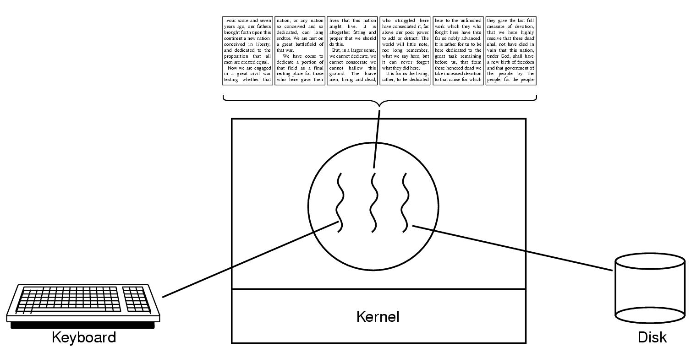
Threads Used by Word Processor Editor
Three threads: Interacting, Reformatting, Saving

Slide 12
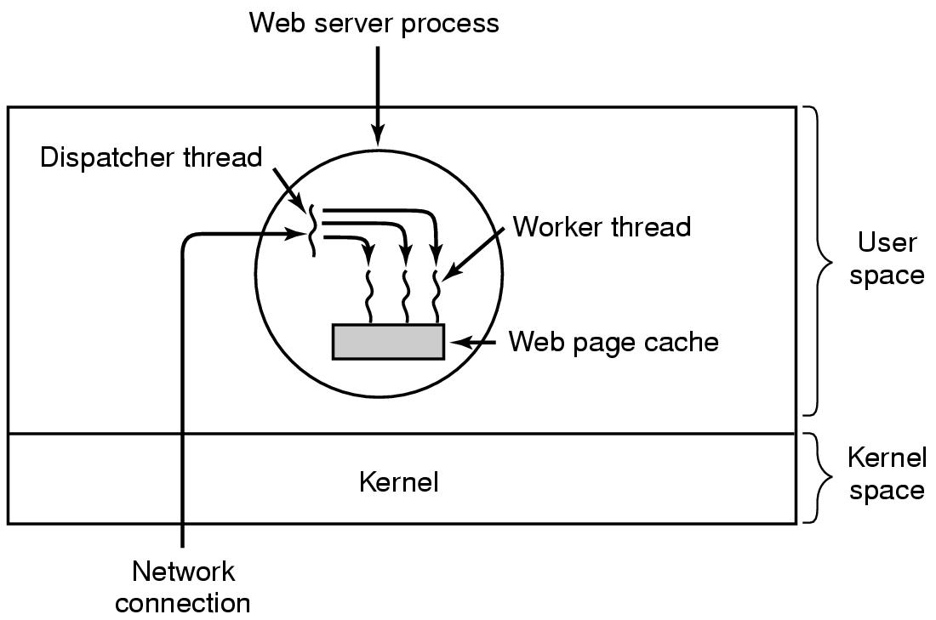
Threads Used by Web Server
Dispatcher – read incoming requests and wake up a worker thread
Worker – check web page cache, if not read from disk (block on I/O)

Slide 13
Introduction
Two tasks are operating concurrently means that they’re both making progress during some period of time.
Two tasks are operating in parallel if they’re executing simultaneously.

Slide 14
Introduction
Programming concurrent applications is difficult and error prone.
Guidelines:
Use existing collection classes and interfaces from the concurrency APIs to manage synchronization.
Advanced programmers who want to control synchronization, use the synchronized keyword and Object methods wait, notify and notifyAll.
Advanced programmers use Locks and Condition

Slide 15
Thread Priorities and Thread Scheduling
Every thread has a thread priority that helps determine the order in which threads are scheduled.
Higher-priority threads should be allocated processor time before lower-priority threads.
Thread priorities cannot guarantee the order in which threads execute.
An O/S thread scheduler determines which thread runs next.

Slide 16
Indefinite Postponement and Deadlock
When a higher-priority thread enters the ready state, the O/S generally preempts the currently running lower-priority thread.
A steady influx of higher-priority threads could postpone—possibly indefinitely—the execution of lower-priority threads.
Indefinite postponement is sometimes referred to as starvation.
O/S employ a technique called aging to prevent starvation.
Deadlock – A problem related to indefinite postponement
Occurs when a waiting thread (thread1) cannot proceed because it’s waiting (either directly or indirectly) for another thread (thread2) to proceed, while simultaneously thread2 cannot proceed because it’s waiting (either directly or indirectly) for thread1 to proceed.
The two threads are waiting for each other, so the actions that would enable each thread to continue execution can never occur.

Slide 17
Creating and Executing Threads with the Executor Framework
Recommended: Use the Executor interface to manage the execution of Runnable objects.
Typically creates and manages a group of threads called a thread pool to execute Runnables.
Executors can reuse existing threads and can improve performance by optimizing the number of threads.
Executor method execute accepts a Runnable as an argument.
An Executor assigns every Runnable passed to its execute method to one of the available threads in the thread pool.
If there are no available threads, the Executor creates a new thread or waits for a thread to become available.

Slide 18
Producer/Consumer Relationship without Synchronization
In a producer/consumer relationship, the producer portion of an application generates data and stores it in a shared object, and the consumer portion of the application reads data from the shared object.
A producer thread generates data and places it in a shared object called a buffer.
A consumer thread reads data from the buffer.
This relationship requires synchronization to ensure that values are produced and consumed properly.
Operations on the buffer data shared by a producer and consumer thread are also state dependent—the operations should proceed only if the buffer is in the correct state.
If the buffer is in a not-full state, the producer may produce; if the buffer is in a not-empty state, the consumer may consume.

