Slide 1
Compilation Process

Slide 2
Sources
quora.com/What-does-assembly-language-look-like
medium.com/@rahul77349/machine-code-vs-byte-code-vs-object-code-vs-source-code-vs-assembly-code-812c9780f24c
howtoprogramming999.blogspot.com/2013/12/difference-between-source-code-and.html
en.wikipedia.org/wiki/Grace_Hopper
youtube.com/watch?v=VDslRumKvRA
youtube.com/watch?v=gSackZtqlUI

Slide 3
Student Learning Goals
role/purpose of different language.
role/purpose of compiler modules.
distinguish source, assembly, object/machine code.
order of compiler operations.

Slide 4
Compiler is composed of multiple modules:
Preprocessor
Compiler
Assembler
Linker

Slide 5
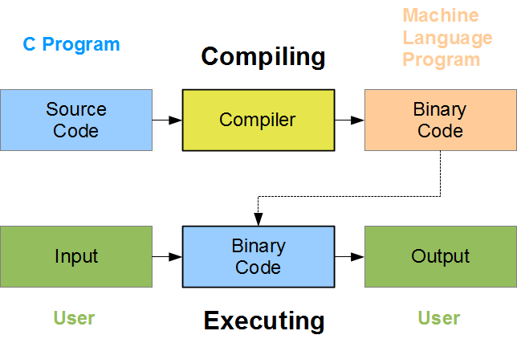

Slide 6
Source code ( .c files ) given to the preprocessor.
Preprocessor processes it and hands it to the compiler.
Compiler generates assembly code file.

Slide 7
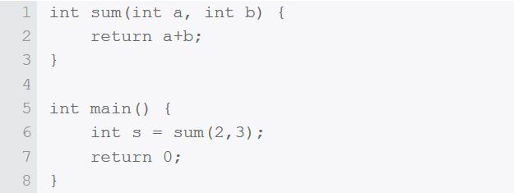

Slide 8
Preprocessor
removes comments and whitespace
includes header file code in file
macro names replaced by their values
Assembly code is still not understood by the machine.

Slide 9
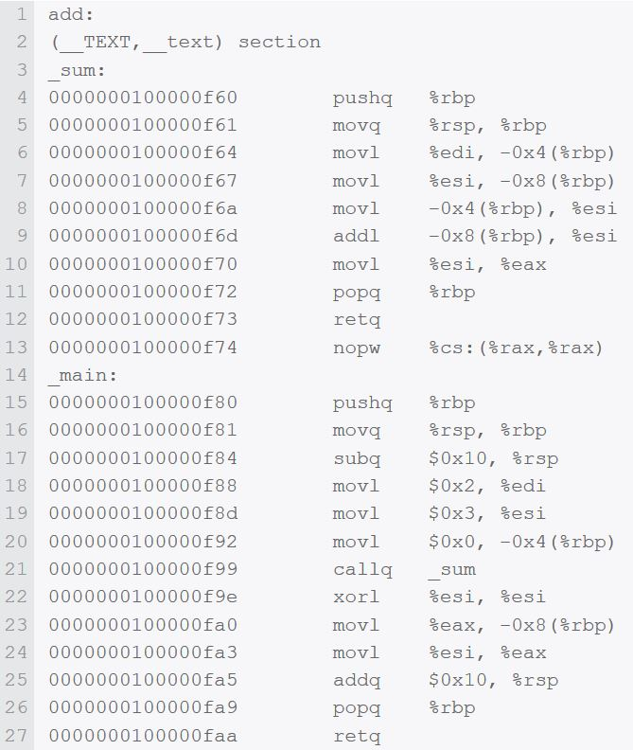
Notes:
The first column is just the location of the code in hex. The middle column is the command, and the right column are the arguments to that command. So "pushq %rbp" means “push the quad-word value of the base pointer (RBP) onto the stack”.

Slide 10
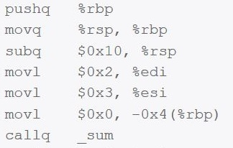

Slide 11
Assembler
Assembler converts assembly language into object code.
Assembly code is still considered source code and "human readable" (if you have a lot of patience.)
How is machine code different from assembly code?

Slide 12
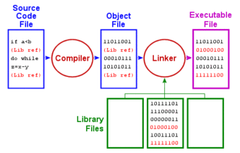

Slide 13
Assembly Code
plain-text and (somewhat) human read-able
direct 1:1 analog with machine instructions
English-like standard instructions.

Slide 14
Object Code
machine code that hasn’t yet been linked
one particular library or module that will make up the completed product
may contain placeholders

Slide 15
Machine Code
binary (1’s and 0’s) code
directly executable by the processor
No further translation

Slide 17
A project might be composed of many different files
including references to libraries of code
we want a single executable

Slide 18
Linker
Takes (possibly multiple) object files
Fills in references to external libraries
Consolidates many files into a self-contained executable

Slide 19

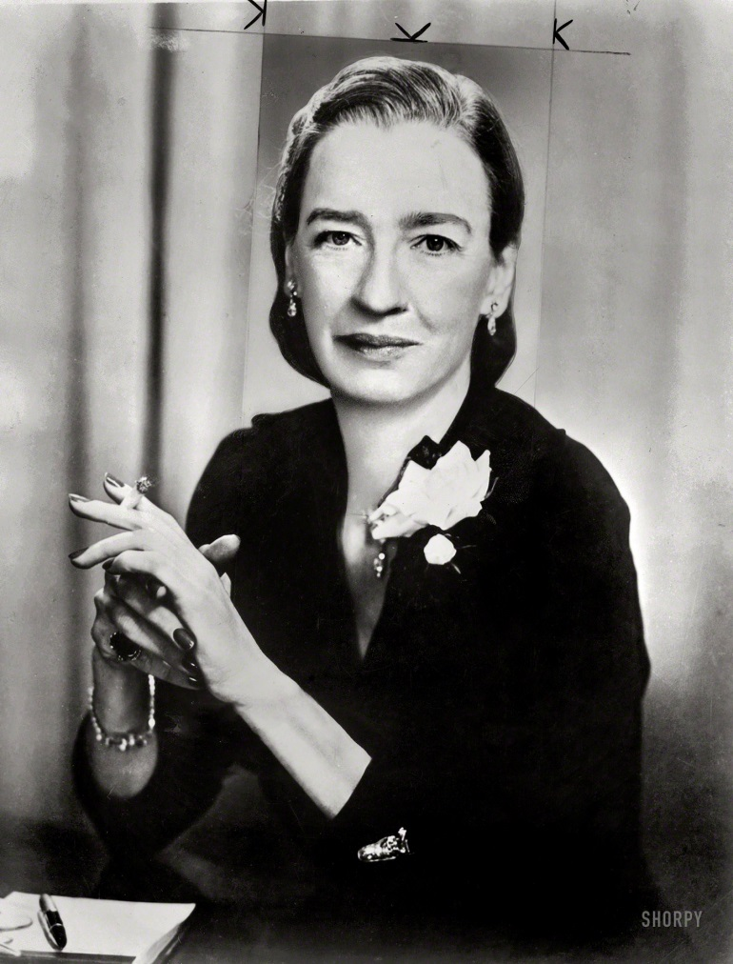
Commodore Grace Hopper 1906-1992

Slide 20

Compiler History
Rear Admiral Grace Hopper
(1906 – 1992)
Attempted to enlist in the Navy during World War II but was rejected because she was 34 years old
Joined the Navy Reserves
Invented one of the first linkers
Popularized the idea of machine-independent programming languages

Slide 21
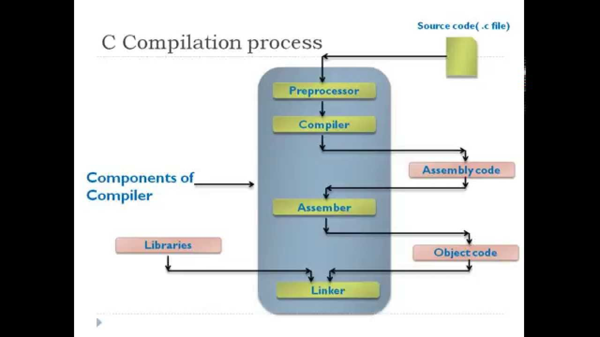

Slide 22
Summary Part 1
Human-readable (high level) source code must be translated into a language of instructions that the computer can implement.
Source code is easier for a human to read.
Assembly is still possible for a human to read and has a 1 to 1 correspondence with machine code.
Machine code can be executed by the computer.
Notes:
Summary:
Human-readable (high level) source code must be translated into a language of instructions that the computer can implement.
Source code is easier for a human to read.
Assembly is still possible for a human to read and has a 1 to 1 correspondence with machine code.
Machine code can be executed by the computer.
Preprocessor removes whitespace and comments, includes header code, replaces macros.
Compiler translates source to assembly. Instructions are still an english word.
Assembler converts assembly into machine language (in binary, ones and zeroes).
Linker consolidates multiple object files and fills in references to external libraries to generate a single executable file.
Ordering: Preprocessor, then compiler, then assembler, then linker.

Slide 24
Summary Part 2
Preprocessor removes whitespace and comments, includes header code, replaces macros.
Compiler translates source to assembly. Instructions are still an English word.
Assembler converts assembly into machine language (in binary, ones and zeroes).

Slide 26
Summary Part 3
Linker consolidates multiple object files and fills in references to external libraries to generate a single executable file.
Ordering: Preprocessor, then compiler, then assembler, then linker.

