Slide 1
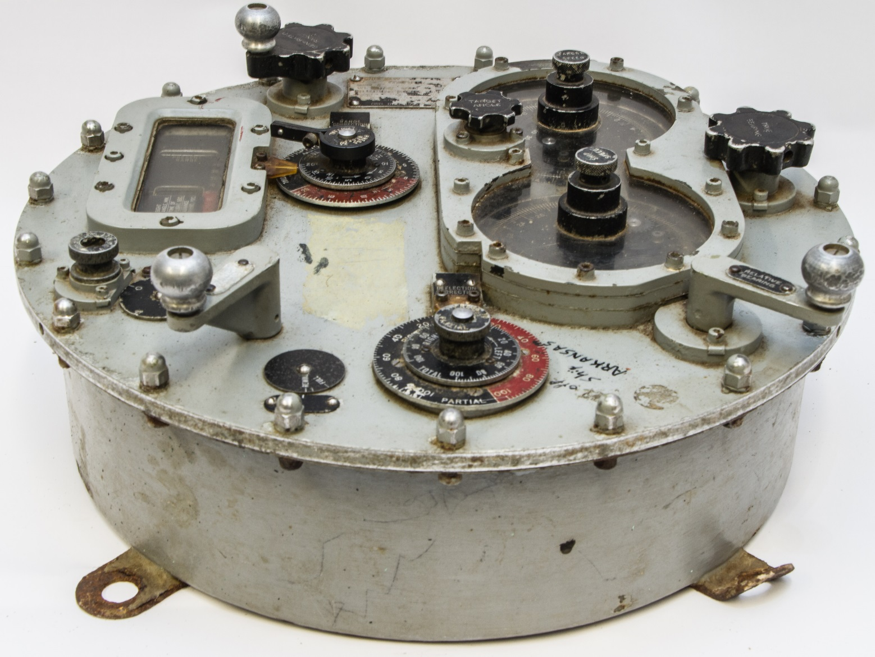
World War 2
Navy Fire Control Computers 1:40
Notes:
Flash forward to World War 2. A version of Babbage's analytical engine is at work inside the navy's battleships and destroyers. Brief snippet of video.
https://www.youtube.com/watch?v=_8aH-M3PzM0

Slide 2
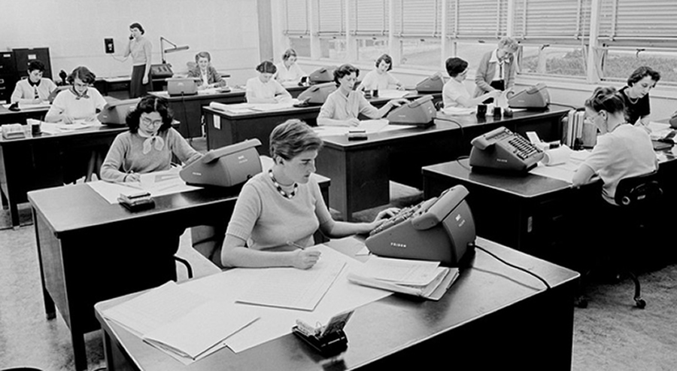
Computer (the profession)
Notes:
Secret codes, ballistics, enigma, and the bomb
The word computer refers to a job title. Women perform calculations for ballistics calculations, code breaking, and scientific research including work on the atomic bomb. They literally do assigned math problems all day long as their job.
Before the 1920s, computers (sometimes computors) were human clerks that performed computations. They were usually under the lead of a physicist. Many thousands of computers were employed in commerce, government, and research establishments. Most of these computers were women. Some performed astronomical calculations for calendars, others ballistic tables for the military.

Slide 3


Slide 4
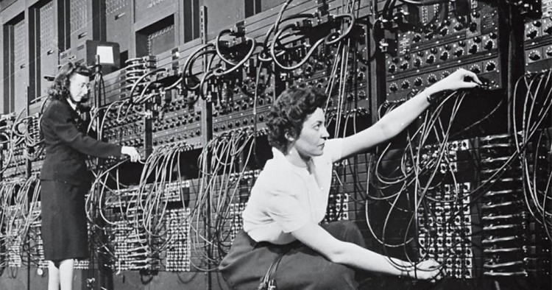
Computer (the profession)
Notes:
Six of them were selected to program a machine that, ironically, would take their name and replace them
Computers replace the women computers, removing one of the few sources of independent income for women at the time, but that's jumping a bit ahead too.

Slide 5
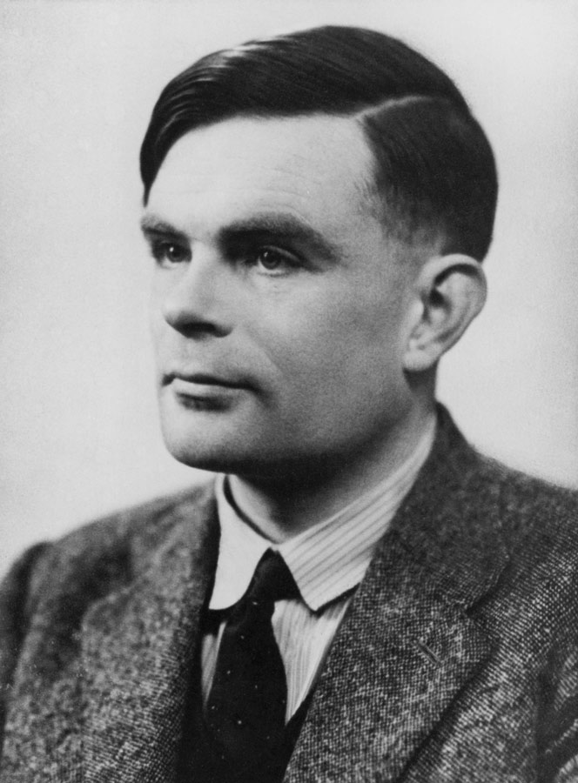
Alan Turing
Imitation Game
Enigma Code Decryption
Notes:
In England, a mathematician by the name of Alan Turing is working alongside other British and American mathematicians to crack the German Enigma codes. Show clip of Imitation Game.
Alan Turing is instrumental in cracking the codes, reducing the length of the war and saving thousands of lives. Turing invents a computing machine, defines what it means for an operation to be computable, and proves that his machine is capable of being programmed to compute ANY computable operation.
Within weeks of arriving at Bletchley Park,[58] Turing had specified an electromechanical machine that could help break Enigma more effectively than the Polish bomba kryptologiczna, from which its name was derived. The bombe, with an enhancement suggested by mathematician Gordon Welchman, became one of the primary tools, and the major automated one, used to attack Enigma-enciphered messages.
https://www.youtube.com/watch?v=Btqro3544p8

Slide 6
Convicted by the British government of homosexual activities.
Accepts chemical castration treatment as alternative to prison.
Commits suicide days before his 42nd birthday.
Notes:
Tragedy: Turing is convicted by the British government of being gay. He is chemically castrated and ends up committing suicide 16 days before his 42nd birthday.
Turing was convicted and given a choice between imprisonment and probation, which would be conditional on his agreement to undergo hormonal treatment designed to reduce libido. He accepted the option of treatment via injections of what was then called stilboestrol (now known as diethylstilbestrol or DES), a synthetic oestrogen; this treatment was continued for the course of one year. The treatment rendered Turing impotent and caused gynaecomastia,[122] fulfilling in the literal sense Turing's prediction that "no doubt I shall emerge from it all a different man, but quite who I've not found out".
Turing was prosecuted in 1952 for homosexual acts, when by the Labouchere Amendment, "gross indecency" was criminal in the UK. He accepted chemical castration treatment, with DES, as an alternative to prison.

Slide 7
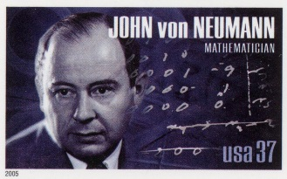
John VonNeumann
Notes:
A contemporary of Turing, John Von Neumann was a Hungarian mathematician working on the atomic bomb and computing at Princeton and then Los Alamos.
Generally regarded as the foremost mathematician of his time and compared to Euler, Gauss, and Hilbert. He made pioneering contributions to quantum mechanics, game theory, and the digital computer.
Von Neumann was a child prodigy. As a 6 year old, he could divide two 8-digit numbers in his head, and could converse in Ancient Greek.
At the age of 15, he began to study advanced calculus.
Since there were few posts in Hungary for mathematicians, and those were not well-paid, his father wanted von Neumann to follow him into industry and thereby invest his time in a more financially useful endeavor than mathematics.
Sometimes your parents really do not know best.

Slide 8
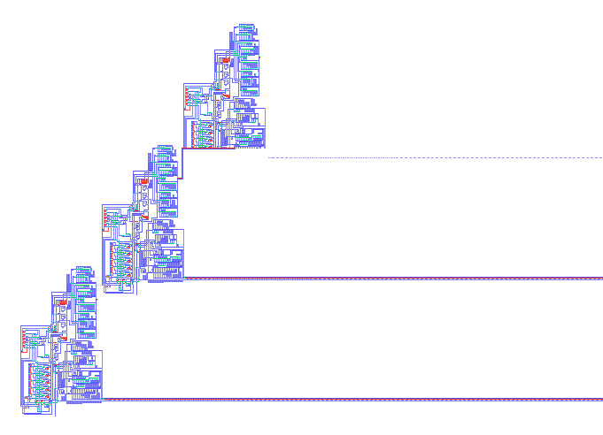
John VonNeumann
Notes:
VN performed some of the first experiments in self-replicating programs, foreseeing viruses and worms decades long before their time.
VN laid the groundwork for a stored program computer.
Up to this point, computers operated on fixed programs and altering their function, like say from performing calculations to word processing, required having to manually rewire and restructure them. The ENIAC, for example, took several days to reprogram.
Ideally, Turing had proposed having the program stored in the memory, which would allow it to be modified by the computer. Von Neumann was intrigued by the concept and in 1945 drafted a report that provided in detail a feasible architecture for stored program computing.
This is how DNA operates. VN, like Turing, was intrigued by Biology.

Slide 9
Fixed program computers
The earliest computers
Could only solve a specific set of problems. The algorithm was fixed.
Operations were not changeable.
Solve a set of linear equations to calculate ballistic trajectory.

Slide 10
Stored program computers
Data and operations (algorithms) are stored in memory and treated the same.
Now the algorithms can change.

Slide 11
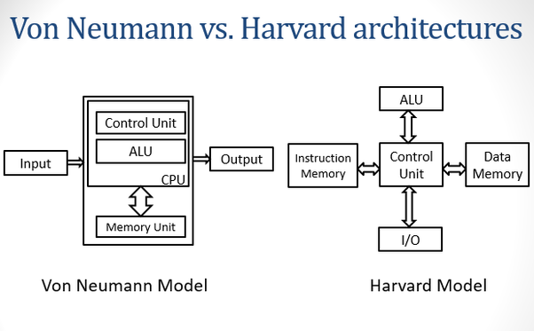
VonNeumann Architecture
Notes:
Insight: VN realized that the same memory that is used to store data could be used to store the instructions that operate on the data. This type of computer became known as the Von Neumman architecture which is the fundamental design in all modern computers.
Ironically, the so-called Non-VonNeumman architecture was also invented by VonNeumman.
Tragedy: VonNeumman died at the age of ___ due to cancer, most likely as a result of exposure from his work on the atomic bomb.
He died at age 53 due to cancer.

Slide 12
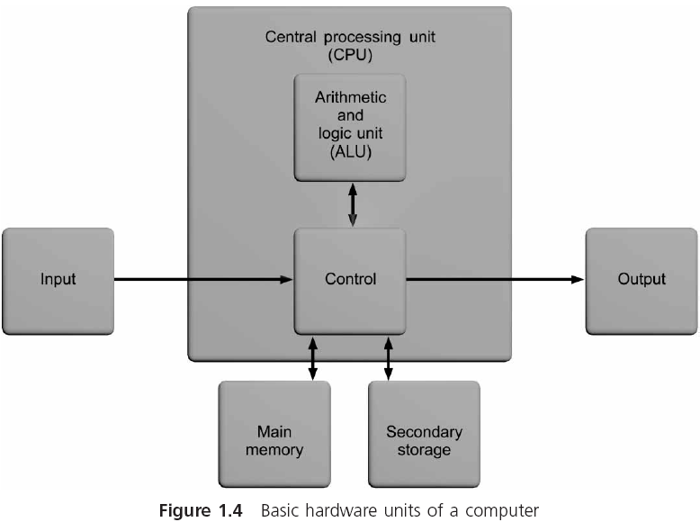

Slide 13
Computer Components
Memory
Processing
Control Unit
ALU – Algorithmic Logic Unit
Accumulator – stores results
Input
Output

Slide 14
Main Memory Unit
Stores data and instructions as sequence of bytes
A program must reside in main memory if it is to operate on the computer
Combines 1 or more bytes into a single unit, referred to as a word
Constructed as random access memory, or RAM
Every section of memory can be accessed randomly as quickly as any other section
Volatile: data is lost when power is turned off
Size is usually specified in bytes (MB or GB)

Slide 15
Central Processing Unit (CPU)
Control unit: directs and monitors the overall operation of the computer
Keeps track of where the next instruction resides
Issues the signals needed to both read data from and write data to other units in the system
Executes all instructions
Arithmetic and Logic Unit (ALU): performs all of the computations, such as addition, subtraction, comparisons, and so on, that a computer provides
CPUs are constructed as a single microchip, which is referred to as a microprocessor

Slide 16
Input/Output Unit
The input/output (I/O) unit provides access to the computer, allowing it to input and output data
It is the interface to which peripheral devices, such as keyboards, console screens, and printers, are attached

Slide 17
Secondary Storage
Used as permanent storage for programs and data
Magnetic tape, magnetic disks, and CD-ROMs
Direct access storage device (DASD): allows a computer to read or write any one file or program independent of its position on the storage medium
Magnetic hard disk consists of rigid platters that spin together on a common spindle
Initially, the most common magnetic disk storage device was the removable floppy disk
Notes:
A direct-access storage device (DASD) (pronounced /ˈdæzdiː/) is a secondary storage device in which "each physical record has a discrete location and a unique address".^{[1]} IBM coined the term DASD as a shorthand describing hard disk drives, magnetic drums, and data cells. Later, optical disc drives and flash memory units are also classified as DASD.^{[2][3]} The term DASD contrasts with sequential storage media such as magnetic tape, and unit record equipment such as card devices like card readers and punches.
Access methods for DASD include sequential, indexed, and direct. Direct access contrasts with the sequential access method used in tape drives. A record on a DASD can be accessed without having to read through intervening records from the current location, whereas reading anything other than the "next" record on tape requires skipping over intervening records, and requires a proportionally long time to access a distant point in a medium. - Wikipedia

Slide 18
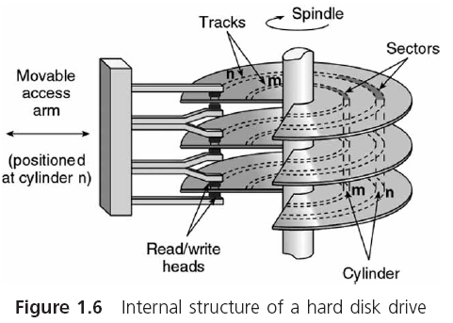
Magnetic Hard Disk

Slide 19
Bits and Bytes
The smallest and most basic data item in a computer is a bit
Open or closed switch
0 or 1
The grouping of 8 bits to form a larger unit is referred to as a byte
Can represent any one of 256 distinct patterns
The collections of patterns consisting of 0s and 1s used to represent letters, single digits, and other single characters are called character codes

