Slide 1
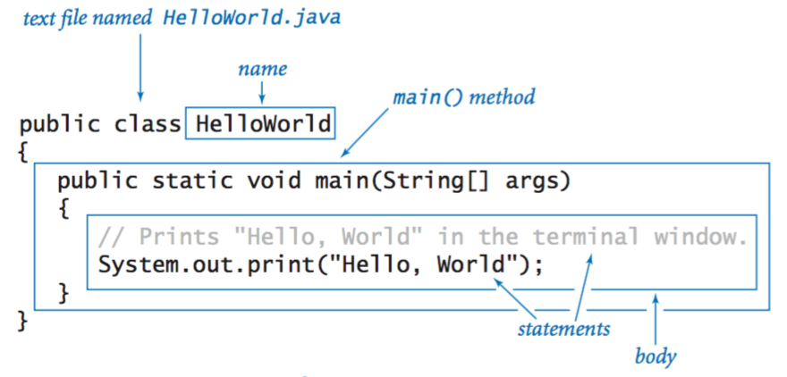
Structure of a Java Class

Slide 2
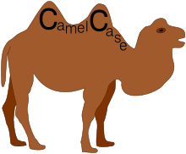
Class identifier (name) should be written in Camel Case: HelloWorld RecordKeeper GeneticAlgorithm

Slide 3
Variable
A name for a location in memory where a value is stored.
Declared with a type and a name.
The data type specifies the size and type of value that can be stored.
int x; // declaration
// assignment statement
x = 5; //initialization: “x gets the value of 5”

Slide 4
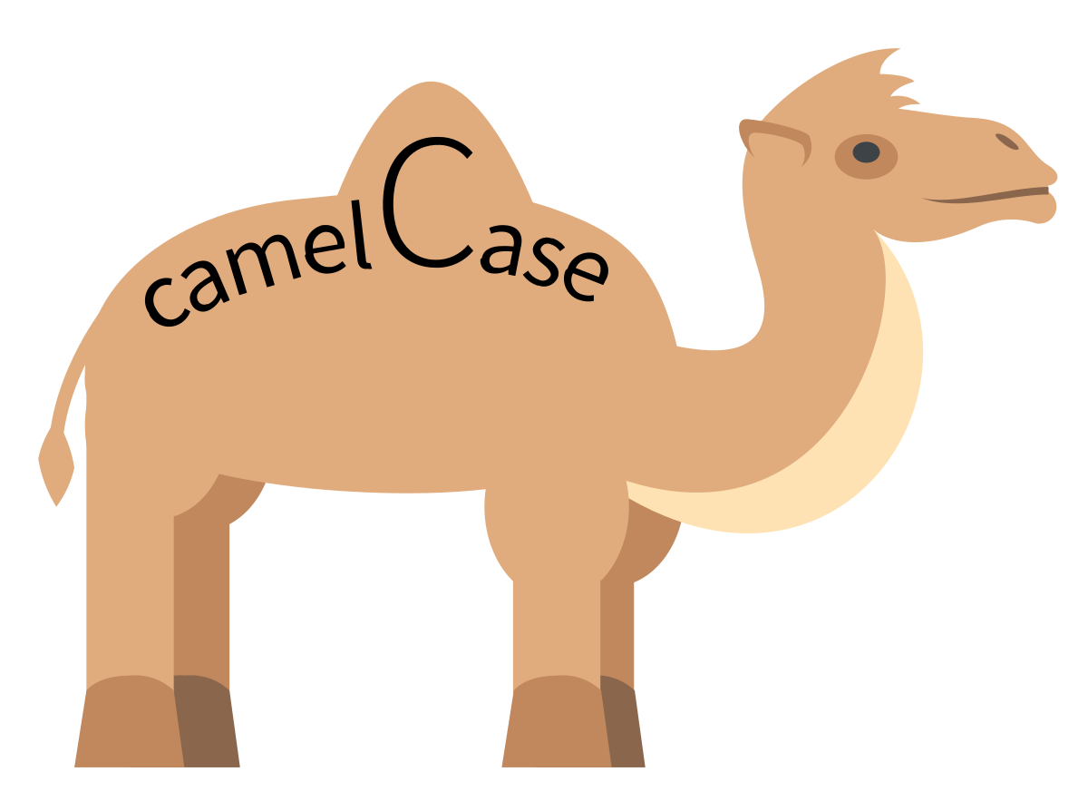
By convention, variable name identifiers use a slightly different camel case: int firstNumber; String lastName; char letter;

Slide 5
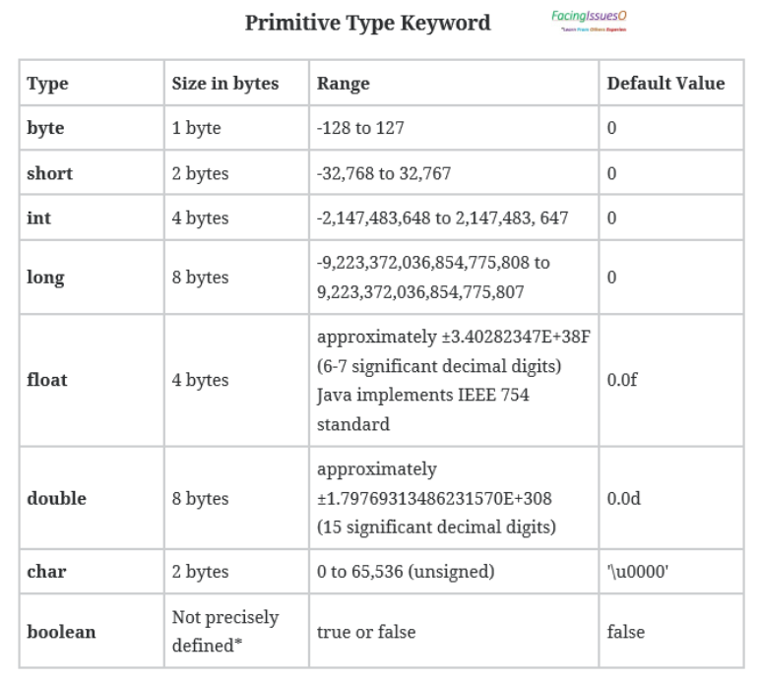
Notes:
https://facingissuesonit.com/2019/06/24/java-primitive-type/

Slide 6
Primitive Data Types
int x = 5;// using 32 bits of memory, 4 bytes
short y = 7;//using 16 bits of memory
long l = 65;//using 64 bit, 8 bytes
double velocity = 65.67;
float average = 45.44f;
char myGrade = 'A';//don't use double quotes
char testGrade = 'A';
char firstGrade;
firstGrade = 'A';//init

Slide 7
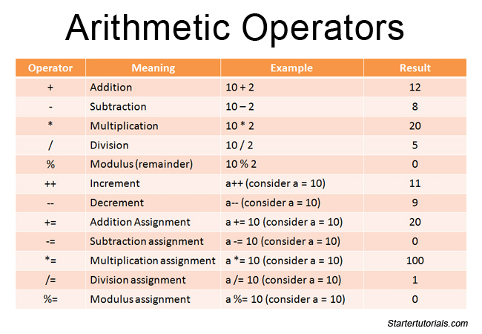
Notes:
https://www.startertutorials.com/corejava/java-operators.html/arithmetic-operators

Slide 8
int x = ...... expression...;
int sum = 75 + 56 + 98;
int average = sum/3;
int mult = sum * sum;
int mod = 6%3;//mod gets 0
int mod = 7%3;//mod gets 1
int average = (75 + 56 + 98)/3;
int average = 75 + 56 + 98/3;

Slide 9
System.out.println(“Say hello”);
String greeting = “Hi, there.”
System.out.println(greeting);

Slide 10
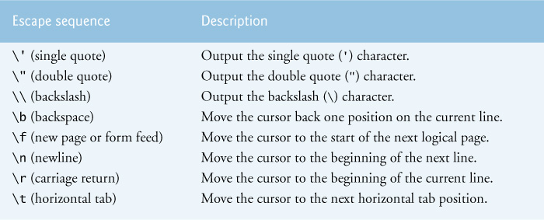

Slide 11
x = expression
int y = 5;
int x;
x = y+3;
Let’s go to the code and see some examples

