Slide 1
Computer Systems
A computer system is a combination of hardware and software components that help us to solve problems.
Hardware are tangible devices.
Software are logic sequences used to control the behavior of hardware.

Slide 2
Programming Languages
Programming languages are tools that help us convert problem solving logic to machine’s behavior.
Familiar a programming language is important
Knowing HOW to solve problem is critical
Tools are only useful if the user know what to do, otherwise they are useless

Slide 3
What is a computer program?
What is an algorithm?
Where did computers come from?
What parts make up a computer?

Slide 4
Declarative Knowledge
Statement of facts:
“y is the square root of x if and only if y*y = x”

Slide 5
Imperative Knowledge
Tells how to solve a problem.
A sequence of steps.
A recipe.
How to find the square root of x:
Start with a guess, g
If g*g is close enough to x, then g is the square root of x.
Otherwise create a new g based on the average g_new = (g + x/g) / 2
Using new g, return to step 2.

Slide 6
Algorithm
A sequence of steps to compute, to solve
Has to have a terminate condition
Has to converge
Has a flow of control

Slide 7
Programming Languages
Computer program: data and instructions used to operate a computer and produce a specific result
A program or set of programs is called software
Programming: writing instructions in a language that the computer can respond to and that other programmers can understand
Programming language: set of instructions that can be used to construct a program

Slide 8
Fixed program computers
The earliest computers
Could only solve a specific set of problems. The algorithm was fixed.
Operations were not changeable.
Solve a set of linear equations to calculate ballistic trajectory.

Slide 9

Weaving in the late 1700s
Weaving 0:30
Punchcard weaving 2:26
Notes:
https://www.youtube.com/watch?v=lwozgRPLVC8
https://www.youtube.com/watch?v=K6NgMNvK52A
http://www.youtubetime.com/

Slide 10
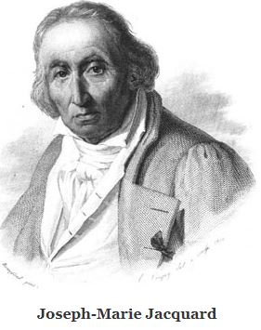
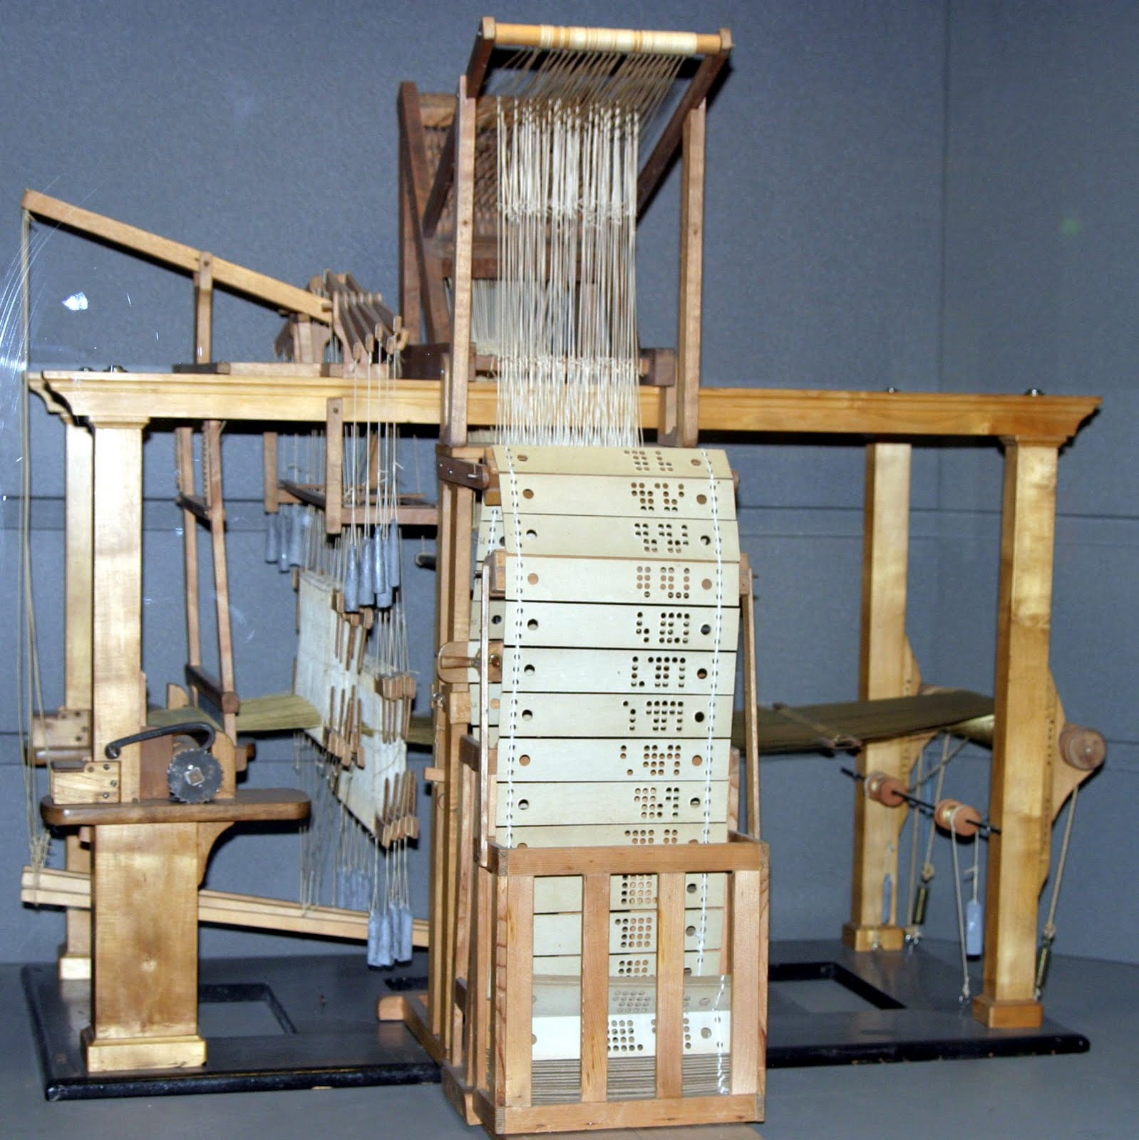
Joseph-Marie Jacquard 1752-1834
Notes:
Jacquard invented attachment to loom.
Beautiful patterns for the masses. Craftsmen and artists out of a job.
The advantages and disadvantages of technology. Some benefit. Others suffer.

Slide 11
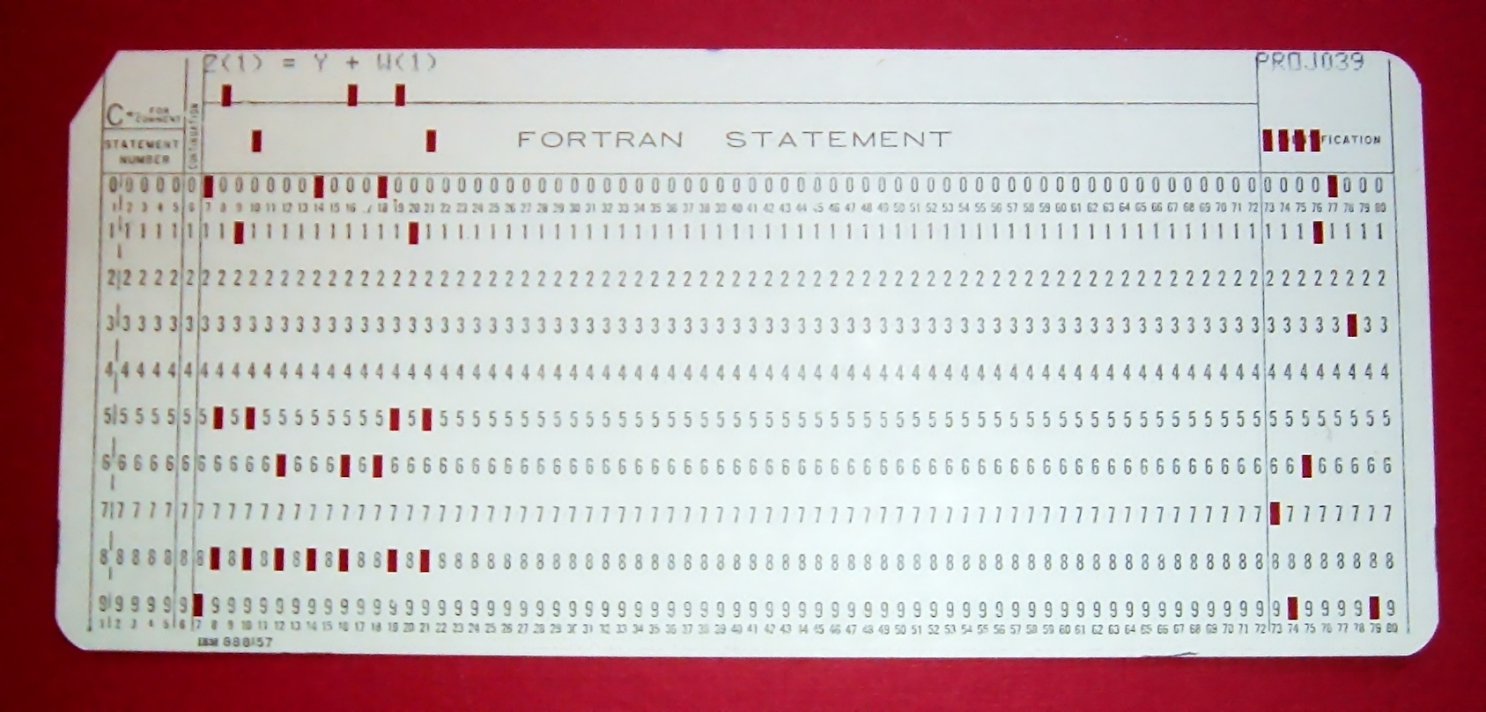
Punch Card Programming 1960s and 70s
Notes:
Punch card programming was a direct descendant of programmable Jacquard looms.

Slide 12
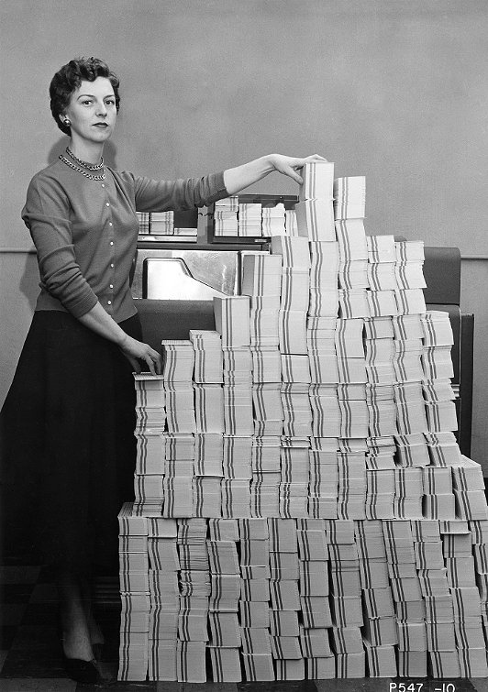
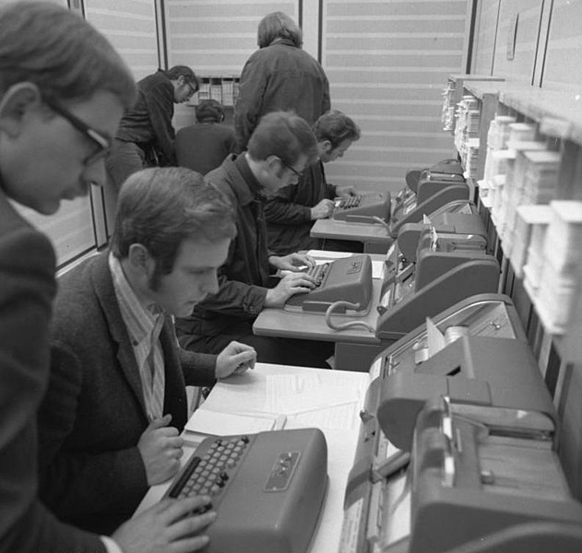
Punch Card Programming
Notes:
Punch card programming was a direct descendant of programmable Jacquard looms.
But again

Slide 13
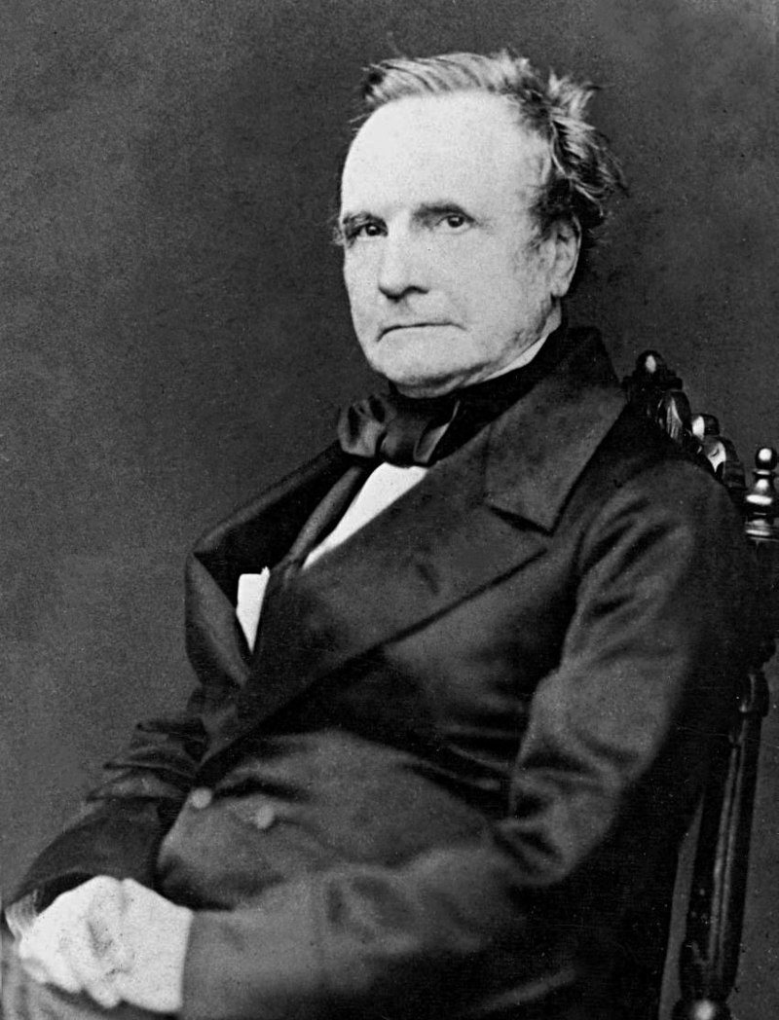
Charles Babbage 1791-1871
Notes:
Charles Babbage proposes a machine to perform mathematical calculations: an analytical engine.
Numbers are entered into the machine by cranking numerically labeled cylinders into specific arrangements and then turning a primary crank to perform the calculations.
Babbage's first attempt at a mechanical computing device, the Difference Engine, was a special-purpose machine designed to tabulate logarithms and trigonometric functions.
During this project, he realized that a much more general design, the Analytical Engine, was possible.[9] The work on the design of the Analytical Engine started in c. 1833.

Slide 14
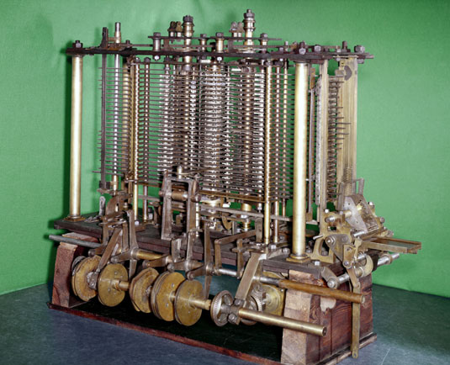
The Analytical Engine 1837
Arithmetic logic
Control flow
Branches
Loops
Integrated memory
Notes:
The input, consisting of programs and data ("formulae" and "data")[13][9] was to be provided to the machine via punched cards, a method being used at the time to direct mechanical looms such as the Jacquard loom.
The Analytical Engine incorporated an arithmetic logic unit, control flow in the form of conditional branching and loops, and integrated memory, making it the first design for a general-purpose computer that could be described in modern terms as Turing-complete.[5][6] In other words, the logical structure of the Analytical Engine was essentially the same as that which has dominated computer design in the electronic era.

Slide 15
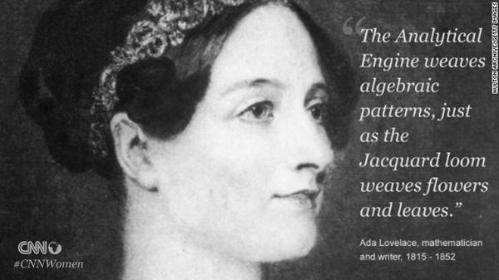
The Analytical Engine 1837

Slide 16
Who is Ada Lovelace?

Slide 17
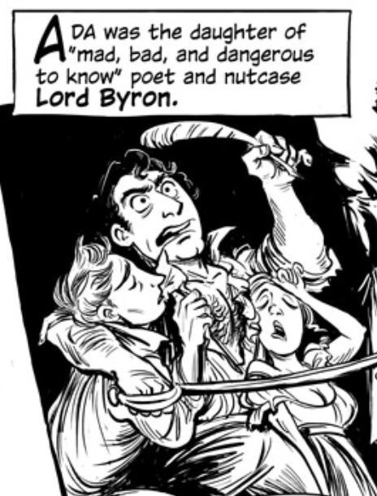
Who is Ada Lovelace?
Notes:
The only legitimate child of Lord Byron.
George Gordon Byron, 6th Baron Byron.
Often described as the most flamboyant and notorious of the major Romantics, Byron was both celebrated and castigated in life for his aristocratic excesses, including huge debts, numerous love affairs – with men as well as women, as well as rumors of a scandalous liaison with his half-sister – and self-imposed exile.

Slide 18
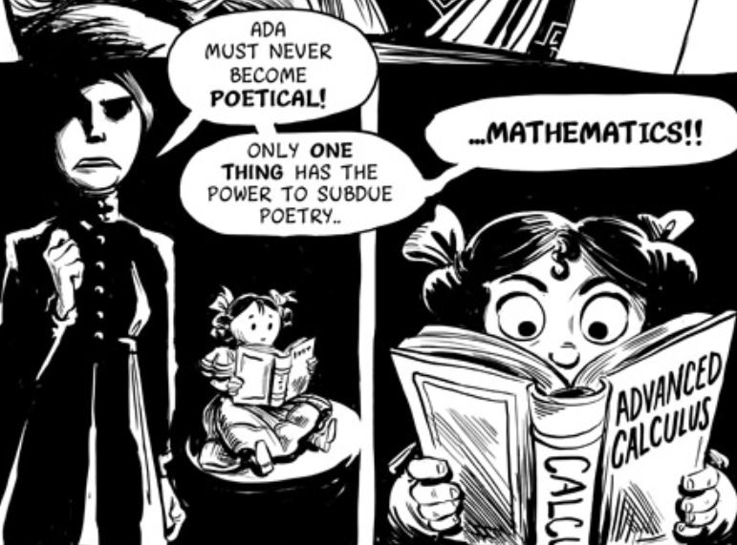
Ada’s mother had no choice…
Notes:
To protect her daughter from her father’s poetical blood…

Slide 19
Contributions to Computing
Ada Lovelace 2:40

Slide 20
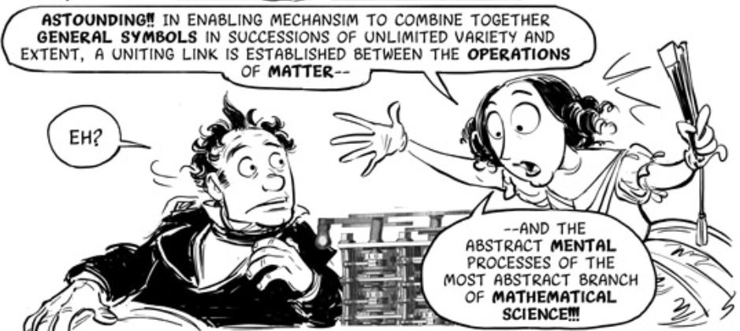
Lovelace meets Babbage
Notes:
http://sydneypadua.com/2dgoggles/lovelace-the-origin-2/
https://www.youtube.com/watch?v=xiZozgCLHc4
https://www.youtube.com/watch?v=uBbVbqRvqTM
Introducing Ada Lovelace.
Insight: Just as the numbers can be mechanically represented, the operations themselves could be modified so that one machine could perform more than one operation. The machine itself could be programmed.

Slide 21
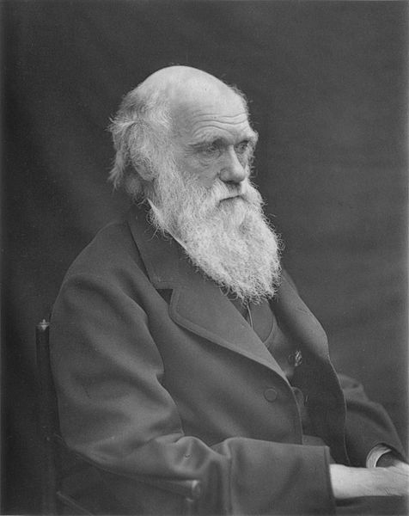
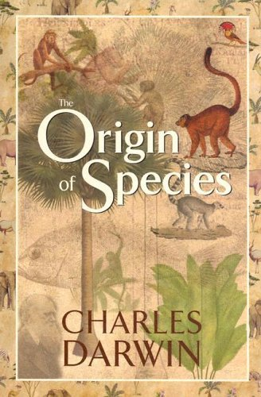
Humanity’s Conception of Itself
Notes:
Mid 1800’s
Situate Charles Darwin in the timeline. Man's egotistical ideas about what was special about himself was being assaulted on all sides.
Some claimed that the ability to do math separates man from beast.
Now makes humanity special cannot be math. Inanimate objects can perform math.

Slide 22
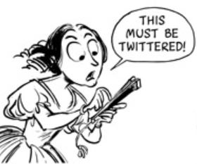
Spread the word!

Slide 23
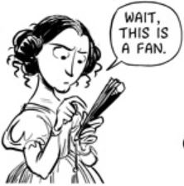
Spread the word!

Slide 24
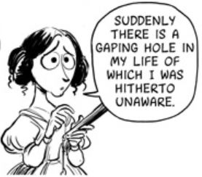
Spread the word!
Notes:
Babbage called Ada the Enchantress of Numbers
She is widely considered the first computer programmer.

Slide 25
Babbage never constructs his Analytical Engine.
Ada dies of cancer at the age of 36.
Notes:
Tragedy: babbage never constructs his engine. Ada dies of cancer at the age of 36.
Due to financial and personal challenges, Babbage never constructs his Analytical Engine.

Slide 26
To Be Continued…

