Slide 1

Q-DELOREAN
Engineering of a QNLP pipeline for Software Requirements Classification
Marco Calenda - 0522501165 | Prof. Fabio Palomba
Software Engineering for Artificial Intelligence – 2022/2023

Slide 2
Introduction: Compositional and Distributional semantics
Compositional semantics
Distributional semantics
Focus on how the meaning of a complex expression is derived from the meaning of its constituents.
Less success in real application.
Closer view to a real human cognitive process, steps towards a grammar-informed NLP.
Examines the relationships between words based on their co-occurrence patterns in a Corpus.
Exploited by Big Data, is the current pivot of state-of-the-art NLP solutions (GPT-4, BERT).

Slide 3
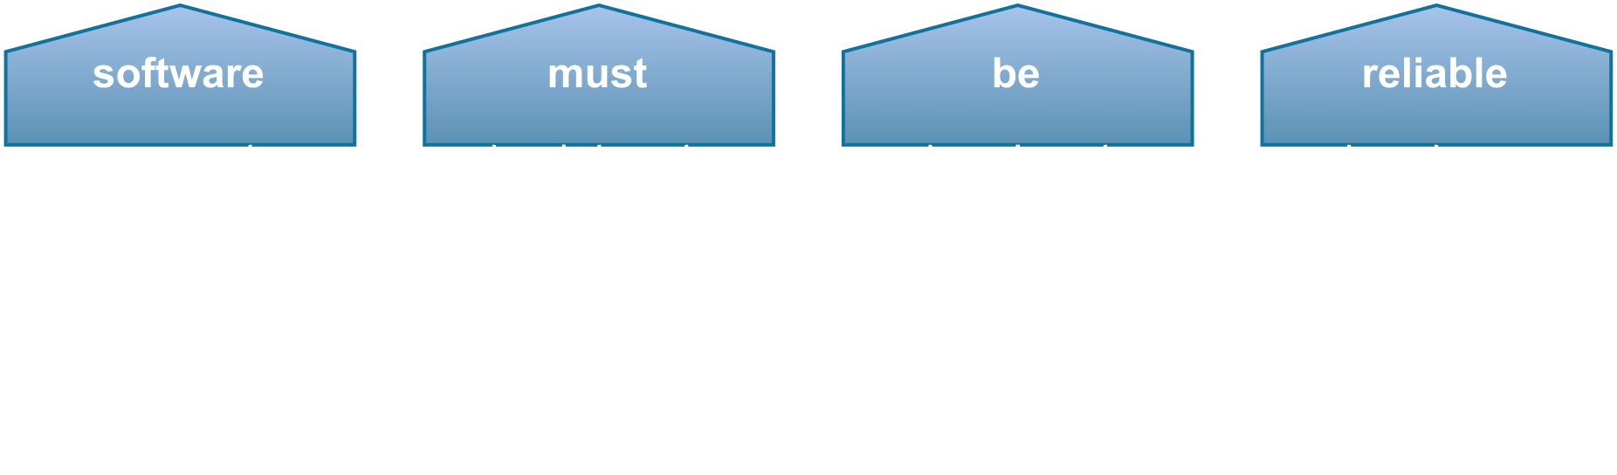
Introduction: Compositional and Distributional semantics
Compositional semantics
The de facto compositional framework is the model of Coecke et al. often dubbed as DisCoCat.
It allows encoding sentences as string diagrams and monoidal categories:
Focus on how the meaning of a complex expression is derived from the meaning of its constituents.
Less success in real application.
Closer view to a real human cognitive process, steps towards a grammar-informed NLP.
The mathematical foundations are suitable for a translation into quantum circuits able to exponentially speed up the process (Quantum Natural Language Processing, QNLP).

Slide 4
Introduction: Requirements Classification with QNLP
Individuation of Non-Functional Requirements (NFRs):
Time-consuming and experienced task.
They are not always explicit and often concealed into ambiguous sentences.
The lack of knowledge of NFRs in the early stages has a huge impact on the total cost and the failure rate of IT projects.
By applying a so-called quantum-inspired approach, namely a ML solution trained and tested on classical hardware yet quantum-ready, we explore the QNLP potential applied into a quasi-real scenario task of binary classification of FRs/NFRs.

Slide 5
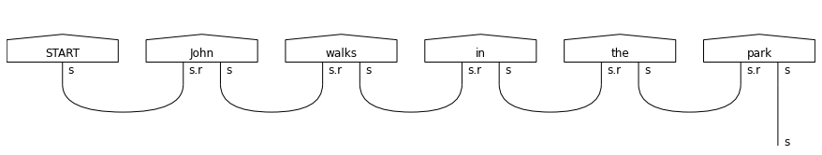
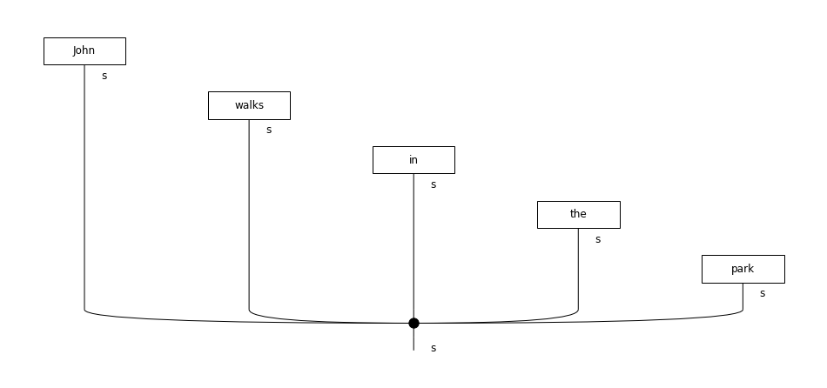
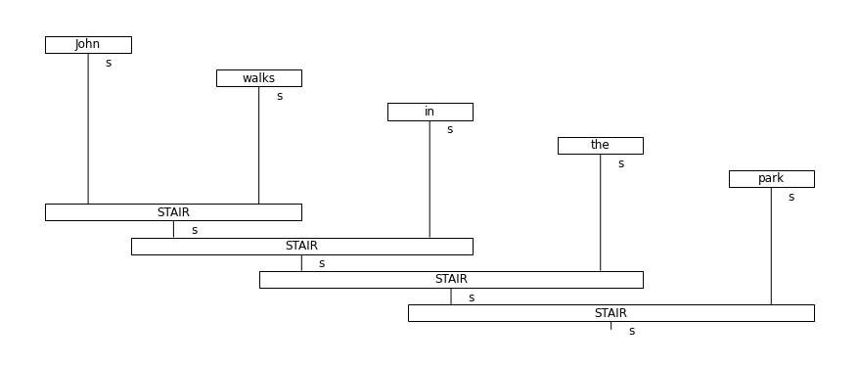
Research
Questions
RQ1. To what extent can the proposed tool classify FRs and NFRs?
RQ2. How does the DisCoCat framework compared to other compositional models?
Cups
Spiders
Stairs
RQ3. How does the proposed tool when compared to classical NLP models?
TF-IDF & Naïve Bayes
Word2Vec & Feed-Forwarded Neural Network

Slide 6
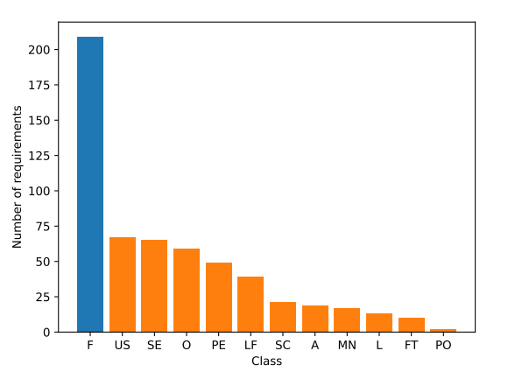
PROMISE NFR dataset
15
Projects
255
FRs
Data Collection
370
NFRs
Manual Filtering
Large requirements description
Sentences with a complex grammatical structure
Sentences with words to much specific
Data Balancing with Undersampling

Slide 7










Q-DELOREAN
NLTK
lambeq
Requirements Description
pre-processing
rules
ansatz
Parsing
Rewriting
Parameterization
String Diagram
Functional
Tensor Contraction
non-Functional
Sigmoid
Linear
Relu
Linear
Tensor Network

Slide 8
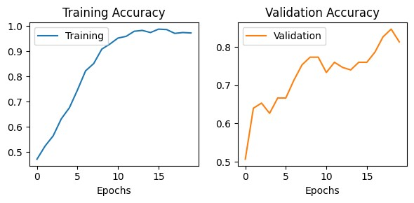
Grid Search & Cross-Validation
Learning Rate | Batch Size | Hidden Layers Size | Training Accuracy | Validation Accuracy
0.07 | 32 | 32 | 90.9% | 81.3%
0.07 | 32 | 8 | 97.4% | 86.0%
0.03 | 16 | 16 | 87.1% | 79.2%
0.1 | 16 | 16 | 78.2% | 70.8%
The experiments are conducted on the Google Colab Pro platform using a hardware accelerated runtime with a GPU NVIDIA A100 Tensor Core.

Slide 9
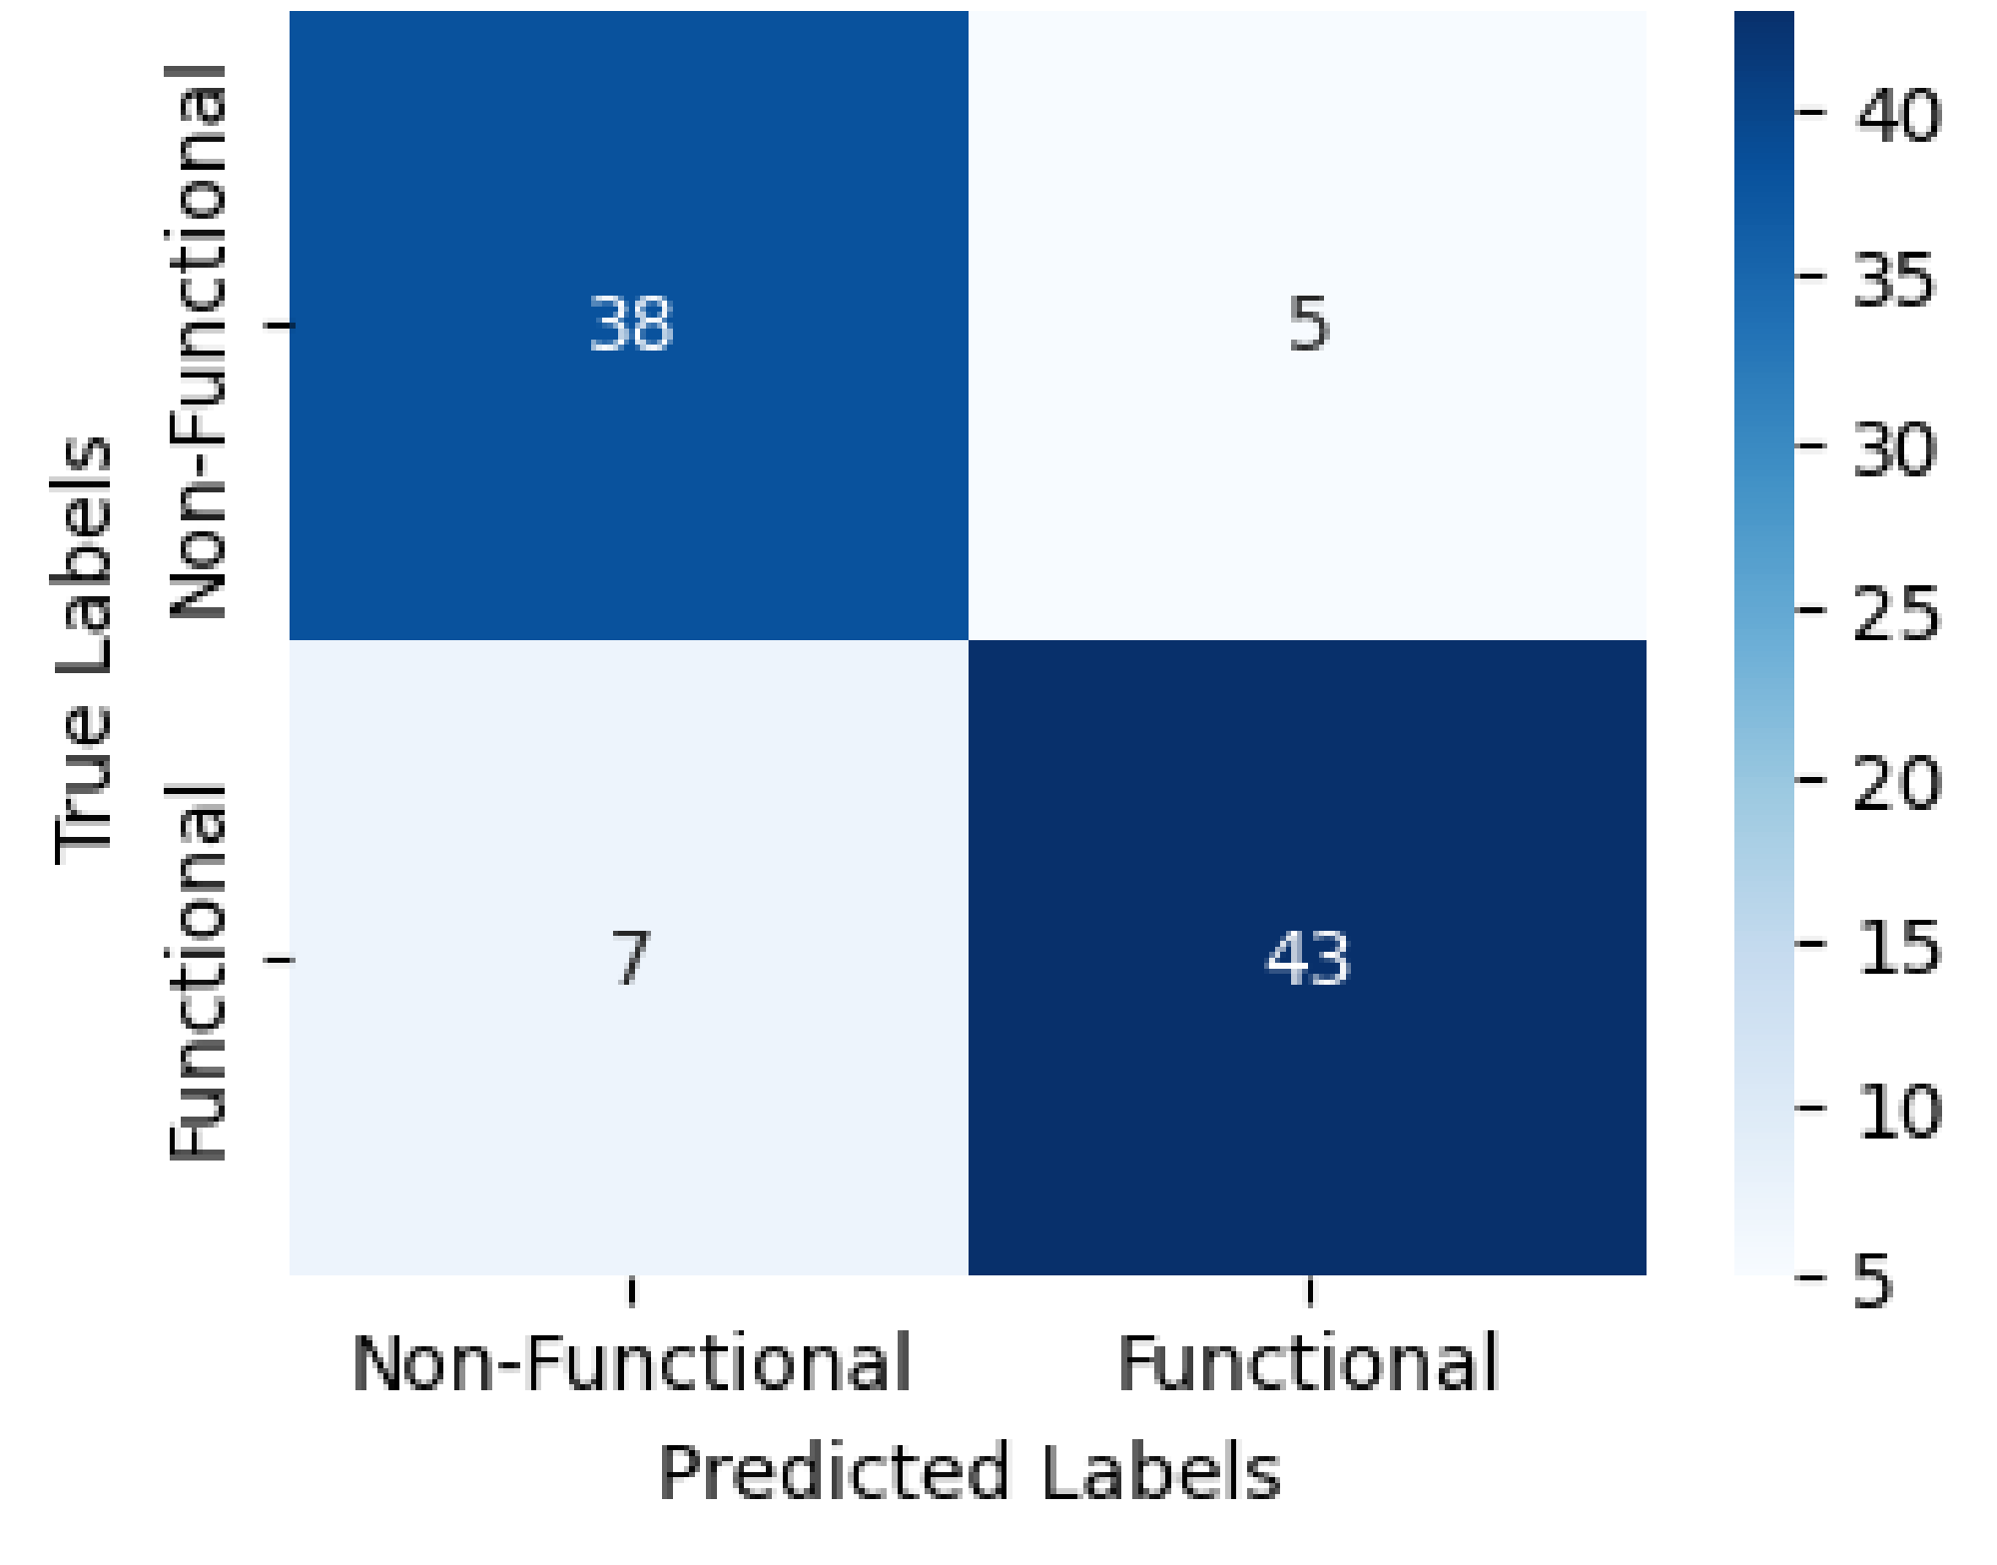
Results: Readers Comparison
 | Reader | Training Accuracy | Test Accuracy
4-Dim | Stairs | 80.0% | 68.8%
 | Cups | 84.9% | 76.3%
 | Tree | 90.2% | 83.9%
 | DisCoCat | 97.4% | 87.6%
2-Dim | Spiders | 93.8% | 69.2%
The experiments are conducted on the Google Colab Pro platform using a hardware accelerated runtime with a GPU NVIDIA A100 Tensor Core.

Slide 10
Results: Models Comparison - 1
Model | No. of parameters | Test Accuracy | Training time (15 epochs) | Inference time (100 sentences)
Q-DELOREAN | 58 | 87.6% | 1.3 min | 5 s
TF-IDF Naïve Bayes | 0 | 75.2% | - | -
Word2Vec NN | 23k | 88.2% | 30 s | 2 s
The experiments are conducted on the Google Colab Pro platform using a hardware accelerated runtime with a GPU NVIDIA A100 Tensor Core.

Slide 11
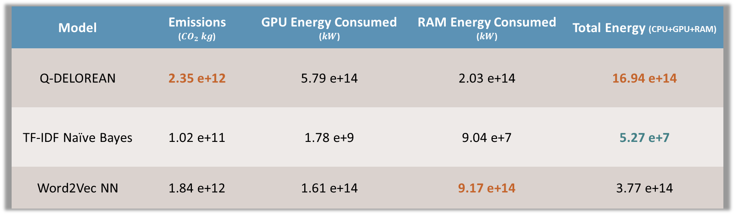
Results: Models Comparison - 2
Model | Emissions ($CO_{2} kg$) | GPU Energy Consumed ($kW$) | RAM Energy Consumed ($kW$) | Total Energy (CPU+GPU+RAM)
Q-DELOREAN | 2.35 e+12 | 5.79 e+14 | 2.03 e+14 | 16.94 e+14
TF-IDF Naïve Bayes | 1.02 e+11 | 1.78 e+9 | 9.04 e+7 | 5.27 e+7
Word2Vec NN | 1.84 e+12 | 1.61 e+14 | 9.17 e+14 | 3.77 e+14
The experiments are conducted on the Google Colab Pro platform using a hardware accelerated runtime with a GPU NVIDIA A100 Tensor Core.

Slide 12
Conclusions & Future Works
Our study demonstrates the effectiveness of Q-DELOREAN in classifying requirements obtaining overall promising results.
The findings of this study open up several avenues for future researches:
Further exploration can be done to enhance the performance of the Linear Readers by incorporating additional linguistic features and/or ad-hoc classifiers.
Extending this approach to other types of languages, e.g., programming languages, could prove to be effective since their fixed grammar makes them well-suited for compositional techniques like the one employed in our study.

Slide 13
Thanks for the attention!

