Slide 1
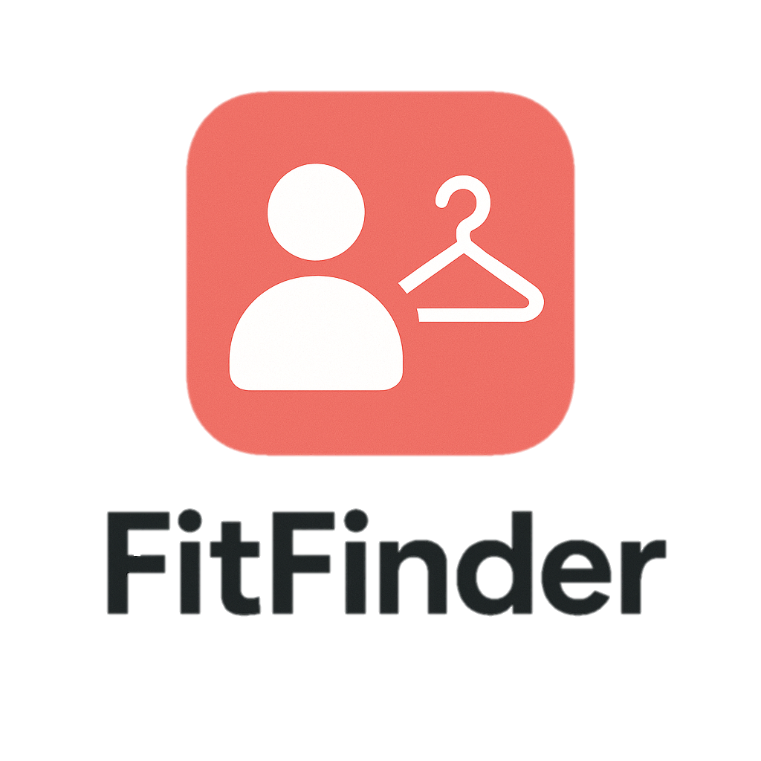
Fit Finder
Outfit Recommendation Application
Notes:
Welcome to Fit finder

Slide 2

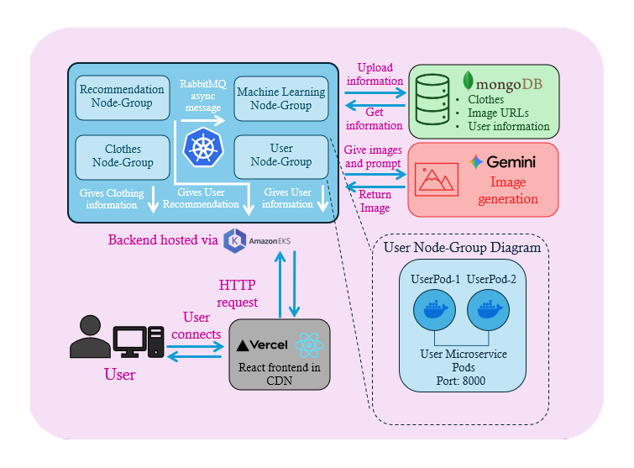
Architecture Diagram
Notes:
Arch diag
How the app works
User to Vercel
Vercel HTTP AWS EKS
RABBITMQ between service
AWS EKS to MONGO/GEMINI

Slide 3
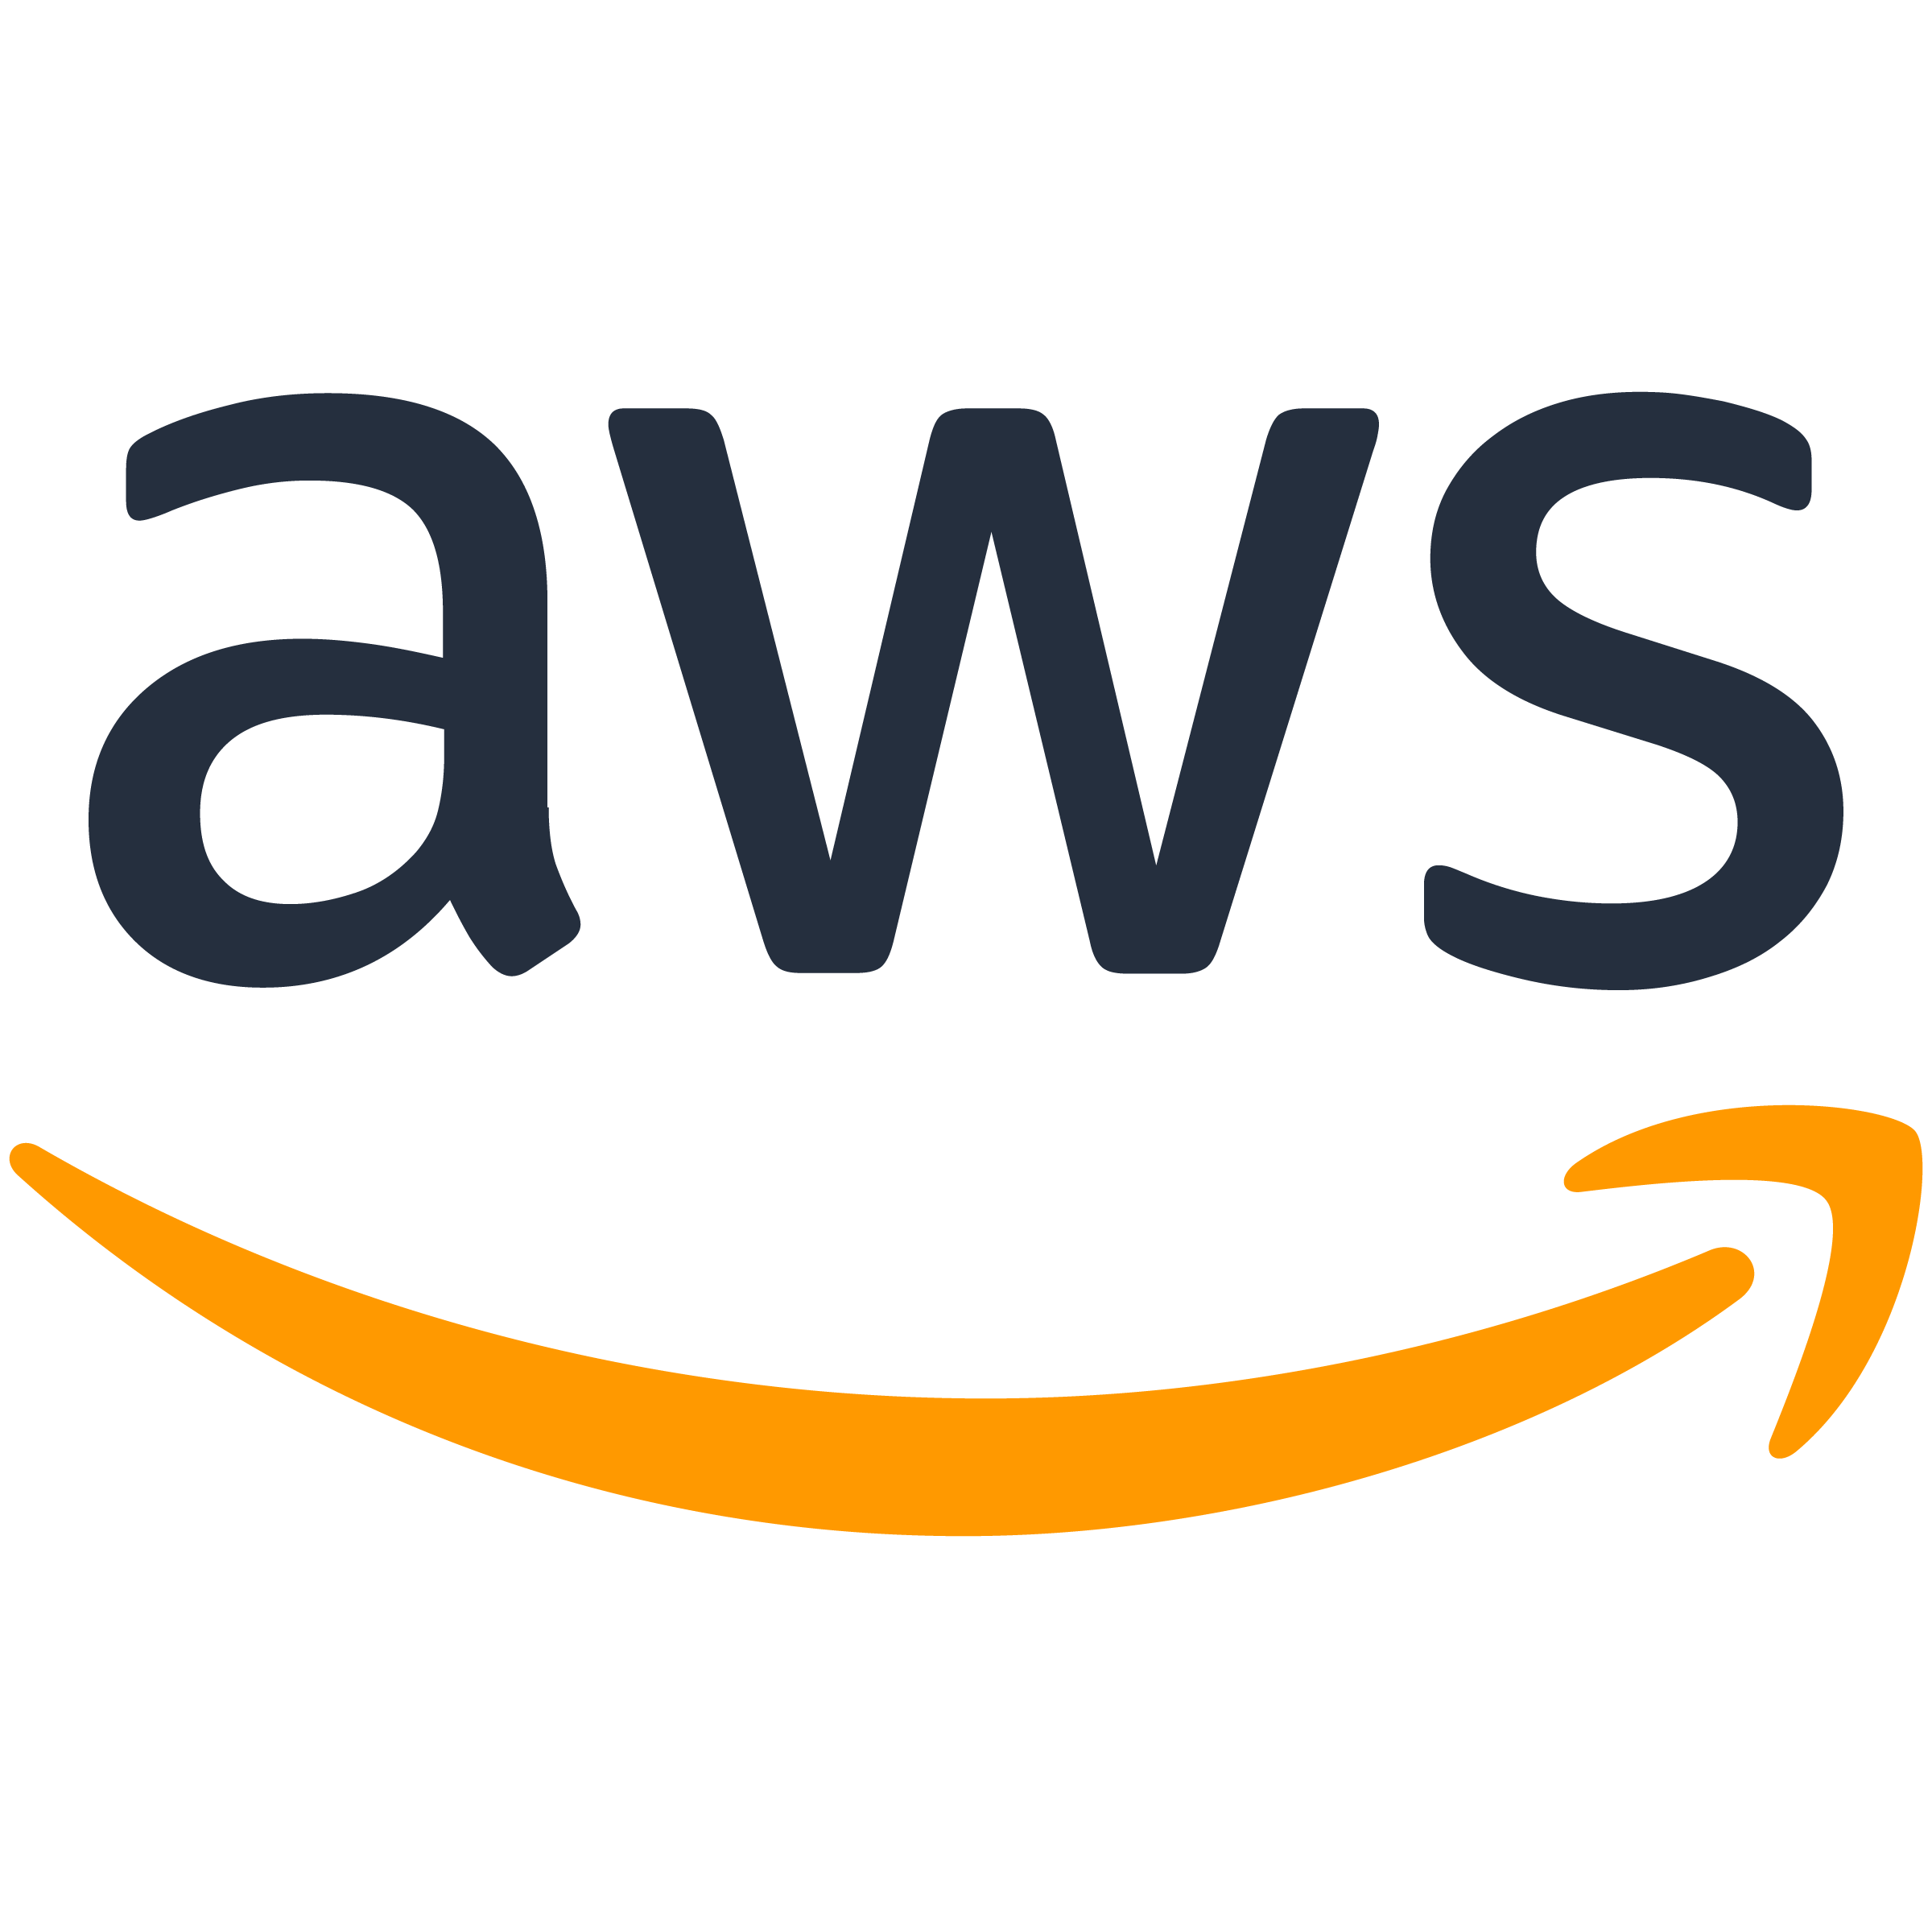
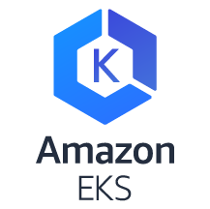
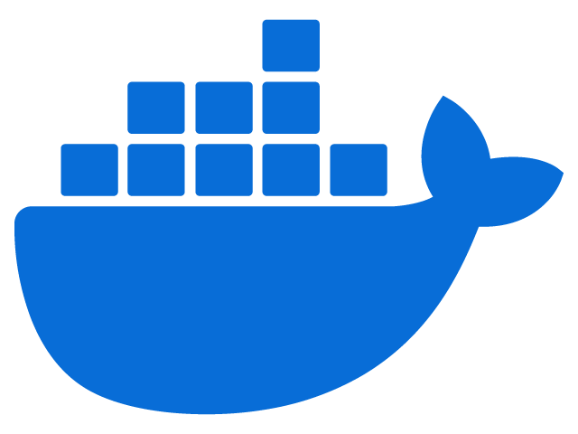
Kubernetes
Pods
Self Healing
Autoscaling
Fit-Finder
Cluster
User Node-Group
Recom Node-Group
Clothes Node-Group
UserPod-1
UserPod-2
RecomPod-1
RecomPod-2
CheckoutPod-1
CheckoutPod-2
User Microservice Pods
Recom Microservice Pods
Checkout Microservice Pods
Port: 8001
Port: 8002
Port: 8003
Notes:
How I’m using it for FF
Smart container manager
Using ff as example
For each svc I have made a docker image

Slide 4

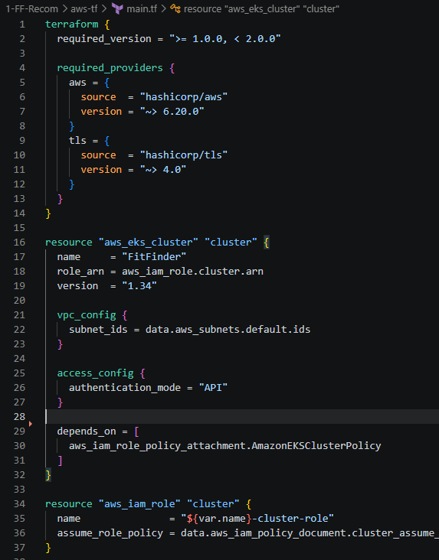
Terraform
Cloud management
Kubernetes Deployment
KEDA configuration
Notes:
Terraform is a tool that I used to automate backend creation and management
Cloud management
Terraform creates the aws resources for eks, these being the cluster and node groups along with IAMs
Kubernetes Deployment
Terraform also deploys the Kubernetes attached to the node groups, each deployment corresponding to the respective node group
KEDA
Keda is the autoscaling
CloudWatch has to be configured for it to work.

Slide 5

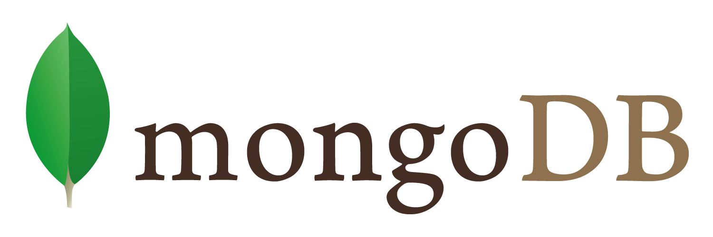
Other Technologies
RabbitMQ
Message Queuing
Machine Learning
Improve recommendation algorithm
MongoDB
Store clothing
Store user information
Notes:
RabbitMQ
Recom -> ML for async
ML
ML to train the info
Mongo
Store info

Slide 6
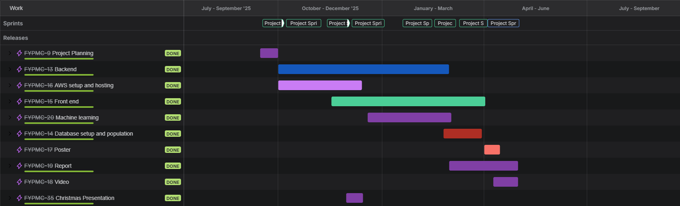
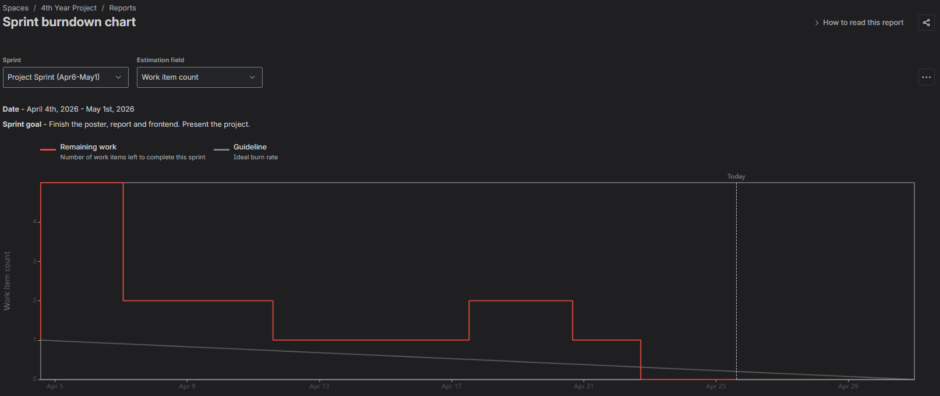
Project Planning
Jira
Used Sprints to plan project tasks
One Note
Took weekly logs to record progress
Supervisor meetings
Weekly meetings to gauge progress
Notes:
Jira
Project timeline
Sprints
One Note
Weekly logs were taken to track
SupMeet

Slide 7

Collaboration
Weekly standup
Talking with classmates
Meetings with RTR

Slide 8
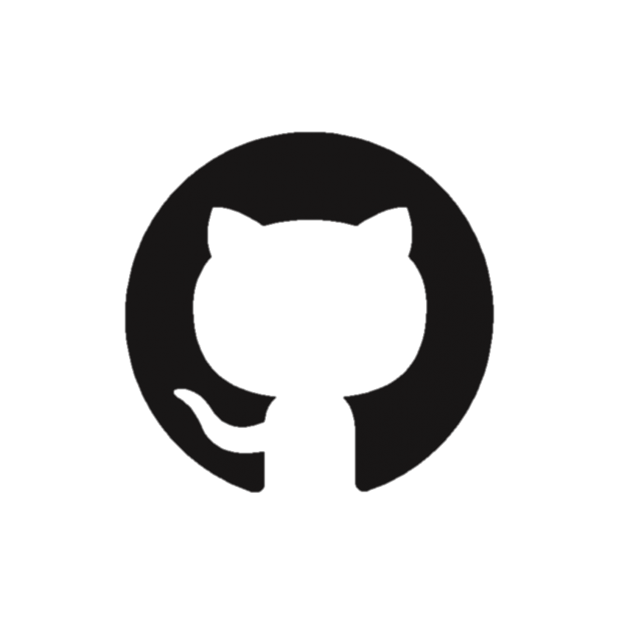

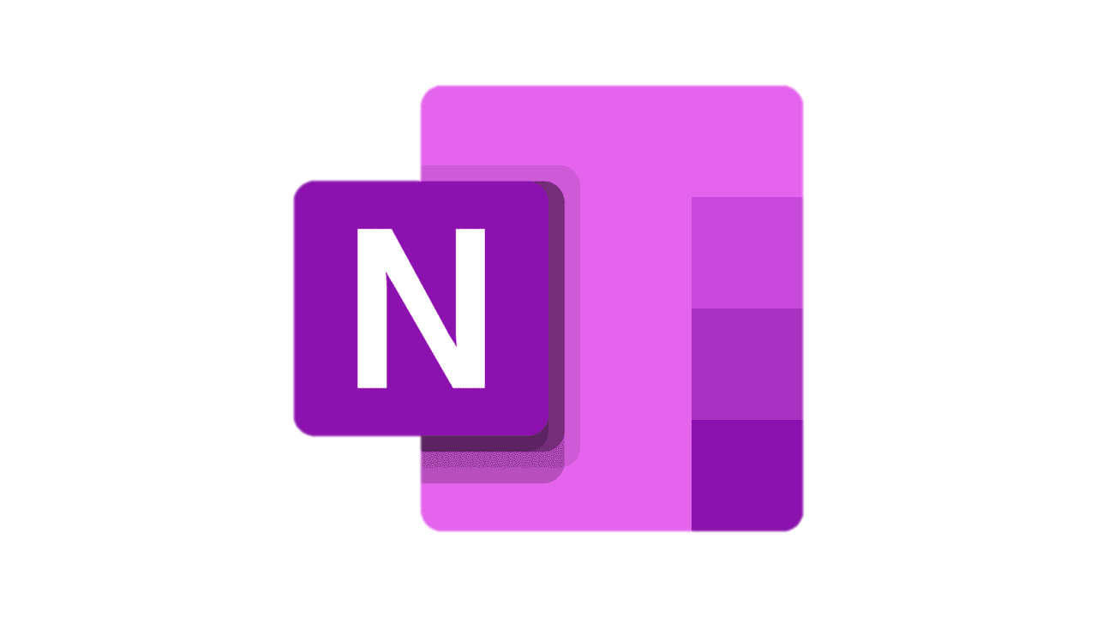
Links
GitHub
Jira
OneNote

Slide 9
Demo Time

