Slide 1

The Road to Riches: Predicting the Price of BTC using Linear Regression
Martha CASSETTI, soon to be retired data scientist

Slide 2

Road to Riches
Use linear regression to predict the price of Bitcoin
Make lots of $$$
Buy Lamborghini
Fly to moon

Slide 3
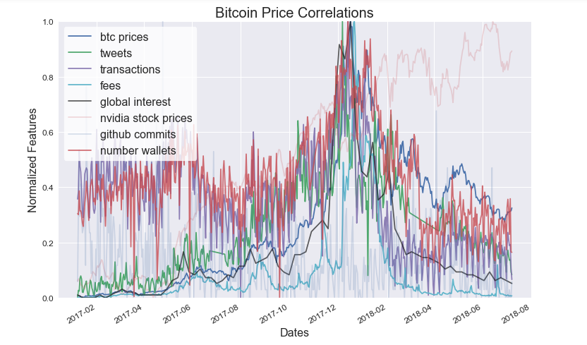
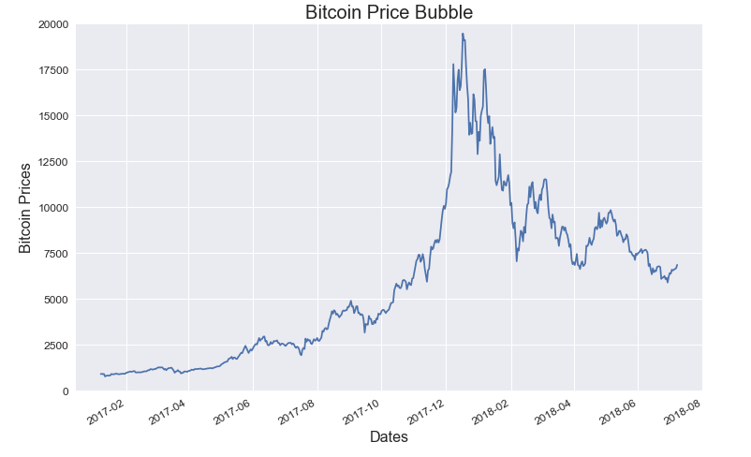
Plan of attack
Too lazy to do market analysis
Notice correlations related to bitcoin ”hype”
Bitcoin “hype”
Social sentiment
Tweets
Global Interest according to google
Interest in technology
Gihub commits
Nvidia Stock Price
Adoptability
Transactions
Transaction Fees
Wallets
Use data for only past year

Slide 4
Linear Regression Approach
Models: Basic, Regularized, Polynomial with and without Feature Engineering
Train and Validate
Cross Validate
Predict
Training Data
Model
Best Model
For each model:
Cross Validation scores
Profit!
Test Scores
Test Data

Slide 5
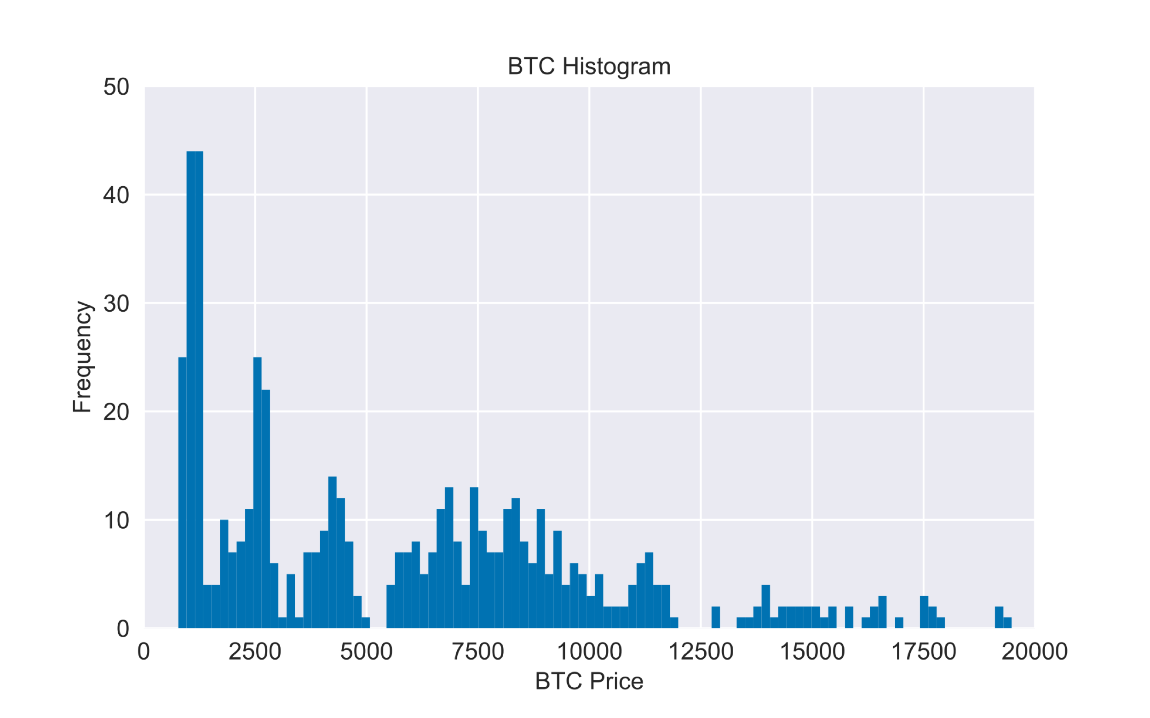
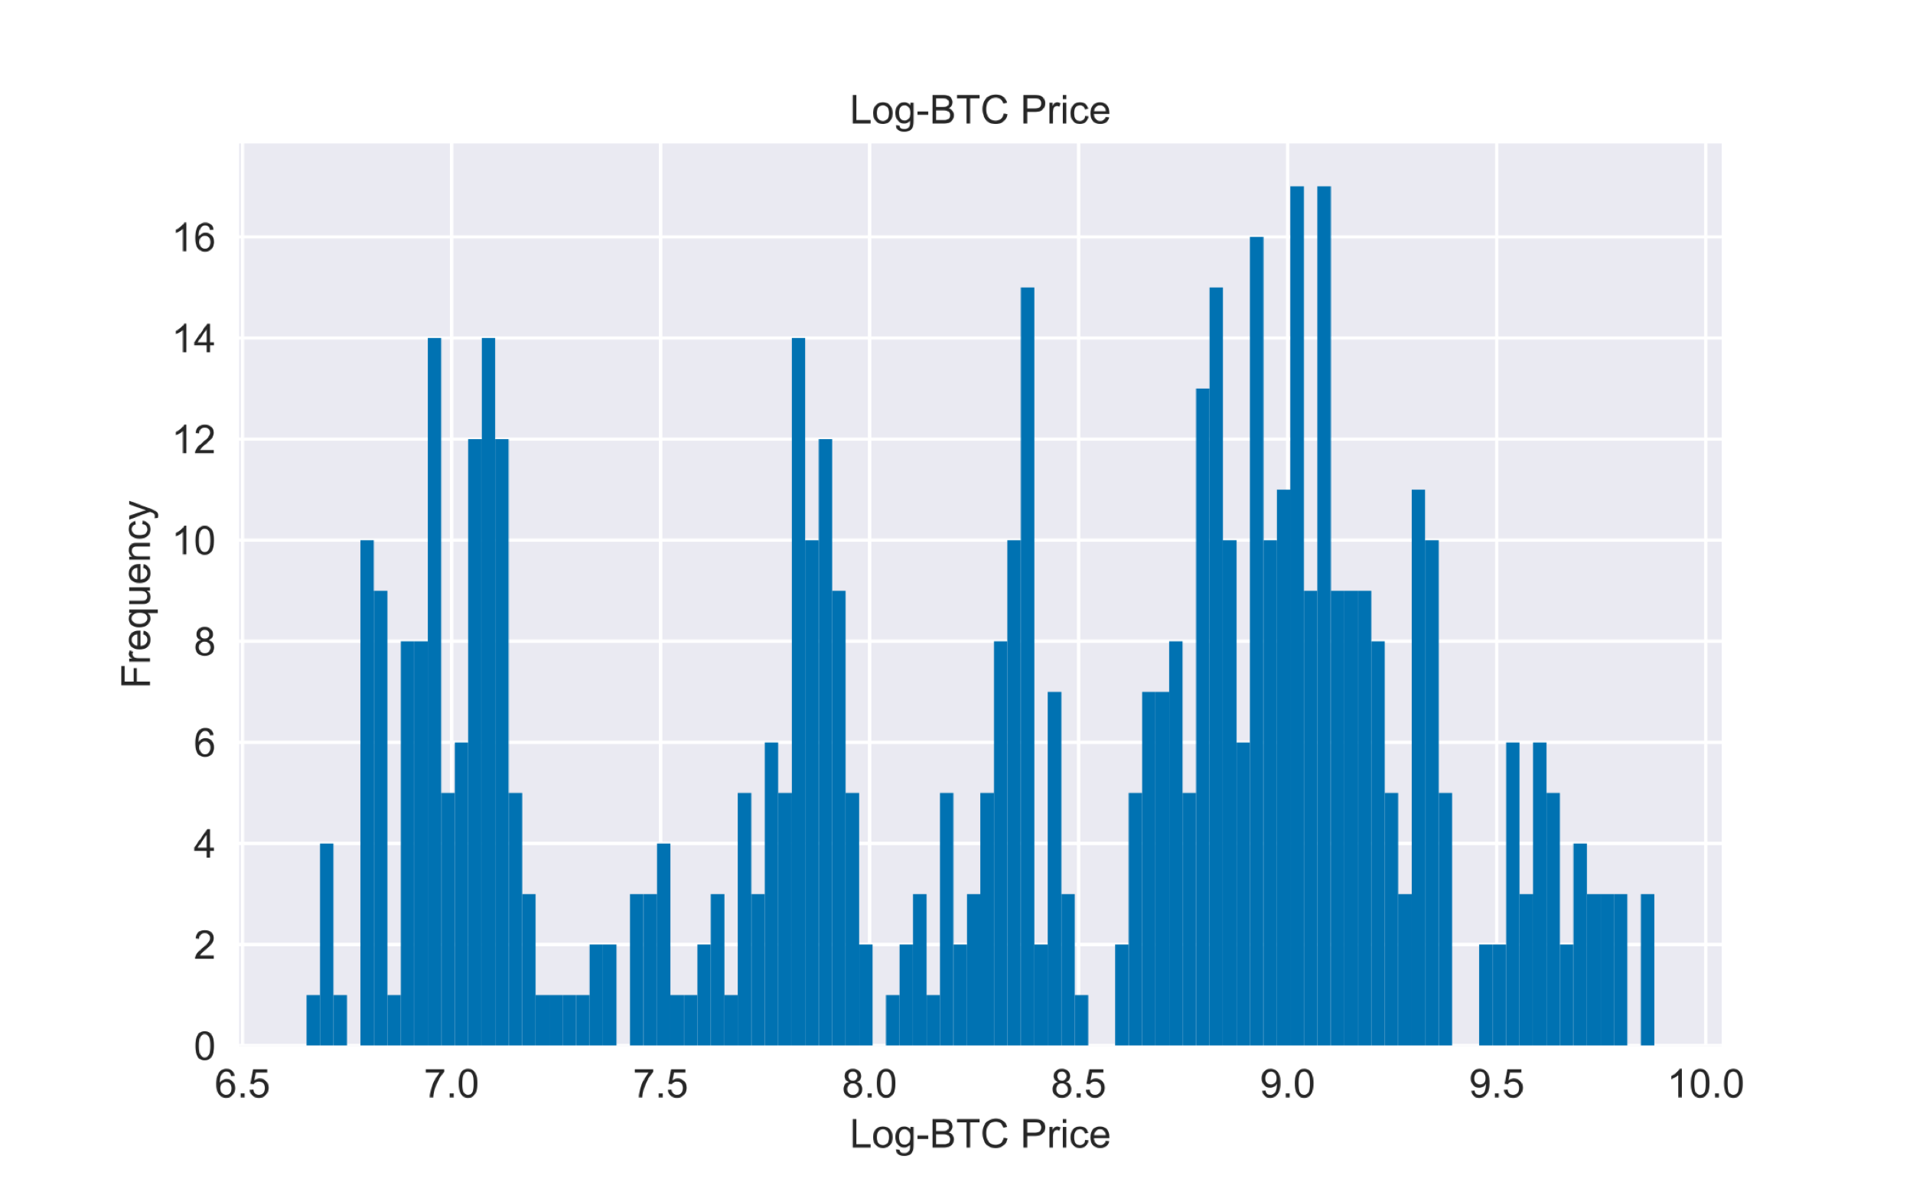
Feature Engineering
Transformation Example
BTC Prices do not appear normal
Attempt to linearize features or normalize distribution
Log bitcoin prices
Box-cox of tweets, transactions number, number of wallets
Removed commits as feature
Log of global interest, transaction fees, Nvidia Stock Prices
Log Transformed gets us closer

Slide 6
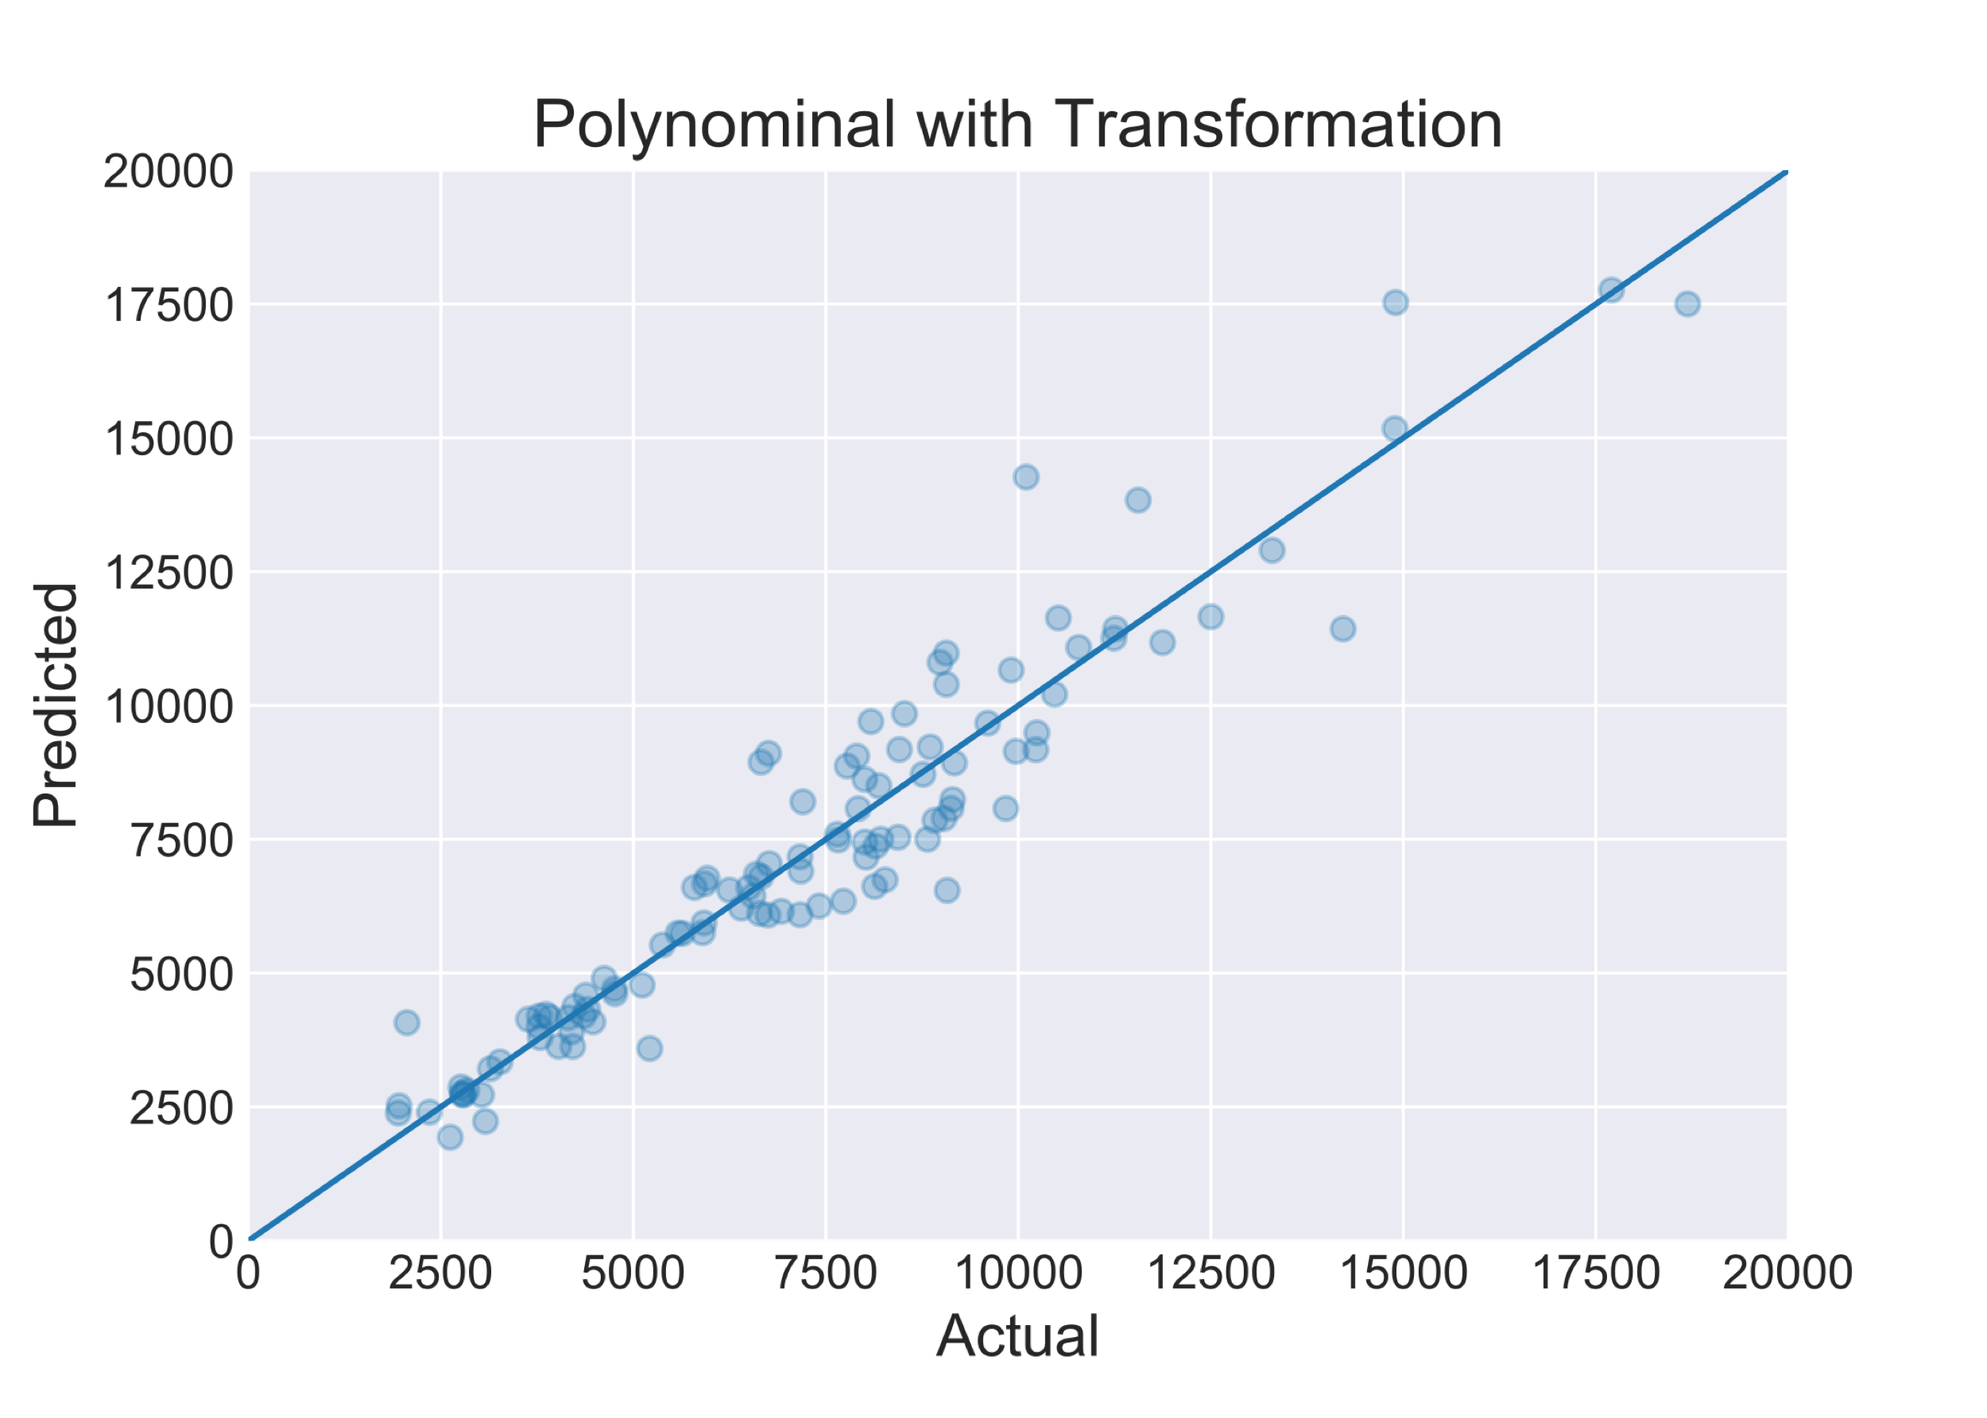

Results
Cross Validated R² = 0.916 Test R² = 0.914
Best model was polynomial
Regularization made little difference
Plot looks decent, but..
Can we predict price on given day?
Date | Predicted (USD) | Actual (USD)
2017-07-17 | 2954.04 | 2177.78
2017-12-20 | 19945.23 | 20014.32
2018-02-02 | 11232.15 | 10302.49
2018-06-02 | 9505.70 | 8493.15
Date | Predicted (USD) | Actual (USD)
2017-07-17 | 2954.04 | 2177.78
2017-12-20 | 19945.23 | 20014.32
2018-02-02 | 11232.15 | 10302.49
Date | Predicted (USD) | Actual (USD)
2017-07-17 | 2954.04 | 2177.78
Date | Predicted (USD) | Actual (USD)
Date | Predicted (USD) | Actual (USD)
2017-07-17 | 2954.04 | 2177.78
2017-12-20 | 19945.23 | 20014.32

Slide 7
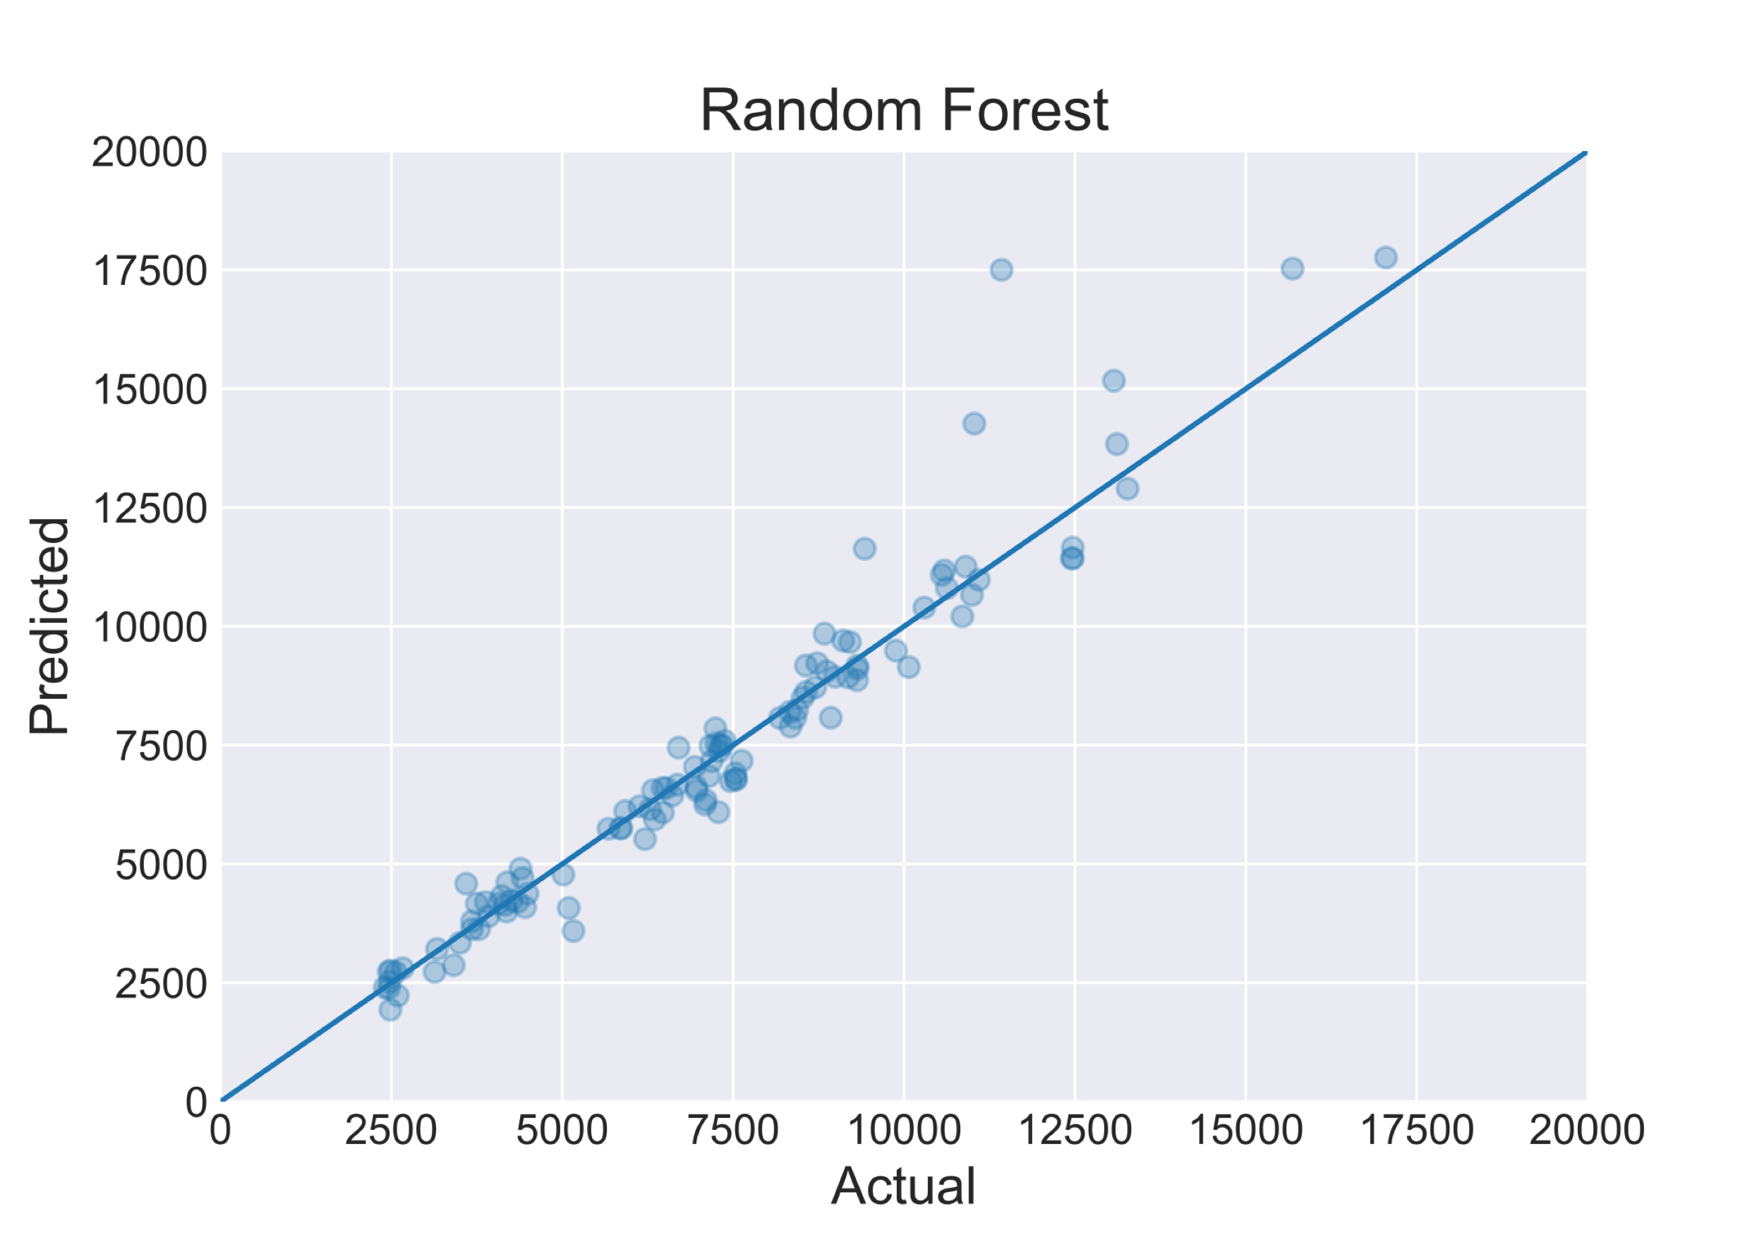
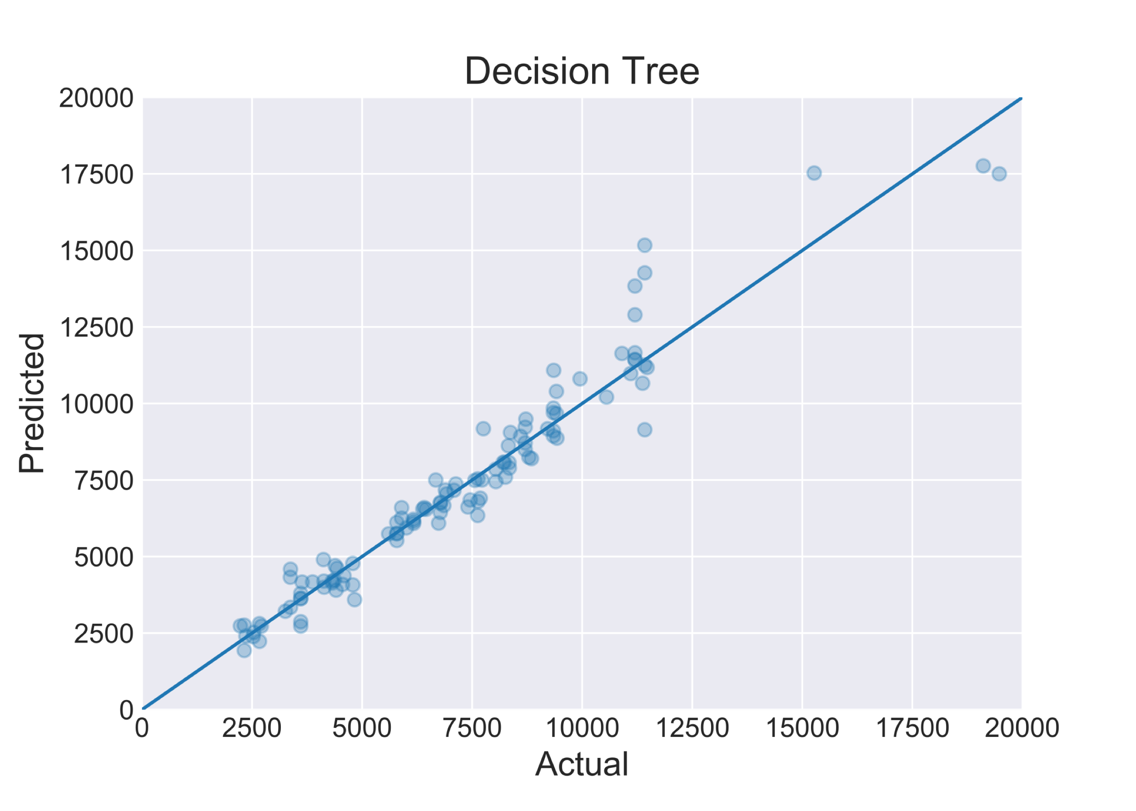

Additional Models
CV R² = 0.958
Test R² = 0.951
Non linear regression
Random Forest
Decision Tree
How does the prediction look now? Try Random Forest
Date | Predicted (USD) | Actual (USD)
2017-07-17 | 2763.50 | 2177.78
2017-12-20 | 19645.11 | 20014.32
2018-02-02 | 12302.18 | 10302.49
2018-06-02 | 7981.0 | 8493.15
CV R² = 0.940
Test R² = 0.956
Date | Predicted (USD) | Actual (USD)
2017-07-17 | 2763.50 | 2177.78
Date | Predicted (USD) | Actual (USD)
2017-07-17 | 2763.50 | 2177.78
2017-12-20 | 19645.11 | 20014.32
2018-02-02 | 12302.18 | 10302.49
Date | Predicted (USD) | Actual (USD)
2017-07-17 | 2763.50 | 2177.78
2017-12-20 | 19645.11 | 20014.32
Date | Predicted (USD) | Actual (USD)

Slide 8
Conclusion
Although scores is high, price volatility still makes these predictions a risky trade strategy
Current model has causality issues
No moon lambos yet, get a job as a data scientist in meantime

Slide 9

Future Plans
Time series is it’s own beast as it exhibits autocorrelation
Non randomized data for test/train data
Include other features (i.e. economic sentiment)
Prediction with time offset in features (previous day, hour, etc..)
Get off couch and learn technical analysis

