Slide 1
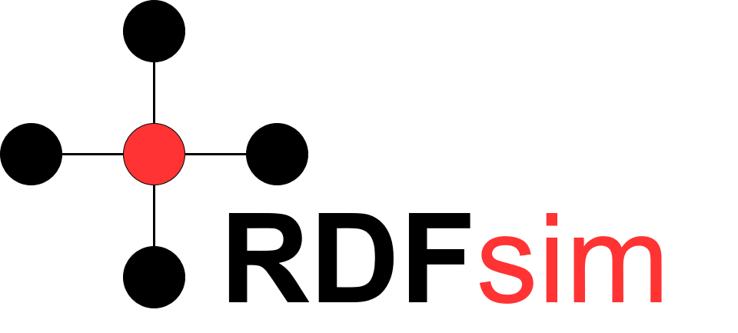
Similarity Browsing Tool over RDF Databases
Manos Chatzakis (chatzakis@ics.forth.gr)

Slide 2
Πλαίσιο
Το browsing είναι μία από τις σημαντικότερες ενέργειες στον παγκόσμιο ιστό .
Οι RDF βάσεις δεδομένων, άρα και οι Γράφοι Γνώσης (Knowledge Graphs) περιέχουν πολλά χρήσιμα δεδομένα που μπορούν να χρησιμοποιηθούν για διάφορες ενέργειες.
Οι απλοί χρήστες δεν είναι συνηθισμένοι με τις έννοιες του σημασιολογικού ιστού.

Slide 3
Βασικές Έννοιες
Γράφος Γνώσης/Knowledge Graph: Networks that contain entities and visualize the relationships among them (e.g. Google Knowledge Graph, Dbpedia and more…). Δίκτυο/Γράφος που περιέχει οντότητες και οπτικοποιεί τις σχέσεις μεταξύ τους.
RDF Triple: A set of 3 entities, representing a sentence in subject-predicate-object format.
RDF Database: A database storing the triples of a knowledge graph
Similarity-Based Browsing (SBB): A method to browse data by exploring the similar entities to a given one.
Natural Language Processing (NLP): The branch of AI that focuses on producing methods to make computers semantically understand the text (e.g. Speech Recognition, Sentiment analysis, Spam identification).
Word Embedding: The task of mapping words into vector representations, with the aim of semantically similar words to be placed closer on the multidimensional space (i.e. their vectors to be similar)

Slide 4
Motivation
Are there user friendly/easy ways to browse the data of an RDF database?
Should we explore different ways to retrieve information, considering classic I.R. (information retrieval) methods?
Can we develop software to easily work on any RDF database, in order to make similarity-based browsing easily applicable to any DB?
What is the best method to implement and use SBB? Is it applicable? What resources do we need?

Slide 5
What is RDFsim (and why it is useful)?
RDFsim is a web application designed to provide a UI for browsing over the data of an RDF database.
It provides an easy and interactive way to browse over entities of a RDF DB, by showing the entities that are semantically similar to a corresponding entity, while it is able to show information about this entity (Wikipedia page, dbpedia page or raw triples).
It can be configured to work on any RDF database (for this demo version, Dbpedia is used)
For any given configuration, it pre-calculates the data, thus it can be run on any common machine supposing that the input dataset is provided.
It is independed from the library that provides the methods to find the similar entities to a given one, thus it is easily refactored.
It exploits the recent trend of producing word (entity) embedding over a Knowledge graph.
Important: RDFsim is NOT a classic search engine i.e. it does not offer browsing over web pages, it offers browsing over information/entities of the database.

Slide 6
How does it work (simply)
RDFsim takes as configuration an RDF Database, and downloads the desired triples in N-triple format, i.e. s,p,o …
It uses NLP libraries that produce word embeddings (current: word2vec, future: BERT). After the N-triple format is saved to a file, it is given as an input to the aforementioned library, in order to produce word embeddings: This means that every entity (every URI) will be mapped to a vector of a multidimensional vector space.
As these libraries exploit pre-trained (or fine-tuned) neural networks, we suppose that based on the context of the input file, entities that are semantically similar will be mapped to closer vectors in out vector space. Eg, if the input file contains the following triples: Aristotle, type, Philosopher – Socrates, type, Philosopher – Inception, type, Movie, we expect that the vectors of Aristotle and Socrates (which are both philosophers) will be closer in the vector space regarding the vector of Inception.
This way, we can determine the TOP-K similar entities of a given entity by retrieving the closest vectors in the vector space, and provide similarity based browsing.

Slide 7
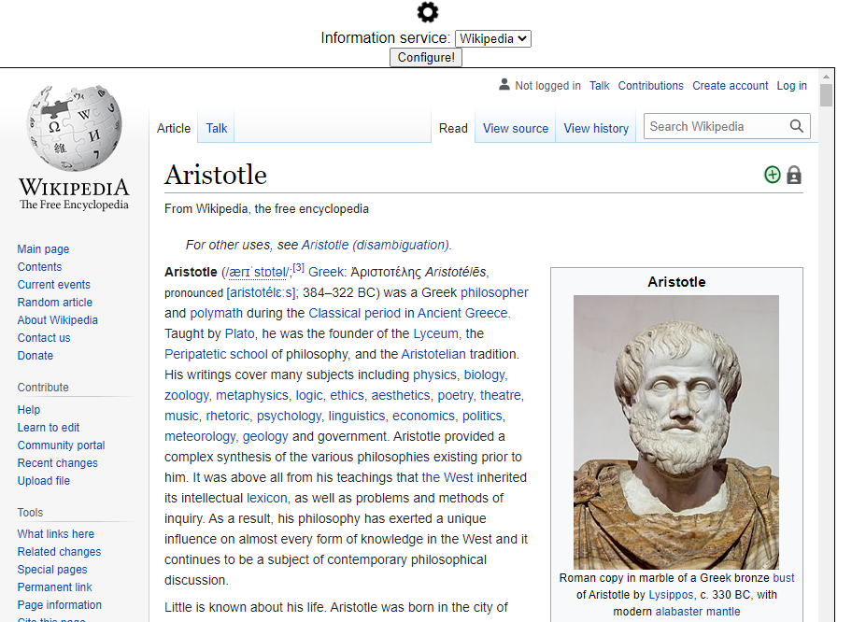
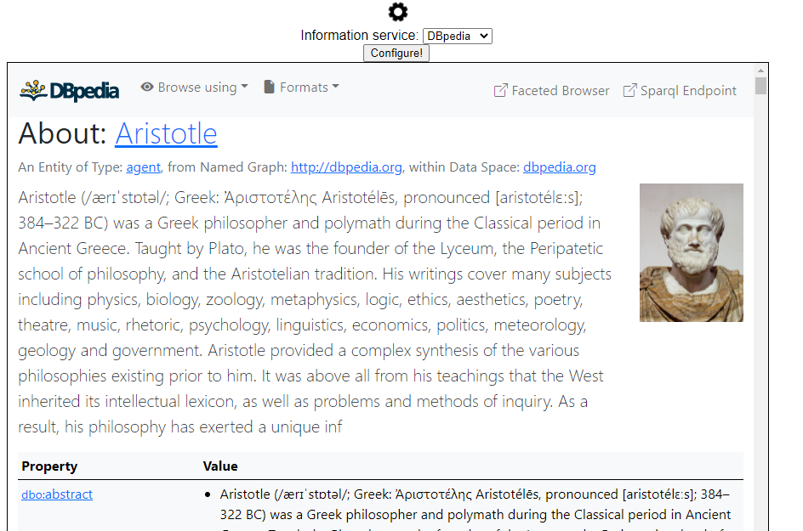
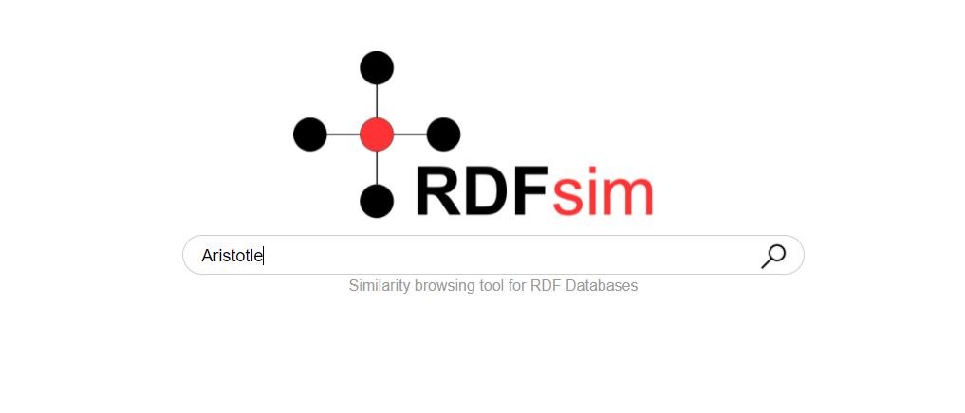
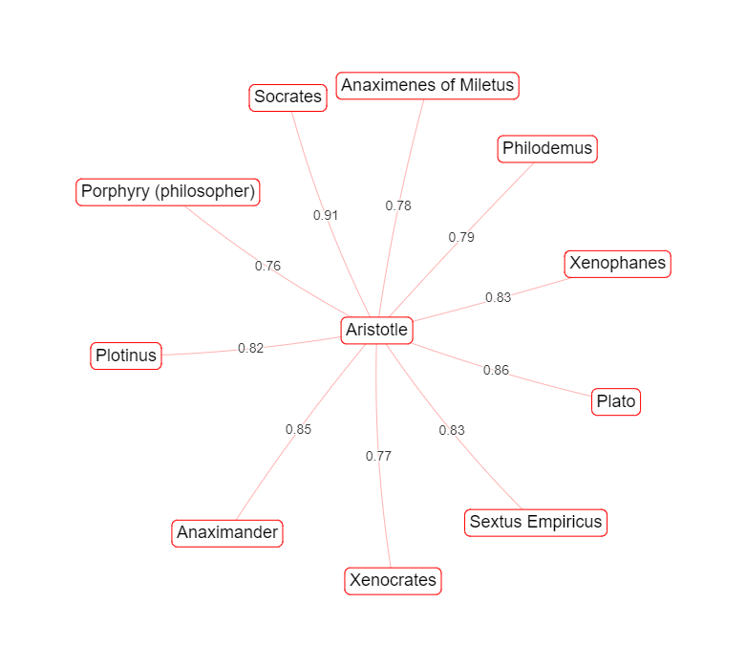
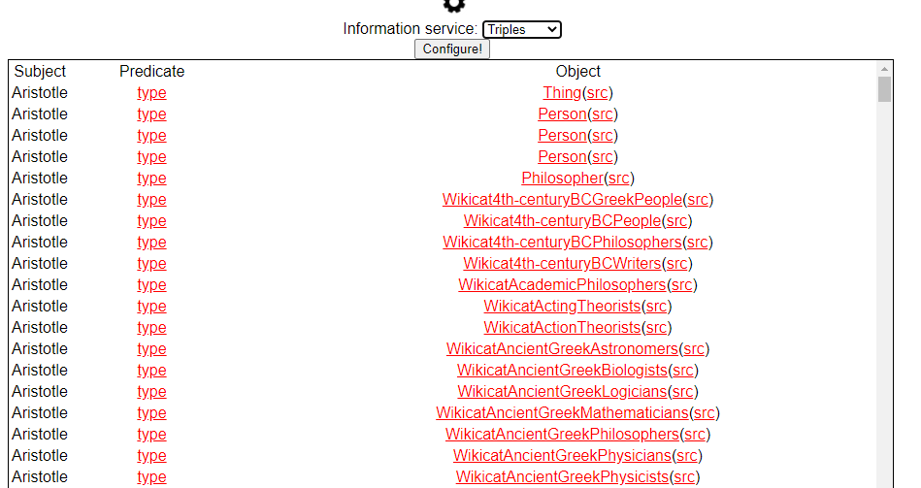
Examples (UI and functions)
Dataset: ~40k triples of philosophers from Dbpedia.
Try this at: XXX

