Slide 1

Similarity Browsing Tool over RDF Databases
Manos Chatzakis (chatzakis@ics.forth.gr)

Slide 2
Context
Browsing is one of the most important actions of the web.
RDF Databases/Knowledge graph containing lots of useful information (As RDF format is really good at expressing information).
Are there user friendly/easy ways to browse the data of an RDF database?
Simple users are unfamiliar with the Semantic Web concepts.
Should we explore different ways to retrieve information, considering classic I.R. (information retrieval) methods?
Background:
RDF Databases/Knowledge Graphs
RDF Triples
Natural Language Processing (NLP)/Word Embeddings

Slide 3
What is RDFsim (and why it is useful)?
RDFsim is a web application designed to provide a UI for browsing on the data of an RDF database.
It provides an easy and interactive way to browse over entities of a RDF DB, by showing the entities that are semantically similar to a corresponding entity, while it is able to show information about this entity (Wikipedia page, dbpedia page or raw triples).
It can be configured to work on any RDF database (for this demo version, Dbpedia is used)
For any given configuration, it pre-calculates the data, thus it can be run on any common machine supposing that the input dataset is provided.
It is independed from the library that provides the methods to find the similar entities to a given one, thus it is easily refactored.
Important: RDFsim is not a classic search engine i.e. it does not offer browsing over web pages, it offers browsing over information/entities of the database.

Slide 4
How does it work (simply)
RDFsim takes as configuration an RDF Database, and downloads the desired triples in N-triple format, i.e. s,p,o …
It uses NLP libraries that produce word embeddings (current: word2vec, future: BERT). After the N-triple format is saved to a file, it is given as an input to the aforementioned library, in order to produce word embeddings: This means that every entity (every URI) will be mapped to a vector of a multidimensional vector space.
As these libraries exploit pre-trained neural networks, we suppose that based on the context of the input file, entities that are semantically similar will be mapped to closer vectors in out vector space. Eg, if the input file contains the following triples: Aristotle, type, Philosopher – Socrates, type, Philosopher – Inception, type, Movie, we expect that the vectors of Aristotle and Socrates (which are both philosophers) will be closer in the vector space regarding the vector of Inception.
This way, we can determine the TOP-K similar entities of a given entity by retrieving the closest vectors in the vector space, and provide similarity based browsing.

Slide 5
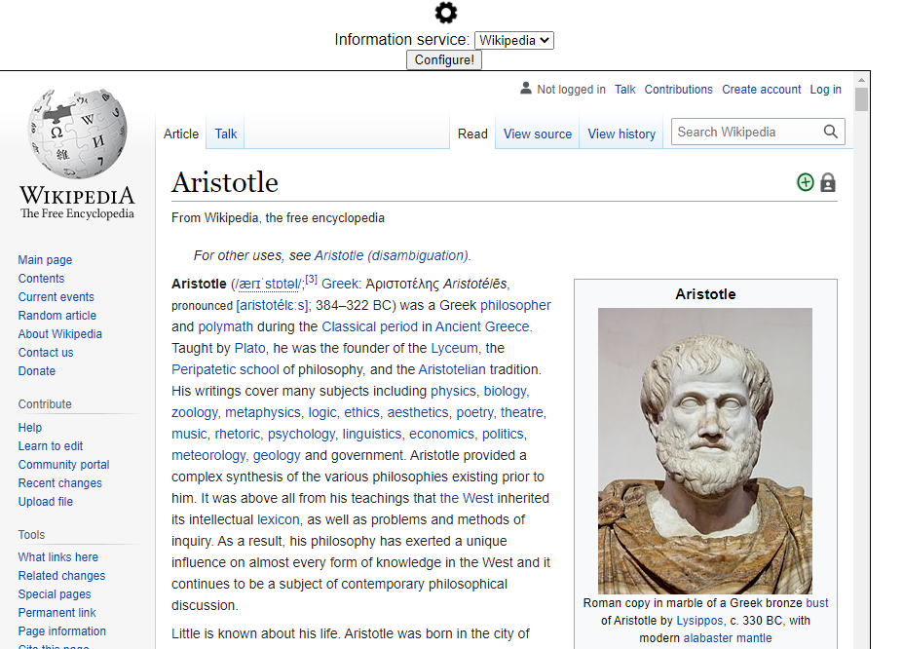
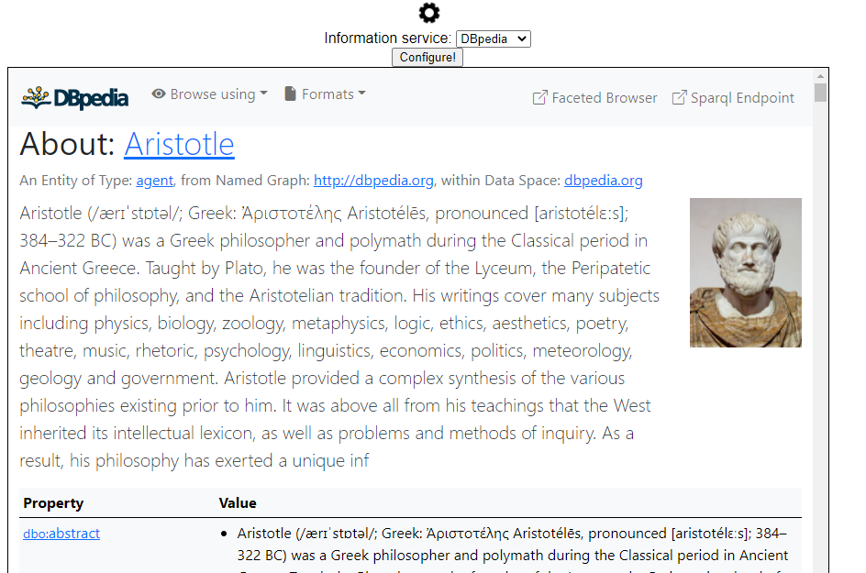
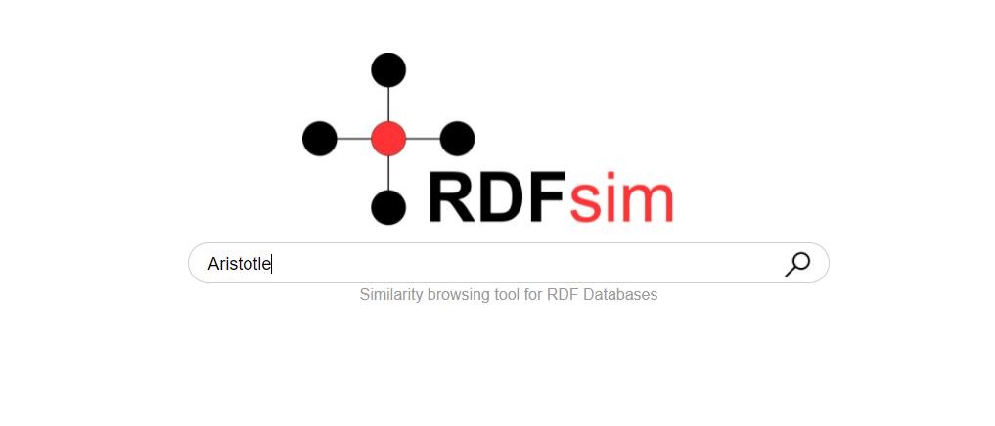
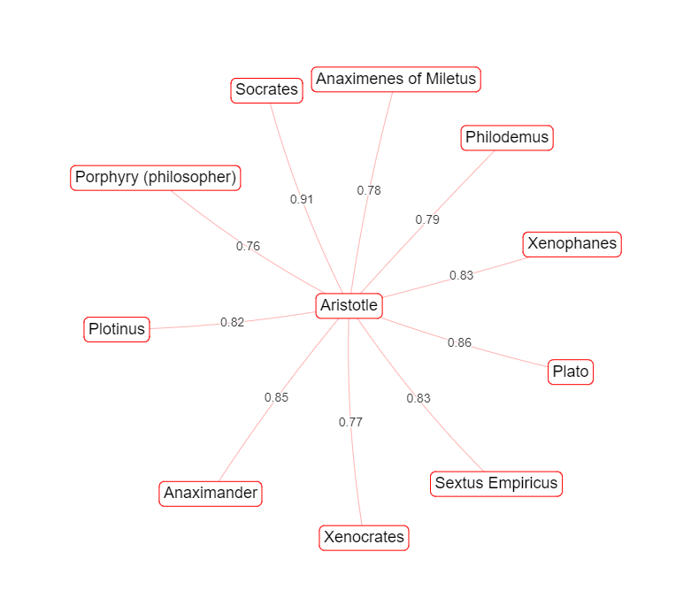
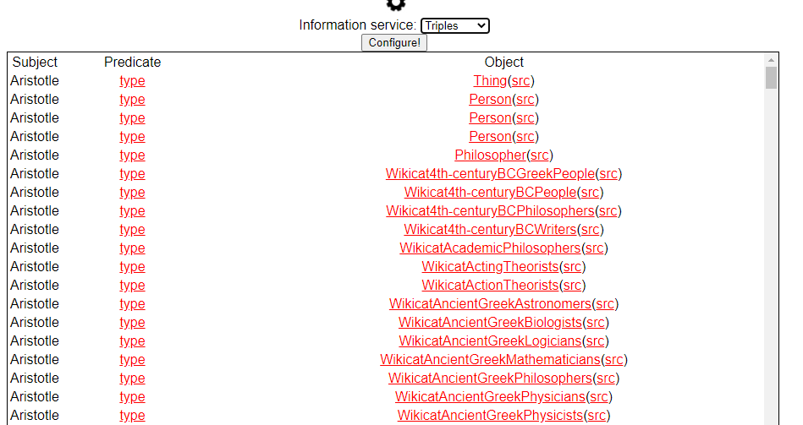
Examples (UI and functions)
Dataset: ~40k triples of philosophers from Dbpedia.
Try this at: XXX

