Slide 1
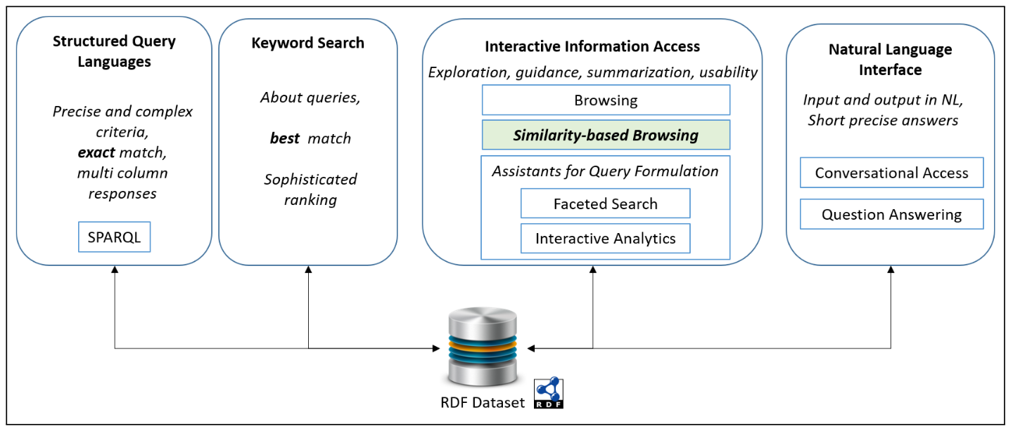
RDFsim
Similarity Browsing Tool
Initial Version
Manos Chatzakis (chatzakis@ics.forth.gr), Michalis Mountantonakis (mountant@ics.forth.gr)

Slide 2
General: Features supported (by now)
QUERIES: Supports SPARQL queries to REST and Virstuoso endpoints and retrieves data in JSON format (Ariadne, Dbpedia and Wikidata tested)
VOCABULARY: Parses the data to produce URI triples or bigger sequences based on the query given. Produces a file containing all the data (to be given as input for w2v)
EMBEDDINGS: Uses w2v library to create a vector representation for each URI
RDFsim API: Uses a w2v wrapper to provide API functionality for the application (etc. find top K similars, compute cos similarity, add/sub expressions)
UI: Provides a very (very) basic user interface running on browser to host and test the above services
Current Technologies: Java (Servlets, DL4J API), HTML/CSS, JavaScript (jQuery)

Slide 3
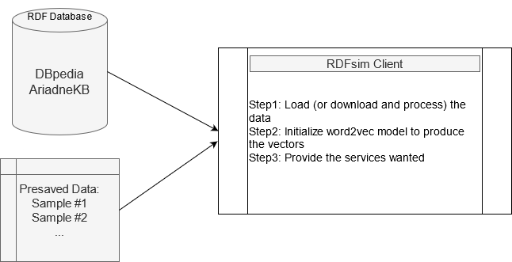
Queries
Retrieves the data as JSONObject()
Parses the JSONObject and creates the String representation of data as text
RDF Database
Data in JSON
Creates the “name”.rdf file
SPARQL Query
Notes:
Databases tested:
DBPedia, WikiData (Virtuoso endpoints)
AriadneKB (REST)
What else should we look?
Space Problems:
1) Should we pre-save complete databases?
2) Downloading data at frontend configuration is slow (but its supported)

Slide 4
How the embeddings are created
Embedding API + Parameters
(etc. w2v + window size, dimensions….)
Train the model
Multidimensional Vector Space
Input file(Raw RDF triples or URI sequences – both supported)
The code is pretty similar with LODvec tool
Currently we work with small datasets and we have not tested the accuracy of the model. (eg. Philosophers and People from Ariadne). (Note: when it’s ready, we could download and preload complete DBs, or generally bigger RDF datasets.

Slide 5
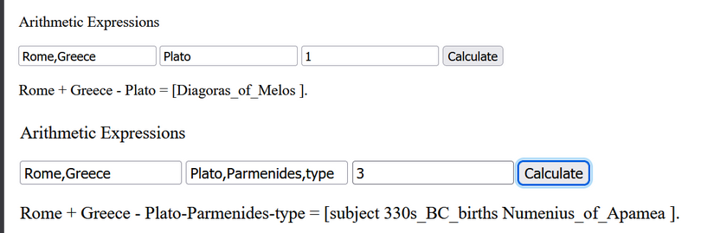
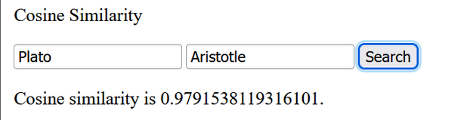
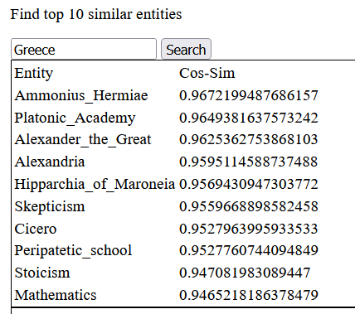
Services
Find top-K similars:
Find cosine similarity:
Word additions/substractions:
Complex Queries? (ideas..)
Triples: How (and if) we should present them + Entities
Redirection: When a user clicks on a URI, where should we go?
Notes: URIs of AriadneKB is not that readable and also, Ariadne is slower than DBPedia

Slide 6
UI – Web application
Now: Basic, Just to test the functionality
Simple UI
Tab for each service
Follow Elad4RDF format? (Simple + Tabs)
Should make some mockups
What we need to show (for sure):
TOP-K similars (What should the table contain?)
Cosine similarity
Arithmetic Expressions
Complex Queries Form
What else? (triples, entities etc….)

Slide 7
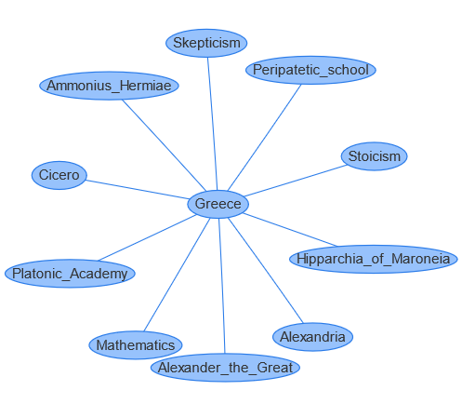
Idea: Similarity Graph
Is it useful to create a graph with starting node the given entity and add the K similar as neighbor nodes and proceed to a given depth using a BFS-like traversal of the dataset? (Undirected weighted graph) Nodes:=Entities Edges:=Weight ->Cosine similarity
Pros: Provides a fast view about the similarity set of a small part of the dataset.Cons: It’s not that informative as an RDF Graph (links are the cosine similarity, not predicates)
Algorithm: Use a BFS-like algorithm to create the graph based on the levels (depth)

Slide 8
Measurements and Efficiency
Specs: 16Gb ram, 8 cores (But download takes more time anyways)
Query: select * where {?s ?p ?o.}
Measuring: Time to Retrieve/Parse the triples, train the model for both REST and Virtuoso endpoint (seconds)
The values are approximated – Ariadne is slower
Triples (limit step) | Ariadne | DBPedia
1000 | 7.08 seconds | 3.013 seconds
10000 | 393.53 seconds | 46.732 seconds
30000 | 3197.217 seconds | 139.402 seconds
50000 | Todo | 210.329 seconds
100000 | Todo | 410.689 seconds

Slide 9
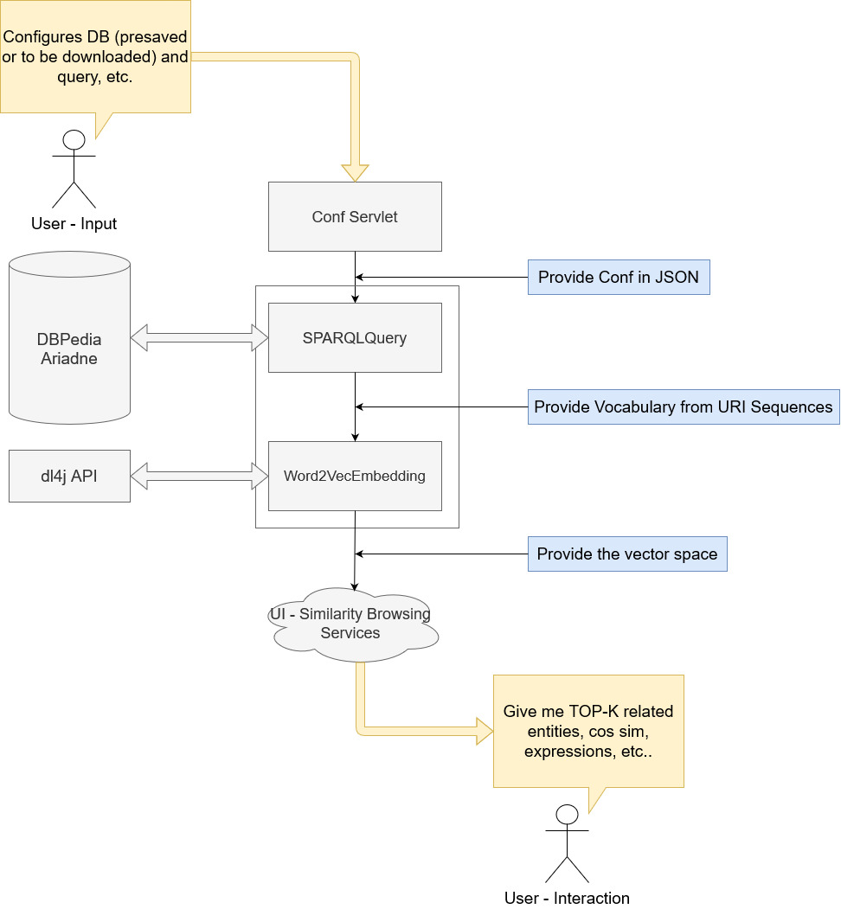
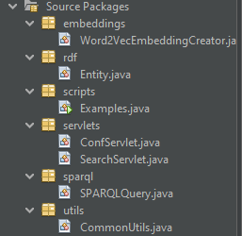
RDFsim Architecture
Sequential Architecture
Future: Provide more embedding methods and try to compare
Question:Discussion about the “Entity” object
Keep URI
Keep double [] vector
(…)Keep triples (also really slow to keep them as objects eg. Oo+lists)
Slow..
We could retrieve this data with new queries at front when need them (?)

