Slide 1
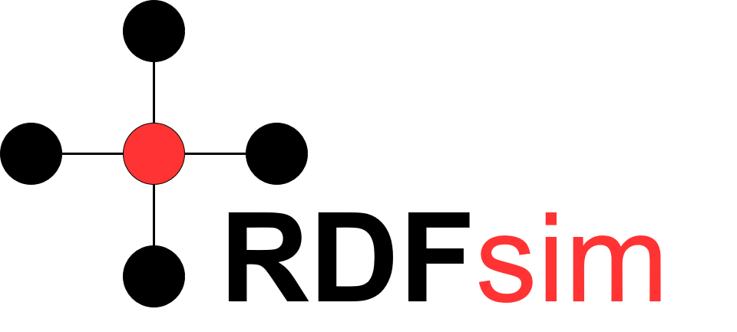
Similarity Browsing tool for RDF databases.
Manos Chatzakis (chatzakis@ics.forth.gr)

Slide 2
What it is
RRFsim is a web application designed to help the user browse data over a selected RDF database
It tries to determine which entities are the most semantically similar to a given one, allowing the user to explore information based on how similar two entities are
Warning! Its not a classic search engine (i.e. does not use classic IR methods): Does not offer browsing over web pages, it offers browsing among information/entities available on a given RDF database.

Slide 3
Why it is useful
Context:
Browsing is one of the most important tasks of the web.
By now, there is no friendly way to interact with an RDF database (Generally, basic users are unfamiliar with the semantic web and its resources).
It provides an easy and interactive way to browse and extract information of an RDF database
It can be configured to work on any RDF databases! For this demo version, it is configured with Dbpedia datasets.
It has pre-calculated the embeddings (i.e. vectors) and supports a Random Access system, that ensures efficiency, and ability to run of common computers with a provided dataset.
It is independed from the embedding method/library, which means that it is easilty refactored as a software.

Slide 4
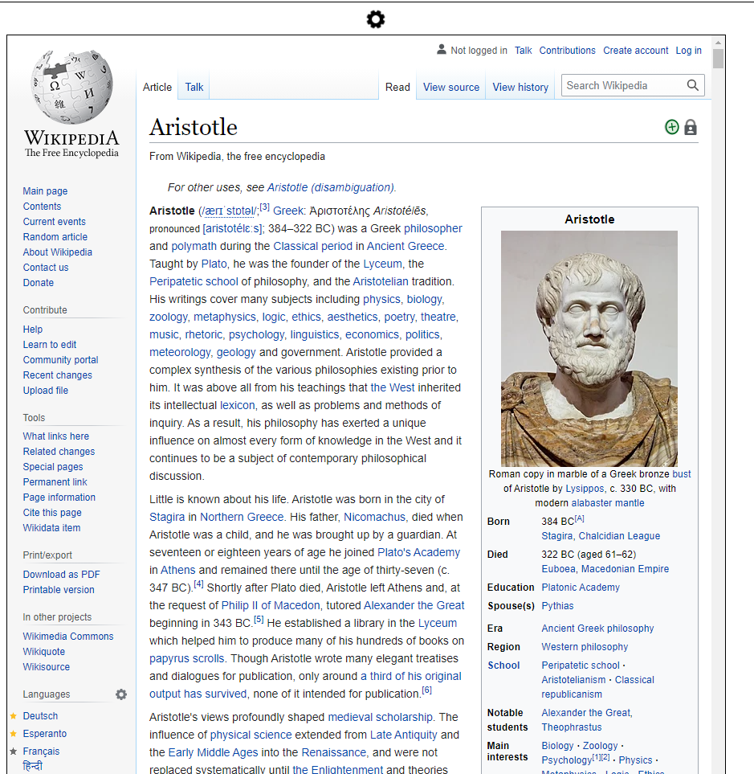
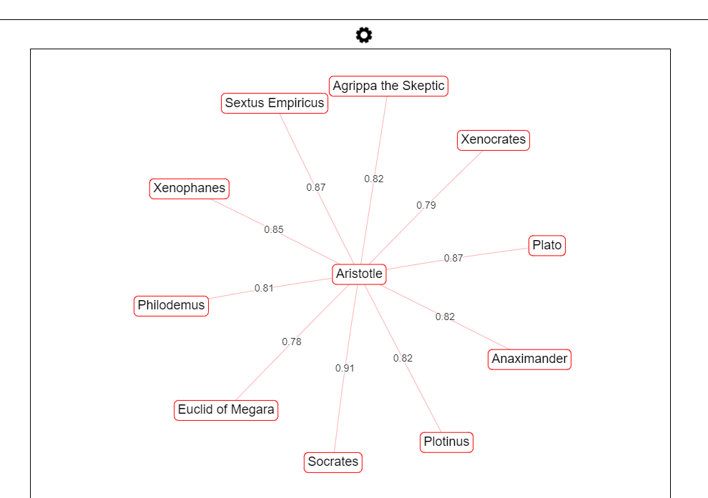
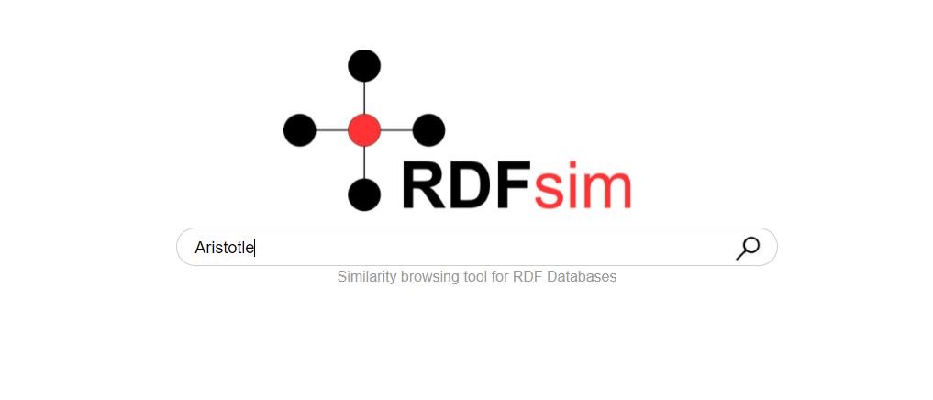
Examples
Dataset: A custom dataset containing ~40k triples of Dbpedia philosophers:

Slide 5
How does RDFsim work (in simple terms)
RDFsim takes as a configuration an RDF database and downloads its data in RDF Ntriple format (s,p,o …. )
It loads the Ntriple file to an NPL library (w2v (currently), bert (future)…) in order to produce word embeddings:
This means that every entity is transformed into a vector (in a multidimensional vector space), and if two entities are semantically similar, their vectors are similar too e.g. for the triples: Aristotle bornIn Greece, Socrates bornIn Greece, X bornIn Italy, we expect that Aristotle’s vector will be similar to Socrates, and not X.

Slide 6
How does RDFsim work (in simple terms) [2]
It exploits the embeddings to find similar entities to the given one.
It offers a basic User Interface so that the users can interact easily and efficiently with it.

