Slide 1
Android In-App Advertising
Group No: 81
MEGHA CHETAN CHINCHAMALATPURE
ROLL NO :- 1114
MAYURI MADHUKAR JADHAV
ROLL NO :-1113

Slide 2
Objective:
Advertising has three primary objectives:
inform,
persuade, and
remind.
Informative Advertising creates awareness of brands, products, services, and ideas.

Slide 3
Traditional Advertising Vs In-App Advertising
Traditional Approach Mobile Approach
1.Easy to understand 1.Many different channels to choose from
2.It’s Tangible and communication 2.Social Media networks are optimized and
is face-to-face communication is anywhere and anytime
3.It costs lot of money 3.less expensive
4.Difficult to track and Measure results 4.Easier to track results
5. Less engaging and no effective 5.More engaging and personalization
6.Outdated 6.Viral Potential

Slide 4
Why In-app advertising?
Mobile enables location marketing in a way that desktops can’t match.
In-app advertising is an effective monetization strategy for mobile publishers
Data tracking and user targeting
The in-app environment also allows advertisers to reach consumers with pinpoint accuracy
Mobile advertising helps to deliver highly interactive ads with compelling formats and interactive contents.

Slide 5
What is In-App Advertising??
Mobile app advertising refers to ads and ad campaigns expressly designed for mobile devices.Mobile ads can appear within apps, on websites viewed from mobile devices, or on social media platforms viewed through mobile devices.

Slide 6
What are the in-app advertising types?
Interstitial ads :Interstitial ads are full-screen banners that appear between game levels.
Banner ads:Mobile banner ads are the static ad units which are displayed at the top or at the bottom of the screen
Rewarded video ads :Rewarded ads offer the incentive/reward to the user who’s watching the ad
Offerwall:An offerwall is a rewarded advertising unit that presents the opportunity to earn rewards through ad engagements.

Slide 7
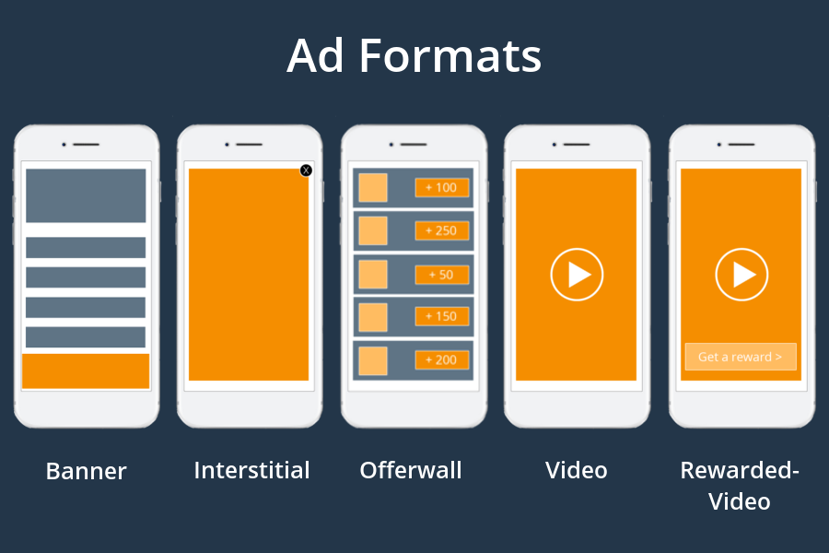

Slide 8
Benefits of In-App Advertising
Less distractive
Highly interactive
Better controlled and managed
You can earn more money
Create a better user experience
Improve user engagement and retention
Better consumer experience
Accessibility

Slide 9
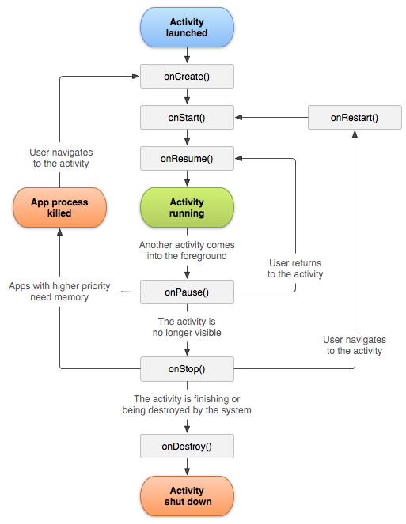
Application Flow
.

Slide 10
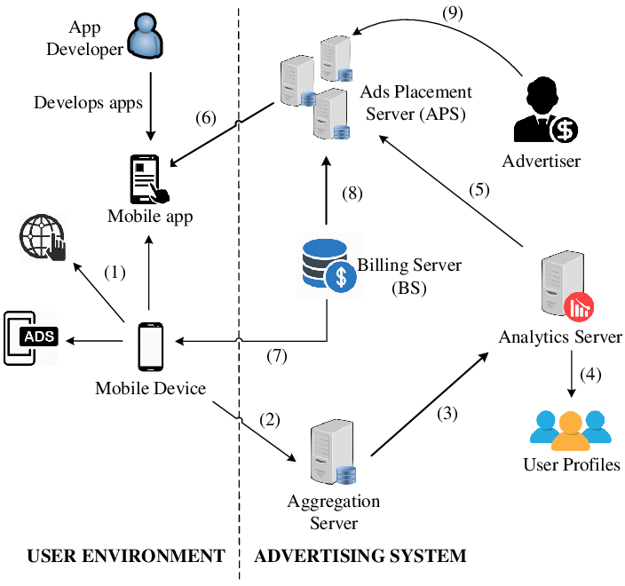

Slide 11
Ad Network
connects advertisers and developers.
uses algorithms to identify and deliver the highest paying ad to the user in real time.
sdk integration
Google AdMob
IronSource sdk

Slide 12
Features:
Application is android mobile OS 6 and above specific
It serves main purpose of showing every type of ad formats
Local push notification is provided

Slide 13
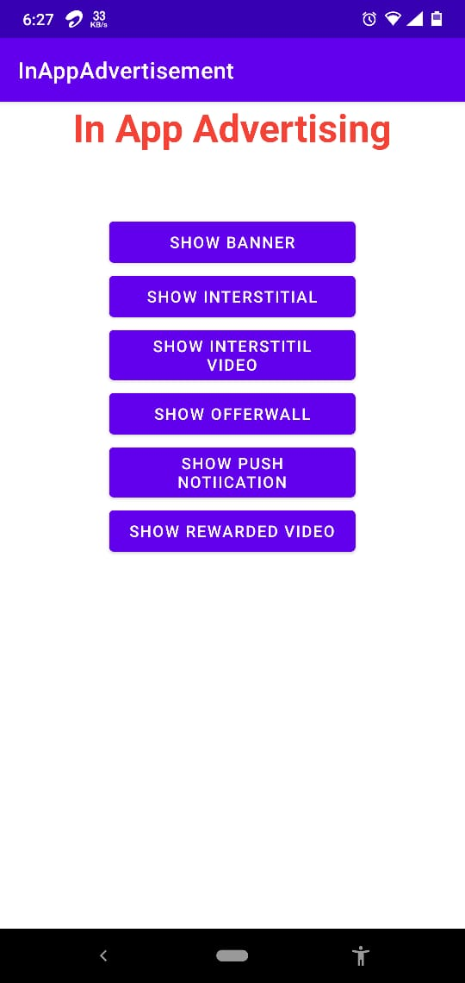
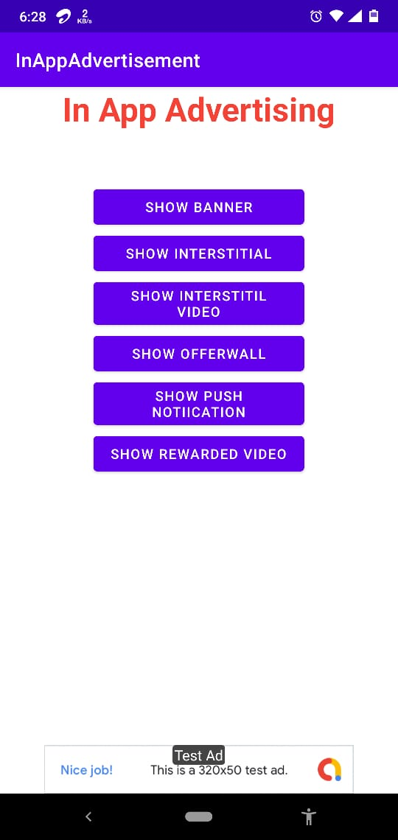
Home Page: BannerAd:

Slide 14
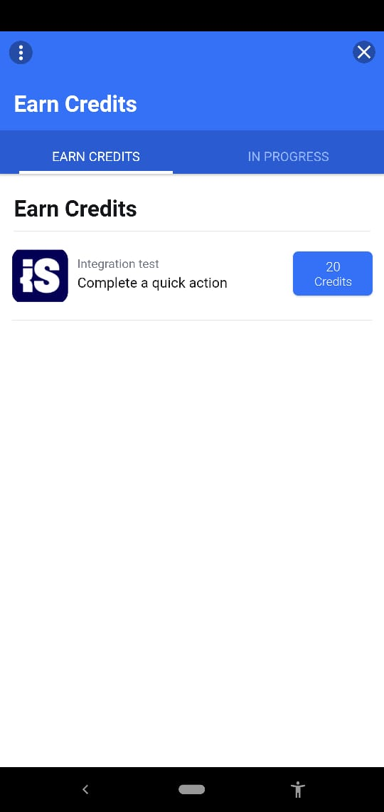
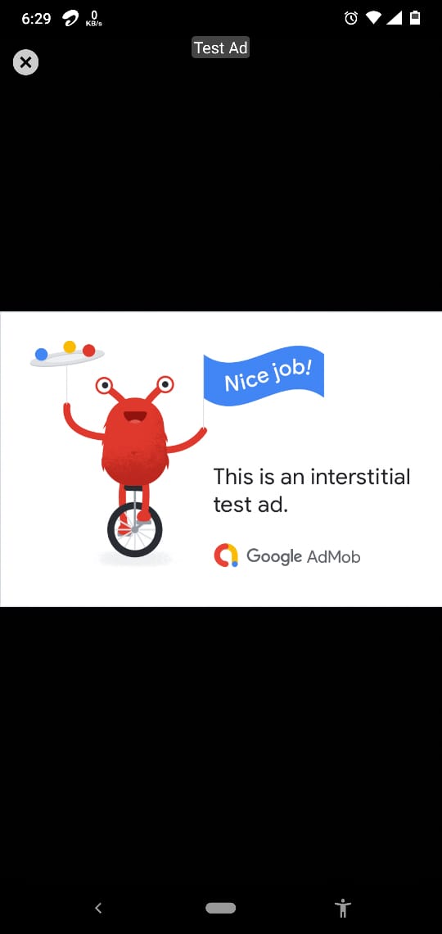
Offerwall Interstitial

Slide 15
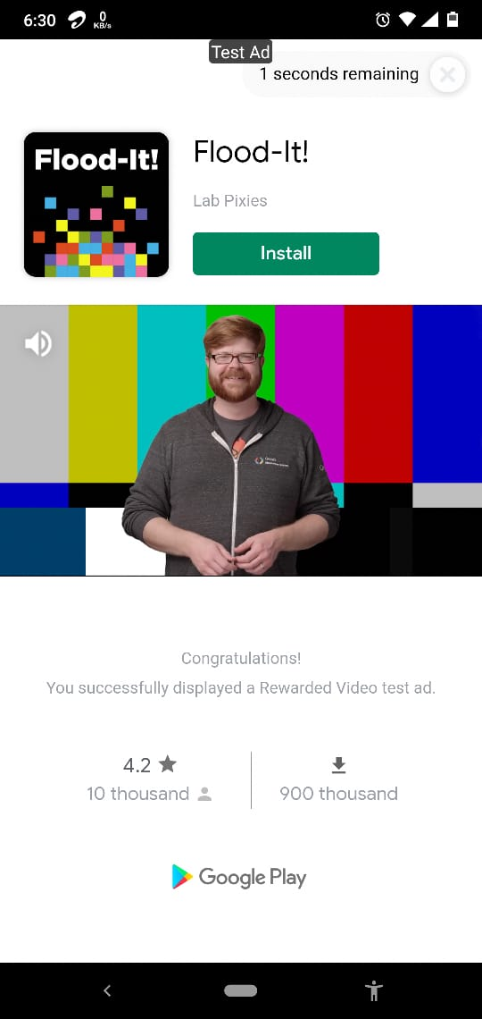
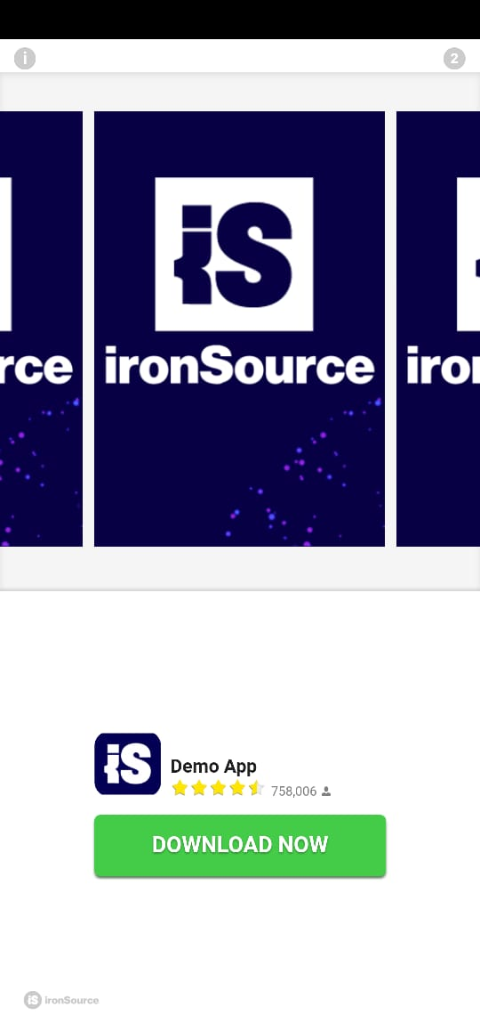
Rewarded video Interstitial video

Slide 16
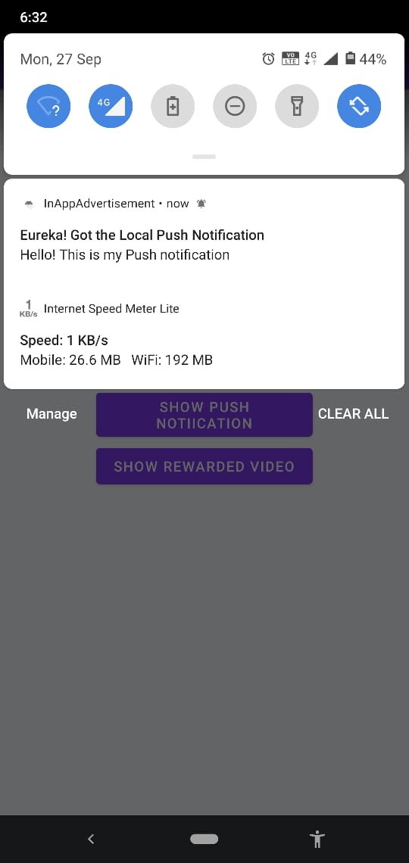
Push notification:

Slide 17
Limitations of In-App Advertising
Ad Server fill rate may affect the ad outputs.
Internet Connection is mandatory
Privacy Issues

Slide 18
Future Scope
This project can be enhanced further by adding ad monetization strategies using various types of advertisement formats
The software is flexible enough to be modified and implemented as per future requirements
Server notification(Firebase) for android application
Application analytics(firebase) ad revenue calculation, Ads personalization
Android application permission.

Slide 19
Thank you

