Slide 1
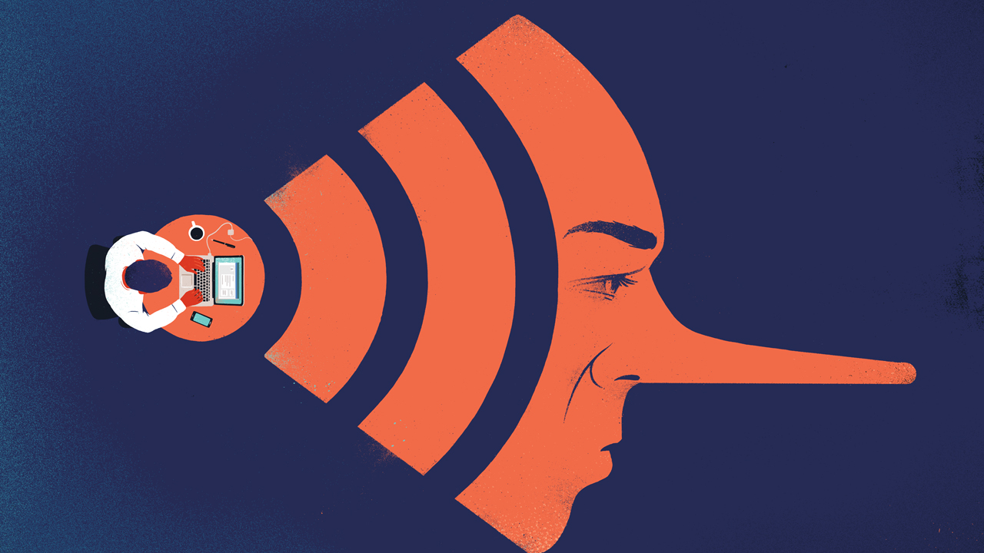
Fake News detection
in press articles

Slide 2
Why?
“Infostrateg” / NCBiR 2021
  Fake News
MLP-Mixer architecture advantages
  Unlike RNNs, mixer operates in parallel on entire sequence
  Unlike transformers, their complexity scales linearly with the sequence length and yet they can capture long-range dependencies
  Conversly to CNN, MLP is not local as filter spans entire spacial area
  Based on MLP blocks for which hardware acceleration is ubiquitous
  much less number of parameters compared to CNN and transformer-based models, which leads to less training and serving computational cost
Mixer for NLP task
  Sequence text model to detect fake news that scales well
  Comparison to CNN (the most frequent referred)

Slide 3

Fake News
FAKE NEWS:
„False stories that appear to be news, spread on the internet or using other media, usually created to influence political views or as a joke”
Cambridge Dictionary
„False or misleading information presented as news. Fake news often has the aim of damaging the reputation of a person or entity, or making money through advertising revenue. […]
first used in 1890s when sensational reports in newspapers were common”
Wikipedia
General idea for information distortion that employs falsity or manipulation to intentionally cause gains for the fake news issuer.

Slide 4
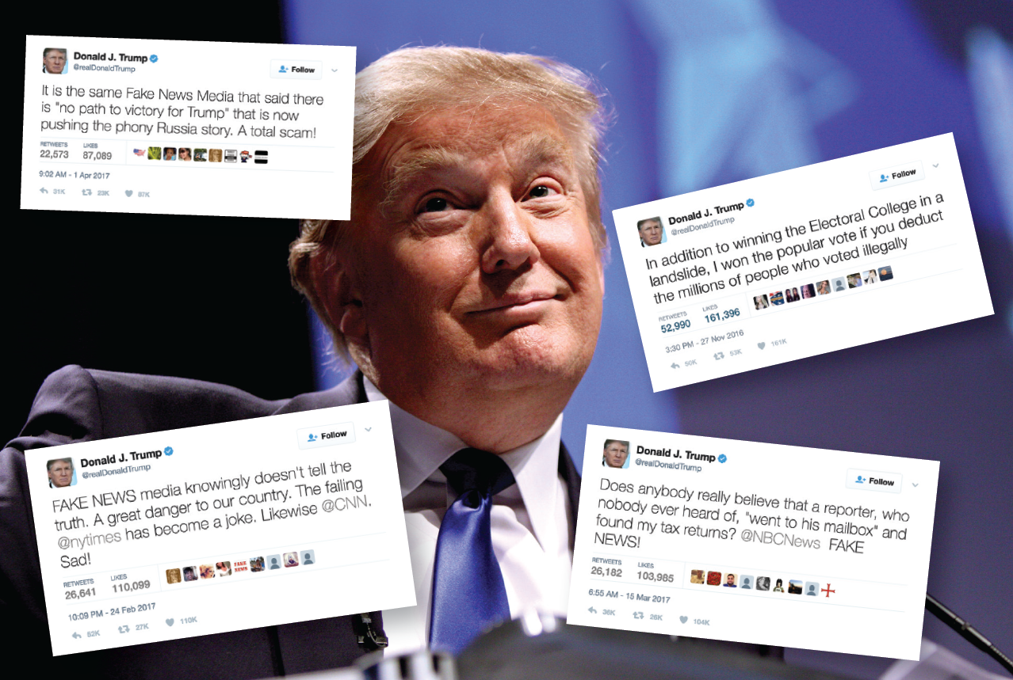
2016 Explosion of sensational reports

Slide 5
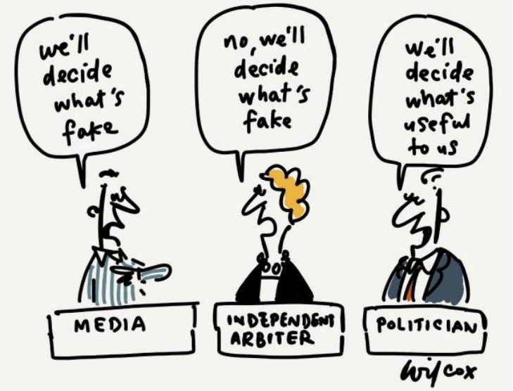
Who gets to decide?
Cartoon by Cathy Wilcox, drawn for UNESCO for World Press Freedom Day 2017.

Slide 6
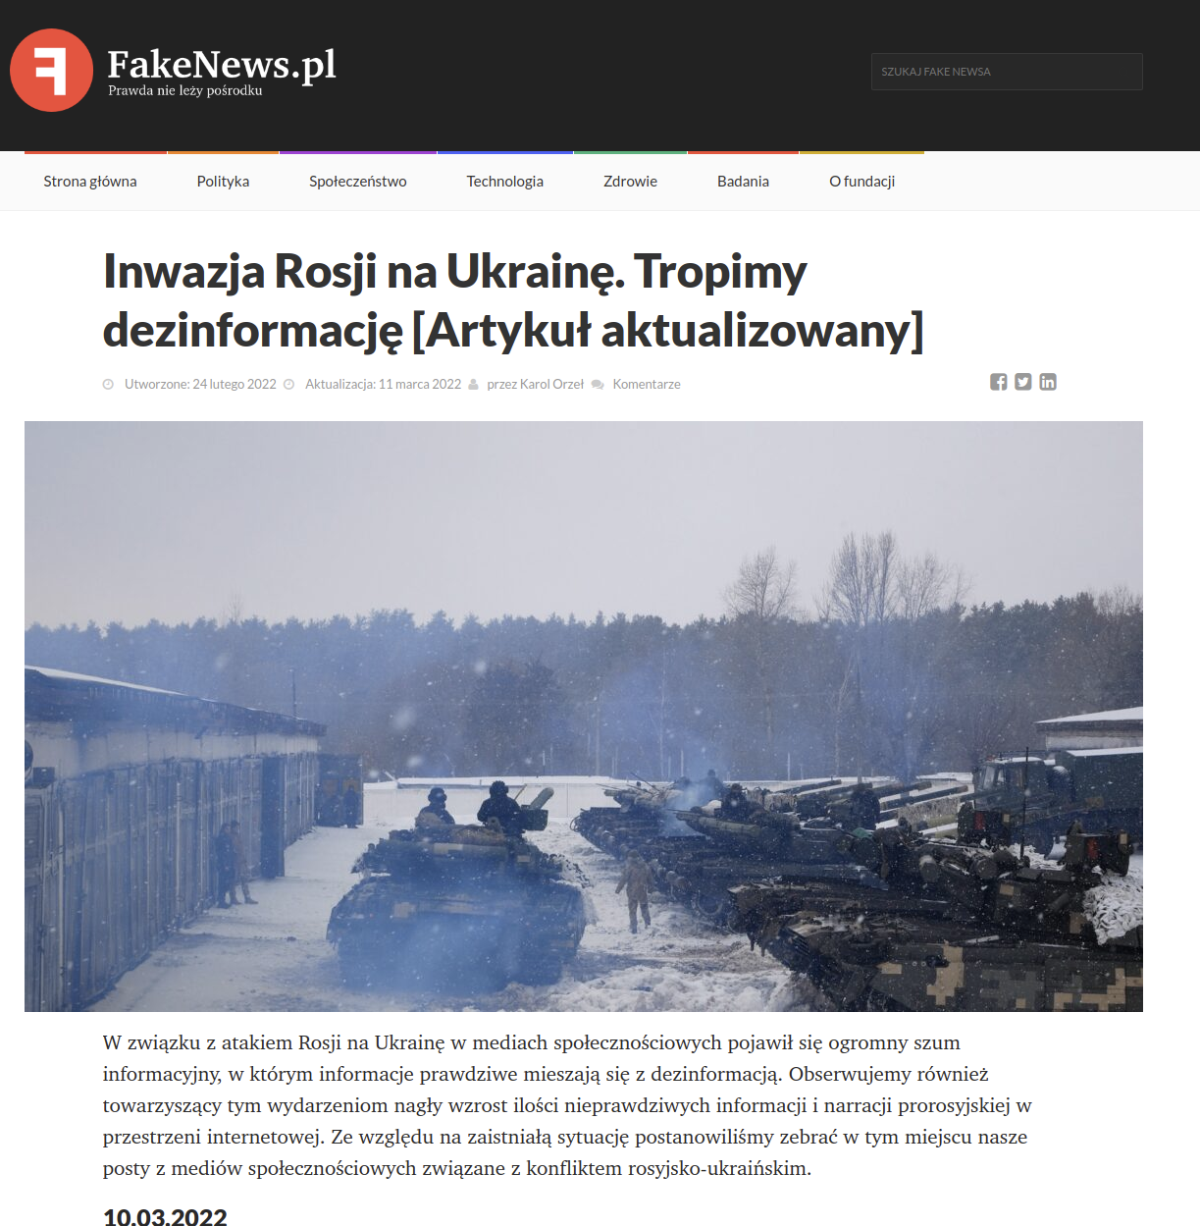
Fact checking
Published by the Council of Europe
(F-67075 Strasbourg Cedex)
fact-checking database created by
Duke University’s Reporter’s Lab
https://reporterslab.org/fact-checking/
  Agence France-Presse (AFP) AFP Fact Check (Poland) https://sprawdzam.afp.com/list
  https://pravda.org.pl/
  https://fakenews.pl/ FUNDACJA “PRZECIWDZIAŁAMY DEZINFORMACJI”
List of countries:
Poland:
  Demogog is a project of the Demogog Association, the first professional fact-checking organization in Poland.
  OKO.press fact-checks statements made by Polish public figures. It was founded in 2016 and is supported entirely by individual donations.
    Indyvidual donations...

Slide 7

Combat Fake News
Polish Press Agency (PAP)
https://fakehunter.pap.pl/
www.truthorfiction.com
Which fake news was the most read each year on different platforms such as Twitter or Facebook,

Slide 8
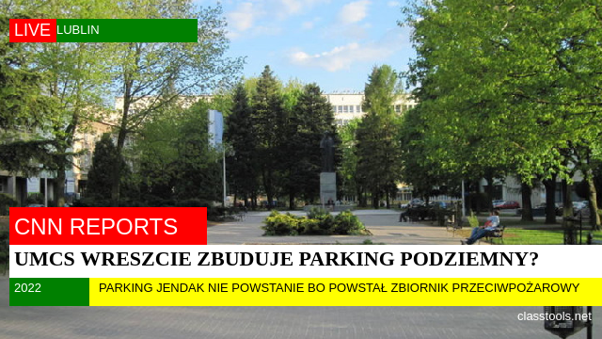
Fake News detection

Slide 9
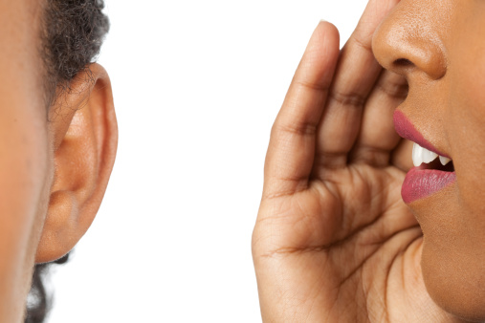
Fake news comes from lack of editorial standards
Fake news use the mechanizm of gossiping and chinese wispers
Many people now get news from social media sites and networks → no standards
  Filter bubbles
  Echo chambers
It can be difficult to tell whether stories are credible or not
Information overload + general lack of understanding about how the internet works
Social media sites can play a big part in increasing the reach of these type of stories → my friend likes it so am I – social proof
The economics of social media favour gossip, novelty, speed and “shareability”

Slide 10

False / Fake news? fake - udawać
False information is news, stories or
hoaxes created to deliberately misinform
or deceive readers.
Usually, these stories are created to:
  influence people’s views,
  push a political agenda or
  cause confusion and
  can often be a profitable business for
  online publishers.
False information can deceive people by:
  looking like trusted websites or
  using similar names and web addresses to reputable news organisations.

Slide 11
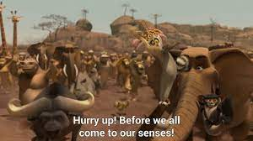

Call to action
Engade reader to prompt response
“Best” response is to:
  share
  comment
  even object
  the more action.. the better
More traffic
  → the more visibility
  → more spread
Kind like virus infection

Slide 12


Fake News evaluation characteristics
Emotions
Negativity
Provocation
Stereotypical
Fulfilling demand
Use recent events to authenticate itself
Judging / evaluation statements
False support from bot / fake via social networks
Easy to generate
Targeted to specified social group audience focused on thier daily limitations or new constraints, threats

Slide 13
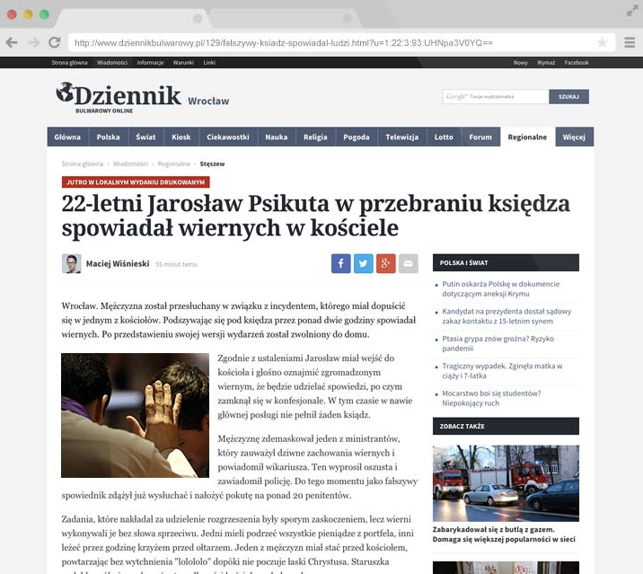
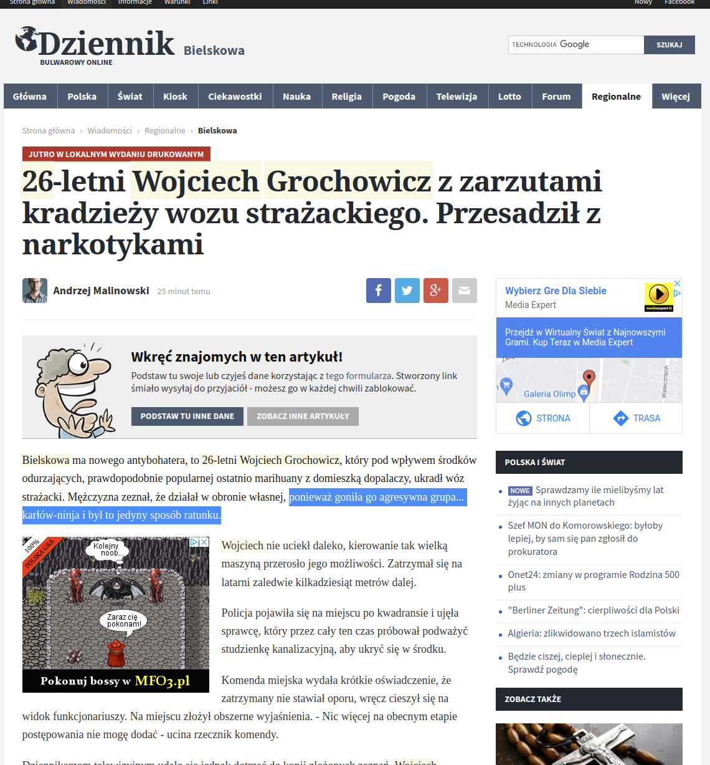
Fake news for dummies
http://dziennikbulwarowy.pl/

Slide 14
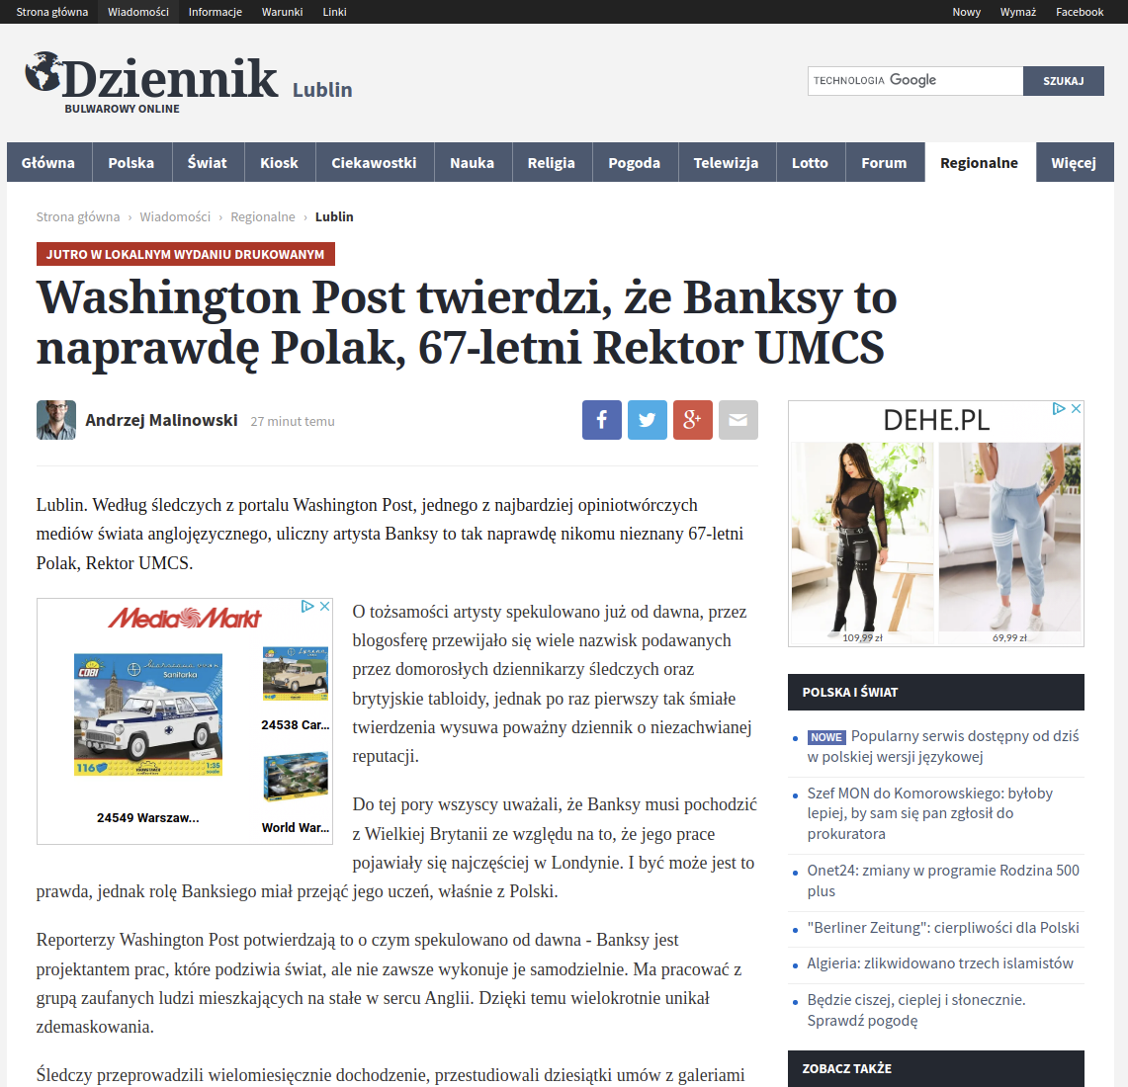
General problem
Spreads false information
Can cause panic
Can defame people / institutions / countries
Spread false medical facts and manipulations
Market / financial market manipulation

Slide 15

Information disorder reports - 2017
Published by the Council of Europe (F-67075 Strasbourg Cedex)
Fake news inadequate to describe the complex phenomena of information pollution
Politicians around the world to describe news organisations whose coverage they find disagreeable
Conceptual framework for examining information disorder, identifying the three different types: mis-, dis- and mal-information
Use the dimensions of harm and falseness

Slide 16
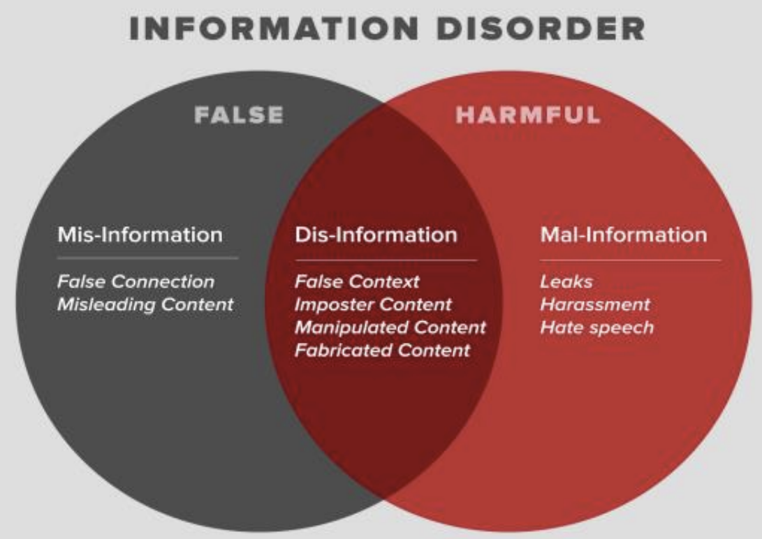
Framework: types of information disorder
Mis-information is when false information is shared, but no harm is meant.
Dis-information is when false information is knowingly shared to cause harm.
Mal-information is when genuine information is shared to cause harm, often by moving information designed to stay private into the public sphere

Slide 17
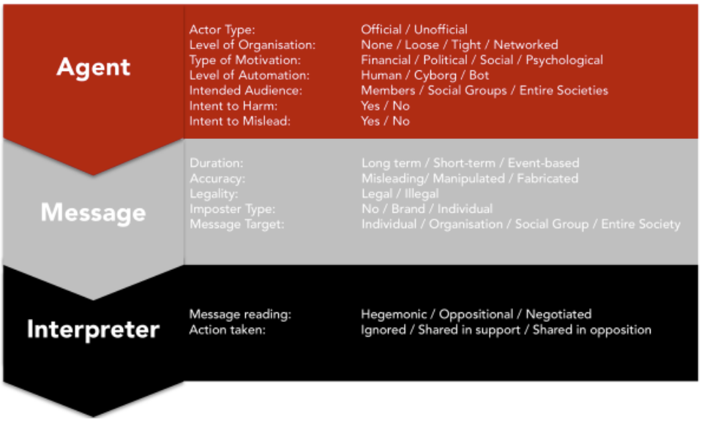
Framework: The components

Slide 18
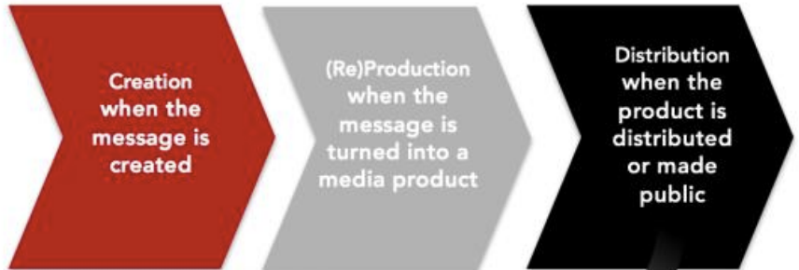
Framework: phases
‘Agent’ who creates a fabricated message might be different to the agent
who produces that message—who might also be different from the ‘agent’ who distributes
the message.
Similarly, we need a thorough understanding of who these agents are and what motivates them.
Understanding the different types of messages being distributed by agents, helps estimating the scale of each and addressing them

Slide 19
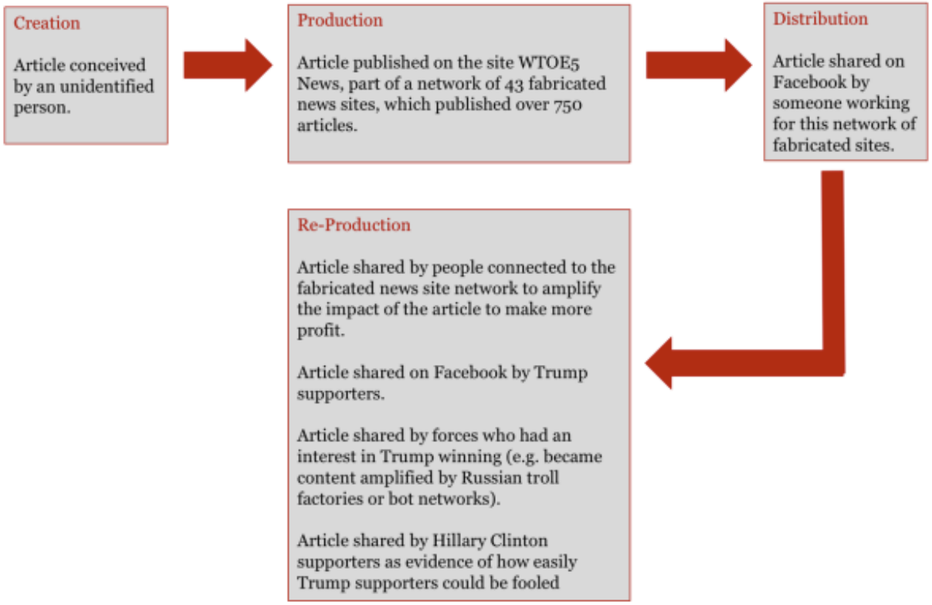
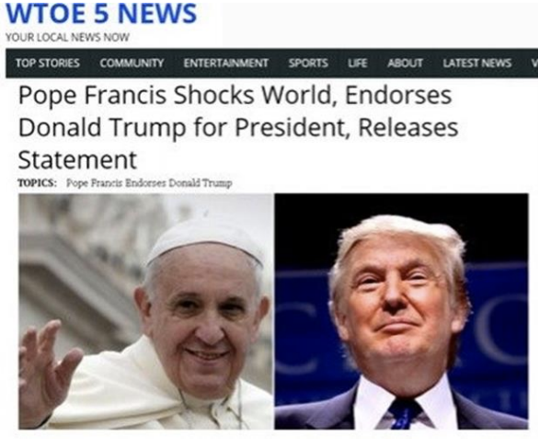
Three phases of information disorder

Slide 20
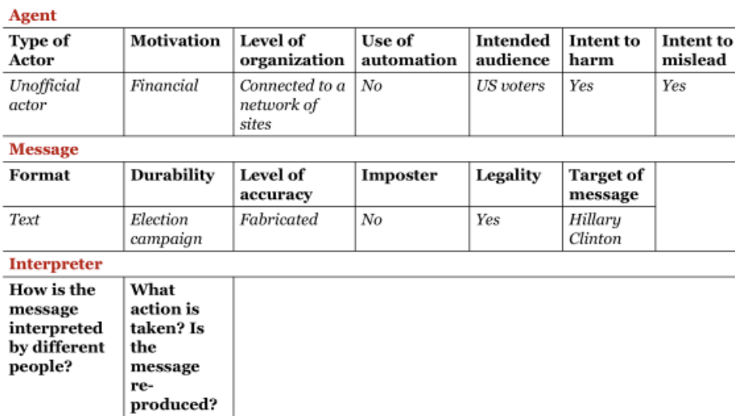
Fake News phase analysis

Slide 21
3 x 3 dimensions of FN
The three types: mis-, dis- and mal-information
The three elements: agents, messages and interpreters
The three phases: creation, production and dissemination

Slide 22
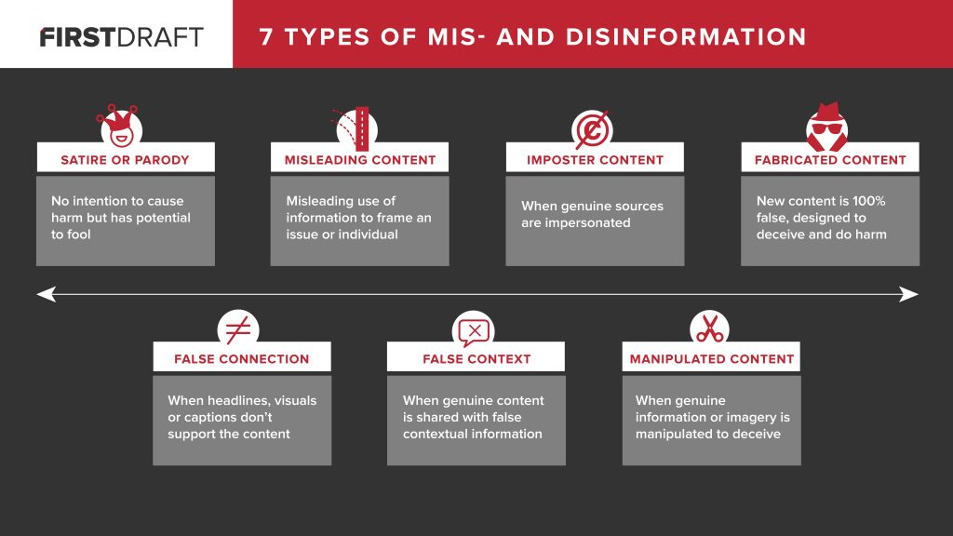

Clickbait
Propaganda
Satire / parody
Sloppy journalism
Misleading headings
Biased/ Slanted News

Slide 23
How to defend against Fake News
Be sceptical: well-read titles, capital letters. incredibly shocking and appears to be untrue, it usually is.
Are you sure it’s not satire?: can be a joke. Fake news is much more serious information.
Verify the sender
Source: Many fake news sites cite a source – verify
Evidence: quoted source - verifying the evidence or research cited by the author
Linguistic correctness: check for errors
Pictures: alterations of old photos, attributing an image to a completely different situation
Dates: timeline is very often wrong. The chronology of events often does not make sense.
Compare information: Has similar information also appeared elsewhere?
Fake news works because of the reach:
Not so much an advice on how to detect fake news, but how to fight it
  remember that it also depends on us whether the fake news spreads further
  we share it on social media, we talk about it and we spread information whose credibility we have not checked in any way.
  put some effort into verifying the news we pass on.

Slide 24
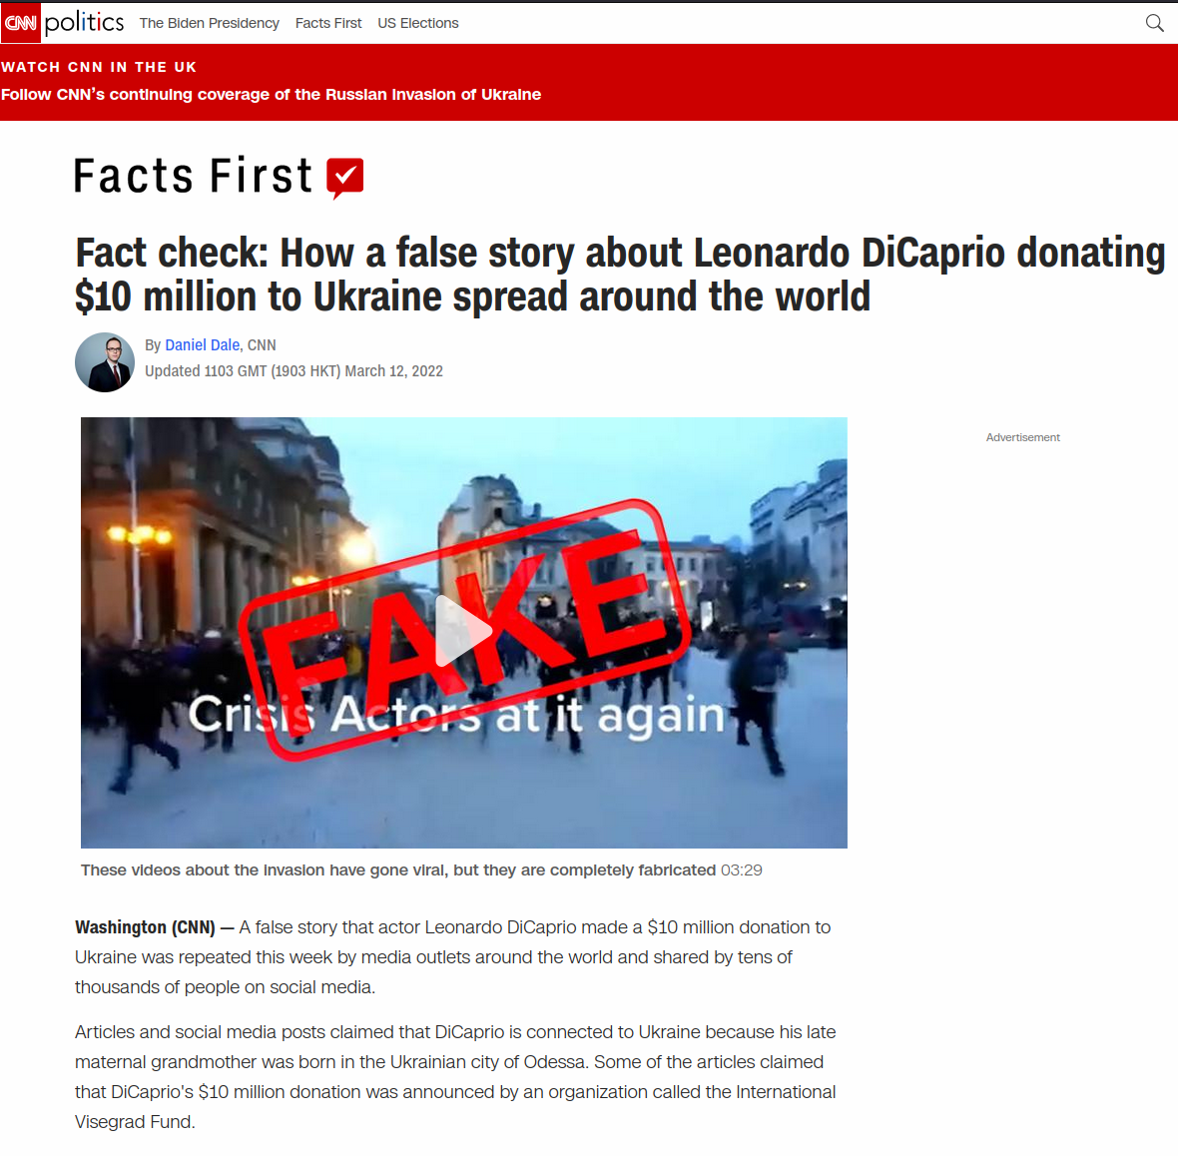


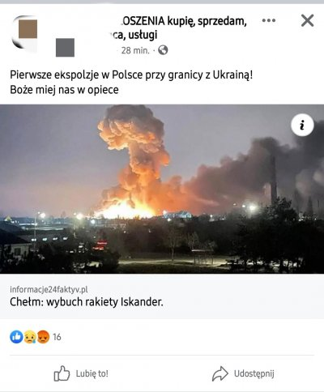
Fog of war
FN as a weapon
No way to verify information
Most messages are emotional
Most messages spread as a fake news as mostly they are

Slide 25

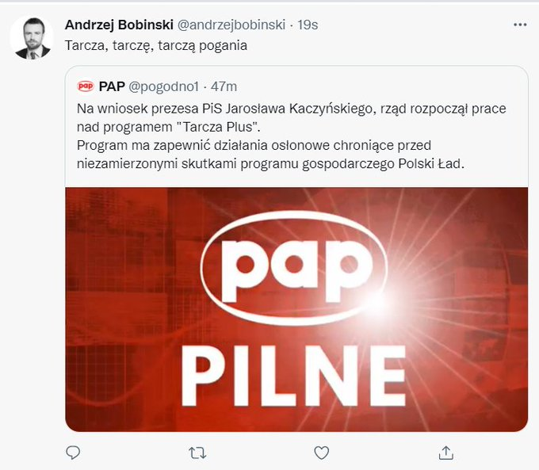
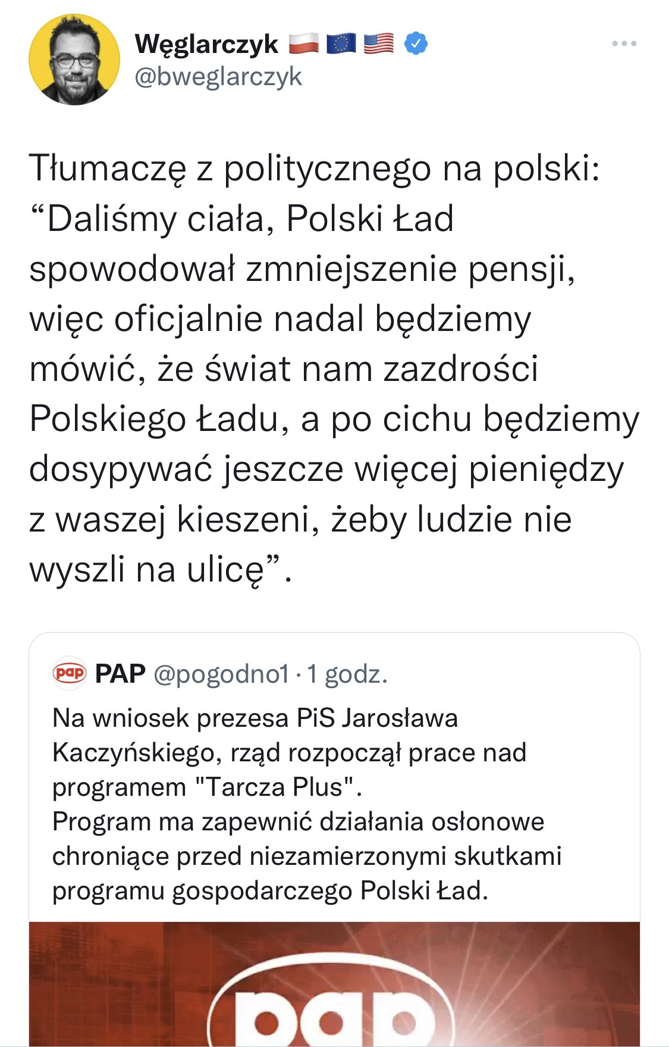
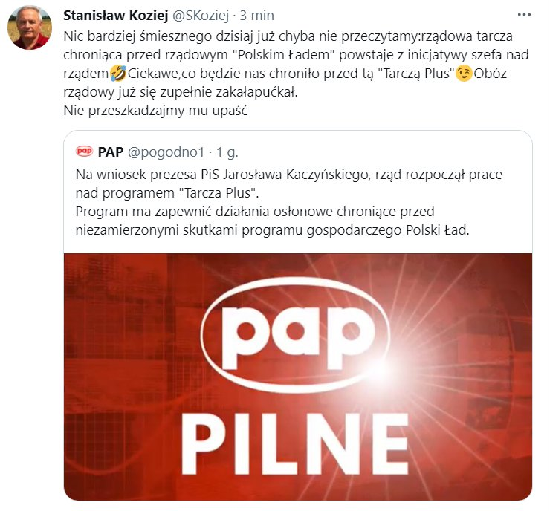
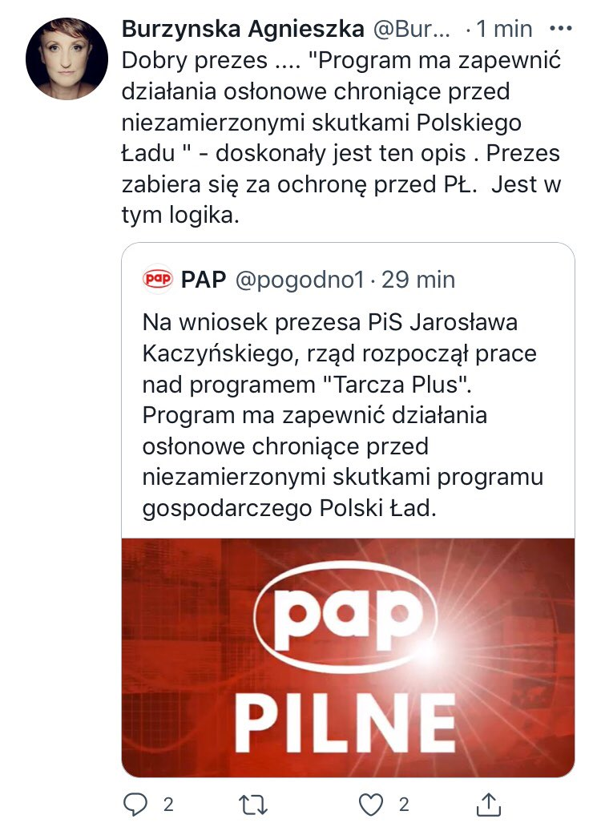
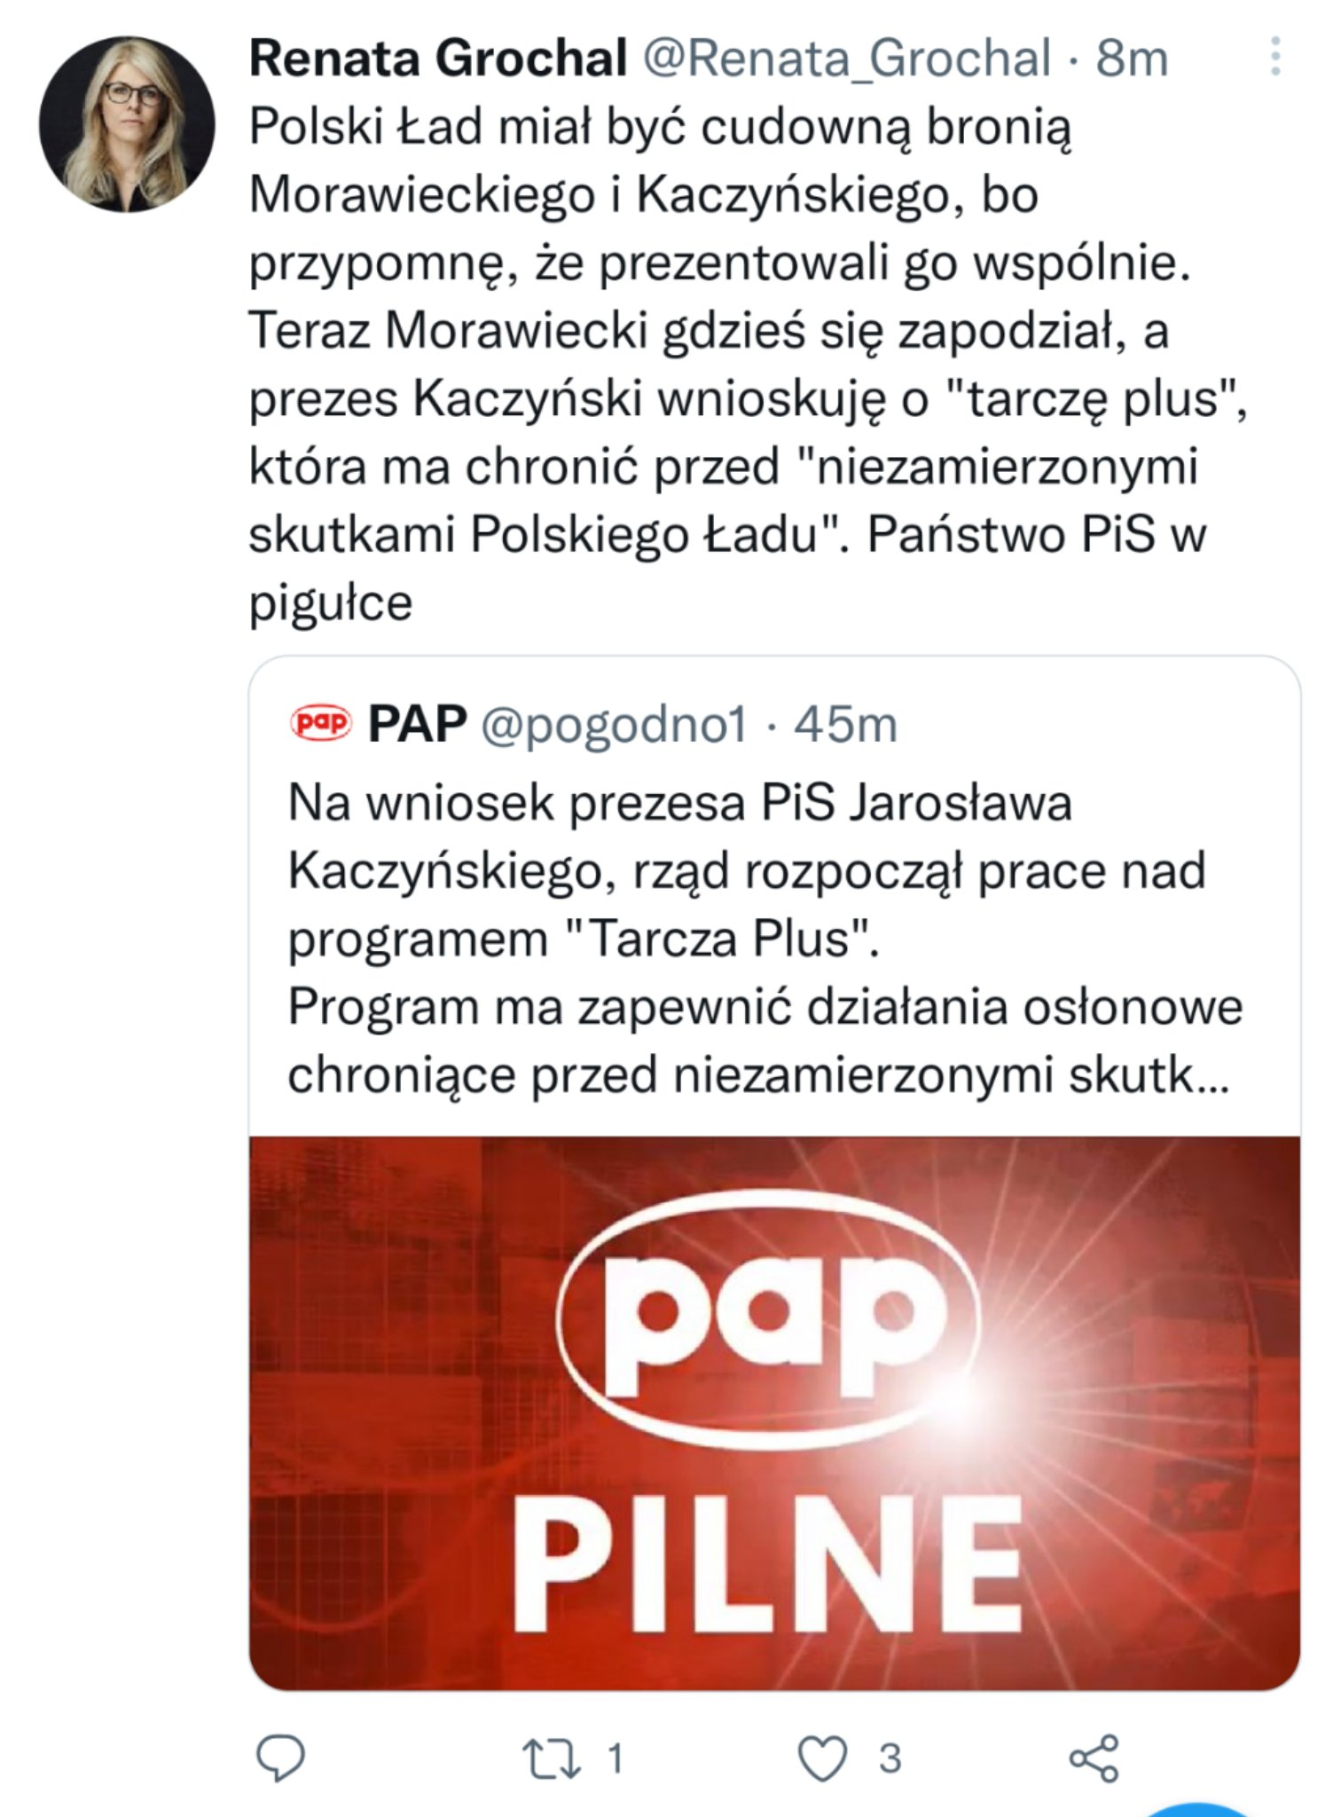
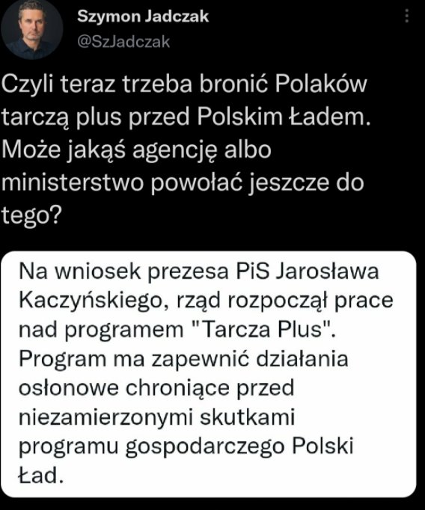
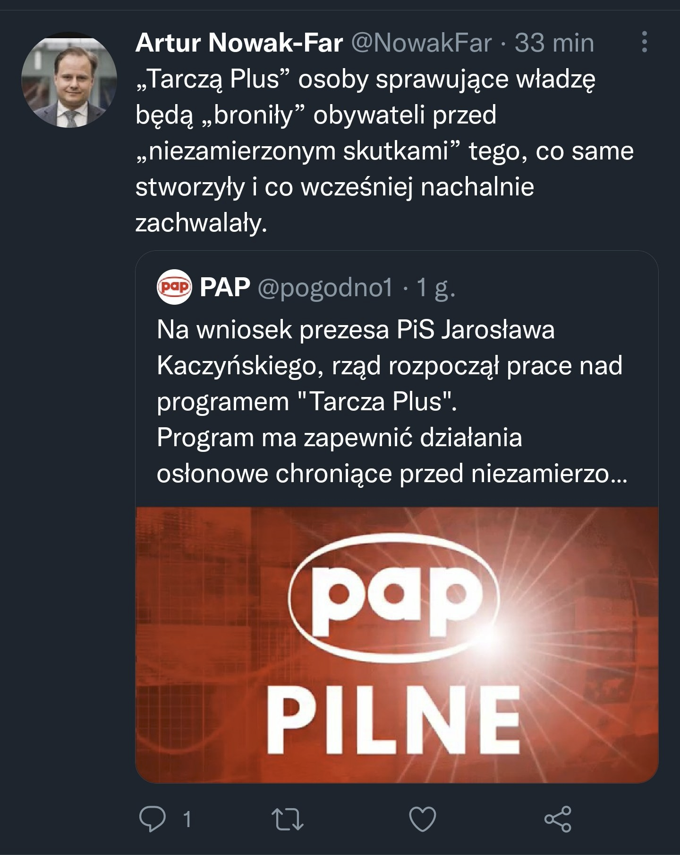
Szef Polityka Insight Centrum Analityczne
Były szef Biura Bezpieczeństwa Narodowego (lata 2010 – 2015)
profesor wnauk wojskowych wykładowwca akademicki.
5 styczeń 2022
Dziennikarz onet
dziennikarz śledczy i publicysta. Dwukrotny laureat nagrody Grand Press dla dziennikarza roku
Dziennikarz newsweek
Dziennikarz onet
Profesor prawa SGH

Slide 26

Challnage
Manual fact-checking is time consuming → to long
  Fake news spreads fast
  Hard to rectify
In need to find automatic assisting tool for FN detection

Slide 27
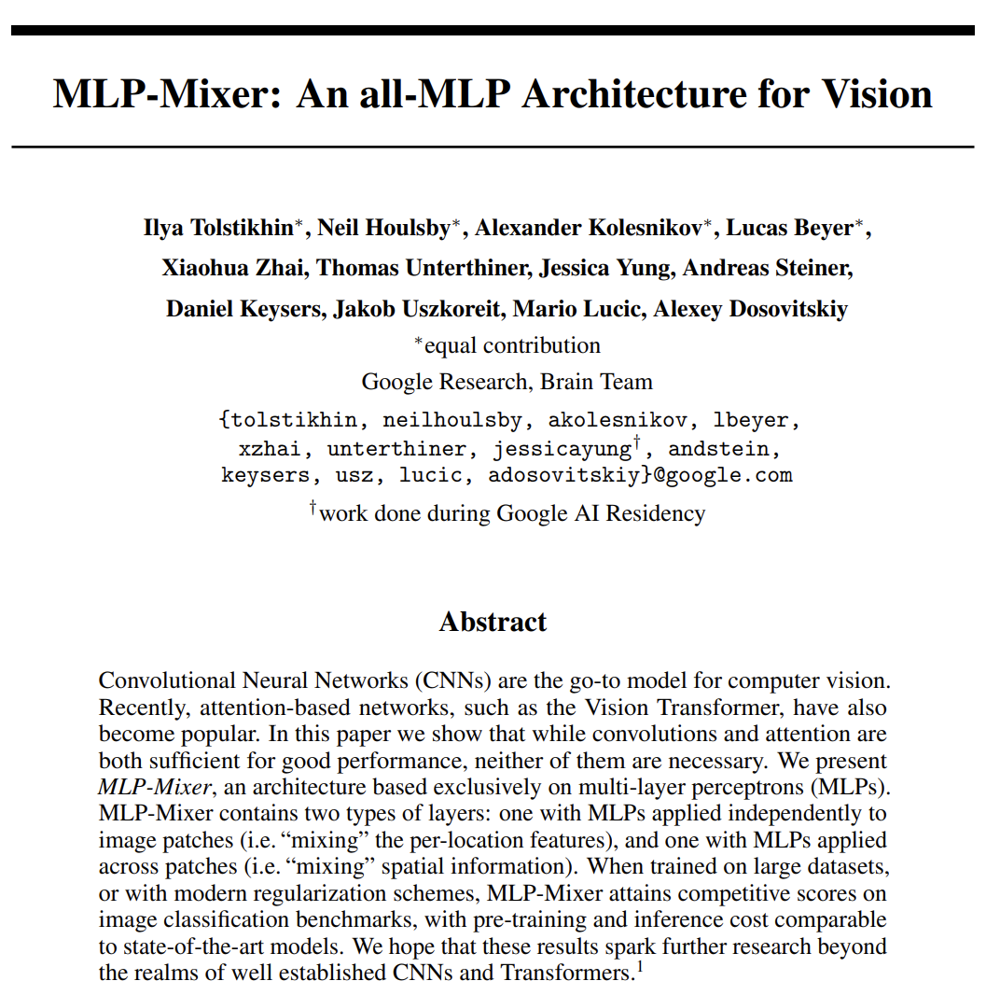
MLP architecture is just
  FFN MLP
  No convolutions (? controversy)
  No attention mechanizm
Consequently MLP Mixer is:
  Matrix multiplicactions
  Non-linearities
  Normalization
  Skip connections
General idea:
  Apply MLP repeatadly for spatial locations and feature channels
Why

Slide 28
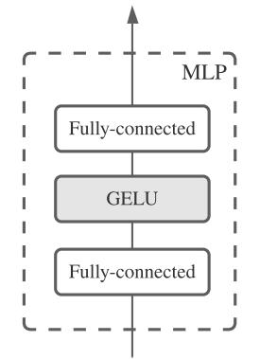
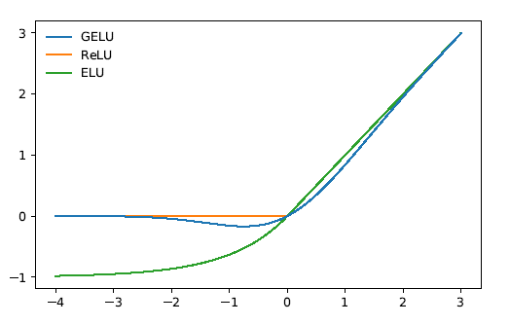
MLP-Mixer
MLP Mixer architecture key points:
  Performs adequatly at large scale
    Not SOTA but comparable
  Benefit much more from scaling than
  previous architectures
  Linear complexity in number of input
  pixels
    Similar to CNN, in contrast to ViT O(n²)
  Conversly to CNNs is not localized as its
  filter spans entire spatial area
    No resolution shrinking
    Stack layers of same size

Slide 29
Why non linearity
the purpose of the activation function is to introduce non-linearity into the network to model nonlinear data
in turn, this allows you to model a response variable (aka target variable, class label, or score) that varies non-linearly with its explanatory variables
non-linear means that the output cannot be reproduced from a linear combination of the inputs
  which is not the same as output that renders to a straight line - the word for this is affine ax+b
another way to think of it:
without a non-linear activation function in the network, a NN, no matter how many layers it had, would behave just like a single-layer perceptron, because summing these layers would give you just another linear function.

Slide 30
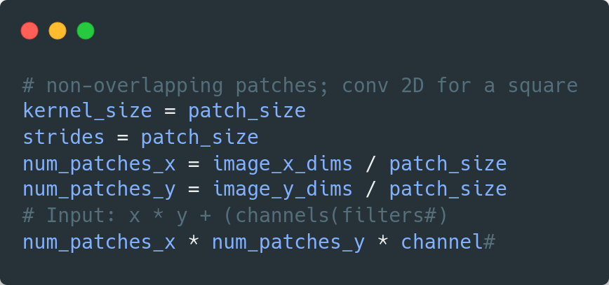
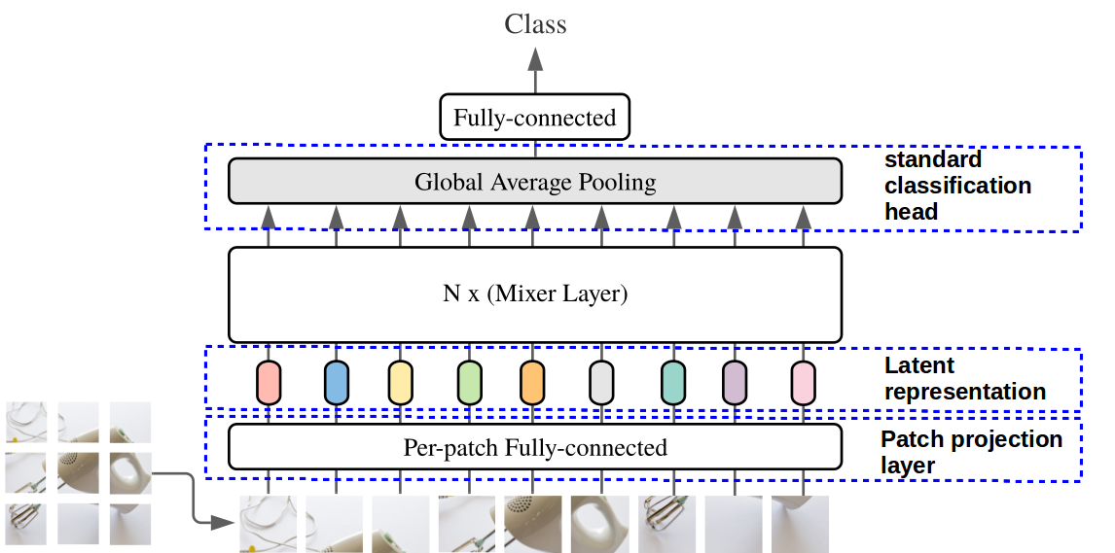
Architecture

Slide 31
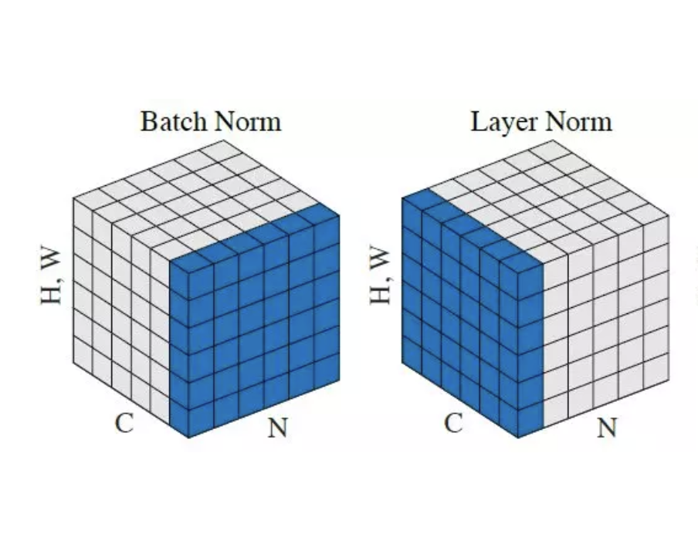
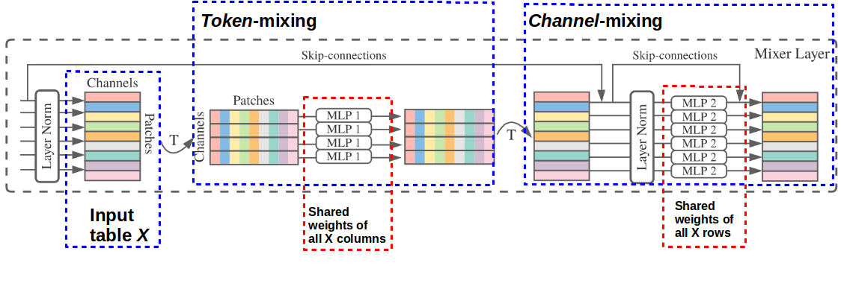
Architecture
Layer norm:
mean and variance of all summed inputs of a neuron are used to perform normalization

Slide 32
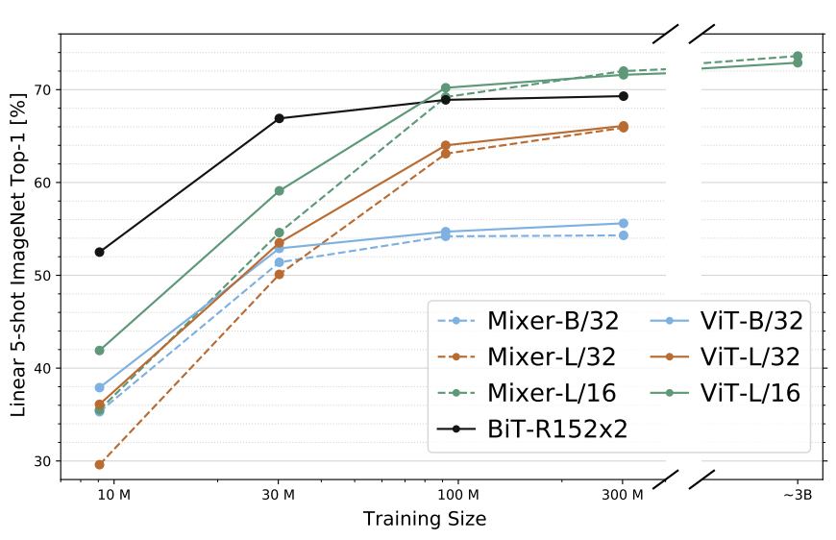
Why mixer?
Benefits more from data scale
  Top-1 accuracy

Slide 33
Use it for Fake News classification
Change the sequence of image patch tokens into sequence of text tokens
Channels are now token embedding dimensions
Patches are produced form sequence with Conv1D
The fake news clasification mixer will have:
embedding_dims: 64, token_mixing_mlp_dims: 32, channel_mixing_mlp_dims = 64
patch_size = 5, num_mixer_layers = 8

Slide 34
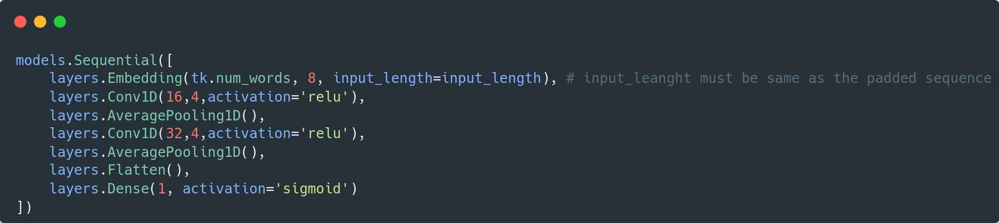
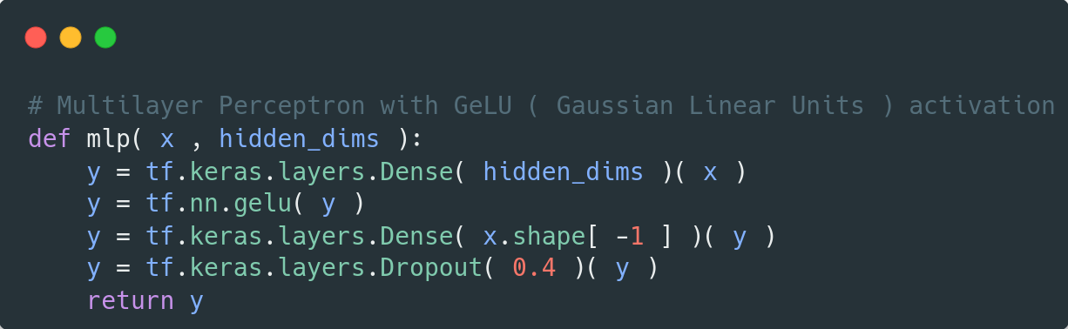
Results
Mixer vs CNN is comparable on same dataset in terms of precision / recall / f1-score
Mixer is susceptible to overfitting
→
regularization is required
  Best results with Dropout (0.4)
Better results by increasing:
  The embedding dimensions
  Number of mixer blocks
  Training model for longer
precision recall f1-score support
not fake 0.79 0.72 0.75 898
fake 0.64 0.72 0.68 625

Slide 35
Future work
Corpus creation for polish
  More in-deph: tagged with manipulation techniques and conceptual framework
Test for larger dataset
  Multiclass classification → how malitious a fake news is
  Multilabel mis-infomration, dis-information, mal-information
Test the projection layer model instead of fixed learned embedding like using non-trainable hash functions
  locality sensitive hashing (LSH) to create representations form text
  min-hash

Slide 36
References:
"The real story of 'fake news': The term seems to have emerged around the end of the 19th century". Merriam-Webster. Retrieved October 13, 2017.
“INFORMATION DISORDER: Toward an interdisciplinary framework for research and policy making” Council of Europe report DGI(2017)09 Claire Wardle, PhD; Hossein Derakhshan
Soll, Jacob (December 18, 2016). "The long and brutal history of fake news". Politico Magazine. Retrieved March 25, 2019.
“The science of fake news” David M. J. Lazer, Matthew A. Baum,Yochai Benkler, Adam J. Berinsky, Kelly M. Greenhill, Filippo Menczer, Miriam J. Metzger, Brendan Nyhan, Gordon Pennycook, David Rothschild, Michael Schudson, Steven A. Sloman, Cass R. Sunstein, Emily A. Thorson, Duncan J. Watts, Jonathan L. Zittrain SCIENCE, 9 Mar 2018, Vol 359, Issue 6380, pp. 1094-1096, DOI: 10.1126/science.aao2998
Tolstikhin, I., Houlsby, N., Kolesnikov, A., Beyer, L., Zhai, X., Unterthiner, T., Yung, J., Steiner, A., Keysers, D.,Uszkoreit, J., Lucic, M., and Dosovitskiy, A. Mlp-mixer: An all-mlp architecture for vision. CVPR 2021
Iftikhar Ahmad, Muhammad Yousaf, Suhail Yousaf, Muhammad Ovais Ahmad, "Fake News Detection Using Machine Learning Ensemble Methods", Complexity, vol. 2020, Article ID 8885861, 11 pages, 2020. https://doi.org/10.1155/2020/8885861
Indyk, P. and Motwani, R. Approximate nearest neighbors: towards removing the curse of dimensionality. In Proceedings of the thirtieth annual ACM symposium on Theory of computing, pp. 604–613, 1998.

