Slide 1

OLIST E-COMMERCE
Data Pipeline
Turning marketplace transactions into trusted executive metrics, reusable analytics models, and repeatable decisions.
9+
4
6+
Daily
source datasets ingested
core dimensions
quality gates
scheduled ELT run
Audience: CEO / CMO / CFO / CTO / VP Engineering

Slide 2

EXECUTIVE SUMMARY
One trusted path from raw order files to board-ready growth metrics.
Business value
Decision value
A repeatable pipeline makes revenue trends, category performance, and customer value visible without manual spreadsheet work.
Executives get reliable inputs for merchandising focus, retention investment, and fulfillment performance.
Technical value
Operating thesis
DuckDB, dbt, and Dagster separate storage, transformation, quality, and orchestration into maintainable layers.
Treat analytics as a product: tested, scheduled, documented, and ready for business users.
Olist e-commerce data pipeline | DuckDB + dbt + Dagster
02

Slide 3
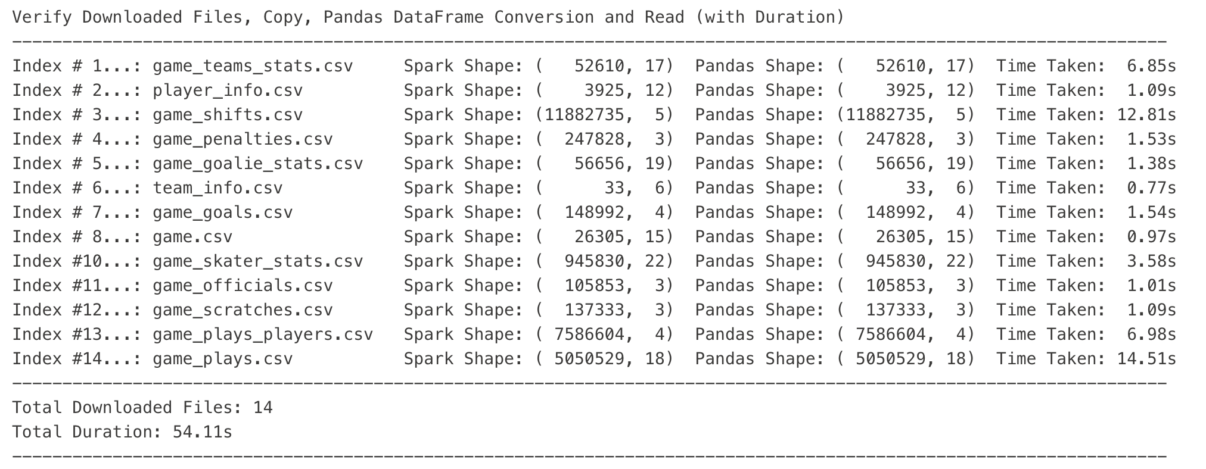
ARCHITECTURE
A layered ELT architecture keeps raw data auditable and marts business-ready.
Raw files
Ingestion
Warehouse
ELT
Quality
Use cases
Olist CSV / Excel
Python loaders
DuckDB raw schema
dbt staging and marts
dbt + SQL checks
BI and Python analysis
Design principle
Preserve source fidelity in raw tables, then apply business definitions once in dbt models.
Olist e-commerce data pipeline | DuckDB + dbt + Dagster
03

Slide 4

WAREHOUSE DESIGN
The star schema is optimized for sales, customer, product, seller, and time questions.
DimCustomer
DimProduct
customer geography and identity
category and attributes
FactSales
orders - items - revenue - freight - delivery
DimSeller
Executive coverage
DimDate
seller origin and role
growth, category mix, retention, delivery performance
month, quarter, year grain
Olist e-commerce data pipeline | DuckDB + dbt + Dagster
04

Slide 5
DATA QUALITY
Quality gates turn a public dataset into a trusted analytical product.
Completeness
Uniqueness
Integrity
Business logic
Primary keys and critical facts cannot be null.
Fact and dimension keys are checked for duplicates.
Fact rows must resolve to customer and product dimensions.
Amounts are non-negative; delivered orders have delivery timing.
Operational rule: failed quality checks stop analysis outputs and surface the failed test set.
Olist e-commerce data pipeline | DuckDB + dbt + Dagster
05

Slide 6
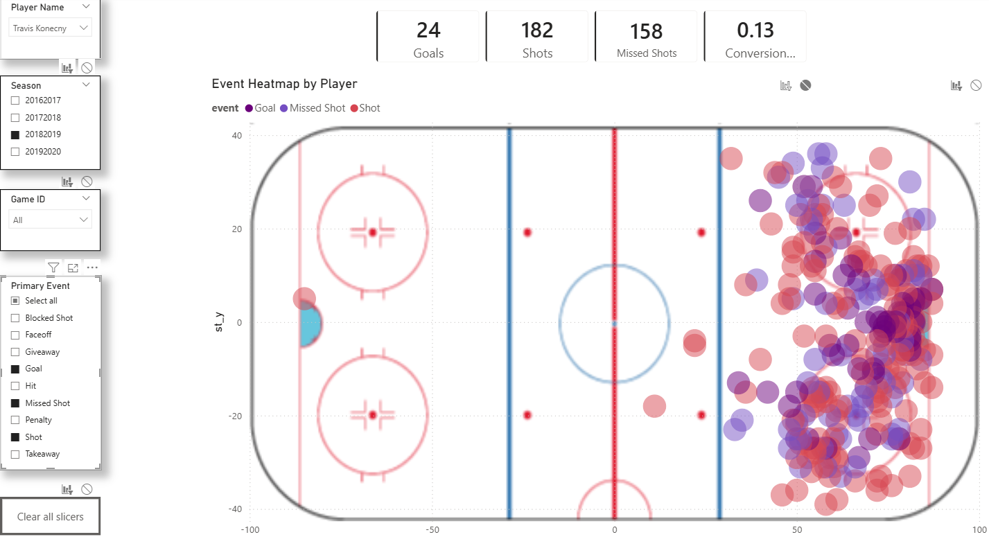
ANALYSIS
The workflow answers three executive questions first.
When are we growing?
What should we push?
Who should we retain?
Monthly revenue and order trends establish the operating cadence.
Top product categories by revenue focus merchandising and campaign planning.
Customer lifetime value segments support lifecycle and loyalty targeting.
Revenue trend
Category rank
CLV segment
Olist e-commerce data pipeline | DuckDB + dbt + Dagster
06

Slide 7

RECOMMENDATIONS
The first moves are merchandising focus, retention targeting, and fulfillment control.
1
Merchandising
Use category revenue rankings to prioritize assortment, campaign inventory, and seller enablement.
2
Retention
Build lifecycle campaigns for loyal and high-value customers using customer lifetime value.
3
Operations
Track delivery days as an executive KPI because fulfillment performance protects repeat purchase behavior.
Olist e-commerce data pipeline | DuckDB + dbt + Dagster
07

Slide 8
RISK AND MITIGATION
The main risks are freshness, definition drift, and production hardening.
Risk
Mitigation
Public dataset is historical
Connect fresh operational exports or cloud object storage.
Metric definitions can drift
Centralize definitions in dbt models and tests with reviewed pull requests.
Local DuckDB is not enterprise serving
Promote the same dbt models to BigQuery, Snowflake, or Postgres when scale demands.
Quality failures can block reporting
Pair blocking tests with owner alerts, failed-row tables, and incident triage.
Next step: connect fresh exports, schedule Dagster, publish the mart contract, and wire the BI layer.
Olist e-commerce data pipeline | DuckDB + dbt + Dagster
08

