Slide 1


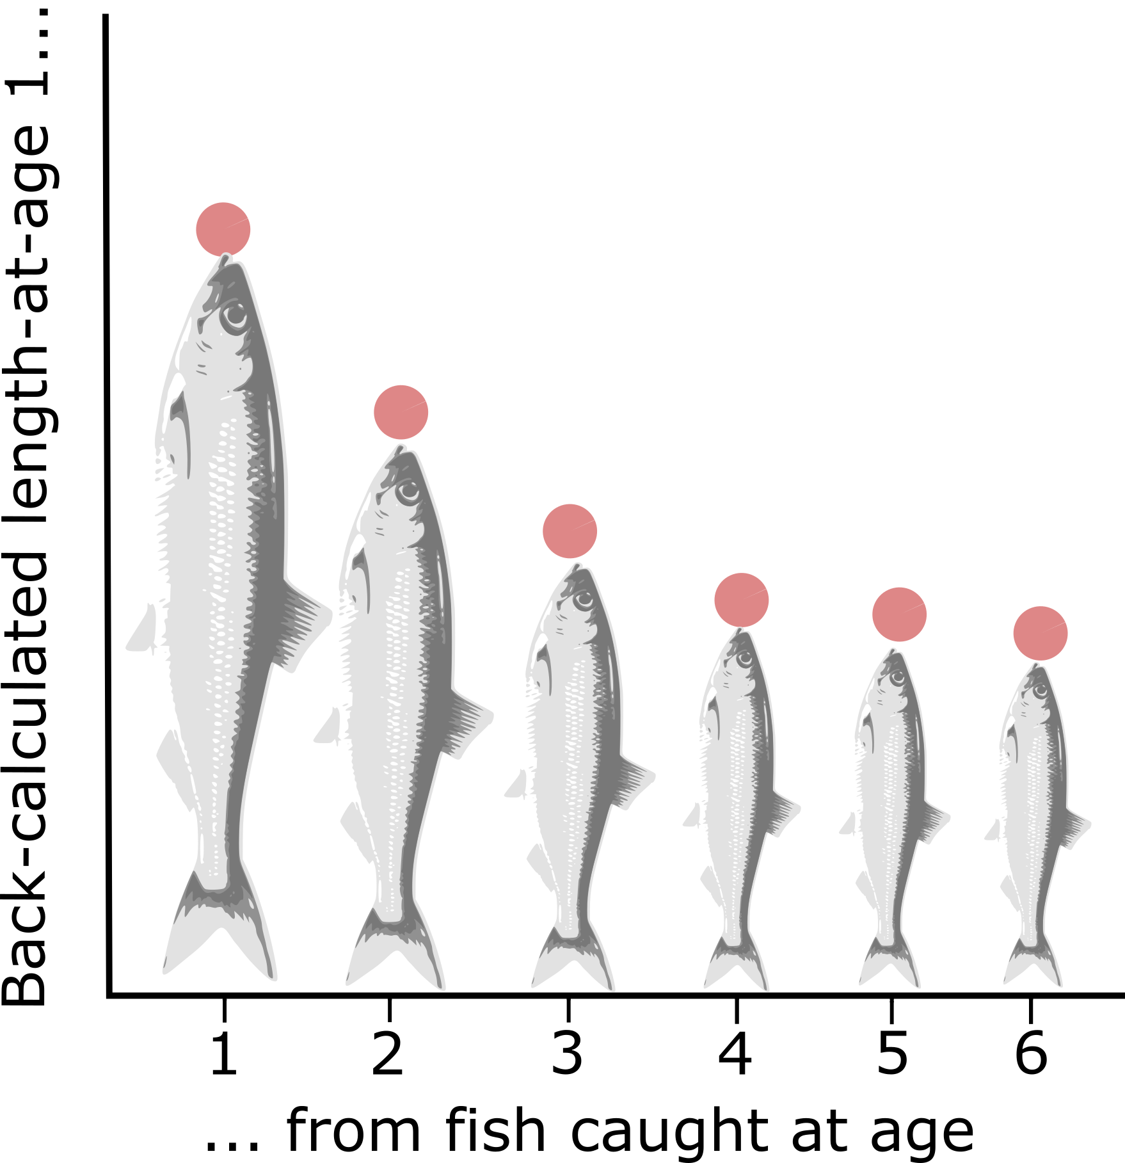
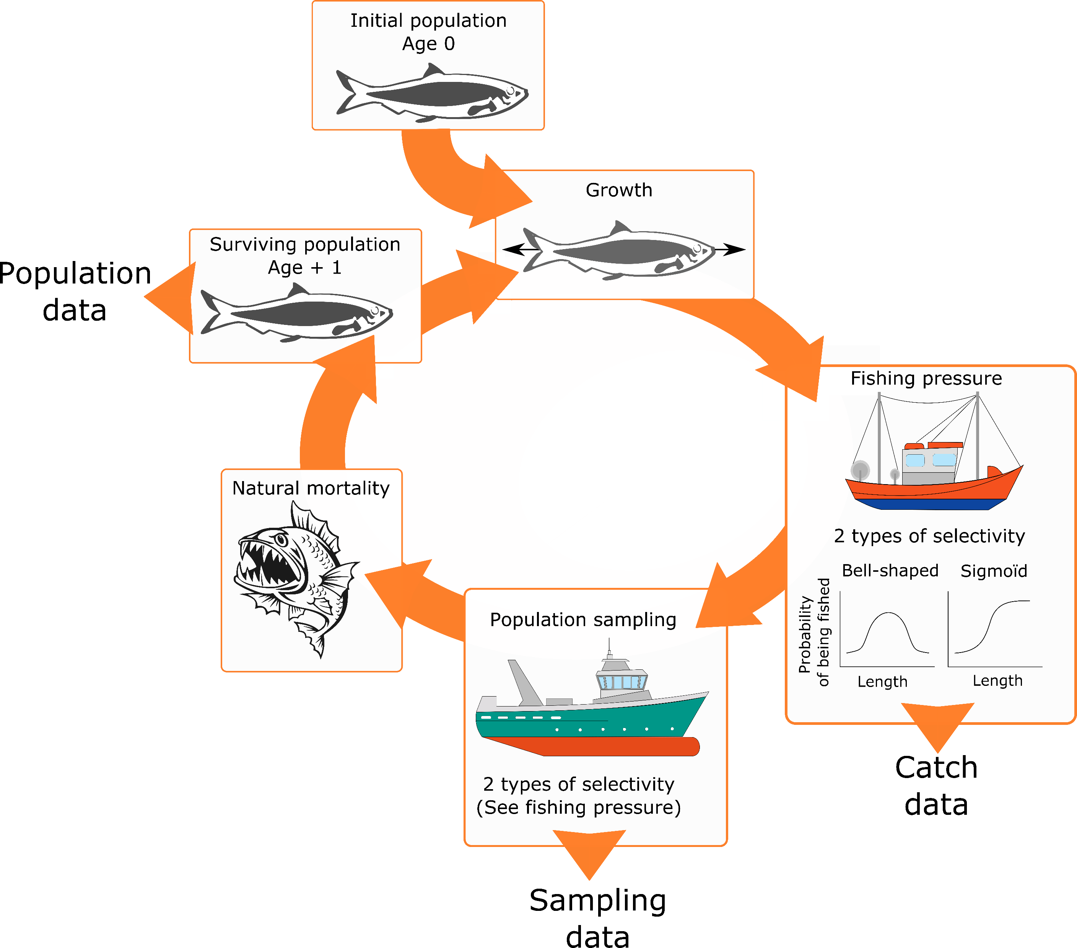
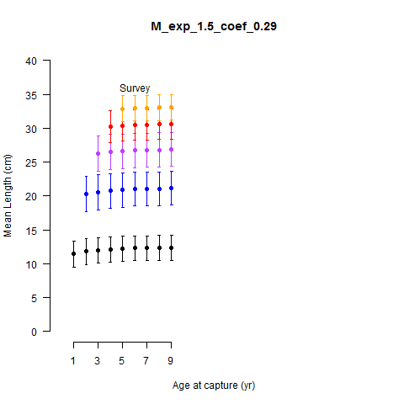
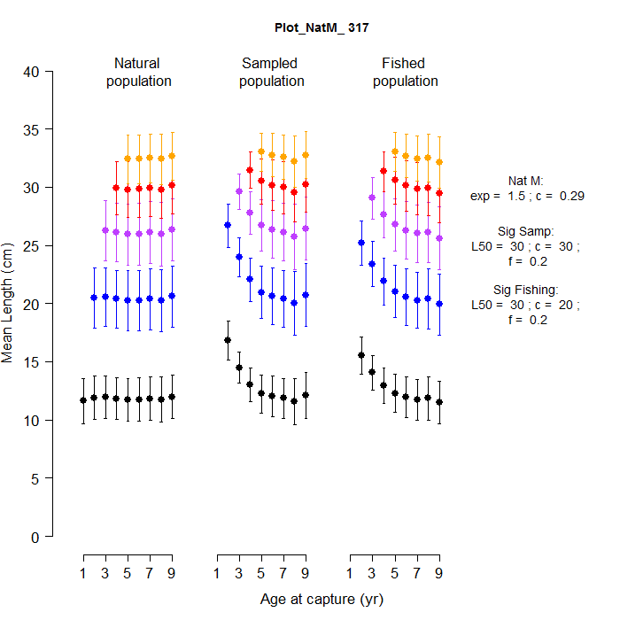
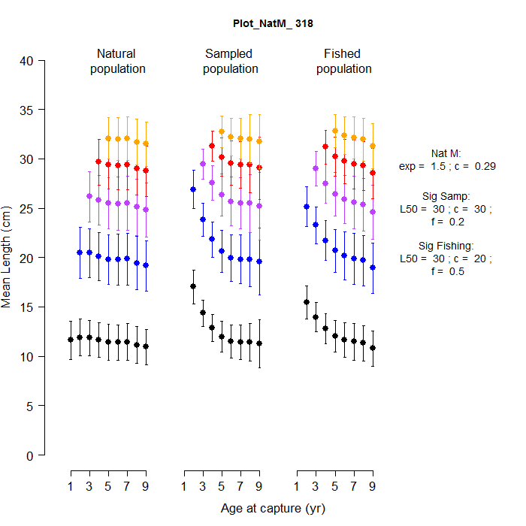
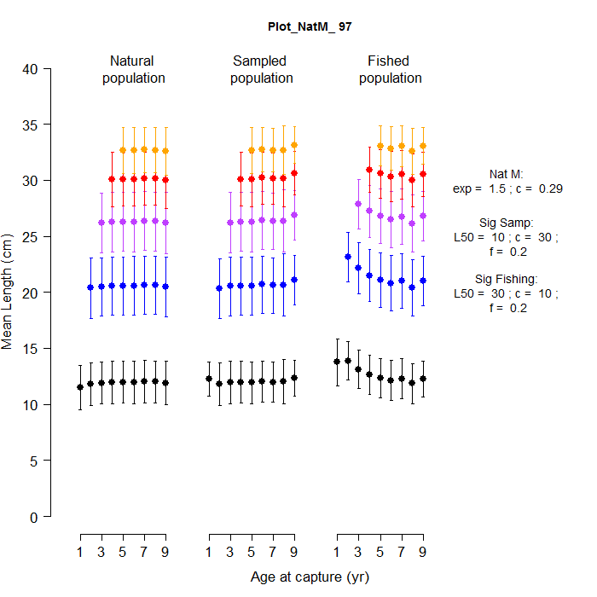
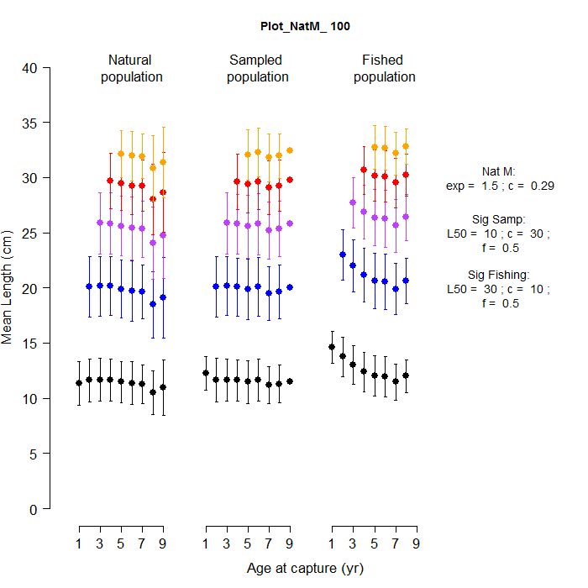
The Rosa Lee phenomenon revisited
Sampling and selectivity affect the apparent changes in growth rate
Marion Claireaux*, Arild Folkvord, Mikko Heino, Katja Enberg
*marion.claireaux@gmail.com
https://marionclaireaux.wordpress.com/
Research supported by the Norwegian Research Council (grant n.4243735)
1. Introduction
2. Methods
Fish scales have growth rings used to age individual fish. The Rosa Lee phenomenon, first described by Rosa Lee in 1912^{[1]}, occurs when different growth rates are obtained when back-calculating from an older fish or from a younger fish
THE MODEL
THE DATA
Survey and catch length data back-calculated from scales
Several factors can lead to the Rosa Lee Phenomenon^{[1][2]} :
The back-calculation procedure is not adapted to the studied species
The population is not sampled representatively
Selective mortality (natural or fishing) leads to fast- or slow-growing individuals dying faster
Aggregated in 3 periods:
Pre-collapse (1930-1960)
Collapse (1968-1980)
Post-collapse (1989-2009)
Illustration of the Rosa Lee Phenomenon. When calculating size at a specific age, lengths obtained from younger fish are different than the ones obtained from older fish
OBJECTIVES
Using a simple individual-based model parameterised from herring:
How do sampling bias and fishing selectivity affect the Rosa Lee phenomenon?
Can we use the Rosa Lee phenomenon to infer about the selectivity landscape?
What are the consequences for the calculation of biological parameters?
Applying conclusions from the model to a data-rich species: the Norwegian Spring-spawning herring
3. Results
30
25
20
15
10
THE MODEL
COMPARISON WITH THE DATA
40
Natural population
with natural mortality only
Fishing/sampling intensity is a more important factor than selectivity in inducing the Rosa Lee Phenomenon in the population
35
A high selectivity at a low intensity can lead to the Rosa Lee phenomenon in the data, without it existing in the natural population
TOO FEW DATA
30
Mean length (cm)
25
20
Catch data / biased survey data can give a wrong picture of the selective pressures a population faces, illustrated by the Rosa Lee phenomenon
15
10
1 3 5 7 9
Age at capture (yr)
Low intensity
High intensity
40
Natural population
Sampled population
Fished population
40
Natural population
Sampled population
Fished population
35
35
30
30
25
25
Mean length (cm)
High selectivity
20
20
15
15
10
1 3 5 7 9
1 3 5 7 9
1 3 5 7 9
10
1 3 5 7 9
1 3 5 7 9
1 3 5 7 9
Mean back-calculated length at ages 1 to 5 (cm) of individuals caught from age 1 to 10. The numbers on the left indicate the age-class. The error bars represent the 1st and 3rd quartiles of the distribution. The shaded areas represent the period of first maturation. The stars indicate the mean length-at-age in the population. Values considered non reliable (e.g. low number of individuals) are not shown on the figure
Age at capture (yr)
Age at capture (yr)
Fished population
40
Natural population
Sampled population
Fished population
40
Natural population
Sampled population
35
35
Collapse period:
Low fishing pressure and episodic sampling.
The back-calculated size-at-age (dots) corresponds relatively well to the mean size at age of the population (stars). Is the Rosa Lee phenomenon observed a result of natural mortality?
Post-collapse period:
Regular surveys covering a wide area.
From survey data, slow-growing individuals seem to be favoured
But, discrepancy between back-calculated data (dots) and population data (stars)
30
30
25
25
Low selectivity
Mean length (cm)
20
20
15
15
10
1 3 5 7 9
1 3 5 7 9
1 3 5 7 9
10
1 3 5 7 9
1 3 5 7 9
1 3 5 7 9
Age at capture (yr)
Age at capture (yr)
4. Conclusion and remarks
Presence of the Rosa Lee phenomenon in data does not mean it is present in the population and vice-versa
Determining if the data reflect the population requires good knowledge of the selectivity and intensity of both the surveys and the fishery
Important implications for fisheries management: ignoring the Rosa Lee phenomenon can lead to a biased estimate of fishing mortality and wrong calculations of individual growth curves^{[2][3]}
Can the Rosa Lee phenomenon revealed in the Post-collapse data be an indicator of selective-pressures leading to evolution of the Norwegian Spring-spawning herring?
Does density-dependence play a role in explaining the patterns observed through changes in natural mortality?
References
[1] Lee, R.M. 1912. An investigation into the methods of growth dtermination in fishes by means of scales. Publications de Circonstance, 1:3-34
[2] Ricker, W. 1969. Effects of size-selective mortality and sampling bias on estimates of growth, mortality, production, and yield. Journal of the Fisheries Board of Canada, 26:479-541
[3] Hordyk, A.R. et al. 2016. A simple length-structured model based on life history ratios and incorporating size-dependent selectivity: application to spawning potential ratios for data-poor stocks. Canadian Journal of Fisheries and Aquatic Sciences, 73:1787-1799

