Slide 1
PR-10 Care Path Review
November 2024 PRM update
Mark Collins
06/11/2024

Slide 2
Available time
Site | Hrs / Year | Hrs / Week | Days / Week | ½ days / Week | Number of CCO’s / planning slots
Colorectal | 157 | 3.74 | 0.75 | 2 | 4
Urology | 757.75 | 18.04 | 3.6 | 8 | 7
Breast | 516 | 12.29 | 2.46 | 5 | 5
CNS | 57.75 | 1.38 | 0.28 | 1 | 2
Gynae | 153 | 3.64 | 0.73 | 2 | 2
Head and Neck | 394.5 | 9.39 | 1.88 | 4 | 3
Lung | 466 | 11.09 | 2.22 | 5 | 4
Upper GI | 20 | 0.48 | 0.09 | 1 | 2
SABR Mets | 58 | 1.38 | 0.28 | 1 | 1
Other / Palliative | 154.5 | 2.96 | 0.59 | 2
Notes:
Using data from Oct 23 – Sept 24, the number of patients and required time for each site/plan type shows that we are one planning session short per week for Urology, H&N, and Lung.

Slide 3
Water-marking
Task / Activity | Water-mark
Pre-CT Phone Call* | Monday 09:00 – 17:00
CCO Outlining | To each Dr’s planning time
Peer Review | Wed 14:30 – 15:00 Thurs 11:00 – 12:30
Fraction 0 | Monday to Thursday 18:00 – 21:00
PSQC | Tuesday and Thursday 18:00 – 21:00
CCO | Planning time
Radwa Ahmed | Mon 09:00 – 13:00 Wed 09:00 – 17:00
Chris Jingree | Tues 13:00 – 17:00 Wed 13:00 – 17:00
Yoodhvir Nagar | Mon 09:00 – 13:00 Wed 13:00 – 17:00
Maja Uherek | Wed 09:00 – 17:00
* Pre-CT Phone call is only scheduled for hormone patients

Slide 4
Care Path Construction
Issues when pinning Care Path to start date and scheduling backwards.
Start on Wed/Thurs – Peer Review previous Thurs giving Physics and Central Report less than a week.
Pin to CT, and schedule forwards.
Start date not part of Care Path – scheduled separately.
Prostate/bed
Prostate/bed + LN
SABR Prostate
SABR Prostate + LN
Bladder
Bladder + LN
Palliative Urology

Slide 5
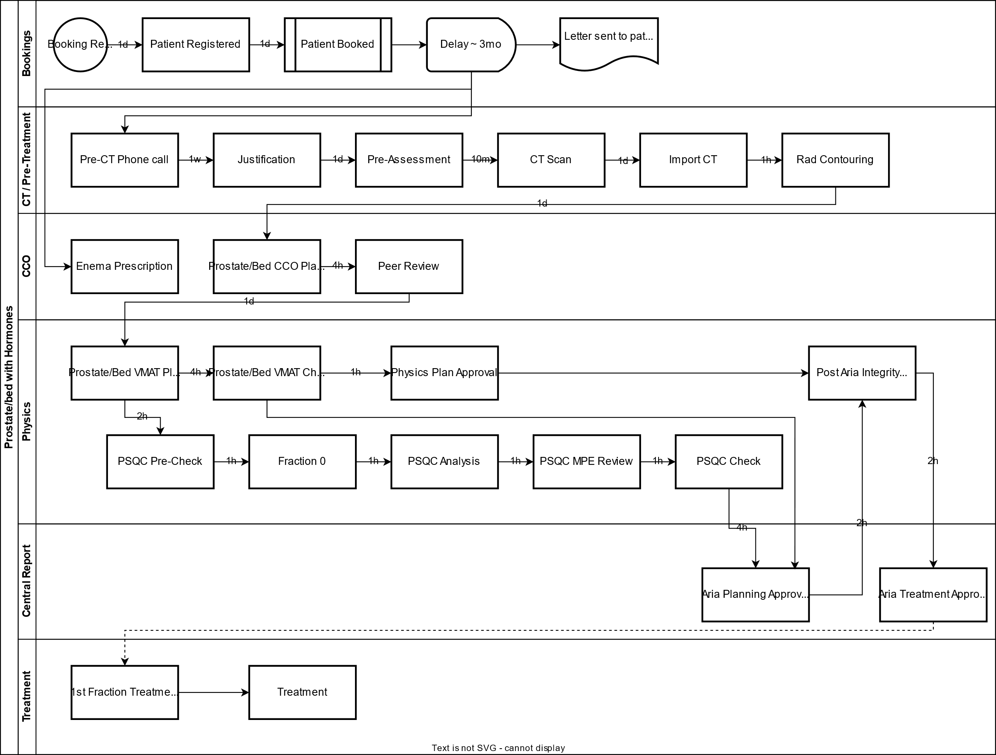
Prostate / Bed Care Path

