Slide 1
DJ Ascentia End of Year Position
Mark Collins
Notes:
Hello, Welcome to the end of year position presentation for the endorsement options for DJ Ascentia.

Slide 2
Agenda
Year 1 Sales
Reflection on current performance
Next steps for Runi
ARMBand offer
Options
Notes:
A quick overview of what we will be covering today. First, we will review the Year one sales for both Runi and ARMBand, and where each company sits in relation to their predicted sales. Second, we will look at the performance of our chosen product, Runi, and reflect on why the actual sales do not meet the predicted (spoiler alert for item 1). Next we will look at what we need to do for Runi to boost sales. Next we will look at ARMBand. They have presented a new offer, which on the face of it, looks to be quite appealing. Finally, we will look at the options available, the risks, and the mitigations and make a final recommendation.

Slide 3
Year 1 sales
ARMBand
Runi
750 units sold (800 predicted)
Income £300,000
-£248,719 Project costs
-£204,000 Manufacture costs
End of year position: -£52,718
1500 self assembly kits sold
0 complete units sold
Income £262,500
-£162,645 Project costs
-£61,250 Manufacture costs
End of year position: £38,604
Commission: £2,702 (predicted £26,047)
Notes:
Lets first look at the one that never was – ARMBand. The Band of Bros have seen sales of 750 units, against a projected 800. That’s 94% of predicted units. They of course were predicted to be in the red at the end of the first year, at negative £46k. They have ended the year on £53k in the red. Runi on the other hand, have not sold anywhere near as many units as predicted. They have only sold 1500 self-assembly units against a predicted 2750 and have not managed to sell any completed units. By following an Agile style of implementation, they were able to save on some costs and were predicted to end the year with a gross profit of £370k, however they have only managed a profit of £38.5k, leaving DJ Ascentia with just shy of £3k commission. We had predicted £26k to DJ Ascentia.

Slide 4

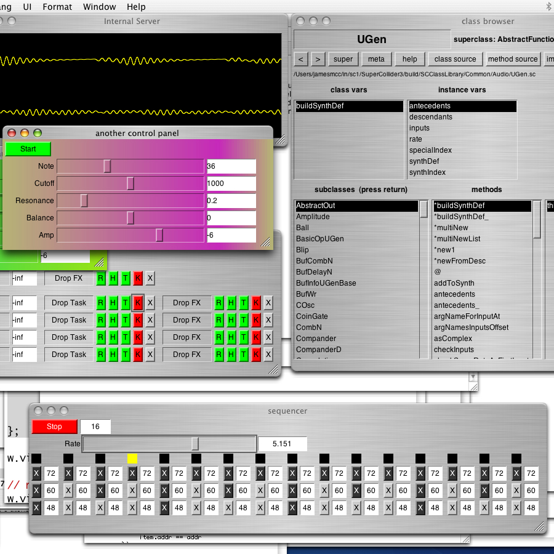
Runi Reflection
£24k missing commission.
Nornes UI not open source.
Ass-u-me
64% predicted self assembly kits sold
No demos possible
McCartney (2023)
Monome (2024)
Notes:
So, what went wrong. Whilst the end off year position is better than where we would have been had we chosen ARMBand, we are still £24k short of where we thought we would be in terms of commission. The main reason behind this is the lack of completed units sold. An error in assumptions was made regarding the licensing of the User Interface components, and we have not been able to port the Norns ( @monome2024 ) software. Because of this, DJ Ascentia has not been able to produce any demos, which has drastically affected sales.
Of the self-assembly kits, we have seen sales of only 1500 against a predicted 2750. That’s only 64% of predicted self-assembly kits sold. It is unclear if these sales would be better if DJ Ascentia had been able to make demos on the completed unit.
@mccartneySuperCollider2023

Slide 5
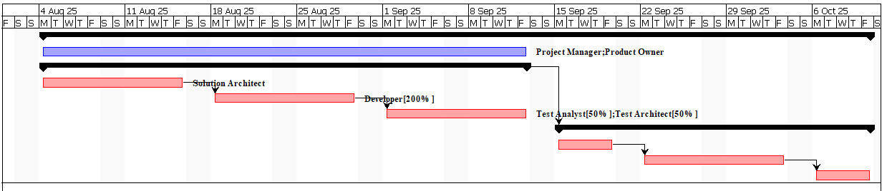
Runi next steps
6 weeks to reverse engineer UI, including testing.
Direct dependencies
Two developers
No work contours
Huges (2019)
Notes:
What are the next steps for Runi?
The development team estimate approximately six weeks to reverse engineer the Nornes UI. On top of that, DJ Ascentia will need another four weeks to produce the Demos needed to sell the completed unit, so that’s the next ten weeks without the completed units on the market.
Unfortunately, we need to take a waterfall approach ( @hughesProjectManagementITrelated2019 ) to this as there are clear direct dependencies – DJ Ascentia cannot make a demo without a finished product.

Slide 6
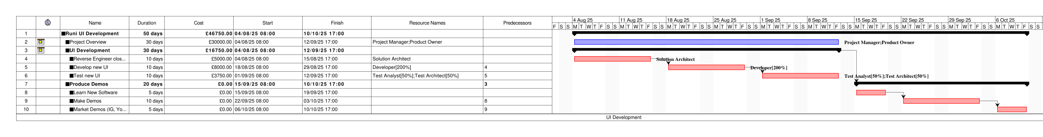
Runi Project costs and outline
O’Brien and Chrettienau (2021)
Notes:
To ensure that this project is achieved, we will assign our resources on a flat rate for the duration of their tasks. We will also assign two developers to the development stage. Over the six week development time frame we will work in two week sprints. The first - to reverse engineer the Nornes UI. The second - to build our own, and the final one to test. The second phase will require DJ Ascentia to first learn the new software, then produce the demo's and then finally make the appropriate marketing material for Insta, Youtube etc.
All in-all, the additional project work is going to cost an additional ~£47k. @obrienProjectLibre2021

Slide 7
Runi Finances
Worst case scenario:
All sales estimated reduced to 64% of original
Completed units annual sales reduced by additional 42/52
Year 2 commission £18,751
Year 3+ commission £46,921
 | Year 1 | Year2 | Year3 | Year 4 | Year 5
Set-up Costs | -£162,645.50 | -£46,750.00 | 0 | 0 | 0
Manufacture costs (DJ) | -£61,250 | -£144,733 | -£164,610 | -£164,610 | -£164,610
Income (DJ) | £262,500.00 | £458,930.77 | £505,700.00 | £505,700.00 | £505,700.00
Gross Profit (DJ) | £38,604.50 | £267,447.69 | £670,310.00 | £670,310.00 | £670,310.00
Annual Commission (7%) | £2,702.32 | £18,721.34 | £46,921.70 | £46,921.70 | £46,921.70
Cumulative Commission | £2,702.32 | £21,423.65 | £68,345.35 | £115,267.05 | £162,188.75
Notes:
If we want to model worst case scenario, then we can make the following assumptions:
Any income from the completed units for the first year will be reduced by 42/52, or 80%.
The lower amount of earnings will be based on 65% of predicted annual sales. If we make these assumptions, then any predictions will be the lowest expected earnings.
We are looking at nearly £19k commission in the next year after development costs have been deducted, and then £47k each year after, which is still better than the original ARMband offer.

Slide 8
New ARMBand offer
No longer require upfront investment
Offering 8% profits in commission
Open to non-exclusive deal
Assume 94% predicted 1500 units with endorsement
Round to 1400 units
Potential earnings of at least £10k first year and £14k each year after
£14k Y1 and £20k for exclusive deal
 | Year 1 | Year2 | Year3 | Year 4 | Year 5
Starting Position | -£148,718.75 | -£52,718.75 | £0.00 | £0.00 | £0.00
Manufacture Costs | -£204,000.00 | -£380,800.00 | -£380,800.00 | -£380,800.00 | -£380,800.00
Income | £300,000.00 | £560,000.00 | £560,000.00 | £560,000.00 | £560,000.00
Gross Profit | -£52,718.75 | £126,481.25 | £179,200.00 | £179,200.00 | £179,200.00
Annual Commission (8%) |  | £10,118.50 | £14,336.00 | £14,336.00 | £14,336.00
Annual Commission (11%) |  | £13,912.94 | £19,712.00 | £19,712.00 | £19,712.00
Notes:
The Band of Bros have approached with a new offer, which is worth consideration.
Having completed their first year of sales, and brought their product to market, they are no longer looking for initial investment, and also do not need exclusivity, but are offering a lower commission of 8%. That said, if the Runes reject a non-exclusive deal, Band of Bros will increase their offer to 11%.
Given they managed to sell 94% of predicted products without DJ Ascentia, we can make the same assumption for the Runi, and apply 94% to the endorsed sale numbers.
Because the ARMBand product was starting at a deficit at the end of year one / beginning of year 2, their next year Gross profits and therefor commission are projected to be either £10k for non-exclusive deal or £14 for an exclusive deal.

Slide 9
Options appraisal
1. Stick with Runi
2. Runi + ARMBand
ARMBand Only
Y2 Gross profit £267k
Commission £18.7k
Y3+ Gross profit £670k
Commission £47k
Y2 Gross profit £394k
Commission £29k
Y3+ Gross profit £849k
Commission £61k
Y2 Gross profit £126k
Commission £14k
Y3+ Gross profit £179k
Commission £20k
Notes:
Ultimately we have three options, one of which is not 100% within our control.
Option 1, is if we were to continue with Runi and the Runes. This would result in next year gross profit of £266k and commission of £18.6 and then £46.6k Commission each year after.
Option 2, is if we were to take on the ARMBand at their non-exclusive offer. this would add an additional £10k - £14k to option 1, which I think we can all agree is the best possible outcome.
Unfortunately if we go with option 2, there is a 50-50 chance that Runes will withdraw and we will lose their product and income. This will force us into option 3, which is the ARMBand exclusive deal, giving us a gross profit and commission of £14k-£20.

Slide 10
Fourth option
Complete failure of Runi UI development.
Y2 Gross profit £154k
Commission £11k
Y3+ Gross profit £324k
Commission £22k
George (2020)
Olson and Wu (2020)
Notes:
This is an additional scenario that we need to consider before making a final decision, and that is the distinct possibility that the Runes fail to complete the next stage of their project, and the pre-assembled unit never actually makes it to market. If that is the case, then the sales we saw in year one are the best they are going to get. Combined with the £47k invested to try and reverse engineer the user interface, we will be left with £11k commission the next year and then £22k each year after.
@georgeEssenceRiskIdentification2020 @Olson2020

Slide 11
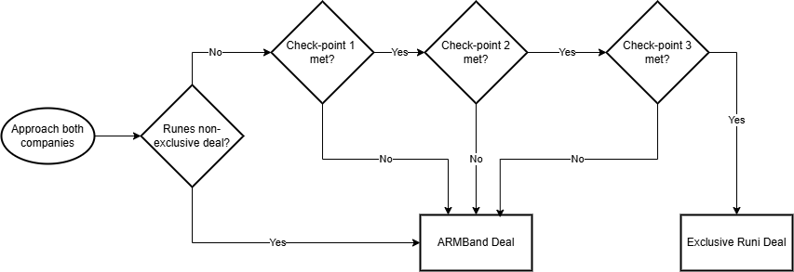
Recommendation
Notes:
So based on all of these options, my recommendation is to re-enter negotiations with both companies.
The counter offer we should approach The Runes with is they need to ensure the UI can be successfully reverse engineered. At the end of each sprint, we will have checkpoints with defined requirements. If they are unable to meet any of the objectives of these checkpoints, then they will be dropped as a client.
We will also re-approach the exclusivity clause with The Runes. With their final position on exclusivity, we can then approach Band of Bros. If the Runes are still insistent on an exclusive deal, we will ask Band of Bros to wait up to six weeks before confirming either way. If the Runes agree to no longer require an exclusive deal, then we can start working with them straight away. otherwise if the Runes miss any checkpoints with the Runi UI, we can switch to ARMBand.
Whilst the exclusive deal with ARMBand is still less than worst case Runi scenario, the difference is only 10% over the next four years, and the threat of withdrawing support may convince The Runes to accept the non-exclusive deal.

Slide 12
Conclusion
Assessed performance and options
Considered risks
Mitigated as much as possible
Assumptions remain
Will Band of Bro’s wait?
Will the threat of dropping support convince The Runes to agree to non-exclusive deal?
Notes:
We have assessed the performance of both brands, and the potential options for moving forward.
A recommendation for next steps has been made, which mitigates the risk as much as possible, and also provides an improved bargaining position for negotiating a non-exclusive deal with both companies.
There are a couple of assumptions that remain, for example, will Band of Bros wait the six weeks until we know for certain that the Runi UI will be delivered on time.
We are also assuming that the threat of dropping Runi wil sway the Runes into signing a non-exclusive deal.

Slide 13
References
George, C. (2020) ‘The Essence of Risk Identification in Project Risk Management: An Overview’, International Journal of Science and Research (IJSR), 9(2), pp. 973–978. Available at: https://doi.org/10.21275/SR20215023033.
Hughes, B. (ed.) (2019) Project management for IT-related projects. Third edition. Swindon, UK: BCS Learning and Development.
McCartney, J. (2023) SuperCollider [Computer program]. Available at: supercollider.github.io (Accessed: 13 February 2025).
Monome (2024) Norns [Computer program]. Available at: https://github.com/monome/norns-image.
O’Brien, M. and Chrettienau, L. (2021) ProjectLibre [Computer program]. Available at: www.projectlibre.com (Accessed: 2 January 2025).
Olson, D.L. and Wu, D. (2020) Enterprise risk management models. 3rd edn. Berlin: Springer Nature. Available at: https://doi.org/10.1007/978-3-662-60608-7.

