Slide 1
Future Trends in Security and Risk Management
Mark Collins
Unit 12 Seminar
2024-10-16

Slide 2
Security Trends in Media
Artificial Intelligence
Machine Learning
Zero-day attacks

Slide 3
AI to Prevent Zero-Day Attacks
Por, L.P., Yang, J., Phan, K.Y., Ku, C.,S. (2024) A Systematic Literature Review on AI-Based Methods and Challenges in Detecting Zero-Day Attacks. IEEE Access 12(Sept.): 144150-144163. DOI: 10.1109/ACCES
S.2024.3455410
Methods:
Machine learning based
Deep Learning based
Hybrid Model
Anomaly-based

Slide 4
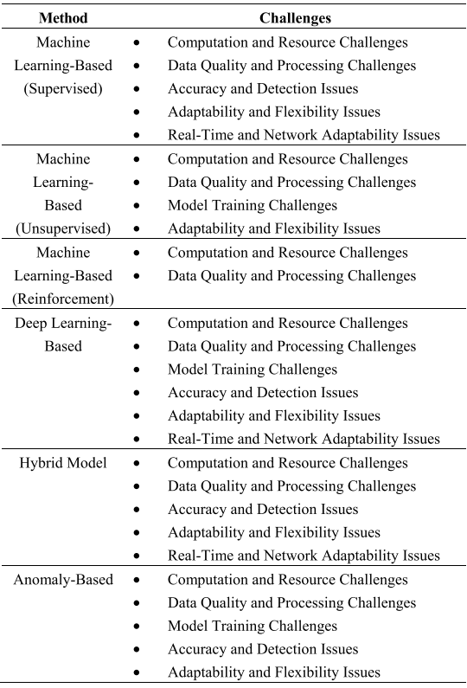
Advantages & Disadvantages
Pros
Cons
Quicker Detection
Using “big data”
Autonomous cyber defence

Slide 5
Additional points for Debate
Outsourcing Security
Ownership of risk?

