Slide 1


Post-MDT Oncology Workflow Bottlenecks
A Design Science Study of an NHS Integrated Data Repository and Decision Support Dashboard
Master of Science (MSc) Enterprise IT Management
Mark Collins
August 2026
Notes:
Hello, my name is Mark, and this is the presentation for my project looking at bottlenecks in the cancer pathway, focussing on after the MDT meeting.

Slide 2
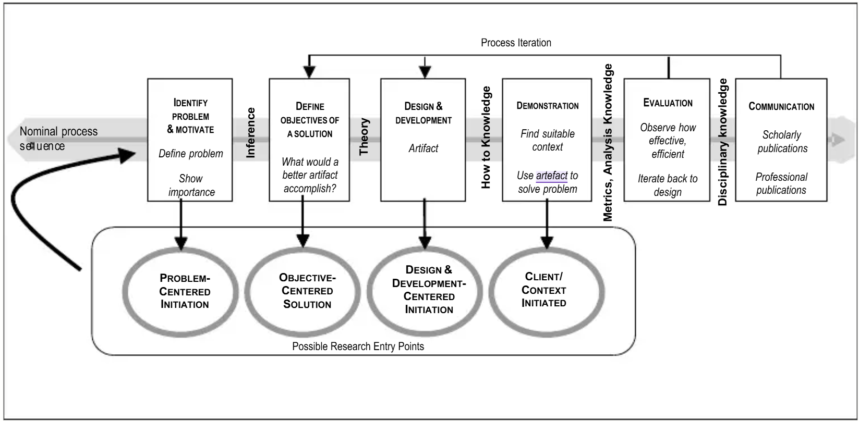
Methodology: Design Science Research
Problem identification
Objectives
Design & development
Demonstration
Evaluation
Communication
Peffers (2007)
Notes:
The methodology of the project, and the outline of this presentation, follows the six stages of Design Science Research as outlined by Peffers. The reason for DSR fits onto the solution phase of DSRM, which I will discuss a bit more when we have identified the problem.

Slide 3
Cancer Pathways
DSRM:
Identify Problem & Motivate
Notes:
The first phase of Design Science Research is Problem Identification. My day-to-day job is working on Cancer Pathways, where timely treatment is essential for the best possible outcome.

Slide 4
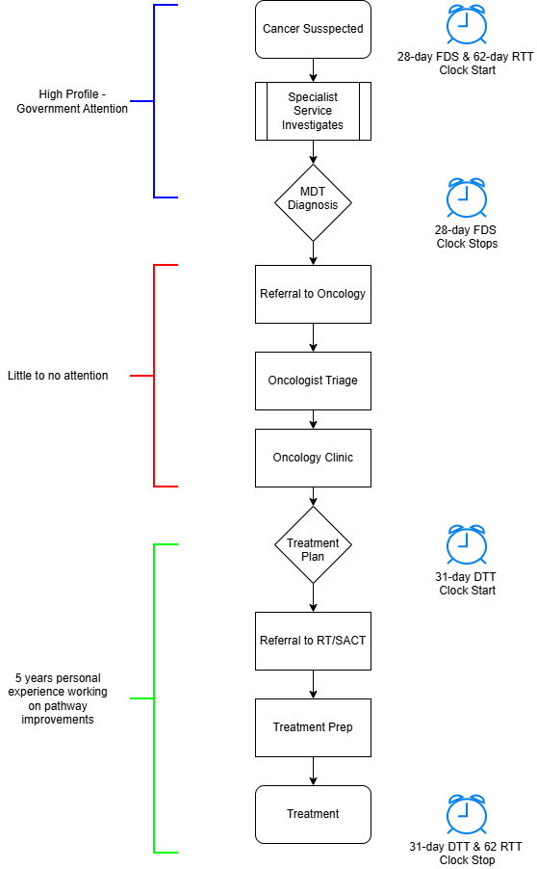
Cancer Pathway
Three key waiting time standards (Johnson, 2024)
28-day FDS
62-day RTT
31-day DTT
28-day FDS lead to Community Diagnostic Centres (NHS England, 2025)
PHU has dedicated department co-ordinating specialist services (corporate cancer service) (Calman, K. and Hine, D., 1995)
Once MDT decision made, Oncology department responsible for delivering treatment.
CCS stop tracking
I have spent last 5 years working on pathway improvements once Decision to Treat has been made.
Notes:
In 2023, the National Cancer Wait Times were updated and simplified to three main standards.
These are:
the 28-day Faster Diagnostic Standard, where a diagnosis should be confirmed within 28 days of suspected cancer.
The 62-day Referral to Treat standard, where treatment should begin within 62-days of that suspected cancer referral.
And the 31-day Decision to Treat standard, where treatment should begin within 31 days of a patient agreeing to a treatment plan with their Dr.
There has been a lot of media attention and government policy relating to the FDS – it’s the driving force behind the Community Diagnostic Centres that are being build across the country. Portsmouth Hospitals have a dedicated department for tracking and co-ordinating patients undergoing the 28-day diagnostic pathway, which has its routes in the 1995 Calman-Hine Report where all patients should have a MDT. Unfortunately, once the MDT decision has been made, Corporate Cancer Services stop tracking the patient, and it falls to the Oncology department to manage the pathway.
My personal experience from the last five years, has been focussed on improving the 31-day pathway for patients that have been referred to Radiotherapy, but there has been very little attention paid to activities that occur after MDT and before DTT, which based on the 62-day pathway should take less than three days.

Slide 5
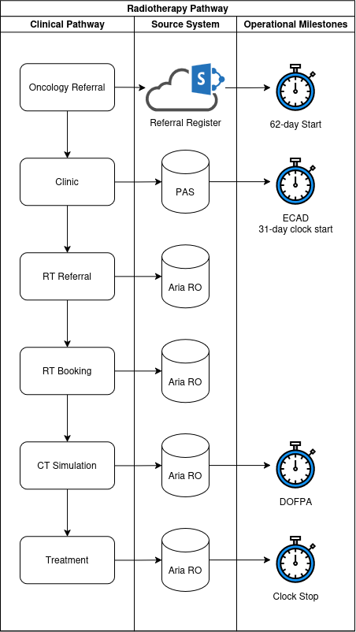
Lack of Visibility
Multiple Systems in use
SharePoint Register
PAS
ARIA RO
ARIA MO
Data Fragmentation
Reporting is focused on performance, after the fact
Notes:
As a result, there is a lack of visibility across the pathway as a whole. From the point of MDT decision, there are at least four different systems in use to manage the patient's cancer treatment. This is an unfortunate side-effect of the Hospitals Digital strategy of using “Best of breed” applications. For the most part, these systems are arguably the best tool for the job, but they result in data fragmentation.
Added to this most reporting of the cancer wait times is done after the fact – once the patient has started treatment. If there are delays in the pathway for any reason, we don’t really know until they have already breached.

Slide 6
Consequences of delayed treatment
Delays in treatment have clinical impact
Joint College of Clinical Oncologist (JCCO) (Ash et al., 2004)
Fast growing tumours to be treated within 2 weeks
Delays > 4 weeks = ↓ outcomes:
Coca-Pelaz et al. (2018)
Saleh et al. (2024)
Sharma et al. (2016)
Vilemure-Poliquin et al. (2025)
Notes:
And there are consequences of patients breaching. Its not just performance metrics used by politicians and hospital execs. The targets are routed in clinical evidence. In 2003, twenty years before the current Cancer Wait Time targets, the Joint College of Clinical Oncologists made the recommendation that the fast-growing cancers should start treatment within two weeks.
More recently, there are numerous studies showing not insignificant impacts of delaying most treatments by more than four weeks.

Slide 7
Research Gap
Literature Shows
Gap Identified
Treatment delays adversely affect outcomes
MDTs operate under increasing operational pressure
Integrated Data Repositories support data integration
Dashboards improve information visibility
Limited visibility of where delays accumulate after MDT
Few repositories designed for operational oncology management
Existing reporting is largely retrospective
Limited evidence for proactive pathway decision-support
Notes:
Before designing a solution, I needed to understand what was already known and where the literature was lacking.
The literature clearly demonstrates that delays to treatment are associated with poorer clinical outcomes. It also shows that MDTs are operating under increasing pressure and that Integrated Data Repositories can successfully integrate healthcare datasets.
Four gaps identified:
most studies measure diagnosis-to-treatment delay as a single interval and provide little visibility of where delay actually accumulates.
many repository implementations are designed for research, genomics, or population-health applications rather than day-to-day operational management.
existing reporting approaches tend to identify problems after breaches have occurred rather than supporting proactive intervention.
there is limited evidence regarding operational dashboards specifically designed for oncology pathway management.
This gap provided the justification for the project and led directly to the development of an operationally focused Integrated Data Repository and dashboard suite.

Slide 8
Aims & Objectives
DSRM:
Define Objectives of a Solution
Notes:
So, this brings us onto developing a solution, which is where Design Science Research really helps. Can I find a way to track and identify patients at risk of breaching, before they suffer a clinical impact. Standard PDCA improvement cycles, and case studies rely on measuring the current position, and then looking at the result after a change has been made. This is fine for most research or service improvements, but we have real people wo will experience real consequences if they do not receive their treatment in-time.

Slide 9
Research Aims
Multiple Source Systems
Integrated Data Repository
Decision Support Dashboard
Improve operational visibility
Reduce data fragmentation
Support proactive pathway management
Notes:
So, our research aims are to:
Improve operational visibility
Reduce data fragmentation
And provide a tool that supports proactive pathway management.

Slide 10
Research Objectives
Identify
Identify post-MDT delays
Analyse
Analyse operational factors
Design
Design integrated data architecture
Build
Build user-centred dashboards
Evaluate
Evaluate usability & utility
Derive
Derive design principles
Notes:
From these aims, the specific objectives of the research project are:
Identify delays in the pathway after the MDT
Analyse the operational factors leading to delay
Design an Integrated Data Repository, reducing data fragmentation
Build a user-centred dashboard suite, enabling operational managers to make informed decisions.
Evaluate the usability and utility of the tools built
And derive a set of design principles that can be applied to environments outside of the current study environment.

Slide 11
IDR & Dashboard
DSRM:
Design and Development of Artifact
Notes:
Integrated Data Repositories are an ideal way to resolve the data fragmentation of the multiple systems in use, although careful consideration is needed for what data feeds into the IDR, and what you need out of it, in our case, decision support dashboards.

Slide 12
Scope
Parallel Projects
ARIA MO upgrade
Digital Referrals
Remove SACT from scope
Data pathway should allow for changes in referral processes
Notes:
Before diving into the development of the IDR, I needed to consider the scope, and other improvement projects currently in progress at PHU. The system used for managing the Systemic Anti Cancer Therapy (SACT), commonly known as chemotherapy, is undergoing an upgrade. The same system is used across the local network of hospitals, and one of the main improvements is reporting functionality. So for the purpose of this project, I have left SACT data outside scope, and will focus on Radiotherapy.
Another project currently in-flight is the development of digital referral to oncology, instead of handwritten, scanned forms, emailed to a shared inbox (can we see where some delays might occur?).
So anything developed, needs to be allow for changes when these projects are complete.

Slide 13
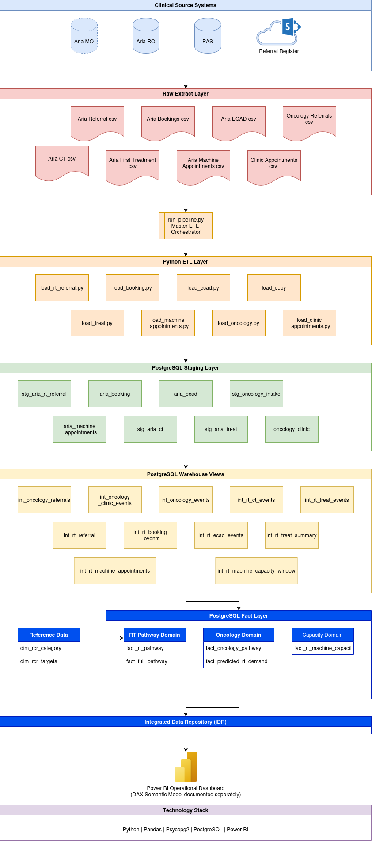
IDR Architecture
Layered architecture
ETL layer
Staging layer
Intermediate layer
Fact layer
Raw extract layer
CSV/Excel
Comon export format
Notes:
The architecture adopted for the IDR was layered architecture, with an ETL and staging layers, performing data quality, while maintaining data provenance and auditability, an intermediate layer where various business rules were applied (e.g. 31-day; 62-day; capacity calculated etc.), and a fact table layer, containing all the required data for reporting.
In order to maintain simplicity, the raw extract data used a similar structure. All source systems has multiple export options, but tabular csv/excel was the one common format across all systems (particularly when considering the planned additions mentioned in the previous slide).

Slide 14
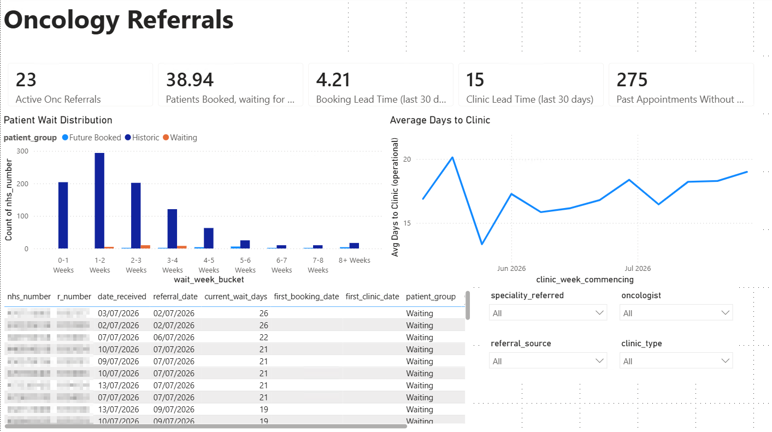
Oncology Referral Dashboard
Notes:
The Oncology Referral Dashboard combined data from a referral register (SharePoint list) and Clinic appointment information (excel extract from Patient Administration System – PAS).
Here we can see:
the number of patients received by the Oncology department, awaiting to be booked into an appointment (23),
the average wait time in days from all clinic appointments being booked to attendance (38.94). This includes 6-week follow-up patients, so isn’t useful for RTT pathway, but is an indicator of capacity,
The average time from referral to being booked (4.21 days)
The average time from referral to clinic (15 days)
And 275 past appointments without an outcome (e.g. attended, not-attended (no show, cancelled etc). )
We have two visuals/charts in the middle of the screen showing the median wait time for historic patients, those booked into clinic but not yet seen, and those waiting to be booked. We also have historic performance, allowing us to identify trends before they manifest into operational problems.
At the bottom, we have a patient worklist of un-booked patients, sorted by wait time. This allows operational and clinical management to investigate these patients. We can also filter by speciality, Dr, the source of referral and the type of clinic. This allows the management team know if they need to find additional clinic capacity, or make targeted service improvements (e.g. is one speciality making referrals without all the required information?)
This is the one dashboard I would like to make the most improvements to after the project is over. For example, colour code the patient worklist to a Red, Amber, Green for wait time. I don’t think I could have done that before getting this data, as I didn’t know what would be reasonable. I could have used the three days between 28-day FDS and 31-day DTT to stay within the 62-day RTT, but everything would be red, and mean nothing. I can now work with clinical management on what colours would actually allow for meaningful action to be taken.

Slide 15
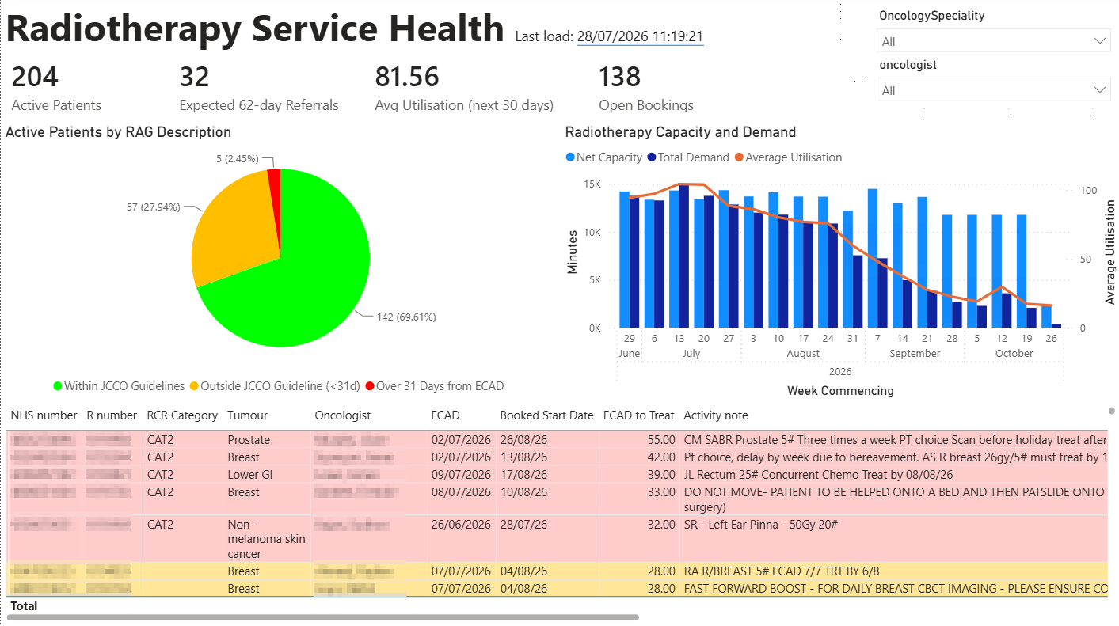
Radiotherapy Service Health
Notes:
The Radiotherapy Service Health dashboard does allow for a traffic light system.
This dashboard shows that at the time, there were 204 patients referred to Radiotherapy that had not yet started treatment. Of those, the pie-chart shows that just under. 70% are booked to start treatment within the JCCO guidelines, and approx. 28% of patients, while outside JCCO guidelines, are within the mandatory 31-day target.
The dashboard shows that there are 32 patients that are booked into a clinic to see a Radiation Oncologist in the next 30 days (from the previous dashboard), giving an indication of future demand where RT will be the primary treatment.
We have our current booked patients over the next couple of months, with the current treatment machine capacity. Not all Radiotherapy treatments take the same amount of time, so we expect to see a tailing off, allowing the capacity for patients being referred.
At the bottom of the page, we have our patient worklist of patients not yet started, and their expected wait time to start, allowing for targeted intervention.
Early validation identified double-counting of referral events within the integration layer. Refinement of ETL business rules subsequently resolved this issue, illustrating the importance of validating analytical outputs against operational source systems.

Slide 16
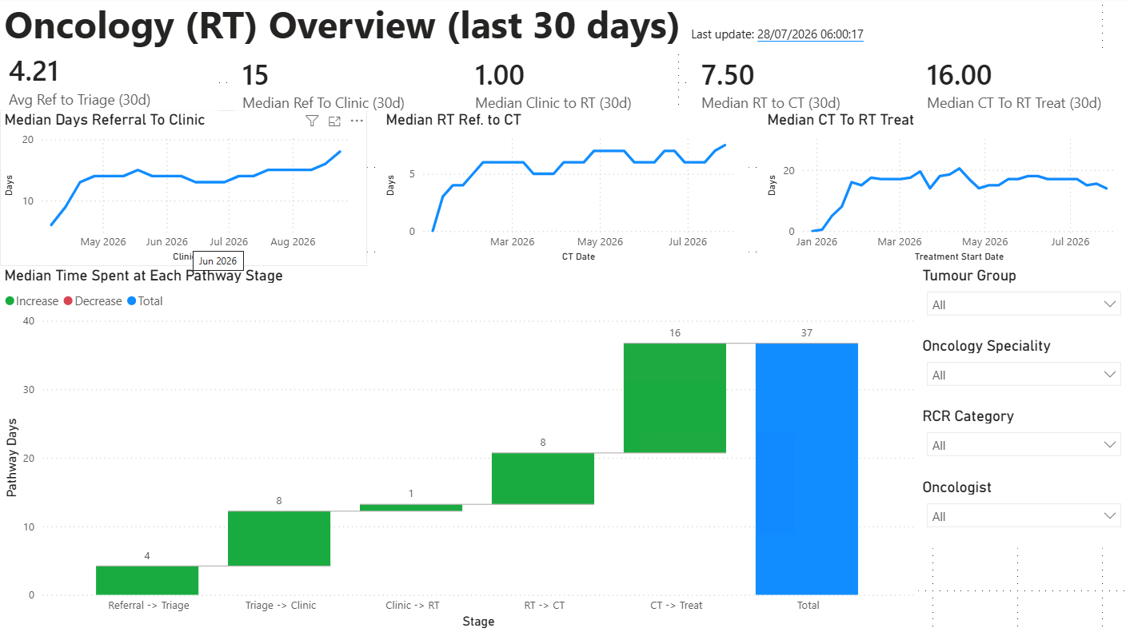
Oncology Pathway Overview
Notes:
The final dashboard I made looks at the full Radiotherapy pathway, from referral to Oncology through to treatment. The waterfall visual is the one that jumps out, and shows that the median time from referral to radiotherapy treatment is 37 days, with the longest delay between CT simulation and treatment (although there are additional activities not captured), and over a week between triage and clinic, and RT referral and CT treatment. Trend lines at the top show this to be mostly stable. Of all the dashboards, I personally felt this was the most revealing.

Slide 17
Stakeholder Feedback
DSRM:
Demonstration & Evaluation

Slide 18
Evaluation Results
Participant | SUS Score
P1 | 95.0
P2 | 90.0
P3 | 95.0
Mean | 93.3
Stakeholders:
Clinical Director
Cancer Care Group Manager*
RT Ops Manager
Lead Radiographer
Reported Benefits:
Improved visibility
Earlier breach detection
Reduced manual reporting
Operational adoption likely
*CGM not available for SUS scoring but heavily involved in iterative design.
Notes:
I demonstrated these dashboards to some key management personnel. Due to being the middle of the summer holidays, it was impossible to demonstrate to all relevant stakeholders together, but I did manage to demonstrate individually to the Oncology Clinical Director, Radiotherapy Operations Manager, and the Lead Treatment Radiographer. The Care Group Manager unfortunately was not available during the demonstration and evaluation phase but was heavily involved in the iterative design stage. For example, it was their input that led away from mean intervals to median, so the data was not overly skewed by outliers.
SUS scoring came out as being exceptionally high, and the reported benefits were improved visibility, earlier breach detection and reduced manual reporting. All users felt that adoption into day-to-day management would be likely.

Slide 19
Feedback
Theme | Feedback
Most Useful Features | Waterfall visualisation of pathway delays; filtering by Dr. and speciality; Patient worklist and breach monitoring
Missing Features | SACT Data; Clinic Utilisation; visibility of emergency pathway; utilisation breakdown by machine availability vs service demand
Operational Decisions Supported | Referral Monitoring; Patient Tracking; bottleneck identification; overtime planning; shift extensions; additional capacity planning
Future Enhancements | Clinic-capacity modelling; CT-to-treatment decomposition; utilisation analysis; integration of electronic referrals; SACT data
General Comments | “Very good. Can’t wait to start using it” “Looks Good”
Notes:
A few of the captured comments from the stakeholders.

Slide 20
Results and Discussion
DSRM:
Communication
Notes:
Results and discussion. This probably has a bit of evaluation stage, but I would put it as communication. What is science if we can’t communicate our findings?

Slide 21
Pathway Delays
Stage | Days
Referral → Triage | 4
Triage → Clinic | 8
Clinic → RT Referral | 1
RT Referral → CT Sim | 8
CT Sim → Treatment | 16
Total | 37
Median Post-MDT pathway: 37 days
NCWT:
62-day RTT
28-day FDS
34 days available for Post-MDT pathway
Longest Delays:
CT Sim → Treatment: 16 days
Additional activities not captured
Triage → Clinic: 8 days
Administrative & Capacity delays
RT Referral → CT Sim: 8 days
Administrative & Capacity delays
Notes:
Pathway delay analysis showed three areas to focus on:
CT simulation to treatment takes approximately 16 days. There are additional planning activities included here that are not captured. They are not the canonical “patient” events, so were not included in this study, but will be part of the next phase.
Triage to clinic and RT referral to CT both take 8 days. Anecdotally, capacity is the driver here. We cannot offer appointments with less than a week's notice.
Finaly, it is taking 4 days for a Oncologist to triage and confirm if a referral is appropriate. There are definitely systems of work that can be implemented here to speed up this process.

Slide 22
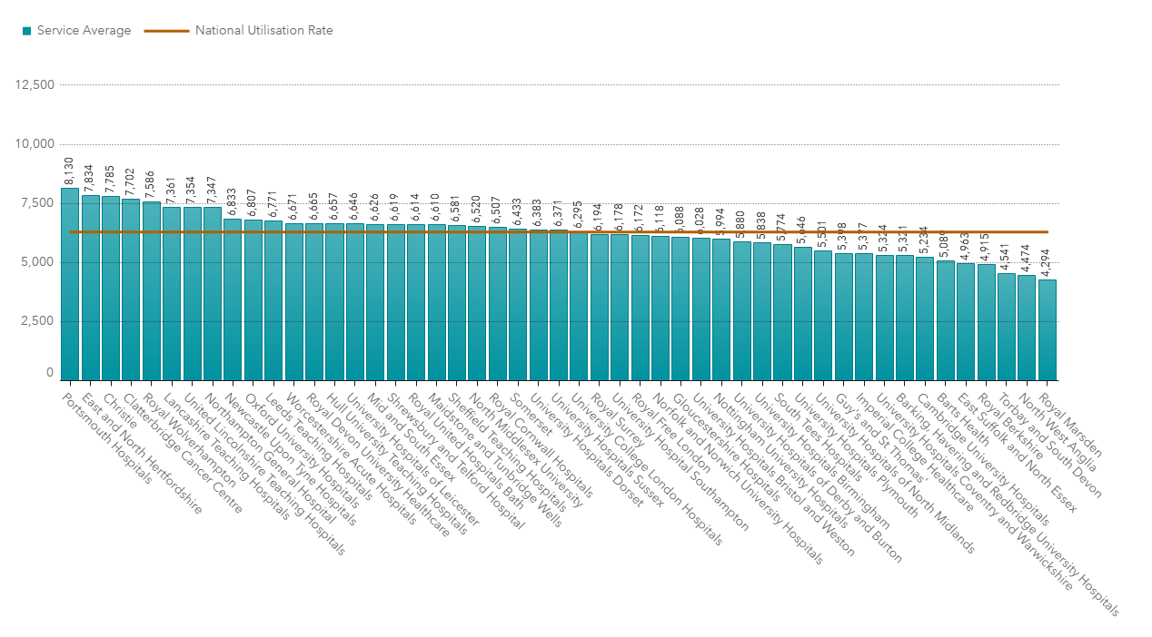
Radiotherapy Capacity Insights
81.56% utilisation
Portsmouth highest utilisation in the country (NHS Digital, 2026)
Risk stratification:
69.6% within JCCO guidelines
27.9% outside JCCO, inside NCWT
2.45% breaching 31-day DTT
Notes:
In terms of Radiotherapy insights – capacity was quite telling. Unofficial recommendations say that Radiotherapy centres should sit below 80% capacity, to allow for machine breakdown and emergency patient pathways. Portsmouth were at 81.56% at the time of the screenshots used for this presentation, and there is nothing of note happening in the wider picture to indicate we are operating out of the ordinary. This actually tracks well with the national picture, where Portsmouth have the highest number of attendances per treatment machine than any other NHS Radiotherapy centre.
Combining this utilisation with performance, I think Portsmouth is doing extremely well with less than 2.5% breaching the 31-day standard, and we can focus our efforts on the 28% of patients outside the JCCO guidelines.

Slide 23
Design Principles
Surface breach risks early
01
Pair risks with capacity
02
Use canonical pathway events
03
Refresh at operational cadence
04
Preserve provenance
05
Align dashboards with real tasks
06
Notes:
I was able to identify and implement six key design principles:
I was able to surface breach risks before they happened.
I was able to combine breach risk with capacity
I used canonical pathway events, although there are additional events that should be included
The refresh cadence was perfect for this use-case, however one user stated that the refresh rate does not allow for changes to service to be visualised (e.g. if an extra shift was put on, they would have to wait 24 hrs to see what impact that had on capacity), but for strategic-operational visibility, nightly is good enough.
I was able to preserve the provenance of all data using the staged IDR architecture, meaning all data and decisions can be traced to original source.
The dashboards were aligned to real task, and were built with specific operational questions in mind.

Slide 24
Research Contributions
Practical Contribution
Integrated Data Repository for operational oncology workflows
Decision-Support dashboard suite
Improved visibility of post-MDT bottlenecks
Evidence-based baseline metrics for pathway performance
Academic Contribution
Application of Design Science Research in NHS operational analytics
Six evaluated design principles for operational oncology analytics
Evidence linking operational visibility, data quality, and manual administrative processes
Strategic Contribution
Platform for evaluating digital referral transformation
Support NHS Shift from analogue to digital working
Notes:
This study makes contributions at three levels.
1. the practical contribution is the development of a lightweight Integrated Data Repository and dashboard suite that provides visibility across previously disconnected parts of the post-MDT pathway.
The repository enabled identification of bottlenecks that were not previously observable using existing reporting processes.
One example is referral-to-clinic performance. Prior to this study, no integrated dataset existed that consistently captured referral receipt, triage, booking and clinic attendance. As a result, there was no evidence-based understanding of what constituted a typical referral-to-clinic interval. The repository now provides that baseline.
2. the academic contribution is the generation and evaluation of six design principles for operational oncology analytics. These principles represent reusable design knowledge that may be transferable beyond Portsmouth Hospitals.
3. the study provides a strategic contribution by creating a platform capable of evaluating future digital transformation initiatives.
In particular, the introduction of electronic oncology referrals presents an opportunity to quantify changes in data quality, referral processing time and pathway performance using pre- and post-implementation measurements generated by the repository.
Together, these contributions demonstrate that meaningful operational insight can be obtained through lightweight integration of existing NHS systems without replacing them.

Slide 25
Limitations
Single-site study
Small user sample group
High impact users
Dependant on Source-system data quality
CT → Treatment interval aggregates hidden processes
Evaluation focused on usability, not outcomes
Notes:
There are a few limitations to highlight.
Mainly, this was a single-site study. Taking this to a near-by hospital may not have the same results as we all work slightly differently, but the participants in this study were key decision makers at this centre.
A limitation that I was not expecting to be as much of an issue was data quality. There were a not-insignificant number of duplicate referrals, and formatting of key patient identifiers meant pairing was difficult without first cleaning during the ETL layer.
The biggest delay was also the stage that has a number of additional tasks to be completed, and doesn’t necessarily give the full picture,
And finally, the evaluation focused on the stakeholder's usability, and their ability to make decisions, not the outcomes of those decisions.

Slide 26
Future work
Digital referral integration
Decomposition of CT → Treatment workflow
SACT dataset integration
Clinic-capacity modelling
Targeted pathway interventions
Notes:
There is some planned future work, and the Oncology management team are keen to use this, so I am not going to be walking away any time soon.
The first improvement will be the use of digital referrals to oncology. In the last week, we went live with Urology-to-Oncology referrals. This IDR and dashboard now means we can quantify the impact of this, from the data-quality of structured data, to the time to triage ensuring the minimum dataset is supplied.
I will be breaking down the CT-to-treatment workflow, and have been working on improvements in parallel to this study.
The capacity visualisation used for Radiotherapy utilisation will be extremely useful for outpatient clinics.
Finaly, any service improvements can use the data in this IDR and dashboard to make meaningful, targeted and measurable interventions.

Slide 27
Conclusion
Lightweight IDR improves visibility
Dashboard reveals hidden bottlenecks
Supports operational management
Provides transferable design principles
Enables faster, more reliable progression to treatment
Notes:
In conclusion, I have managed to show that a lightweight IDR improves visibility of cancer pathways; dashboards can reveal hidden bottlenecks, and support operational management. I have manged to provide transferable design principles, which I will be able to confirm when I apply the same to the SACT data when available, and by surfacing individual breach risk patients, we can enable faster, more reliable progression to treatment.

Slide 28
References
Ash, D., Barrett, A., Hinks, A. and Squire, C. (2004) ‘Re-audit of radiotherapy waiting times 2003,’ Clinical Oncology, 16(6), pp. 387–394
Calman, K. and Hine, D. (1995) A Policy Framework for Commissioning Cancer Services : A Report by the Expert Advisory Group on Cancer to the Chief Medical Officers of England and Wales, Tech. rep., Department of Health, London
Coca-Pelaz, et al. (2018) ‘Head and Neck Cancer: A Review of the Impact of Treatment Delay on Outcome,’ Advances in Therapy, 35(2), pp. 153–160
Johnson, P. (2024) ‘Updating the NHS cancer waiting time standards,’ BMJ Oncology, 3(1)
NHS Digital (2026b) ‘RTDS quality dashboard,’ Available at: https://digital.nhs.uk/ndrs/data/data-outputs/data-quality-and-insights-hub/rtds-hscn-quality-dashboard (Accessed 7th August 2026)
NHS England (2025) Community diagnostic centres. Available at: https://www.england.nhs.uk/long-read/community-diagnostic-centres/ (Accessed 7th August 2026)
Peffers, Ken, Tuunanen, Tuure, Rothenberger, Marcus A. and Chatterjee, Samir (2007) ‘A design science research methodology for information systems research,’ Journal of Management Information Systems, 24(3), pp. 45–77
Saleh, M., et al. (2024) ‘Diagnosis-to-treatment interval in cervical cancer: An exploratory analysis of the SEER database,’ Gynaecologic Oncology, 190, pp. S361–S362
Sharma, S. et al. (2016) ‘Clinical impact of prolonged diagnosis to treatment interval (DTI) among patients with oropharyngeal squamous cell carcinoma,’ Oral Oncology, 56, pp. 17–24,
Villemure-Poliquin, N. et al. (2025) ‘Delayed diagnosis to treatment interval (DTI) in head & neck cancers – A systematic review and meta-analysis,’ Oral Oncology, 160, p. 107106
Notes:
Thank-you for listening.

