Slide 1
Unimore Smart Bottle
Colombari Mattia, Pirrelli Marco

Slide 2
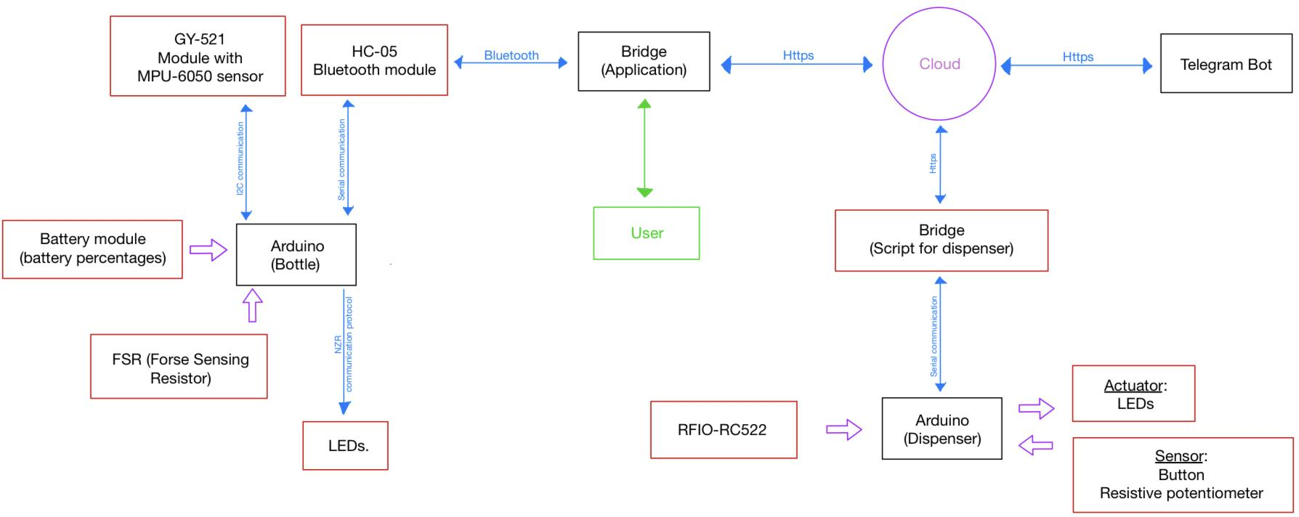
Complete overview of the Architecture

Slide 3
Bridges
Mobile application:
Parse the message from the bottle to the server.
Link the user with his respective bottle, takes the Bottle ID and User ID and notify the server that that specific bottle its owned by this specific user.
Provide a UI to show the results computed by the server.
Dispenser bridge:
Parse the message from the dispenser to the server.
Notify the server a malfunction if necessary.

Slide 4
Communication from bridges
HC-05 BLT Module ←→ Mobile application:
The bottle send to the mobile application the current readings if it’s connected, they establish a serial communication with this structure:
<Bottle ID> ; <Weight value> ; <Battery percentage>
The <Weight value> is the sensor reading [0-1024].
Dispenser ←→ Dispenser bridge:
When the dispenser is used by a user send the data to the bridge, also in this case we have a serial communication, with the following structure:
/ <Bottle ID> - <Water level> 0xFE

Slide 5

Cloud hosted server
RESTful
Hosted remotely on pythonanywhere.com
Handles I/O with the database (MySQL)
Handles the bulk of calculations (such as calculating personal daily water intake)
Has modules for dispenser engagement temporal prediction and dispenser recommendations
Handles Telegram bot commands and data

Slide 6
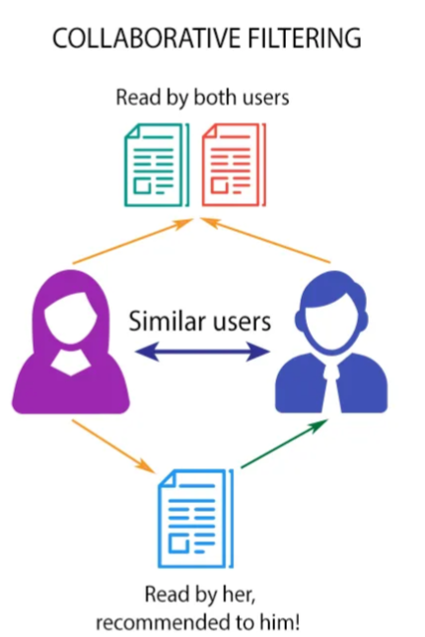
Using collected data
The user data, collected through the bottles and the dispensers, can be a valuable asset.
Based upon other users’ habits it’s possible to provide recommendations - collaborative filtering approach.
The data on bottle refills is also used to predict how busy a cooler will be at a given time.
The combinations of recommendations and engagement predictions aids the redistribution of load on the dispensers.

Slide 7
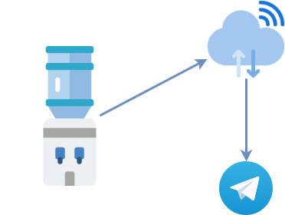
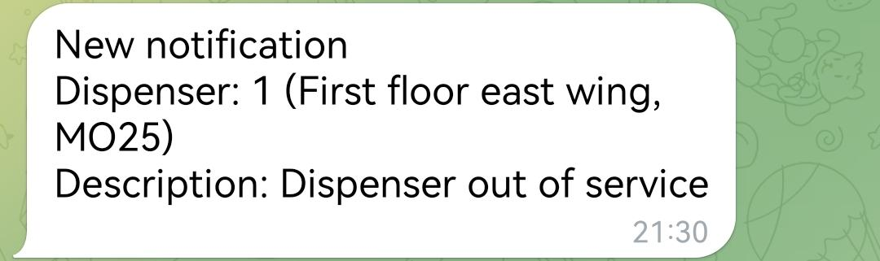
Telegram bot
A simple way to notify maintenance staff of issues with the water coolers. The staff will receive new notifications sent automatically by the dispensers whenever an issue is detected.
The maintenance staff can then proceed to delete or insert their own notifications.

