Slide 1
Wisconsin Literacy K-12 literacy data and other resources
Matt Cooper Borkenhagen
Liz Fitzpatrick

Slide 2
About me

Slide 3

Why are we talking about K-12 literacy data?
WL member organizations need data for various purposes
Knowledge of community
Reporting to shareholders
Communication to funders
We sought support from the Department of Public Instruction
Put together data
Packaged it up in an online tool for you

Slide 4
Why is it so hard to find literacy data?
Few studies are conducted with large scope
Those that exist use methods that aren’t direct (NAAL, 2003)
Leaves local literacy orgs in the blind about actual literacy levels
Agencies that collect large data samples aren’t at a level useful to WL
For example, census
Leaves us few options for viable sources of information

Slide 5
The solution
Literacy development is, well…developmental
We can look to data on youth literacy performance
Connection between youth literacy and adult outcomes (Baydar et al., 1993; NRP, 2000)
Data accessible through Department of Public Instruction
We’ve curated some relevant data (the topic of today’s webinar)
Though more is publicly available (more on that later)

Slide 6
Where to access the application
Notes:
Show where the access point is though the Wl website here

Slide 7
A few basics
You select the county (in the “County” field)
You select the variable (in the “Variable” field)
this selects the variable (type of data) you want to see
When you select a county-variable pair, a graph will be shown
Two years will appear automatically (2015-16 and 2016-17)
A description will appear automatically

Slide 8
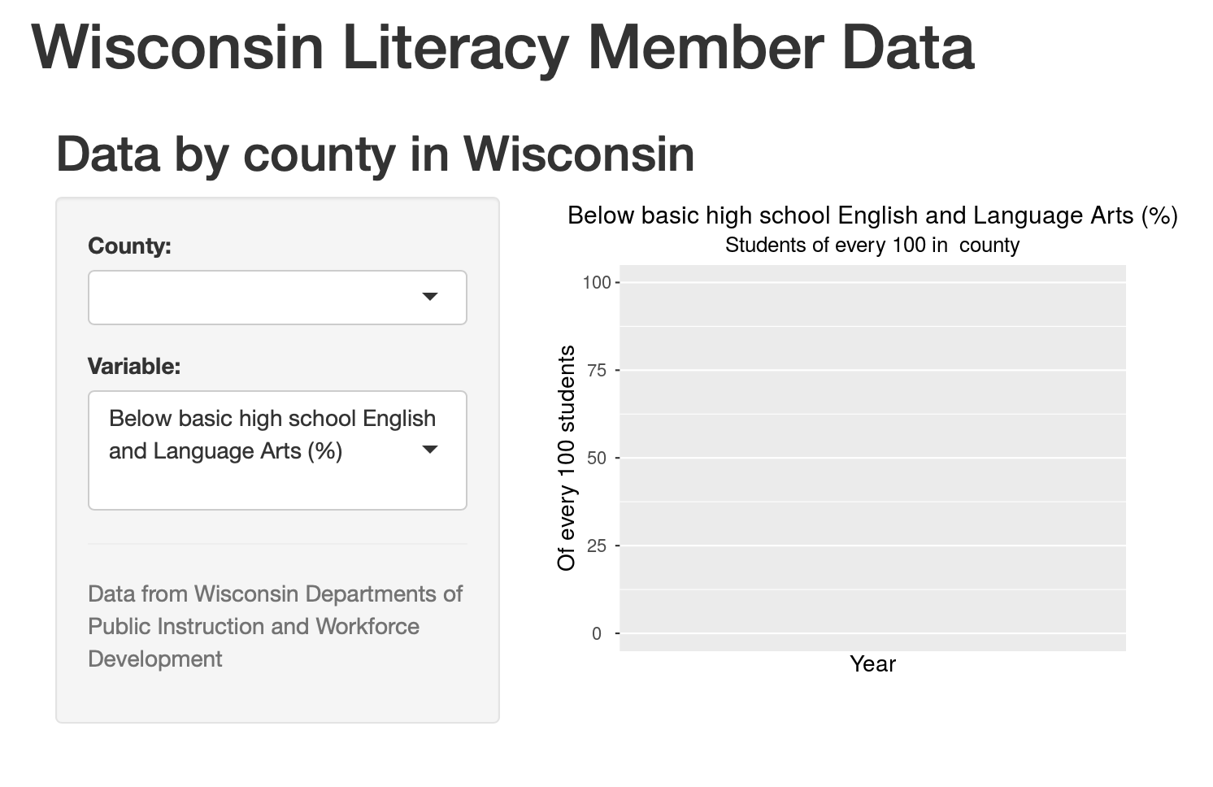
county

Slide 9
variable

Slide 10
graph and
explanation will appear

Slide 11
Let’s go to the application
Notes:
Include URL link in the PPT
Make it clear that we are presenting the data in plain language, reference other resources. Ask a comprehension question about the data presented, just to check to see if people are following

Slide 12
Additional resources
Wisconsin DPI has a good deal more data
Their platform is called WISEdash
Their portal: https://dpi.wi.gov/wisedash
Opportunity Atlas
See:

Slide 13
?

Slide 14
References
Baydar, N., Brooks‐Gunn, J., & Furstenberg, F. F. (1993). Early warning signs of functional illiteracy: Predictors in childhood and adolescence. Child development, 64(3), 815-829.
National Reading Panel (US), National Institute of Child Health, & Human Development (US). (2000). Report of the National Reading Panel: Teaching children to read: An evidence-based assessment of the scientific research literature on reading and its implications for reading instruction: Reports of the subgroups. National Institute of Child Health and Human Development, National Institutes of Health.

