Slide 1
Wisconsin Literacy K-12 literacy data and other resources
Matt Cooper Borkenhagen
Liz Fitzpatrick

Slide 2
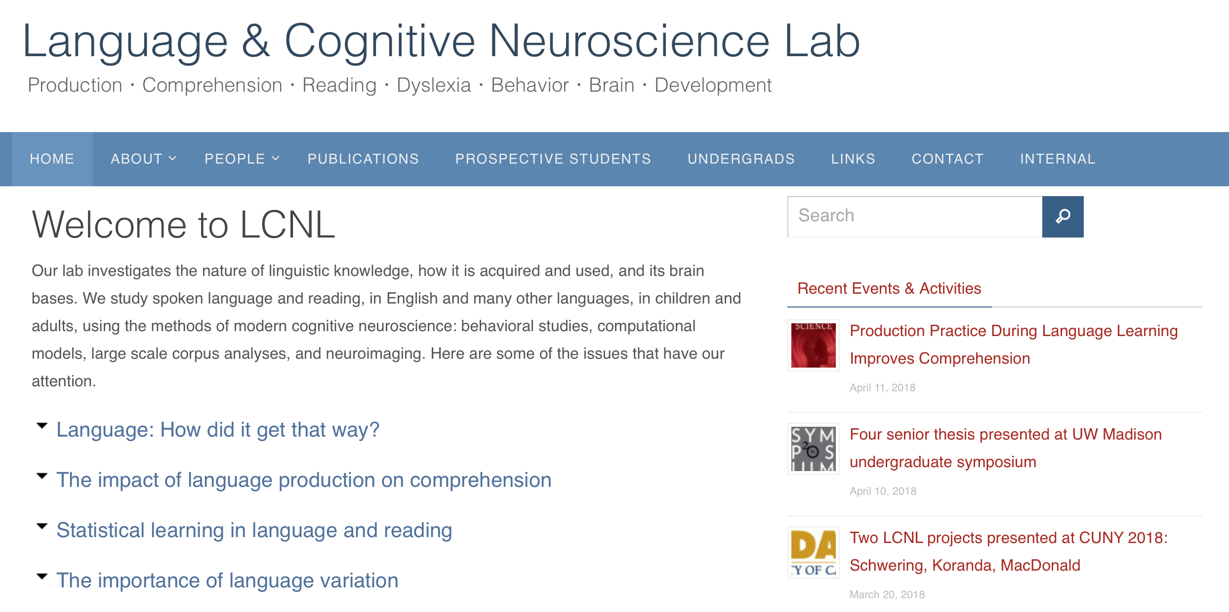
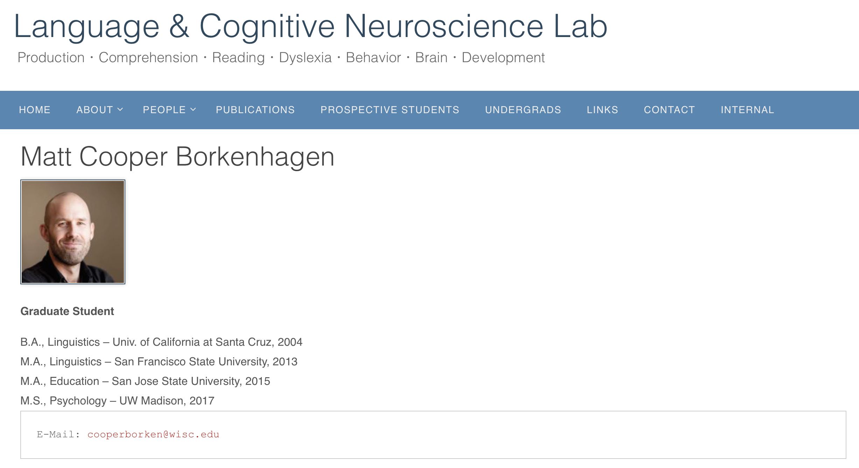


About me

Slide 3

Why are we talking about K-12 literacy data?
WL member organizations need data for various purposes
Knowledge of community
Reporting to stakeholders
Communication to funders
We sought support from the Department of Public Instruction
Put together data
Packaged it in an online interactive tool for you
Along with other resources

Slide 4
Why is it so hard to find literacy data?
Few studies are conducted with large scope
Those that exist use methods that aren’t direct (NAAL; , 2003)
Leaves local literacy orgs in the blind about actual literacy levels
Agencies that collect large data samples aren’t at a level useful to WL
For example, census
Leaves us few options for viable sources of information
Notes:
NAAL = “National Assessment of Adult Literacy”

Slide 5
The solution
Literacy development is…developmental
We can look to data on youth literacy performance
Connection between youth literacy and downstream outcomes (Baydar et al., 1993; NRP, 2000; Seidenberg, 2017)
Data accessible through Department of Public Instruction
We’ve curated some relevant data (the topic of today’s webinar)
Existing publicly available resources (more on that later)

Slide 6
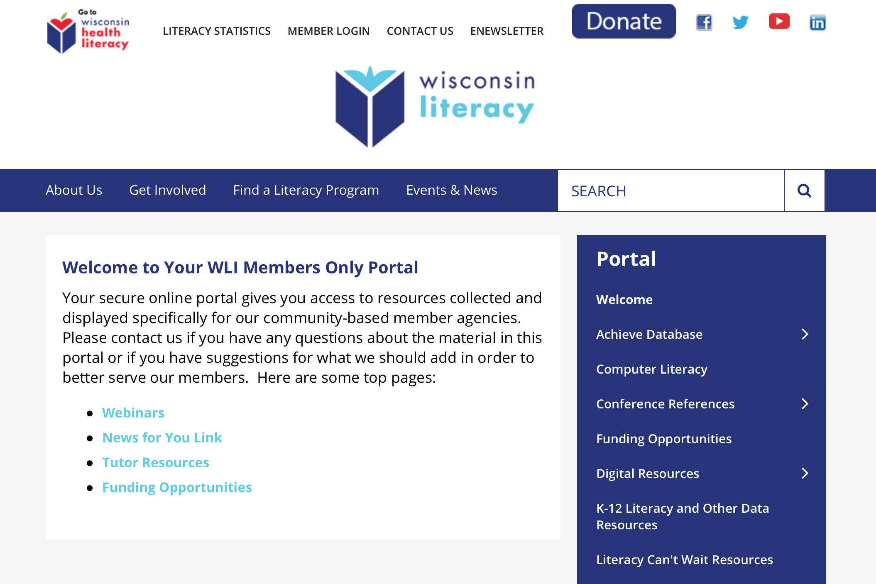
Where to access the application

Slide 7
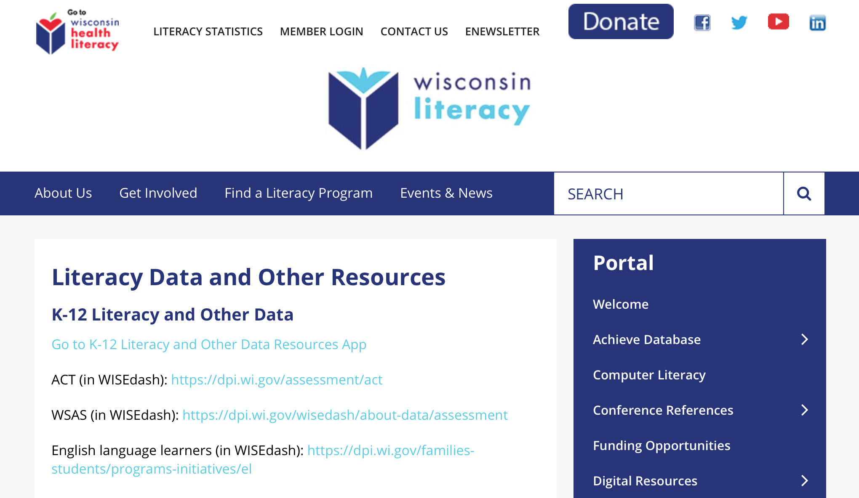

Slide 8
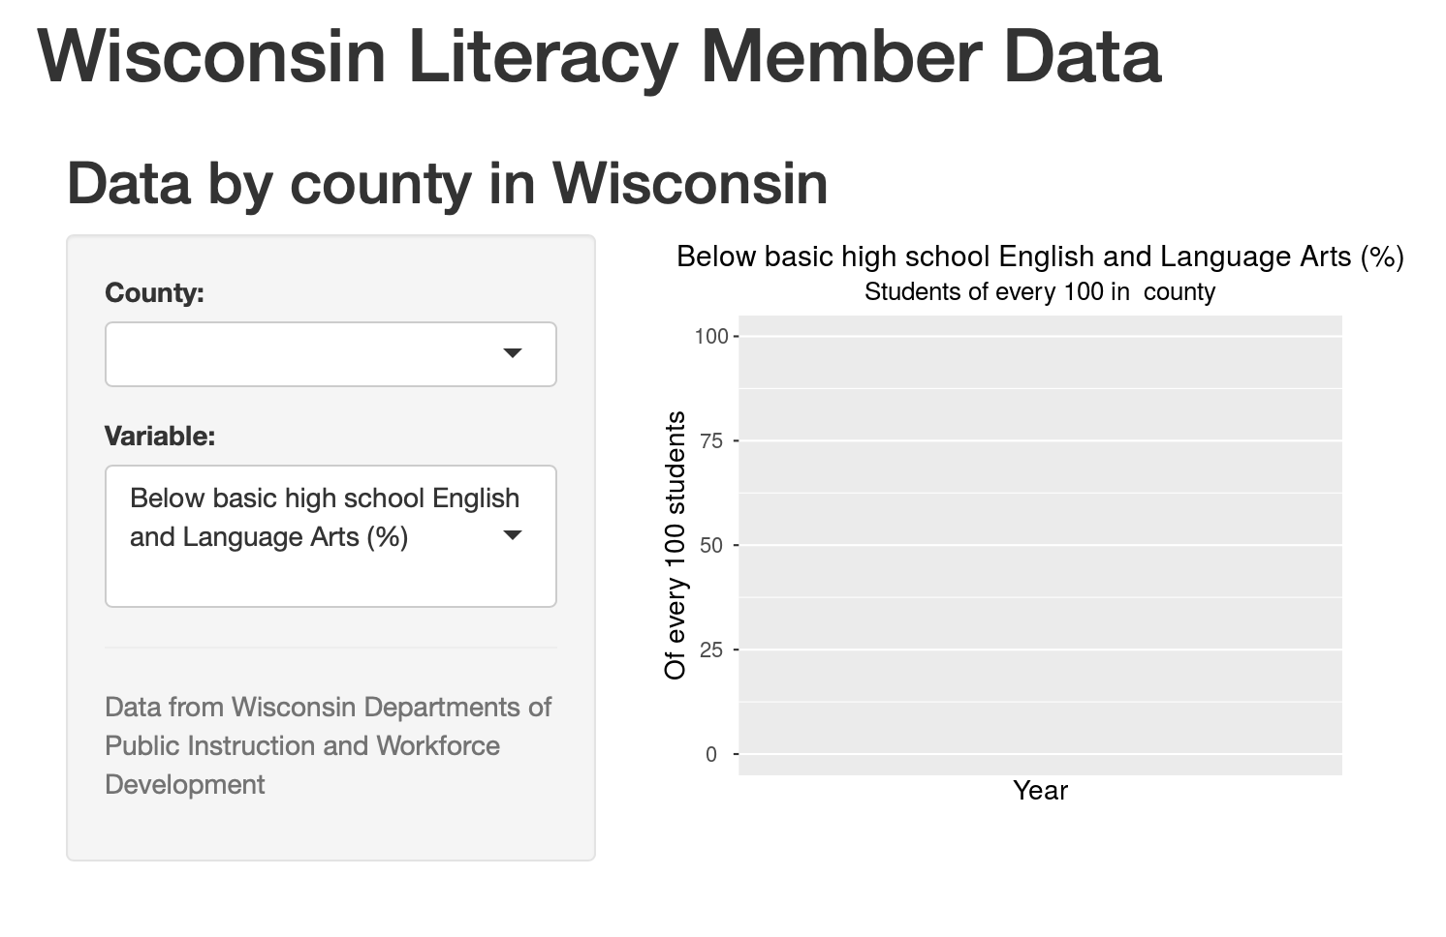

Slide 9
A few basics of the interactive tool
You select the county (in the “County” field)
You select the variable (in the “Variable” field)
this selects the variable (type of data) you want to see
When you select a county-variable pair, a graph will be shown
Two years will appear automatically (2015-16 and 2016-17)
A description will appear automatically

Slide 10
county

Slide 11
variable

Slide 12
graph and
explanation will appear

Slide 13
Let’s go to the application
You can also find it here

Slide 14
Additional resources
Wisconsin DPI has a good deal more data
Their platform is called WISEdash
Their portal: dpi.wi.gov/wisedash
Opportunity Atlas
See: opportunityatlas.org
Income, housing data by region and demographic

Slide 15
Articles
Wisconsin State Journal article "Less than half of Wisconsin students in grades 3-8 proficient or better in English, math" (includes interactive district data chart)
Journal Sentinel article “Fewer than half of Wisconsin students are proficient in math and reading, new test scores show”

Slide 16
?

Slide 17
Thank you!
Contact:
cooperborken@wisc.edu (Matt)
liz@wisconsinliteracy.org (Liz)

Slide 18
References
Baer, J., Kutner, M., Sabatini, J., & White, S. (2009). Basic Reading Skills and the Literacy
of America's Least Literate Adults: Results from the 2003 National Assessment of
Adult Literacy (NAAL) Supplemental Studies. NCES 2009-481. National Center for
Education Statistics.
Baydar, N., Brooks‐Gunn, J., & Furstenberg, F. (1993). Early warning signs of functional
illiteracy: Predictors in childhood and adolescence. Child development, 64(3), 815-829.
National Reading Panel (US), National Institute of Child Health, & Human Development
(US). (2000). Report of the National Reading Panel: Teaching children to read: An
evidence-based assessment of the scientific research literature on reading and its
implications for reading instruction: Reports of the subgroups. National Institute of Child
Health and Human Development, National Institutes of Health.
Seidenberg, M. (2017). Language at the speed of sight: How we read, why so many can’t,
and what can be done about it. New York: Basic Books.

