Slide 1
Tackling the Global Obesity Crisis: An Exploration of Adult BMI Prevalence Across the World
Rajput,Deepak Shersingh
Yeramreddy,Teja Vineeth Reddy
Mohammed, Ahteshamuddin
Chetipalli,Aditya
Khazi,Nasiruddin
Shanigarapu,Soumya

Slide 2
ABSTRACT
MOTIVATION: Main motivation is to investigate the factors contributing to the increasing prevalence of obesity, with a focus on analyzing the impact of varying food consumption habits on obesity rates across different regions.
PROJECT GOAL:The goal of this project is to use datasets data to examine the relationship between food consumption habits and obesity prevalence among adults worldwide and identify the main reasons of the issue from the datasets of food consumption and prevalence of obesity among adults.
PROPOSED METHOD AND TOOLS:
Data cleaning and preprocessing: EXCEL
Data Modeling ,Data Querying and Data Migration: Mysql
Data Visualization:Tableau
User Interface: Python, Html
EXPECTED OUTCOMES:The expected outcomes of this project are to uncover new insights into the relationship between food consumption habits and obesity prevalence among adults across different regions. The project may reveal patterns and trends that were previously unknown, leading to potential new solutions and strategies for preventing and managing obesity.

Slide 3
BACKGROUND
Obesity is a major public health concern worldwide and its prevalence has been rapidly increasing over the past few decades.
According to the World Health Organization (WHO), in 2016, over 1.9 billion adults worldwide were overweight, and of these, over 650 million were obese
The prevalence of obesity varies across different regions and countries, and it is influenced by various cultural, social, and economic factors.
While traditional diets that are high in fiber and low in fat and sugar have been replaced by processed foods and fast foods in some countries, lack of access to healthy food options and limited physical activity opportunities due to urbanization and changing lifestyles have contributed to the rise in obesity rates in other regions.
Obesity accounts for 18% of deaths among American adults, according to the Commonwealth Fund.
.Despite numerous studies on the individual aspects of food consumption and obesity prevalence, there is a lack of comprehensive research that explores the potential relationship between these two factors.

Slide 4




METHODS
Datasets:
Data on Prevalence of Obesity and Over-weight
Obesity among adults by country,1975-2016
Global Food Consumption Data
a4-global-food-consumption
Data cleaning and preprocessing: EXCEL
Data Modeling ,Data Querying and Dara Migration: Mysql
Data Visualization:
User Interface: Python and Html

Slide 5
WORKFLOW
The data from the datasets will be collected
from two different sources and will be cleaned
and filtered through Microsoft Excel.
The resultant data will then be imported into
MYSQL and a RDBMS will be created.
Next, the relational system will be imported
into the next layer, where the data will be
visualized using Tableau.
A frontend will be built using Python and Html
to enable users to interact with our model.

Slide 6
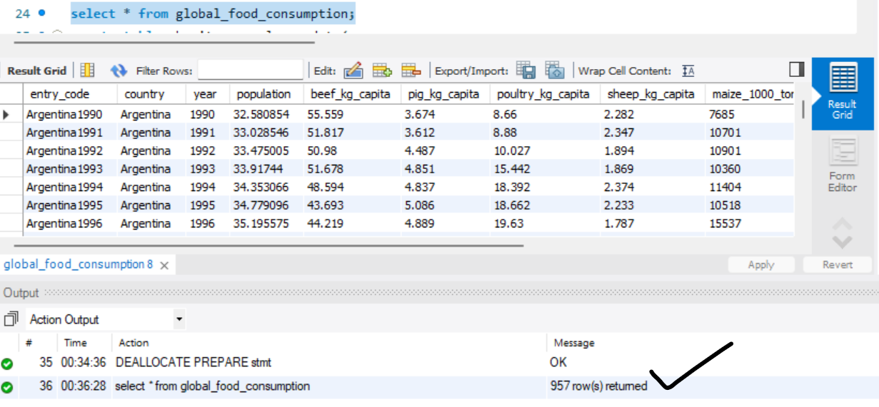
LOADING OF DATASET
IMAGE OF LOADING GLOBAL FOOD CONSUMPTION INTO MYSQL WORKBENCH

Slide 7
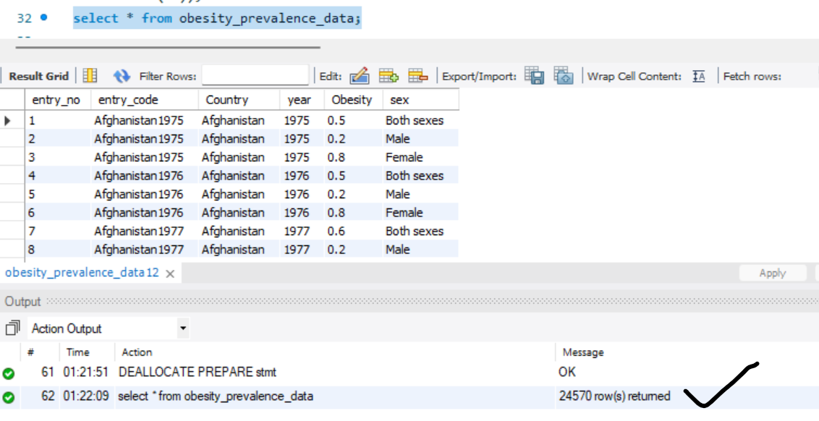
IMAGE OF LOADING OBESITY PREVALENCE INTO MYSQL WORKBENCH

Slide 8
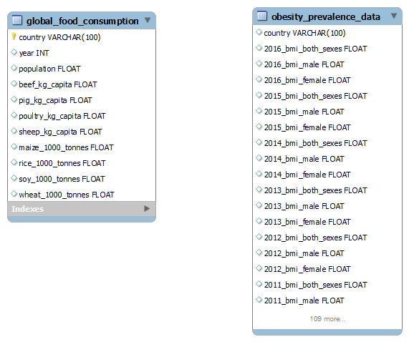
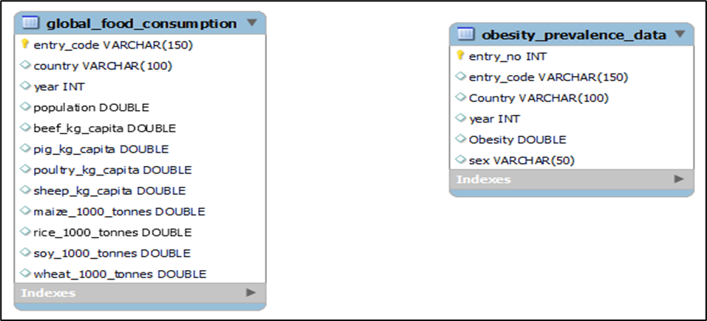
IMAGE OF ER DIAGRAM OF DATASETS
AFTER CLEANING
BEFORE CLEANING

Slide 9
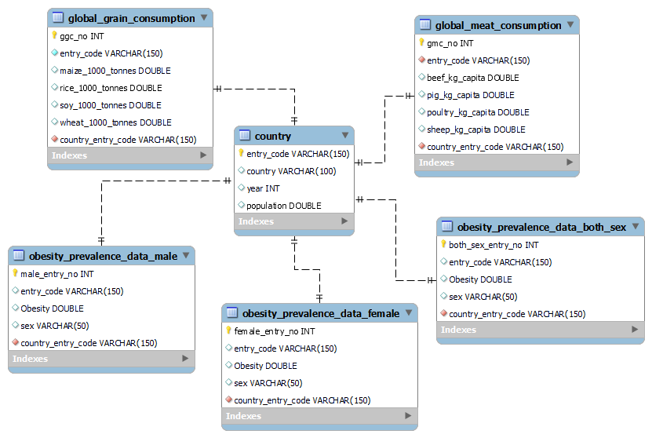
IMAGE OF RELATIONAL DATABASE ERD FOR VISUALIZATION AND ANALYSIS

Slide 10
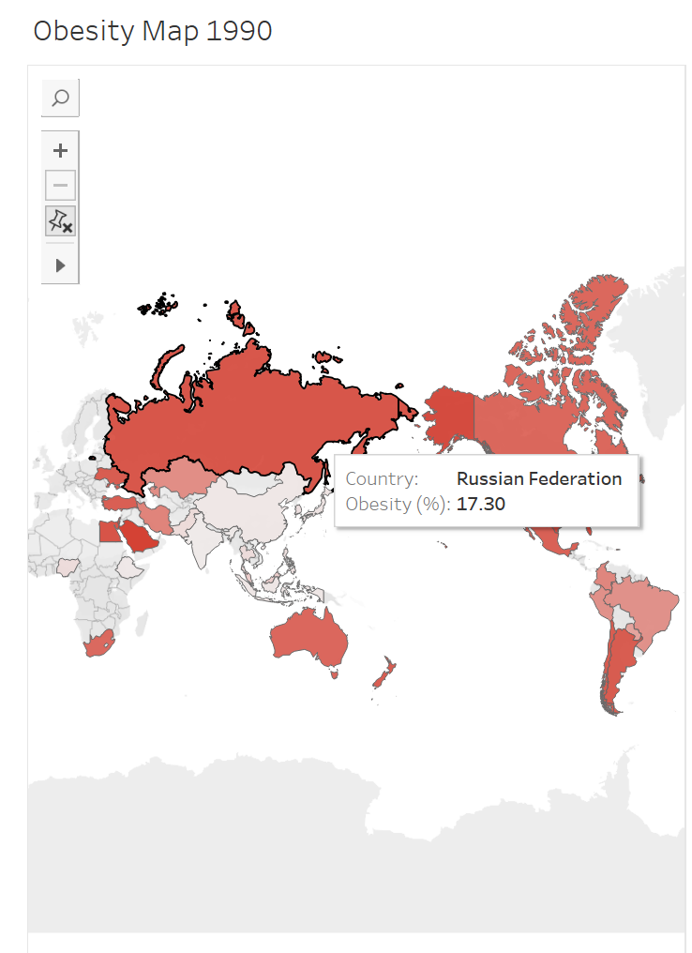
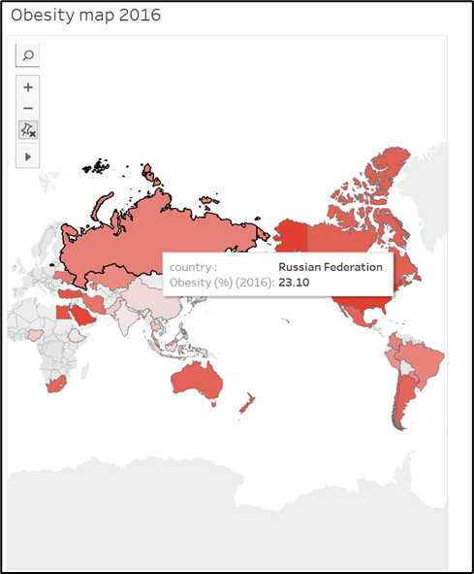
Data Visualization for the Raw Data:

Slide 11
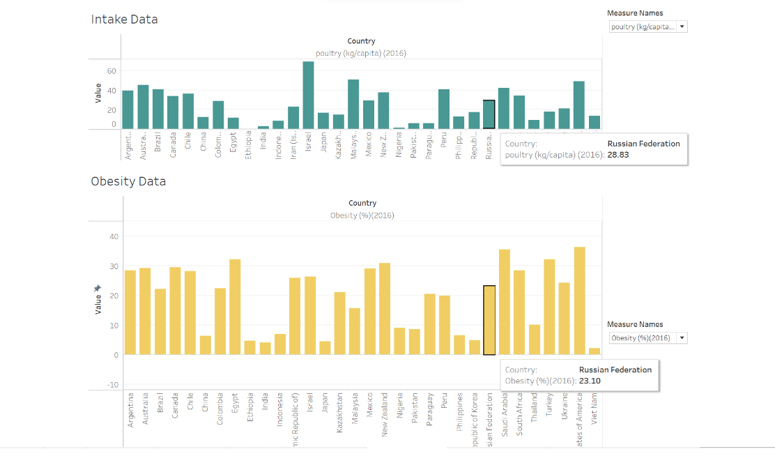
BAR GRAPH for the Raw Data:

Slide 12
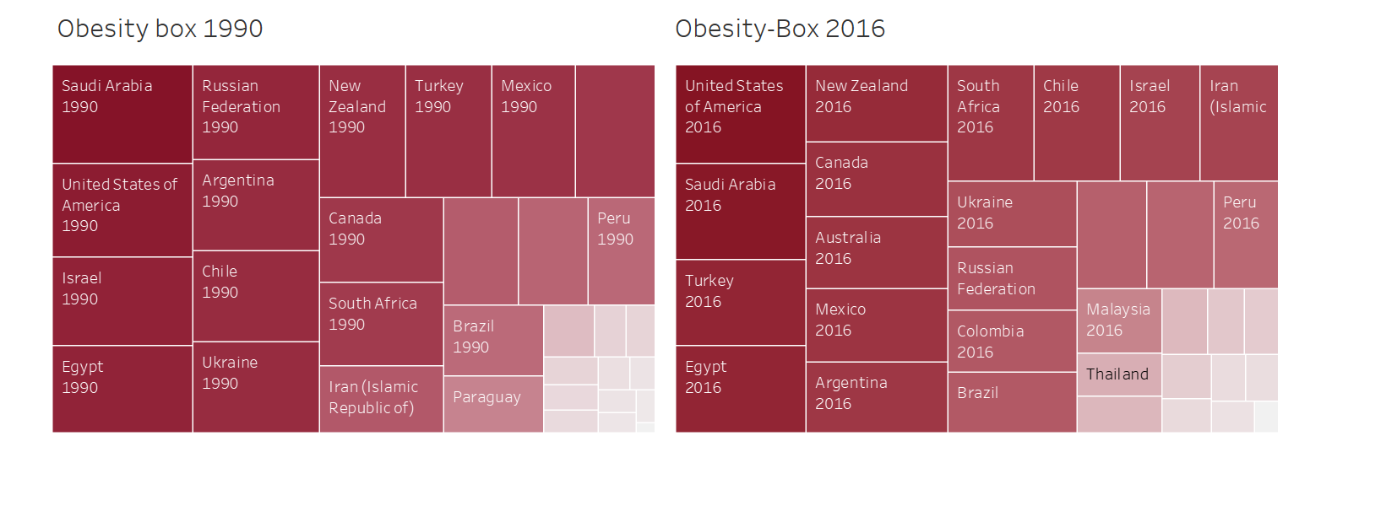
TREE MAP FOR BOTH DATASETS:

Slide 13
Database Challenges & limitations:
Limited Data Scope: The consumption dataset only includes 35 countries, which may not provide a complete picture of worldwide consumption patterns and their impact on obesity.
Exclusion of European countries: The consumption data does not include any European countries, which could lead to biased results.
Exclusion of Children: As obesity rates among children are increasing, excluding them from the study could limit the understanding of current trends.
Missing Data: The absence of data on fruit and vegetable consumption may limit the insights that can be drawn from the analysis.
Data Age: The data only extends up to 2016, which may not reflect the current situation accurately.
Data Collection Methods: The lack of information on data collection methods raises questions about the study's authenticity and reliability.
Limited Analysis: Comparing raw consumption items with obesity rates may not provide enough information to identify the primary drivers of obesity, requiring further analysis.

Slide 14
FUTURE SCOPE AND DEVELOPMENT:
Live dashboard and graphs with updated data would aid in tracking obesity.
Messaging or notifications in the tool would improve its performance and impact.
Including all countries in the consumption data would provide a more comprehensive understanding.
Including data on all age groups would enable tracking of obesity severity across different age groups.
Vegetable and fruit consumption data would enable more precise comparisons among different consumption items and obesity.

Slide 15
REFERENCES:
Seidell, J. C., & Rissanen, A. M. (2003). Prevalence of obesity in adults: the global epidemic. In Handbook of obesity (pp. 109-124). CRC Press.
Zhao, W., Zhai, Y., Hu, J., Wang, J., Yang, Z., Kong, L., & Chen, C. (2008). Economic burden of obesity‐related chronic diseases in Mainland China. Obesity reviews, 9, 62-67.
Peralta, M., Ramos, M., Lipert, A., Martins, J., & Marques, A. (2018). Prevalence and trends of overweight and obesity in older adults from 10 European countries from 2005 to 2013. Scandinavian journal of public health, 46(5), 522-529.
Arora, M., Shinde, S., & Patwardhan, R. (2017). Prevalence of overweight or obesity in adolescent school children from Pune, India. Imperial Journal of Interdisciplinary Research, 3(3), 1272-1276.
Popkin, B. M., & Doak, C. M. (1998). The obesity epidemic is a worldwide phenomenon. Nutrition reviews, 56(4), 106-114.
Williams, E.P., Mesidor, M., Winters, K. et al. Overweight and Obesity: Prevalence, Consequences, and Causes of a Growing Public Health Problem. Curr Obes Rep 4, 363–370 (2015

