Slide 1
Tod Casasent
CI/CD for Research and Development
Reproducibility via Docker and GitLab 2024-03-21-1030

Slide 2
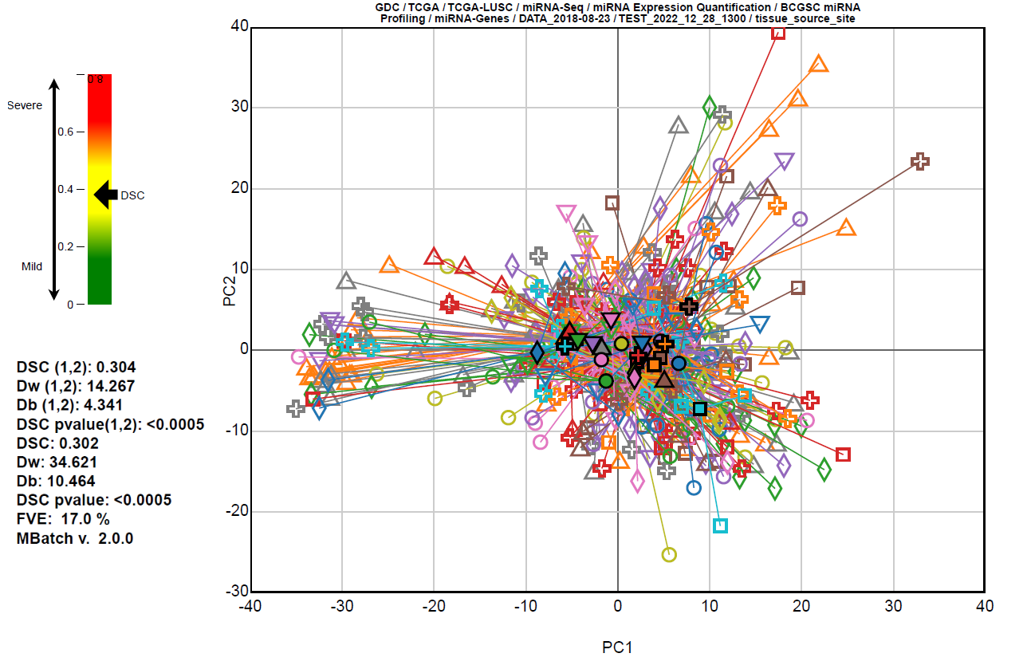
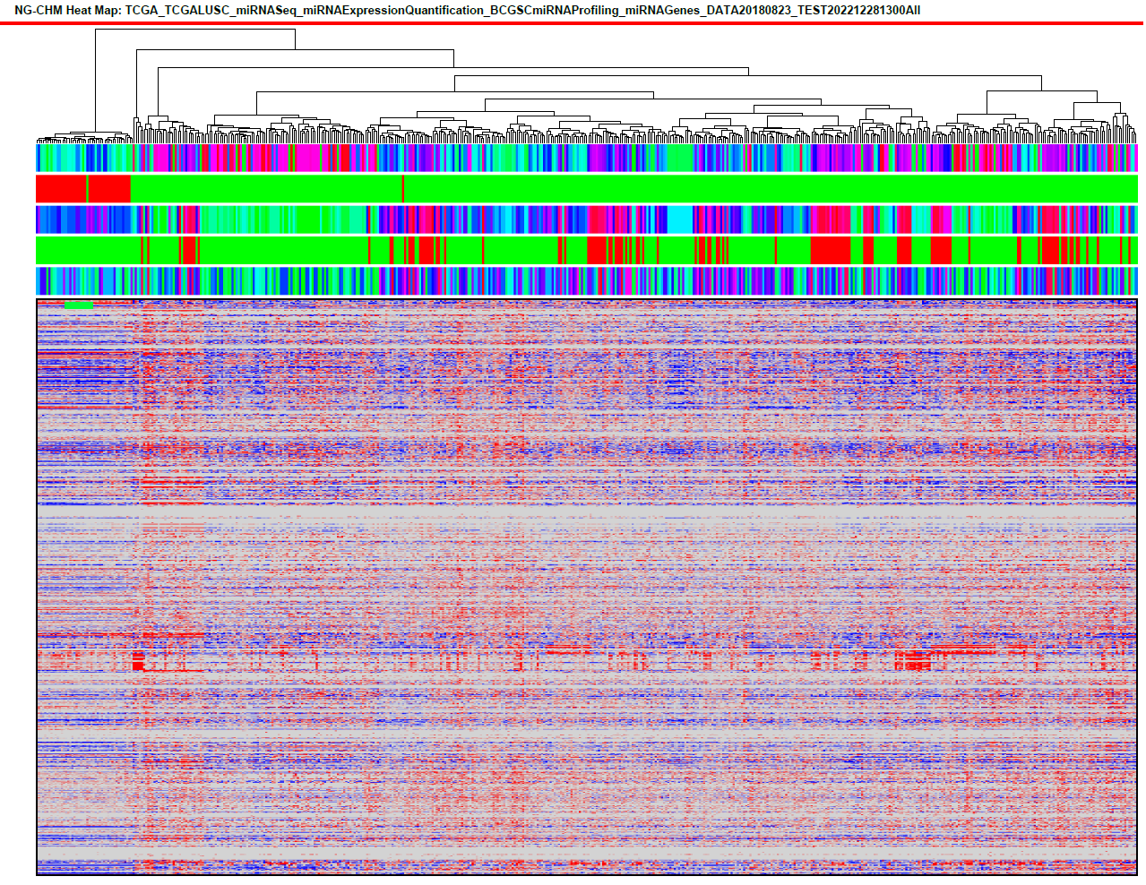
As used in the Batch Effects Project
http://bioinformatics.mdanderson.org/main/TCGABatchEffects:Overview

Slide 3
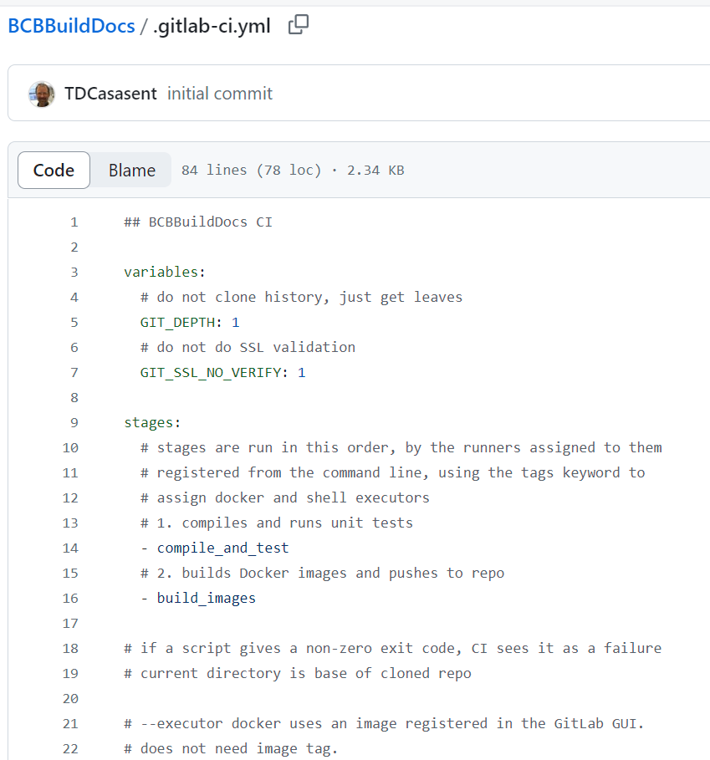
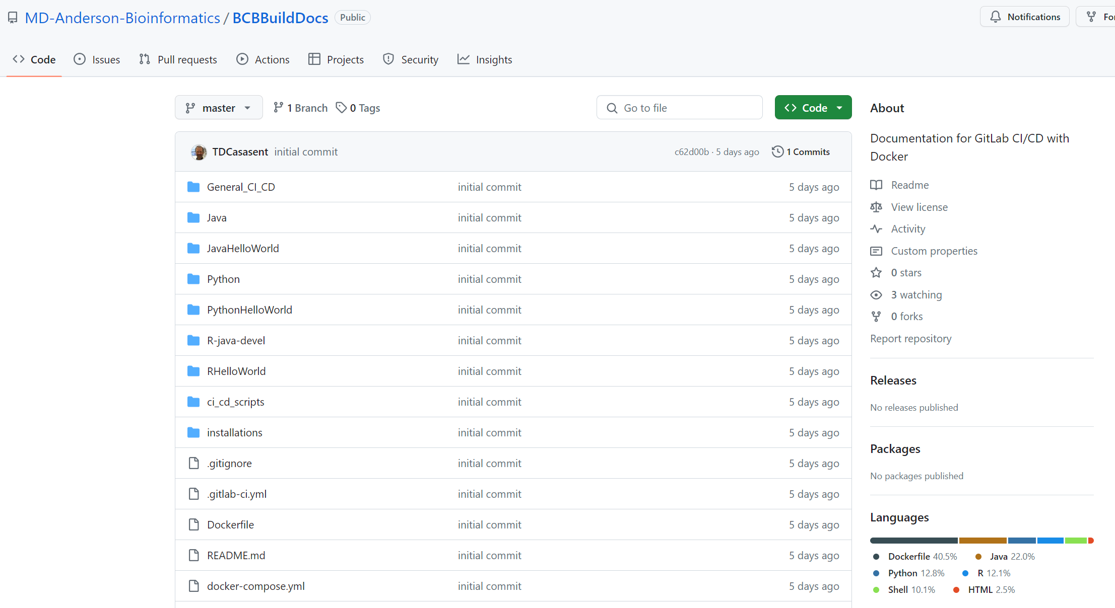
Slides (standalone) and step by step runnable examples online
https://github.com/MD-Anderson-Bioinformatics/BCBBuildDocs

Slide 4
Overview
Intro to CI/CD
Gitlab CI/CD
Workflow Overview
Notes
Other Links

Slide 5
Introduction to CI/CD

Slide 6
Introduction to CI/CD
Git, GitLab, and Docker
Git is a source code repository.
It stores versioned instances of your code.
It lets you tag versions of the code with particular strings.
GitLab is a GUI front end to Git.
It also adds issue tracking and CI/CD.
Docker lets you build virtual images of servers.
Increases reproducibility by providing the same environment long-term.
Docker Hub (or a Docker Registry) stores many Docker images.
Allows users to pull images down to other Docker servers and run them.

Slide 7
Introduction to CI/CD
Introduction
https://www.jetbrains.com/teamcity/ci-cd-guide/
CI is Continuous Integration - an automated process to pull code releases from a repo and perform builds and testing on the code
CD is Continuous Deployment - an automated process to similarly pull code releases from a repo and build deployable deliverables.
The same images are used in development, stage, and production, so development and stage testing of the images remain valid.

Slide 8
Introduction to CI/CD
Consistent Environments
Docker can use same version of operating system, packages, libraries between builds.
Share the same image via Docker Hub.
Reproducible Executables and Testing
Automated builds and testing make code reliable. (Or, at least as reliable as the tests.)
Without human intervention, no changes are unintentionally or intentionally introduced.
Linked to Code Repository
Linking CD to a repository tag means exact version of code is always known.
Bugs and processing issues are more readily linked to code.

Slide 9
GitLab CI/CD
Setup for CI/CD
Post-Cleanup for CI/CD
CI/CD Application Builds and Unit Tests

Slide 10
GitLab CI/CD Setup for CI/CD Part 1
GitLab Documentation explaining CI/CD
Well-documented by GitLab at https://docs.gitlab.com/ee/ci/
Central IT moving away from GitLab, similar is available via GitHub and our Kubernetes group.
Register GitLab Runners
Runs on CI/CD Server – compiles/builds deliverables
On CI/CD Server, register one runner to run in a Docker image
Use “--executor docker” and “--tag-list” docker to register
Use “--docker-image” to register Docker image
On CI/CD Server, register an OS runner
Use “--executor shell” and “--tag-list shell”
.gitlab-ci.yml setup
Build a YAML file named .gitlab-ci.yml and place it into the root directory of your repo
By convention, in the first line of my GitLab CI YAML files, I put in a comment indicating for which repository this is a CI YAML
This becomes useful when debugging or comparing files
sudo gitlab-runner register -n \
--url https://your.gitlab.server/ \
--registration-token YOURregistrationTOKEN \
--tag-list docker \
--executor docker \
--description "CI Compile and Unit Test" \
--docker-image "your.docker.repo.server:5000/docker_group/docker_image:latest"

Slide 11
GitLab CI/CD Setup for CI/CD Part 2
BCB Processing Step One
Compile and run unit tests on applications and code.
Build a job artifact of compiled apps and other files.
Uses a “build” Docker image.
BCB Processing Step Two
Use job artifact to build Docker image.
Uses server OS, to avoid issues with building Docker images within Docker.

Slide 12
GitLab CI/CD Setup for CI/CD Part 3
GitLab CI File: Variables Section
GIT_DEPTH: 1 only downloads leaf.
GIT_SSL_NO_VERIFY: 1 no SSL validation.
GitLab CI File: Stages Section
The two stages (jobs) are run in order listed
Stages correspond steps from previous slide
The first stage is named compile_and_test
The second stage is named build_images
The next sections link these names to script commands.
.gitlab-ci.yml
variables:
# do not clone history, just get leaves
GIT_DEPTH: 1
# do not do SSL validation
GIT_SSL_NO_VERIFY: 1
stages:
# stages are run in this order, # by the runners assigned to them
# registered from the command line,
# using the tags keyword to
# assign docker and shell executors
# 1. compiles and runs unit tests
- compile_and_test
# 2. builds Docker images and pushes to repo
- build_images

Slide 13
GitLab CI/CD Setup for CI/CD Part 4
GitLab CI File: Compile and Test Job
Job entry names end with "_job“
The code here is for the compile_and_test stage.
Note the details in the docs – useful when debugging.
"compile_and_test_job" is job name (based on the stage name).
"only: - /^BCB_.*$/" indicates this job should only be started when a tag of the form "BCB_" is added to the repository.
"tags: - docker" indicates this job has the docker notation tied to the "tags-list" docker entry for the runner
"stage: compile_and_test" indicates stage for this job
Next section is the script section. Any portion of the script section with a non-zero exit code is seen as a failure.
The artifacts section includes a file name and the paths to be included.
.gitlab-ci.yml
# --executor docker uses an image registered in the GitLab GUI.
# does not need image tag.
compile_and_test_job:
# this tells job to only run on tags of the form BCB_*
# tag used is available in CI_COMMIT_REF_NAME
only:
- /^BCB_.*$/
# tags here refers to docker/shell tags on runners
tags:
- docker
stage: compile_and_test
# everything under script is run in the Docker container
# fetch/clone is into /builds/BatchEffects_clean/BatchEffectsPackage
script:
- hostname
- pwd
- whoami
- id
- env
- echo $0
- CUR_DUR_DQS=`pwd`
- echo ${CUR_DUR_DQS}
- ls -l ${CUR_DUR_DQS}
- ls -l ${CUR_DUR_DQS}/ci_cd_scripts
# run build script
- ${CUR_DUR_DQS}/ci_cd_scripts/build_apps.bash "${CUR_DUR_DQS}"
# copy files to artifact directory
- mkdir ${CUR_DUR_DQS}/art_bcbbuilddocs
- ${CUR_DUR_DQS}/ci_cd_scripts/build_copy.bash "${CUR_DUR_DQS}" "${CUR_DUR_DQS}/art_bcbbuilddocs"
# use "top-level for repo" directory names for artifact
# and GitLab CI automatically copies those directories to next job
artifacts:
name: ${CI_COMMIT_REF_NAME}
paths:
- art_bcbbuilddocs
expire_in: 1 week

Slide 14
GitLab CI/CD Post-Cleanup for CI/CD
GitLab CI File: Build Images Job
Unique section here is the “after_script” section.
The "after_script" portion is called in the host server shell after the build is complete (or failes).
The clear images script performs a “docker rmi” to remove any images built by the job. (It uses the fact that all the images have my local Docker Registry in the name.)
.gitlab-ci.yml
# artifacts (only thing needed here) are carried over
build_images_job:
# this tells job to only run on tags of the form BCB_*
# tag used is available in CI_COMMIT_REF_NAME
only:
- /^BCB_.*$/
# tags here refers to docker/shell tags on runners
tags:
- shell
stage: build_images
script:
- hostname
- pwd
- whoami
- id
- env
- echo $0
- CUR_DUR_DQS=`pwd`
- echo ${CUR_DUR_DQS}
- ls -l ${CUR_DUR_DQS}
# build MBatch image
- ${CUR_DUR_DQS}/ci_cd_scripts/build_images.bash "${CUR_DUR_DQS}"
after_script:
- CUR_DUR_DQS=`pwd`
- echo ${CUR_DUR_DQS}
- ${CUR_DUR_DQS}/ci_cd_scripts/clear_images.bash

Slide 15
GitLab CI/CD CI/CD Application Builds and Unit Tests
GitLab CI File: Build and Test
Happens in Docker build image
Regardless of your coding language, they all support some sort of unit testing you can use in CI.
Java can use JUnit.
Python can use the unittest option.
In R, “check” runs the contents of the “tests” directory.
It also runs the code in the manual/docs.
And vignettes are particularly useful for running more complex tests.
Build and Test Bash Script
# Use Maven to compile and JUnit to test Java code
# run from source code directory
mvn clean install dependency:copy-dependencies
# Use Python to compile and unit test Python code
# run from source code directory
python -m unittest test_world.TestHelloWorld
# Use Pyinstaller to create Python executable
# run from source code directory
pyinstaller ./app.py --onefile –noconfirm
--name python_hello_world
--collect-all flask
--collect-all waitress
# Use R to build tar.gz of R Package (does some testing)
# run from source code directory
R CMD build RHelloWorld
# Use R to run “check” (does more testing)
R CMD check RHelloWorld_*.tar.gz
# Use R to “INSTALL” (does final testing)
R CMD INSTALL RHelloWorld_*.tar.gz

Slide 16
Java, Python, and R Installs CI/CD Installations
Details for Installing Java, Python, and R in a Dockerfile
https://github.com/MD-Anderson-Bioinformatics/BCBBuildDocs
Automated, no human interaction
Each section covers
Automated installation without human intervention
Automated testing
How to run the application

Slide 17
Workflow Overview
General Overview

Slide 18
Notes Workflow Overview
CI/CD Build Docker Image
Push Image to PROD Registry
CI/CD Push Image to DVLP Registry
SysAdmins Pull Image to STAG Server
SysAdmins Pull Image to PROD Server
Pull Image to DVLP Server
STAG User Acceptance of Docker Image
PROD User Acceptance of Docker Image
DVLP Test Docker Image

Slide 19
Notes
HPC and Singularity

Slide 20
Notes HPC and Singularity
Building Singularity Image from Docker Image
Generally speaking, because of security concerns (the ability to get root), rather than using Docker, most HPC and similar setups will use Singularity images/containers rather than Docker. The good news is, you can create a Singularity image from a Docker image.
To create a Singularity sif file, we use Docker Registry 2.7. The older version is used as it allows us to do this without needing HTTPS setup.
We first start the Docker Registry. Then we push the image to the registry.
Then run "singularity build" to create the SIF file from the Docker registry. Then we can stop the registry.
Singularity from Docker Image
# start the Docker registry
docker run -d -p 5000:5000 --restart always --name registry registry:2.7
# push your image to the registry
docker push localhost:5000/myimage:VERSION
# build the Singularity SIF image.
# (sudo may or may not be required)
sudo singularity build
--nohttps myimage_VERSION.sif
docker://localhost:5000/mbatchhpc/myimage:VERSION
# then you can stop registry, which wipes out pushed image
# registry does not have convenient way to clear old images
docker stop registry

Slide 21
Other Links

Slide 22
Other Links
GitHub BCBBuildDocs Repo
Additional documentation, code, and examples.
https://github.com/MD-Anderson-Bioinformatics/BCBBuildDocs
Batch Effects Projects
https://github.com/MD-Anderson-Bioinformatics/BatchEffectsPackage
Next Generation Clustered Heatmap Project
https://www.ngchm.net/

Slide 23
Funding This work was supported in part by: U.S. National Cancer Institute (NCI) grant: Weinstein, Broom, Akbani. Computational Tools for Analysis and Visualization of Quality Control Issues in Metabolomic Data, U01CA235510 U.S. National Cancer Institute (NCI) grant: Akbani, Weinstein, Broom. A Genome Data Analysis Center Focused on Batch Effect Analysis and Data Integration, U24CA264006 U.S. National Cancer Institute (NCI) grant: Weinstein, Mills, Akbani. Batch effects in molecular profiling data on cancers: detection, quantification, interpretation, and correction, U24CA210949 U.S. National Cancer Institute (NCI) grant: Weinstein, Broom. "Next Generation" Clustered Heat Maps for Fluent, Interactive Exploration of Omic Data, U24CA199461 U.S. National Cancer Institute (NCI) grant: Weinstein, Mills, Akbani. Integrative Pipeline for Analysis & Translational Application of TCGA Data (GDAC), U24CA143883 The Michael & Susan Dell Foundation The H.A. and Mary K. Chapman Foundation

