Slide 1

Computer Network
Spring 2020
Prof./Dr. Shen Bichuan
School of Electrical and Electronic Engineering Chongqing University of Technology

Slide 2
What is this Course All About
Fundamental principles of Computer Networks
First course – Broad coverage of topics (important topics in depth)
Topics categorized to:
network architectures and technologies
protocols
applications
We will not discuss specific implementations: e.g., how to configure the latest cisco routers

Slide 3
Why Learn about Networking?
Indispensable part of modern society
Commercial – e-commerce, banking, inventorying, telecommunications, archiving, health
Social – critical infrastructure, homeland security, policing
Human interaction/communication – email, chat, videoconferencing, social networking, entertainment

Slide 4
Why Learn about Networking?
Appears in every facet of engineering
Modern trend – Network every (electronic) device (computers, phones, sensors, planes, cars, TVs, appliances, heart monitors, …)
Prolific field to pursue graduate studies
Many problems remain unsolved
Research funding is still strong

Slide 5
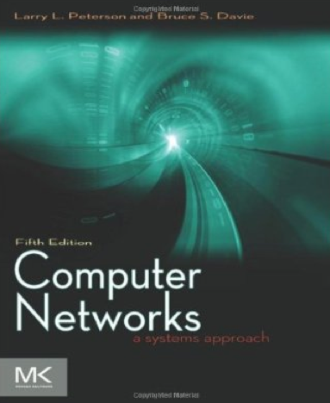
Course Logistics
Textbook
“Computer Networks: A Systems Approach”
L. Peterson, and B. Davie, 5th edition.
Additional References
“Computer Networks”
S. Tanenbaum and D. Wetherall,
5th edition,
Course Website
Lectures, Homework, Useful links,
Supplementary material, Announcements

Slide 6

Where to find me
Office & Hours:
TBD
My Email: shenbc@cqut.edu.cn

Slide 7
Class Expectations
Class participation
Keep up with reading material
Complete assignments and projects on time
Submit clean, organized, and concise reports
Identify potential project partners early (in one week, if possible)
Brush up prior knowledge (Probability theory, C Programming)
Follow academic integrity code

Slide 8
Key to Success
Attendance
Pay attention to lectures and keep extra notes
Ask questions
Effort
Do homework on your own. It’s ok to ask others, but make your own effort
Read extra material on your own. Wealth of information available (library books, online articles, research papers)
Consistency
Keep up with the class pace

Slide 9
Grading Scheme
Homework: TBD
Final Exam: TBD
Assignment | Points
Homework & Labs | 40
Project | 20
Final Exam | 40
Total | 100

Slide 10
Course Objectives
Develop a fundamental understanding of the network design principles and performance metrics
Become familiar with the mechanisms and protocols for reliable data communication via a computer network
Be able to evaluate the performance of various network technologies and protocols
Think as an engineer: Can specify, characterize, and design network, and understand what technologies should be employed to build a network with particular specifications?
Develop interest in performing research in the area of Computer Networks

Slide 11
Topics to be covered
Network architectures, performance metrics, layering
Medium access control
Internetworking, routing
End-to-end protocols, flow control
Congestion control and resource allocation
Applications
Network security

Slide 12
Introduction
Chapter 1

Slide 13
Uses of Computer Networks
Classification based on application domains, areas, and contents etc.
Domains: personal, home, various businesses and industries, education, finance, medical, social, military
Media: wired, wireless, mobile
Contents: text, voice, music, graphic, images, multimedia, hypertext, video (conferencing and streaming)

Slide 14
Applications Examples
Resource Sharing
Common Printer
Backup Systems
VPN (Virtual Private Networks)
Ending the limitation of geographic disperse working environments.
Client - Server

Slide 15
Applications
Information and Data Sharing
Many web applications, including social and industries
Online education
Email
VoIP
Video
Tele-Conferencing
Desktop Sharing
Telemedicine
e-commerce
Shopping from home

Slide 16
Applications
Peer-to-Peer Applications
P2P
Sharing Music and Videos
Email, etc.
Applications that involve interaction between
a person and a remote user
Person-to-person communication

Slide 17
Applications
Person – to – Person Communication
Audio + Video (Wechat, QQ)
Instant Messaging (Wechat, QQ, Twitter)
Online Audio and Music (Radio Channels, Ximalaya, QQ Music, Kugou)
Online Video (Tencent Video, Baidu Video, YouTube)
Telelearning
Social Networking:
Wechat, QQ
Facebook, Linkedin
Wiki – Wikipedia
Home Shopping (Taobao, JD, Suning, Amazon)
Finances (Online Banking,支付宝, Wechat)
Online auctions (eBay)

Slide 18
Applications
Entertainment:
MP3 and DVD-quality movies
TV shows – IPTV (IP TeleVision)
Interactive Live Digital TV
Game Playing
Multiperson real-time simulation games.
Ubiquitous Computing
Smart Home Monitoring
RDIF (Radio Frequency Identification)
Replacing Bar Codes with a smart deivices that my turn the real world inot the Internet of things.

Slide 19
Mobile Applications
Mobile computers (handheld and laptops)
Fastest growing segments in computer history.
Individuals are able to use their mobile devices to:
Read and send email,
Tweet,
Watch Movies,
Download Music,
Play Games,
Serf the Web
Internet connectivity allows for those applications to be easily built
Wireless Networks (Cars, Boats, and Airplanes can not have wired Connections)
Cellular Networks
Wireless hotspots (802.11 Standard).
Wireless Networking vs. Mobile Wireless Networks

Slide 20
Mobile Uses
Smart Phones – Integration of Internet with Telephony
Driving the wireless-mobile applications
3G & 4G cellular networks provides fast data services
GPS is a standard feature
m-commerce (mobile commerce)
NFC (Near Field Communication) smart phones act as an DFID smartcard and interact with nearby reader for payment.
Sensor Networks
Notes that Sense/gather data about state of the physical world.
It is revolutionizing science
Wearable Computers
Implantable Devices
Pacemakers, Insulin pumps, …
Controllable wirelessly

Slide 21
Functions Need to Achieve
Addressing: finding destination, MAC/NET layer in OSI model
Connecting: establishing connection between source to destination, PHY/MAC/NET
Transmission: from start to finish
Negotiating: protocol
Managing: large system, network function correctly, devices, nodes, links, servers, bandwidth allocation, managed centrally or by multiple entities
Configuring: devices and services
Arbitrating: conflicting access or collision

Slide 22
Requirements and Challenges
Connectivity, Scale and Scalability, Efficiency, Reliability, Managibility
Usability:
Scalability: extension and expansion, growing rapidly and uncontrollably
Flexibility:
Quality: system metrics and individual QoS across network, many impacted factors

Slide 23
Requirements and Challenges
Fairness: access and load fairness, schedule and priority
Reliability: failures including bit errors, burst, block or packet errors, node or link cutoff, complicated by limited resources, heterogeneous devices and nodes, software and networks
Complexity
Security and threat: cybersecurity issues and solutions
Coverage: broad and wide

Slide 24
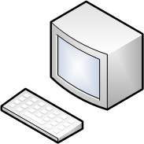

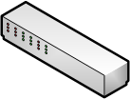
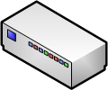
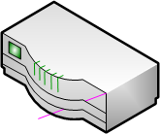
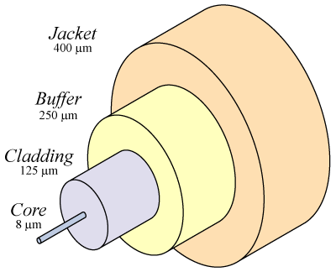
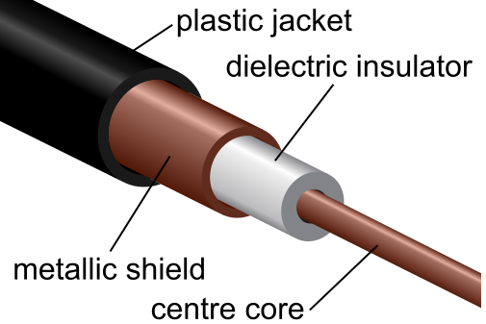

Network Elements
Nodes: Special purpose devices
Links: Connections between nodes
PC
server
switch
bridge
router
Optical fiber
Coaxial cable
wireless

Slide 25
Network Design
The task of connecting nodes via links, so that nodes can exchange information, reliably, timely, efficiently, safely, privately, and with low cost.
Need to define the network architecture, protocols, applications, interfaces, policies, usages.
Let’s start with the architecture
Directly connected networks
Circuit-switched networks
Packet-switched Networks

Slide 26
What Drives Network Design?
Applications
WWW, email, chat, videoconferencing, e-commerce, audio/video streaming, VOIP, file sharing
Who deploys the network
Enterprise, government, end-user
Where is the network deployed
Home, building, company, organization, city, country, international

Slide 27
How do we Evaluate a Network
Metrics (think again a transportation network)
How many cars can it service (throughput)?
How fast can it service them (delay)?
How reliable can it service them (collisions, losses, outage probabilities, etc)?
Can it provide any guarantees (QoS)?
Any other metrics you can think of?

Slide 28
Directly-Connected Networks
Point-to-point links: Each node is directly connected to all others via a link
Multiple access: All nodes share the same physical medium
point-to-point
multiple access

Slide 29
Switched Networks
Circuit-Switched
A dedicated circuit is established across a set of links
Example: Telephone network
Packet-Switched
Data is split into blocks called packets or messages.
Store-and-forward strategy
Switches: Store and forward packets
terminal/
host
switch

Slide 30
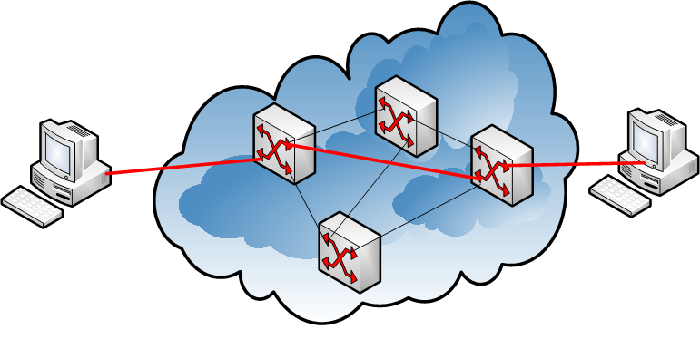
Circuit-Switched Networks
End-to-end permanent connection
Dedicated path for communication
No need for a destination address since a path is already established
Once communication is complete, connection is ended and links are released.

Slide 31
Advantages of Circuit Switching
Guaranteed bandwidth (Quality of Service)
Predictable bitrate and delay
Good for delay-sensitive applications
Reliable communication
Rare packet loss
Packets are delivered in order
Simple data routing
Forwarding based on time slot or frequency (multiplexing)
No need to inspect a packet header for address
Low per-packet overhead
Forwarding based on time slot or frequency
No IP (and TCP/UDP) header on each packet

Slide 32
Disadvantages of Circuit Switching
Wasted bandwidth
Bursty traffic leads to idle connection during silent period
Blocked connections
Connection refused when resources are not sufficient
Unable to offer “okay” service to everybody
Connection set-up delay
No communication until the connection is set up
Unable to avoid extra latency for small data transfers
Network state
Network nodes must store per-connection information
Unable to avoid per-connection storage and state

Slide 33
Packet Switched Networks
Data is divided into packets (messages)
Each packet contains identification info (source/destination address seq. number, etc)
Packets traverse the network individually
Use the destination address to forward packets
May use more than one routes, nodes may store packets temporarily

Slide 34
Advantages of Packet Switching
No wasted bandwidth (not entirely true)
Links are not reserved during idle period
Multiplexing (see next slides)
Frequency, time, statistical multiplexing
Service
More connections of lesser quality
No blocking of users
Adaptation
Can adapt to network congestion and failures

Slide 35
Multiplexing
Three pairs of senders/receivers share the same physical link to communicate
A switch is multiplexing packets from different senders into one packet stream

Slide 36
Multiplexing Methods
Time Division Multiplexing
Frequency Division Multiplexing
S₁
S₂
S₃
S₁
S₂
S₃
S₁
S₂
S₃
S₁
S₂
S₃
time
frequency
f₃
S₃
f₂
S₂
f₁
S₁
time

Slide 37
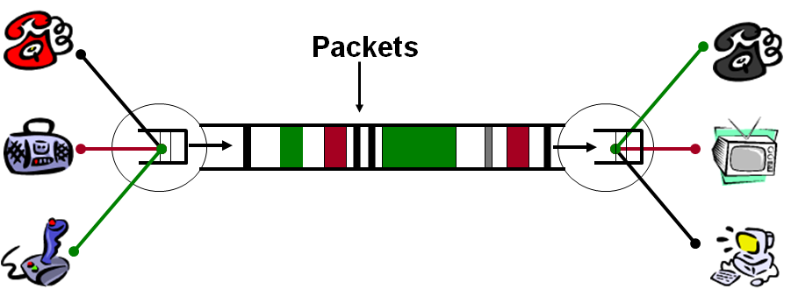
Multiplexing Methods
Statistical multiplexing
Division of the communication medium into a number of channels of variable bandwidth

Slide 38
Disadvantages of Packet Switching
No guaranteed bandwidth
Harder to build applications requiring QoS
Per packet overhead
Need a header with source/dest. address, etc.
Complex end-to-end control
Packets can be lost, corrupted or delivered out-of-order
Delay and Congestion
No congestion control, can lead to arbitrary delays and packet drops

Slide 39
Network Hardware (1)
Personal area networks
Local area networks
Metropolitan area networks
Wide area networks
The internet

Slide 40
Network Hardware
Transmission Technology
Scale

Slide 41
Network Hardware
Two types of transmission technologies:
Broadcast
Communication channel shared by all machines
Packets send by any machine are received by all the others.
An address field within each packed specifies the intended recipient.
If packed is intended for some other machine, it is just ignored
If packed is indented for the recipient machine then it is processed.
Wireless network is a common example of a broadcast link
Communication is shared over a coverage region that depends on the wireless channel and the transmitting machine.
Broadcast systems usually also allow the possibility of addressing a packet to all destinations.
Point-to-point
Connect individual pairs of machines
Packets (short messages) may have to visit one or more intermediates machines.
Multiple routes of different lengths are possible.
Finding good ones is important.
Unicasting – transmission with exactly one sender and exactly one receiver.

Slide 42
Network Hardware
Alternative Criteria: Scale
Distance is important as a classification metric because different technologies are used at different scales.

Slide 43
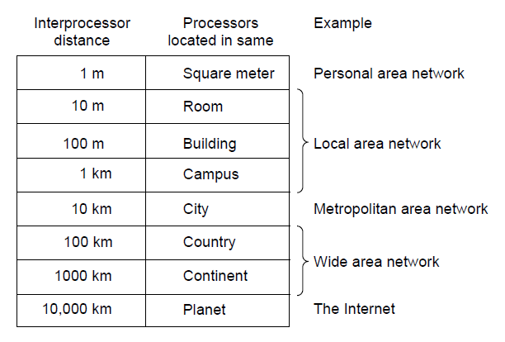
Network Hardware (2)
Classification of interconnected processors by scale.

Slide 44
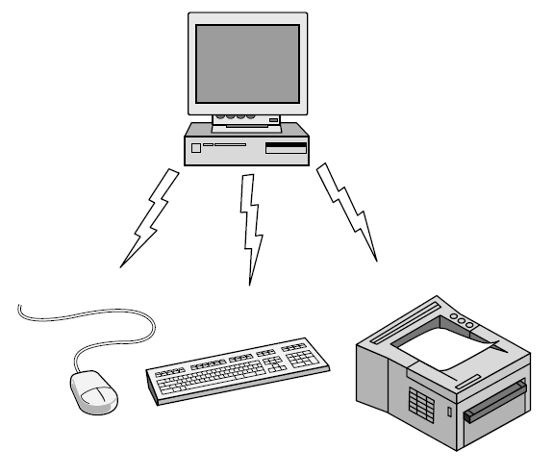
Personal Area Network
Bluetooth PAN (Personal Area Network) configuration

Slide 45
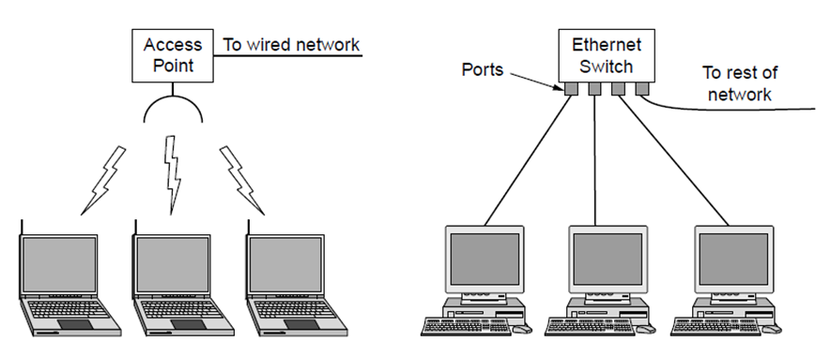
Local Area Networks
Wireless and wired LANs. (a) IEEE 802.11 or WiFi.
(b) Switched Ethernet (802.3).

Slide 46
Local Area Networks (LAN)
Switched Ethernet
Switch; Hardware that connects two devices point-to-point
A Switch has multiple ports
Physical vs. Virtual LAN – VLAN
Dynamic vs. Static Channel Allocation
Static Allocation: Each device is allocated its time slot weather or not it uses it.
Dynamic methods allow changing the time allocation scheme.
Dynamic Allocation
Centralized
Decentralized

Slide 47
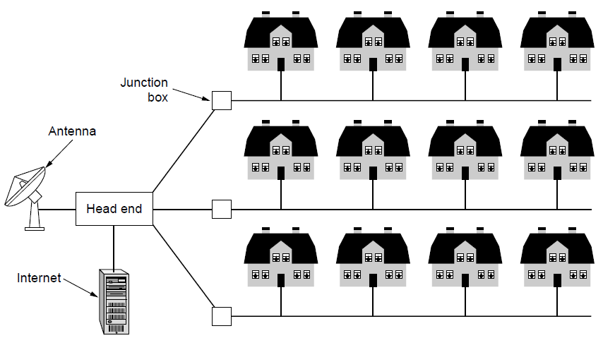
Metropolitan Area Networks
A metropolitan area network based on cable TV.

Slide 48
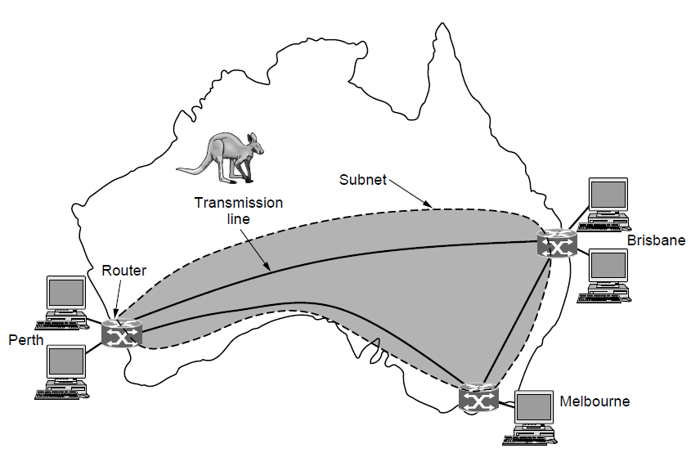
Wide Area Networks (1)
WAN that connects three branch offices in Australia

Slide 49
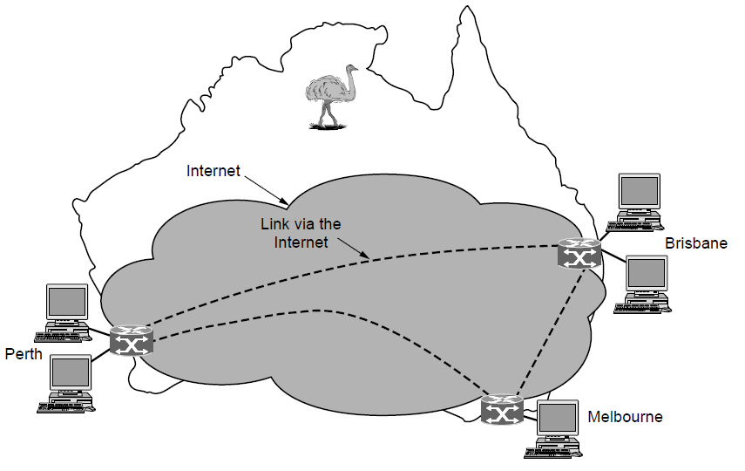
Wide Area Networks (2)
WAN using a virtual private network.

Slide 50
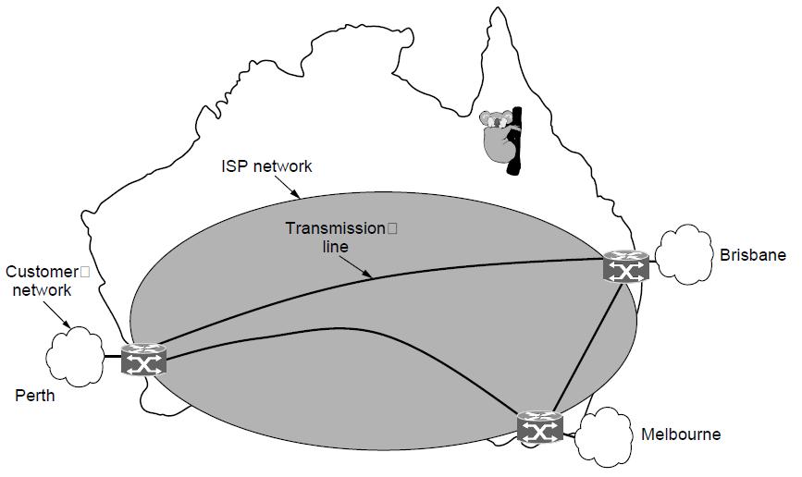
Wide Area Networks (3)
WAN using an ISP network.

Slide 51
Network Software
Protocol hierarchies
Design issues for the layers
Connection-oriented versus connectionless service
Service primitives
Relationship of services to protocols

Slide 52
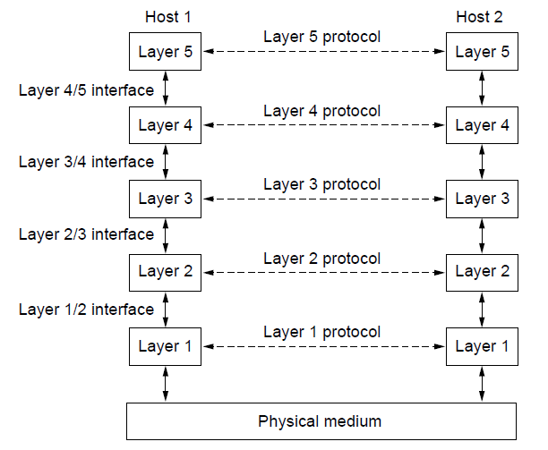
Protocol Hierarchies (1)
Layers, protocols, and interfaces.

Slide 53
Definitions
Protocol – is an agreement between the communicating parties.
Peers – the entities comprising corresponding layers on different machines.
Peers use the protocol to communicated with each other.
No data is directly transferred from layer n on one machine to layer n on another machine.
Each Layer passed data and control information to the layer immediately below it until the lowest layer is reached.
Below layer 1 is the physical medium through which actual communication occurs.
Virtual communication is shown by dotted lines and physical communication by solid lines the previous figure.

Slide 54
Definitions
Interface
It defines which primitive operations and services the lower layer makes available to the upper one.
Network Architecture:
A set of layers and protocols.
The specification of the network architecture must contain enough information to allow an implementation of the program or the hardware for each layer so that it will obey appropriately the protocol.
Protocol Stack:
The list of protocols used by a certain system – one protocol per layer.

Slide 55
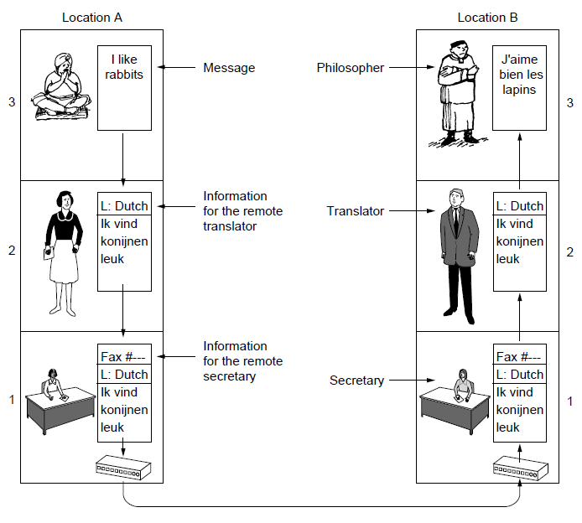
Protocol Hierarchies (2)
The philosopher-translator-secretary architecture

Slide 56
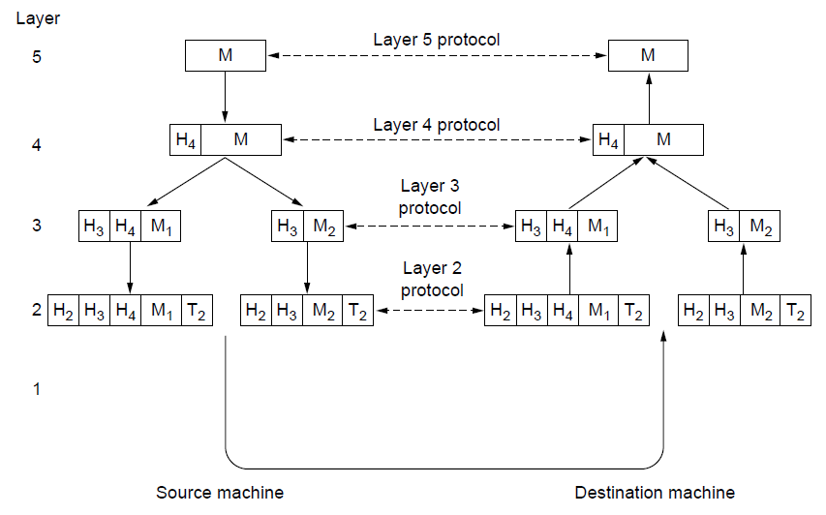
Protocol Hierarchies (3)
Example information flow supporting virtual communication in layer 5.

Slide 57
Protocol Hierarchies (3)
The peer process abstraction is crucial to all network design.
Level 4 protocol conceptually think of their communication as being “horizontal”:
SendToOtherSide
GetFromOtherSide

Slide 58
Design Issues
Reliability:
Network must operate correctly although it is made up of a collection of components that are themselves unreliable.
Error Detection:
It typically uses codes to locate the erroneously transmitted bit(s) and request re-transmission.
Error Correction
Correct messages is recovered from the possibly incorrect bit(s) that were originally received.
Routing:
Finding a working path through a network.
Protocol Layering:
Networks grow larger over time and new designs emerge that need to connected to the existing networks.

Slide 59
Design Issues (cont.)
Addressing and Naming:
Every layer needs a mechanism for identifying the senders and receivers that are involved in a particular message.
Internetworking:
Different network technologies often have different limitations:
Not all communication channels preserve the order of messages send on them.
Differences in the maximum size of a message that the networks can transmit.
Scalable:
Designs that continue to work well when the network gets large.
Resource Allocation
Networks work with their resources to provide services to various hosts. If they are not aware of limitations of the networks resources than the network is providing proper resource allocation.
Flow Control
Feedback from the receiver to the sender is often used to alleviate the problem of the sender swamping the slow receiver with data.

Slide 60
Design Issues (cont.)
Congestion:
The problem may occur when the network is oversubscribed because to many computers want to send too much traffic and the network will not be able to deliver them all.
Overloading problem of the network.
One strategy is for each computer to reduce its demand.
Quality of Service
Additional Resources (other then Bandwidth),
Real-time delivery (for applications that require high throughput),
Live Video,
Network Security
How good is the network against different kinds of threats
Eavesdropping,
Confidentiality,
Authentication,
Integrity, etc.

Slide 61
Connection-Oriented Versus Connectionless Service
Layers can offer two different types of service to the layers above them:
Connection-oriented, and
Connectionless

Slide 62
Connection-Oriented Service
Modeled after telephone system:
Pickup-the-phone
Dial the number
Talk
Hang-up
Service User:
Establishes a connection,
Uses a connection (sender pushes objects in at one end and the receiver takes them out at the other end).
In some cases when connection is established, the sender, receiver, and a subnet conduct a negotiation about the parameters to be used:
Maximum message size,
Quality of service required,
Other issues (like …?)

Slide 63
Connection-Oriented Service
A circuit:
Another name for a connection with associated resources such as a fixed bandwidth.

Slide 64
Connectionless Service
Modeled after a postal system:
Each message carries the full destination address, and
Each one is routed through the intermediate nodes inside the system independent of all the subsequent messages.
Different Names for Messages:
Store-and-forward switching: Packet, a message, is processed in full before sending it on the next node.
Cut-through-switching: when the onward transmission of a message at a node start before it is completely received.
Each kind of the Service can be further characterized by its reliability:
A reliable service is implemented by having the receiver acknowledge the receipt of each message.
Acknowledgment service introduces overhead and delays.

Slide 65
Connection-Oriented Service
Example: File Transfer
The owner want to be sure that all the bits arrive correctly and in the same order they were sent.
Almost there are no instances were the consumers prefer service that occasionally scrambles or loses a few bits for the gained speed.

Slide 66
Connection-Oriented Service
Reliable connection-oriented service:
Message Sequences, and
Byte Streams
Message Sequences:
Message boundaries are preserved.
Example: Two 1024 byte messages are sent, the arrive as two distinct 1024-byte messages; Never as one 2048-byte message.
Byte Streams:
Message is send as a stream of bytes with no concepts of message boundaries.
Example: When a 2048-byte message arrives at the receiver there is no way to tell if they were sent as
One 2048-byte message,
Two 1024-byte message, or
2048 1-byte messages.

Slide 67
Example of Applications
The transit delays introduced by acknowledgments are unacceptable:
Digitized voice traffic for Voice-Over-IP (VoIP).
Digitized video conference
Not all applications require connections. Spam:
Spammer does not want to go through the trouble of setting up and latter tearing down a connection to a recipient just to send them one more item.
100% reliability is not essential either.
Datagram:
Unreliable (not acknowledged) connectionless service.
It is analogous to telegram service

Slide 68
Example of Applications
Acknowledged Datagram:
The convenience of not having to establish a connection, but
Reliability essential
Similar to “Return Receipt” for the letter.
Example: Text Messaging on mobile phones
Request-Reply Service:
Sender transmits a single datagram containing a request;
The reply contains the answer.
Example: Mobile phone sending the query to a “map server” to retrieve the map data.

Slide 69
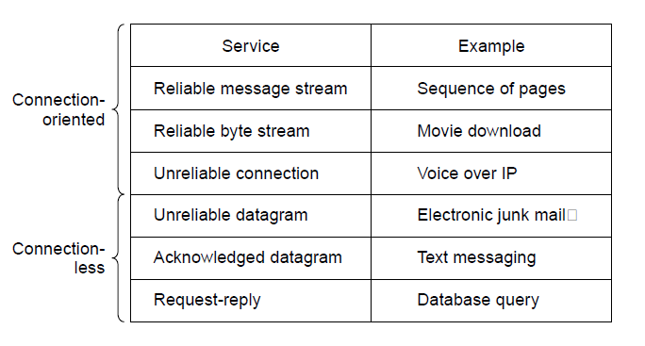
Connection-Oriented Versus Connectionless Service
Six different types of service.

Slide 70
Reliable vs. Unreliable Communication
Why would one prefer unreliable communication vs. reliable one?
Reliable communication may not be available: Ethernet.
Packets can be damaged.
It is up to higher levels of protocol to recover from this problem.
Many reliable services are built on top of the unreliable service.
The delays for providing reliable service are not acceptable:
Real time applications such as multimedia.

Slide 71
Service Primitives (1)
A service is formally specified by a set of primitives (operations).
Primitives are operations that are available to the user processes to access the service.
The set of primitives available are different for connection-oriented services from those of connectionless service.
Example in the next slide

Slide 72
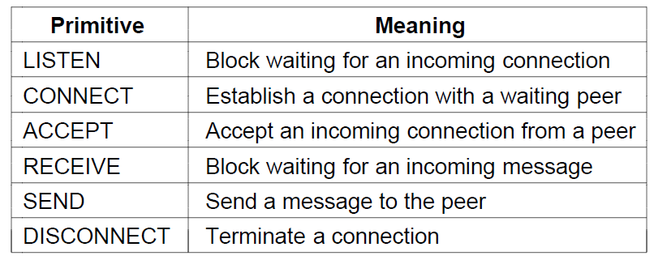
Service Primitives (1)
Six service primitives that provide a simple connection-oriented
service

Slide 73
Service Primitives
The primitives presented in the previous slide might be used for request-reply interaction in a client-server environment:
Server executes LISTEN to indicate that it is prepared to accept incoming connections.
Blocking system call.
The server process is blocked until a request for connection appears.
Client process executes CONNECT to establish a connection (1) with the server.
Specifies who to connect to (parameter giving the server’s address).
OS sends a packed to the peer asking it to connect (See Figure next slide).
Client process is suspended until there is a response.

Slide 74
Service Primitives
The server process can establish the connection by executing ACCEPT primitive (2).
OS sees that the packet is requesting a connection upon reception of the packet.
OS checks to see if there is a listener and if so it unblocks it.
Sends a response back to the client process to accept the connection.
The arrival of this response then releases the client.
At this point both client and server a running and they have connection established.
The server will execute RECEIVE to prepare to accept the first request.
Server does this immediately upon being released from the LISTEN, before acknowledgment can get back to the client.
The RECEIVE is a blocking call.

Slide 75
Service Primitives
The client will execute SEND to transmit its request (3) followed by RECEIVE to get the reply.
The arrival of the request packed at the Server unblocks it so it can handle the request.
After the server has done the work it will issue a SEND to return the answer to the client (4).
The arrival of the this packed unblocks the client which can now inspect the answer.
If further request are required it can make them now.

Slide 76
Service Primitives
When the client is done it executed DISCONNECT to terminate the connection (5).
Initial DICONNECT is a blocking call, suspending the client and sending a packet to the server saying that the connection is no longer needed.
When the server gets the packed it also issues a DISCONNECT of its own, acknowledging the client and releasing the connection (6).
When the server’s packet gets back to the client machine, the client process is released and the connection is broken.

Slide 77
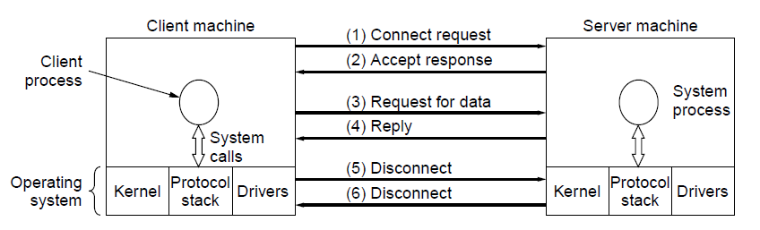
Service Primitives (2)
A simple client-server interaction using acknowledged datagrams.

Slide 78
Service Primitives
Many things can go wrong:
Timing (e.g., CONNECT is done before LISTEN)
Packets can get lost, …
Why not using connectionless service:
Only two (2) packets would be needed vs. six (6), however,
Large messages
Transmission errors
Lost packets
Etc.
Example:
How would the client know whether the last packet actually received was really the last packet sent?

Slide 79
The Relationship of Services to Protocols
A service is a set of primitives (operations) that a layer provides to the layer above it.
The service defines what operations the layer is prepared to perform on behalf of its users, but it does not say anything at all about how these operation are implemented.
A protocol is a set of rules governing the format and meaning of the packets, or messages that are exchanged by the peer entities within a layer.
Entities use protocols to implement their service definitions.
They are free to change their protocols at will, provided they do not change the service visible to their users.
In this way the service and the protocol are completely decoupled.

Slide 80
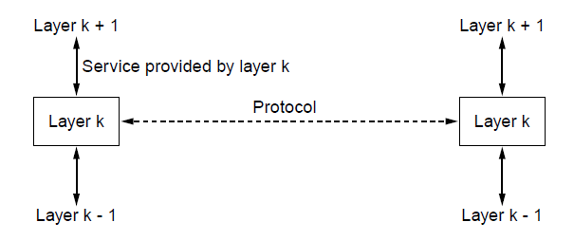
The Relationship of Services to Protocols
The relationship between a service and a protocol.

Slide 81
The Relationship of Services to Protocols
Key Concept:
Services relate to interfaces between layers
Protocols relate to the packets send between peer entities on different machines.
Programming Languages Analogy:
Service is like an abstract data type or an object in an object-oriented language.
It defines operations that can be performed on an object bud does not specify how these operations are implemented.
Protocol relates to the implementation of the service and as such is not visible to the user of the service.

Slide 82
Reference Models
OSI reference model
TCP/IP reference model
Model used for this text
Comparison of OSI and TCP/IP
Critique of OSI model and protocols
Critique of TCP/IP model

Slide 83
The OSI Reference Model
Principles for the seven layers
Layers created for different abstractions
Each layer performs well-defined function
Function of layer chosen with definition of international standard protocols in mind
Minimize information flow across interfaces between boundaries
Number of layers optimum

Slide 84
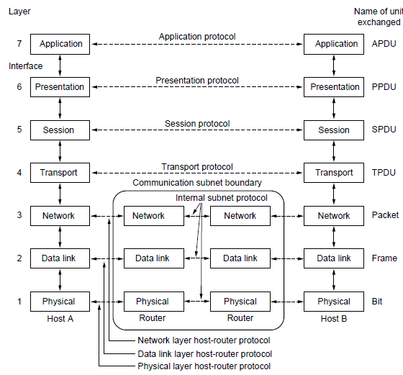
The OSI Reference Model
The OSI reference model

Slide 85
OSI Reference Model Layers
Physical layer
Data link layer
Network layer
Transport layer
Session layer
Presentation layer
Application layer

Slide 86
Physical Layer
Is concerned with transmitting raw bits over a communication channel.
Design Issues:
Ensuring that when one side sends a 1 – bit of information it is received as 1-bit (not as 0-bit or 2-or more- bits).
What type of signal should be used to represent “1” and “0”?
How many nano seconds a bit lasts?
Whether transmission can occur simultaneously in both direction?
How initial connection is being established?
How it is torn down when both sides are finished?
How many pins the network connector has?
What each pin is used for? Etc.
Deals with mechanical, electrical, timing interfaces, and the physical transmission medium.

Slide 87
Data Link Layer
Main task of the data link layer is to transform a raw transmission facility into a line that appears free of undetected transmission errors.
It does this by:
Break up the input data into data frames.
Sequential transmission of each frame.
The receiver confirms correct receipt of each frame by sending back an acknowledgment frame.
How to keep a fast transmitter from drowning a slow receiver in data.
Some traffic mechanism may be needed to let the transmitter know when the receiver can accept more data.
Broadcast networks have an additional issue in the data link layer:
How to control access to the shared channel?
A special sublayer of the data link layer, called “Medium Access Control” sublayer, deals with this problem

Slide 88
Network Layer
This layer controls the operation of the subnet.
Key design issue is determining how packets are routed from source to destination.
Static tables are wired into the network and are rarely changed, or
They are changed more often dynamically to avoid failed components.
They can be determined at the start of each conversation (e.g., login session), or
They can be highly dynamic and for each packed the new routing can be established depending on the load.
Congestion handling: If two many packets are present in the subnet at the same time, they will get in each other’s way forming bottlenecks.
Quality of Service:
Delay,
Transit time,
Jitter, Etc.
are also a network layer issues.
It is up to the network layer to overcome all the problems that occur in heterogeneous networks so that they may be interconnected.
In broadcast networks the routing problem is simple so the network layer is often thin or even nonexistent.

Slide 89
Transport Layer
The main function of Transport Layer is to:
Accept data from above it,
Split it up into smaller units if needed be,
Pass these to the network layer,
Ensure that the pieces all arrive correctly at the other end,
All this must be done efficiently and in a way that isolated the upper layers from the inevitable changes in the hardware technology over the course of time.
In addition, it is charged for determining what type of service to provide to the session layer, and ultimately, to the user of the network.
Example:
Error-free point-to-point channel that delivers messages or bytes in the order in which they were send.
Transporting of isolated messages with no guarantees about the order of delivery,
Broadcasting of messages to multiple destination.
Transport Layer is a true end-to-end layer; it carries data all the way form the source to the desitnation.

Slide 90
Session Layer
The session layer allows users on different machines to establish sessions between them.
Services:
Dialog control - Keeping track the whose turn is it to transmit,
Token management – Preventing tow parties from attempting the same critical operation simultaneously, and
Synchronization – Checkpointing long transmissions to allow them to pick up form where they left off in the event of a crash and subsequent recovery.

Slide 91
Presentation Layer
This layer is concerned with the presentation of the message; that is syntax and semantics of the information transmitted.
It deals with different internal data representations on different machines:
Abstract data structures,
Standard encoding to be used,

Slide 92
Application Layer
This layer commonly contains a variety of protocols that are needed by the users.
For example:
HTTP – Hyper Text Transfer Protocol,
FTP - File Transfer Protocol
POP/SMTP – E-mail Protocol,
RSS – Network News, etc.

Slide 93
The TCP/IP Reference Model Layers
Link layer
Internet layer
Transport layer
Application layer

Slide 94
The TCP/IP Reference Model
Grandparent of all wide area computer networks ARPANET
It’s successor Internet
ARPANET research network sponsored by the DoD.
Used initially leased telephone lines.
When satellite and radio networks were included the new reference architecture was needed.
Hence the ability to connect to multiple networks in a seamless way was one of the major design goals.
This architecture latter became known as the TCP/IP Reference Model.
Design criteria:
Network be able to survive loss of subnet hardware without existing conversations being broken off.
Applications with divergent requirements were supported ranging from file transfer to real-time speech transmission.

Slide 95
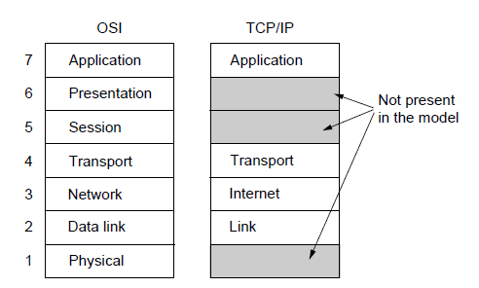
The TCP/IP Reference Model (1)
The TCP/IP reference model

Slide 96
Link Layer
Packet switched network
Connectionless layer that runs across different networks.
The lowest layer, the link layer, describes what links such as serial lines and classic Ethernet must do to meet the needs of this connectionless internet layer.
It is not actual layer in the classical sense of the term rather is an interface between hosts and transmission links.

Slide 97
Internet Layer
The Internet Layer holds this architecture together.
Its job is to permit hosts to inject packets into any network and have them travel independently to the destination (potentially on a different network).
The packets may arrive in a completely random order from the original and the higher layer must rearrange them – if in-order of delivery is desired.
The internet layer define san official packet format and protocol called IP (Internet Protocol).
Packet routing is a major issue and IP has not proven effective at avoiding congestion.

Slide 98
Transport Layer
Transport Layer is designed to allow peer entities on the source and destination hosts to carry on a conversation, similarly to the OSI transport layer.
Two end-to-end transport protocols:
TCP (Transmission Control Protocol) – reliable connection-oriented protocol that allows a byte stream originating on one machine to be delivered without error on any other machine in the internet.
UDP (User Datagram Protocol) – is unreliable connectionless protocol.

Slide 99
Transport Layer
TCP (Transmission Control Protocol) – reliable connection-oriented protocol that allows a byte stream originating on one machine to be delivered without error on any other machine in the internet.
It segments the incoming byte stream into discrete messages
Passes each one on to the internet layer.
At the receiver the TCP process reassembles the received messages.
Flow control is also managed by TCP to ensure that a fast sender cannot swamp a slow receiver.
UDP (User Datagram Protocol) – is unreliable connectionless protocol.
For applications that do not want TCP’s sequencing or flow control and they want to provide one of their own.
Widely used for one-shot, client-server-type request-reply queries and application in which prompt deliver is more important than accurate delivery.
Speech
Video

Slide 100
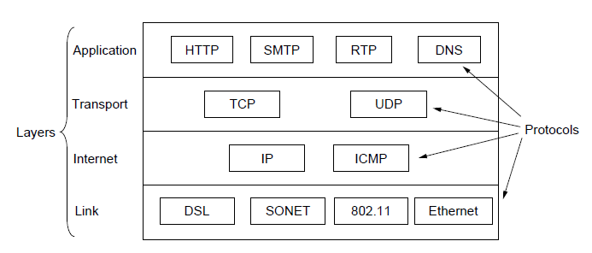
The TCP/IP Reference Model (2)
The TCP/IP reference model with some protocols we will study

Slide 101
Application Layer
Applications must include any session or presentation functions that they require.
Experience with the OSI model has proven this view to be correct: these layers are of little use to most applications.
Application Layer contains all the higher-level protocols.
TELNET - Virtual Terminal
FTP – File Transfer Protocol
SMTP – electronic mail
Many other protocols have been added (see figure in the previous slide):
DSN – Domain Name System
HTTP – Hyper Text Transfer Protocol
RTP – Real-time Transfer Protocol

Slide 102
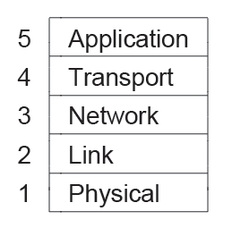
The Model Used in this Book
The reference model used in this book.

Slide 103
The Model Used in this Book
Using the 5 layers:
Physical
Link
Network
Transport, and
Application
Value of OSI model is retained for understanding network architecture.
In addition we concentrate primarily on protocols that are important in practice:
TCP/IP
802.11
SONET
Bluetooth.

Slide 104
Comparison of the OSI and TCP/IP Reference Models
Concepts central to OSI model
Services
Interfaces
Protocols

Slide 105
Service
Each layer provides a service to the layer above it.
The service definition tells what the layer does, not how entities above it access it or how the layer works.
It defines the layer’s semantics.

Slide 106
Interface
A layer’s interface tells the processes above it how to access it.
It specifies what the parameters are and what results to expect.
This layer also says nothing about how the layer works inside.

Slide 107
Protocol
A layer’s protocol its is own business: it can use any protocols it wants to as long as it gets the job done (i.e. provides the offered services).
A layer is allowed to change the protocol with the condition that it will not affect the software in higher layers.

Slide 108
Object Oriented Programming
Those ideas fit very nicely with modern ideas about object-oriented programming.
An object has:
A set of methods (operations) that processes outside the object can invoke.
A set of data (method’s parameters) that defines the object.
The code internal to the object is its protocol and is not visible or of any of concern outside the object.
The object provides the set of services through object’s interface.

Slide 109
The Properties
TCP/IP model did not originally distinguish between:
Services
Interfaces, and
Protocols
The model was retrofitted after the fact to make it more OSI-like.
However, OSI model has a better hidden then in the TCP/IP model and can be replaced relatively easily as the technology changes.

Slide 110
The Properties
The OSI reference model was devised before the corresponding protocols were invented.
This ordering meant that the model was not biased toward one particular set of protocols: a fact that made it quite general.
The downside of this ordering was that the designers did not have much experience with the subject and did not have a good idea of which functionality to put in which layer.
With TCP/IP the reverse was true: The protocols came first, and the model was really just a description of the existing protocols.
There was no problem with protocols fitting the model.
The trouble was that the model did not fit any other protocol stacks: It was not especially useful for describing other non-TCP/IP networks.

Slide 111
Critique of the TCP/IP Model
Does not distinguish clearly the concepts of services, interfaces, and protocols.
Good Software Engineering practice requires differentiating between the specification and the implementation.
The link layer is really not a layer at all: It is an interface between the network and data link layers. The distinction between in interface and a layer is crucial.
TCP/IP model does not distinguish between the physical and data link layers.
Physical layer has to do with the transmission characteristics of the medium used (copper wire, fiber optics, wireless communication, etc.).
Data link layer job is to delimit the start and end of frames and get them from one side to the other with the desired degree of reliability.
IP and TCP protocols were carefully thought out and well implemented, however, the other protocols were ad-hoc.
Example - TELNET designed for a ten-character-per second mechanical Teletype terminal and it does not know anything about graphical user interfaces and mice.

Slide 112
Example Networks
Internet
ARPANET
NSFNET
Third-generation mobile phone networks
Wireless LANs: 802.11
RFID and sensor networks

Slide 113
Internet
Is a vast collection different networks that use certain common protocols and provide certain common services.

Slide 114
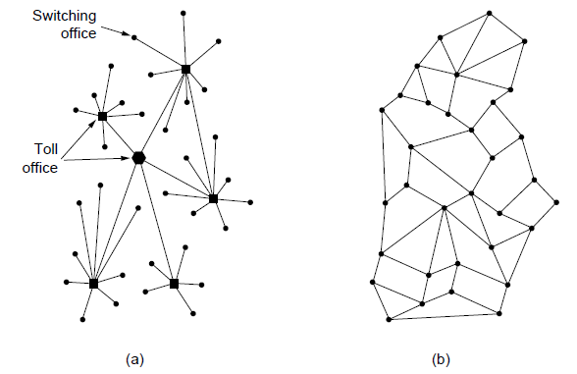
The ARPANET
Structure of the telephone system.
Baran’s proposed distributed switching system.

Slide 115
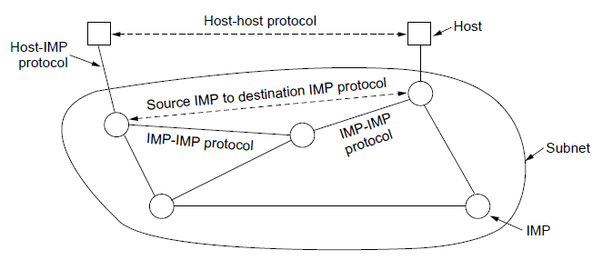
The ARPANET (2)
The original ARPANET design

Slide 116
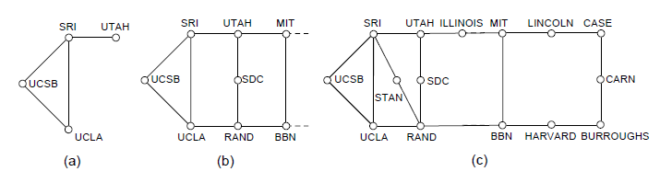
The ARPANET (3)
Growth of the ARPANET.
December 1969.
July 1970.
March 1971.

Slide 117
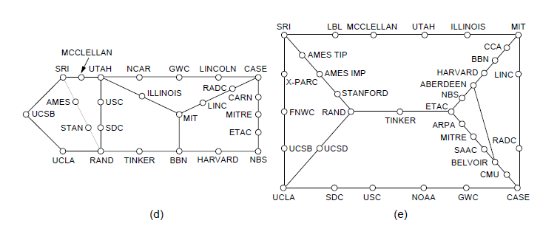
The ARPANET (4)
Growth of the ARPANET.
April 1972.
September 1972.

Slide 118
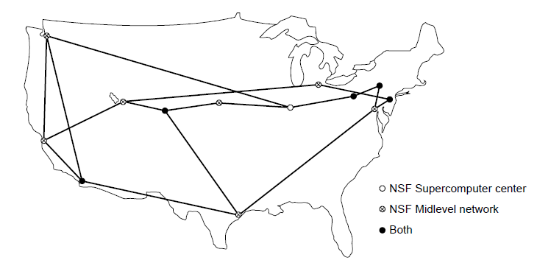
NSFNET
The NSFNET backbone in 1988.

Slide 119
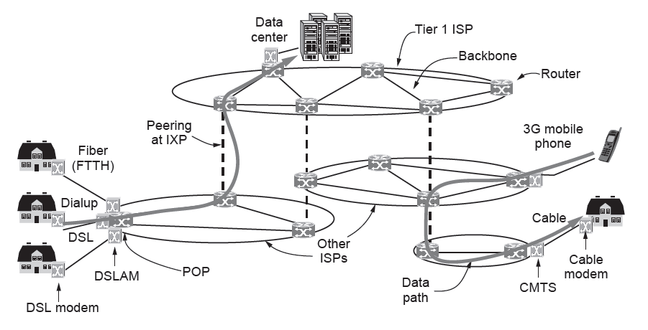
Architecture of the Internet
Overview of the Internet architecture

Slide 120
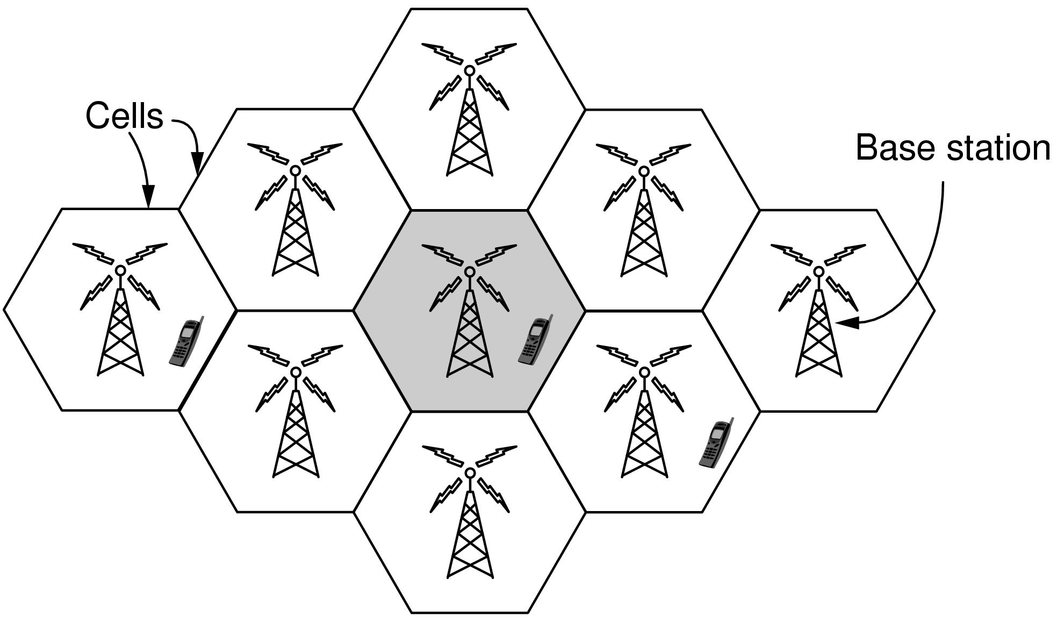
Third-Generation Mobile Phone Networks (1)
Cellular design of mobile phone networks

Slide 121
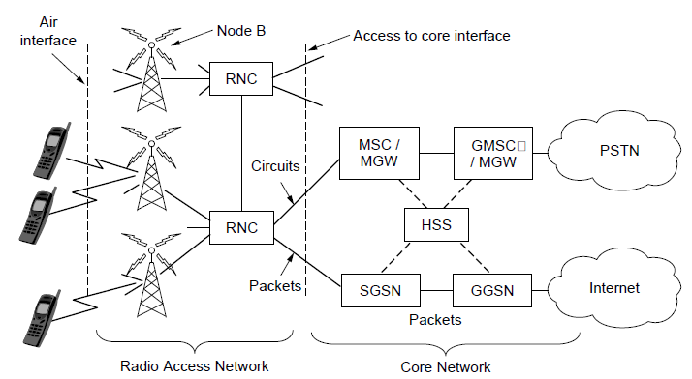
Third-Generation Mobile Phone Networks (2)
Architecture of the UMTS 3G mobile phone network.

Slide 122
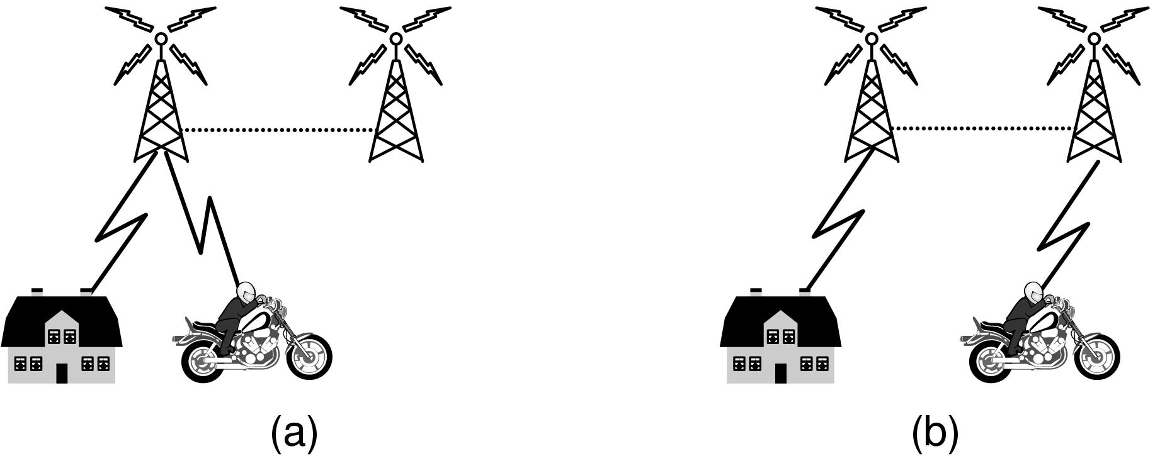
Third-Generation Mobile Phone Networks (3)
Mobile phone handover (a) before, (b) after.

Slide 123
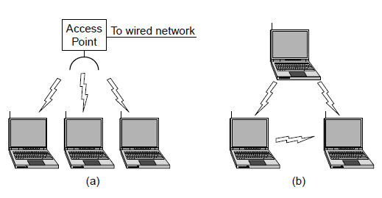
Wireless LANs: 802.11 (1)
Wireless network with an access point.
Ad hoc network.

Slide 124
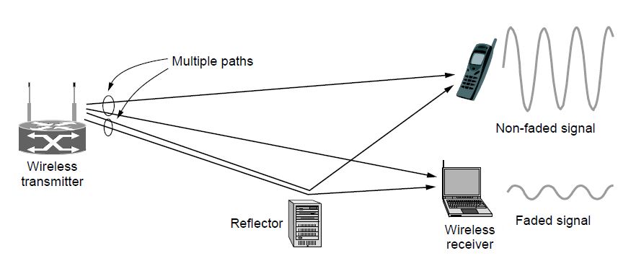
Wireless LANs: 802.11 (2)
Multipath fading

Slide 125
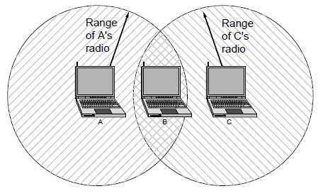
Wireless LANs: 802.11 (3)
The range of a single radio may not cover the entire system.

Slide 126
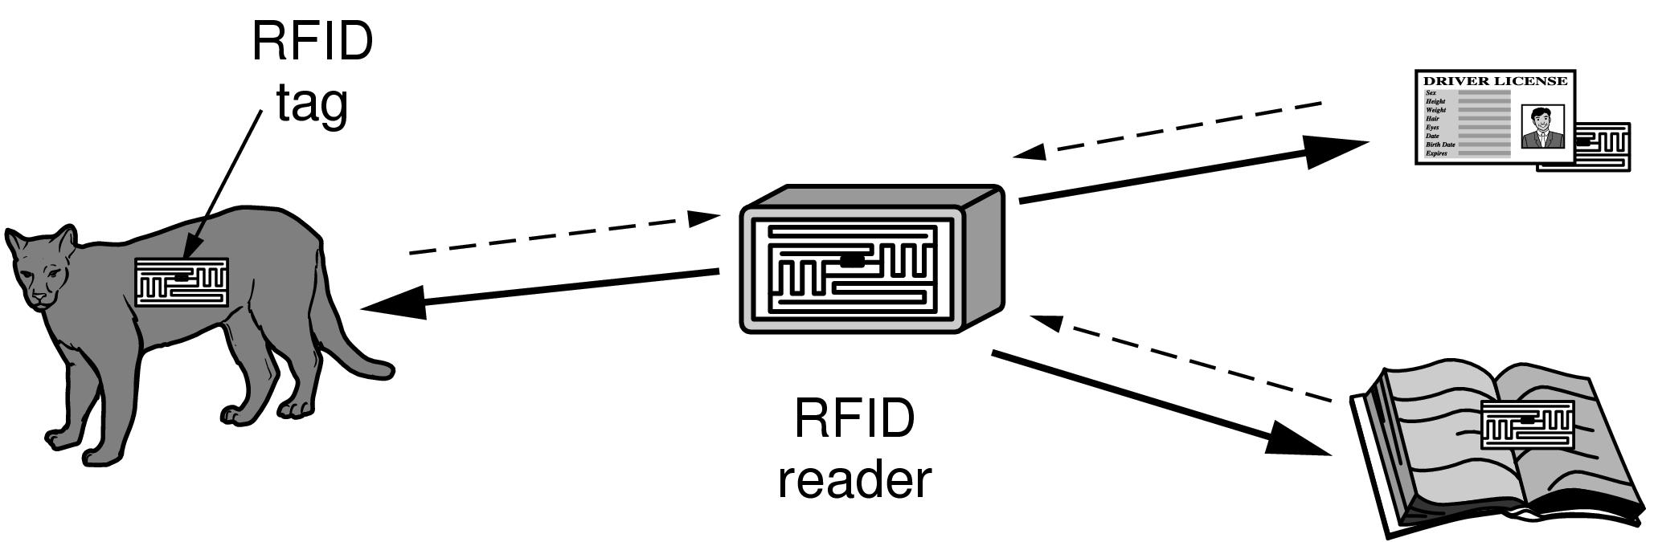
RFID and Sensor Networks (1)
RFID used to network everyday objects.

Slide 127
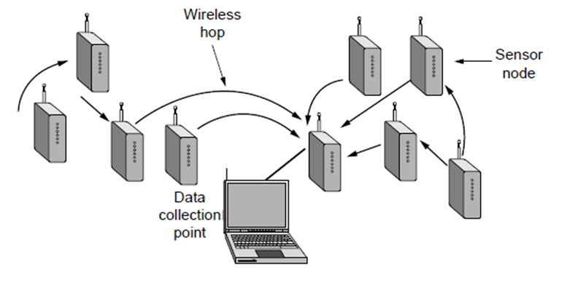
RFID and Sensor Networks (2)
Multihop topology of a sensor network

Slide 128
Network Standardization
Who’s Who in telecommunications
Who’s Who in international standards
Who’s Who in internet standards

Slide 129
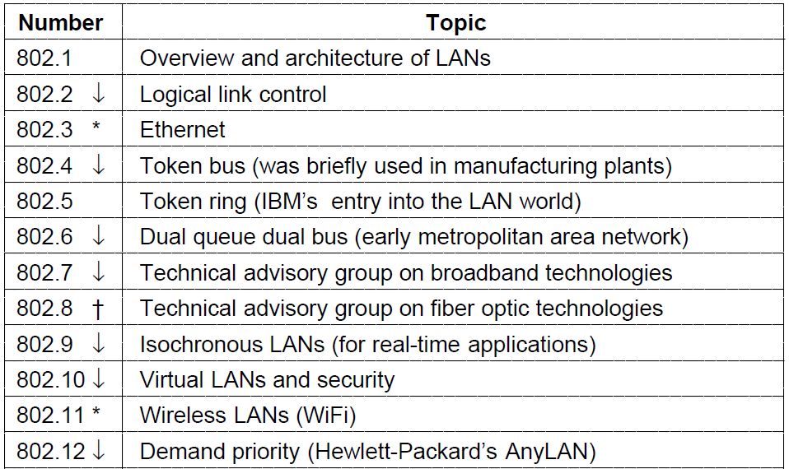
Who’s Who in International Standards (1)
The 802 working groups. The important ones are marked with *.
The ones marked with ↓ are hibernating. The one marked with † gave up and disbanded itself.

Slide 130
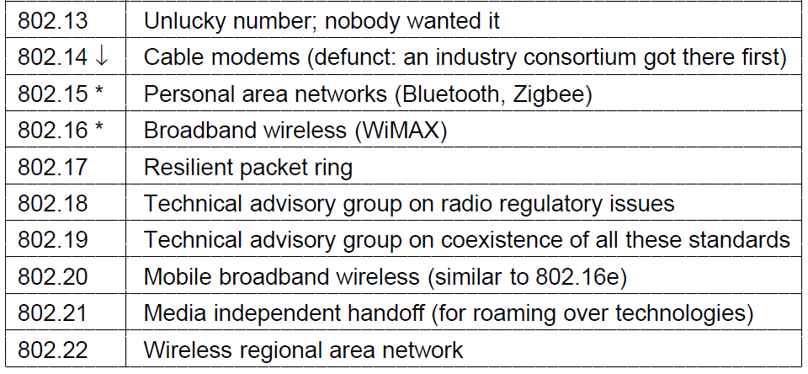
Who’s Who in International Standards (2)
The 802 working groups. The important ones are marked with *.
The ones marked with ↓ are hibernating. The one marked with † gave up and disbanded itself.

Slide 131
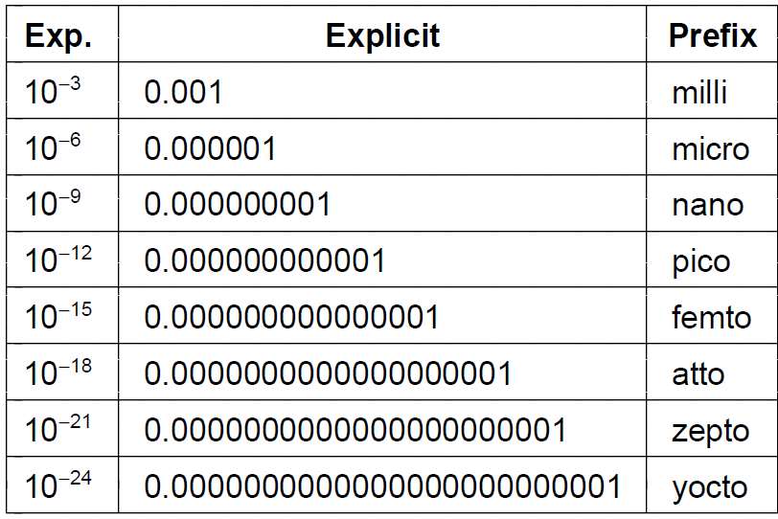
Metric Units (1)
The principal metric prefixes

Slide 132
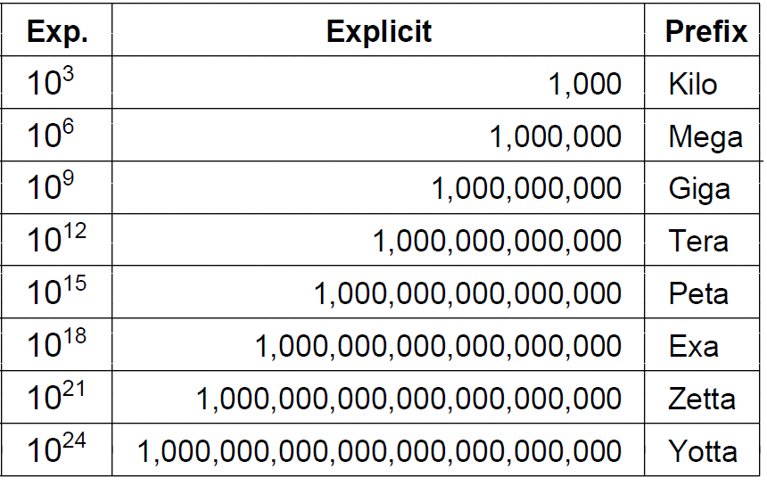
Metric Units (2)
The principal metric prefixes

Slide 133
End
Chapter 1

