Slide 1
Network Security
Chapter 8

Slide 2
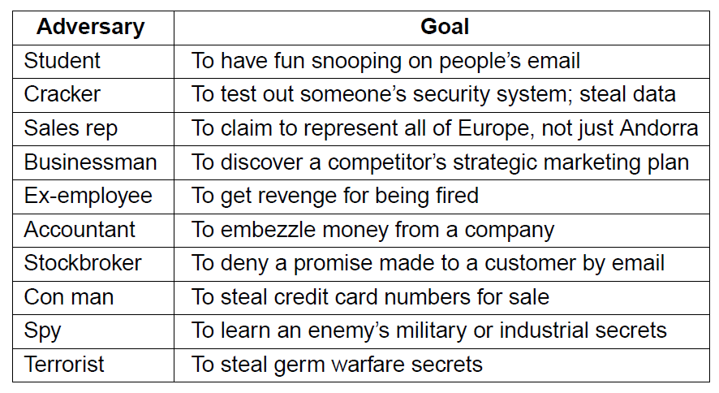
Network Security
Some people who cause security problems and why.

Slide 3
Cryptography
Introduction
Substitution ciphers
Transposition ciphers
One-time pads
Fundamental cryptographic principles

Slide 4
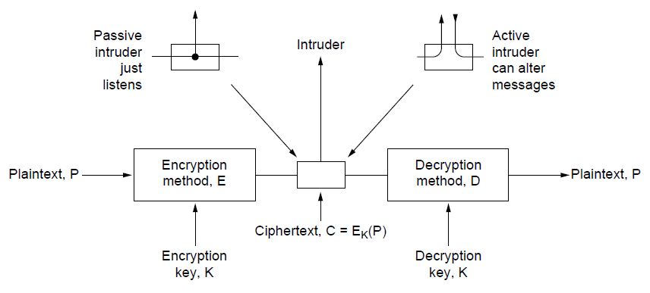
Introduction
The encryption model (for a symmetric-key cipher).

Slide 5
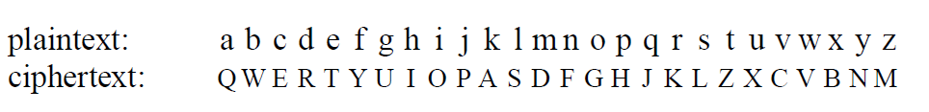
Substitution Ciphers
Monoalphabetic substitution

Slide 6
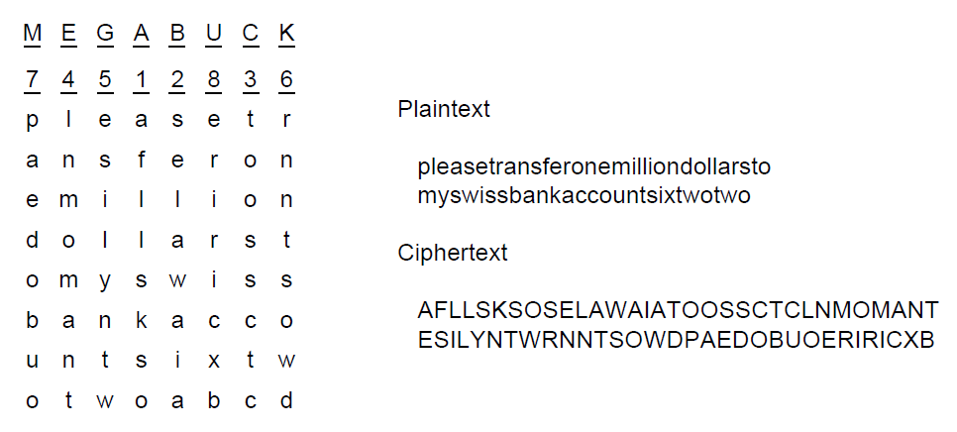
Transposition Ciphers
A transposition cipher

Slide 7
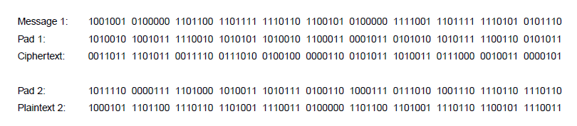
One-Time Pads (1)
The use of a one-time pad for encryption and the possibility of getting any possible plaintext from the ciphertext by the use of some other pad.

Slide 8
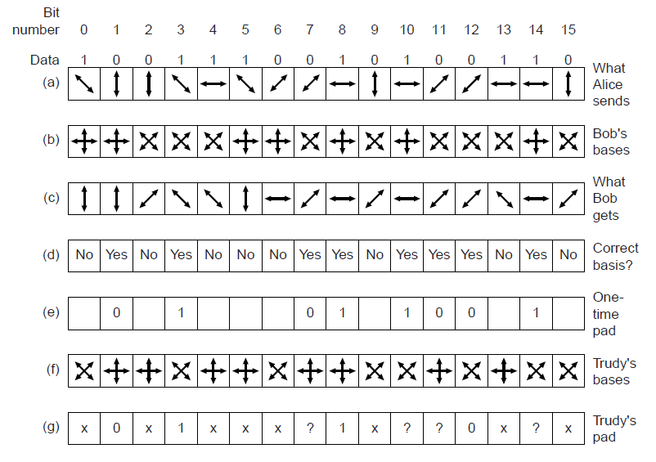
One-Time Pads (2)
An example of quantum cryptography

Slide 9
Fundamental Cryptographic Principles
Messages must contain some redundancy
Some method is needed to foil replay attacks

Slide 10
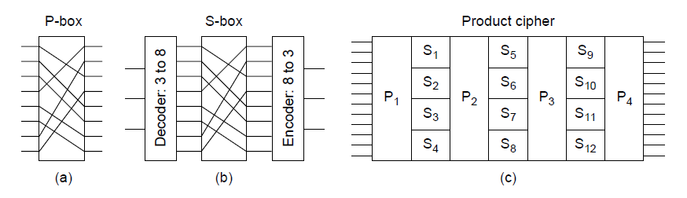
Symmetric-key Algorithms (1)
Basic elements of product ciphers.
(a) P-box. (b) S-box. (c) Product.

Slide 11
Symmetric-key Algorithms (2)
Data encryption standard
Advanced encryption standard
Cipher modes
Other ciphers
Cryptanalysis

Slide 12
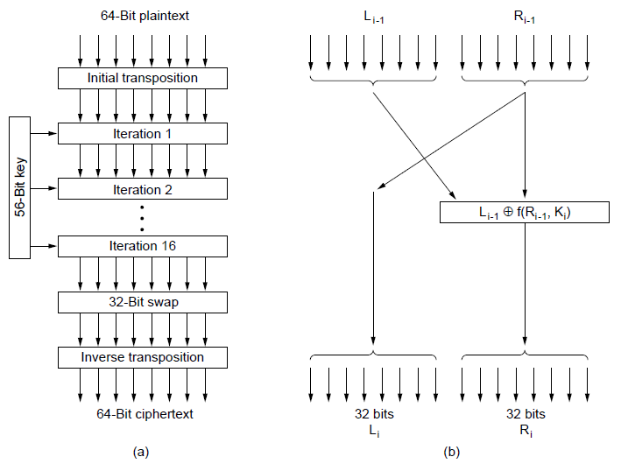
Data Encryption Standard (1)
The data encryption standard. (a) General outline. (b) Detail of one iteration. The circled + means exclusive OR.

Slide 13
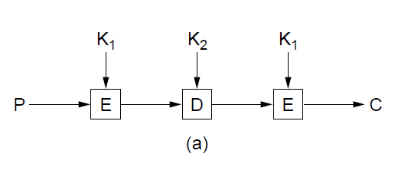
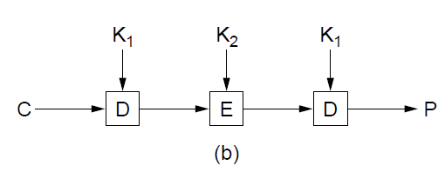
Data Encryption Standard (2)
(a) Triple encryption using DES. (b) Decryption

Slide 14
Advanced Encryption Standard (1)
Algorithm symmetric block cipher.
Full design must be public.
Key lengths of 128, 192, and 256 bits supported.
Software and hardware implementations possible.
Algorithm public or licensed on nondiscriminatory terms.

Slide 15
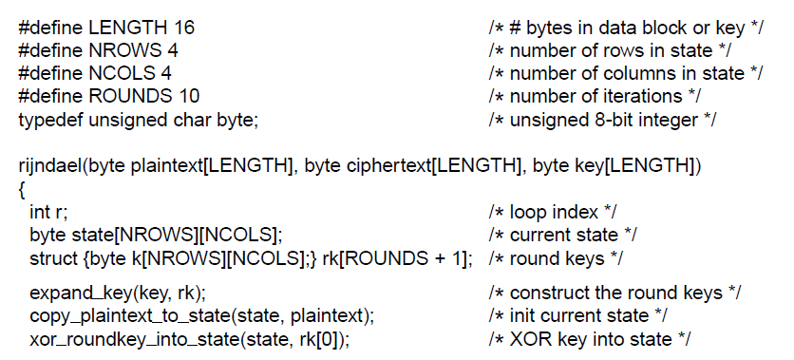
Advanced Encryption Standard (2)
. . .
An outline of Rijndael

Slide 16
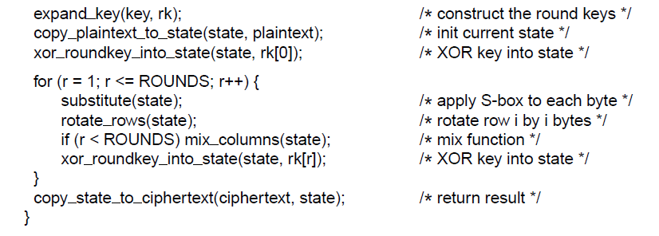
Advanced Encryption Standard (3)
. . .
An outline of Rijndael

Slide 17
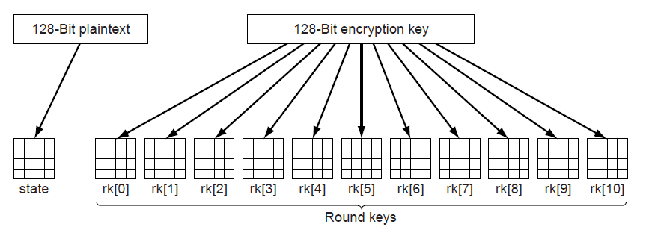
Advanced Encryption Standard (4)
Creating of the state and rk arrays

Slide 18
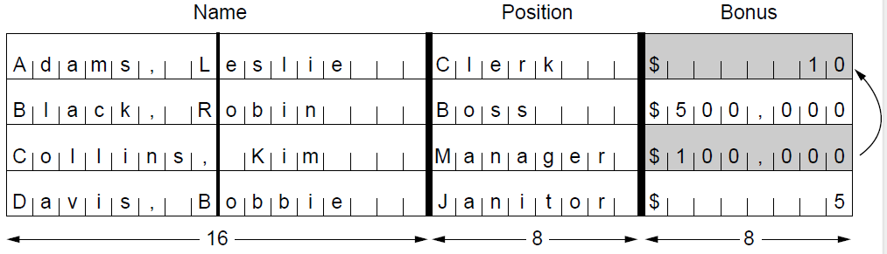
Cipher Modes (1)
The plaintext of a file encrypted as 16 DES blocks.

Slide 19
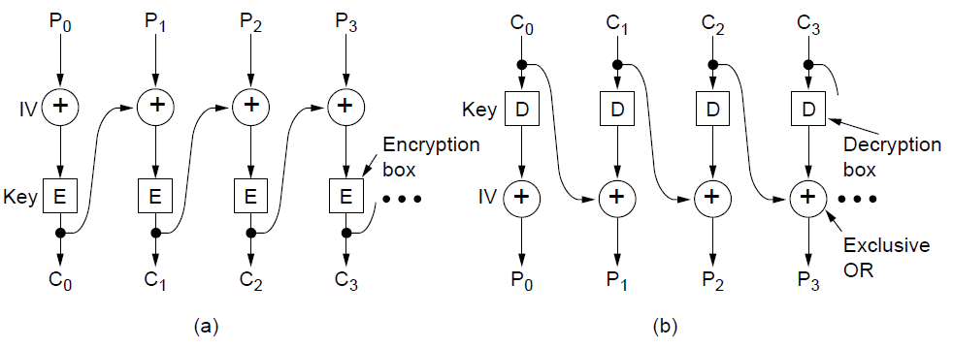
Cipher Modes (2)
Cipher block chaining. (a) Encryption. (b) Decryption

Slide 20
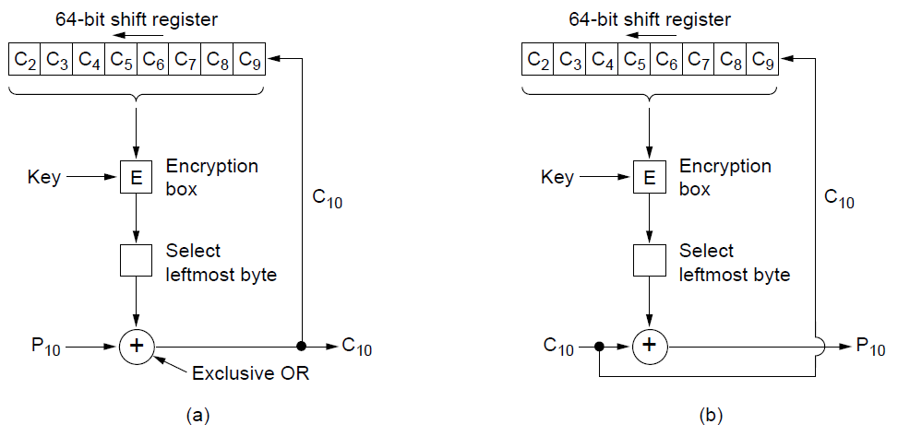
Cipher Modes (3)
Cipher feedback mode. (a) Encryption. (b) Decryption

Slide 21
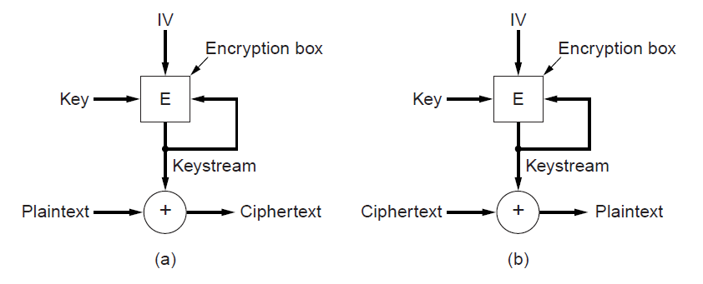
Cipher Modes (4)
A stream cipher. (a) Encryption. (b) Decryption

Slide 22
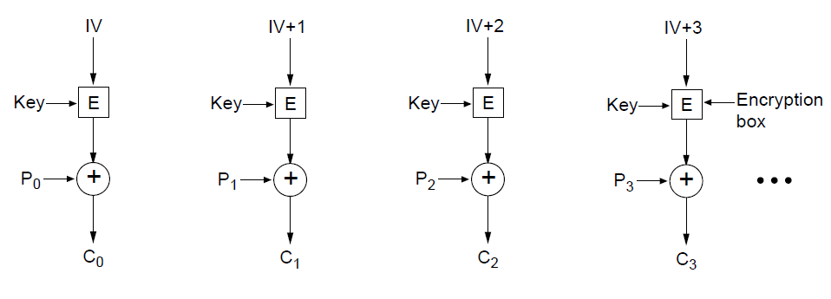
Cipher Modes (5)
Encryption using counter mode

Slide 23
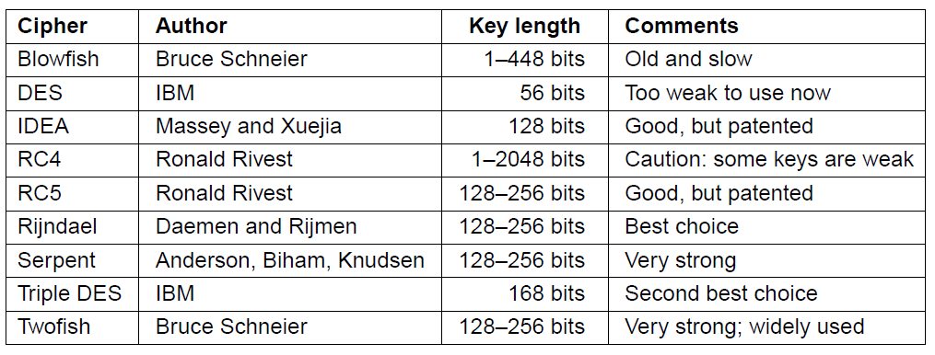
Other Ciphers
Some common symmetric-key cryptographic algorithms

Slide 24
Public-key Algorithms
RSA
  Authors: Rivest, Shamir, Adleman
Other Public-Key Algorithms

Slide 25
RSA (1)
Method Summary
Choose two large primes, p and q
Compute
n = p × q and z = ( p − 1) × (q − 1).
Choose number relatively prime to z
call it d.
Find e such that e × d = 1 mod z.

Slide 26
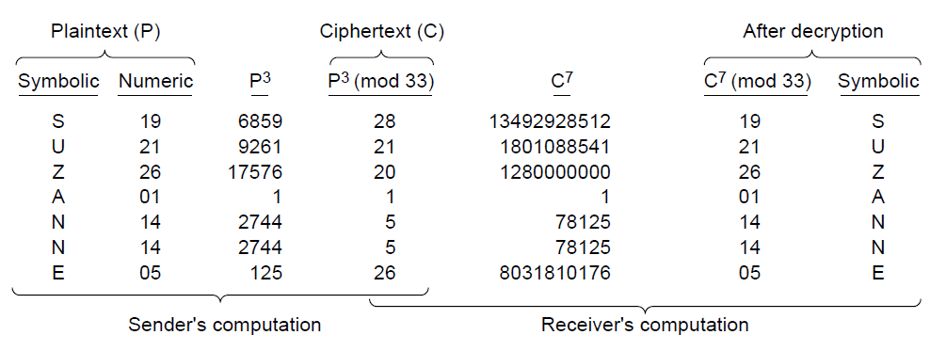
RSA (2)
An example of the RSA algorithm

Slide 27
Digital Signatures (1)
Required Conditions:
Receiver can verify claimed identity of sender.
Sender cannot later repudiate contents of message.
Receiver cannot have concocted message himself.

Slide 28
Digital Signatures (2)
Symmetric-key signatures
Public-key signatures
Message digests
The birthday attack

Slide 29
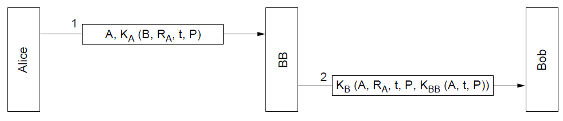
Symmetric-key Signatures
Digital signatures with Big Brother

Slide 30
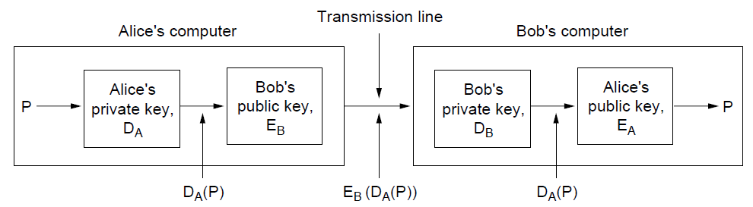
Public-Key Signatures (1)
Digital signatures using public-key cryptography.

Slide 31
Public-Key Signatures (2)
Criticisms of DSS:
Too secret
Too slow
Too new
Too insecure

Slide 32
Message Digests (1)
Message Digest properties
Given P, easy to compute MD(P).
Given MD(P), effectively impossible to find P.
Given P no one can find P′ such that MD(P′) = MD(P).
Change to input of even 1 bit produces very different output.

Slide 33
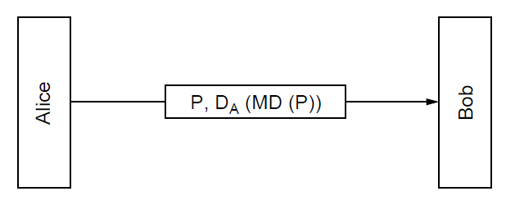
Message Digests (2)
Digital signatures using message digests

Slide 34
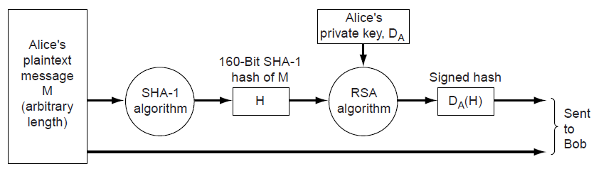
Message Digests (3)
Use of SHA-1 and RSA for signing nonsecret messages

Slide 35
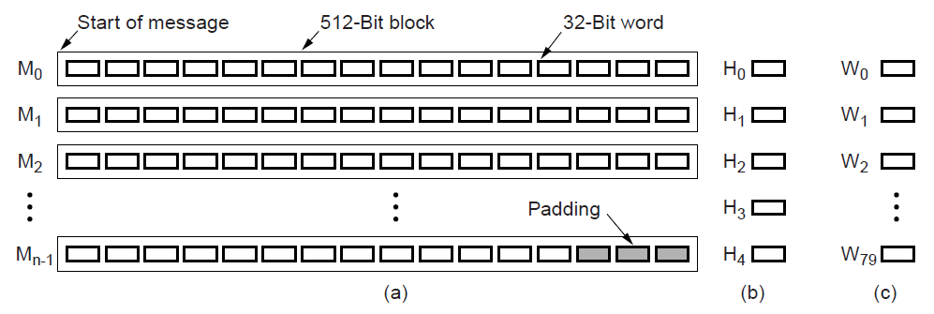
Message Digests (4)
A message padded out to a multiple of 512 bits.
The output variables.
The word array.

Slide 36
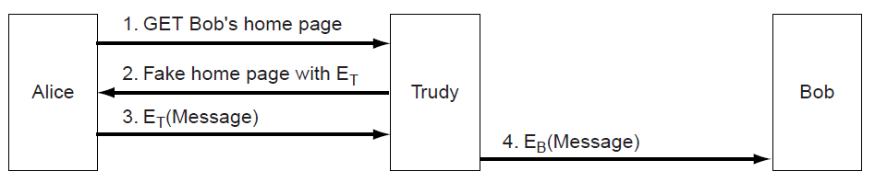
Management of Public Keys (1)
A way for Trudy to subvert public-key encryption

Slide 37
Management of Public Keys (2)
Certificates
X.509
Public key infrastructures

Slide 38
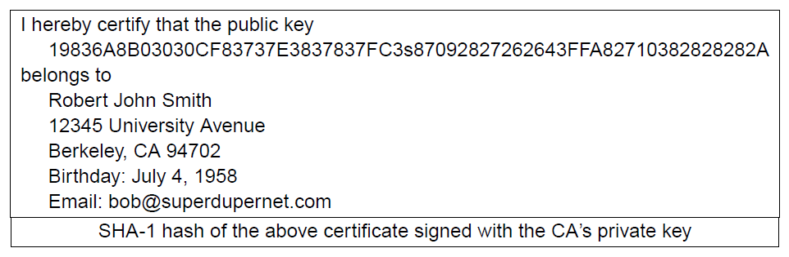
Certificates
A possible certificate and its signed hash

Slide 39
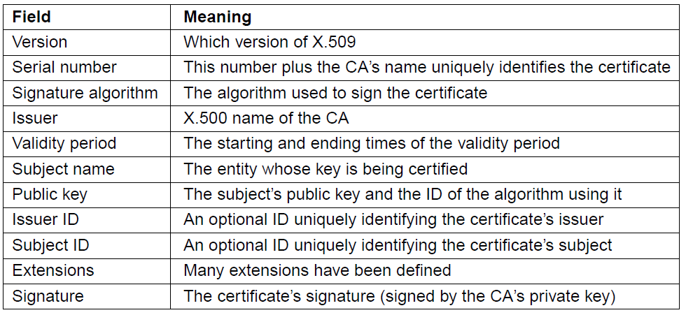
X.509
The basic fields of an X.509 certificate

Slide 40
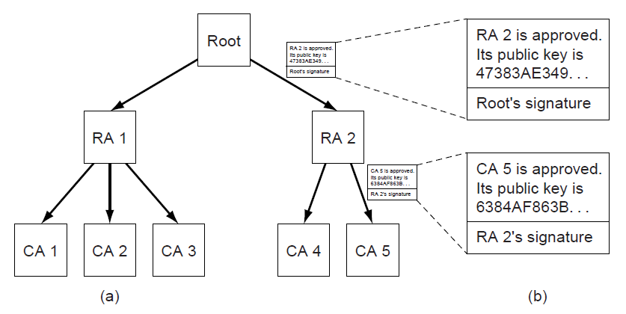
Public Key Infrastructures
(a) A hierarchical PKI. (b) A chain of certificates.

Slide 41
Communication Security
IPsec
Firewalls
Virtual private networks
Wireless security

Slide 42
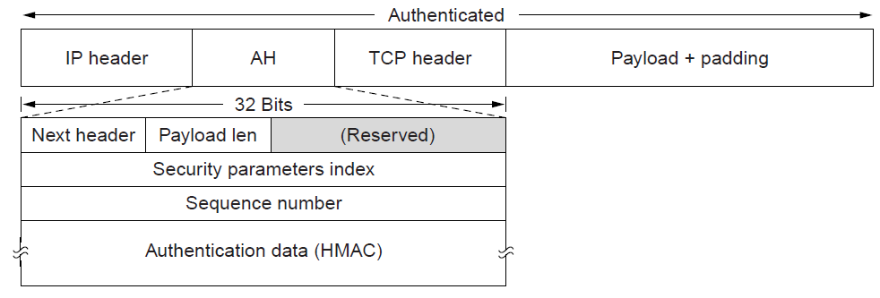
IPsec (1)
The IPsec authentication header in transport mode for IPv4.

Slide 43
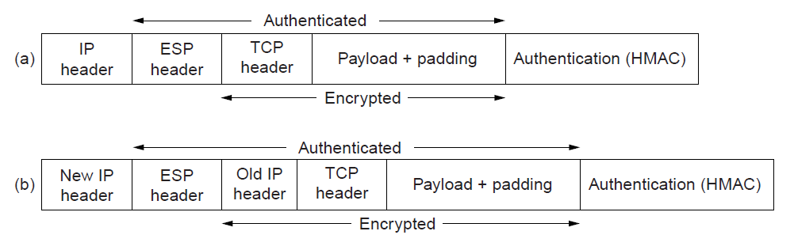
IPsec (2)
(a) ESP in transport mode. (b) ESP in tunnel mode.

Slide 44
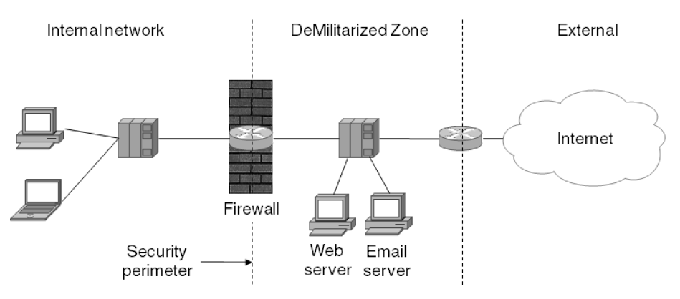
IPsec (3)
A firewall protecting an internal network

Slide 45
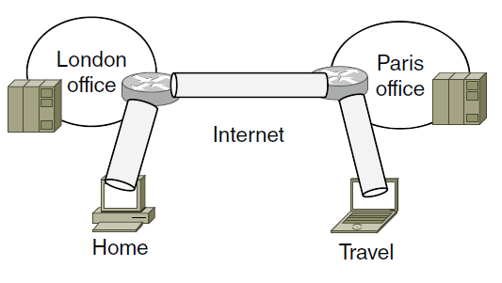
Virtual Private Networks (1)
A virtual private network

Slide 46
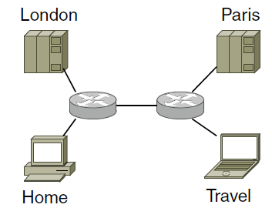
Virtual Private Networks (2)
Topology as seen from the inside

Slide 47
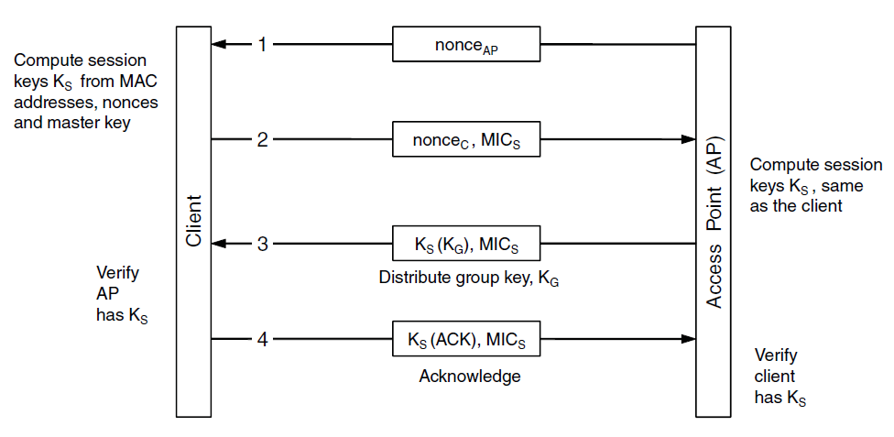
Wireless Security
The 802.11i key setup handshake

Slide 48
Authentication Protocols
Shared secret key
Establishing a shared key:
the Diffie-Hellman key exchange
Key distribution center
Kerberos
Public-key cryptography

Slide 49
Shared Secret Key (1)
Notation for discussing protocols
A, B are the identities of Alice and Bob.
R_{i}’s are the challenges, where the subscript identifies the challenger.
K_{i} are keys, where i indicates the owner.
K_{S} is the session key.

Slide 50
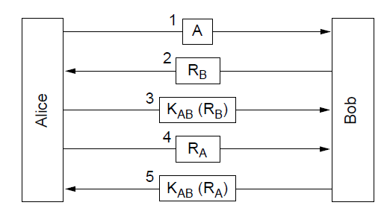
Shared Secret Key (2)
Two-way authentication using a challenge-response protocol.

Slide 51
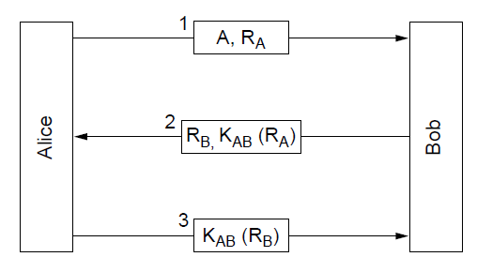
Shared Secret Key (3)
A shortened two-way authentication protocol

Slide 52
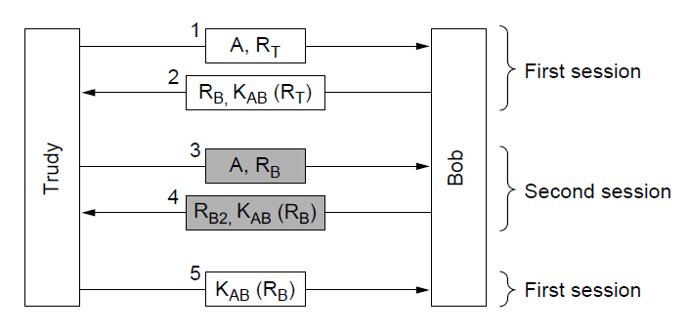
Shared Secret Key (4)
The reflection attack.

Slide 53
Shared Secret Key (5)
General design rules
Have initiator prove who she is before responder
Initiator, responder use different keys
Draw challenges from different sets
Make protocol resistant to attacks involving second parallel session

Slide 54
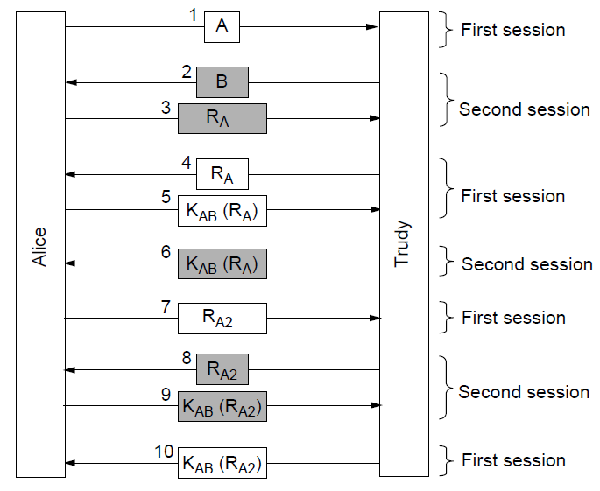
Shared Secret Key (6)
A reflection attack on the protocol of Fig. 8-32

Slide 55
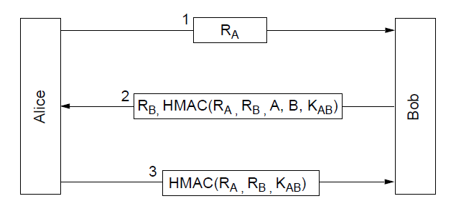
Shared Secret Key (7)
Authentication using HMACs

Slide 56
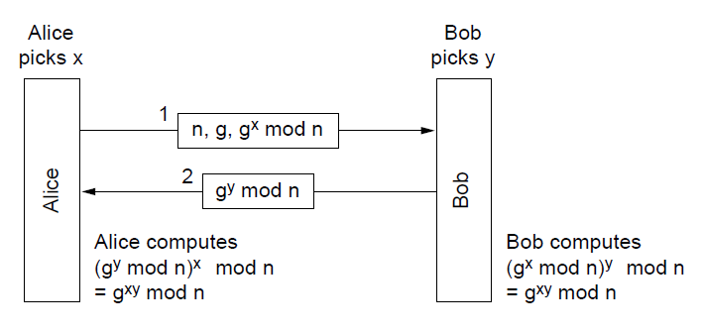
The Diffie-Hellman Key Exchange (1)
The Diffie-Hellman key exchange

Slide 57
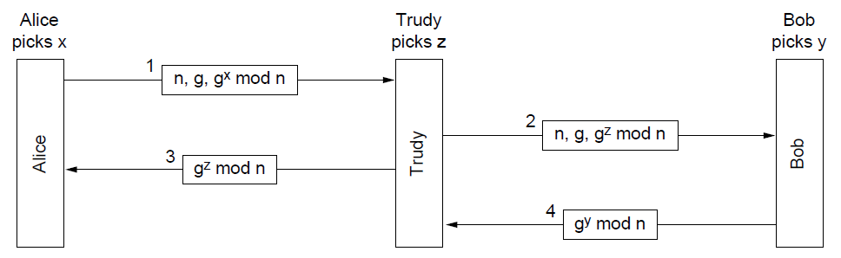
The Diffie-Hellman Key Exchange (2)
The man-in-the-middle attack

Slide 58
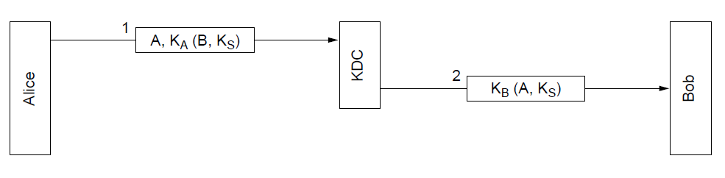
Key Distribution Center (1)
A first attempt at an authentication
protocol using a KDC.

Slide 59
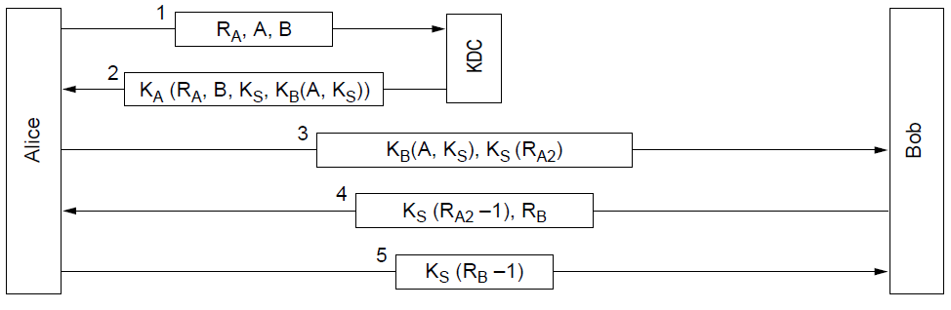
Key Distribution Center (2)
The Needham-Schroeder authentication protocol

Slide 60
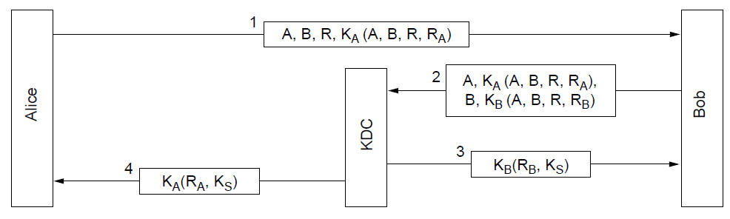
Key Distribution Center (3)
The Otway-Rees authentication
protocol (slightly simplified).

Slide 61
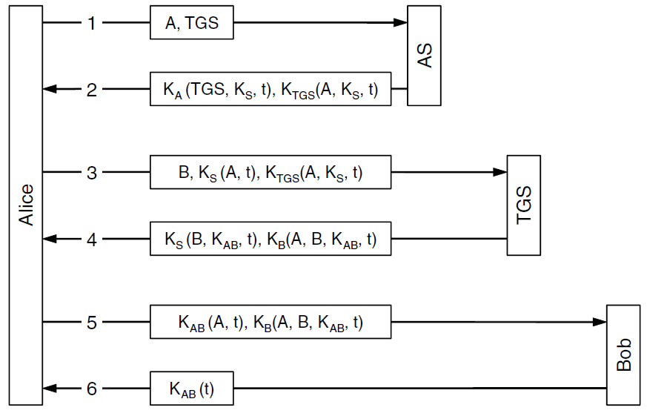
Kerberos
The operation of Kerberos V5

Slide 62
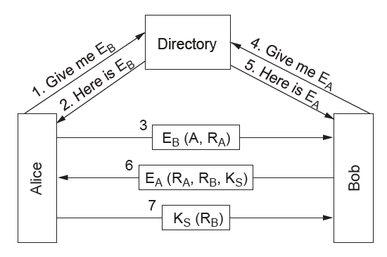
Public-Key Cryptography
Mutual authentication using public-key cryptography

Slide 63
Email Security
PGP—Pretty Good Privacy
S/MIME

Slide 64
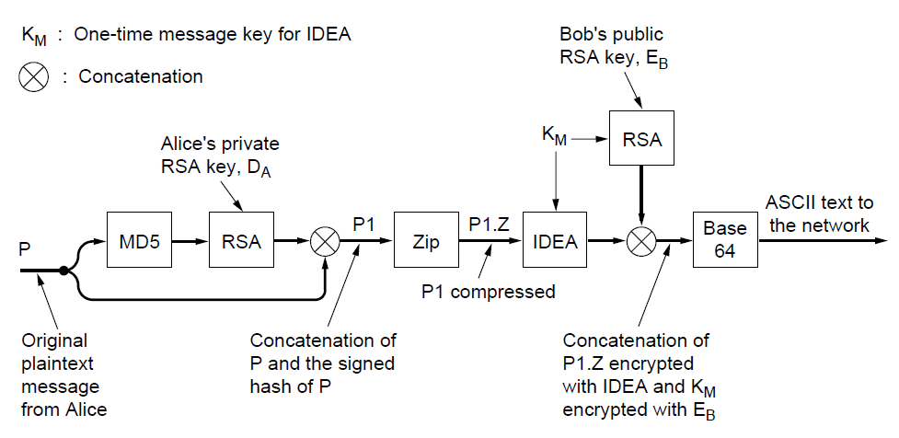
PGP—Pretty Good Privacy (1)
PGP in operation for sending a message

Slide 65
PGP—Pretty Good Privacy (2)
Casual (384 bits):
  Can be broken easily today.
Commercial (512 bits): b
  Breakable by three-letter organizations.
Military (1024 bits):
  Not breakable by anyone on earth.
Alien (2048 bits):
  Unbreakable by anyone on other planets

Slide 66
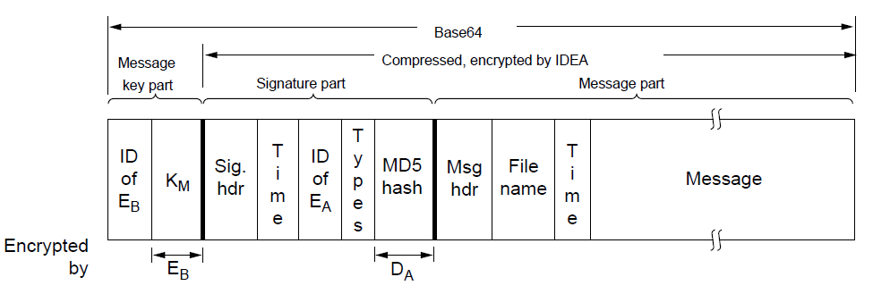
PGP—Pretty Good Privacy (3)
A PGP message

Slide 67
Web Security
Threats
Secure naming
SSL—the Secure Sockets Layer
Mobile code security

Slide 68
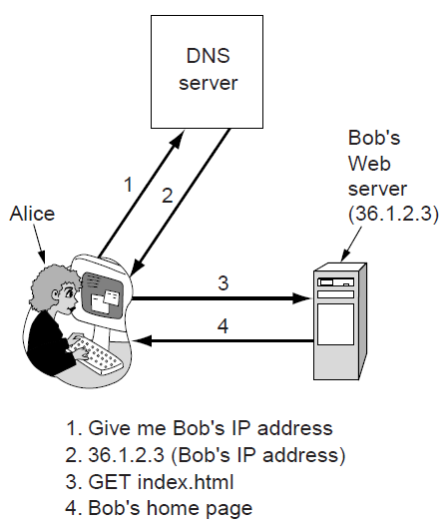
Secure Naming (1)
Normal situation

Slide 69

Secure Naming (2)
An attack based on breaking into DNS
and modifying Bob’s record.

Slide 70

Secure Naming (3)
How Trudy spoofs Alice’s ISP.

Slide 71
Secure Naming (4)
DNSsec fundamental services:
Proof of where the data originated.
Public key distribution.
Transaction and request authentication.

Slide 72

Secure Naming (5)
An example RRSet for bob.com. The KEY record is Bob’s public key. The SIG record is the top-level com server’s signed hash of the A and KEY records to verify their authenticity.

Slide 73
SSL—The Secure Sockets Layer (1)
Secure connection includes …
Parameter negotiation between client and server.
Authentication of the server by client.
Secret communication.
Data integrity protection.

Slide 74

SSL—The Secure Sockets Layer (2)
Layers (and protocols) for a home
user browsing with SSL.

Slide 75

SSL—The Secure Sockets Layer (3)
A simplified version of the SSL connection establishment subprotocol.

Slide 76

SSL—The Secure Sockets Layer (4)
Data transmission using SSL

Slide 77

Mobile Code Security
Applets can be interpreted by a Web browser

Slide 78
Social Issues
Privacy
Freedom of speech
Copyright

Slide 79

Privacy
How Alice uses 3 remailers to send Bob a message

Slide 80
Freedom of Speech (1)
Possible banned material:
Inappropriate for children
Hate aimed at various groups
Information about democracy
History that contradicts government position
Manuals for potentially illegal activities

Slide 81

Freedom of Speech (2)
(a)
(b)
Three zebras and a tree.
Three zebras, a tree, and the complete text of five plays by William Shakespeare.

Slide 82
End
Chapter 8

