Slide 1

Computer Network
Spring 2020
Prof./Dr. Shen Bichuan
College of Computer Science and Engineering Chongqing University of Technology

Slide 2
The Data Link Layer
Chapter 3

Slide 3
Data Link Layer Design Issues
Encoding, framing, error detection, for reliable delivery, and medium access control mediation, arbitration
Network layer services
Framing, identify the beginnings and endings of frames and packets
Error control
Flow control

Slide 4
Data Link Layer
Algorithms for achieving:
Reliable, +
Efficient, communication of a whole units – frames (as opposed to bits – Physical Layer) between two machines.
Two machines are connected by a communication channel that acts conceptually like a wire (e.g., telephone line, coaxial cable, or wireless channel).
Essential property of a channel that makes it “wire-like” connection is that the bits are delivered in exactly the same order in which they are sent.

Slide 5
Data Link Layer
For ideal channel (no distortion, unlimited bandwidth and no delay) the job of data link layer would be trivial.
However, limited bandwidth, distortions and delay makes this job very difficult.

Slide 6
Data Link Layer Design Issues
Physical layer delivers bits of information to and from data link layer. The functions of Data Link Layer are:
Providing a well-defined service interface to the network layer.
Dealing with transmission errors.
Regulating the flow of data so that slow receivers are not swamped by fast senders.
Data Link layer
Takes the packets from Physical layer, and
Encapsulates them into frames

Slide 7
Data Link Layer Design Issues
Frame management is what Data Link Layer does.
Reasons why need framing: how can a receiver tell when one frame or packet stops and the next one begins
Determining the beginnings and endings of frames and packets
Length field in the header can be used in principle, but not to be widely used for framing, because of restoring order after desynchronization can be difficult.

Slide 8
Data Link Layer Design Issues
Overlap of framing with encoding: for example, the existence of non-data bit special patterns used as unambiguous frame delimiters.
Each frame has a
frame header – a field for holding the packet, and
frame trailer.

Slide 9
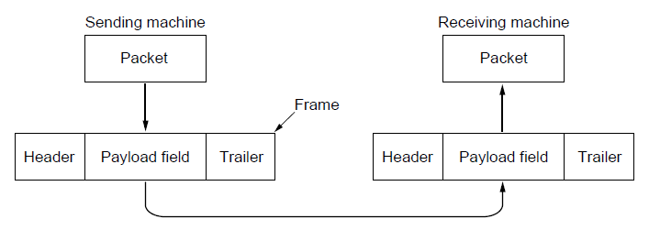
Packets and Frames
Relationship between packets and frames.

Slide 10
Services Provided to the Network Layer
Principal Service Function of the data link layer is to transfer the data from the network layer on the source machine to the network layer on the destination machine.
Process in the network layer that hands some bits to the data link layer for transmission.
Job of data link layer is to transmit the bits to the destination machine so they can be handed over to the network layer there (see figure in the next slide).

Slide 11
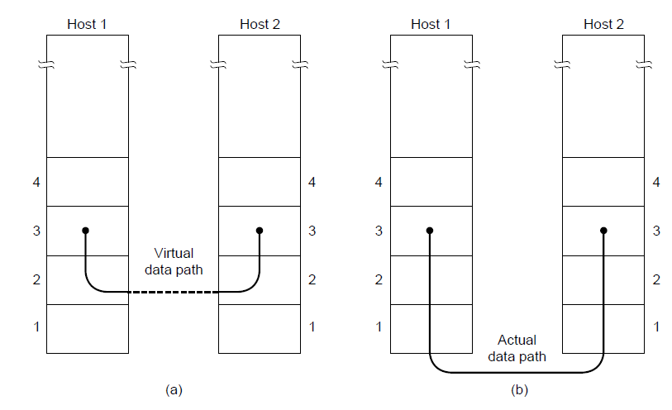
Network Layer Services
(a) Virtual communication. (b) Actual communication.

Slide 12
Possible Services Offered
Unacknowledged connectionless service.
Acknowledged connectionless service.
Acknowledged connection-oriented service.

Slide 13
Unacknowledged Connectionless Service
It consists of having the source machine send independent frames to the destination machine without having the destination machine acknowledge them.
Example: Ethernet, Voice over IP, etc. in all the communication channel were real time operation is more important that quality of transmission.

Slide 14
Acknowledged Connectionless Service
Each frame send by the Data Link layer is acknowledged and the sender knows if a specific frame has been received or lost.
Typically the protocol uses a specific time period that if has passed without getting acknowledgment it will re-send the frame.
This service is useful for commutation when an unreliable channel is being utilized (e.g., 802.11 WiFi).
Network layer does not know frame size of the packets and other restriction of the data link layer. Hence it becomes necessary for data link layer to have some mechanism to optimize the transmission.

Slide 15
Acknowledged Connection Oriented Service
Source and Destination establish a connection first.
Each frame sent is numbered
Data link layer guarantees that each frame sent is indeed received.
It guarantees that each frame is received only once and that all frames are received in the correct order.
Examples:
Satellite channel communication,
Long-distance telephone communication, etc.

Slide 16
Acknowledged Connection Oriented Service
Three distinct phases:
Connection is established by having both side initialize variables and counters needed to keep track of which frames have been received and which ones have not.
One or more frames are transmitted.
Finally, the connection is released – freeing up the variables, buffers, and other resources used to maintain the connection.

Slide 17
Framing
To provide service to the network layer the data link layer must use the service provided to it by physical layer.
Stream of data bits provided to data link layer is not guaranteed to be without errors.
Errors could be:
Number of received bits does not match number of transmitted bits (deletion or insertion)
Bit Value
It is up to data link layer to correct the errors if necessary.

Slide 18
Framing
Transmission of the data link layer starts with breaking up the bit stream
into discrete frames
Computation of a checksum for each frame, and
Include the checksum into the frame before it is transmitted.
Receiver computes its checksum error for a receiving frame and if it is different from the checksum that is being transmitted will have to deal with the error.
Framing is more difficult than one could think!

Slide 19
Framing Methods
Byte count.
HDLC over asynchronous links: Flag bytes with byte stuffing.
HDLC over synchronous links: Flag bits with bit stuffing.
Physical layer coding violations.

Slide 20
Byte Count Framing Method
It uses a field in the header to specify the number of bytes in the frame.
Once the header information is being received it will be used to determine end of the frame.
See figure in the next slide:
Trouble with this algorithm is that when the count is incorrectly received the destination will get out of synch with transmission.
Destination may be able to detect that the frame is in error but it does not have a means (in this algorithm) how to correct it.

Slide 21
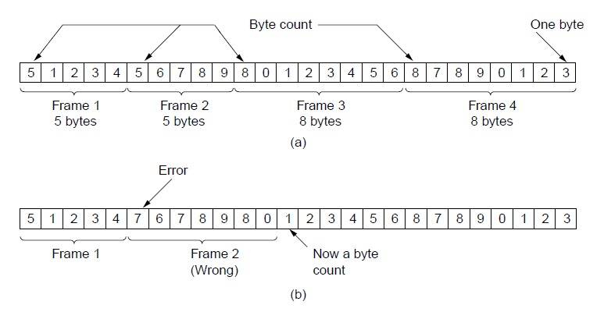
Framing (1)
A byte stream. (a) Without errors. (b) With one error.

Slide 22
Flag Bytes with Byte Stuffing Framing Method
This methods gets around the boundary detection of the frame by having each appended by the frame start and frame end special bytes.
If they are the same (beginning and ending byte in the frame) they are called flag byte.
In the next slide figure this byte is shown as FLAG.
If the actual data contains a byte that is identical to the FLAG byte (e.g., picture, data stream, etc.) the convention that can be used is to have escape character inserted just before the “FLAG” character.

Slide 23
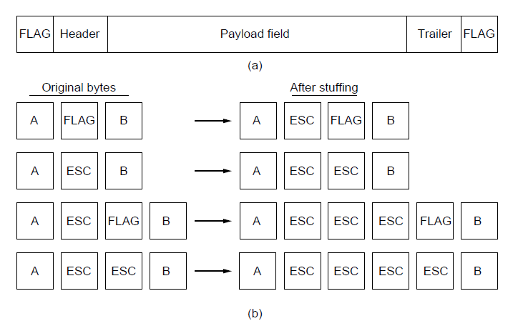
Framing (2)
A frame delimited by flag bytes.
Four examples of byte sequences before and after byte stuffing.

Slide 24
Flag Bits with Bit Stuffing Framing Method
This methods achieves the same thing as Byte Stuffing method by using Bits (1) instead of Bytes (8 Bits).
It was developed for High-level Data Link Control (HDLC) protocol.
Each frames begins and ends with a special bit patter:
01111110 or 0x7E <- Flag Byte
Whenever the sender’s data link layer encounters five consecutive 1s in the data it automatically stuffs a 0 bit into the outgoing bit stream.
USB uses bit stuffing.

Slide 25
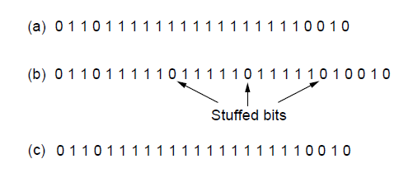
Framing (3)
Bit stuffing. (a) The original data. (b) The data as they appear on
the line. (c) The data as they are stored in the receiver’s memory after destuffing.

Slide 26
Framing
Many data link protocols use a combination of presented methods for safety. For example in Ethernet and 802.11 each frame begin with a well-defined pattern called a preamble.
Preamble is typically 72 bits long.
It is then followed by a length fileld.

Slide 27
Error Control
After solving the marking of the frame with start and end the data link layer has to handle eventual errors in transmission or detection.
Ensuring that all frames are delivered to the network layer at the destination and in proper order.
Unacknowledged connectionless service: it is OK for the sender to output frames regardless of its reception.
Reliable connection-oriented service: it is NOT OK.

Slide 28
Error Control
Reliable connection-oriented service usually will provide a sender with some feedback about what is happening at the other end of the line.
Receiver Sends Back Special Control Frames.
If the Sender Receives positive Acknowledgment it will know that the frame has arrived safely.
Timer and Frame Sequence Number for the Sender is Necessary to handle the case when there is no response (positive or negative) from the Receiver .

Slide 29
Flow Control
Important design issue for the cases when the sender is running on a fast powerful computer and receiver is running on a slow low-end machine.
Two approaches:
Feedback-based flow control
Rate-based flow control

Slide 30
Feedback-based Flow Control
Receiver sends back information to the sender giving it permission to send more data, or
Telling sender how receiver is doing.

Slide 31
Rate-based Flow Control
Built in mechanism that limits the rate at which sender may transmit data, without the need for feedback from the receiver.

Slide 32
Bit Errors in a Link
Types of errors
Isolated errors: Bit errors that do not affect other bits
Burst errors: A cluster of bits in which a number of errors occur
Burst errors increase with data rate
1μs of impulse noise or fading effect will affect
At most 2 bits when data rate is 1Mbps
At most 101 bits when data rate is 100Mbps

Slide 33
How Often do Errors Occur?
Let two independent events have probability p, q
Probability of either event is:
1 - (1 - p)(1 - q) = p + q – pq ≈ p + q, for p, q small
BER = 10⁻⁷, and a file is 10⁴ long, then the probability of a single error is 10⁴ x 10⁻⁷ = 10⁻³
Probability of exactly two errors. For two bits i, j the probability of error is 10⁻⁷ x 10⁻⁷
Total # of pairs:
Probability of two errors: 5 x 10⁷ x 10⁻¹⁴ = 5 x 10⁻⁷

Slide 34
Dealing with Errors
Receiver must be aware that an error occurred in a frame
Need to have an error detection mechanism
Receiver must receive the correct frame
Two possible strategies
Add information redundancy to correct errors (error correcting codes)
Ask sender to re-send frame (retransmission strategies)
In practice both are employed

Slide 35
Error Detection
Single parity checks
Append a single parity bit at end of frame. Parity is 1 if # of ones is odd, and zero otherwise
Example: 0 1 1 0 1 0 1 0 1 1 0 0 ← parity
Single parity check can detect any odd # of errors
Cannot tell where the error took place or how many occurred
Not useful for burst errors

Slide 36
Two-dimensional Parity
Arrange bits of a frame into a two dimensional array
Can detect all 1-, 2-, and 3-bit errors, and most 4-bit errors but not all
Can also correct 1-bit errors, if it is known that a one-bit error occurred
Overhead: 13/35
1 | 0 | 0 | 1 | 0 | 1 | 0 | 1
0 | 1 | 1 | 1 | 0 | 1 | 0 | 0
1 | 1 | 1 | 0 | 0 | 0 | 1 | 0
1 | 0 | 0 | 0 | 1 | 1 | 1 | 0
0 | 0 | 1 | 1 | 0 | 0 | 1 | 1
1 | 0 | 1 | 1 | 1 | 1 | 1 | 0

Slide 37
(IP) Checksum
Treat data as 16-bit words
Add 16-bit words two at a time
Add carry to LSB
Once done, compute one’s complement (i.e. invert result)
E.g. Assume the following header
1000 0110 0101 1110
1010 1100 0110 0000
0111 0001 0010 1010
1000 0001 1011 0101
What type of errors can remain undetected?

Slide 38
Cyclic Redundancy Check (CRC)
Add k redundant bits on a n-bit message
Design goal k<<n so that overhead is low
Example: 32-bit CRC adequate for 12,000 bits (1,500) bytes
Represent (n+1)-bit messages as n degree polynomials
Example: 10011010 maps to x⁷ + x⁴ + x³ + x¹
The bits of the message to be transmitted become the coefficients of the polynomial

Slide 39
Polynomial Arithmetic
Any polynomial B(x) is divisible by a polynomial C(x) if deg(B) ≥ deg(C) C(x) is called the divisor
If C(x) and B(x) are of the same degree, the remainder is obtained by subtracting C(x) from B(x)
Modulo 2 arithmetic, subtraction is an XOR operation between coefficients
Example B(x) = x³ + 1, C(x) = x³ + x² + 1
Remainder: R(x) = x²
B(x) = 1001, C(x) =1101, R(x) = 0100 (XOR of B(x), C(x))

Slide 40
CRC Calculation
Goal: For message M(x), and divisor C(x), construct polynomial P(x) that is divisible by C(x)
C(x) known to both sender and receiver
Process:
Step 1: multiply M(x) by x^{k} (add k zeros at the end of message) and obtain T(x) . k is the degree of C(x).
Step 2: Divide T(x) by C(x)
Step 3: Subtract the remainder R(x) from T(x).
Step 4: Obtain P(x) = M(x)|R(x) divisible by C(x)

Slide 41
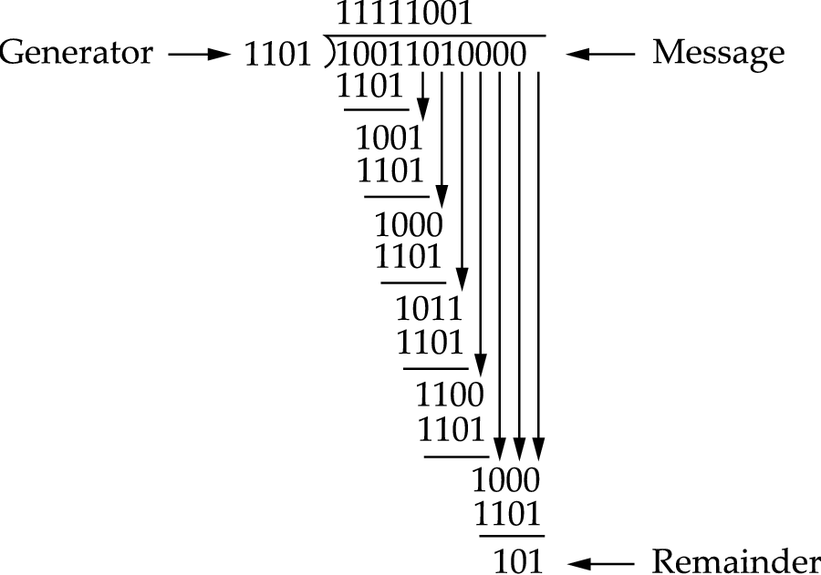
Example: CRC Calculation
M = 10011010, C(x) = x³ + x² +1
T(x) = 10011010 | 000
R(x) = 101
P(x) = 10011010 | 101

Slide 42
Selection of C(x)
Bit errors can be seen as a polynomial E(x) added to P(x)
Error remains undetected if E(x) is divisible by C(x)
Single-bit errors: E(x) = x^{i}, x^{k}, x⁰ coefficients are nonzero, all single-bit errors detected
Double-bit errors: C(x) has a factor with at least 3 terms
Odd number errors: C(x) contains the factor (x+1)
Any burst error of less than k bits and most burst errors of larger than k bits

Slide 43
Commonly Used CRCs
CRC | C(x)
CRC-8 | x⁸ + x² + x + 1
CRC-10 | x¹⁰ + x⁹ + x⁵ + x⁴ + x + 1
CRC-12 | x¹² + x¹¹ + x³ + x² + 1
CRC-16 | x¹⁶ + x¹⁵ + x² + 1
CRC-CCITT | x¹⁶ + x¹² + x⁵ + 1
CRC-32 | x³² + x²⁶ + x²³ + x²² + x¹⁶ + x¹² + x¹¹ + x¹⁰ + x⁸ + x⁷ + x⁵ + x⁴ + x² + x +1

Slide 44
Fundamentals of Coding
Coding: Map an k-bit word to an n-bit word.
Notation: This code is usually referred to as (n,k)-code
Weight of a word: The number of ones in the word.
Ex.: W(100011101)= 5
Hamming distance between x, y: d(x,y) = W(x⊕y)
Ex. x = 10011101, y = 11100110, d = 6
# words at a hamming distance d:
# words at a distance up to d:
Minimum distance: the minimum Hamming distance out of all distances in a code

Slide 45
Detecting and Correcting Errors
An (n, k)-code can detect up to n-k-1 errors and correct up to n-k/2 errors
Example
Hamming (7,4)-code, can detect any single or two bit errors, and correct any single bit error
Well known codes
Hamming codes
Reed-Solomon codes: used in DSL, WiMax, CD, DVD, Blue-Ray Discs

Slide 46
Error Detection and Correction
Two basic strategies to deal with errors:
Include enough redundant information to enable the receiver to deduce what the transmitted data must have been. Error correcting codes.
Include only enough redundancy to allow the receiver to deduce that an error has occurred (but not which error). Error detecting codes.
In addition, sender to re-send frame (retransmission strategies)

Slide 47
Error Detection and Correction
Error codes are examined in Link Layer because this is the first place that we have run up against the problem of reliability transmitting groups of bits.
Codes are reused because reliability is an overall concern.
The error correcting code are also seen in the physical layer for noise channels.
Commonly they are used in link, network and transport layer.

Slide 48
Error Detection and Correction
Error codes have been developed after long fundamental research conducted in mathematics.
Many protocol standards get codes from the large field in mathematics.

Slide 49
Error Detection & Correction Code (1)
Hamming codes.
Binary convolutional codes.
Reed-Solomon codes.
Low-Density Parity Check codes.

Slide 50
Error Detection & Correction Code
All the codes presented in previous slide add redundancy to the information that is being sent.
A frame consists of
m data bits (message) and
r redundant bits (check).
Block code - the r check bits are computed solely as function of the m data bits with which they are associated.
Systemic code – the m data bits are send directly along with the check bits.
Linear code – the r check bits are computed as a linear function of the m data bits.

Slide 51
Error Detection & Correction Code
n – total length of a block (i.e., n = m + r)
(n, m) – code
n – bit codeword containing n bits.
m/n – code rate (range ½ for noisy channel and close to 1 for high-quality channel).

Slide 52
Error Detection & Correction Code
Example
Transmitted: 10001001
Received: 10110001
XOR operation gives number of bits that are different.
XOR: 00111000
Number of bit positions in which two codewords differ is called Hamming Distance. It shows that two codes are d distance apart, and it will require d errors to convert one into the other.

Slide 53
Error Detection & Correction Code
All 2^{m} possible data messages are legal, but due to the way the check bits are computers not all 2^{n} possible code words are used.
Only small fraction of 2^{m}/2^{n}=1/2^{r} are possible will be legal codewords.
The error-detecting and error-correcting codes of the block code depend on this Hamming distance.
To reliably detect d error, one would need a distance d+1 code.
To correct d error, one would need a distance 2d+1 code.

Slide 54
Error Detection & Correction Code
All 2^{m} possible data messages are legal, but due to the way the check bits are computers not all 2^{n} possible code words are used.
Only small fraction of 2^{m}/2^{n}=1/2^{r} are possible will be legal codewords.
The error-detecting and error-correcting codes of the block code depend on this Hamming distance.
To reliably detect d error, one would need a distance d+1 code.
To correct d error, one would need a distance 2d+1 code.

Slide 55
Error Detection & Correction Code
Example:
4 valid codes:
0000000000
0000011111
1111100000
1111111111
Minimal Distance of this code is 5 => can correct double errors and it can detect quadruple errors.
0000000111 => single or double – bit error. Hence the receiving end must assume the original transmission was 0000011111.
0000000000 => had triple error that was received as 0000000111 it would be detected in error.

Slide 56
Error Detection & Correction Code
One cannot perform double errors and at the same time detect quadruple errors.
Error correction requires evaluation of each candidate codeword which may be time consuming search.
Through design this search time can be minimized.
In theory if n = m + r, this requirement becomes:
(m + r + 1) ≤ 2^{r}

Slide 57
Hamming Code
Codeword: b1 b2 b3 b4 ….
Check bits: The bits that are powers of 2 (p1, p2, p4, p8, p16, …).
The rest of bits (m3, m5, m6, m7, m9, …) are filled with m data bits.
Example of the Hamming code with m = 7 data bits and r = 4 check bits is given in the next slide.

Slide 58
The Hamming Code
Consider a message having four data bits (D) which is to be transmitted as a 7-bit codeword by adding three error control bits. This would be called a (7,4) code. The three bits to be added are three EVEN Parity bits (P), where the parity of each is computed on different subsets of the message bits as shown below.
7 | 6 | 5 | 4 | 3 | 2 | 1
D | D | D | P | D | P | P | 7-BIT CODEWORD
D | - | D | - | D | - | P | (EVEN PARITY)
D | D | - | - | D | P | - | (EVEN PARITY)
D | D | D | P | - | - | - | (EVEN PARITY)

Slide 59
Hamming Code
Why Those Bits? - The three parity bits (1,2,4) are related to the data bits (3,5,6,7) as shown at right. In this diagram, each overlapping circle corresponds to one parity bit and defines the four bits contributing to that parity computation. For example, data bit 3 contributes to parity bits 1 and 2. Each circle (parity bit) encompasses a total of four bits, and each circle must have EVEN parity. Given four data bits, the three parity bits can easily be chosen to ensure this condition.
It can be observed that changing any one bit numbered 1..7 uniquely affects the three parity bits. Changing bit 7 affects all three parity bits, while an error in bit 6 affects only parity bits 2 and 4, and an error in a parity bit affects only that bit. The location of any single bit error is determined directly upon checking the three parity circles.

Slide 60
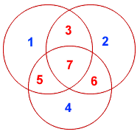
Hamming Code

Slide 61
Hamming Code
For example, the message 1101 would be sent as 1100110, since:
7 | 6 | 5 | 4 | 3 | 2 | 1
1 | 1 | 0 | 0 | 1 | 1 | 0 | 7-BIT CODEWORD
1 | - | 0 | - | 1 | - | 0 | (EVEN PARITY)
1 | 1 | - | - | 1 | 1 | - | (EVEN PARITY)
1 | 1 | 0 | 0 | - | - | - | (EVEN PARITY)

Slide 62
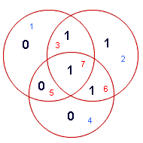
Hamming Codes
When these seven bits are entered into the parity circles, it can be confirmed that the choice of these three parity bits ensures that the parity within each circle is EVEN, as shown here.

Slide 63
Hamming Code
It may now be observed that if an error occurs in any of the seven bits, that error will affect different combinations of the three parity bits depending on the bit position.
For example, suppose the above message 1100110 is sent and a single bit error occurs such that the codeword 1110110 is received:
transmitted message received message
1 1 0 0 1 1 0 ------------> 1 1 1 0 1 1 0
BIT: 7 6 5 4 3 2 1 BIT: 7 6 5 4 3 2 1
The above error (in bit 5) can be corrected by examining which of the three parity bits was affected by the bad bit:

Slide 64
Hamming Code
7 | 6 | 5 | 4 | 3 | 2 | 1
1 | 1 | 1 | 0 | 1 | 1 | 0 | 7-BIT CODEWORD
1 | - | 1 | - | 1 | - | 0 | (EVEN PARITY) | NOT! | 1
1 | 1 | - | - | 1 | 1 | - | (EVEN PARITY) | OK! | 0
1 | 1 | 1 | 0 | - | - | - | (EVEN PARITY) | NOT! | 1

Slide 65
Hamming Code
In fact, the bad parity bits labeled 101 point directly to the bad bit since 101 binary equals 5. Examination of the 'parity circles' confirms that any single bit error could be corrected in this way.
The value of the Hamming code can be summarized:
Detection of 2 bit errors (assuming no correction is attempted);
Correction of single bit errors;
Cost of 3 bits added to a 4-bit message.
The ability to correct single bit errors comes at a cost which is less than sending the entire message twice. (Recall that simply sending a message twice accomplishes no error correction.)

Slide 66
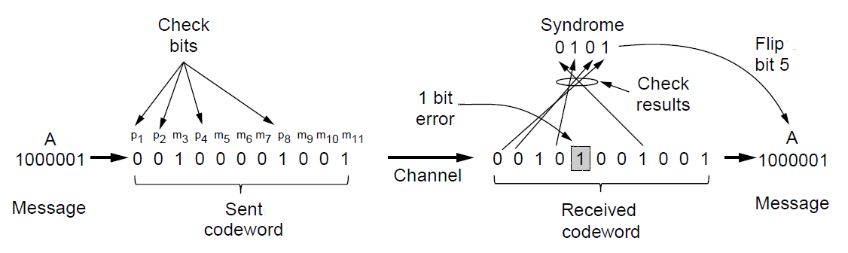
Error Detection Codes (2)
Example of an (11, 7) Hamming code correcting a single-bit error.

Slide 67
Convolutional Codes
Not a block code
There is no natural message size or encoding boundary as in a block code.
The output depends on the current and previous input bits. Encoder has memory.
The number of previous bits on which the output depends is called the constraint length of the code.
They are deployed as part of the
GSM mobile phone system
Satellite Communications, and
802.11 (see example in the previous slide).

Slide 68
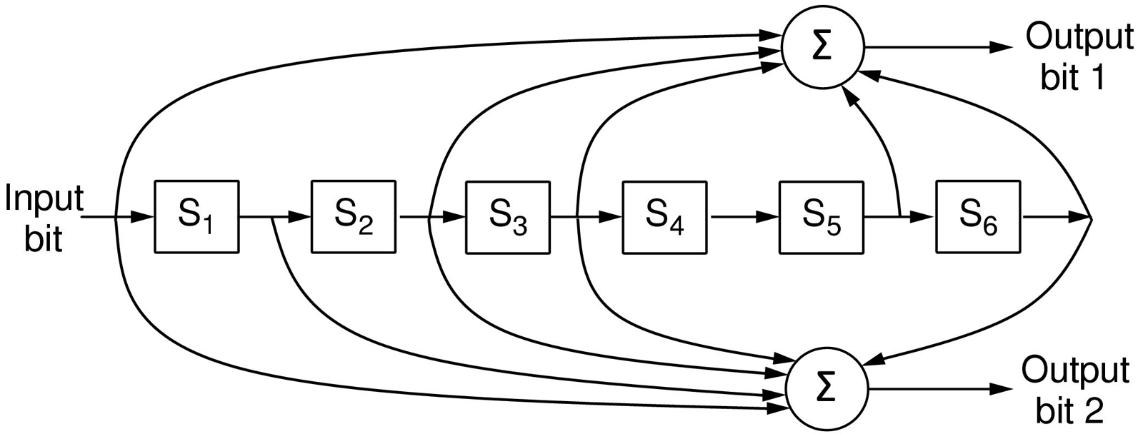
Error Detection Codes (3)
The NASA binary convolutional code used in 802.11.

Slide 69
Convolutional Encoders
Like any error-correcting code, a convolutional code works by adding some structured redundant information to the user's data and then correcting errors using this information.
A convolutional encoder is a linear system.
A binary convolutional encoder can be represented as a shift register. The outputs of the encoder are modulo 2 sums of the values in the certain register's cells. The input to the encoder is either the unencoded sequence (for non-recursive codes) or the unencoded sequence added with the values of some register's cells (for recursive codes).
Convolutional codes can be systematic and non-systematic. Systematic codes are those where an unencoded sequence is a part of the output sequence. Systematic codes are almost always recursive, conversely, non-recursive codes are almost always non-systematic.

Slide 70
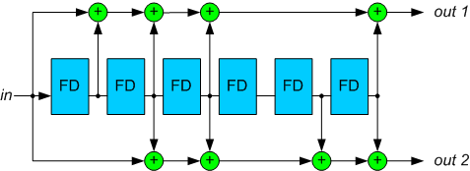
Convolutional Encoders
A combination of register's cells that forms one of the output streams (or that is added with the input stream for recursive codes) is defined by a polynomial. Let m be the maximum degree of the polynomials constituting a code, then K=m+1 is a constraint length of the code.
Figure 1. A standard NASA convolutional encoder with polynomials (171,133).

Slide 71
Convolutional Encoders
For example, for the decoder on the Figure 1, the polynomials are:
g₁(z)=1+z+z²+z³+z⁶
g₂(z)=1+z²+z³+z⁵+z⁶
A code rate is an inverse number of output polynomials.
For the sake of clarity, in this article we will restrict ourselves to the codes with rate R=1/2. Decoding procedure for other codes is similar.
Encoder polynomials are usually denoted in the octal notation. For the above example, these designations are “1111001” = 171 and “1011011” = 133.
The constraint length of this code is 7.
An example of a recursive convolutional encoder is on the Figure 2.

Slide 72
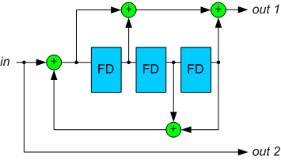
Example of the Convolutional Encoder
Figure 2. A recursive convolutional encoder.

Slide 73
Trellis Diagram
A convolutional encoder is often seen as a finite state machine. Each state corresponds to some value of the encoder's register. Given the input bit value, from a certain state the encoder can move to two other states. These state transitions constitute a diagram which is called a trellis diagram.
A trellis diagram for the code on the Figure 2 is depicted on the Figure 3. A solid line corresponds to input 0, a dotted line – to input 1 (note that encoder states are designated in such a way that the rightmost bit is the newest one).
Each path on the trellis diagram corresponds to a valid sequence from the encoder's output. Conversely, any valid sequence from the encoder's output can be represented as a path on the trellis diagram. One of the possible paths is denoted as red (as an example).

Slide 74
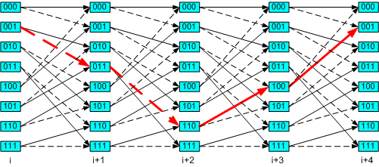
Trellis Diagram
Figure 3. A trellis diagram corresponding to the encoder on the Figure 2.

Slide 75
Trellis Diagram
Note that each state transition on the diagram corresponds to a pair of output bits. There are only two allowed transitions for every state, so there are two allowed pairs of output bits, and the two other pairs are forbidden. If an error occurs, it is very likely that the receiver will get a set of forbidden pairs, which don't constitute a path on the trellis diagram. So, the task of the decoder is to find a path on the trellis diagram which is the closest match to the received sequence.

Slide 76
Trellis Diagram
Let's define a free distance d_{f} as a minimal Hamming distance between two different allowed binary sequences (a Hamming distance is defined as a number of differing bits).
A free distance is an important property of the convolutional code. It influences a number of closely located errors the decoder is able to correct.

Slide 77
Viterbi Algorithm
Viterbi algorithm reconstructs the maximum-likelihood path for a given input sequence.

Slide 78
Error-Detecting Codes (1)
Linear, systematic block codes
Parity.
Checksums.
Cyclic Redundancy Checks (CRCs).

Slide 79

Parity Bit Error Detection
Block Size (m) 1000 bits from the equation: we need (r) 10 check bits (1011 < 1024).
1 Mbit of data would require 10 kbits.
To detect a block with a single bit of error, one parity bit would suffice.
Once every 1000 blocks (bit error rate is 10⁻⁶) one extra block would have to be re-transmitted.
$$\left(m+r+1\right)≤2^{r}$$

Slide 80
Parity Bit Error Detection
Problem with multiple bit errors in burst errors.
Considerer the data stream as a matrix of n bits by k bits. Each (k) row is computed a parity.
Interleaving is used to compute parity in different order from that that is being transmitted.
Compute parity for each n columns
Transmit the data as k rows.
The last row we will send the n parity bits.
Example in the next slide gives the case for n=7 and k=7.

Slide 81
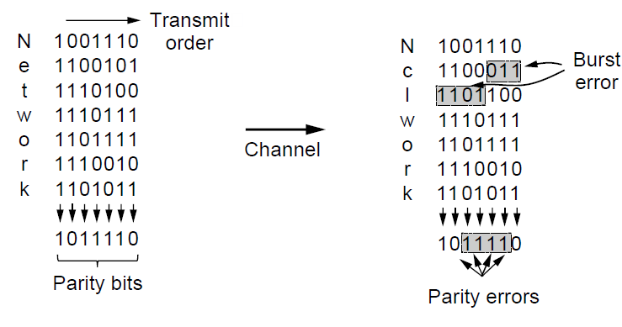
Parity Error-Detecting Codes (2)
Interleaving of parity bits to detect a burst error.

Slide 82
Parity Error-Detecting Codes
A burst of length n+1 will pass undetected.
The probability of that any of the n columns will have the correct parity by accident is 0.5; the probability of a bad block being accepted as a good one is 2^{-n}.

Slide 83
Checksum Error-Detecting Codes
A group of parity bits is one example of a checksum.
Stronger checksums are based on a running sum of the data bits of the message.
The checksum is usually placed at the end of the message – complementary sum.
Errors can be detected by summing the entire received codeword, both data bits and checksum bits.
If result is zero – no error has been detected.

Slide 84
Checksum Error-Detecting Codes
Example if checksum is the 16-bit Internet error detection used as part of the IP protocol.
It is applied to 16-bit words.
It will detect an error for cases where parity detection fails.
Checksum error would fail for:
Deletion or addition of zero data,
Swapping part of the message,
Messages splices in which parts of two packets are put together.
Those are typical errors caused by faulty hardware.

Slide 85
Checksum Error-Detecting Codes
Fletcher’s checksum
Includes positional component- adding the product of the data and its position to the running sum.
The stronger kind of error-detecting code is Cyclic Redundancy Check (CRC) know as polynomial code.
A k-bit frame is regarded as the coefficient list for a polynomial with k terms ranging from x^{k-1} to x⁰

Slide 86
CRC Error-Detecting Codes
Example:
110001: 1x⁵ + 1x⁴ + 0x³ + 0x² + 0x¹ + 1x⁰
Module 2 arithmetic –
Addition and Subtraction are equivalent to exclusive OR.
Long division is carried the same way except that subtraction operation is again done module 2.

Slide 87
CRC Error-Detecting Codes
Protocol requires that sender to agree in advance with the receiver on the generator polynomial, G(x).
Both high- and low-order bits must be 1.
CRC is computed for a frame of length m- bits corresponding that is longer than the G(x).
When the receiver gets a checksummed frame it divides it by G(x). If there the result is not equal to zero it means that there has been transmission error.

Slide 88
CRC Error-Detecting Codes
Algorithm:
Let r be the degree of G(x). Append r zero bits to the low-order end of the frame so it now contains m+r bits and corresponds to the polynomial x^{r}M(x)
Divide the bit string corresponding to G(x) into the bit string corresponding to x^{r}M(x) using modulo 2 division.
Subtract the remanider (which is always r or fewer bits) from the bit string corresponding to x^{r}M(x) using module 2 subtraction. The result is the checksummed frame, T(x), to be transmitted.

Slide 89
CRC Error-Detecting Codes
Example:
Frame: 1101011111
Generator: x⁴+x+1

Slide 90
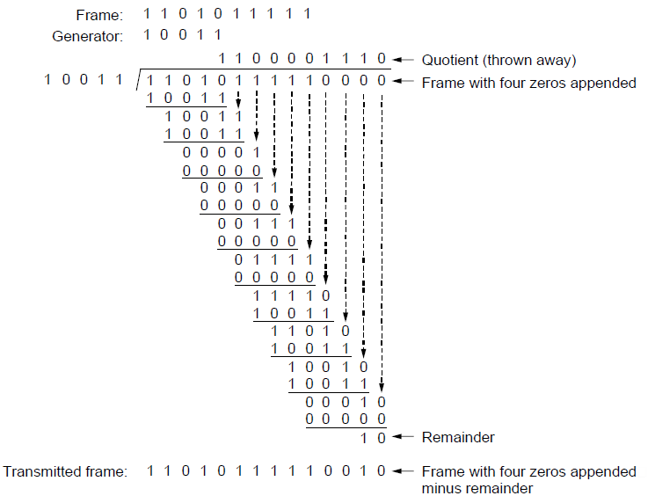
Error-Detecting Codes (3)
Example calculation of the CRC

Slide 91
CRC Error-Detecting Codes
Certain polynomials have become international standards: IEEE 802
x³² + x²⁶ + x²³ + x²² + x¹⁶ + x¹² + x¹¹ + x¹⁰ + x⁸ + x⁷ + x⁴ + x² + x¹ + 1

Slide 92
Elementary Data Link Protocols (1)
Utopian Simplex Protocol
Simplex Stop-and-Wait Protocol
Error-Free Channel
Simplex Stop-and-Wait Protocol
Noisy Channel

Slide 93
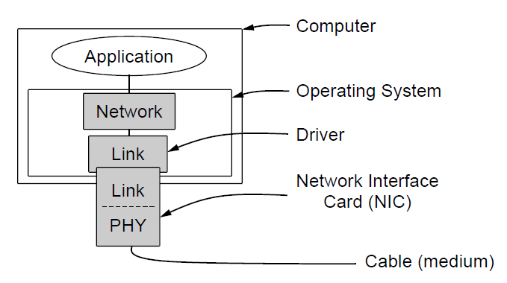
Elementary Data Link Protocols (2)
Implementation of the physical, data link, and network layers.

Slide 94
Elementary Data Link Protocols
Assumptions:
A wants to send a long stream of data to machine B.
It uses reliable connection-oriented service.
It assumes to have infinite supply of data ready to send,
It does not have to wait for data to be produced.
Machines A and B do not crash
Data link layer treads the data as packets of pure data whose every bit is to be delivered to the destination's network layer.

Slide 95
Elementary Data Link Protocols
Data Link layer job is to:
FRAMEING: encapsulate the data packets in a frame by adding the header and trailer.

Slide 96
Elementary Data Link Protocols
Error Correction and Detection:
Control information is added to header, and
Checksum is added to trailer.
Frame is then transmitted to the other machine.

Slide 97
Elementary Data Link Protocols
Library procedures:
to_physical_layer
from_physical_layer
wait_for_event(&event)
event object will contain the information what has happened.
In the receiving end:
Data is being received and the checksum is being computed.
If the error has occurred the data link layer is being informed: event = chksum_err
If the data has arrived undamaged: event = frame_arrival.

Slide 98
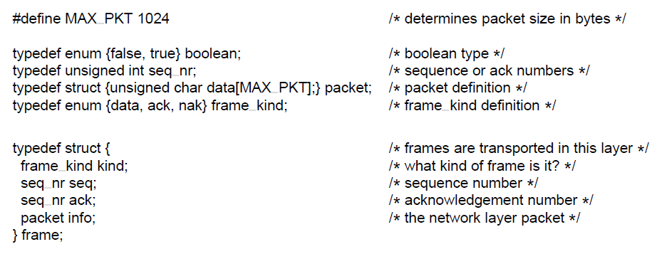
Elementary Data Link Protocols (3)
. . .
Some definitions needed in the protocols to follow. These definitions are located in the file protocol.h.

Slide 99
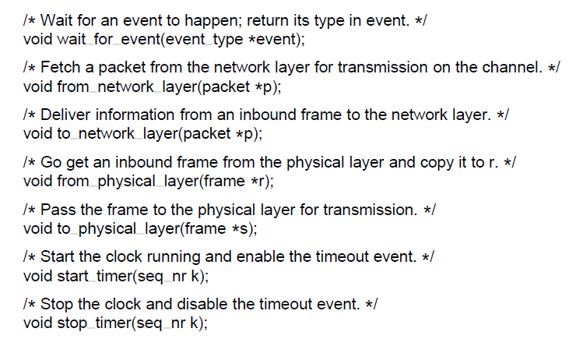
Elementary Data Link Protocols (4)
. . .
Some definitions needed in the protocols to follow. These definitions are located in the file protocol.h.

Slide 100
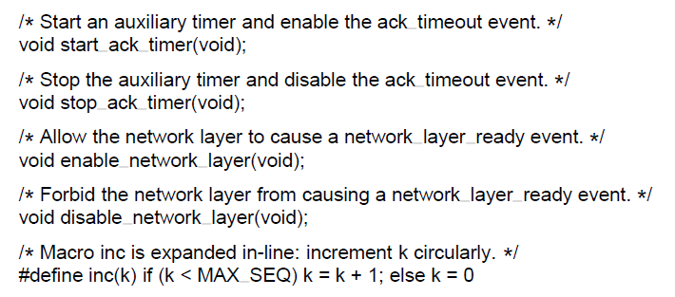
Elementary Data Link Protocols (5)
Some definitions needed in the protocols to follow. These definitions are located in the file protocol.h.

Slide 101
Data Link Protocols
During transmission, frames still corrupted or lost even with various error control and protection mechanisms in place, such as error detection and correction parity check bits, checksums, CRC etc
Error control and protection mechanisms incur overheads and they are link error rate dependent
For example, on some unreliable wireless links, errors may be too severe to be corrected. As a result, some corrupt frames must be discarded.
A link-level protocol that wants to deliver frames reliably must somehow recover from these discarded (lost) frames. This is a question itself!!!

Slide 102
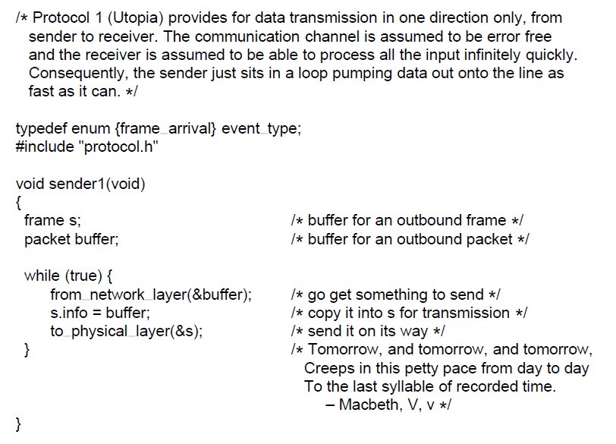
Utopian Simplex Protocol (1)
. . .
A utopian simplex protocol.

Slide 103
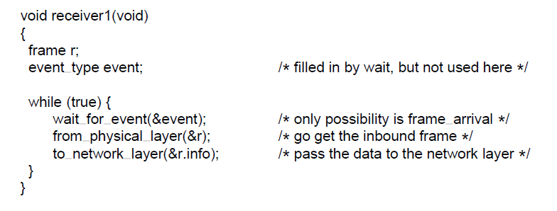
Utopian Simplex Protocol (2)
A utopian simplex protocol.

Slide 104
Utopian Simplex Protocol
Unrealistic
It does not handle flow control
It does not handle error correction
Resembles connectionless service that relies on higher layer to solve those problems.

Slide 105
Data Link Protocols
Combination of two fundamental mechanisms—acknowledgments and timeouts, called automatic repeat request (abbreviated ARQ)
An acknowledgment ACK is a small control frame, a header without any data
Piggyback an ACK on a data frame by sending in the opposite direction.
Receipt of an acknowledgment indicates to the sender of the original frame that its frame was successfully delivered.
If the sender does not receive an acknowledgment after a reasonable amount of time, then it retransmits the original frame. This action of waiting a reasonable amount of time is called a timeout
What reasonable amount of time, fixed or adaptive schemes? If adaptive, how to measure and accomodate various links??

Slide 106
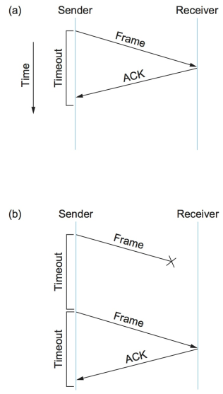
Timeline showing four different scenarios for the stop-and-wait algorithm. (a) The ACK is received before thetimer expires; (b) the original frame is lost;

Slide 107
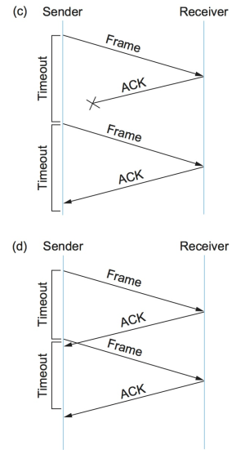
Timeline showing four different scenarios for the stop-and-wait algorithm. (c) the ACK is lost; (d) the timeout fires too soon.

Slide 108
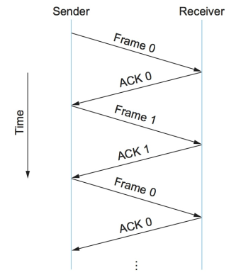
Timeline for stop-and-wait with 1-bit sequence number.

Slide 109
Data Link Protocols
The main shortcoming of the stop-and-wait algorithm is that it allows the sender to have only one outstanding frame on the link at a time, and this may be far below the link's capacity.
Use the delay × bandwidth product to represent the amount of data that could be in transit.
We would like to be able to send this much data without waiting for the first acknowledgment.
The principle at work here is often referred to as keeping the pipe full.

Slide 110
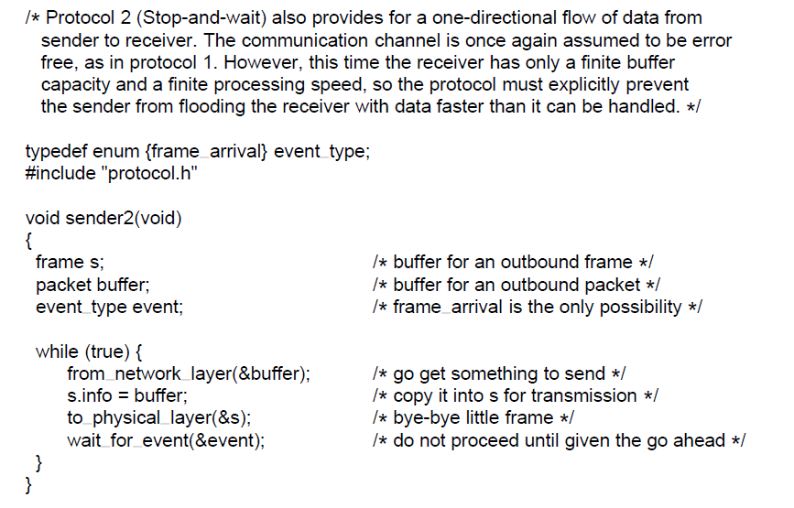
Simplex Stop-and-Wait Protocol for a Noisy Channel (1)
. . .
A simplex stop-and-wait protocol.

Slide 111
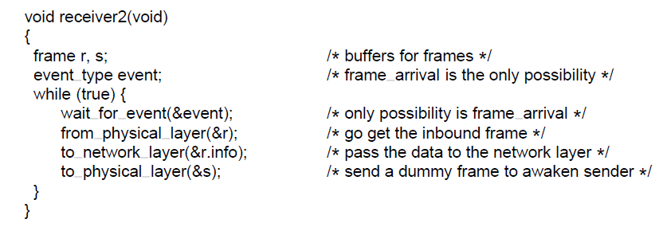
Simplex Stop-and-Wait Protocol for a Noisy Channel (2)
A simplex stop-and-wait protocol.

Slide 112
Simplex Protocol
Solves the problem of flow control.
Blocking acknowledgment of the reception of the frame partially achieves this.
If acknowledgment frame gets lost the protocol will fail.
Error correction is not implemented.
One direction only.

Slide 113
Sliding Window Protocols
Full duplex data transmission
Running two instances of one of the previous protocols,
Each uses separate data link for simplex data traffic in different directions (“forward” channel and “reverse” channel).
Better idea is to use the same channel in both directions.
A and B frames are intermixed with acknowledgment frames from A and B.
Kind field in the header of the incoming frame will be used to tell the difference.

Slide 114
Sliding Window Protocols
In addition to being able to use duplex communication, the further protocol improvement would be to send the acknowledgment frame together with the new data frame. This provides for a “free ride”.
The technique of delaying the acknowledgment for a bit to be added to the next packet is know as piggybacking.
This technique add another complication.
If the data frame is available within a short time period (less than msec) it will use piggybacking.
Otherwise, it will send separate acknowledgment.

Slide 115
Sliding Window
At any instant of time the sender maintains a set of sequences numbers that correspond to frames that are permitted to be send.
Those frames are said to fall within a sending window.
Receiver also maintains a receiving window that corresponds to the set of frames that it is permitted to accept.

Slide 116
Sliding Window
The sequence numbers within the sender’s window represent the frames that have been sent or can be sent but are not yet been acknowledged.
Whenever the a new packet arrives from the network layer, it is given the next highest sequence number, and
The upper edge of the window is advanced by one.
When acknowledgement arrives the lower edge is advance by one.
This is how the protocol maintains the list of unacknowledged frames.

Slide 117
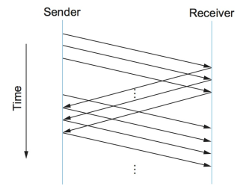
Timeline for the sliding window algorithm.

Slide 118
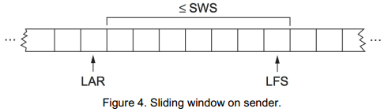
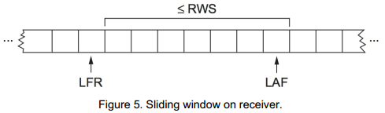
Sliding window algorithm
The sender also maintains the following invariant: LFS - LAR <= SWS
Receiver also maintains the following invariant: LAF - LFR <= RWS

Slide 119
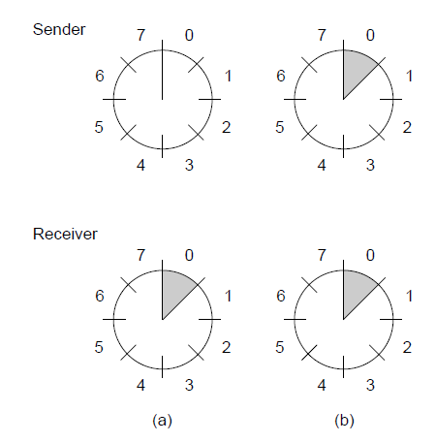
Sliding Window Protocols
A sliding window of size 1, with a 3-bit sequence number. (a) Initially. (b) After the first frame has been sent.

Slide 120
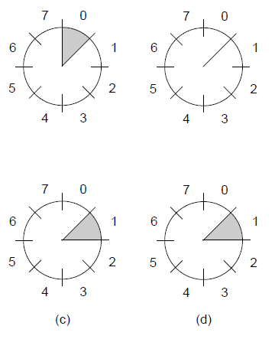


Sliding Window Protocols
A sliding window of size 1, with a 3-bit sequence number
(c) After the first frame has been received. (d) After the first acknowledgement has been received.

Slide 121
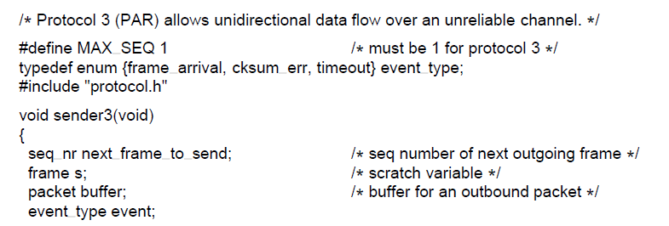
Sliding Window Protocols (1)
. . .
A positive acknowledgement with retransmission protocol.

Slide 122
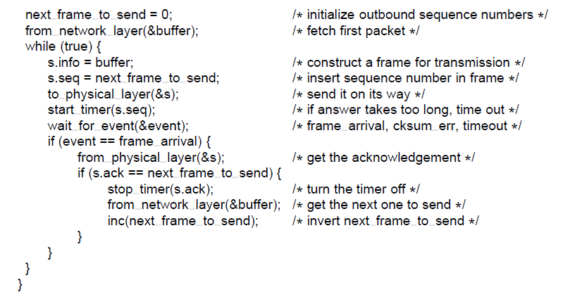
Sliding Window Protocols (2)
. . .
A positive acknowledgement with retransmission protocol.

Slide 123
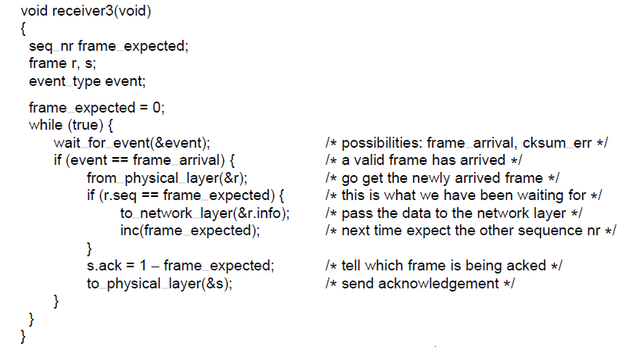
Sliding Window Protocols (3)
A positive acknowledgement with retransmission protocol.

Slide 124
One-Bit Sliding Window Protocol
Window size = 1
Stop-and-wait Sender transmits a frame and waits for its acknowledgment before it sends the next one.
Figure of next slide depicts such a protocol.

Slide 125
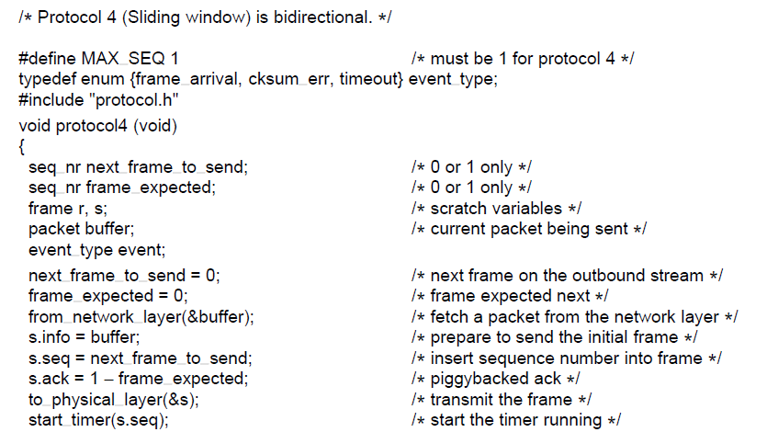
One-Bit Sliding Window Protocol (1)
. . .
A 1-bit sliding window protocol.

Slide 126
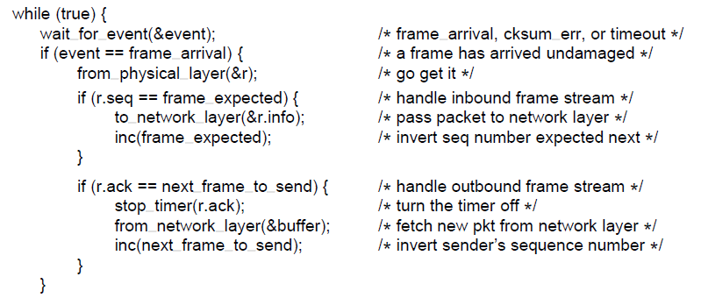
One-Bit Sliding Window Protocol (2)
. . .
A 1-bit sliding window protocol.

Slide 127
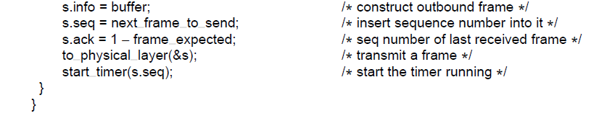
One-Bit Sliding Window Protocol (3)
A 1-bit sliding window protocol.

Slide 128
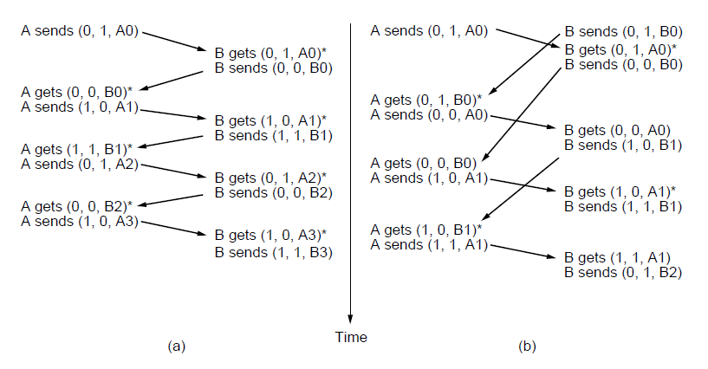
One-Bit Sliding Window Protocol (4)
Two scenarios for protocol 4. (a) Normal case. (b) Abnormal
case. The notation is (seq, ack, packet number). An asterisk indicates where a network layer accepts a packet

Slide 129
Protocol Using Go-Back-N
Up-to-know the protocols depicted so far are based on the assumption that the time required for transmission and reception of the acknowledgment packets is negligible.
If this assumptions is not true then round-trip time can have important implications in the efficiency of the communication and the bandwidth utilization.

Slide 130
Protocol Using Go-Back-N
Example:
50 kbps satellite channel
500 msec round-trip propagation delay.
Lets use Protocol 4 (previous slides) to send a 1000 bit frames via the satellite.
t = 0: the sender starts the first frame
t = 20 msec: the frame has been completely sent.
t = 270 msec: the frame has fully arrived at the satellite.
t = 520 msec: the acknowledgment has arrived at the sender.
Sender was blocked 500/520 or 96% of the time. In order to send the packed the sender utilized 4% of the available bandwidth.

Slide 131
Protocol Using Go-Back-N
The problem?
Consequence of the rule that requires a sender to wait for an acknowledgment before sending another frame.
Relaxing this condition will enable achieving significantly better throughput.
Solution!
Allowing sender the transmit w frames before blocking.
Acknowledgment will arrive for previous frames before the window becomes full.

Slide 132
Protocol Using Go-Back-N
Must correctly establish what is the actual size of w.
Number of frames to fit inside the channel.
Capacity of the channel is determined by
Bandwidth in bits/sec
One-way transit time, or
The bandwidth-delay product of the link: BD
The actual size should be set to:
w = 2BD+1

Slide 133
Protocol Using Go-Back-N
Example:
Link with the bandwidth of 50 kbps
One way transit time of 250 msec
Bandwidth delay product is BD = 50 kbps x 250 msec = 12.5 kbits or 12.5 frames of 1000 bits.
2BD+1 = 26 frames.
t = 0: sends a first frame and subsequent frames after 20 msec.
t = 520 msec: acknowledgment for the first frame is received, while 26 frames were transmitted.
Thereafter, acknowledgments will arrive every 20 msec.

Slide 134
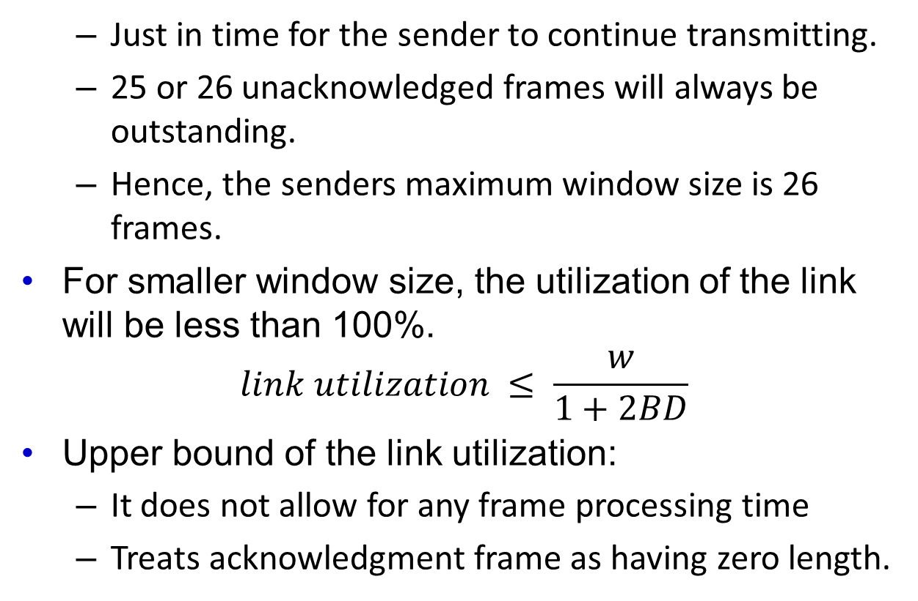
Protocol Using Go-Back-N
Just in time for the sender to continue transmitting.
25 or 26 unacknowledged frames will always be outstanding.
Hence, the senders maximum window size is 26 frames.
For smaller window size, the utilization of the link will be less than 100%.
$$link utilization ≤ \frac{w}{1+2BD}$$
Upper bound of the link utilization:
It does not allow for any frame processing time
Treats acknowledgment frame as having zero length.

Slide 135
Protocol Using Go-Back-N
From the equation:
Large bandwidth-delay product requires a large window.
With stop-and-wait for which w = 1, of there is even one frame’s worth of propagation delay, the efficiency will be less than 50%.
Pipelining – technique where the number of frames (much greater than 1) are send immediately.
What will happen then when a certain frame is received in error?!

Slide 136
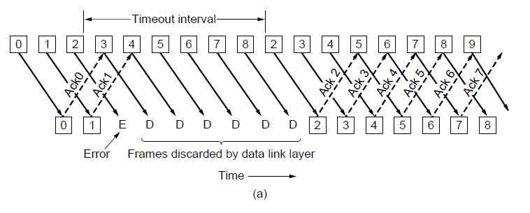
Protocol Using Go-Back-N (1)
Pipelining and error recovery. Effect of an error when
(a) receiver’s window size is 1

Slide 137
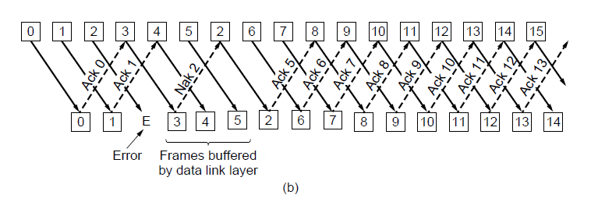
Protocol Using Go-Back-N (2)
Pipelining and error recovery. Effect of an error when
(b) receiver’s window size is large.

Slide 138
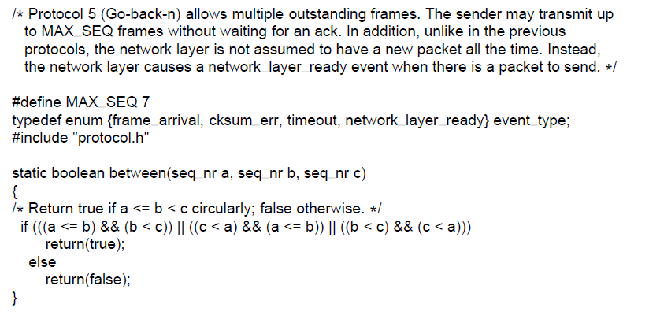
Protocol Using Go-Back-N (3)
. . .
A sliding window protocol using go-back-n.

Slide 139
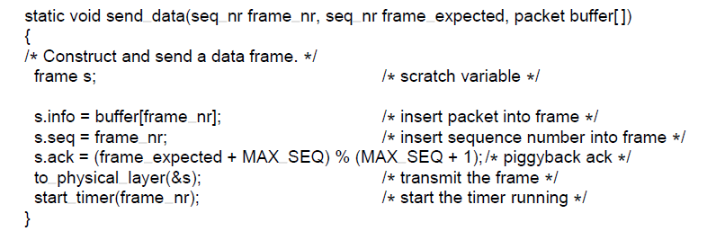
Protocol Using Go-Back-N (4)
. . .
A sliding window protocol using go-back-n.

Slide 140
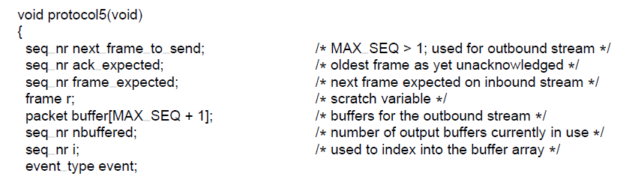
Protocol Using Go-Back-N (5)
. . .
A sliding window protocol using go-back-n.

Slide 141
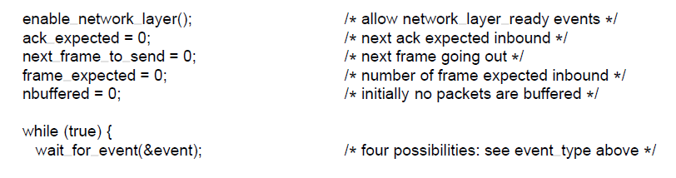
Protocol Using Go-Back-N (6)
. . .
A sliding window protocol using go-back-n.

Slide 142
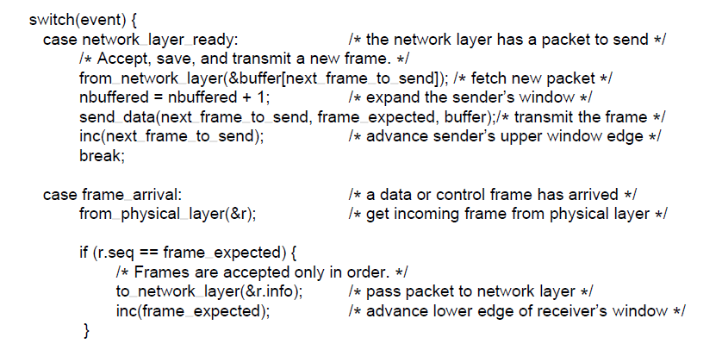
Protocol Using Go-Back-N (7)
. . .
A sliding window protocol using go-back-n.

Slide 143
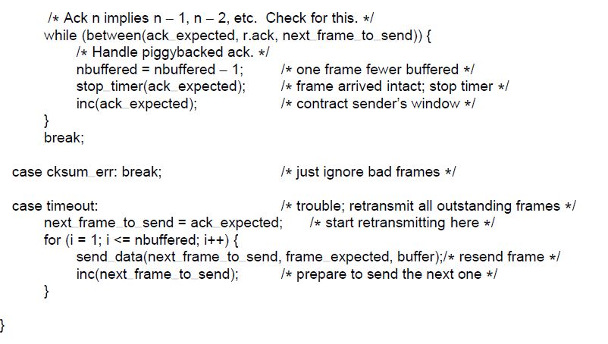
Protocol Using Go-Back-N (8)
. . .
A sliding window protocol using go-back-n.

Slide 144
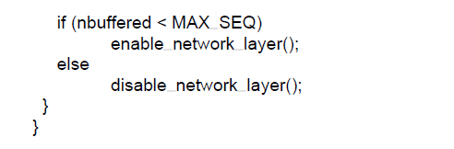
Protocol Using Go-Back-N (9)
A sliding window protocol using go-back-n.

Slide 145
Cumulative Acknowledgment
When an acknowledgment comes in for frame n, frames n-1, n-2, … are also automatically acknowledged.
Because protocol 5 has multiple outstanding frames, it logically needs multiple timers, one per outstanding frame.
Each frame times out independently of all the other ones.
The pending timeouts from a linked list, with each node of the list containing the
Number of clock ticks until the timer expires,
Frame being timed,
A pointer to the next node

Slide 146
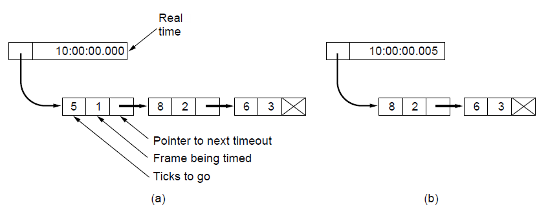
Protocol Using Go-Back-N (10)
Simulation of multiple timers in software. (a) The queued timeouts (b) The situation after the first timeout has expired.

Slide 147
Selective Repeat
The go-back-n protocol works well if errors are rare.
If the line is poor it wastes a lot of bandwidth on retransmitting frames.
A Selective Repeat protocol allows the receiver to accept and buffer the frames following a damaged or lost one.

Slide 148
Selective Repeat
Sender and Receiver maintain a window of outstanding and acceptable sequence numbers, respectively.
Sender:
Window size starts a 0,
Grows to some predefined maximum,
Receiver:
Is always fixed in size
Equal to the predetermined maximum.

Slide 149
Selective Repeat
Sender and Receiver maintain a window of outstanding and acceptable sequence numbers, respectively.
Sender:
Window size starts a 0,
Grows to some predefined maximum,
Receiver:
Is always fixed in size
Equal to the predetermined maximum.
Has a buffer reserved for each sequence number within its fixed window.
Associated with it is a bit (arrived) telling whether the buffer is full or empty.

Slide 150
Selective Repeat
Whenever the frame arrives, the receiver does the following:
Check the frame sequence number if it does fall within its fixed window,
If this is the case and the sequence has not been received in previous transmissions it will be stored.
It does so without regard if the frame contains the next packet expected by the network layer.
This frame is going to be kept until all the lower-numbered frames have already been delivered to the network layer in the correct order.

Slide 151
Selective Repeat
Consequential receive introduces further constrains on frame sequence numbers vs. the protocols that accepted frames in order.

Slide 152
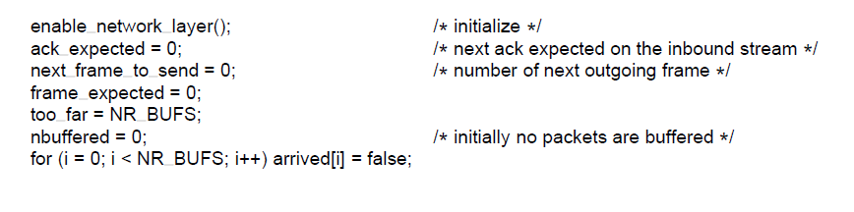
Protocol Using Selective Repeat (4)
. . .
A sliding window protocol using selective repeat.

Slide 153

Protocol Using Selective Repeat (1)
. . .
A sliding window protocol using selective repeat.

Slide 154

Protocol Using Selective Repeat (2)
. . .
A sliding window protocol using selective repeat.

Slide 155

Protocol Using Selective Repeat (3)
. . .
A sliding window protocol using selective repeat.

Slide 156

Protocol Using Selective Repeat (5)
. . .
A sliding window protocol using selective repeat.

Slide 157

Protocol Using Selective Repeat (6)
. . .
A sliding window protocol using selective repeat.

Slide 158

Protocol Using Selective Repeat (7)
. . .
A sliding window protocol using selective repeat.

Slide 159

Protocol Using Selective Repeat (8)
. . .
A sliding window protocol using selective repeat.

Slide 160

Protocol Using Selective Repeat (9)
A sliding window protocol using selective repeat.

Slide 161
Selective Repeat
Example:
3-bit sequence number,
7 frames are permitted to be send by transmitter, before it is required to wait (for acknowledgment).
Window size restriction:
Must be at most half the range of the sequence numbers.
Window size for protocol 6 is (MAX_SEQ+1)/2.

Slide 162

Protocol Using Selective Repeat (10)
Initial situation with a window of size7
After 7 frames sent and received but not acknowledged.
Initial situation with a window size of 4.
After 4 frames sent and received but not acknowledged.

Slide 163
Selective Repeat
If there is a lot of traffic in one direction and no traffic in the other direction, the protocol will block when the sender window reaches its maximum.
Axillary timer is started by start_ack_timer after an in-sequence data frame arrives.
If no reverse traffic has presented itself for piggybacking before the timer expires, a separate acknowledgement will be send.
Interrupt due to this timer is called ack_timeout event.

Slide 164
Example Data Link Protocols
Packet over SONET
ADSL (Asymmetric Digital Subscriber Loop)

Slide 165

Packet over SONET (1)
Packet over SONET. (a) A protocol stack. (b) Frame relationships

Slide 166
Packet over SONET (2)
Point-to-Point Protocol (PPP) Features
Separate packets, error detection
Link Control Protocol
Network Control Protocol

Slide 167

Packet over SONET (3)
The PPP full frame format for unnumbered mode operation

Slide 168

Packet over SONET (4)
State diagram for bringing a PPP link up and down

Slide 169

ADSL (Asymmetric Digital Subscriber Loop) (1)
ADSL protocol stacks.

Slide 170

ADSL (Asymmetric Digital Subscriber Loop) (1)
AAL5 frame carrying PPP data

Slide 171
End
Chapter 3

