Slide 1

Computer Network
Spring 2020
Prof./Dr. Shen Bichuan
College of Computer Science and Engineering Chongqing University of Technology

Slide 2
The Medium Access Control Sublayer
Chapter 4

Slide 3
The Medium Access Control Sublayer
Network Links can be divided into:
Point-to-point connections
Broadcast channels
Point-to-Point connections were discussed in chapter 2.
Broadcast Links and their Protocols will be discussed next.

Slide 4
The Medium Access Control Sublayer
In any broadcast network, the key issue is how to determine who gets to use the channel when there is competition.
Example: teleconferencing.
Also know as: Multi-access channels or random access channels.

Slide 5
The Medium Access Control Sublayer
The protocols belong to sublayer of the data link layer called Medium Access Control (MAC) sublayer.
Especially important in LAN’s and especially in wireless communication.
WANs use point-to-point links with exception of satellite links.

Slide 6
Channel Allocation Problem
Static channel allocation
Assumptions for dynamic allocation.

Slide 7
Static Channel Allocation
Traditionally capacity of the channel is split among multiple competing users (e.g., TDM or FDM).
Example: FM radio stations.
However, when the number of senders is large and varying or the traffic is bursty FDM presents some problems.

Slide 8
Static Channel Allocation
If the spectrum is cut up into N regions and
Fewer than N users are currently interested in communicating, a large piece of valuable spectrum will be wasted.
More than N users want to communicate some of them will be denied permission for lack of bandwidth.
Dividing the channel into constant number of users of static sub channels is inherently inefficient.

Slide 9
Static Channel Allocation
A static allocation is poor fit to most computer systems, in which data traffic is extremely bursty:
Peak traffic to mean traffic ratios of 1000:1 are common.
Consequently most of the channels will be idle most of the time.

Slide 10
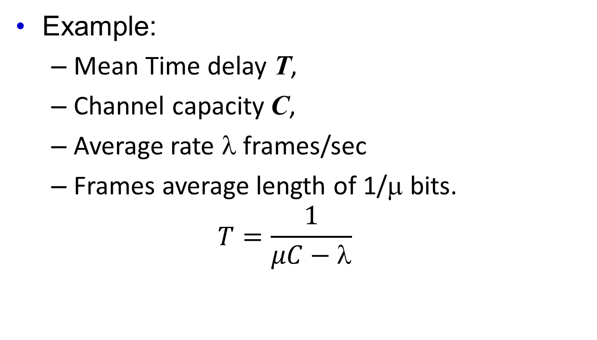
Static Channel Allocation
Example:
Mean Time delay T,
Channel capacity C,
Average rate λ frames/sec
Frames average length of 1/μ bits.
$$T=\frac{1}{μC−\text{l}}$$

Slide 11

Static Channel Allocation
C = 100 Mbps,
1/μ = 10,000 bits
λ = 5000 frames/sec
T = 200 μsec
This result holds only when there is no contention in the channel.
$$T=\frac{1}{μC−\text{l}}$$

Slide 12

Static Channel Allocation
Divide a single channel into N independent channels:
C/N = 100/N Mbps,
1/μ = 10,000 bits
λ/Ν = 5000 frames/sec
T_{N} = Nx200 μsec
For N=10 => T_{N} = 2 msec.
$$T_{N}=\frac{1}{μ\left(\frac{C}{N}\right)−\left(\frac{\text{l}}{N}\right)}=\frac{N}{μC−\text{l}}=NT$$

Slide 13
Assumptions for Dynamic Channel Allocation
Independent traffic
Single channel
Observable Collisions
Continuous or slotted time
Carrier sense or no carrier sense

Slide 14
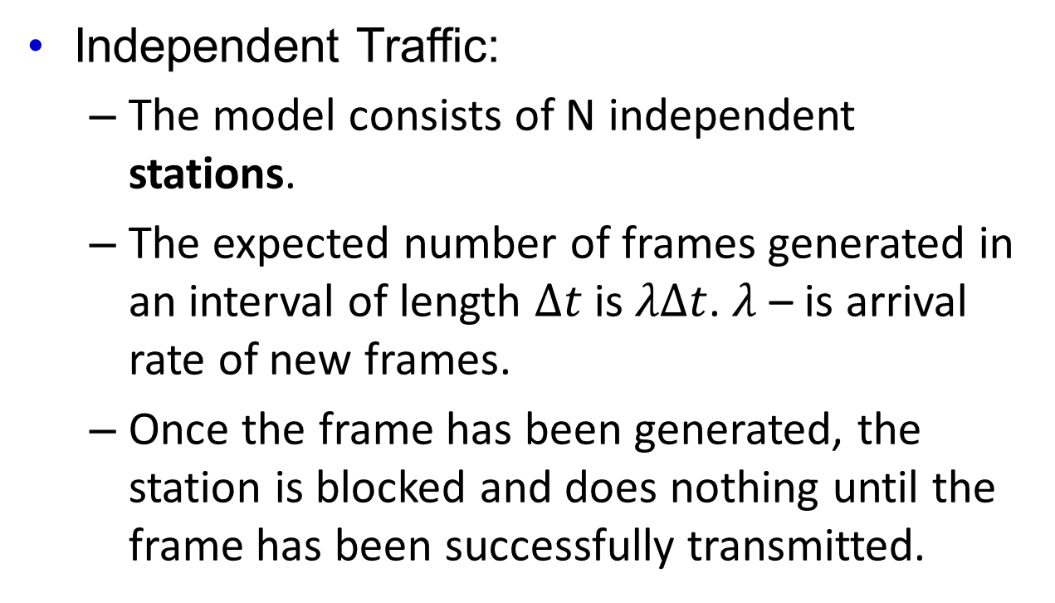
Assumptions for Dynamic Channel Allocation
Independent Traffic:
The model consists of N independent stations.
The expected number of frames generated in an interval of length $Δt$ is $λΔt$. $λ$ – is arrival rate of new frames.
Once the frame has been generated, the station is blocked and does nothing until the frame has been successfully transmitted.

Slide 15
Assumptions for Dynamic Channel Allocation
Single Channel:
The single channel is available for all communication.
All stations can transmit on it and all can receive from it.
The stations are assumed to be equally capable though protocols may assign the different roles (i.e., priorities)

Slide 16
Assumptions for Dynamic Channel Allocation
Observable Collisions:
If two frames are transmitted simultaneously, they overlap in time and the resulting signal is garbled.
This event is know as collision.
All stations can detect that a collision has occurred. A collided frame must be retransmitted.
No errors other than those generated by collision occur.

Slide 17
Assumptions for Dynamic Channel Allocation
Continuous or Slotted Time:
Time may be assumed continuous. In which case frame transmission can begin at any instant.
Alternatively, time may be slotted or divided into discrete intervals (called slots).
Frame transmission must then begin at the start of a slot.
A slot may contain 0, 1 or more frames, corresponding to an idle slot, a successful transmission, or collision, respectively.

Slide 18
Assumptions for Dynamic Channel Allocation
Carrier Sense or No Carrier Sense:
With the carrier sense assumption, stations can tell if the channel is in use before trying got use it.
No station will attempt to use the channel while it is sensed as busy.
If there is no carrier sense, stations cannot sense the channel before trying to use it.
They will transmit then. One later they can determine whether the transmission was successful.

Slide 19
Assumptions for Dynamic Channel Allocation
Poisson models are used to model independence assumption due to its tractability. This is known to not be true.
Single channel assumption is the heart of the model. This models is not a good model.

Slide 20

Fixed Partitioning
Need to share media with multiple nodes (n)
Multiple simultaneous conversations
A simple solution
Divide the channel into multiple, separate channels
Channels are physically separate
Bitrate of the link is split across channels
Nodes can only send/receive on their assigned channel
Several different ways to do it
Multiple Access madlibs…

Slide 21

Frequency Division (FDMA)
Divide bandwidth of f Hz into n channels each with bandwidth f/n Hz
Easy to implement, but unused subchannels go idle
Used by traditional analog cell phone service, radio, TV
Amplitude
Frequency
Amplitude
Frequency

Slide 22
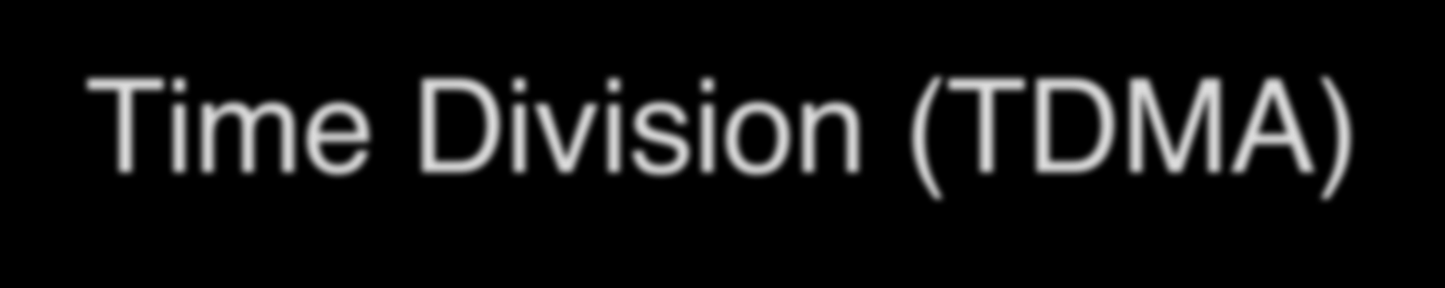
Time Division (TDMA)
Divide channel into rounds of n time slots each
Assign different hosts to different time slots within a round
Unused time slots are idle
Used in GSM cell phones & digital cordless phones
Example with 1-second rounds
n=4 timeslots (250ms each) per round
Host #
1 | 2 |  | 3 |  | 1 | 2 | 3 | 4 |  | 2 |  | 4
1 sec
1 sec
1 sec

Slide 23

Code Division (CDMA)
Do nothing to physically separate the channels
All stations transmit at same time in same frequency bands
One of so-called spread-spectrum techniques
Sender modulates their signal on top of unique code
Sort of like the way Manchester modulates on top of clock
The bit rate of resulting signal much lower than entire channel
Receiver applies code filter to extract desired sender
All other senders seem like noise with respect to signal
Used in newer digital cellular technologies

Slide 24

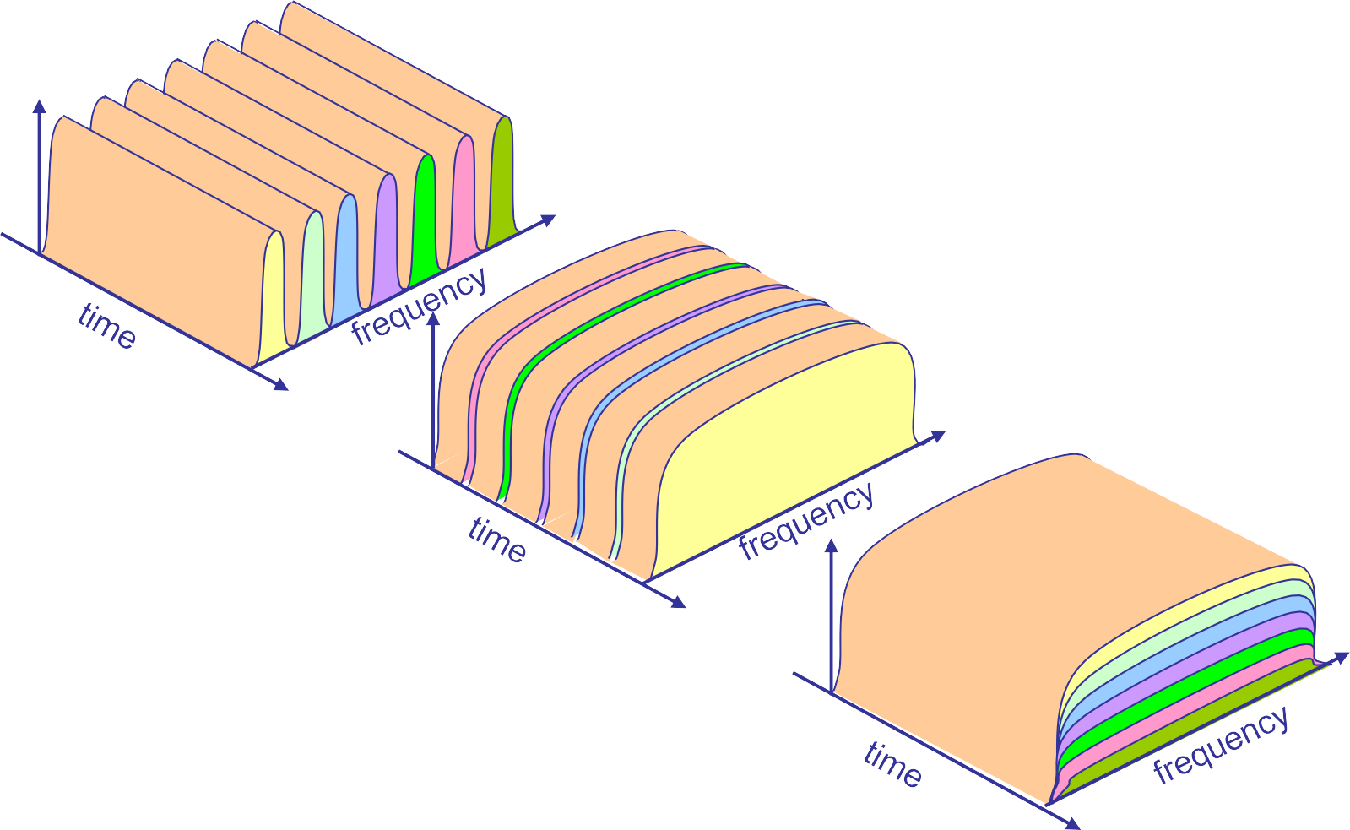
Partitioning Visualization
FDMA
power
TDMA
power
CDMA
power
Courtesy Takashi Inoue

Slide 25



Problem w/Channel partitioning
Not terribly well suited for random access usage
Why?
Instead, design schemes for more common situations
Not all nodes want to send all the time
Don’t have a fixed number of nodes
Potentially higher throughput for transmissions
Active nodes get full channel bandwidth

Slide 26

Aloha
Designed in 1970 to support wireless data connectivity
Between Hawaiian Islands—rough!
Goal: distributed access control (no central arbitrator)
Over a shared broadcast channel
Aloha protocol in a nutshell:
When you have data send it
If data doesn’t get through (receiver sends acknowledgement) then retransmit after a random delay
Why not a fixed delay?

Slide 27

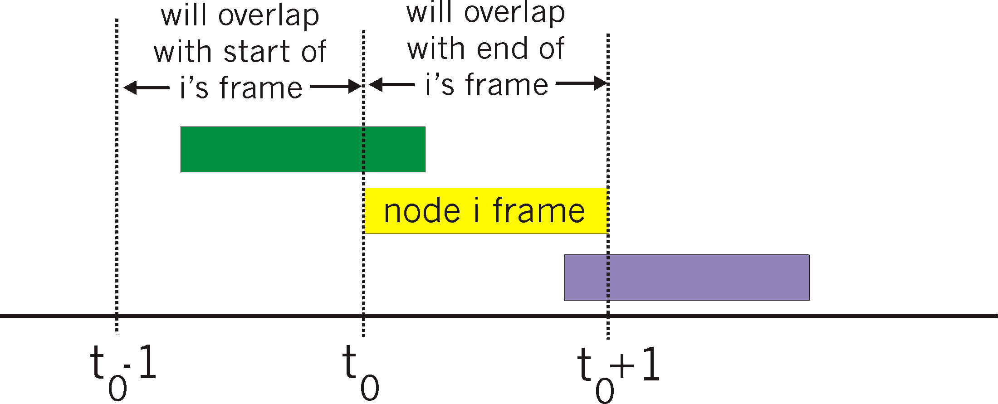
Collisions
Frame sent at t₀ collides with frames sent in [t₀-1, t₀+1]
Assuming unit-length frames
Ignores propagation delay

Slide 28

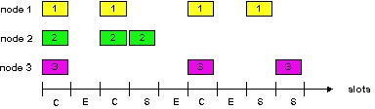
Slotted Aloha
Time is divided into equal size slots (frame size)
Host wanting to transmit starts at start of next slot
Retransmit like w/Aloha, but quantize to nearest next slot
Requires time synchronization between hosts
Success (S), Collision (C), Empty (E) slots

Slide 29

Channel Efficiency
Q: What is max fraction slots successful?
A: Suppose n stations have packets to send
Each transmits in slot with probability p
Prob[successful transmission], S, is:
At best: channel used for useful transmissions 37% of time!
S = p (1-p)^{(n-1)}
0.4
any of n nodes:
0.3
0.2
Slotted Aloha
S = Prob[one transmits] = np(1-p)^{(n-1)}
(optimal p as n->infinity = 1/n)
= 1/e = .37
0.1
Pure Aloha
0.5 1.0 1.5 2.0
offered load = n X p

Slide 30
Multiple Access Protocols
ALOHA
Carrier Sense Multiple Access
Collision-free protocols
Limited-contention protocols
Wireless LAN protocols

Slide 31
ALOHA
1970 Hawaii
Norman Abramson and colleagues have enabled wireless communication between users in a remote island to the central computer in Honolulu.
Two versions of the protocol now called ALOHA:
Pure ALOHA and
Slotted ALOHA

Slide 32
Pure ALOHA
Each user is free to transmit whenever they have data to be sent.
There will be collisions
Senders need some way to find out if this is the case.
In ALOHA after the station transmits its message to the central computer, the computer rebroadcast's the frame to all of the stations.
Original sending station can listen for the broadcast from the hub to see if its frame has gone through.

Slide 33
Pure ALOHA
In other wired systems the sender might be able to listen for collisions while transmitting.
If the frame is destroyed, the sender just waits a random amount of time and sends it again.
Waiting time must be random or the sending frames will collide over and over.
Contention systems: that use the same channel in the way that might lead to conflicts.

Slide 34
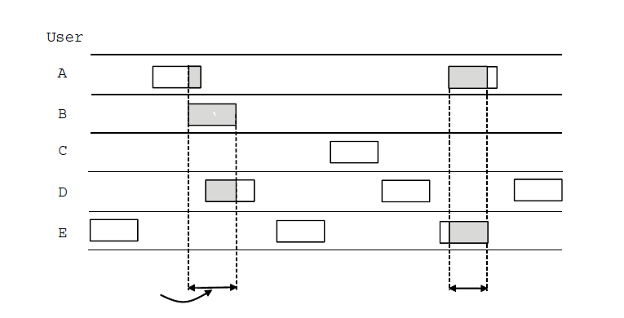
PURE ALOHA (1)
User
A
B
C
D
E
Collision
Collision
Time
In pure ALOHA, frames are transmitted at completely arbitrary times

Slide 35
Pure ALOHA
What is the efficiency of an ALOHA channel?
Infinite collection of users typing at their terminals (stations).
User states: WAITING or TYPING.
When a line is finished, the user stops typing waiting for response.
The station then transmits a frame containing the line over the shared channel to the central computer and checks the channel to see if it was successful.
If so the users sees the reply and goes back to typing
If not, the user continuously to wait while the station retransmits the frame over and over until it has been successfully send.

Slide 36
Pure ALOHA
Frame Time – denotes the amount of time needed to transmit the standard, fixed-length frame.
Each new frame is assumed to be generated by Poisson distribution with a mean of N frames per frame time.
If N>1 the user community is generating frames at a higher rate than the channel can handle, and nearly every farm will suffer a collision.
For reasonable throughput we expect 0 < N < 1.

Slide 37
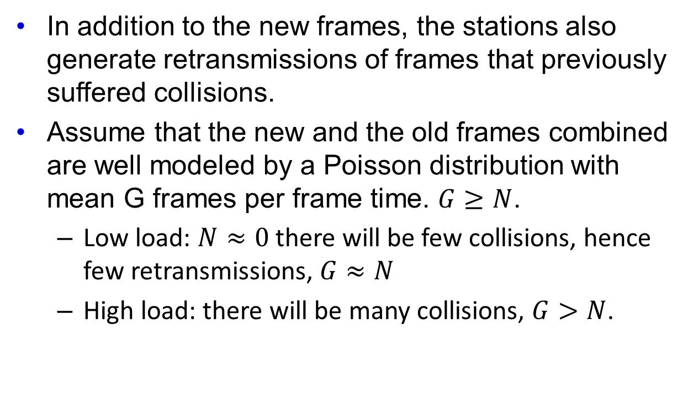
Pure ALOHA
In addition to the new frames, the stations also generate retransmissions of frames that previously suffered collisions.
Assume that the new and the old frames combined are well modeled by a Poisson distribution with mean G frames per frame time. $G≥N$.
Low load: $N≈0$there will be few collisions, hence few retransmissions, $G≈N$
High load: there will be many collisions, $G>N$.

Slide 38

Pure ALOHA
Under all loads the throughput S is just the offered load, G, times the probability P₀ of a transmission succeeding:
$$S=GP_{0}$$

Slide 39
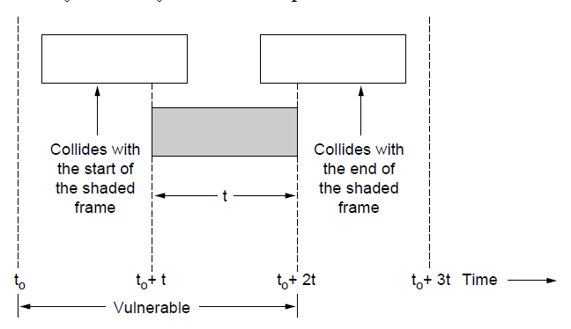
ALOHA (2)
Vulnerable period for the shaded frame.

Slide 40
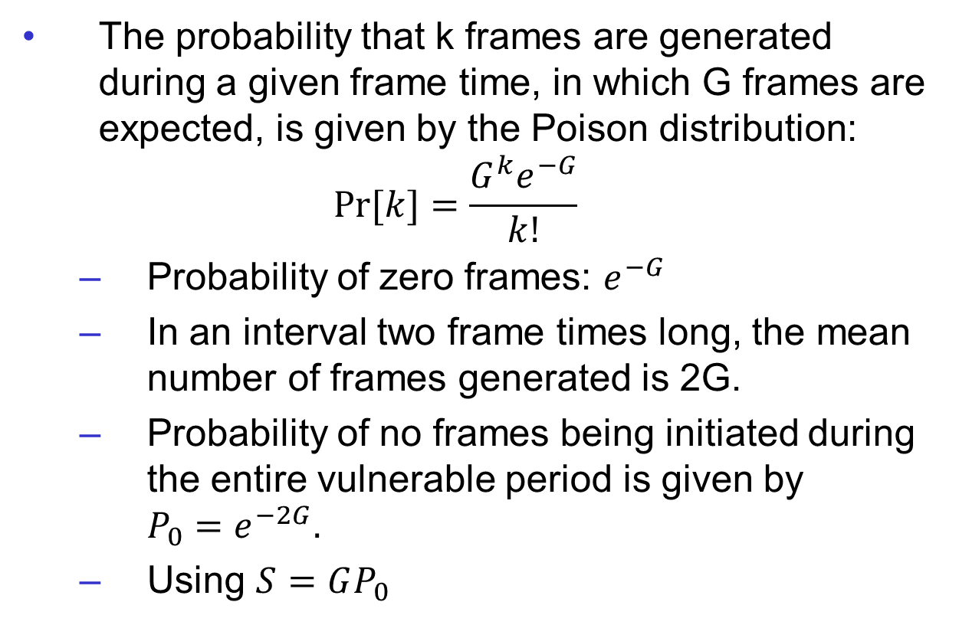
Pure ALOHA
The probability that k frames are generated during a given frame time, in which G frames are expected, is given by the Poison distribution:
$$Pr⁡[k]=\frac{G^{k}e^{−G}}{k!}$$
Probability of zero frames: $e^{−G}$
In an interval two frame times long, the mean number of frames generated is 2G.
Probability of no frames being initiated during the entire vulnerable period is given by $P_{0}=e^{−2G}.$
Using $S=GP_{0}$

Slide 41
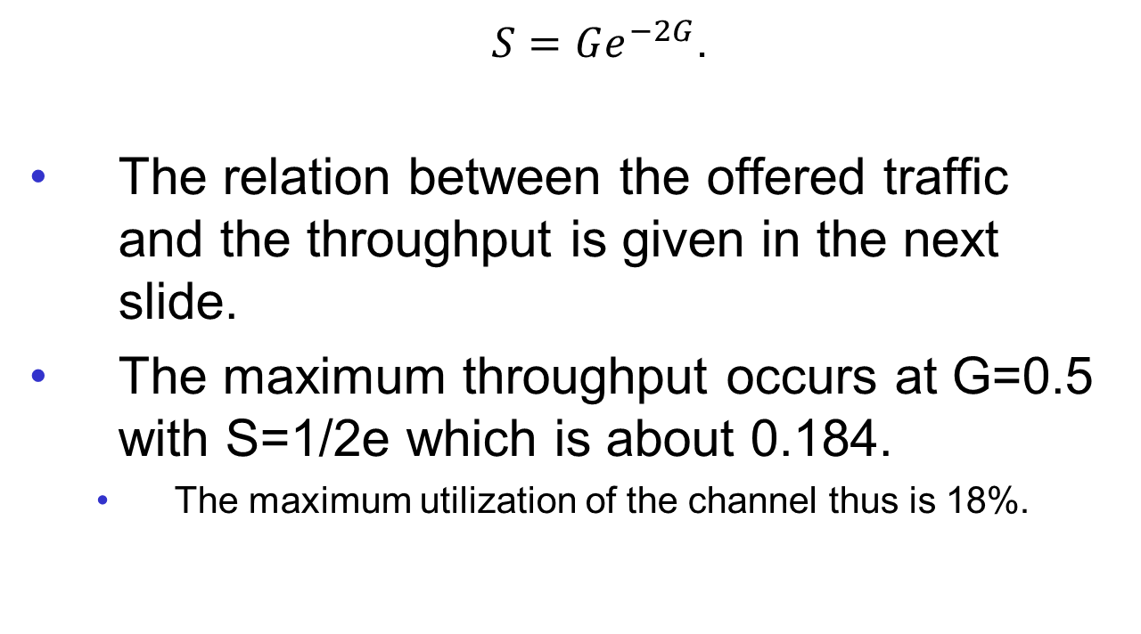
Pure ALOHA
$S=Ge^{−2G}$.
The relation between the offered traffic and the throughput is given in the next slide.
The maximum throughput occurs at G=0.5 with S=1/2e which is about 0.184.
The maximum utilization of the channel thus is 18%.

Slide 42
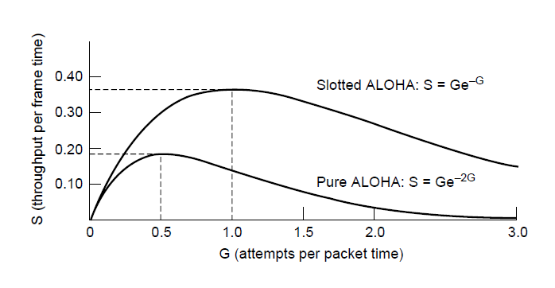
ALOHA (3)
Throughput versus offered traffic for ALOHA systems.

Slide 43
Sloted ALOHA
Roberts in 1972 doubled the capacity of an ALOHA system.
Divide time into discrete intervals called slots.
Each interval corresponds to one frame.
Users will have to agree on slot boundaries.
Synchronization is required:
One special station emit a pip at the start of each interval, like clock.

Slide 44
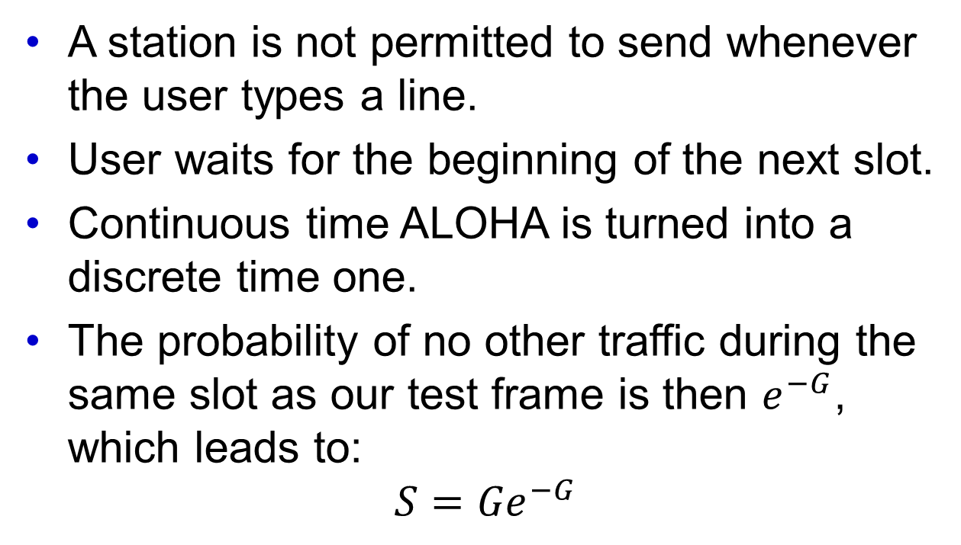
Sloted ALOHA
A station is not permitted to send whenever the user types a line.
User waits for the beginning of the next slot.
Continuous time ALOHA is turned into a discrete time one.
The probability of no other traffic during the same slot as our test frame is then $e^{−G}$, which leads to:
$$S={Ge}^{−G}$$

Slide 45
Slotted ALOHA
Slotted ALOHA
peaks at the G = 1
Throughput S = 1/e = 0.367 or 37%.
The best case scenario:
37% of slots are empty
37% of successes, and
26% collisions.

Slide 46
Carrier Sense Multiple Access Protocols
Protocols in which stations listen for a carrier (i.e., transmission) and act accordingly are called carrier sense protocols.
Several Versions of those protocols will be discussed.
Persistent and Nonpersistent CSMA
CSMA with Collision Detections

Slide 47
Persistent and Nonpersistent CSMA
1-Persistend Carrier Sense Multiple Access (CSMA) protocol.
When a station has data to be send it first listens to the channel to see if anyone else is transmitting at that moment.
If the channel is idle the station sends the data,
Otherwise, the station just waits until it becomes idle.

Slide 48
Persistent and Nonpersistent CSMA
1-Persistend Carrier Sense Multiple Access (CSMA) protocol.
If a collision occurs, the station waits a random amount of time and starts all over again.
This protocol has problems with collisions:
2 patiently waiting stations will start transmitting at the same time when the channel becomes idle.
Propagation delay can make even more suble the collision.

Slide 49
Persistent and Nonpersistent CSMA
1-persistent refers to the probability of 1 of transmission when the channel if found to be idle.

Slide 50
Persistent and Nonpersistent CSMA
Nonpersistent CSMA - Second Carrier Sense protocol is. In this protocol the transmitting stations are less greedy.
The transmitting station will send the packet if the channel is found to be idle, however
If the channel is already in use the station does not continuously sense it for transmission. Instead it waits a random amount of time and then repeats the algorithm.

Slide 51
Persistent and Nonpersistent CSMA
P-persistent CSMA.
The transmitting station will send the packet if the channel is found to be idle with a probability of p (q = 1-p; it defers that action until the next slot).
If the slot is still empty it does or not transmit with the probability of p and q respectively.
If the channel in use the station will treat this as being a collision (waits random amount of time)

Slide 52
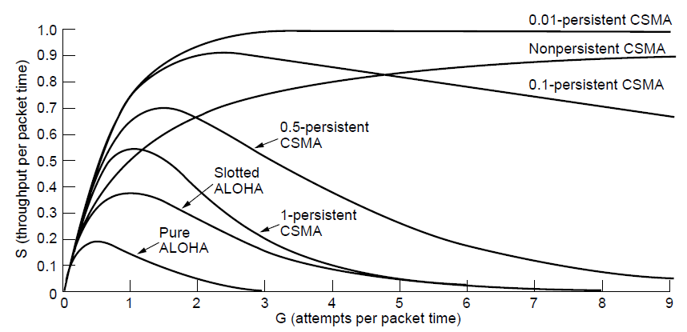
Persistent and Nonpersistent CSMA
Comparison of the channel utilization versus load for various random access protocols.

Slide 53
CSMA with Collision Detection
Protocols that sense Collisions are know as CSMA with Collision Detection (CSMA/CD)
This protocol is a basis of classical Ethernet LAN.
The transmitting station is reading the data that it is transmitting.
If it is garbled up then it will know that collision has occurred.

Slide 54
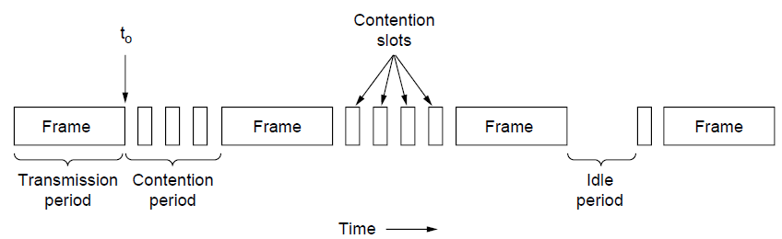
CSMA with Collision Detection
CSMA/CD can be in one of three states: contention, transmission, or idle.

Slide 55
CSMA with Collision Detection
In CSMA/CD collisions do not occur once the station has unambiguously captured the channel, but they still occur during the contention period.
These collisions adversely affect the system performance (e.g., bandwidth-delay product is large – long cable that has a large propagation delay τ and frames are short).

Slide 56
Collision-Free Protocols
Collisions reduce the bandwidth
The increase the time to send a frame
Bad fit for real-time traffic:
VoIP
Video,
Teleconferencing, etc.

Slide 57
Collision-Free Protocols
N – Stations
Each programmed with a unique address: 0-(N-1).
Propagation delay we assume to be negligible.
Question: Which station gets the channel (e.g., the right to transmit) after a successful transmission.

Slide 58
Basic Bit-Map Protocol
Each contention period consists of exactly N slots.
If station 0 has a frame to send, it transmits a 1 bit during the slot 0.
No other station is allowed transmit during this slot.
Regardless what station 0 does, station 1 gets to opportunity to transmit a 1 bit during slot 1, but only if it has a frame queued.
In general, station j may announce that it has a frame to send by inserting a 1 bit into slot j.
After all N slots have passed by, each station has complete knowledge of which stations wish to transmit. At which point they begin transmitting frames in numerical order.

Slide 59
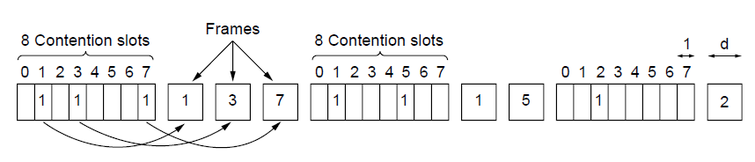
Collision-Free Protocols (1)
The basic bit-map protocol.

Slide 60
Bit-Map Protocol
Protocols that broadcast their intention before that actually transmit are called reservation protocols.
Low-load conditions:
Average wait conditions for low-numbered stations:
N/2 slots for current scan to finish, and
N slots for the following scan to run to completion before it may begin transmitting.
1.5N slots wait time.
Average wait conditions for high-numbered stations:
0.5N slots wait time.
Mean of all stations is N times.

Slide 61


Bit-Map Protocol
Efficiency:
Overhead bits N
Data bits d
High-load
N bit contention period is prorated over N frames, yielding an overhead of only 1 bit per frame:
Efficiency:
Mean delay:
Sum of the time it queues in the station +
(N-1)d + N
$$\frac{d}{\left(d+N\right)}$$
$$\frac{d}{\left(d+1\right)}$$

Slide 62
Token Passing
Message is passed called token form station to the next in the same predefined order.
Token Ring or Token Bus protocols work the same way.
One has to pay attention to the ring because if it is not removed from circulation it will end up being there forever.
Typically it will be removed by the receiving station and/or sending station.

Slide 63
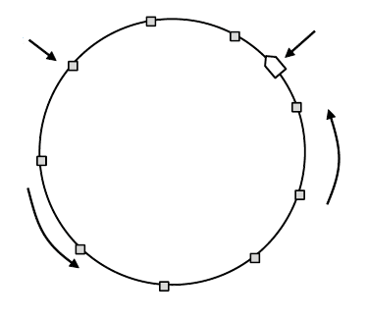
Collision-Free Protocols (2)
Token
Station
Direction of
transmission
Token ring.

Slide 64
Binary Countdown
A problem with the basic bit-map and token passing protocols is the overhead of 1 bit per station.
Large overhead for the network with large number of stations.
A better solution is to use binary station addresses with a channel that combines transmissions.
A station wanting to use the channel now broadcasts its address as a binary bit string, starting with the high-order bit. The addresses are assumed to be the same length.
The bits in each address position from different stations are BOOLEAN.
The are OR-ed together by the channel when they are send at the same time.
Binary Countdown protocol

Slide 65
Binary Countdown
Arbitration rule: As soon as a station sees that a high-ordered bit position that is 0 in its address has been overwritten with 1 it gives up.
Example:
If stations 0010, 0100, 1001, and 1010 are all trying to get the channel, in the first bit time the stations transmit 0, 0, 1, and 1, respectively.
They are OR-ed together to get 1.
Stations 0010 and 0100 see the 1 and know that higher-numbered stations is competing for the channel and they give up for the current round.
Stations 1001 and 1010 continue.

Slide 66
Binary Countdown
The next bit is 0 so both stations continue.
The next bit is 1 so the station 1001 gives up and station 1010 wins the bidding.
This gives it a right to transmit the frame, after which a new cycle starts.

Slide 67
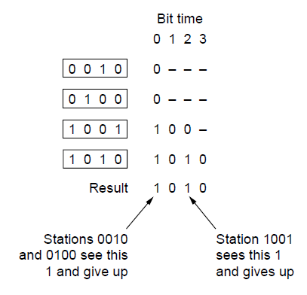
Binary Countdown
The binary countdown protocol. A dash indicates silence.

Slide 68
Limited-Contention Protocols
So far we have considered two basic strategies for channel acquisition in a broadcast network:
Contention (e.g., CSMA), and
Collision free protocols.
Two important performance measures:
Delay at low-loads, and
Channel efficiency at high-loads.

Slide 69
Limited-Contention Protocols
Pure or Slotted ALOHA is preferred under
The low load conditions:
Low delay and
practically collision free.
The high load conditions:
High Delay due to
High number of collisions or contentions

Slide 70
Limited-Contention Protocols
Reverse is true for collision-free protocols
The low load conditions:
High delay and
The high load conditions:
Relatively low Delay due to,
Channel efficiency improves (fixed overheads).
Symmetric Limited-Contention Protocol

Slide 71
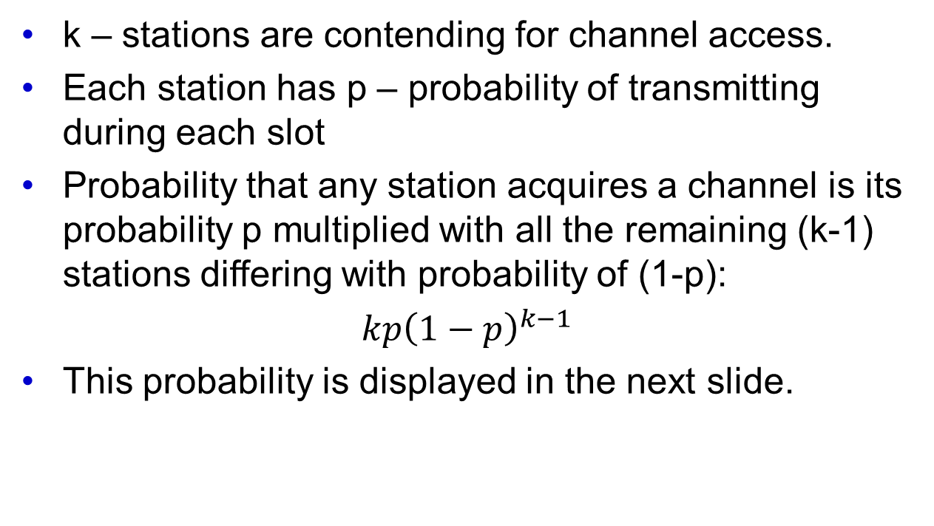
Limited-Contention Protocols
k – stations are contending for channel access.
Each station has p – probability of transmitting during each slot
Probability that any station acquires a channel is its probability p multiplied with all the remaining (k-1) stations differing with probability of (1-p):
$kp{\left(1−p\right)}^{k−1}$
This probability is displayed in the next slide.

Slide 72
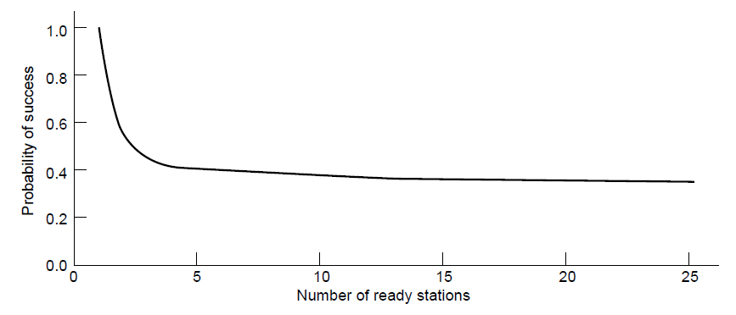
Limited-Contention Protocols
Acquisition probability for a symmetric contention channel.

Slide 73
Limited-Contention Protocols
From the figure in previous slide clearly that probability that some stations will acquire the channel can be increased only by decreasing the amount of competition.
The limited contention protocols do just that by:
Dividing the stations into (not necessarily disjoint) groups.
Only the members of group 0 are permitted to compete for slot 0.
If one of them succeeds, it acquires the channel and transmits its frame.
If there is a collision the members of the group 1 contend for slot 1. etc.

Slide 74
Limited-Contention Protocols
By making an appropriate division of stations into groups the amount of contention for each slot can be reduced, thus operating each slot near the left of the figure presented in previous slide.
The trick is how to assign stations to slots?
Such assignment guarantees that there will never be collisions because at most one station is contending for any given slots (binary countdown protocol)
The next case is to assign two stations per group. The probability that both will try to transmit during a slot is p² which for small p is negligible.

Slide 75
Limited-Contention Protocols
We need a way to assign station slots dynamically:
Many stations per slot when the load is low, and
Few (or just one) station per slot when the load is high.

Slide 76
The Adaptive Tree Walk Protocol
Algorithm used for testing soldiers during World War II:
Blood samples from N soldiers
A portion of each sample was poured into a single test tube.
If this mixed sample was testing:
If none of antibodies were found all the soldiers in the group were declared healthy.
Binary search was performed to pick which soldier was infected.

Slide 77
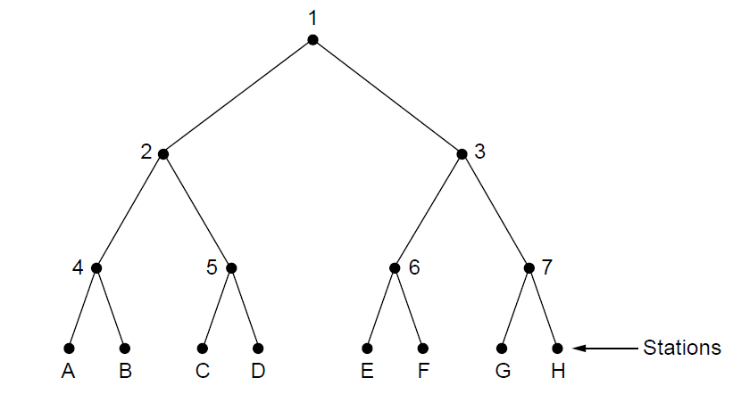
The Adaptive Tree Walk Protocol
The tree for seven stations

Slide 78
The Adaptive Tree Walk Protocol
Slot 0 - First contention slot following the successful transmission when all stations were permitted to try to acquire the channel.
Slot 1 – If there is a collision then during slot 1 only those stations falling under node 2 in the tree (next slide) may compete.
Slot 2 - If one of them acquires the channel the slot following the frame is reserved for those stations under node 3. If on the other hand two or more stations under node 2 want to transmit, there will be a collision during slot 1, in which case it is node 4’s turn.

Slide 79
The Adaptive Tree Walk Protocol
Depth first search of the tree to locate all ready stations if the collision occurs during slot 0. Each bit slot is associated with some particular node in the tree.
If collision occurs the search continues recursively with the node’s left and right children.
If a bit slot is idle or if only one station transmits in it. The searching of its node can stop because all ready stations shave been located.

Slide 80
The Adaptive Tree Walk Protocol
When a load on the system is high it is not worth to dedicate slot 0 to node 1.
Similarly one would argue that nodes 2 and 3 should be skipped.
In general the question is at what level in the tree should we began the search?
Heavier load the farther down the tree the search should begin.

Slide 81
The Adaptive Tree Walk Protocol
We will assume that each station has a pretty good idea of the number of ready stations q, (from monitoring traffic).
Numbering the levels:
Level 0: Node 1
Level 1: Nodes 2, 3
Level 2: Nodes 4,5,6 and 7. etc.

Slide 82
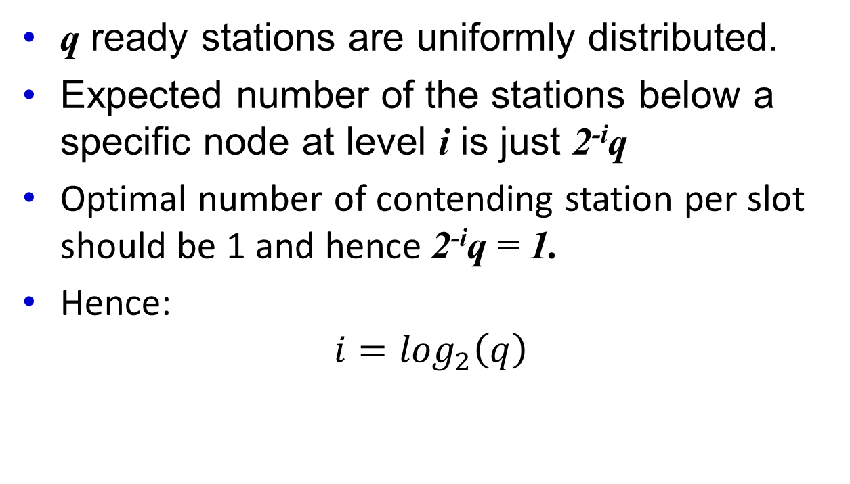
The Adaptive Tree Walk Protocol
q ready stations are uniformly distributed.
Expected number of the stations below a specific node at level i is just 2^{-i}q
Optimal number of contending station per slot should be 1 and hence 2^{-i}q = 1.
Hence:
$$i=\log_{2}\left(q\right)$$

Slide 83
Wireless LAN Protocols
A system of laptop computers that communicate by radio – wireless LAN.
It also has somewhat different properties than a wired LAN.
Leads to different MAC protocols.

Slide 84
Wireless LAN Protocols
Common configuration of wireless LAN:
Office Building with Access Points (APs)
APs Strategically placed
APs are wired together (copper or fiber)
APs provide connectivity

Slide 85
Wireless LAN Protocols
Transmission power of APs and laptops is adjusted to have a range of tens of meters nearby rooms becomes like a single cell and the entire building becomes like the cellular telephony system.
Each cell has only one channel.
This channel is shared by all the stations in the cell, including APs.
Bandwidth provided – up to 600 Mbps.

Slide 86
Wireless LAN Protocols
Wireless system can not normally detect a collision while it is occurring.
The received signal is weak (millions times fainter than the signal that is being transmitted)
Difficulty in finding it.
Instead ACK are used to discover collisions and other errors after the fact.

Slide 87
Wireless LAN Protocols
Additional, and even more important, difference between wireless LAN and wired LAN:
Wireless LAN: A station may not be able to transmit or receive frames to or from all other stations due to limited radio range.
Wired LAN: Once the one station sends a frame, all other stations receive it.

Slide 88
Wireless LAN Protocols
Simplifying assumptions:
Each radio transmitter has some fixed range.
Its range is represented by an ideal circular coverage region
within that region station can sense and receive the station’s transmission.

Slide 89
Wireless LAN Protocols
Naïve approach:
Use CSMA:
Just listen for other transmissions.
In none is doing it then transmit.
Problem:
What matters for reception is interference at the receiver and not at the sender.
See figure in next slide:

Slide 90
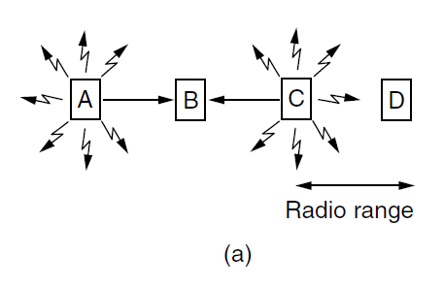
Wireless LAN Protocols (1)
A wireless LAN. (a) A and C are hidden terminals when transmitting to B.

Slide 91
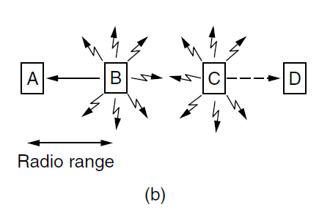
Wireless LAN Protocols (2)
A wireless LAN. (b) B and C are exposed terminals when transmitting to A and D.

Slide 92
Wireless LAN Protocols
Before starting the transmission a station must know whether there is radio activity around the receiver.
CSMA merely tells it whether there is activity near the transmitter by sensing the carrier.
With wired communication all signals propagate to all stations so this distinction does not exist.
However only one transmission can take place at one time.

Slide 93
Wireless LAN Protocols
In a system based on short-range radio waves multiple transmissions can occur simultaneously:
If they all have different destinations, and
These destinations are out of range of one another.
Multiple Access with Collision Avoidance (MACA) - Early protocol that tackles these problems for wireless LAN’s.
The basic idea behind it is for the sender to simulate the receiver into outputting a short frame
Nearby stations can detect this transmission and avoid transmitting for the duration of the upcoming (larger) data frame.

Slide 94
Wireless LAN Protocols
MACA is illustrated in the next slide.
A sends a frame to B – A initiates the request by sending an Request To Send (RTS) to station B.
Short frame (30 bytes) that contains the length of data frame that will eventually follow.
B replies with a Clear To Send (CTS) frame.
This frame contains the data length (copied from RTS).
After reception of the CTS frame the a station A begins transmission.

Slide 95
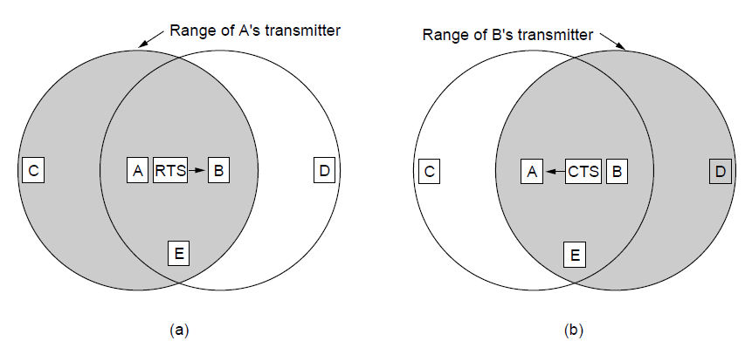
Wireless LAN Protocols (3)
The MACA protocol. (a) A sending an RTS to B. (b) B responding with a CTS to A.

Slide 96
Wireless LAN Protocols
Any station hearing the RTS is clearly close to A and must remain silent long enough for the CTS to be transmitted back to A without conflict.
Any stations hearing CTS are clearly close to B and must remain silent during the upcoming data transmission, whole length it can tell by examining the CTS frame.
Collisions are possible.

Slide 97
Ethernet
Physical layer
MAC sublayer protocol
Ethernet performance
Switched Ethernet
Fast Ethernet
Gigabit Ethernet
10 Gigabit Ethernet
IEEE 802.2: Logical Link Control
Retrospective on Ethernet

Slide 98
Ethernet
Classical Ethernet
Switched Ethernet

Slide 99
Classical Ethernet
Bob Metcalfe with David Boggs designed and implemented the first local area network in 1976 in Xerox Palo Alto Lab.
It used a single long thick coaxial cable.
Speed 3 Mbps.
Ethernet – luminiferous ether.
Successful designed that was later drafted as standard in 1978 by Xerox, DEC, Intel with a 10 Mbps.
In 1983 it became the IEEE 802.3 standard

Slide 100
Classical Ethernet
Thick Ethernet – a thick cable. Segment could be as long as 500 m. Could be used to connect up to 100 computers.
Thin Ethernet – BNC connectors. Segment could be no longer than 185 m. Could be used to connect up to 30 computers.
For a large length connectivity the cables could be connected by repeaters.
Repeater is a physical layer device that receives, amplifies, and retransmits signals in both directions.

Slide 101
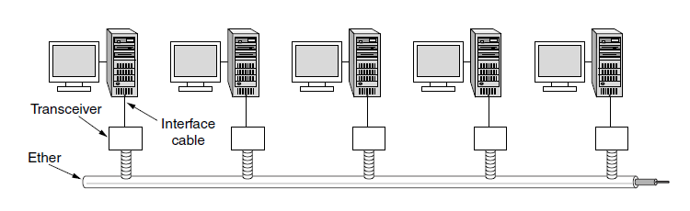
Classic Ethernet Physical Layer
Architecture of classic Ethernet

Slide 102
Classical Ethernet
Over each of those cables the signal was coded using Manchester encoding.
Other restriction was that no two transceivers could be more than 2.5 km apart and no path between any two transceivers could traverse more than four repeaters.
This limitation was impose due to the MAC protocol used.

Slide 103
MAC Sublayer Protocol
The format used to send frames is shown in the figure in next slide.

Slide 104
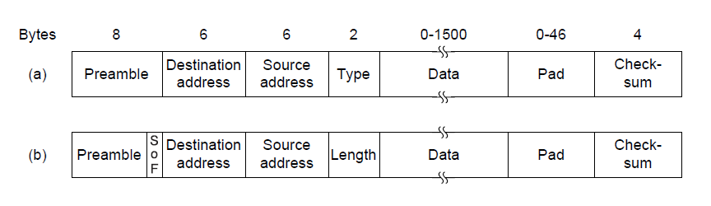
MAC Sublayer Protocol (1)
Frame formats. (a) Ethernet (DIX). (b) IEEE 802.3.

Slide 105
Classic Ethernet MAC Sublayer Protocol
Format to send frames is shown in the figure in the previous slide.
Preamble – 8 bytes
7x 10101010 and 10101011 <- Start of Frame Delimiter (802.3).
The Manchester encoding of this pattern produces 10-MHz wave for 6.4 μsec – used for synchronization.
The last two bits indicate the start of the frame.

Slide 106
Classic Ethernet MAC Sublayer Protocol
Two addresses each 6 bytes – destination + source
First bit of the destination address is 0 for ordinary addresses and 1 for group addresses.
Group address allow multiple destinations to listen to a single address – Multicasting.
Special address consisting of all 1 is reserved for broadcasting.
Uniqueness of the addresses:
First 3 bytes are used for (Organizationally Unique Identifier)
Blocks of 2²⁴ addresses are assigned to a manufacturer.
Manufacturer assigns the last 3 bytes of the address and programs the complete address into the NIC.

Slide 107
MAC Sublayer Protocol
Type or Length field.
Depending whether the frame is Ethernet or IEEE 802.3
Ethernet uses a Type field to tell the receiver what to do with the frame.
Multiple network-layer protocols may be in use at the same time on the same machine. So when Ethernet frame arrives, the operating system has to know which one to hand the frame to. The Type field specifies which process to give the frame to. E.g. 0x0800 indicates the frame contains IPv4 packet.

Slide 108
MAC Sublayer Protocol
Type or Length field.
Depending whether the frame is Ethernet or IEEE 802.3
Ethernet uses a Type field to tell the receiver what to do with the frame.
Multiple network-layer protocols may be in use at the same time on the same machine. So when Ethernet frame arrives, the operating system has to know which one to hand the frame to. The Type field specifies which process to give the frame to. E.g. 0x0800 indicates the frame contains IPv4 packet.

Slide 109
MAC Sublayer Protocol
Length of the field could be carried as well.
Ethernet length was determined by looking inside the data – a layer violation.
Added another header for the Logical Link Control (LLC) protocol within the data. It uses 8 bytes to convey the 2 bytes of protocol type information.
Rule: Any number greater than 0x600 can be interpreted a Type otherwise is considered to be Length.

Slide 110
MAC Sublayer Protocol
Data Field
Up to 1500 bytes.
Minimum frame length – valid frames must be at least 64 bytes long – from destination address to checksum.
If data portion is less than 46 bytes the Pad field is used to fill out the frame to the minimum size.
Minimum filed length is also serves one very important role – prevents the sender to complete transmission before the first bit arrives at the destination.

Slide 111
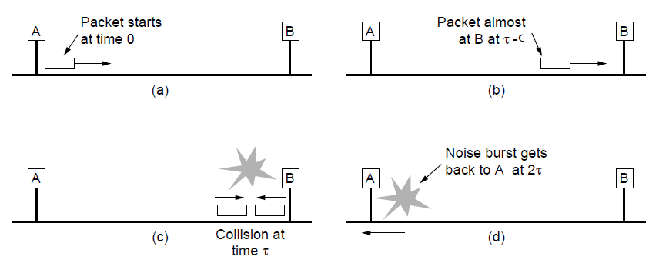
MAC Sublayer Protocol (2)
Collision detection can take as long as 2τ.

Slide 112
MAC Sublayer Protocol
10 Mbps LAN with a maximum length of 2500 m and four repeaters the round-trip time has been determined to be nearly 50 μsec in the worst case.
Shortest allowed frame must take at least this long to transmit.
At 10 Mbps a bit takes 100 nsec
500 bits (numbit = 10 Mbps X 100 nsec) rounded up to 512 bits = 64 bytes.

Slide 113
MAC Sublayer Protocol
Checksum
It is a 32-bit CRC of the kind that we have covered earlier.
Defined as a generator polynomial described in the textbook.

Slide 114
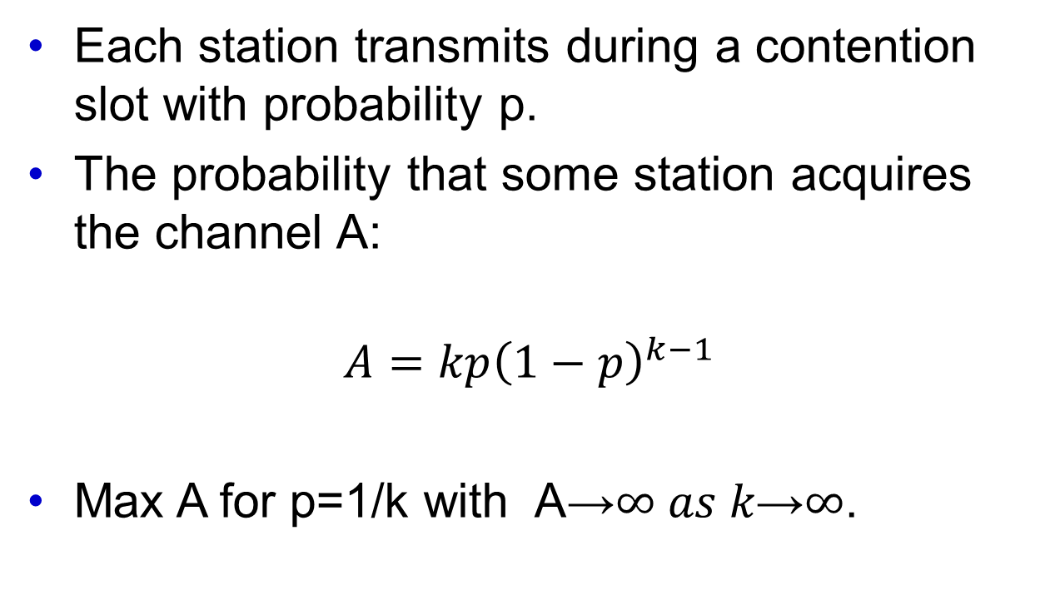
Ethernet Performance
Each station transmits during a contention slot with probability p.
The probability that some station acquires the channel A:
$$A=kp{\left(1−p\right)}^{k−1}$$
Max A for p=1/k with A→$∞ as k\text{→}∞$.

Slide 115
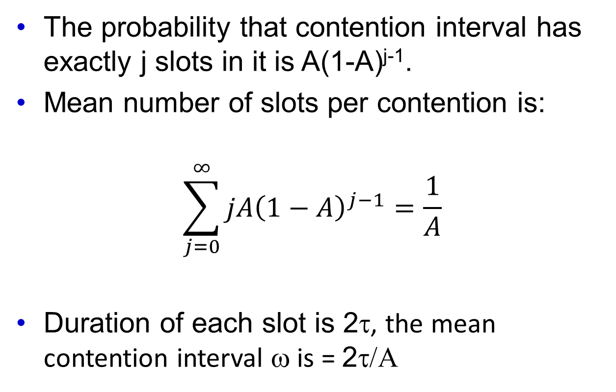
Ethernet Performance
The probability that contention interval has exactly j slots in it is A(1-A)^{j-1}.
Mean number of slots per contention is:
$$\sum_{j=0}^{∞}{jA{\left(1−A\right)}^{j−1}}=\frac{1}{A}$$
Duration of each slot is 2τ, the mean contention interval ω is = 2τ/Α

Slide 116
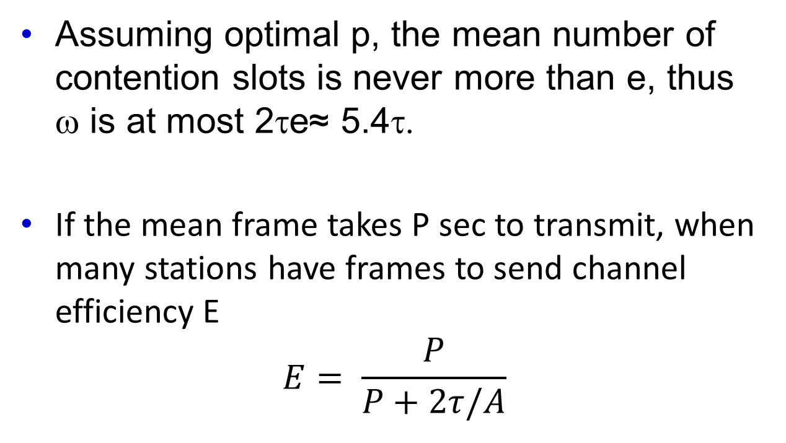
Ethernet Performance
Assuming optimal p, the mean number of contention slots is never more than e, thus ω is at most 2τe≈ 5.4τ.
If the mean frame takes P sec to transmit, when many stations have frames to send channel efficiency E
$$E= \frac{P}{P+2τ/A}$$

Slide 117
Ethernet Performance
Here we see where the maximum cable distanced between any two stations enters into the performance figures.
The longer the cable the longer the contention interval; This is why the Ethernet standard specifies the maximum cable length.
It would be instructive to reformulate the equation in the previous slide in term of the frame length F, network bandwidth B and the cable length L, speed of signal propagation c, for the optimal case e contention slots per frame.

Slide 118
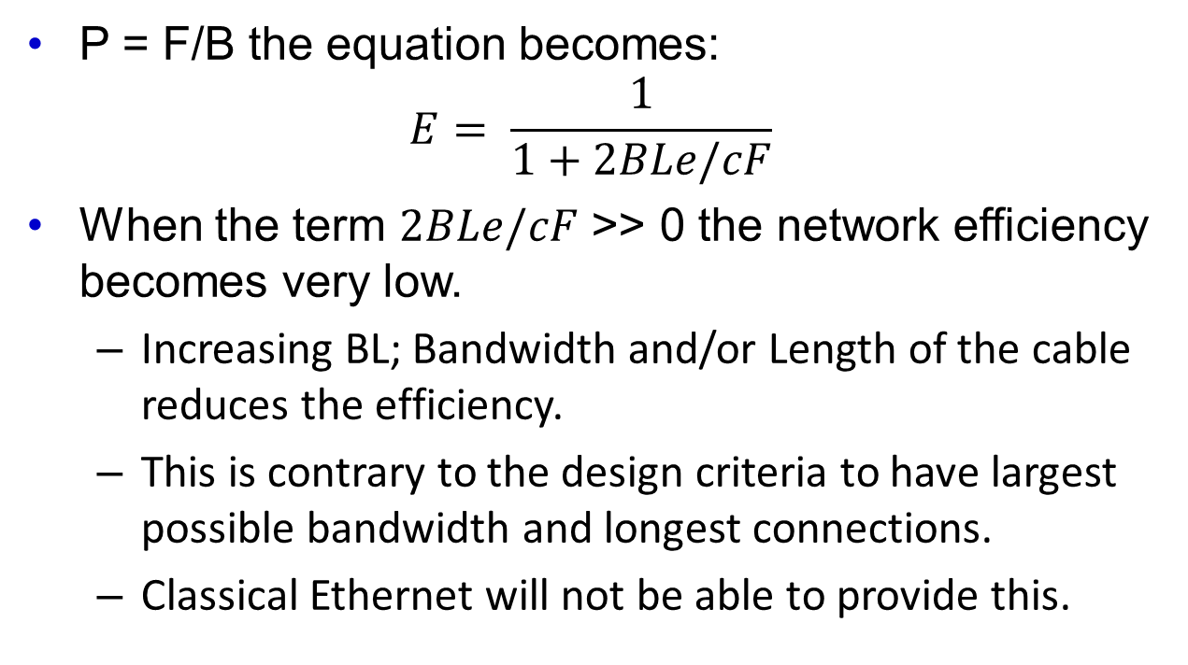
Ethernet Performance
P = F/B the equation becomes:
$$E= \frac{1}{1+2BLe/cF}$$
When the term $2BLe/cF$ >> 0 the network efficiency becomes very low.
Increasing BL; Bandwidth and/or Length of the cable reduces the efficiency.
This is contrary to the design criteria to have largest possible bandwidth and longest connections.
Classical Ethernet will not be able to provide this.

Slide 119
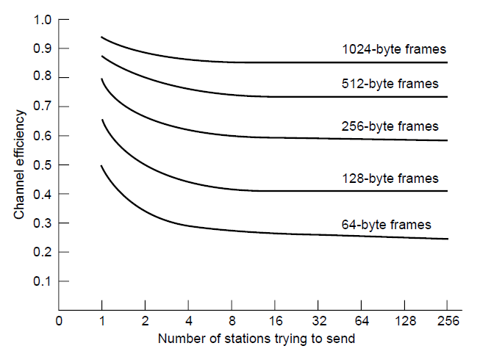
Ethernet Performance
Efficiency of Ethernet at 10 Mbps with 512-bit slot times.

Slide 120
Ethernet Performance
The theoretical result that Ethernet can not work that efficiently is flawed due to several reasons:
Poison distribution of the traffic is not realistic.
Research focuses on only several “interesting” cases.
Practical results show otherwise that the Ethernet works.

Slide 121
Switched Ethernet
Wiring was changed from a long cable architecture to a more complex architecture:
Each station has a dedicated cable running to a central hub. (Fig (a) in the next slide).
Adding and removing a station become much easier.
Cable length was reduced to 100 m for telephone twisted pair wires and to 200 hundred if Category 5 cable was used.
Hubs do not increase capacity – they are equivalent to the single long cable of classic Ethernet.
As more stations were added the performance of each station degraded.

Slide 122
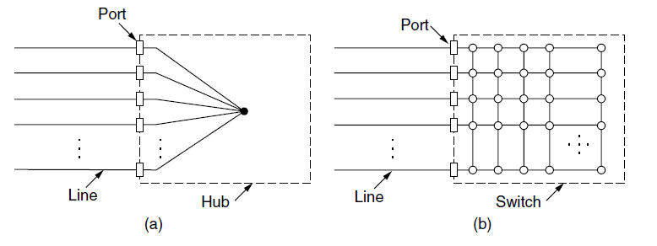
Switched Ethernet (1)
(a) Hub. (b) Switch.

Slide 123
Switched Ethernet
One could solve this problem by increasing the speed of the basic Ethernet from 1 Mbps to 10 Mbps, 100 Mbps or even 1 Gbps.
However, multimedia applications requires even higher bandwidths.
Switch is the solution.
Switch must be able to determine which frame goes to what station.
Security benefits
No collision can occur.

Slide 124
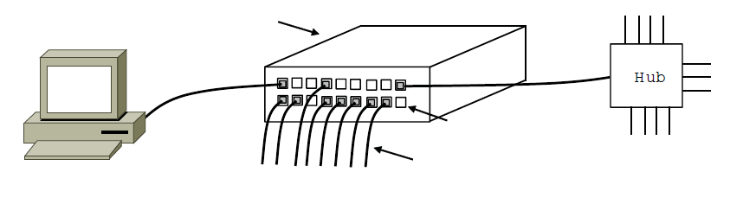
Switched Ethernet (2)
Switch
Hub
Switch ports
Twisted pair
An Ethernet switch.

Slide 125
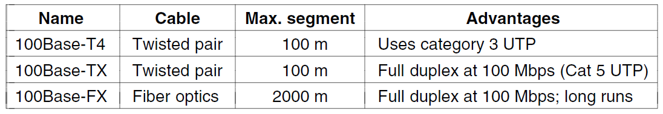
Fast Ethernet
The original fast Ethernet cabling.

Slide 126
GigaBit Ethernet
After the standard for Fast Ethernet was adopted the work for yet even faster standard started: GigaBit Ethernet
Goals:
Increase performance ten fold over Fast Ethernet.
Maintain compatibility with both Classical and Fast Ethernet.
Unacknowledged datagram service with both unicast and broadcast.
Use the same 48-bit addressing scheme already in use,
Maintain the same frame format including minimum and maximum sizes.

Slide 127
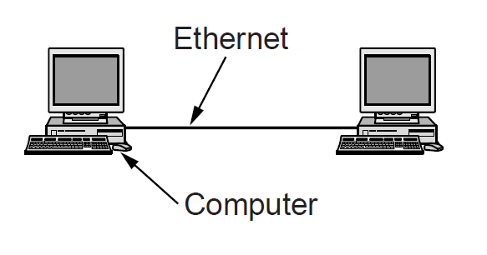
Gigabit Ethernet (1)
A two-station Ethernet

Slide 128
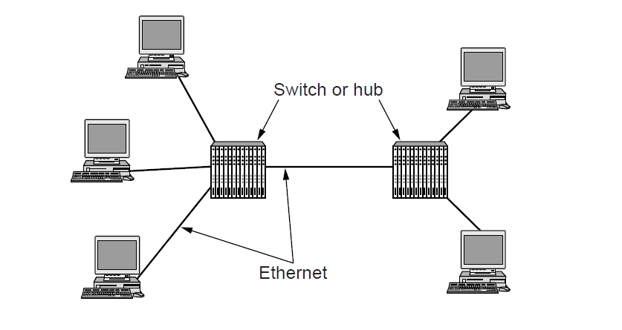
Gigabit Ethernet (2)
A two-station Ethernet

Slide 129
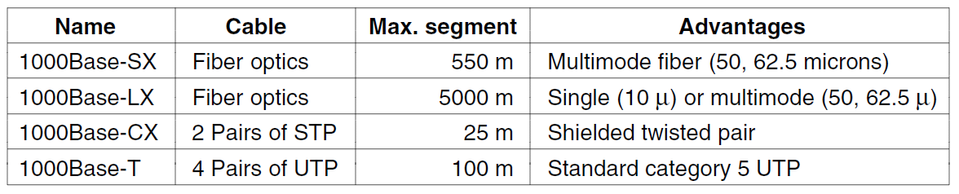
Gigabit Ethernet (3)
Gigabit Ethernet cabling.

Slide 130
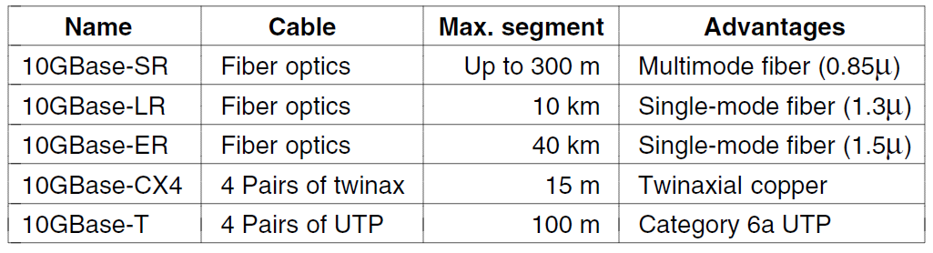
10 Gigabit Ethernet
Gigabit Ethernet cabling

Slide 131
Wireless Lans
802.11 architecture and protocol stack
802.11 physical layer
802.11 MAC sublayer protocol
802.11 frame structure
Services

Slide 132
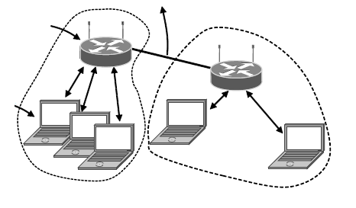
802.11 Architecture and Protocol Stack (1)
To Network
Access Point
Client
802.11 architecture – infrastructure mode

Slide 133
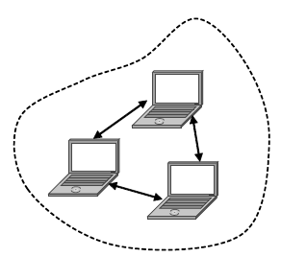
802.11 Architecture and Protocol Stack (2)
802.11 architecture – ad-hoc mode

Slide 134
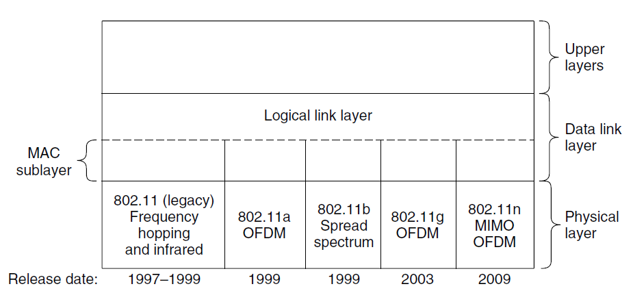
802.11 Architecture and Protocol Stack (3)
Part of the 802.11 protocol stack.

Slide 135
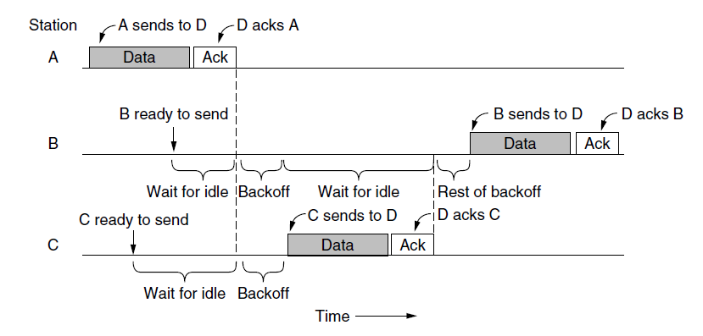
The 802.11 MAC Sublayer Protocol (1)
Sending a frame with CSMA/CA.

Slide 136
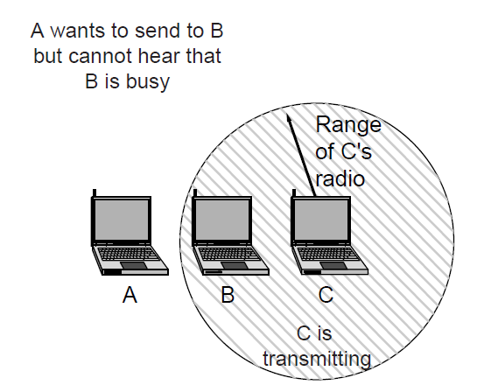
The 802.11 MAC Sublayer Protocol (2)
The hidden terminal problem.

Slide 137

The 802.11 MAC Sublayer Protocol (3)
The exposed terminal problem.

Slide 138

The 802.11 MAC Sublayer Protocol (4)
The use of virtual channel sensing using CSMA/CA.

Slide 139

The 802.11 MAC Sublayer Protocol (5)
Interframe spacing in 802.11

Slide 140

802.11 Frame Structure
Format of the 802.11 data frame

Slide 141
Broadband Wireless
Comparison of 802.16 with 802.11, 3G
802.16 architecture and protocol stack
802.16 physical layer
802.16 frame structure

Slide 142

Comparison of 802.16 with 802.11 and 3G
The 802.16 architecture

Slide 143

802.16 Architecture and Protocol Stack
The 802.16 protocol stack

Slide 144

802.16 Physical Layer
Frames structure for OFDMA with time division duplexing.

Slide 145
802.16 MAC Sublayer Protocol
Classes of service
Constant bit rate service.
Real-time variable bit rate service.
Non-real-time variable bit rate service.
Best-effort service.

Slide 146

802.16 Frame Structure
(a) A generic frame. (b) A bandwidth request frame.

Slide 147
Bluetooth
Architecture
Applications
Protocol stack
Radio layer
Link layers
Frame structure

Slide 148

Bluetooth Architecture
Two piconets can be connected to form a scatternet

Slide 149

Bluetooth Protocol Stack
The Bluetooth protocol architecture.

Slide 150

Bluetooth Frame Structure
Typical Bluetooth data frame at (a) basic, and (b) enhanced, data rates.

Slide 151
RFID
EPC Gen 2 architecture
EPC Gen 2 physical layer
EPC Gen 2 tag identification layer
Tag identification message formats

Slide 152

EPC Gen 2 Architecture
RFID architecture.

Slide 153

EPC Gen 2 Physical Layer
Reader and tag backscatter signals.

Slide 154

EPC Gen 2 Tag Identification Layer
Example message exchange to identify a tag.

Slide 155

Tag Identification Message Formats
Format of the Query message.

Slide 156
Data Link Layer Switching
Uses of bridges
Learning bridges
Spanning tree bridges
Repeaters, hubs, bridges, switches, routers, and gateways
Virtual LANs

Slide 157

Learning Bridges (1)
Bridge connecting two multidrop LANs

Slide 158

Learning Bridges (2)
Bridges (and a hub) connecting seven point-to-point stations.

Slide 159

Learning Bridges (3)
Protocol processing at a bridge.

Slide 160

Spanning Tree Bridges (1)
Bridges with two parallel links

Slide 161

Spanning Tree Bridges (2)
A spanning tree connecting five bridges. The dotted lines are links that are not part of the spanning tree.

Slide 162
Poem by Radia Perlman (1985) Algorithm for Spanning Tree (1)
I think that I shall never see
A graph more lovely than a tree.
A tree whose crucial property
Is loop-free connectivity.
A tree which must be sure to span.
So packets can reach every LAN.
. . .

Slide 163
Poem by Radia Perlman (1985) Algorithm for Spanning Tree (2)
. . .
First the Root must be selected
By ID it is elected.
Least cost paths from Root are traced
In the tree these paths are placed.
A mesh is made by folks like me
Then bridges find a spanning tree.

Slide 164

Repeaters, Hubs, Bridges, Switches, Routers, and Gateways
(a) Which device is in which layer. (b) Frames, packets, and headers.

Slide 165

Virtual LANs (1)
A building with centralized wiring using hubs and a switch.

Slide 166

Virtual LANs (2)
Two VLANs, gray and white, on a bridged LAN.

Slide 167

The IEEE 802.1Q Standard (1)
Bridged LAN that is only partly VLAN-aware. The shaded symbols are VLAN aware. The empty ones are not.

Slide 168

The IEEE 802.1Q Standard (2)
The 802.3 (legacy) and 802.1Q Ethernet frame formats.

Slide 169
End
Chapter 4

