Slide 1

Computer Network
Spring 2020
Prof./Dr. Shen Bichuan
College of Computer Science and Engineering Chongqing University of Technology

Slide 2
The Transport Layer
Chapter 6

Slide 3
Transport Service
Upper Layer Services
Transport Service Primitives
Berkeley Sockets
Example of Socket Programming:
Internet File Server

Slide 4
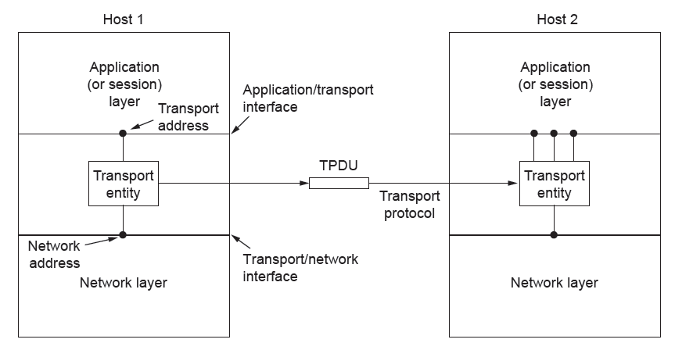
Services Provided to the Upper Layers
The network, transport, and application layers

Slide 5
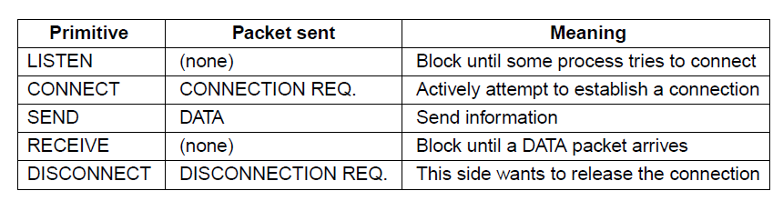
Transport Service Primitives (1)
The primitives for a simple transport service

Slide 6
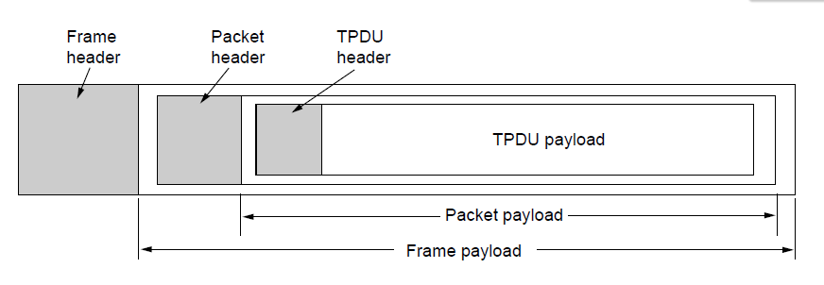
Transport Service Primitives (2)
Nesting of TPDUs, packets, and frames.

Slide 7
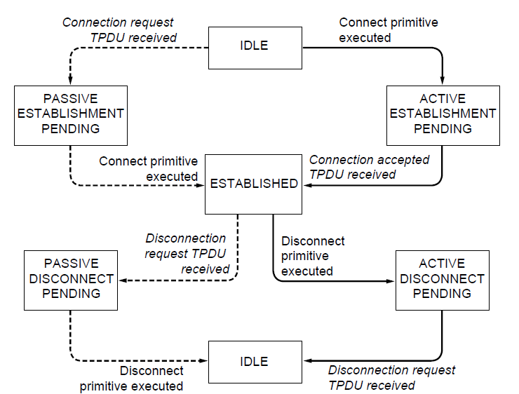
Berkeley Sockets (1)
A state diagram for a simple connection management scheme. Transitions labeled in italics are caused by packet arrivals. The solid lines show the client’s state sequence. The dashed lines show the server’s state sequence.

Slide 8
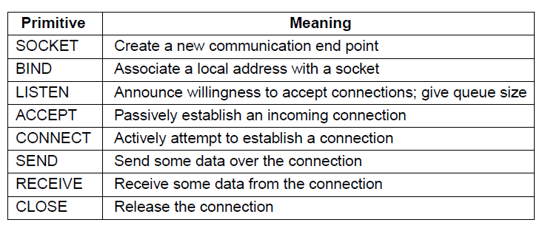
Berkeley Sockets (2)
The socket primitives for TCP

Slide 9
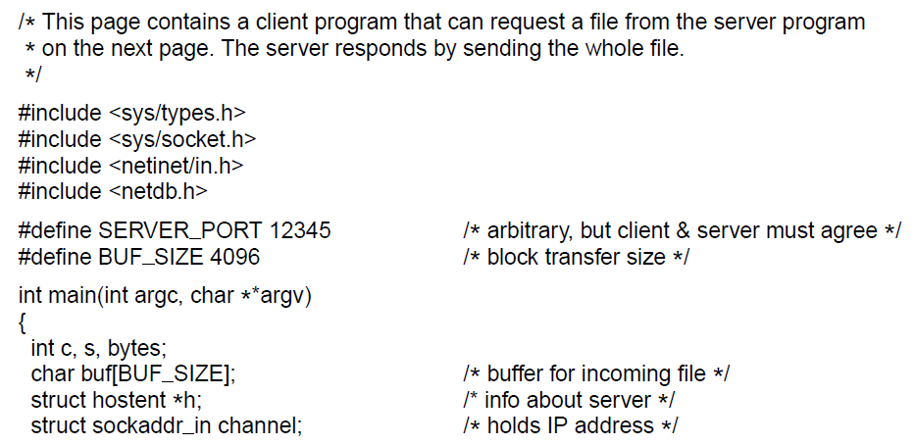
Example of Socket Programming:
An Internet File Server (1)
. . .
Client code using sockets

Slide 10
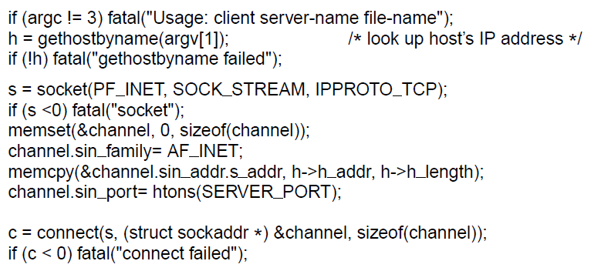
Example of Socket Programming:
An Internet File Server (2)
. . .
. . .
Client code using sockets

Slide 11
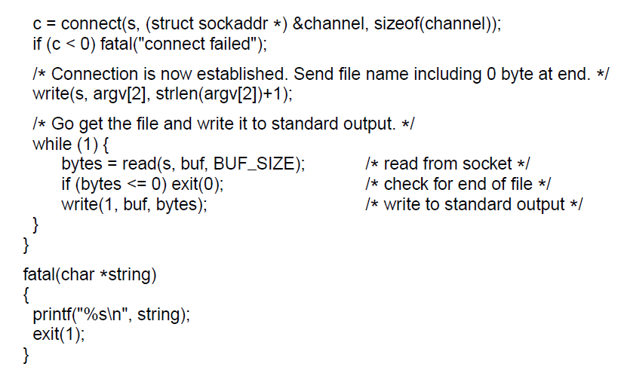
Example of Socket Programming:
An Internet File Server (3)
. . .
Client code using sockets

Slide 12
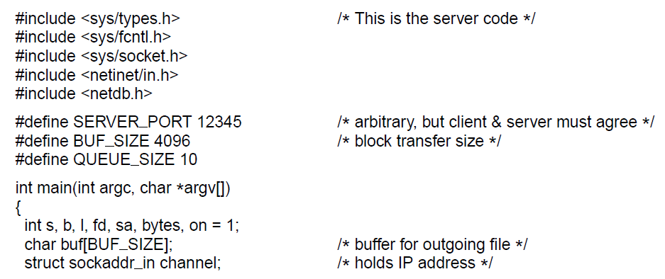
Example of Socket Programming:
An Internet File Server (4)
. . .
Server code

Slide 13
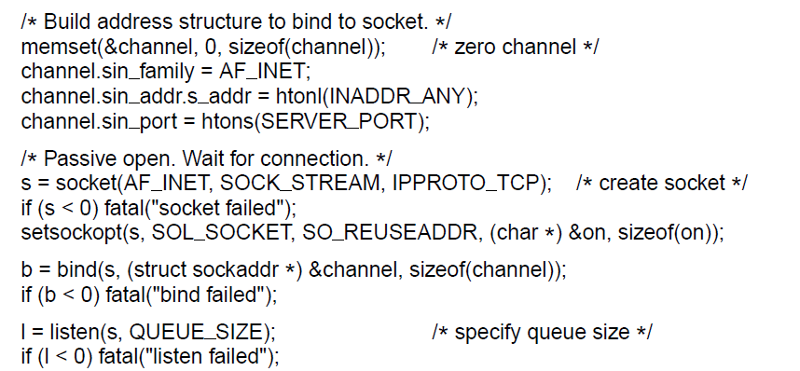
Example of Socket Programming:
An Internet File Server (5)
. . .
. . .
Server code

Slide 14
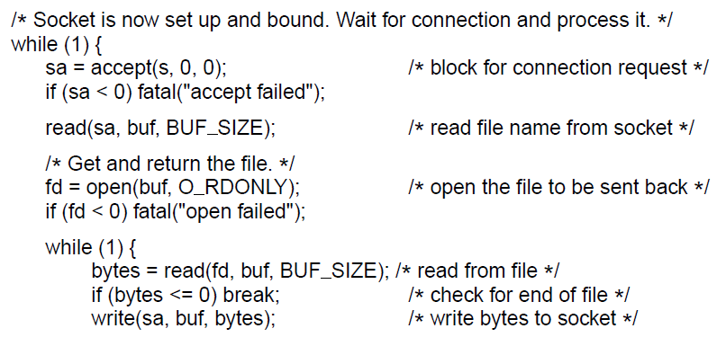
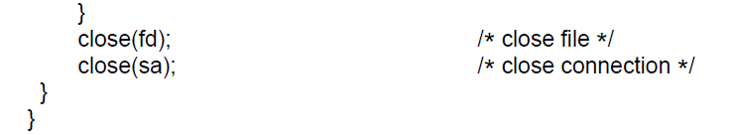
Example of Socket Programming:
An Internet File Server (6)
. . .
Server code

Slide 15
Elements of Transport Protocols (1)
Addressing
Connection establishment
Connection release
Error control and flow control
Multiplexing
Crash recovery

Slide 16
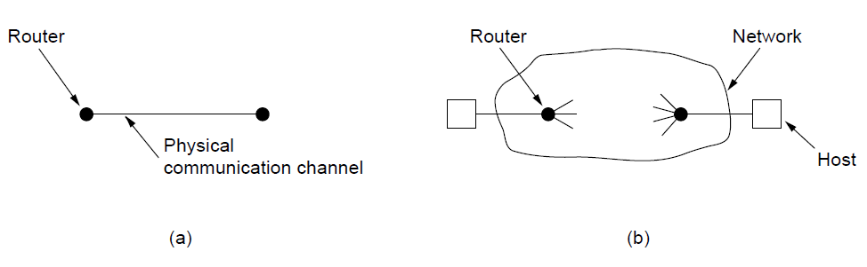
Elements of Transport Protocols (2)
Environment of the data link layer.
Environment of the transport layer.

Slide 17
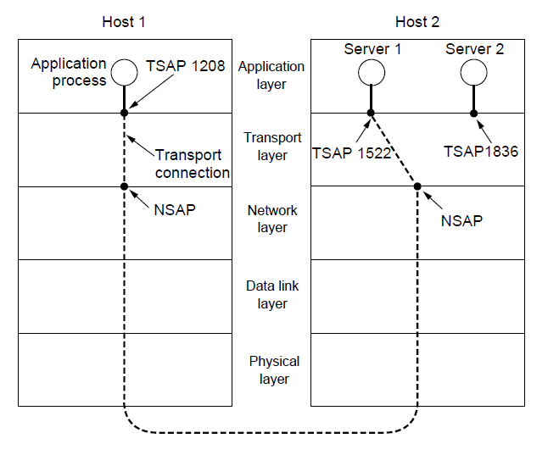
Addressing (1)
TSAPs, NSAPs, and transport connections

Slide 18
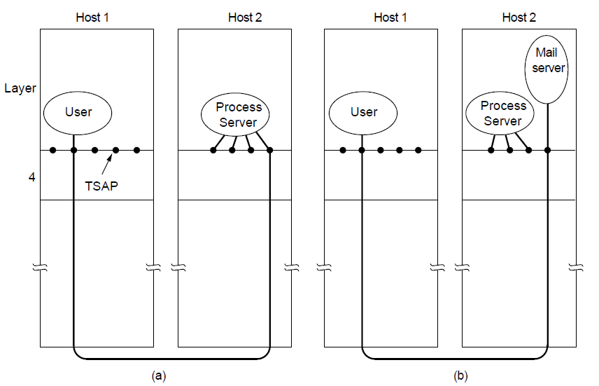
Addressing (2)
How a user process in host 1 establishes a connection
with a mail server in host 2 via a process server.

Slide 19
Connection Establishment (1)
Techniques for restricting packet lifetime
Restricted network design.
Putting a hop counter in each packet.
Timestamping each packet.

Slide 20
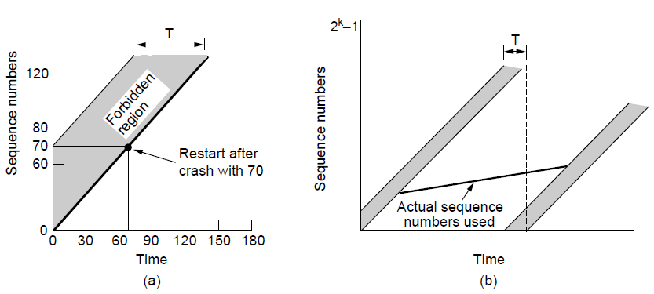
Connection Establishment (2)
TPDUs may not enter the forbidden region.
The resynchronization problem.

Slide 21
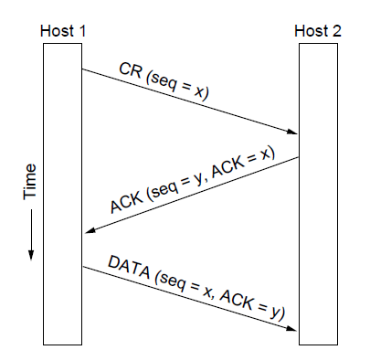
Connection Establishment (3)
Three protocol scenarios for establishing a connection using a
three-way handshake. CR denotes CONNECTION REQUEST. Normal operation.

Slide 22
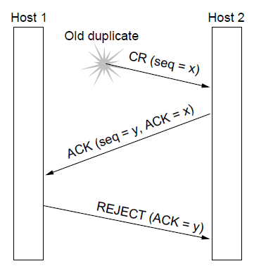
Connection Establishment (4)
Three protocol scenarios for establishing a connection using a
three-way handshake. CR denotes CONNECTION REQUEST. Old duplicate CONNECTION REQUEST appearing out of nowhere.

Slide 23
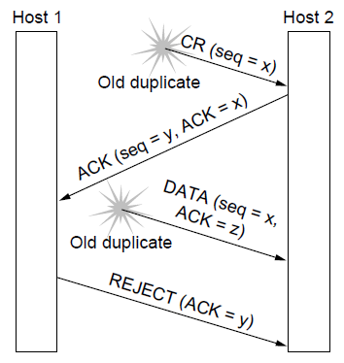
Connection Establishment (5)
Three protocol scenarios for establishing a connection using a
three-way handshake. CR denotes CONNECTION REQUEST. Duplicate CONNECTION REQUEST and duplicate ACK

Slide 24
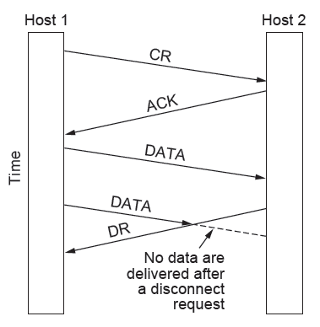
Connection Release (1)
Abrupt disconnection with loss of data

Slide 25
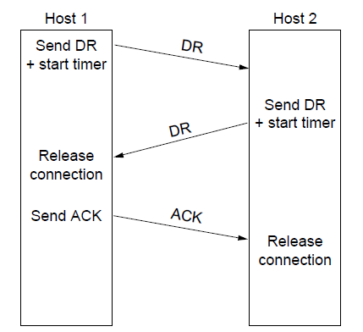
Connection Release (3)
Four protocol scenarios for releasing a connection.
(a) Normal case of three-way handshake

Slide 26
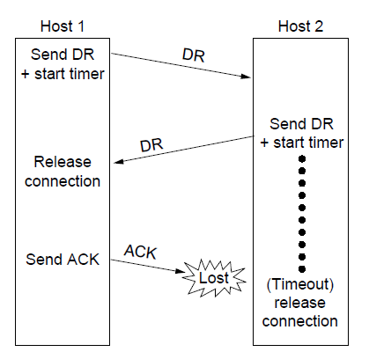
Connection Release (4)
Four protocol scenarios for releasing a connection.
(b) Final ACK lost.

Slide 27
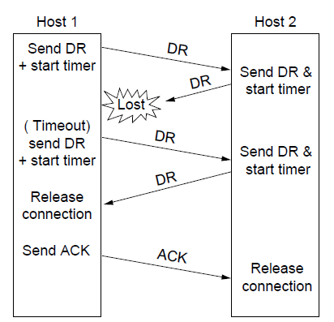
Connection Release (5)
Four protocol scenarios for releasing a connection.
(c) Response lost

Slide 28
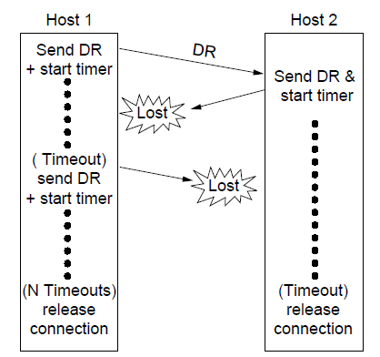
Connection Release (6)
Four protocol scenarios for releasing a connection.
(d) Response lost and subsequent DRs lost.

Slide 29
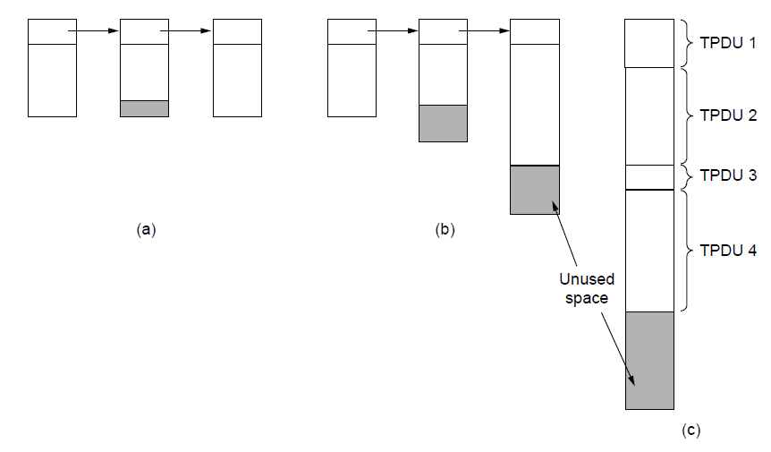
Error Control and Flow Control (1)
(a) Chained fixed-size buffers. (b) Chained variable-sized buffers. (c) One large circular buffer per connection.

Slide 30
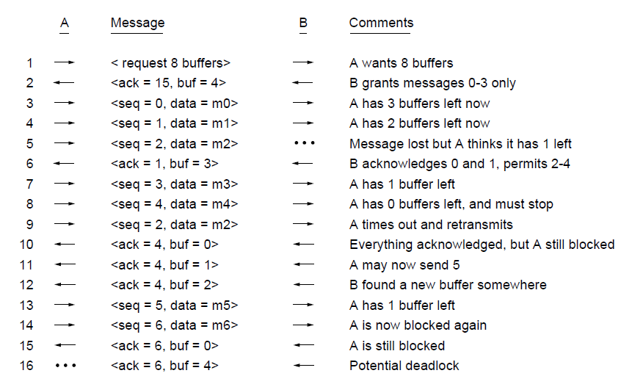
Error Control and Flow Control (2)
Dynamic buffer allocation. The arrows show the direction of transmission. An ellipsis (...) indicates a lost TPDU

Slide 31
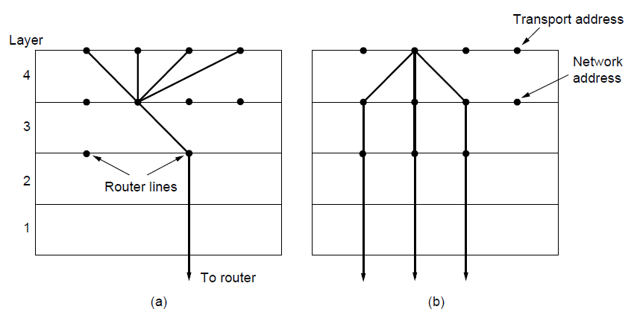
Multiplexing
(a) Multiplexing. (b) Inverse multiplexing.

Slide 32
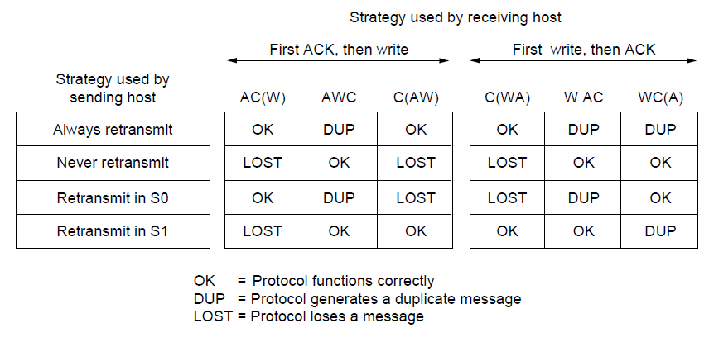
Crash Recovery
Different combinations of client and server strategy

Slide 33
Congestion Control
Desirable bandwidth allocation
Regulating the sending rate

Slide 34
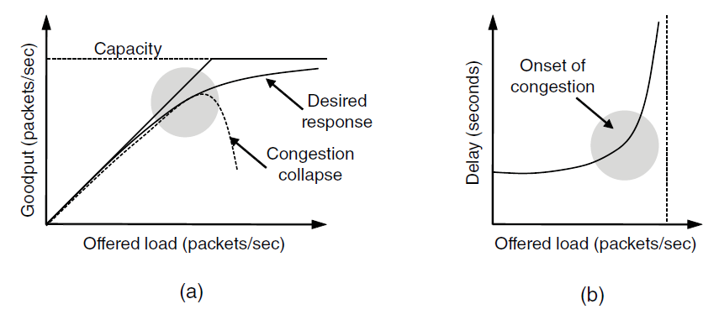
Desirable Bandwidth Allocation (1)
(a) Goodput and (b) delay as a function of offered load

Slide 35
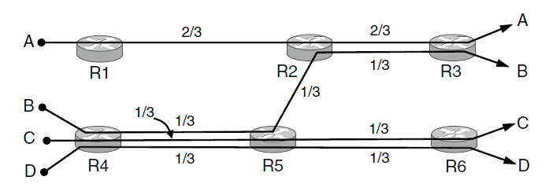
Desirable Bandwidth Allocation (2)
Max-min bandwidth allocation for four flows

Slide 36
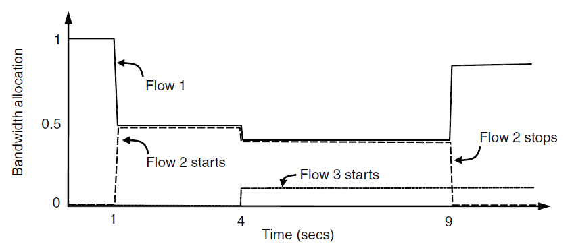
Desirable Bandwidth Allocation (3)
Changing bandwidth allocation over time

Slide 37
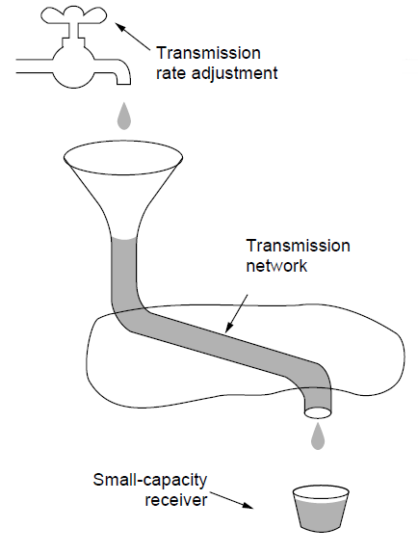
Regulating the Sending Rate (1)
A fast network feeding a low-capacity receiver

Slide 38
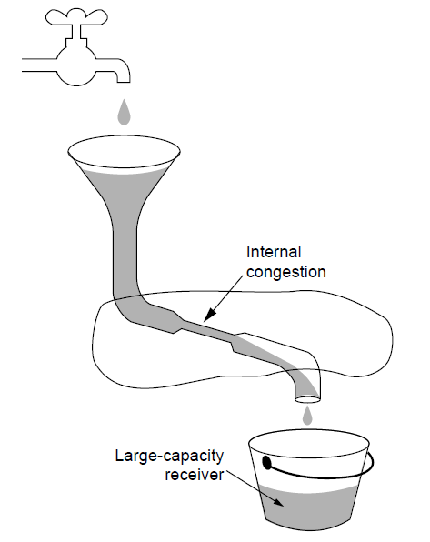
Regulating the Sending Rate (2)
A slow network feeding a high-capacity receiver

Slide 39
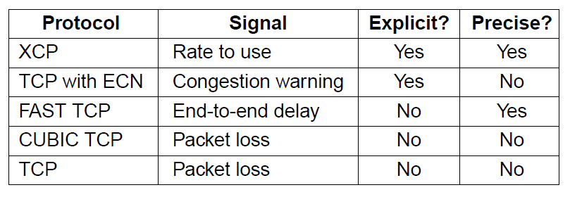
Regulating the Sending Rate (3)
Some congestion control protocols

Slide 40
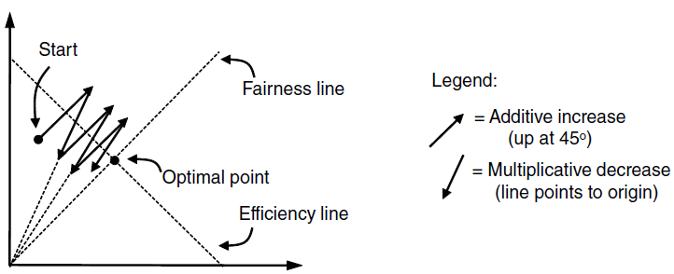
Regulating the Sending Rate (4)
User 2’s allocation
User 1’s allocation
Additive Increase Multiplicative Decrease (AIMD) control law.

Slide 41
The Internet Transport Protocols: UDP
Introduction to UDP
Remote Procedure Call
Real-Time Transport

Slide 42
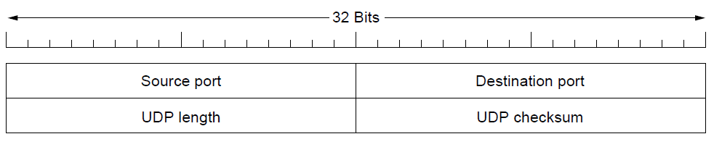
Introduction to UDP (1)
The UDP header.

Slide 43
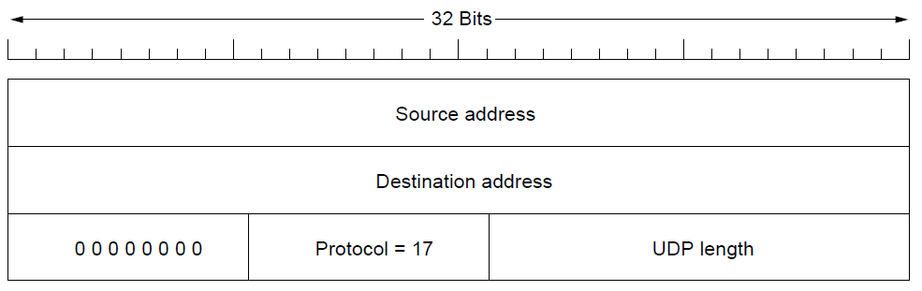
Introduction to UDP (2)
The IPv4 pseudoheader included in the UDP checksum.

Slide 44
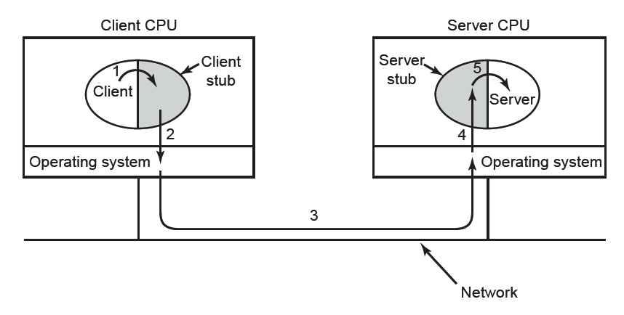
Remote Procedure Call
Steps in making a remote procedure call. The stubs are shaded.

Slide 45
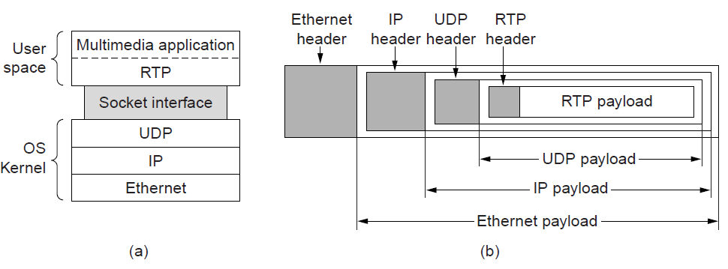
Real-Time Transport (1)
(a) The position of RTP in the protocol stack. (b) Packet nesting.

Slide 46
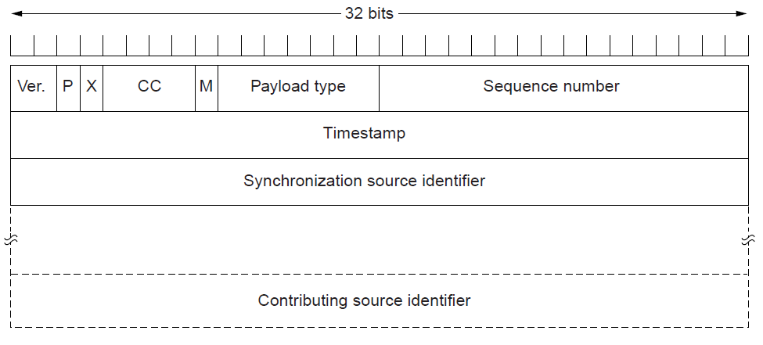
Real-Time Transport (2)
The RTP header

Slide 47
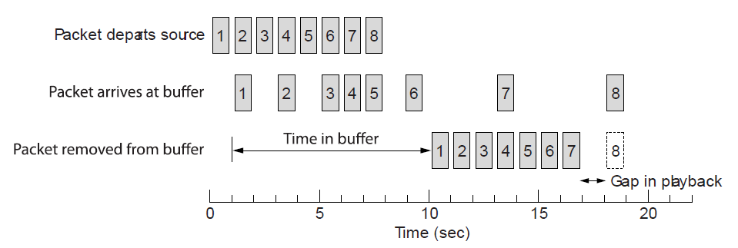
Real-Time Transport (3)
Smoothing the output stream by buffering packets

Slide 48
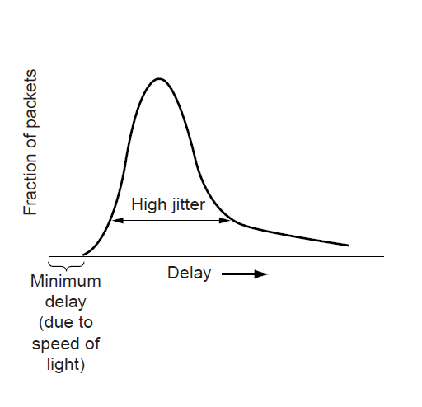
Real-Time Transport (3)
High jitter

Slide 49
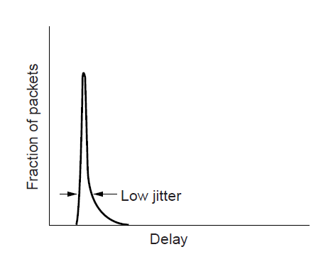
Real-Time Transport (4)
Low jitter

Slide 50
Transmission Control Protocol (TCP)
Connection oriented
  Explicit set-up and tear-down of TCP session
Stream-of-bytes service
  Sends and receives a stream of bytes, not messages
Reliable, in-order delivery
  Checksums to detect corrupted data
  Acknowledgments & retransmissions for reliable delivery
  Sequence numbers to detect losses and data reordering
Flow control
  Prevents overflow of the receiver’s buffer
Congestion control
  Adapts to network congestion for the greater good

Slide 51
Does TCP Duplicate Lower Layer Services?
Sliding-window based algorithm
Incorporates ACK, NACKs, retransmissions, timeouts, ordering
How is TCP different?
  Runs over a route rather than a single physical link → Needs to establish a connection and negotiate parameters (sliding window size)
  Adapts to heterogeneous conditions
    RTT varies with connected hosts, time of the day etc, unpredictable
    Flow control on computers with different resources
  Reorders and retransmits packets end-to-end
    Even if packets are in order on one physical link this does not guarantee end-to-end ordering
  Provides congestion control
    No immediate feedback from the link, no knowledge of conditions along the way
    Congestion control based on feedback

Slide 52
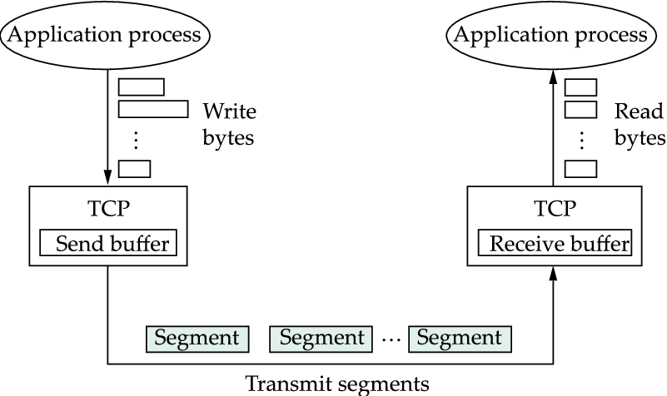
TCP Byte Service
In general, TCP is a full duplex protocol,. i.e. data flows in both directions

Slide 53
TCP Segment
IP Data
TCP Data (segment)
TCP Hdr
IP Hdr
IP packet
  No bigger than Maximum Transmission Unit (MTU)
  E.g., up to 1500 bytes on an Ethernet
TCP packet
  IP packet with a TCP header and data inside
  TCP header is typically 20 bytes long
TCP segment
  No more than Maximum Segment Size (MSS) bytes
  E.g., up to 1460 consecutive bytes

Slide 54
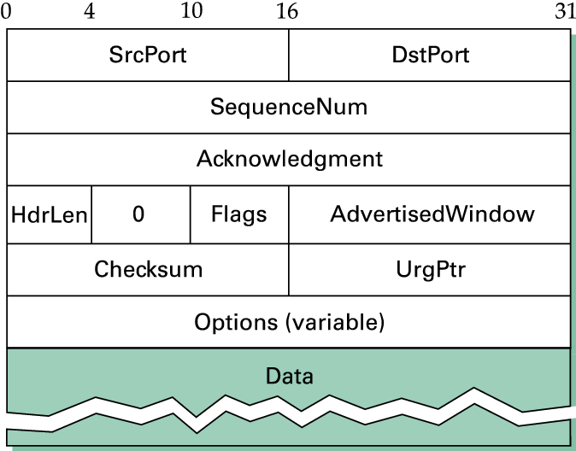
TCP Segment

Slide 55
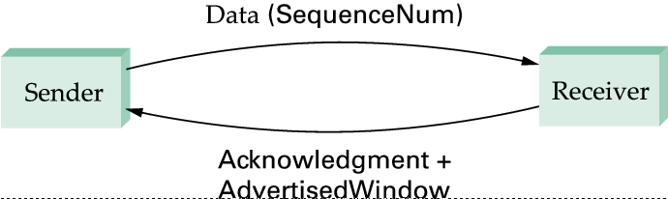
Simplified TCP Flow
Data Sequence Numbers flow toward the receiver
Acks and Window Size flow the opposite direction

Slide 56
Header Fields in a Segment
<SrcPort, SrcIPAddr, DestPort, DestIPAddr> define a TCP connection
SequenceNum: Sequence number of the first byte in the segment
Flags: 6-bit field: SYN, FIN, RESET, PUSH, URG, ACK
  SYN, FIN: Establish and terminate a TCP connection
  ACK: request for an acknowledgement
  URG: Urgent Data UrgPtr points to where the urgent data ends
  PUSH: a notification to the application running over TCP
  RESET: some error occurred and the connection needs to be aborted

Slide 57
Sequence Numbers
Host A
ISN (initial sequence number)
Sequence number = 1st byte
TCP
HDR
TCP Data
ACK sequence number = next expected byte
TCP Data
TCP
HDR
Host B

Slide 58
Initial Sequence Number (ISN)
Sequence number for the very first byte
  E.g., Why not a de facto ISN of 0?
Practical issue
  IP addresses and port #s uniquely identify a connection
  Same port #s may get used again to establish new connection
  and there is a chance an old packet is still in flight
  and might be associated with the new connection
So, TCP requires changing the ISN over time
  Set from a 32-bit clock that ticks every 4 μs
  Wraps around once every 4.55 hours!
But, this means the hosts need to exchange ISNs

Slide 59
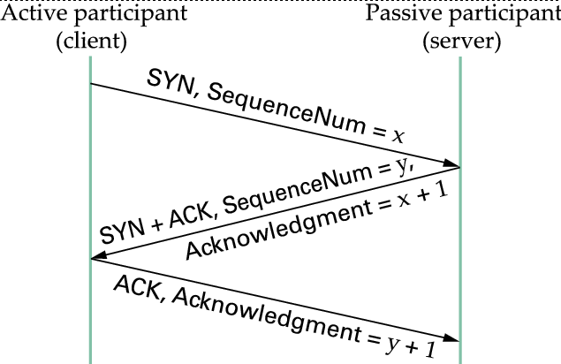
Connection Establishment
Three-Way Handshake
  Exchange of three messages
Timer
Timer

Slide 60
Client’s SYN Packet
Client’s Port
Server’s Port
Client’s ISN
20
SYN

Slide 61
Server’s Reply Packet
Server’s Port
Client’s Port
Server’s ISN
Client’s ISN + 1
20
SYN, ACK

Slide 62
Client’s ACK Packet
Client’s Port
Server’s Port
Server’s ISN + 1
20
ACK

Slide 63
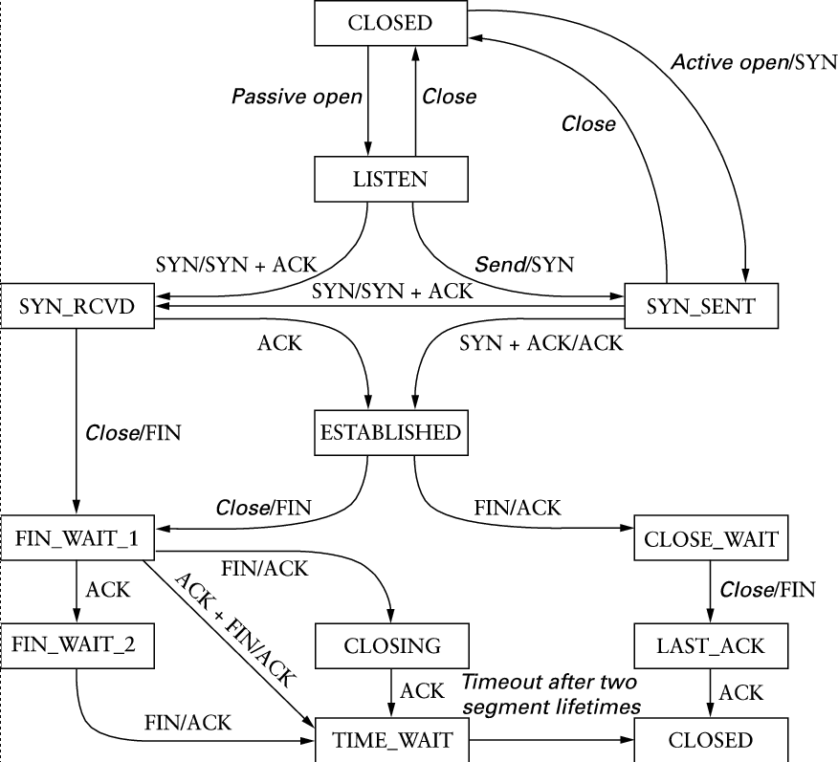
TCP Transition Diagram

Slide 64
Tearing Down the Connection
B
ACK
SYN
SYN ACK
Data
ACK
FIN
FIN ACK
FIN
ACK
A
time
Closing the connection
  Finish (FIN) to close and receive remaining bytes
  And other host sends a FIN ACK to acknowledge
  Reset (RST) to close and not receive remaining bytes

Slide 65
The Internet Transport Protocols: TCP (1)
Introduction to TCP
The TCP service model
The TCP protocol
The TCP segment header
TCP connection establishment
TCP connection release

Slide 66
The Internet Transport Protocols: TCP (2)
TCP connection management modeling
TCP sliding window
TCP timer management
TCP congestion control
TCP futures

Slide 67
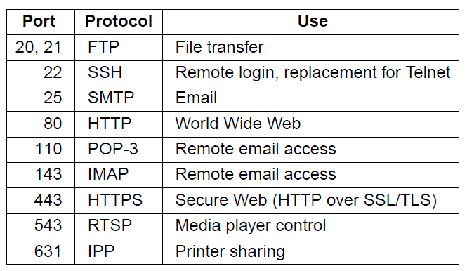
The TCP Service Model (1)
Some assigned ports

Slide 68
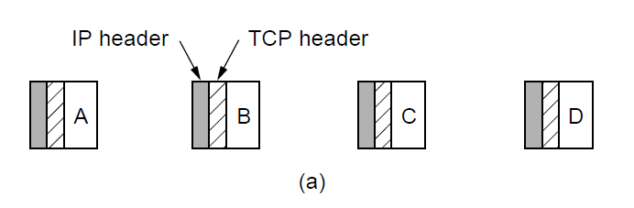

The TCP Service Model (2)
Four 512-byte segments sent as separate IP diagrams
The 2048 bytes of data delivered to the application in a single READ call

Slide 69

The TCP Segment Header
The TCP header.

Slide 70

TCP Connection Establishment
TCP connection establishment in the normal case.
Simultaneous connection establishment on both sides.

Slide 71

TCP Connection Management Modeling (1)
The states used in the TCP connection
management finite state machine.

Slide 72

TCP Connection Management Modeling (2)
TCP connection management finite state machine.
The heavy solid line is the normal path for a client. The heavy dashed line is the normal path for a server. The light lines are unusual events. Each transition is labeled by the event causing it and the action resulting from it, separated by a slash.

Slide 73

TCP Sliding Window (1)
Window management in TCP

Slide 74

TCP Sliding Window (2)
Silly window syndrome

Slide 75

TCP Timer Management
Probability density of acknowledgment arrival times in data link layer. (b) … for TCP

Slide 76

TCP Congestion Control (1)
Slow start from an initial congestion window of 1 segment

Slide 77

TCP Congestion Control (2)
Additive increase from an initial congestion
window of 1 segment.

Slide 78

TCP Congestion Control (3)
Slow start followed by additive increase in TCP Tahoe.

Slide 79

TCP Congestion Control (4)
Fast recovery and the sawtooth pattern of TCP Reno.

Slide 80

Sliding Window in TCP
Goals of sliding window
  Guarantee end-to-end reliable data delivery, and in order
  Enforce flow control between sender and receiver
  LastByteAcked ≤ LastByteSent ≤ LastByteWritten
  LastByteRead < NextByteExpected ≤ LastByteRcvd + 1

Slide 81
Flow Control in TCP
Receiver advertises window no larger than its buffer size
  LastByteRcvd – LastByteRead ≤ MaxRcvBuffer
  AdvertisedWindow = MaxRcvBuffer – ((NextByteExpected – 1) – LastByteRead)
Example: LastByteRcvd = 5, LastByteRead = 1, NextByteExpected = 6, MaxRcvBuffer = 10
  5 – 1 ≤ 10
  AdvertisedWindow = 10 - ((6 – 1) – 1) = 10 – 4 = 6
Sender adheres to the AdvertisedWindow by
  LastByteSent – LastByteAcked ≤ AdvertisedWindow
  EffectiveWindow = AdvertisedWindow – (LastByteSent – LastByteAcked)
  Example: sent 7, ACK 5, EffectiveWindow = 6 – (7 - 5) = 4

Slide 82
Why Ignore LastByteReceived
Example
  MaxReceiverBuffer = 10
  Receiver buffer : 1, 2, 3, 5, 6, 7, 8,
  AdvertisedWindow = 7 (though buffer space is only 3)
  Since only packet 3 is ACKed, sender can only have 4 - 10 UnAcked.
  Sender will send 9, 10 and wait for any ACK.
  Packet 4 timeouts and gets retransmitted.
  An Ack arrives for packet 8, with an updated Advertised Window

Slide 83
Flow Control in TCP
Buffer at the Sender
  LastByteWritten – LastByteAcked ≤ MaxSendSize
Fast sender slow receiver scenario
Sender’s buffer
Receiver’s buffer

Slide 84
Learning about Advertised Window
Sender sends data
  Receiver replies with ACK and Advertised Window
Issue with fast sender slow receiver
  Sender is blocked, receiver will not have data to reply to
  When receiver advertises window of 0, sender periodically sends one byte of data
  Smart sender/Dumb receiver rule
Sender’s buffer
Receiver’s buffer

Slide 85
Sequence Number Wraparound
AdvertisedWindow: 16 bits long, up to 2¹⁶
Sequence number field: 32 bits long up to 2³²
SN>>2 AdvertisedWindow, so there would be no problem in ordering
How fast are sequence numbers exhausted
  T1 (1.5MBps) : 2³² x 8 / 1.5 x 10⁶ ~ 6.4hrs
  Ethernet (10 Mbps) : 57 mins
  T3 (45Mbps) : 13 mins
  Fast Ethernet (100 MBps) : 6 mins TTL = 120 sec
  OC-3 (155Mbps) : 4 mins
  OC-12 (622 Mbps) : 55 sec
  OC-48 (2.5 Gbps) : 14 sec

Slide 86
Failure due to Seq # Wraparound
Sequence number wrap-around on the current connection
  A seq number may be "wrapped" (cycled) within the time that a segment is delayed in queues
Earlier incarnation of the connection
  A delayed segment from the terminated connection could fall within the current window for the new incarnation and be accepted as valid
Solution
  Add a timestamp field on every packet
  Reject a packet with a higher sequence number if earlier ones have a later timestamp

Slide 87
Keeping the Pipe Full
Assume the receiver has adequate buffer space
End-to-end Delay x Bandwidth product
  T1 (1.5MBps) : 1.5 x 10⁶ x 0.1 / 8 ~ 19 KB
  Ethernet (10 Mbps) : 122KB
  T3 (45Mbps) : 549 KB
  Fast Ethernet (100 MBps) : 1.2 MB RTT = 100 msec
  OC-3 (155Mbps) : 1.8 MB
  OC-12 (622 Mbps) : 7.4 MB
  OC-48 (2.5 Gbps) : 29.6 MB
AdvertisedWindow field: 16 bits – 2¹⁶ = 64KB
Handled by TCP extension specification. A scale factor is indicated in the options header of a SYN packet

Slide 88
Triggering TCP Transmissions
Mechanism for triggering transmission of a segment
  Maximum Segment Size (MSS) parameter
    MSS = MTU of underlying network – Headers = 1500 – 20 - 20 = 1460
  Push Operation
    Sending process using TCP request to empty the buffer
  Timer expiration
    A timer with specific task expires and all buffered packets are sent
So far we ignored flow control
  AdvertisedWindow may be smaller than MSS, or closed
  Aggressive stategy: Send whatever you have in an aggressive manner
  Example
MSS
MSS/2

Slide 89


Silly Window Syndrome
Introduces tiny segments that
stay in the system indefinitely
To avoid small segments, receiver advertises open window after MSS buffer size is available
To coalesce tiny segments, receiver may delay ACKs so buffer space empties up
Still, receiver cannot know exactly how much to delay

Slide 90
Nagle’s Algorithm
Use received ACKs as a timer to send more data
  when the application has data to send
    if both data written in buffer and the window ≥ MSS
    Send full segment
  else
    if there are unACKed data in flight
    buffer new data till ACK received
  else
    send all data now

Slide 91
TCP Adaptive Retransmission
Problem
  Estimate RTT between two hosts to set up timeout for retransmissions
Original Algorithm
  Use a running average of RTT
  SampleRTT = RTT of last segment ACKed
  EstimatedRTT = α x EstimatedRTT + (1 - α) x SampleRTT
  α usually in the range 0.8 – 0.9
  Timeout: 2 x EstimatedRTT

Slide 92

Karn/Patridge Algorithm
Problem with SampleRTT measurement
Solution
  Ignore all SampleRTT for segments sent more than once
Additional improvement
  Double the timeout every time you do a retransmission
Exponential backoff mechanism for TCP

Slide 93

Jacobson/Karels Algorithm
Previous approaches did not take into account the variance of RTT
If variance was well known, no need to be too conservative
  Difference = SampleRTT – EstimatedRTT
  EstimatedRTT = EstimatedRTT + (δ x Difference), 0 ≤ δ ≤ 1
  Deviation = Deviation + (δ x (|Difference|- Deviation)
  TimeOut = μ x EstimatedRTT +φ x Deviation, μ = 1, φ = 4

Slide 94

TCP Extensions
Use the Options field and the Hdrlen field to define extensions
Extension #1: Timestamps
  Put a 32-bit timestamp in a segment
  Receiver simply reflects this timestamp in the acknowledgment
  Compute round-trip time based on the time ACK was received and the timestamp in ACK
  Eliminates discrepancies in RTT estimates
Extension #2: Expand the 32-bit sequence number field
  Use the 32-bit timestamp to extend the sequence number space
  Timestamps always increase

Slide 95
TCP Extensions
Extension #3: Extend the window size
  Increase the unit from one byte to several bytes (e.g. 16 bytes)
  Max Window size increases from 2^16 to 2^20
  Window size has to be a multiple of unit (e.g. 16)
Extension #4: Use of Cumulative and Selective ACKs (SACKs)
  Acknowledge normally for segments received in sequence in the standard header
  Indicate the out-of-sequence packets received in optional headers
  If SACK not used, transmitter can use Go-back-N, which may unnecessarily retransmit some segments

Slide 96
Performance Issues
Performance problems in computer networks
Network performance measurement
System design for better performance
Fast TPDU processing
Protocols for high-speed networks

Slide 97

Performance Problems in Computer Networks
The state of transmitting one megabit from San Diego to Boston. (a) At t = 0. (b) After 500 μ sec.
(c) After 20 msec. (d) After 40 msec.

Slide 98
Network Performance Measurement (1)
Steps to performance improvement
Measure relevant network parameters, performance.
Try to understand what is going on.
Change one parameter.

Slide 99
Network Performance Measurement (2)
Issues in measuring performance
Sufficient sample size
Representative samples
Clock accuracy
Measuring typical representative load
Beware of caching
Understand what you are measuring
Extrapolate with care

Slide 100

Network Performance Measurement (3)
Response as a function of load.

Slide 101
System Design for Better Performance (1)
Rules of thumb
CPU speed more important than network speed
Reduce packet count to reduce software overhead
Minimize data touching
Minimize context switches
Minimize copying
You can buy more bandwidth but not lower delay
Avoiding congestion is better than recovering from it
Avoid timeouts

Slide 102

System Design for Better Performance (2)
Four context switches to handle one packet
with a user-space network manager.

Slide 103

Fast TPDU Processing (1)
The fast path from sender to receiver is shown with a heavy line. The processing steps on this path are shaded.

Slide 104

Fast TPDU Processing (2)
(a) TCP header. (b) IP header. In both cases, the shaded fields are taken from the prototype without change.

Slide 105

Protocols for High-Speed Networks (1)
A timing wheel

Slide 106

Protocols for High-Speed Networks (2)
Time to transfer and acknowledge a
1-megabit file over a 4000-km line

Slide 107
Delay Tolerant Networking
DTN Architecture
The Bundle Protocol

Slide 108

DTN Architecture (1)
Delay-tolerant networking architecture

Slide 109

DTN Architecture (2)
Use of a DTN in space.

Slide 110

The Bundle Protocol (1)
Delay-tolerant networking protocol stack.

Slide 111

The Bundle Protocol (2)
Bundle protocol message format.

Slide 112
End
Chapter 6

