Slide 1
Information
Appliance
Rank / Name of Inspecting Officer
Rank / Name of Inspecting Officer
Date Dispatched | 20/05/2026
Time Dispatched | 16:27:03
Time Arrived | 16:27:03
Case ID | 10000
Address | 123 Teck Street
Premises Own By | Unity Pte ltd | T09
Details Accompanying Person | Mr Devan, Technician | 98123
Classification | False alarm
Case handed over to/liasion with | SGT T17123 Boon Lay

Slide 2
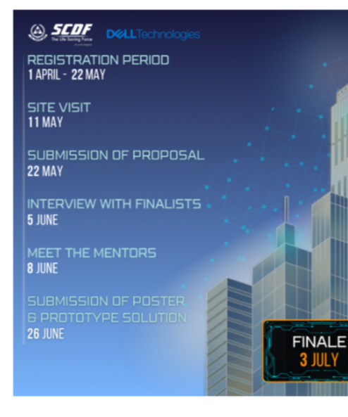
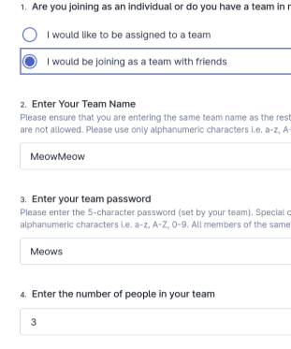
10000
Overview
Main fire alarm panel
Sub fire alarm panel
Overview of the fault at fire safety measure
Close up view of fault at fire safety measure
Other remarks:
Nil

