Slide 1

Interpretable Vision Transformers for Fine-Grained Classification
Exploring ProtoViT and a ResNet for Bird Species Recognition

Slide 2
ProtoViT vs. ResNet: Interpretable and Standard Models for Fine-Grained Image Classification
Presented By
SL #​ | Students ID​ | Students Name​ | Program​ | Section​
1​ | 22-46880-1​ | TASMIA JAHAN MILA​ | BSc in CSE​ | D​
2​ | 22-46887-1​ | MD.JANNATUL ADON​ | BSc in CSE​ | D​

Slide 3

Architectural Showdown: ResNet-50 vs. ProtoViT
Exploring the next generation of visual recognition through deep learning. This presentation compares two powerful models, ResNet-50 and ProtoViT, uncovering their core mechanics and performance metrics.

Slide 4

Our Objective: A Comparative Analysis
Train ResNet-50
Train ProtoViT
Compare Key Aspects
A benchmark convolutional neural network for image classification.
An innovative vision transformer with inherent interpretability.
Architectural design
Fundamental working principles
Classification accuracy

Slide 5





ResNet-50: The Power of Residual Learning
Convolutional Backbone
Residual Blocks
Deep Layer Stacks
Foundation built on powerful Convolutional Neural Networks (CNNs).
Key innovation to overcome vanishing gradients in deep networks.
Multiple convolution and pooling layers for feature extraction.
Global Average Pooling
Fully Connected Output
Reduces spatial dimensions, making the model more robust.
Final layer responsible for producing classification probabilities.

Slide 6
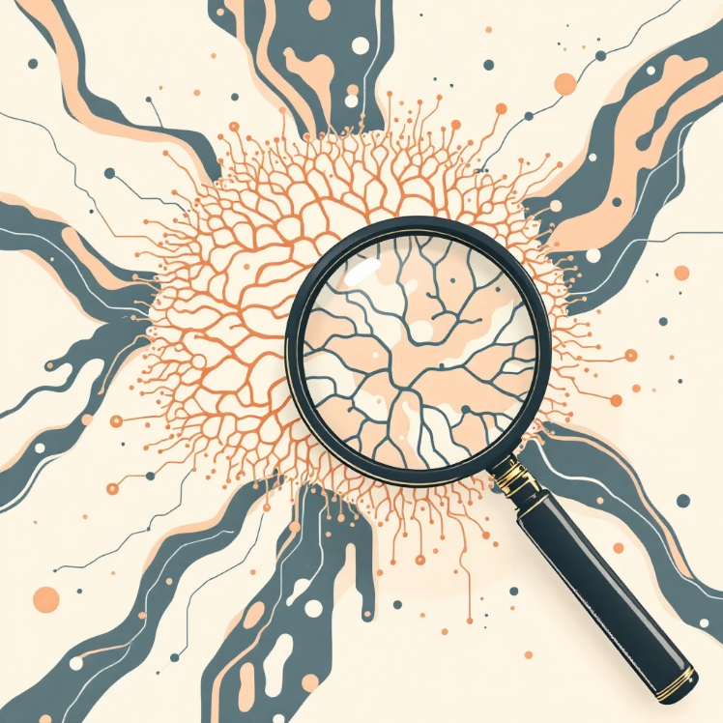



ResNet-50: How it Works
Local Feature Learning
Hierarchical Representation
Single Decision Head
Limited Interpretability
CNNs excel at capturing spatial hierarchies and localized patterns within an image.
Builds increasingly complex features from edges to textures to object parts.
All learned features converge into a singular classification output.
The decision-making process is largely opaque, making it a "black box" model.

Slide 7
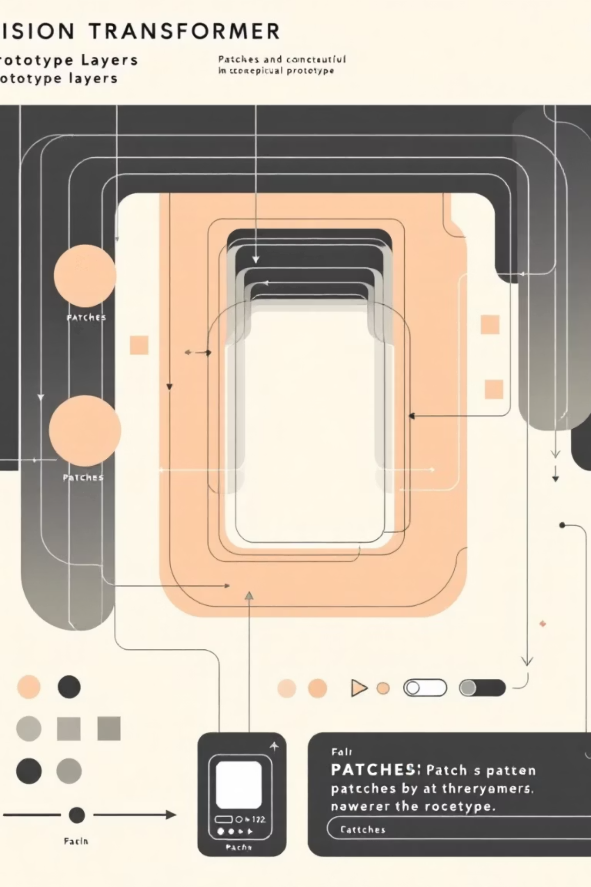
ProtoViT: Vision with Prototypes
01
Patch Embedding
Images are divided into fixed-size patches, each transformed into a token.
02
Vision Transformer
Leverages self-attention mechanisms to learn global relationships between patches.
03
Prototype Layer
Introduces learnable prototypes that represent key visual concepts or parts.
04
Evidence Aggregation
Combines similarities to prototypes for a final, interpretable classification.

Slide 8

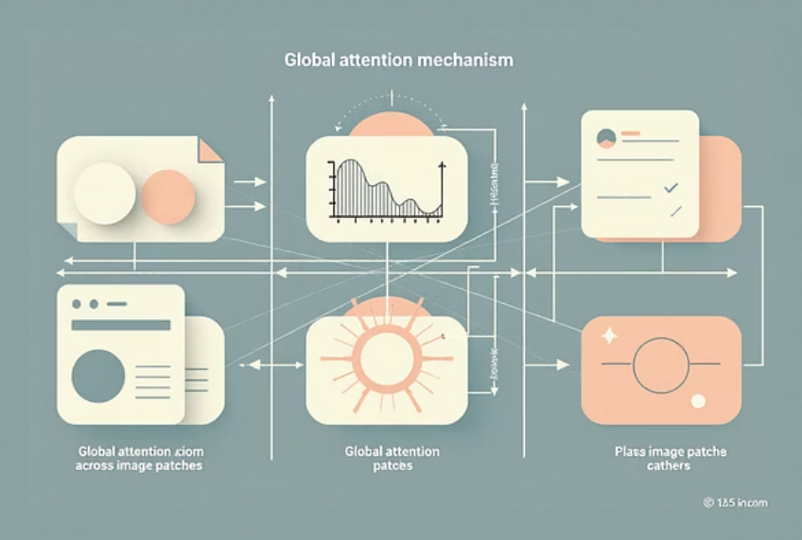
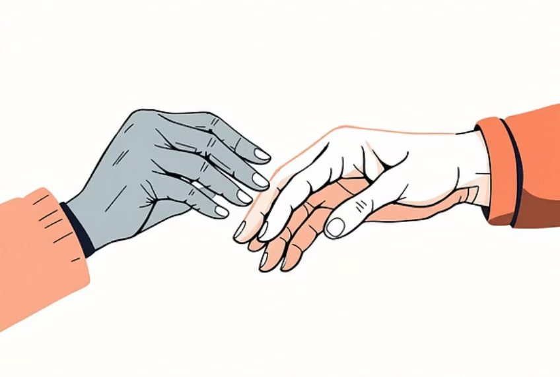
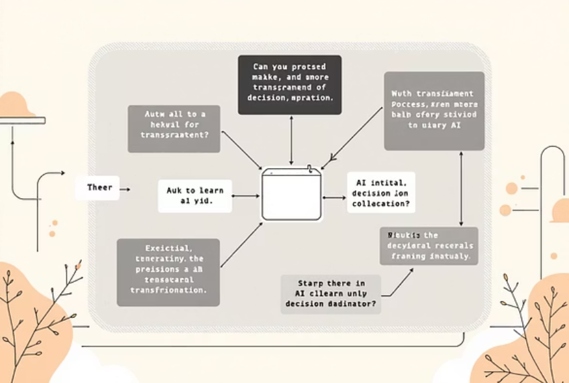
ProtoViT: The Interpretable Approach
Patch-Level Tokens
Global Attention
Prototype Similarity
Explainable Decisions
Breaks down the image into discrete elements for processing.
Considers relationships between all patches, capturing long-range dependencies.
Compares learned features to established "prototypes" to make a decision.
Each classification can be traced back to specific image regions and their resemblance to prototypes.

Slide 9
Architecture at a Glance
A side-by-side comparison of the fundamental components and characteristics.
Aspect
ResNet-50
ProtoViT
Backbone
CNN (Convolutional Neural Network)
ViT (Vision Transformer)
Feature Extraction
Spatial Hierarchies
Patch Tokens with Global Attention
Decision Mechanism
Fully Connected Layer
Prototype Similarity
Interpretability
Limited (Black Box)
Inherent (Explainable)

Slide 10
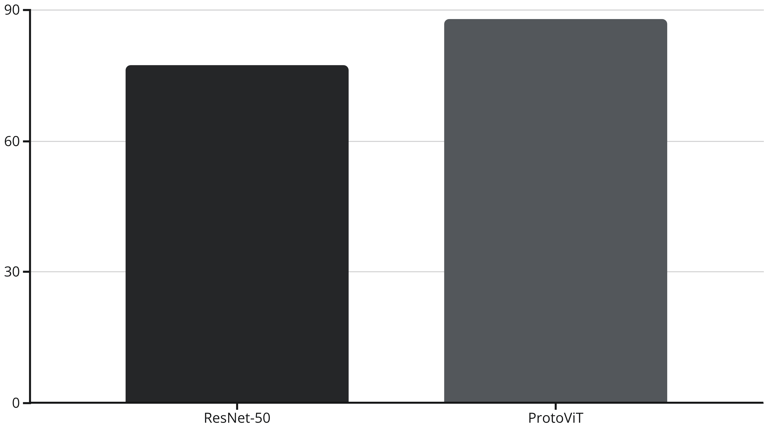
Performance Metrics: Accuracy Comparison
In our evaluation, ProtoViT demonstrates a significant leap in accuracy compared to the established ResNet-50 model on the tested dataset.

Slide 11
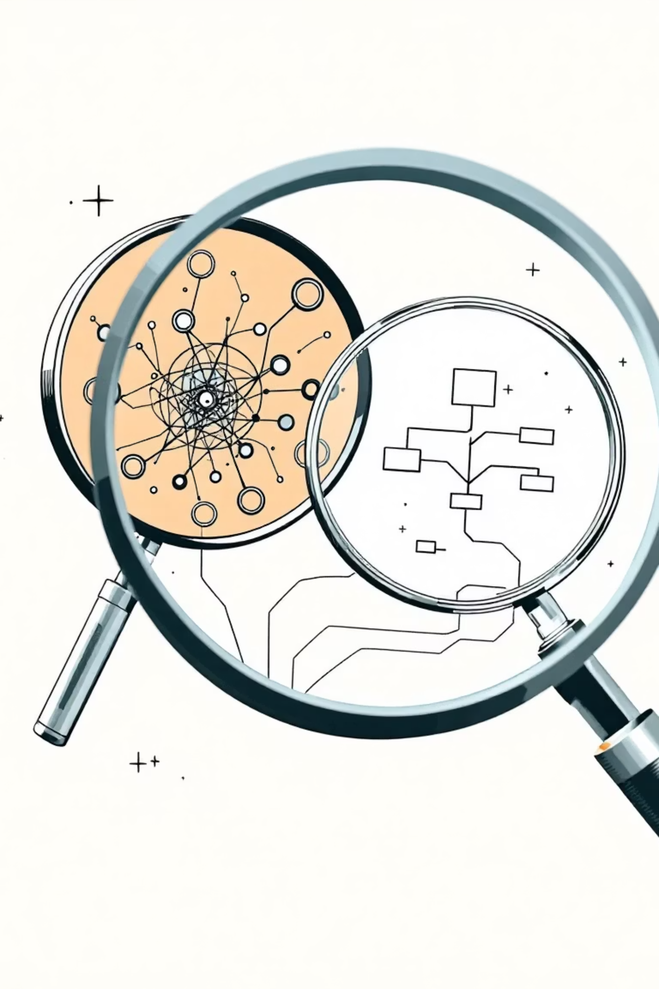
Key Observations and Insights
ResNet-50: Established Strengths
Simple & Efficient: Well-understood architecture, optimized for speed and deployment.
Robust Performance: A reliable choice for a wide range of vision tasks.
ProtoViT: The Future of Vision
Interpretable by Design: Offers transparency into its decision-making process.
Superior Accuracy: Achieves higher performance, particularly in complex scenarios.

Slide 12

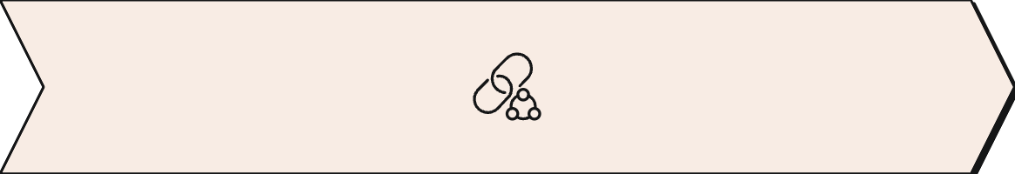
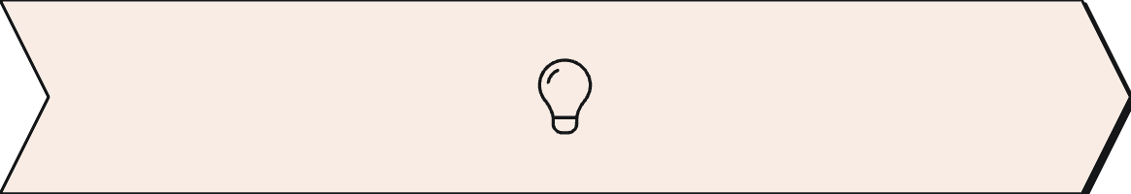
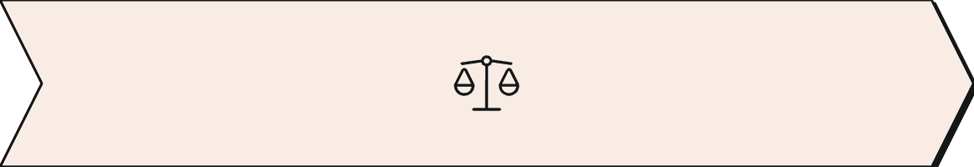
Conclusion: Bridging Accuracy and Interpretability
ResNet-50: Standard CNN
ProtoViT: Interpretable Transformer
Accuracy-Interpretability Trade-off
A powerful, mature CNN architecture, foundational for many deep learning applications.
A novel approach leveraging transformers for vision, offering both high accuracy and crucial explainability.
The comparison highlights a clear divergence, pushing boundaries in both performance and understanding.
The emergence of models like ProtoViT signals a shift towards not just achieving high accuracy, but also understanding why an AI makes its decisions. This is crucial for building trust and enabling broader adoption in critical domains.

Slide 13
Reference :
https://huggingface.co/papers/2410.20722

