Slide 1



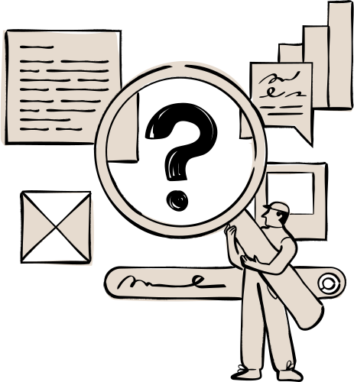

DATA & SECURITY
SEU-CSE1102-GS0105

Slide 2
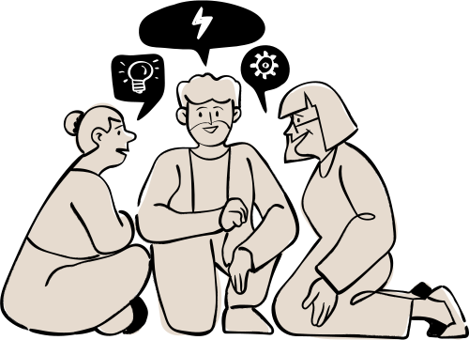
OUR GROUP
MD MAHFUZ SARKER MAHI (2026000000004)
FARZANA AHMED (2026000000007)
TASPRIA CHOWDHURY ANISHA (2026000000017)

Slide 3

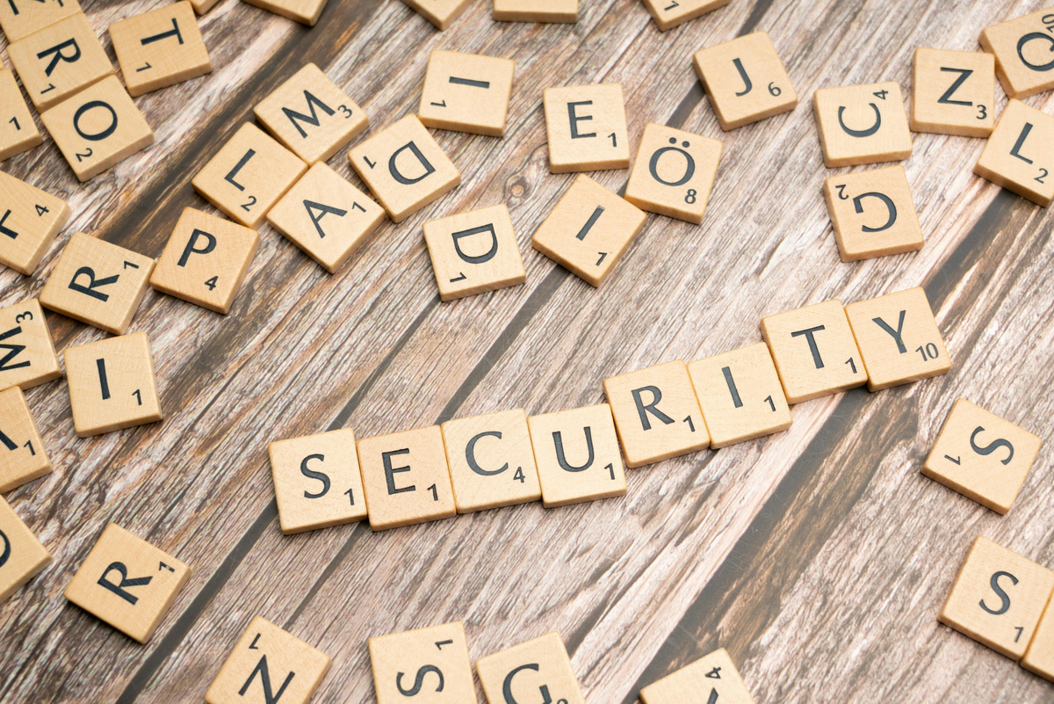
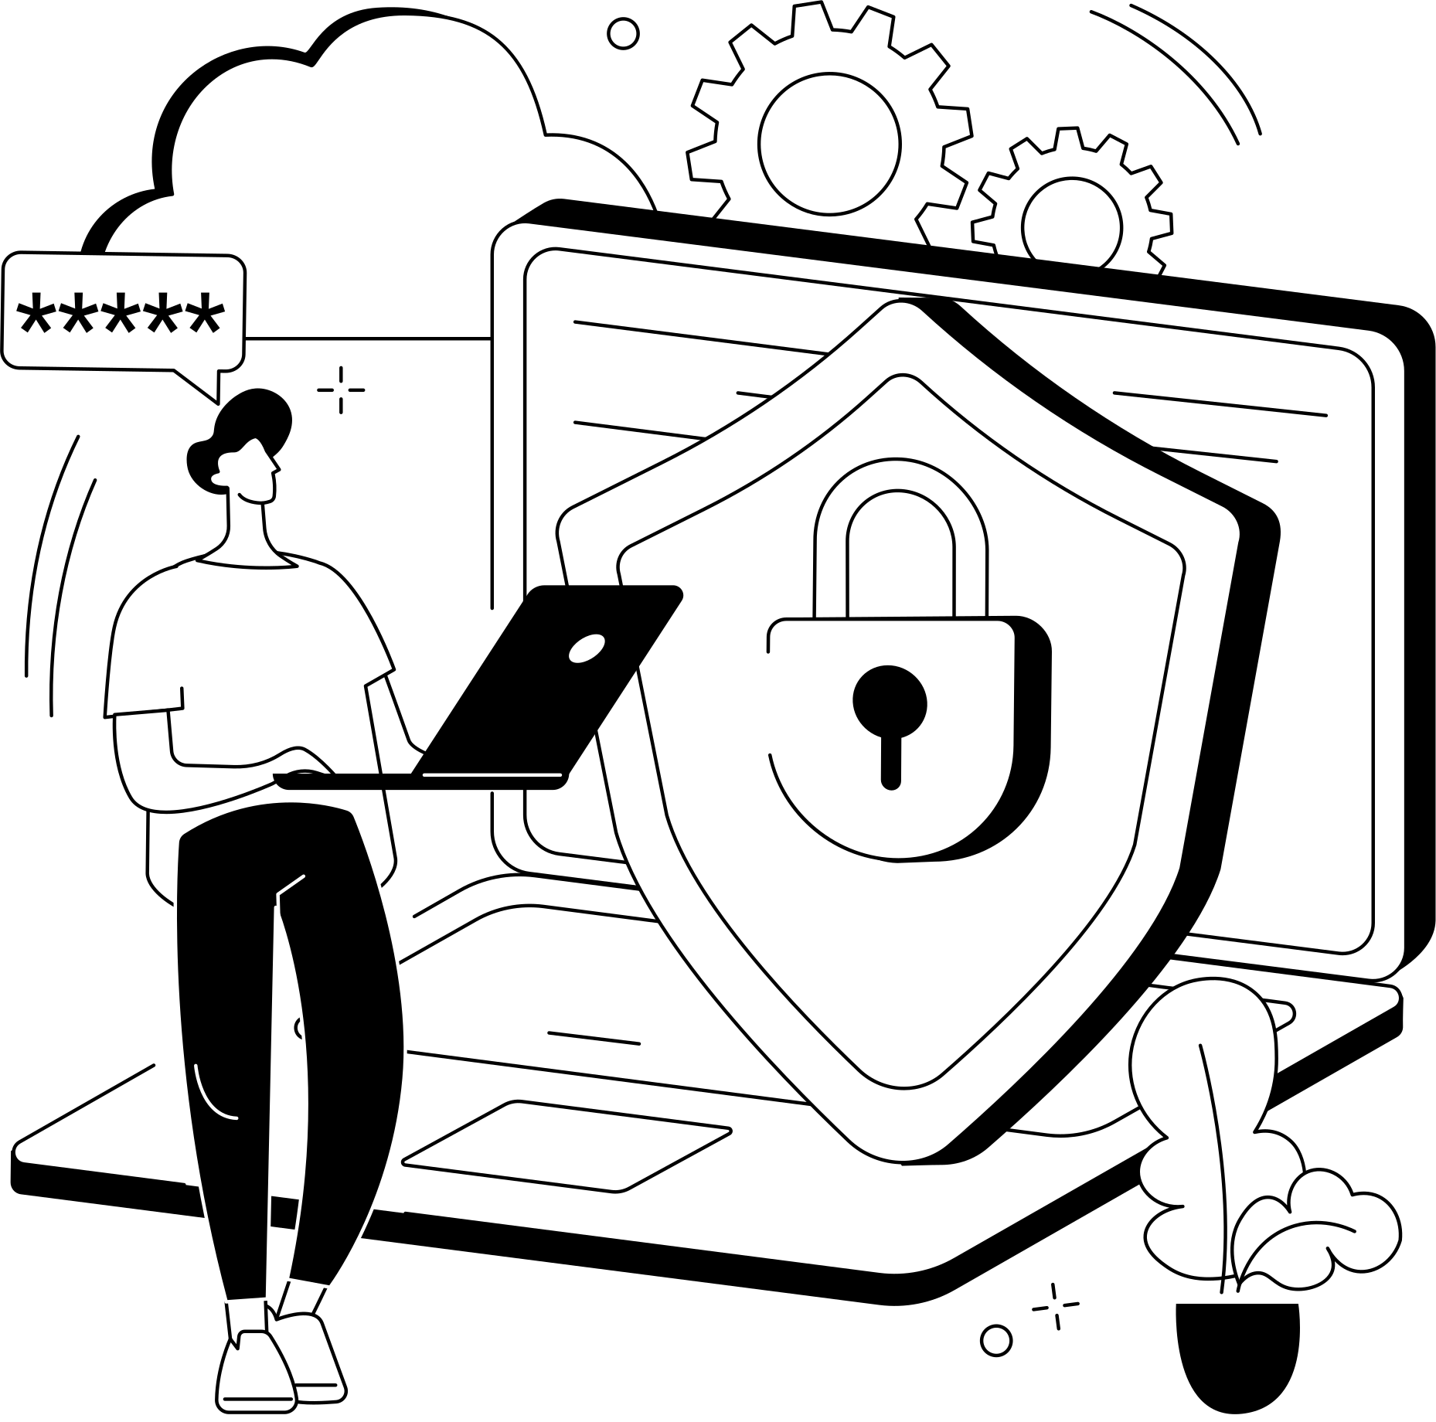
INTRODUCTION
Data is one of the most valuable assets in the digital era
Rapid technology growth has increased cyber threats world wide
Data security protects information from unauthorised access and attacks
The CIA Triad ensures confidentiality, integrity, and availability of data
Encryption and authentication are essential security tools
Strong cybersecurity protects privacy, trust, and digital safety

Slide 4
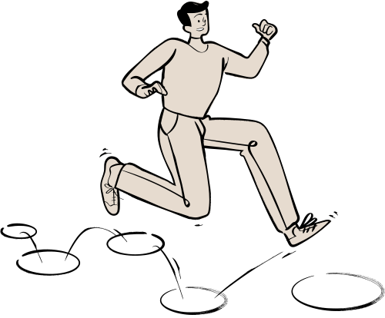
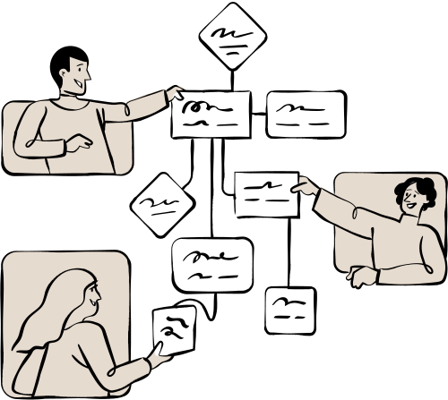
DATA VS INFORMATION
Data
Raw facts
Unprocessed
Unorganized symbols
Numbers
Observations with no context or meaning on their own.
Information
Processed
Organized
Structured
Given context so it becomes meaningful and useful

Slide 5
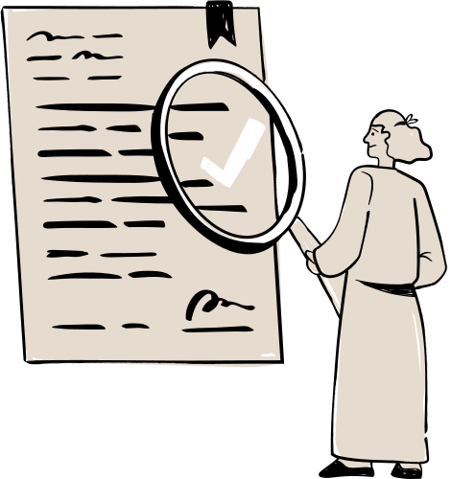
WHAT IS DATE & SECURITY ?
Data security is the discipline of protecting that data throughout its lifecycle from creation and storage to transmission and deletion.
Data & Security rests on three core principles known as the CIA Triad.
Confidentiality (Only the right people see it)
Integrity (It stays accurate)
Availability (It is there when needed)

Slide 6
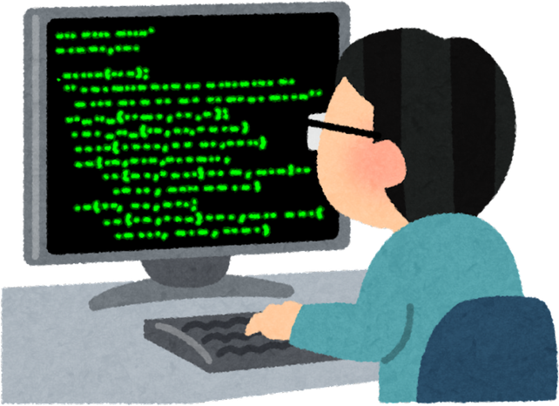
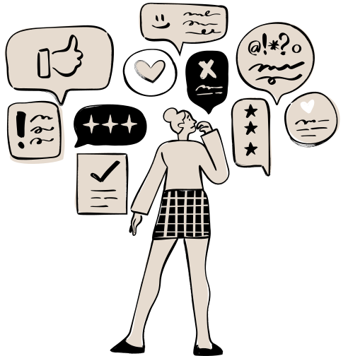
DATA & SECURITY
Importance
Protecting data is a fundamental responsibility in the digital world
Safeguards sensitive information from theft and cyber threats
Maintains privacy, trust, and business continuity
Organisations must comply with GDPR and cybersecurity regulations
A single breach causes financial loss and reputational damage
Average global breach cost — $4.9 million (IBM, 2024)
Benefits
Protects valuable data from cyber threats and theft
Builds trust between organisations and their customers
Strengthens organisational reputation in the digital market
Reduces financial risks from breaches and cyberattacks
Ensures smooth and reliable business operations
Creates a secure and trustworthy digital future
Best Practice for Ensuring Data & Security
Encrypt sensitive data and control access strictly
Apply the principle of least privilege at all times
Regularly test and update all security systems
Train employees on cybersecurity awareness
Maintain backup and disaster recovery plans
Remove unused data to reduce security risks
Monitor systems continuously in real time

Slide 7


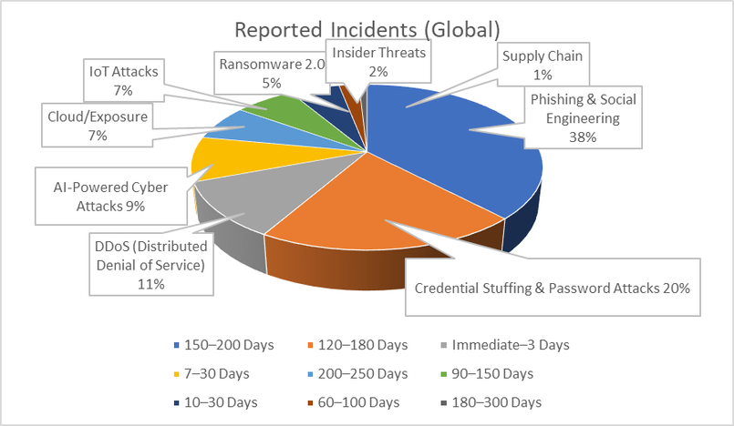

TREATS AND ATTRACTS
Phishing & social engineering
Password attacks
DDoS attacks
AI-powered attacks
Cloud misconfigurationt
IoT attacks
Ransomware 2.0
Insider threats
Supply chain attackst
SECURITY TECHNOLOGIES
CSPM, DLP, CASB — cloud security & data loss prevention
Email Security, MFA, Awareness Training — human layer defence
UEBA, Zero Trust, IAM — identity & behaviour monitoring
EDR, XDR, Backup Systems — endpoint & recovery protection
AI Detection, Behavioural Analytics, SOAR — automated response

Slide 8
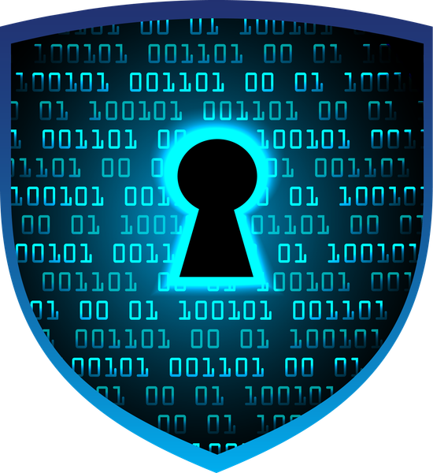





TYPES OF DATA SECURITY
Recovery and Backup
Encryption
1
2
Authorization
Authentication
4
3

Slide 9

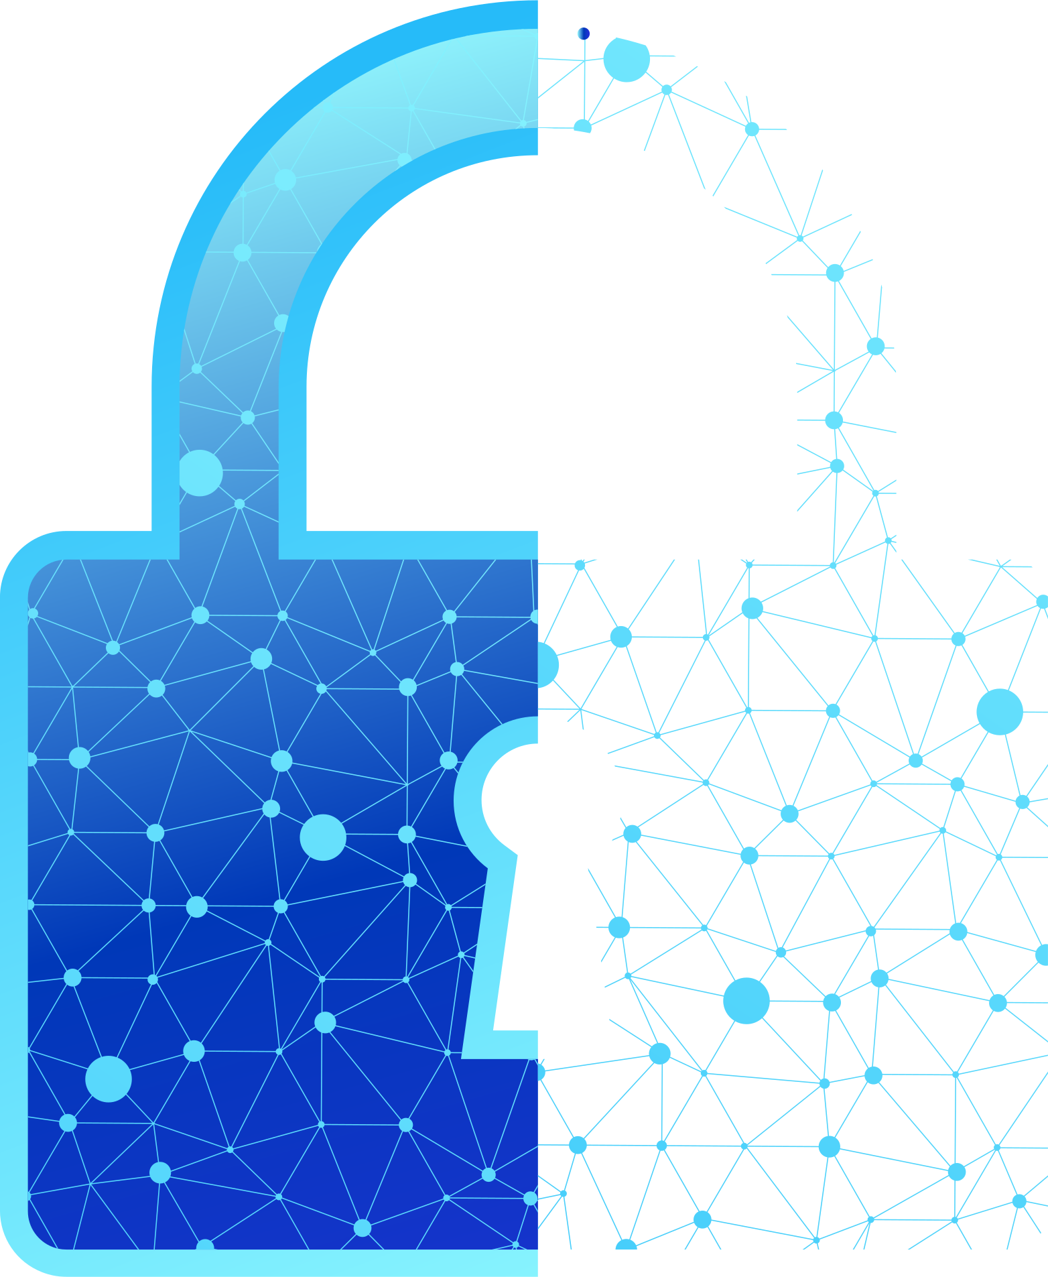
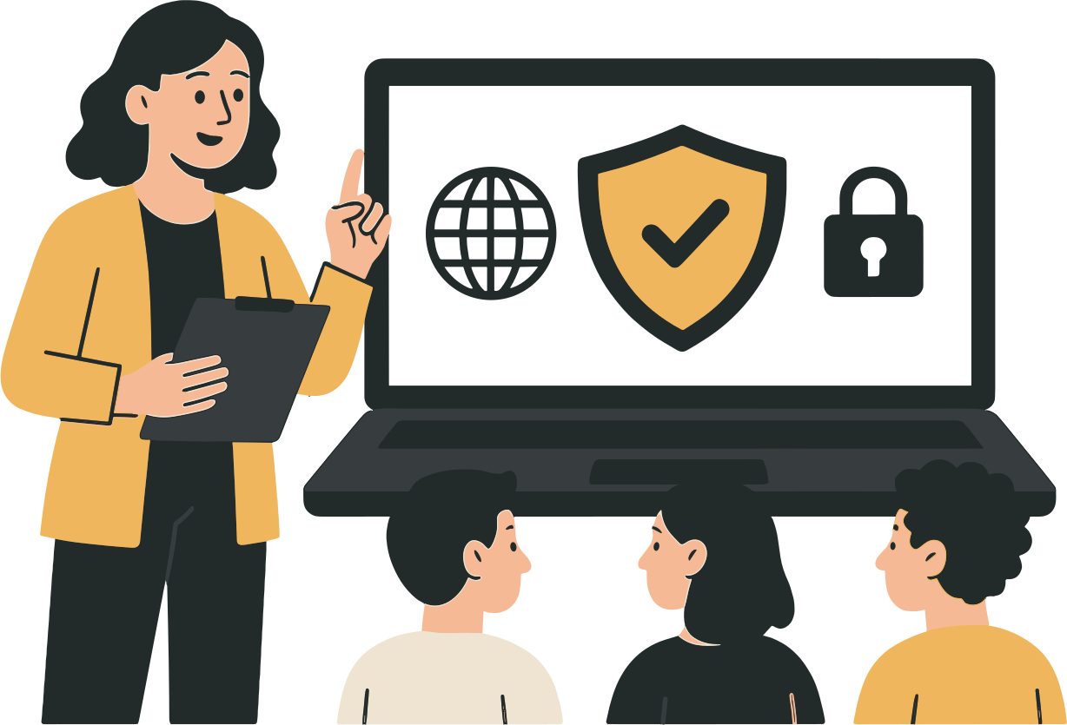
CONCLUSION
Cyber threats grow in scale and sophistication every year
A multi-layered defence strategy is essential
Right technologies + best practices = strong protection
Data security is an ongoing commitment, not a one-time fix
Protects data, people, trust, and organisational integrity

Slide 10
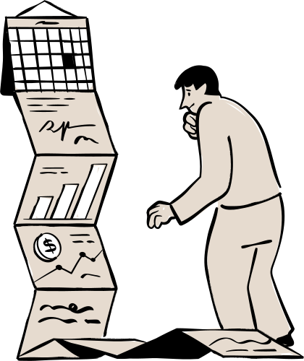

REFERENCE
IBM Security. Cost of a Data Breach Report 2025. IBM Corporation, 2025
[ https://www.ibm.com/reports/data-breach ]
IBM Security. X-Force Threat Intelligence Index 2026. IBM Corporation, 2026
[ https://www.ibm.com/reports/threat-intelligence ]
Verizon Business. Data Breach Investigations Report 2026. Verizon Business, 2026
[ https://www.verizon.com/business/resources/report ]

Slide 11
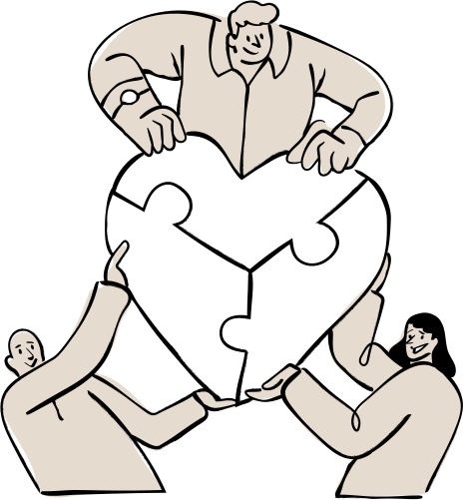
THANK YOU

