Slide 1
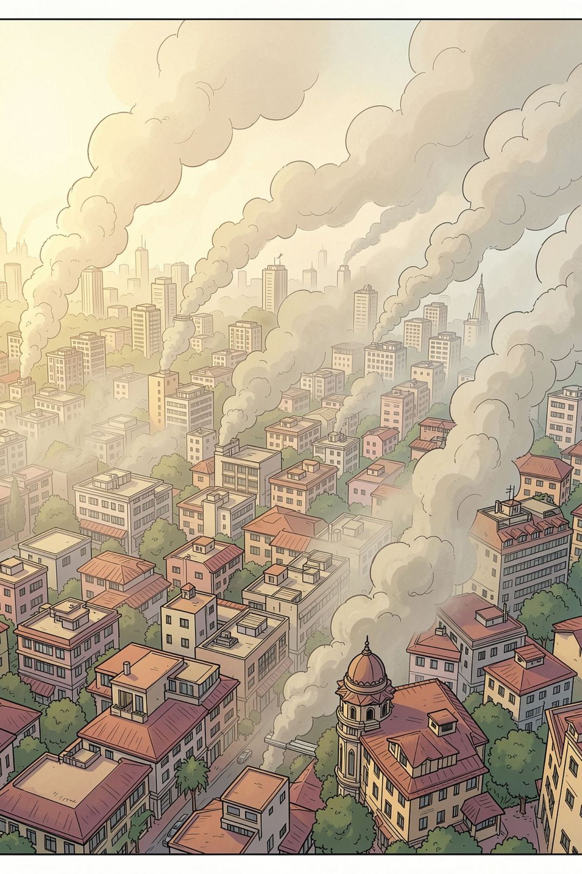
Multi-City Environmental Health Analysis
Process summary: ingest telemetry (weather + air quality), clean and validate with Pandas, store in SQL, run analytical queries, and visualize results in an interactive Power BI dashboard.

Slide 2

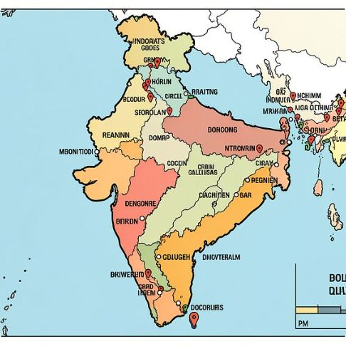
Data Ingestion — Sources & Scope
APIs
Cities
Open-Meteo weather and air-quality endpoints (hourly, 30 past days) for 10 Indian cities.
Delhi, Mumbai, Bengaluru, Kolkata, Chennai, Hyderabad, Ahmedabad, Pune, Jaipur, Gulbarga.

Slide 3

Pandas Wrangling & Cleaning
Standardize
Types & Timestamps
Dedupe
Normalize column names, clean city aliases (e.g., Bangalore → Bengaluru).
Drop exact duplicates; de-duplicate on (city,timestamp) keeping last reading.
Parse timestamps to datetime; coerce numerics for temperature, humidity, pm2_5, pm10, no2, ozone.
Impute
Per-city linear interpolation then forward/backfill; fallback to global medians where needed.

Slide 4

Validation & Range Checks
Clip physical ranges: RH 0–100%, surface pressure 850–1005 hPa, pollutants ≥ 0. Detect and report out-of-range values; clip where appropriate.
Check hourly continuity per city; insert missing hourly rows and interpolate when gaps exist.

Slide 5
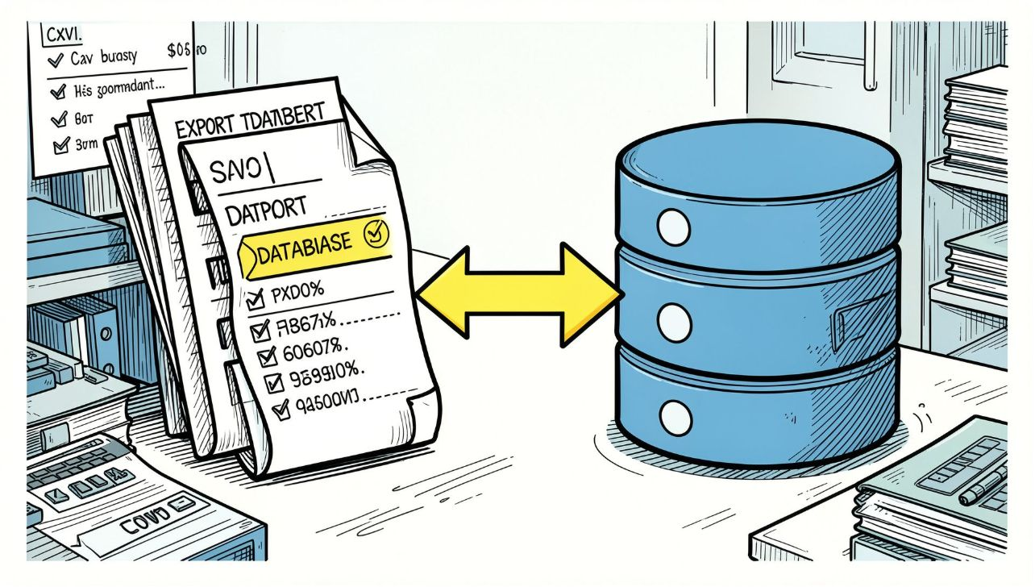
SQL Storage & Loading
Export cleaned CSV and load into MySQL table clean_air_weather via SQLAlchemy. Example: df.to_sql(..., if_exists='replace').
Note: update DB credentials securely (avoid plaintext in production).

Slide 6
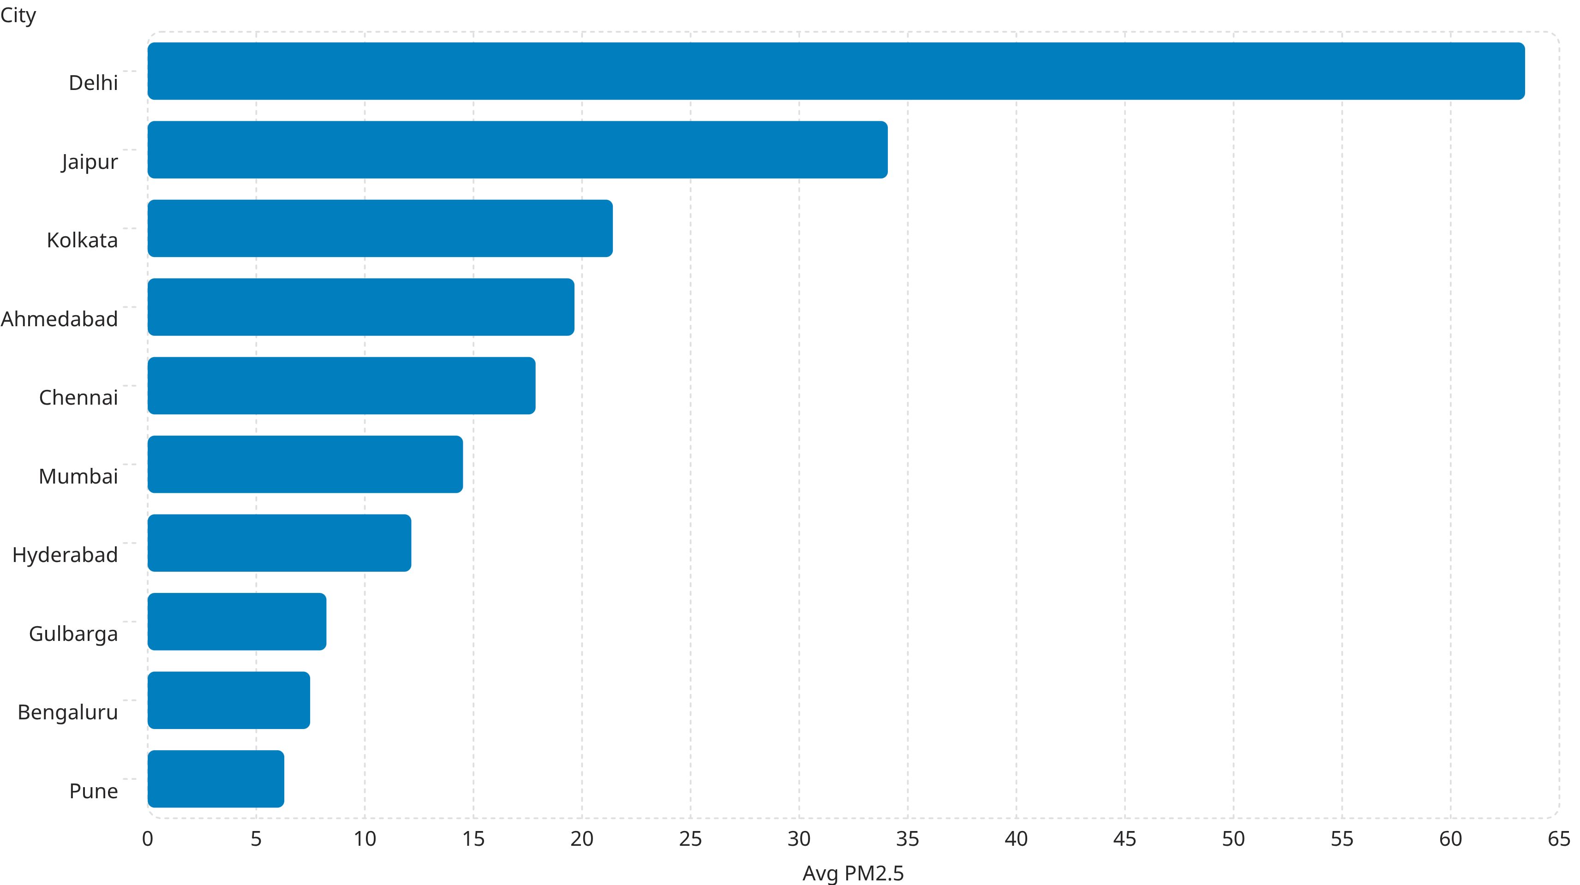
Baseline Pollution Ranking (avg PM2.5)
Delhi exhibits the highest baseline PM2.5 among the 10 cities.

Slide 7
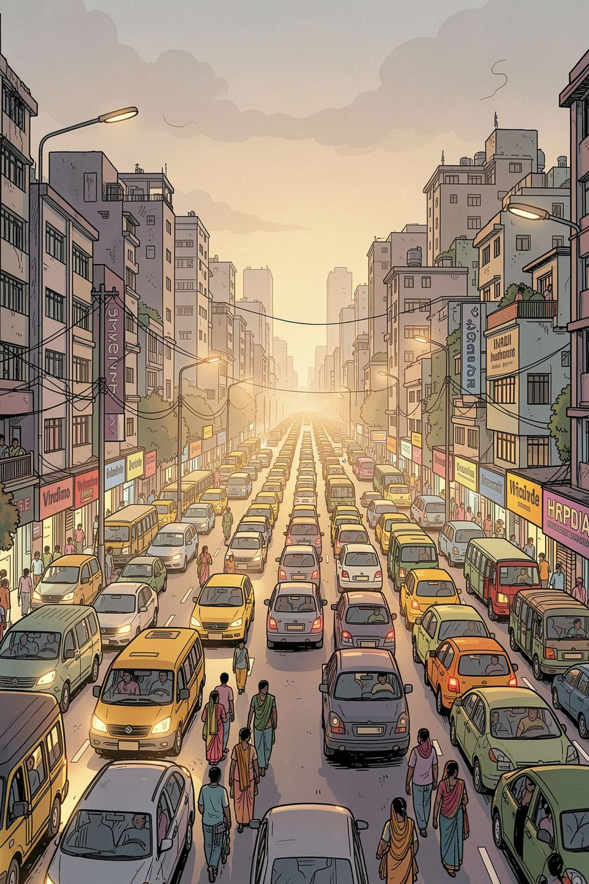
Temporal Patterns — Weekday, Day/Night & Rush Hours
1
Weekday vs Weekend
Mixed patterns: Delhi higher on weekends (61.4 → 68.49). Most cities show small weekday > weekend differences.
2
Day vs Night
Some cities show higher nighttime PM2.5 (e.g., Delhi ~63.6 night), others peak daytime (Ahmedabad daytime 23.62 vs night 14.96).
3
Rush Hours
Rush-hour segmentation reveals simultaneous changes in PM2.5, temperature, RH, and NO2 — e.g., Delhi evening rush PM2.5 79.68, NO2 63.94.

Slide 8

Volatility & Extremes
Compute city-level means and standard deviations for PM10, temperature, humidity, and NO2 to isolate volatility (unexpected fluctuations).
Delhi: avg_pm10 127.18, pm10_volatility 133.88
Jaipur: avg_pm10 100.62, pm10_volatility 77.69
Bengaluru: avg_temp 23.59, temp_volatility 2.89

Slide 9
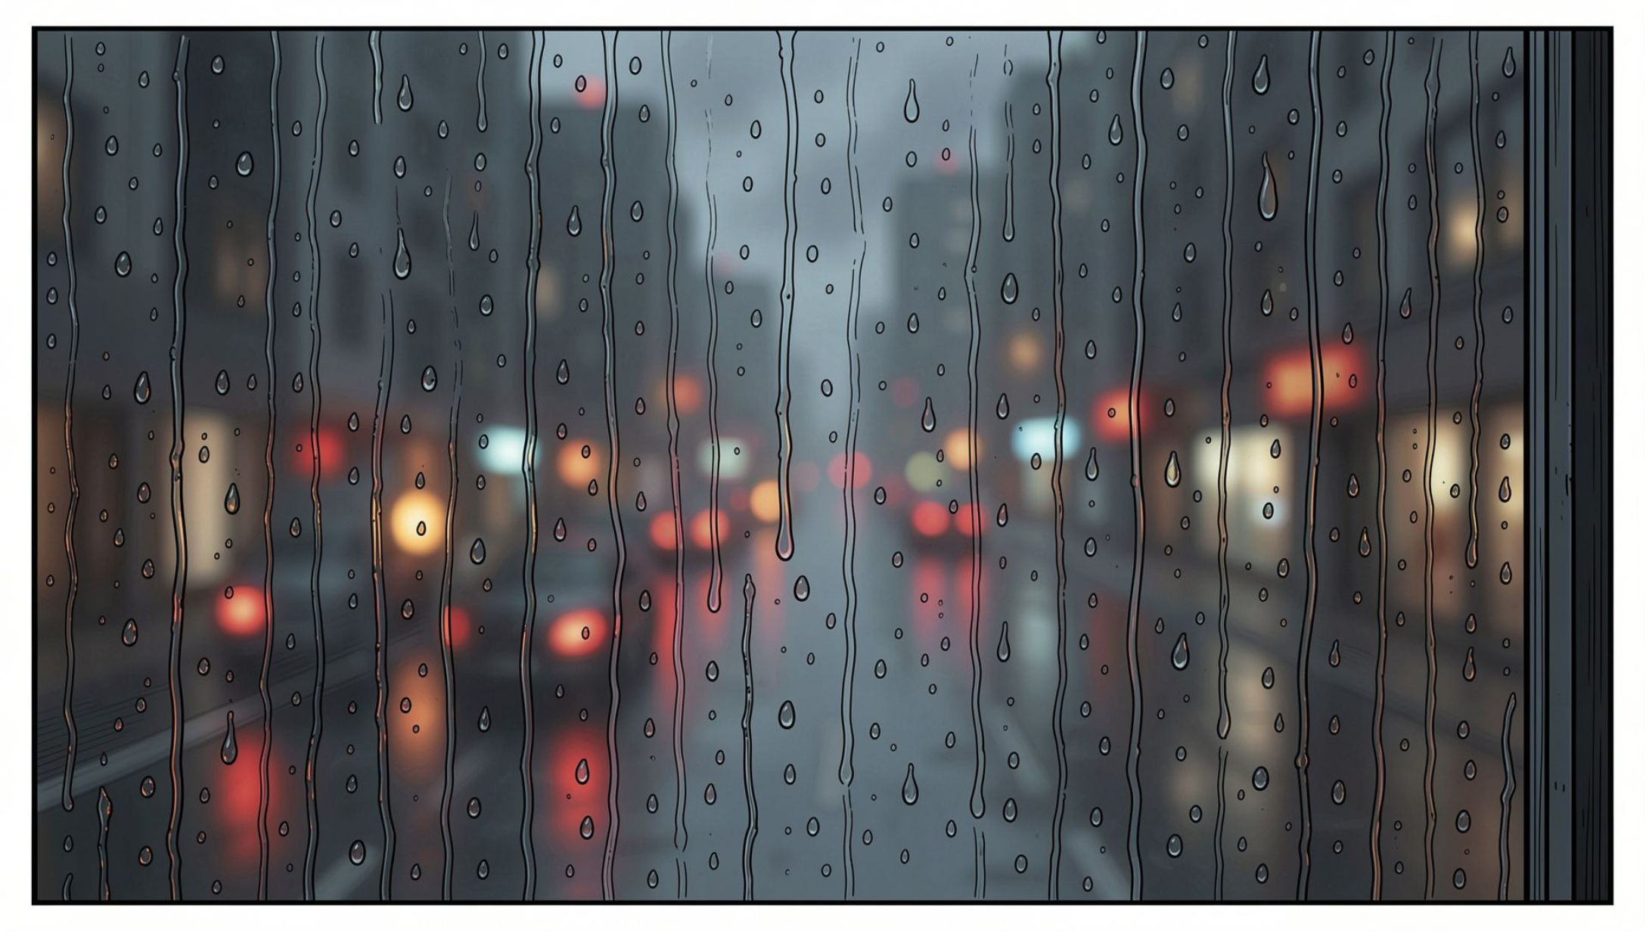
Rain Events & Peak Pollution Days
Rainy hours (precipitation > 0) by city: Mumbai 759, Kolkata 504, Bengaluru 329, Delhi 325, Pune 313.
Peak PM2.5 day per city (single worst day): Delhi 2026-08-31 (116.19), Jaipur 2026-08-27 (59.57), Bengaluru 2026-09-05 (11.15).

Slide 10
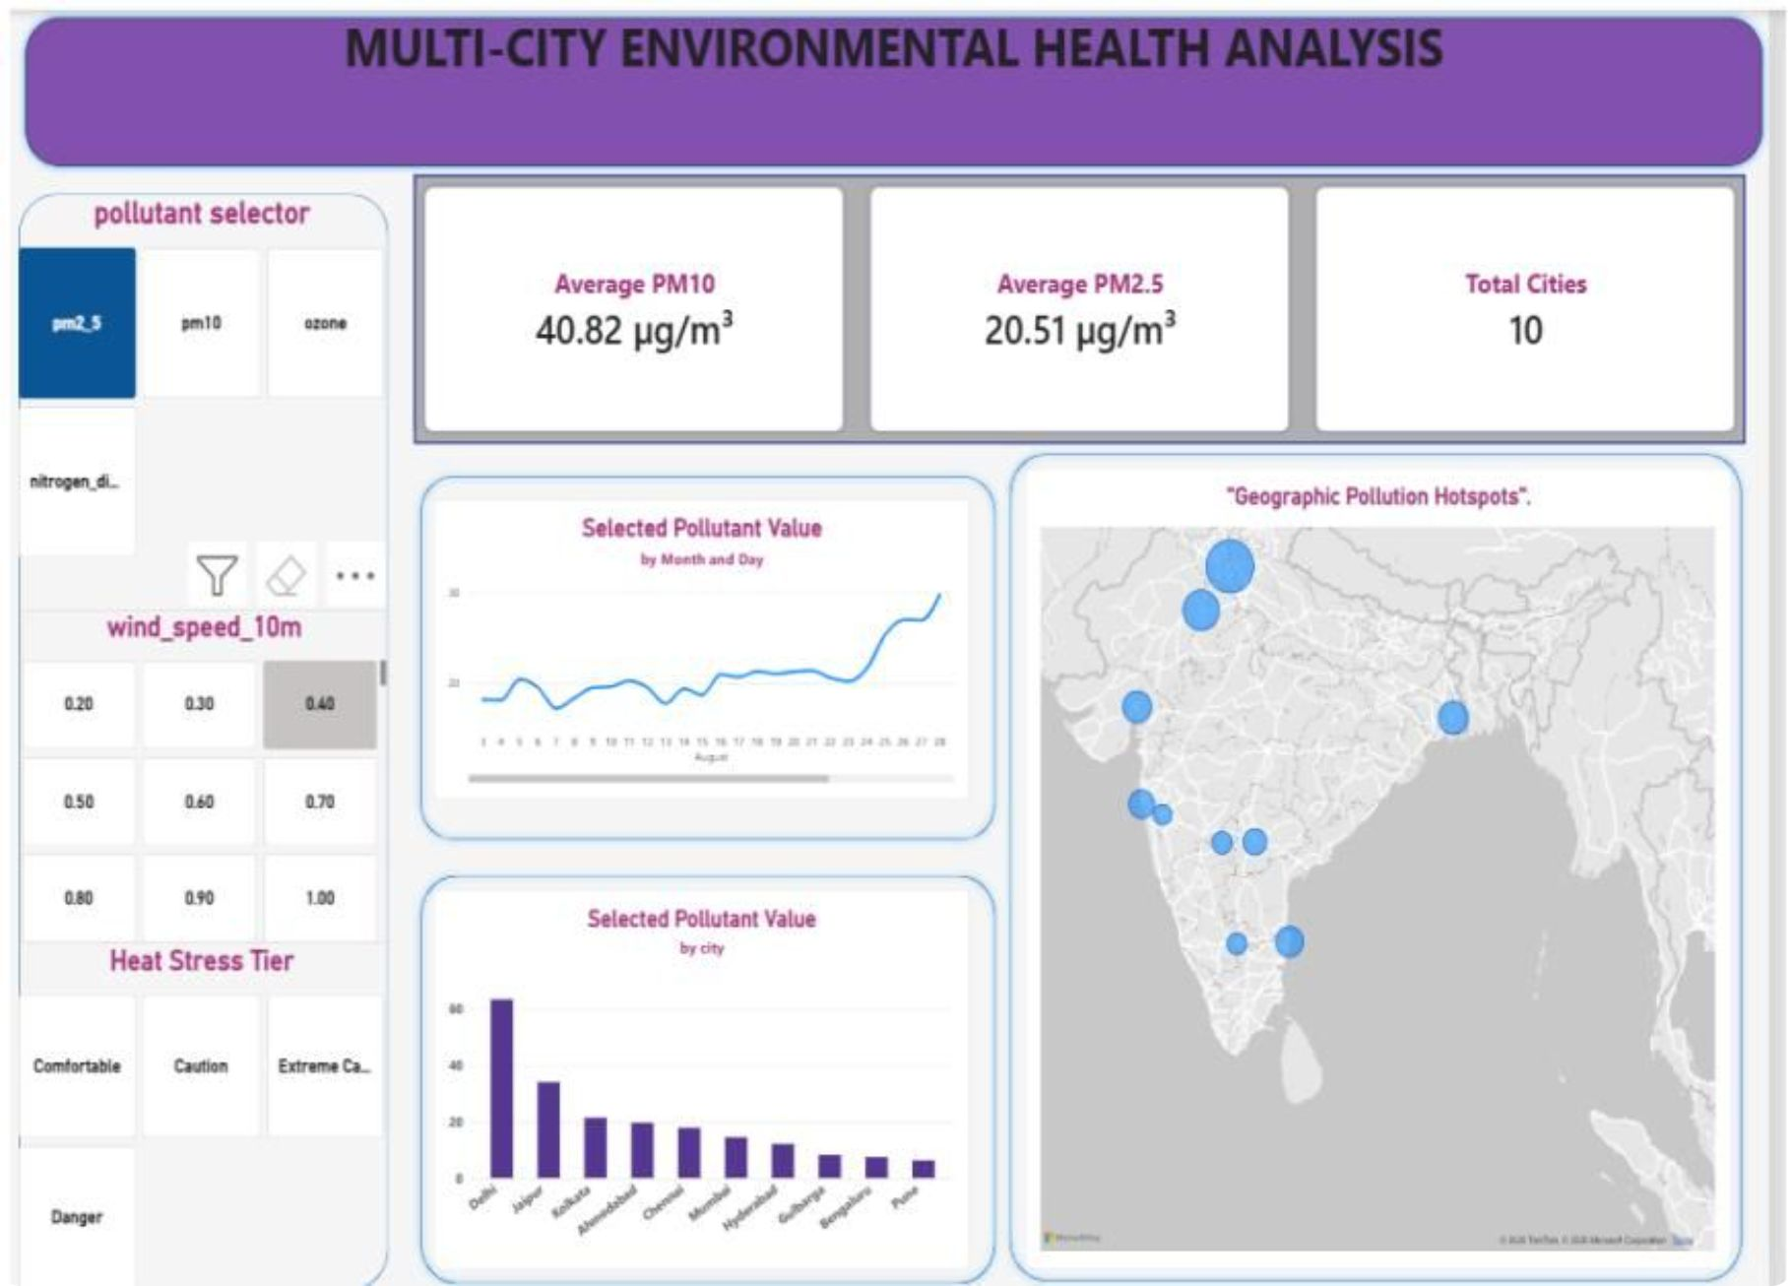

Power BI Dashboard & Next Steps
This interactive dashboard includes pollutant selector (PM2.5 selected), heat-stress tiers, time-series trends, city rankings, and geographic hotspots.
Next steps: operationalize pipeline, secure DB credentials, add real-time streaming, and integrate alerts for peak pollution events.

