Slide 1

Social Engineering
The Art of Human Hacking

Slide 2
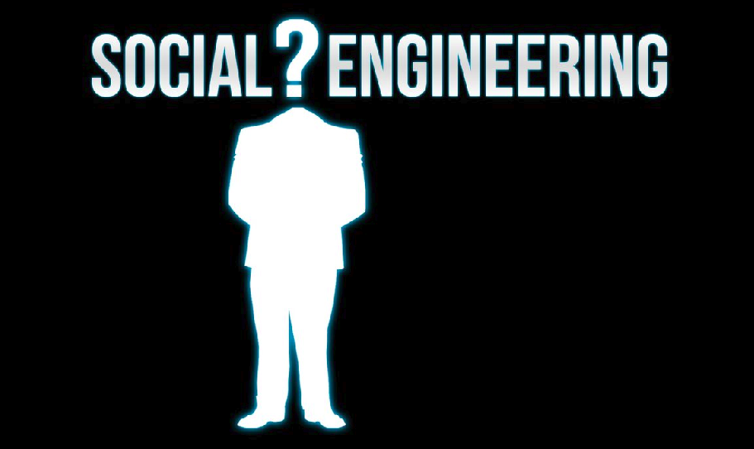
Content-
- What is social engineering?
- Types of social engineering
- Life Cycle of Social engineering attack
- Impact of Social Engineering
- Social Engineering & information system security
- Q&A

Slide 3
What is Social Engineering?
The attempt to control human Social Behaviours & Natural Tendencies.

Slide 4
The 3 Critical Success Factors:
1
You must be trusted by your victim
Trust
2
You opponent must be satisfied to you
Satisfaction
3
The relationship between you & target person will be good.
Relationship

Slide 5
Types of social engineering?
1
Attacker provide fake offers or bait, where attached malware or spyware.
Baiting
2
Victim are Providing Confidential Information through email, text, pop-up for the Urgency, Curiosity, & Fear by attacker.
Phishing
3
Specific version of phishing where an attacker chooses specific individuals or enterprises.
Spear Phishing
4
victims being bombarded with false alarms and fictitious threats.
Scareware
5
Intruders impersonate as a bank official, police officer, etc and cleverly manipulate user to provide the credential.
Pretexting

Slide 6
Life Cycle of Social engineering attack:
Information Gathering
Developing Relationship
Social Engineering
Execution
Exploitation

Slide 7
Impact of Social Engineering:
It exploits the Human Psychology to Manipulate people into-
Making Security mistakes
Giving away Confidential Information

Slide 8
Social Engineering & Information System Security:
You need to be follow some method for securing your Information System from Social Engineering attack. Such as-
You have to be very attentive in determining fake offers.
Avoid opening unknown email and attachments.
Avoid sharing personal information.
Use two-factor or multifactor Authentication.
Keep your device updated.

Slide 9
Q&A
?

Slide 10
Thank You

