Slide 1













Slide 2


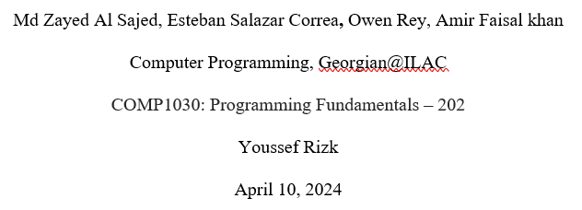

Slide 3



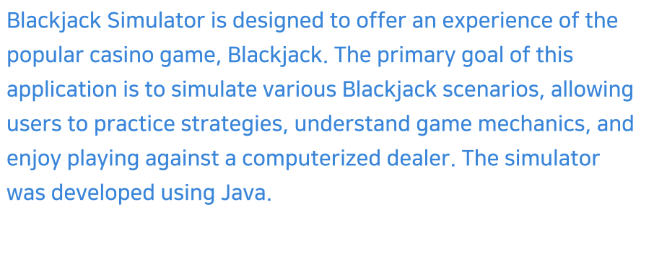

Slide 4
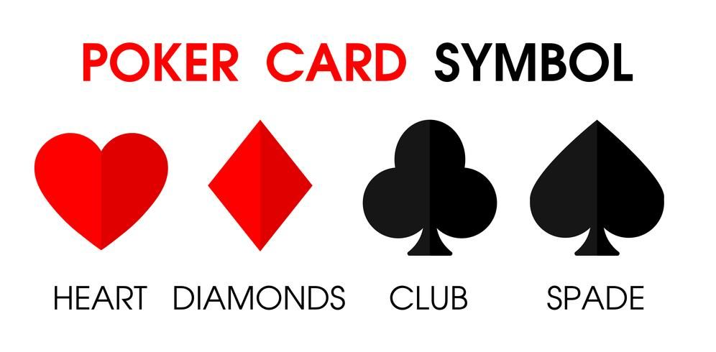
Blackjack Game Concept
Players receive all cards face up and the dealer's first card is face up and the second is face down. The object of the game is to get closer to 21 than the dealer without going over 21. If a hand goes over 21, it is called a “bust” or “break” and the wager is lost. In 21, Jacks, Queens, Kings and 10s count as 10. Here ACEs count as 11 or 1

Slide 5






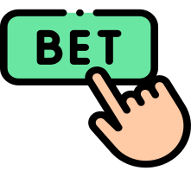





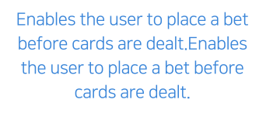
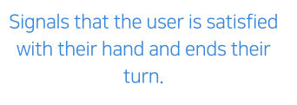



Slide 6





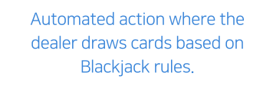


Slide 7
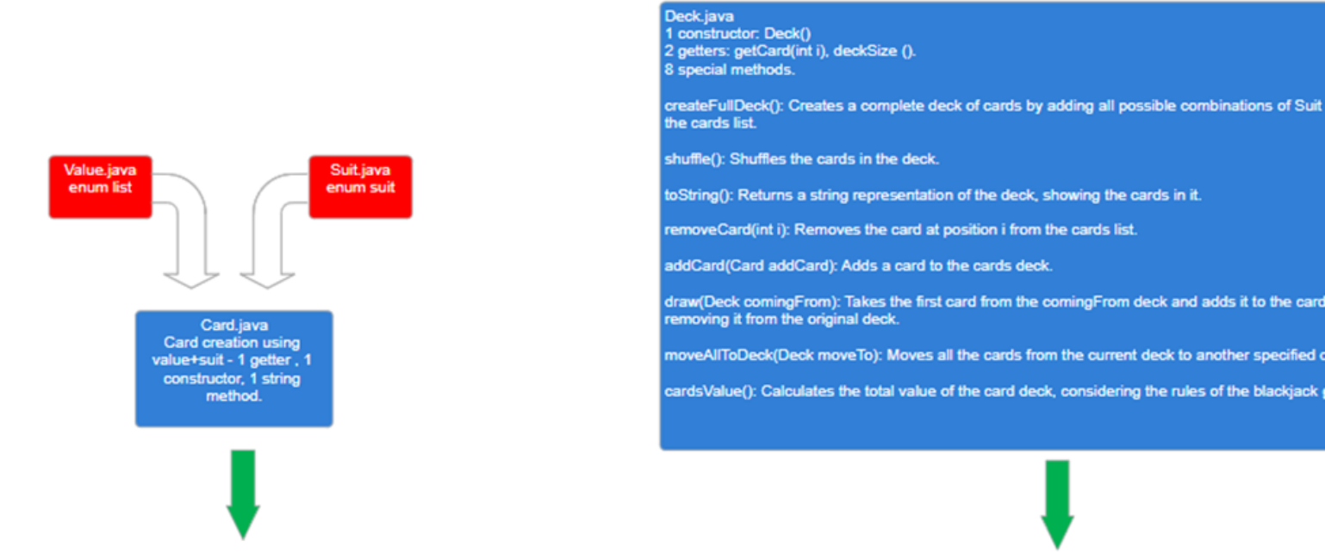

Slide 8
