Slide 1

Deebak Balaji M — AI Systems Developer
BE CSE (3rd Year) — Kumaraguru College of Technology
deebakbalaji07@gmail.com
LinkedIn: www .linkedin.com/in/deebak-balaji/
GitHub: github.com/MD-dev-007
Portfolio : portfolio-deebak.vercel.app

Slide 2
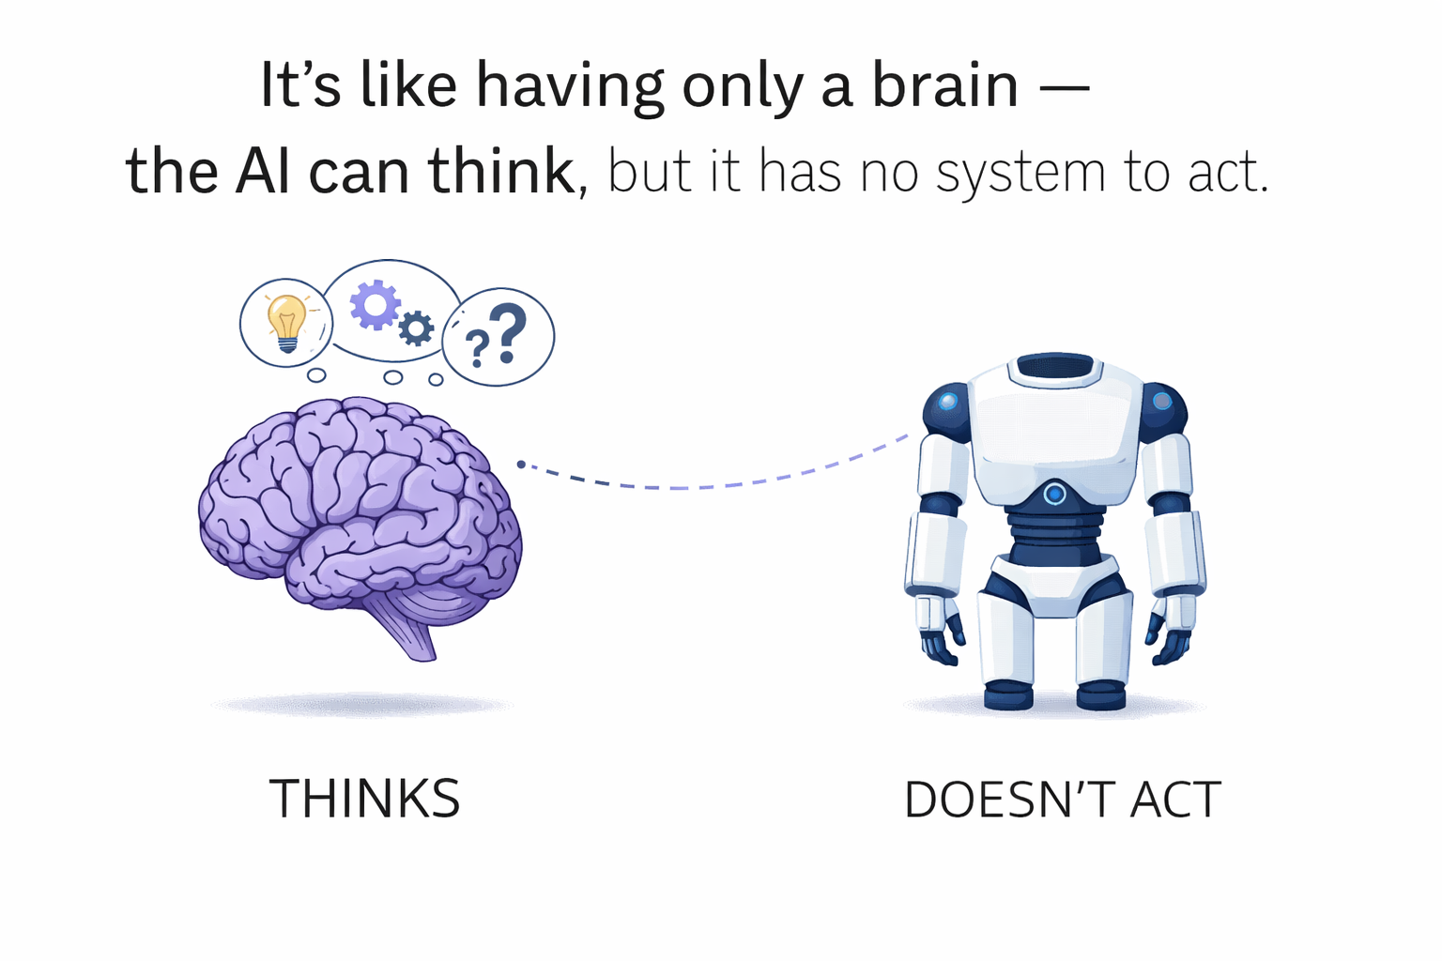
AI assistants are passive (chat only)
Cannot perform real-world tasks reliably
No control, validation, or safety layer
Poor multi-step reasoning & tool chaining
Problem Statement

Slide 3
Mother AI
“ AI that doesn’t just respond — it executes real-world tasks autonomously ”
- By ‘Deebak balaji’

Slide 4
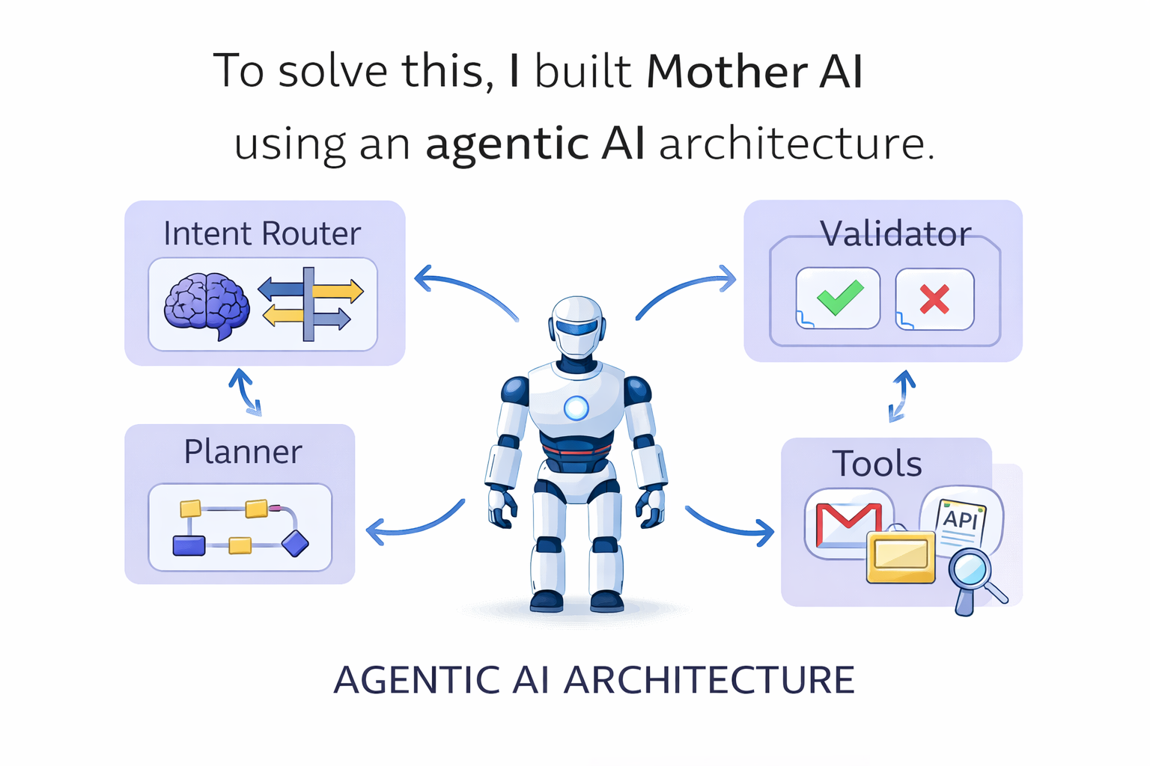
Solution
Autonomous task execution
Tool chaining system
Validation + approval layer
Intelligent planning

Slide 5
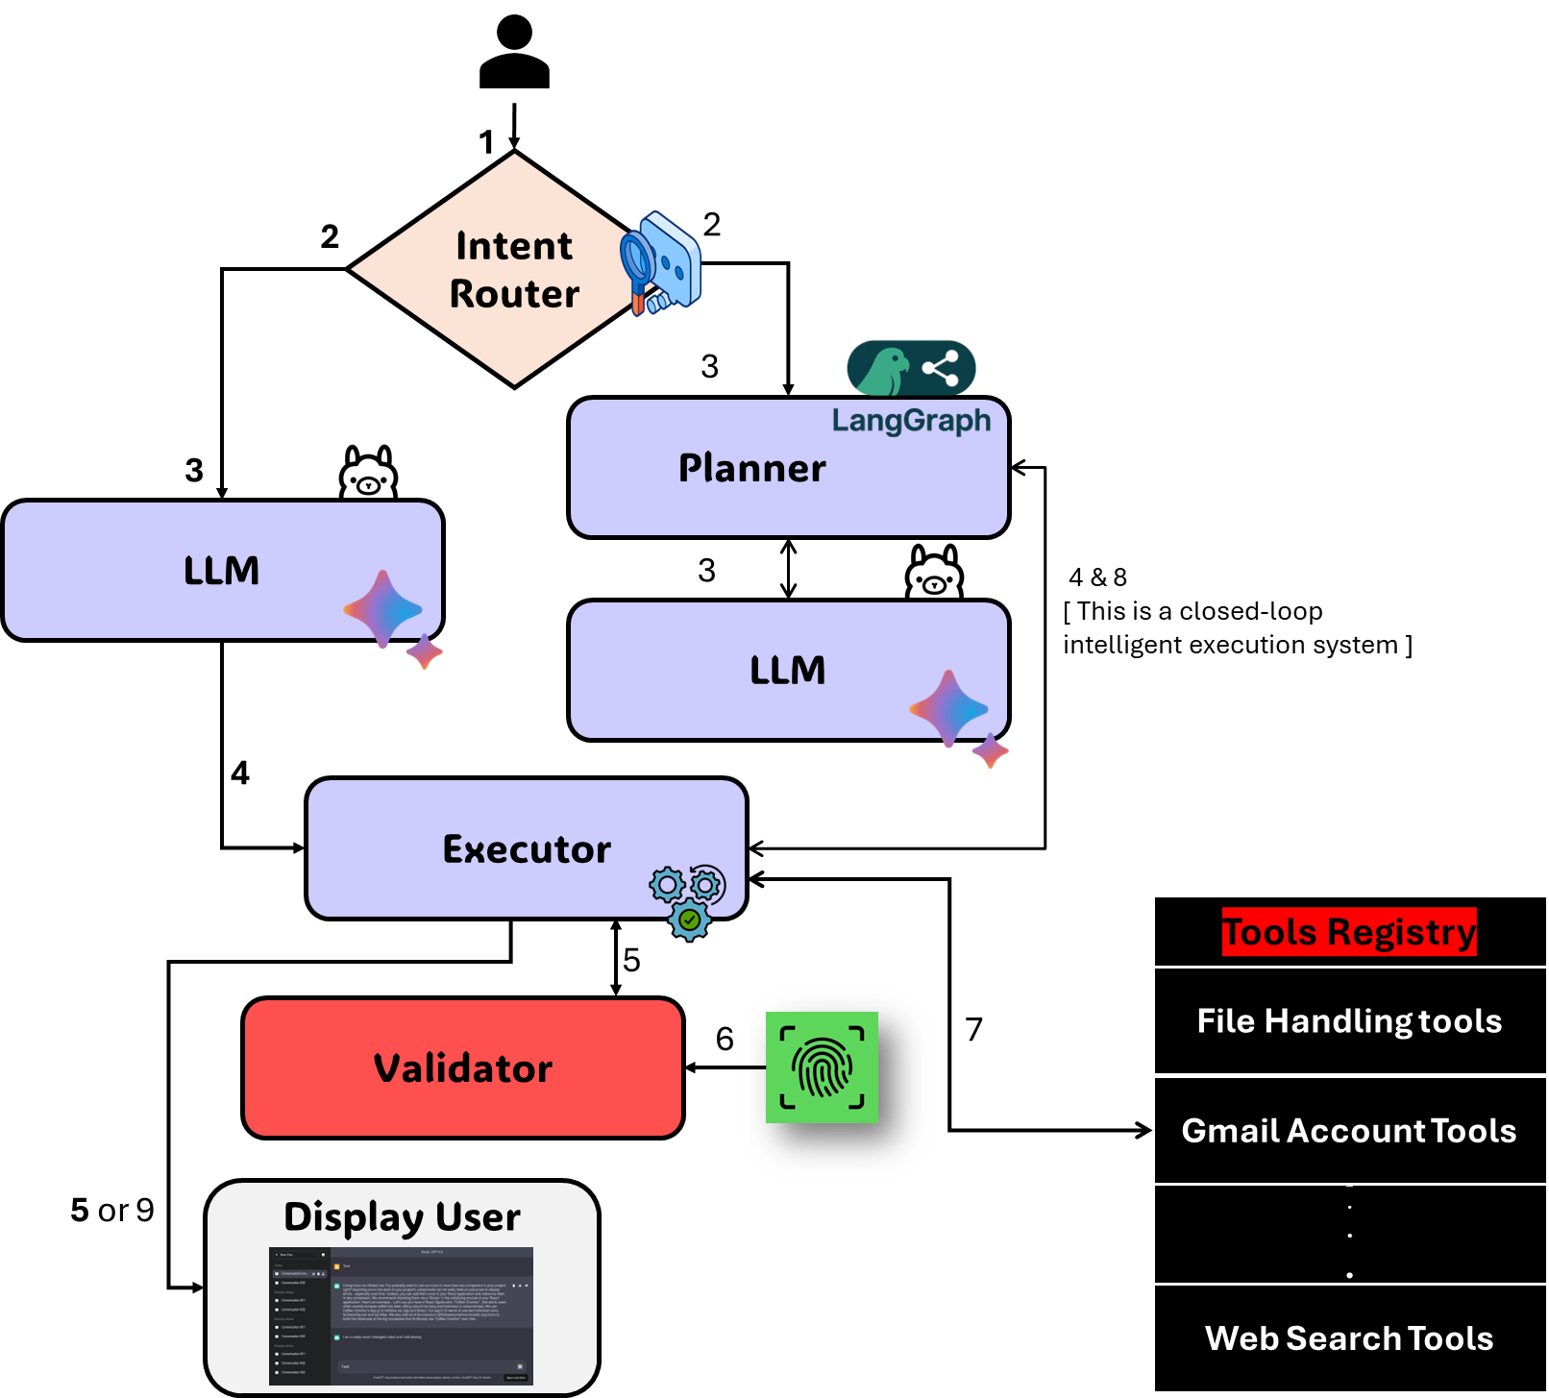
WORKING FLOW
Addition Internal work:
Loop-based reasoning
Variable resolver for chaining
Fast vs reasoning mode

Slide 6
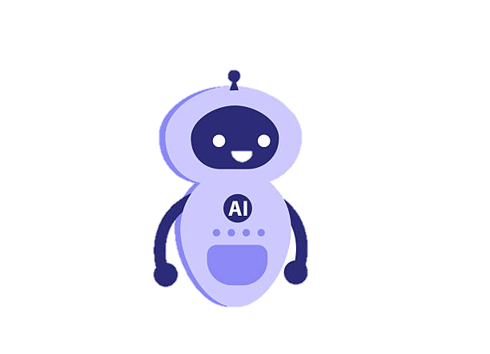
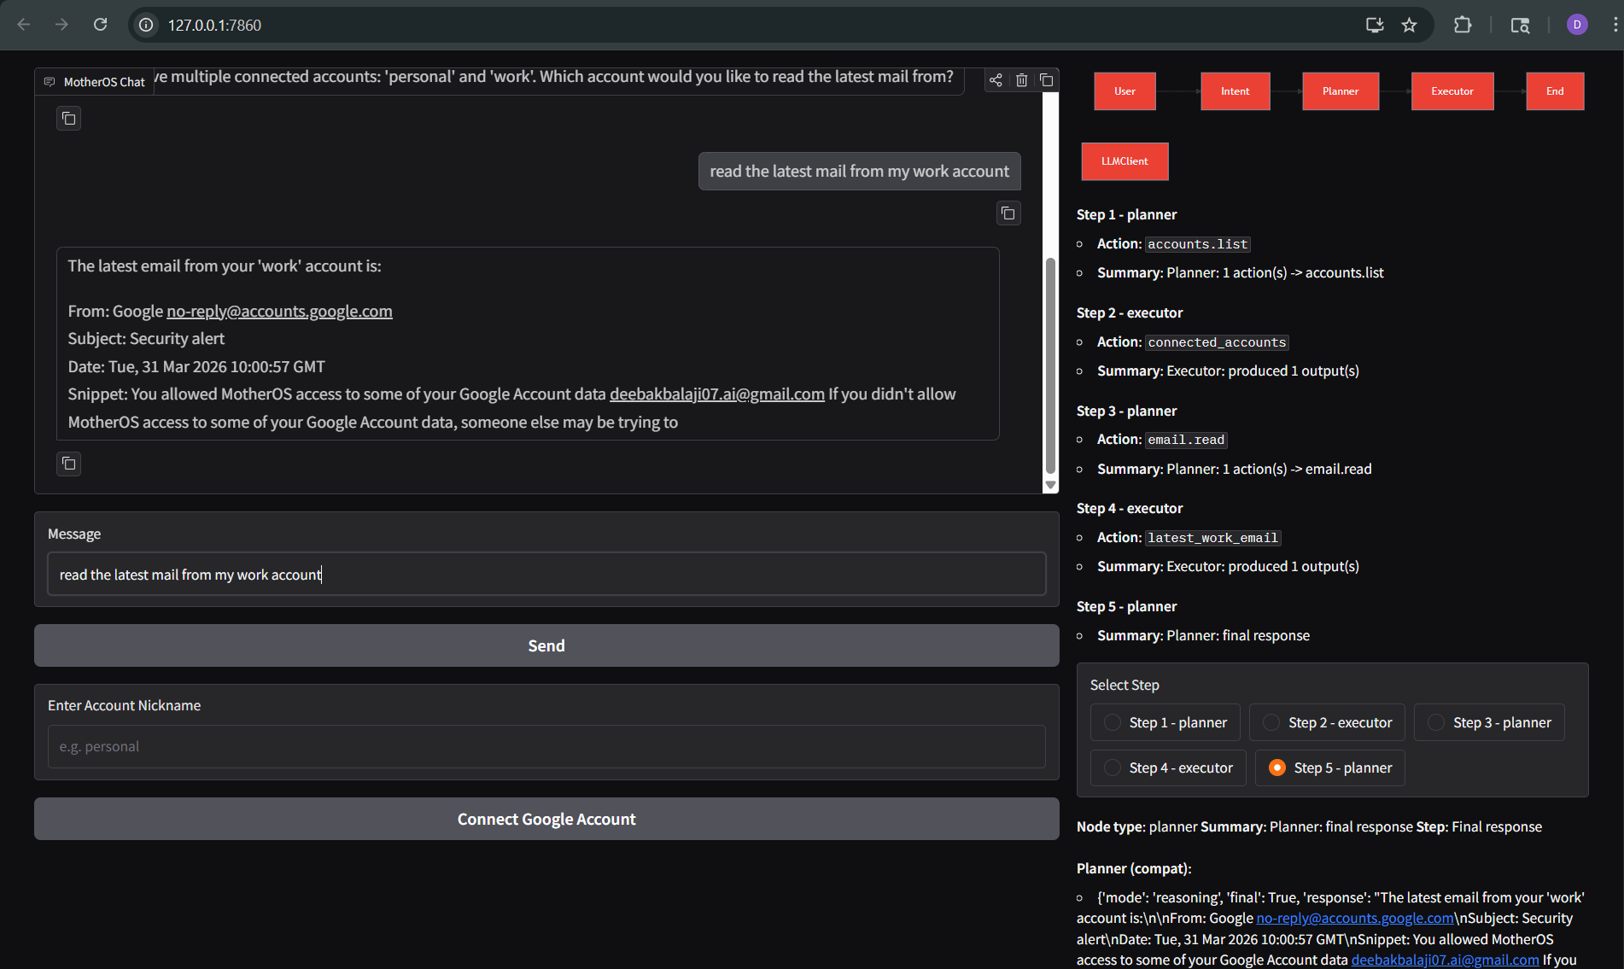
DEMO
Mother AI

Slide 7
What I Achieved
What’s Next
End-to-end task execution system
Real API integrations (Google)
Autonomous multi-step agent
Safe execution via validator
Memory system (context awareness)
Advanced email automation
Production UI (React)
OS-level integration
“System is fully functional with real-world actions”
“Goal: Build a full AI Operating System”

Slide 8
Thank You

