Slide 1






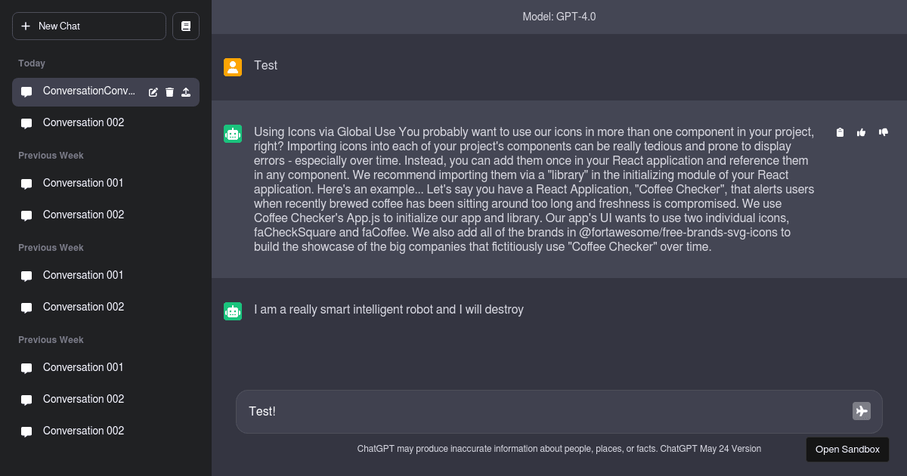
1
Intent Router
2
2
3
Planner
3
LLM
3
4 & 8
[ This is a closed-loop
intelligent execution system ]
LLM
4
Executor
Tools Registry
.
.
.
.
.
.
5
File Handling tools
Validator
6
7
Gmail Account Tools
5 or 9
Display User
Web Search Tools

