Slide 1
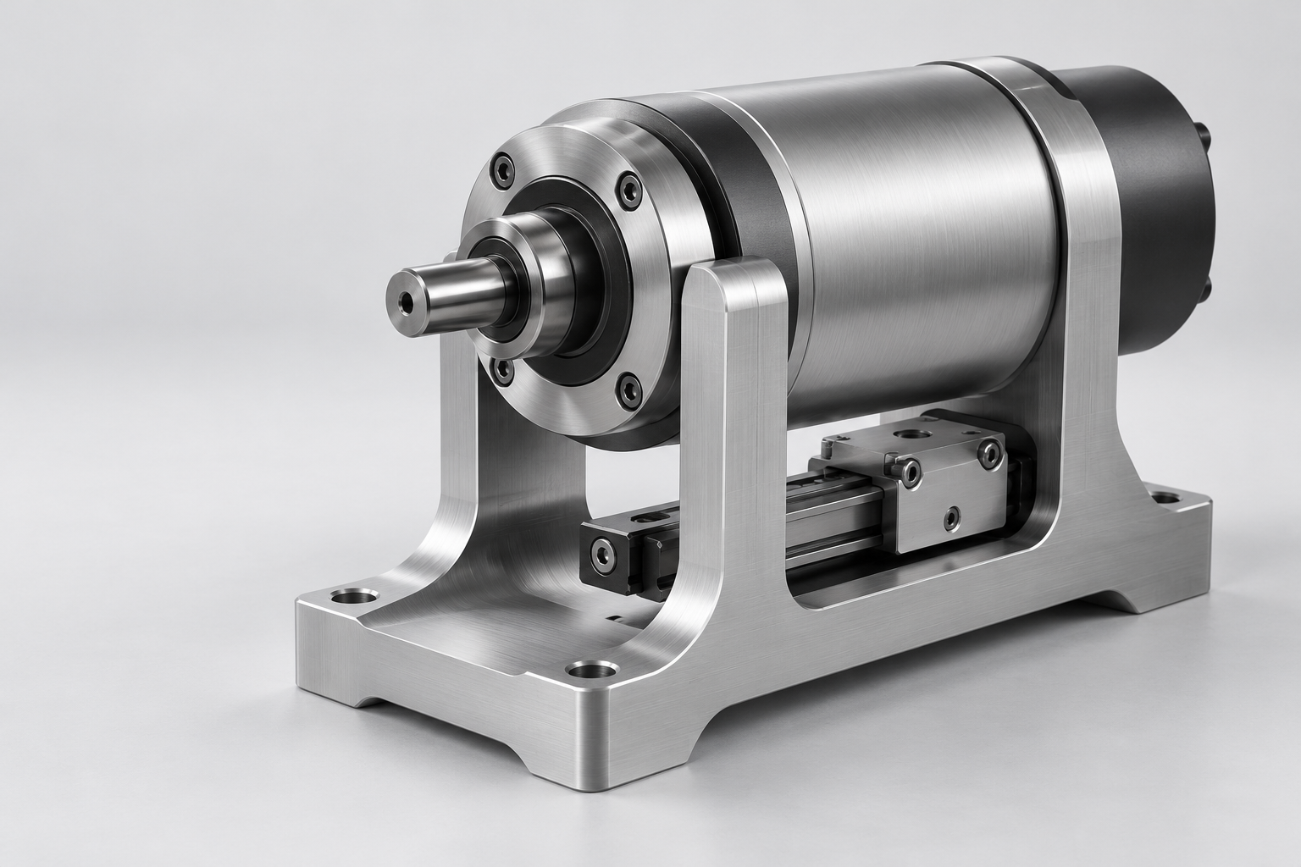
01 / PROJECT OVERVIEW
PRECISION
ASSEMBLY
Product development study
Housing, interfaces and assembly
FROM CONCEPT TO PRODUCTION
DALE / ILLUSTRATIVE CONCEPT
01
Notes:
DALE project presentation template. All project copy is illustrative, not a factual case study or binding offer. Replace with verified project details. Visual source: previously generated precision mechanism in this conversation, not a DALE client project. Approved DALE vector artwork and user-supplied Domus Titling Extralight, Domus Titling Light and DINOT fonts. Cover example: a hypothetical housing development study.

Slide 2
02 / PROJECT BRIEF
THE DESIGN
CHALLENGE
A compact housing around a precision assembly.
The concept brings service access and component
interfaces into one coherent product architecture.
APPLICATION
Precision assembly
SCOPE
Housing and component interfaces
STAGE
Concept development
REVIEW
Function, assembly and manufacturing
DALE / ILLUSTRATIVE CONCEPT
02
Notes:
DALE project presentation template. All project copy is illustrative, not a factual case study or binding offer. Replace with verified project details. Visual source: previously generated precision mechanism in this conversation, not a DALE client project. Approved DALE vector artwork and user-supplied Domus Titling Extralight, Domus Titling Light and DINOT fonts. All brief content is example copy and must be replaced for a real proposal.

Slide 3
03 / SERVICES
PRODUCT DEVELOPMENT SERVICES
01
02
03
PRODUCT STRATEGY
INDUSTRIAL DESIGN
MECHANICAL ENGINEERING
Requirements and user needs.
Product form and ergonomics.
CAD and component integration.
A clear brief for development.
Concepts for design review.
A considered assembly approach.
04
05
06
PROTOTYPING
TESTING & VALIDATION
PRODUCTION SUPPORT
Models and functional prototypes.
Test planning and evaluation.
Documentation and supplier input.
Early checks of design assumptions.
Findings that guide revisions.
Support for production preparation.
DALE / ILLUSTRATIVE CONCEPT
03
Notes:
DALE project presentation template. All project copy is illustrative, not a factual case study or binding offer. Replace with verified project details. Visual source: previously generated precision mechanism in this conversation, not a DALE client project. Approved DALE vector artwork and user-supplied Domus Titling Extralight, Domus Titling Light and DINOT fonts. Six proposed service areas. This is a draft taxonomy to confirm against the actual DALE service offering.

Slide 4
04 / DEVELOPMENT PROCESS
DEVELOPMENT PROCESS
01
DEFINE
Requirements, interfaces and review criteria
Deliverable: agreed development brief
02
DESIGN
Product architecture and concept alternatives
Deliverable: selected design direction
03
ENGINEER
Detailed CAD, materials and assembly approach
Deliverable: engineering package for review
04
VALIDATE
Prototype evaluation and design revisions
Deliverable: documented findings and next steps
DALE / ILLUSTRATIVE CONCEPT
04
Notes:
DALE project presentation template. All project copy is illustrative, not a factual case study or binding offer. Replace with verified project details. Visual source: previously generated precision mechanism in this conversation, not a DALE client project. Approved DALE vector artwork and user-supplied Domus Titling Extralight, Domus Titling Light and DINOT fonts. The four stages describe an example collaboration process. Scope and acceptance gates must be agreed for each project.

Slide 5
05 / DEFINE / STAGE DETAIL
01
DEFINE
OUTPUT / DEVELOPMENT BRIEF
Requirements and review criteria
A shared starting point for product development.
ACTIVITIES AT THIS STAGE
Clarify product goals and the intended use.
Review available CAD, reference products and existing documentation.
Capture functional requirements and user needs.
Map component interfaces and installation constraints.
Identify technical risks, open questions and required inputs.
Agree the development brief and acceptance criteria for the next stage.
DALE / ILLUSTRATIVE CONCEPT
05
Notes:
DALE project presentation template. All project copy is illustrative, not a factual case study or binding offer. Replace with verified project details. Visual source: previously generated precision mechanism in this conversation, not a DALE client project. Approved DALE vector artwork and user-supplied Domus Titling Extralight, Domus Titling Light and DINOT fonts. Example expansion of chapter 01 Define. The six editable bullet points describe proposed activities, not completed work. Confirm the actual scope and outputs for each engagement.

Slide 6
06 / PROJECT TIMELINE
PROJECT TIMELINE
ILLUSTRATIVE 8-WEEK PLAN
W01
W02
W03
W04
W05
W06
W07
W08
01
DEFINE
Brief approval
02
DESIGN
Concept selection
03
ENGINEER
Engineering review
04
VALIDATE
Prototype review
Review gates close each phase.
Final timing depends on scope, prototype lead times and client reviews.
DALE / ILLUSTRATIVE CONCEPT
06
Notes:
DALE project presentation template. All project copy is illustrative, not a factual case study or binding offer. Replace with verified project details. Visual source: previously generated precision mechanism in this conversation, not a DALE client project. Approved DALE vector artwork and user-supplied Domus Titling Extralight, Domus Titling Light and DINOT fonts. Illustrative schedule only: Define week 1, Design weeks 2-3, Engineer weeks 4-6, Validate weeks 7-8. These are not agreed durations or commitments. Review gates indicate decisions after each phase. All bars and labels are editable native slide objects.

Slide 7
07 / SOLUTION
01
02
03
PRODUCT
01 / OVERVIEW 02 / DETAIL 03 / INTERFACE
ARCHITECTURE
Illustrative views for concept review.
DALE / ILLUSTRATIVE CONCEPT
07
Notes:
DALE project presentation template. All project copy is illustrative, not a factual case study or binding offer. Replace with verified project details. Visual source: previously generated precision mechanism in this conversation, not a DALE client project. Approved DALE vector artwork and user-supplied Domus Titling Extralight, Domus Titling Light and DINOT fonts. This slide deliberately repeats the same generated illustrative mechanism as an overview and two detail crops, following the approved C3.2 composition. The images are not dimensional evidence or manufacturing documentation.

Slide 8
08 / PROJECT DELIVERABLES
PROJECT DELIVERABLES
PHASE
FILES AND MATERIALS
REVIEW GATE
01 / DEFINE
Development brief
Brief approval
Requirements and interface assumptions
02 / DESIGN
Concept package
Concept selection
Design alternatives and selected direction
03 / ENGINEER
Engineering package
Engineering review
CAD models and agreed documentation
04 / VALIDATE
Validation summary
Prototype review
Prototype findings and revision priorities
The agreed scope defines the final deliverables and file formats.
DALE / ILLUSTRATIVE CONCEPT
08
Notes:
DALE project presentation template. All project copy is illustrative, not a factual case study or binding offer. Replace with verified project details. Visual source: previously generated precision mechanism in this conversation, not a DALE client project. Approved DALE vector artwork and user-supplied Domus Titling Extralight, Domus Titling Light and DINOT fonts. Proposed deliverables by phase. Actual files, formats, documentation depth and acceptance criteria require agreement in a project scope.

Slide 9
09 / SCOPE OF WORK
SCOPE OF
COLLABORATION
DEVELOPMENT BRIEF
PROJECT TIMING
Requirements and interfaces
Schedule follows the agreed scope
DESIGN PACKAGE
and review milestones.
Concept direction and CAD structure
ENGINEERING REVIEW
PIOTR DALEWSKI
Materials, assembly and open questions
PRODUCT DEVELOPMENT ENGINEER
PROJECT HANDOFF
Agreed files and next development steps
piotr@dale.com
dale.com
DALE / ILLUSTRATIVE CONCEPT
09
Notes:
DALE project presentation template. All project copy is illustrative, not a factual case study or binding offer. Replace with verified project details. Visual source: previously generated precision mechanism in this conversation, not a DALE client project. Approved DALE vector artwork and user-supplied Domus Titling Extralight, Domus Titling Light and DINOT fonts. Deliverables and schedule are illustrative placeholders for scoping. No price, duration or technical result is asserted. Contact details supplied by the user.

Slide 10
10 / CONTACT
THANK YOU
FOR YOUR ATTENTION
PIOTR DALEWSKI
PRODUCT DEVELOPMENT ENGINEER
piotr@dale.com
+48 573 826 419
dale.com
DALE.COM
DALE / PRODUCT DEVELOPMENT
10
Notes:
DALE project presentation template. All project copy is illustrative, not a factual case study or binding offer. Replace with verified project details. Visual source: previously generated precision mechanism in this conversation, not a DALE client project. Approved DALE vector artwork and user-supplied Domus Titling Extralight, Domus Titling Light and DINOT fonts. Closing slide. Name, role, email and website match the business card. The phone number +48 573 826 419 remains a randomly generated example, not a verified contact number. QR target: https://dale.com.

