Slide 1
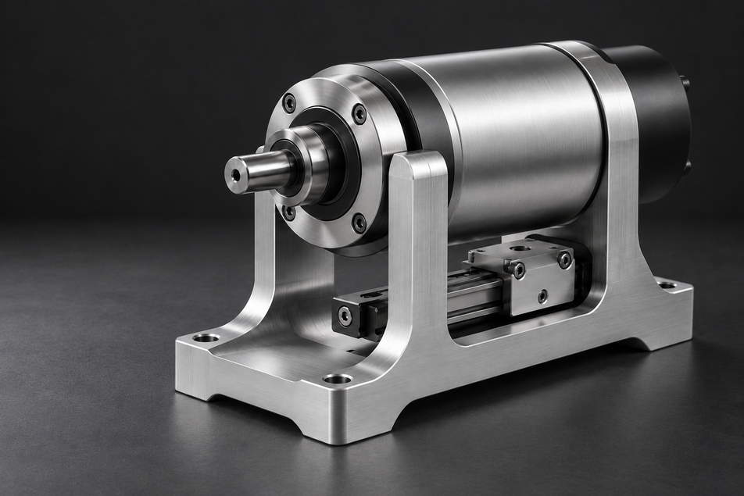
FROM CONCEPT
TO PRODUCTION
PROJECT SPOTLIGHT
Product development / Design & engineering
DALE / CONCEPT SAMPLE
01
Notes:
Visual source: generated DALE studio illustration from this conversation, not an actual DALE client project. Approved DALE vector logo. User-provided Domus Titling Extralight, Domus Titling Light and DINOT fonts. Sample copy.

