Slide 1
TEST RESULTS
LOAD & DISPLACEMENT
KEY FINDING
[Main conclusion]
[Explain the comparison]
[in one short sentence.]
TEST BASIS
[Test method / fixture]
[Material / temperature]
[Report and revision]
DALE / EXAMPLE DATA AND ILLUSTRATIONS
01
Notes:
DALE technical graphics template. All numeric values are invented examples, not measured product performance. Replace values, units, conditions and references before use. Fonts supplied by the user: Domus Titling Extralight, Domus Titling Light, DINOT. Native editable line chart. Load 0,50,100,150,200,250 N. A displacement 0,.16,.31,.47,.63,.78 mm; B 0,.12,.24,.35,.48,.60 mm. Equally spaced load categories. Native labels at the last points identify each series instead of a legend. Markers differ to aid identification. No test method, material or sample count is asserted.

Slide 2
CONCEPT COMPARISON
MASS COMPARISON
KEY FINDING
[Main conclusion]
[State the difference]
[and the comparison basis.]
COMPARISON BASIS
[Same product scope]
[Same material basis]
[CAD / source and revision]
DALE / EXAMPLE DATA AND ILLUSTRATIONS
02
Notes:
DALE technical graphics template. All numeric values are invented examples, not measured product performance. Replace values, units, conditions and references before use. Fonts supplied by the user: Domus Titling Extralight, Domus Titling Light, DINOT. Native editable column chart. Example masses in kg: A 1.24, B 1.09, C .98. Zero baseline. Lime consistently identifies B, not a selected or approved design.

Slide 3
DECISION SUPPORT
CONCEPT COMPARISON
Criterion | Unit | Concept A | Concept B | Concept C
Mass | kg | 1.24 | 1.09 | 0.98
Displacement at 250 N | mm | 0.78 | 0.60 | 0.68
Part count | pcs | 9 | 7 | 8
Manufacturing route | - | [Add route] | [Add route] | [Add route]
Verification status | - | [Add status] | [Add status] | [Add status]
REVIEW DECISION
[Selected concept]
[One reason for selection]
REVIEW BASIS
[Requirements and risks]
[Evidence still needed]
[Owner / date / next step]
Compare the same scope and conditions. Keep assumptions separate from verified results.
DALE / EXAMPLE DATA AND ILLUSTRATIONS
03
Notes:
DALE technical graphics template. All numeric values are invented examples, not measured product performance. Replace values, units, conditions and references before use. Fonts supplied by the user: Domus Titling Extralight, Domus Titling Light, DINOT. Native editable PowerPoint table. Numeric values are examples only and match the charts where metrics overlap. Concept C displacement .68 mm, no corresponding series on slide 1. No combined score, financial estimate or approval is implied.

Slide 4
DEVELOPMENT PROCESS
PROCESS & REVIEW POINTS
01
02
03
04
DEFINE
DESIGN
ENGINEER
VALIDATE
Requirements and interfaces
Architecture and concepts
CAD, materials and assembly
Prototype evaluation
Agreed development brief
Selected design direction
Engineering review package
Findings and next steps
REVIEW AT EACH STAGE
[Record the review outcome, open issues and agreed next action.]
DALE / EXAMPLE DATA AND ILLUSTRATIONS
04
Notes:
DALE technical graphics template. All numeric values are invented examples, not measured product performance. Replace values, units, conditions and references before use. Fonts supplied by the user: Domus Titling Extralight, Domus Titling Light, DINOT. Editable square stage fields, labels and attached arrow connectors. The four stages follow the previously approved project presentation. This is a process diagram, not a dated schedule.

Slide 5
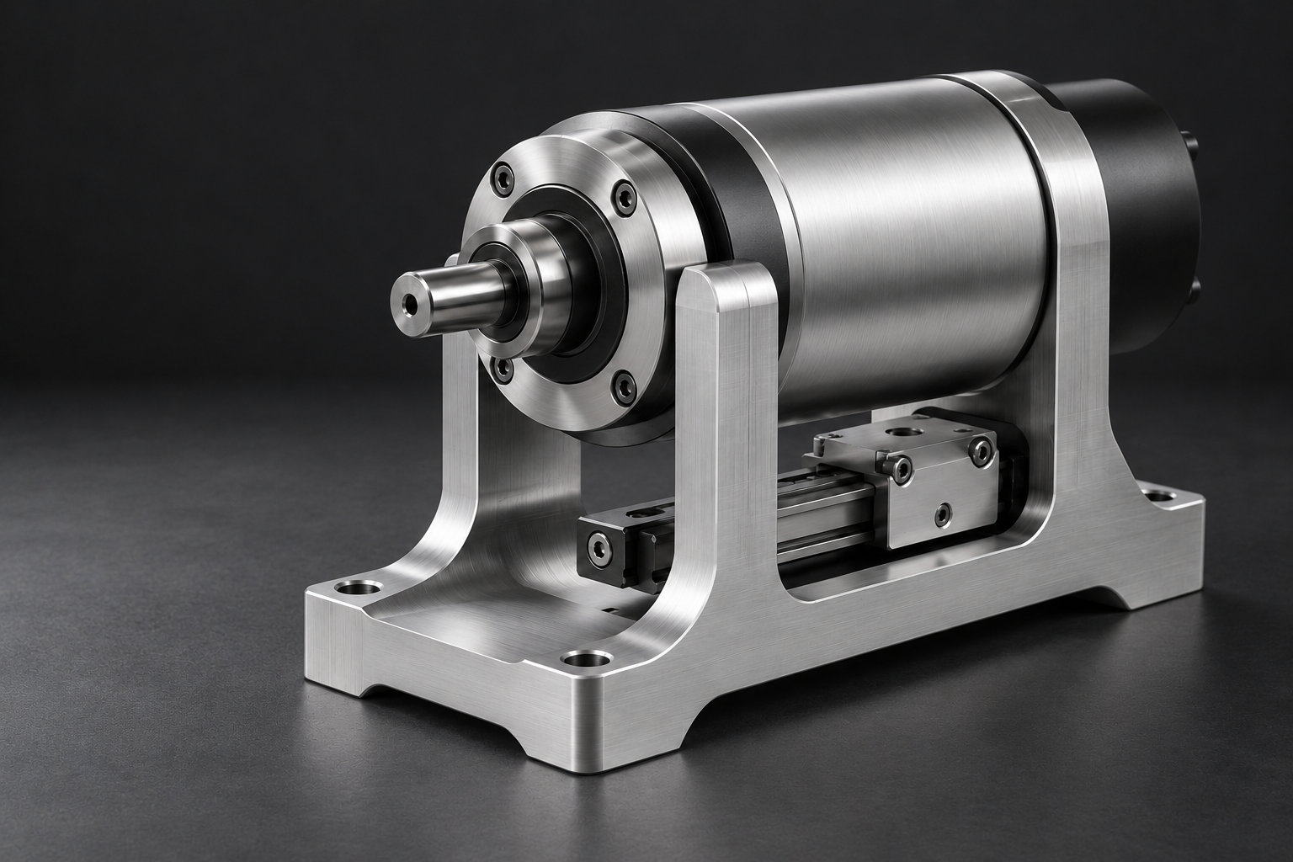
TECHNICAL ANNOTATIONS
DETAILS & CALLOUTS
DETAIL VIEW
01 / SHAFT INTERFACE
02
[Explain the function
or mating interface.]
01
[Describe the feature
02
shown in the detail.]
DALE / EXAMPLE DATA AND ILLUSTRATIONS
05
Notes:
DALE technical graphics template. All numeric values are invented examples, not measured product performance. Replace values, units, conditions and references before use. Fonts supplied by the user: Domus Titling Extralight, Domus Titling Light, DINOT. Main image and detail inset are separate editable picture objects; the inset uses the same source image. Callout dots, numbered badges, labels and elbow connectors are native objects. Matching 02 badges link the main view to the detail inset. Reposition target dots when changing the image. The illustration is generated, not actual engineering documentation. No dimensions or technical performance are asserted.

