Slide 1
ELECTROCHEMISTRY
Grade 12 Chemistry · Module 4
Dr. Baya Education
Redox Reactions · Galvanic Cells · Electrolytic Cells · Industrial Applications · Corrosion

Slide 2
TOPICS COVERED
01 Introduction to Electrochemistry
02 Oxidation Numbers & Rules
03 Redox Reactions
04 Balancing Redox Equations
05 Electric Cells – Overview
06 Galvanic (Voltaic) Cell
07 Daniell Cell & Components
08 Cell Notation & Representation
09 Electromotive Force (EMF)
10 Standard Hydrogen Electrode
11 Electrode Potentials
12 Spontaneity & Free Energy
13 Nernst Equation
14 Concentration Cells & pH
15 Primary Batteries
16 Secondary Batteries
17 Electrolytic Cell – Basics
18 Electrolysis of NaCl & Water
19 Faraday's Laws of Electrolysis
20 Corrosion – Process
21 Corrosion Prevention
22 Industrial: Aluminum Production
23 Electroplating & Electrorefining
24 Galvanic vs Electrolytic
25 Key Formulas & Summary

Slide 3
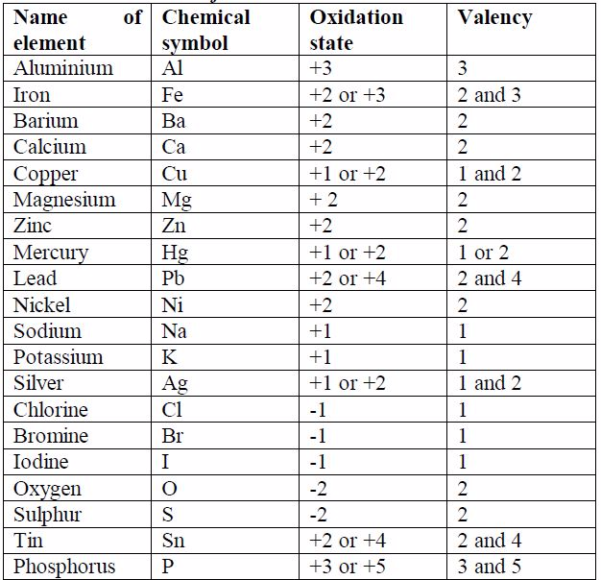
WHAT IS ELECTROCHEMISTRY?
Branch of chemistry studying the relationship between electrical energy and chemical reactions.
Involves Redox (Oxidation-Reduction) reactions that transfer electrons between species.
TWO MAIN TYPES OF ELECTROCHEMICAL CELLS:
⚡ Galvanic Cell – converts Chemical Energy → Electrical Energy (spontaneous)
🔌 Electrolytic Cell – converts Electrical Energy → Chemical Energy (non-spontaneous)
KEY APPLICATIONS:
➤ Batteries & fuel cells
➤ Electroplating & metal refining
➤ Corrosion prevention
➤ Industrial production (Al, Cl₂, NaOH)

Slide 4
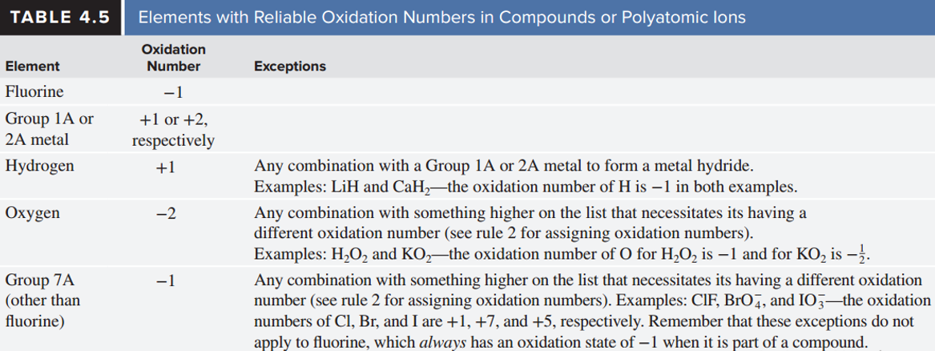
OXIDATION NUMBERS
DEFINITION: Hypothetical charges assigned assuming electrons go to the more electronegative atom
RULES FOR ASSIGNING OXIDATION NUMBERS:
• Pure elements (O₂, Fe, Zn) → Oxidation number = 0
• Monoatomic ions (Na⁺, Cl⁻) → Oxidation number = ion charge
• Hydrogen → usually +1 | EXCEPTION: –1 in metal hydrides (NaH)
• Oxygen → usually –2 | EXCEPTION: –1 in peroxides (H₂O₂), +2 in OF₂
• Neutral compounds → sum of all oxidation numbers = 0
• Polyatomic ions → sum of oxidation numbers = overall ion charge
• Transition metals → may have multiple valid oxidation states
EXAMPLE – Water (H₂O):
Oxygen (O) = –2 | Hydrogen (H) = +1 | Sum = 0 ✓
EXAMPLE – Fe₃O₄ (Magnetite):
3x + 4(–2) = 0 → x = +8/3 (fractional oxidation state, mixture of Fe²⁺ and Fe³⁺)

Slide 5
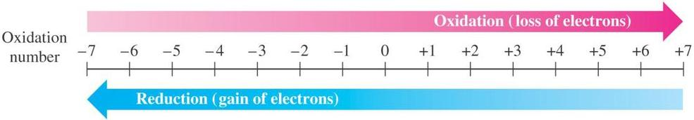
REDOX REACTIONS
OXIDATION
REDUCTION
• Loss of electrons
• Increase in oxidation number
• Occurs at the ANODE
• Example: Zn → Zn²⁺ + 2e⁻
• Agent: REDUCING AGENT
⇌
• Gain of electrons
• Decrease in oxidation number
• Occurs at the CATHODE
• Example: Cu²⁺ + 2e⁻ → Cu
• Agent: OXIDIZING AGENT
Simultaneous
OVERALL: Zn(s) + Cu²⁺(aq) → Zn²⁺(aq) + Cu(s) EMF = +1.10 V ✓ Spontaneous
OIL RIG Memory Aid: Oxidation Is Loss | Reduction Is Gain
• Electrons transferred from REDUCING AGENT (Zn) to OXIDIZING AGENT (Cu²⁺)
• Electrons lost at anode in oxidation = Electrons gained at cathode in reduction
• Half-reaction method: Write each process separately, balance e⁻, then combine

Slide 6
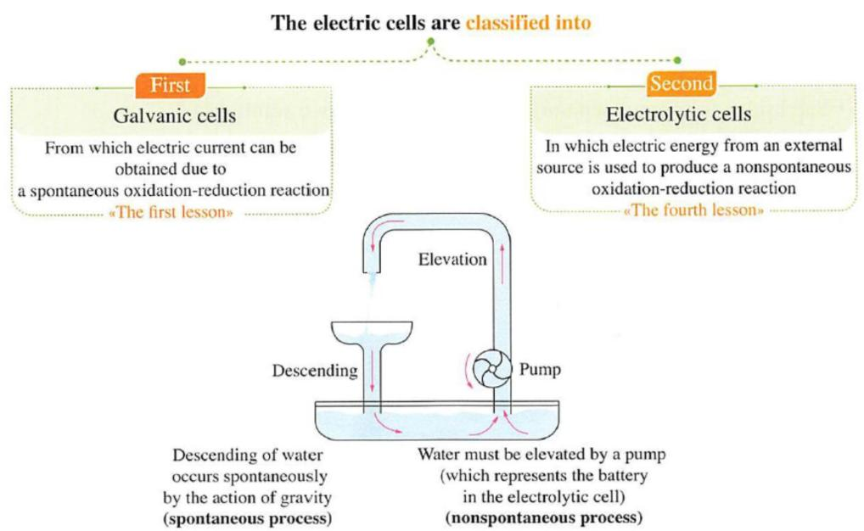
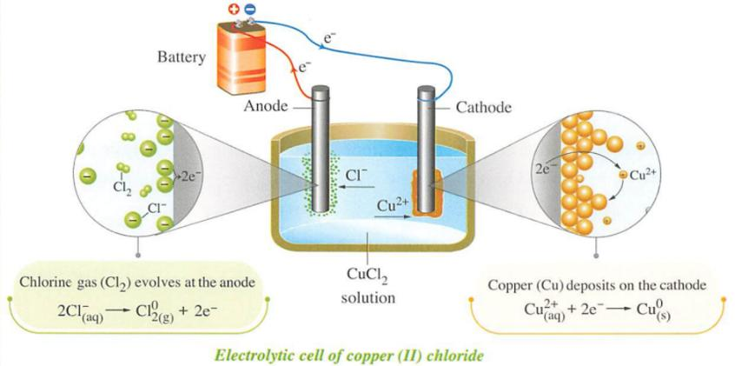
TYPES OF ELECTROCHEMICAL CELLS
⚡ GALVANIC CELL
🔌 ELECTROLYTIC CELL
(Voltaic / Daniel Cell)
(Electrolysis Cell)
• Chemical → Electrical Energy
• SPONTANEOUS reaction (E° > 0)
• Anode = negative electrode (–)
• Cathode = positive electrode (+)
• No external power supply needed
• Electrons: Anode → Cathode
• Example: All batteries
• Electrical → Chemical Energy
• NON-SPONTANEOUS (E° < 0)
• Anode = positive electrode (+)
• Cathode = negative electrode (–)
• Requires external power source
• Follows Faraday's Laws
• Example: Electroplating, electrolysis
VS

Slide 7
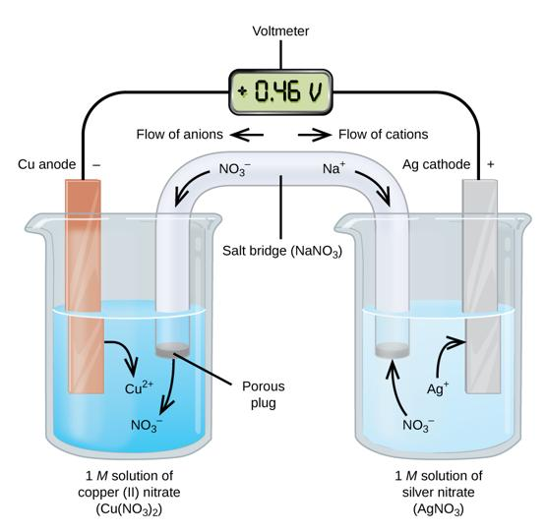
GALVANIC CELL – KEY COMPONENTS
ANODE (–)
Oxidation site. Metal dissolves, releasing electrons.
CATHODE (+)
Reduction site. Accepts electrons, metal deposits.
ELECTROLYTE
Ion-conducting medium (e.g., ZnSO₄, CuSO₄ solution)
SALT BRIDGE
Maintains electrical neutrality by allowing ion flow between half-cells
POROUS DISK
Alternative to salt bridge; tiny passages allow controlled ion flow
EXTERNAL WIRE
Conducts electrons from anode → cathode (external circuit)

Slide 8
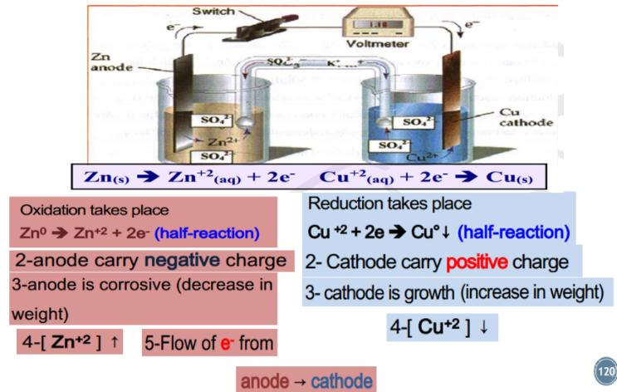
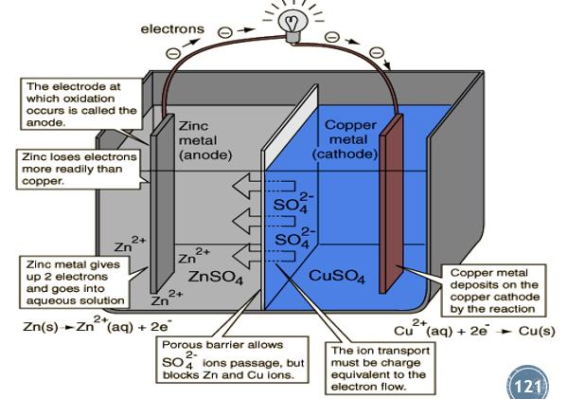
THE DANIELL CELL (Zn / Cu)
INVENTED:
1836 by John Frederic Daniell (British chemist)
ANODE (Zn):
Zn(s) → Zn²⁺(aq) + 2e⁻ [OXIDATION – Zn dissolves]
CATHODE (Cu):
Cu²⁺(aq) + 2e⁻ → Cu(s) [REDUCTION – Cu deposits]
OVERALL:
Zn(s) + Cu²⁺(aq) → Zn²⁺(aq) + Cu(s)
EMF:
E°cell = E°Cu – E°Zn = 0.34 – (–0.76) = +1.10 V
ELECTRON FLOW:
Zn (anode) → external wire → Cu (cathode)
ION FLOW:
Maintained by porous barrier or salt bridge
ELECTROLYTES:
ZnSO₄ solution | CuSO₄ solution

Slide 9
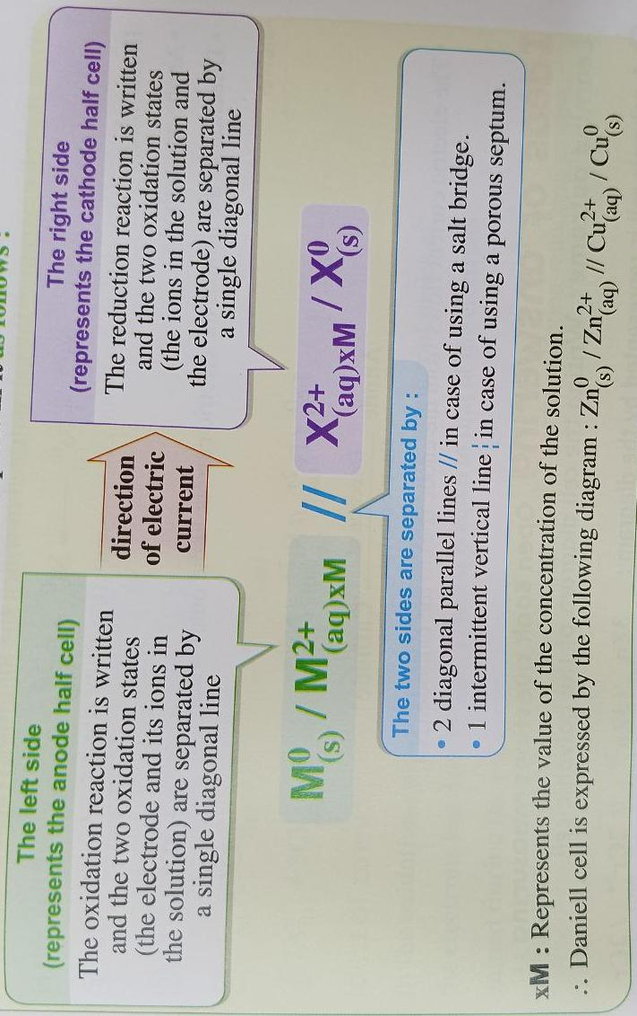
CELL NOTATION & SALT BRIDGE
SALT BRIDGE vs. POROUS DISK
Feature
Salt Bridge
Porous Disk
Composition
Strong electrolyte in gel matrix
Tiny passages in solid structure
Function
Allows ion flow, minimal mixing
Controlled, selective ion flow
Purpose
Maintains electrical neutrality
Maintains electrical neutrality
GALVANIC CELL NOTATION FORMAT:
Anode | Anode solution (conc.) ‖ Cathode solution (conc.) | Cathode
DANIELL CELL:
Zn(s) | Zn²⁺(aq) ‖ Cu²⁺(aq) | Cu(s)
| = Phase boundary (solid–electrolyte interface)
‖ = Salt bridge or porous barrier separating the two half-cells
Anode always on the LEFT, Cathode always on the RIGHT

Slide 10
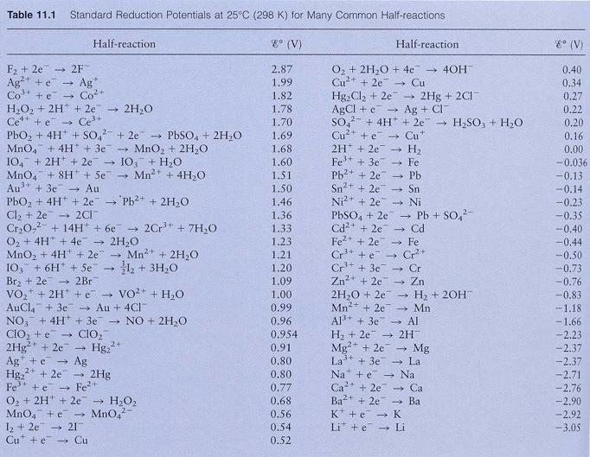
ELECTROMOTIVE FORCE (EMF)
EMF = E°cathode − E°anode (Reduction Potential − Oxidation Potential)
RULES OF EMF:
E°cell > 0 (Positive)
→ SPONTANEOUS reaction (e.g., galvanic cells)
E°cell < 0 (Negative)
→ NON-SPONTANEOUS (e.g., electrolytic cells)
Doubling concentration
→ EMF stays CONSTANT (unchanged)
Reversing the reaction
→ Sign of EMF REVERSES (+ ↔ –)
DANIELL CELL EMF CALCULATION:
E°cathode (Cu²⁺/Cu) = +0.34 V
E°anode (Zn²⁺/Zn) = –0.76 V
E°cell = 0.34 – (–0.76) = +1.10 V ✓ Spontaneous!

Slide 11
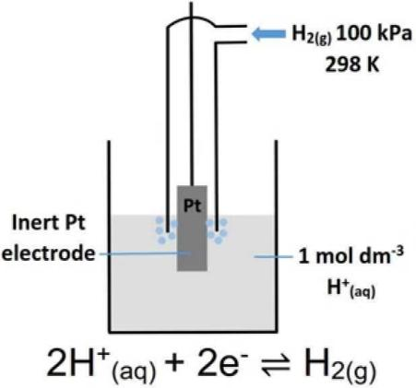
STANDARD HYDROGEN ELECTRODE (SHE)
DEFINITION:
Reference electrode with assigned standard potential E° = 0 V
ELECTRODE:
Platinum sheet (1 cm²) coated with spongy black platinum
ELECTROLYTE:
1 M H⁺ solution (usually HCl) at 25°C
GAS SUPPLY:
H₂ gas bubbled at constant 1 atm pressure
TEMPERATURE:
Maintained at 25°C (298 K) – standard conditions
PURPOSE:
Universal reference to measure electrode potentials of other half-cells
HALF-REACTION:
2H⁺(aq) + 2e⁻ ⇌ H₂(g) E° = 0.00 V
KEY FACT:
Cannot measure absolute electrode potential — only difference between two electrodes
FACTORS ALTERING SHE: Temp ≠ 25°C | [H⁺] ≠ 1 M | P(H₂) ≠ 1 atm

Slide 12
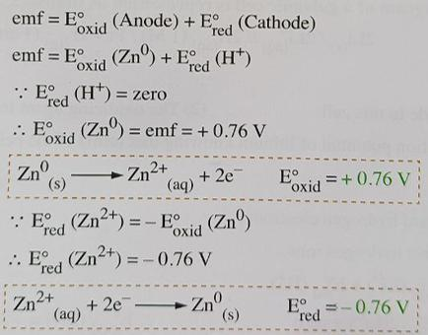
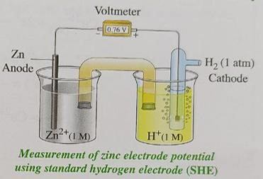
ELECTRODE POTENTIALS & ELECTROCHEMICAL SERIES
Zn vs SHE Voltmeter: 0.76 V Zn = ANODE E°(Zn) = −0.76 V (Zn is oxidized)
Cu vs SHE Voltmeter: 0.34 V Cu = CATHODE E°(Cu) = +0.34 V (Cu is reduced)
STANDARD REDUCTION POTENTIALS:
Li⁺ + e⁻ → Li
–3.04 V
Strongest Reducing Agent
Zn²⁺ + 2e⁻ → Zn
–0.76 V
Above H₂ → tends to oxidize (Anode)
2H⁺ + 2e⁻ → H₂
0.00 V
Reference (SHE)
Cu²⁺ + 2e⁻ → Cu
+0.34 V
Below H₂ → tends to reduce (Cathode)
Ag⁺ + e⁻ → Ag
+0.80 V
Strong oxidizing tendency
Au³⁺ + 3e⁻ → Au
+1.50 V
Strongest Oxidizing Agent

Slide 13
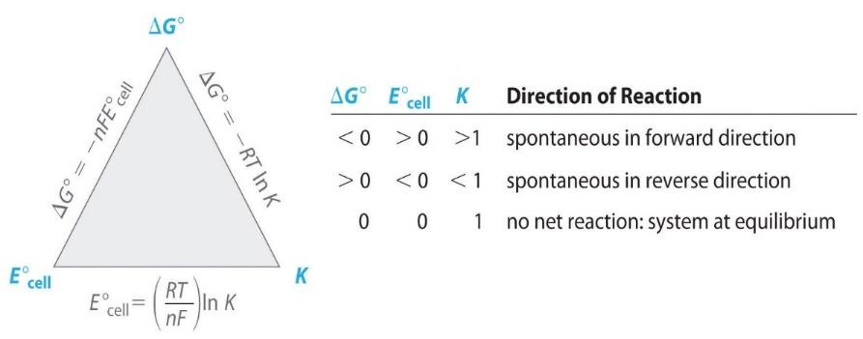
FREE ENERGY, SPONTANEITY & NERNST EQUATION
FREE ENERGY RELATIONSHIPS:
NERNST EQUATION:
ΔG = −nFE°cell
W_max = −nFE_cell
ΔG° = −RT ln K = −nFE°cell
E°cell = (0.0592 / n) × log K [at 25°C]
n = moles of electrons transferred
F = Faraday's constant = 96,500 C/mol e⁻
K = equilibrium constant
E = E° − (RT/nF) × ln Q At 25°C: E = E° − (0.0592/n) × log Q
Q = reaction quotient (products/reactants)
As cell discharges: Q increases → E decreases
At equilibrium: Q = K, E = 0 (dead battery)
Zn/Cu Cell Example:
E = 1.10 − (0.0592/2) × log([Zn²⁺]/[Cu²⁺])
Le Châtelier's Principle:
• ↑ reactant → ↑ E (cell voltage increases)
• ↑ product → ↓ E (cell voltage decreases)
✓ E°cell > 0 | ΔG < 0 → SPONTANEOUS
⚖ E°cell = 0 | ΔG = 0 → EQUILIBRIUM
✗ E°cell < 0 | ΔG > 0 → NON-SPONTANEOUS

Slide 14
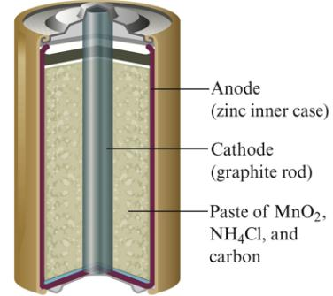
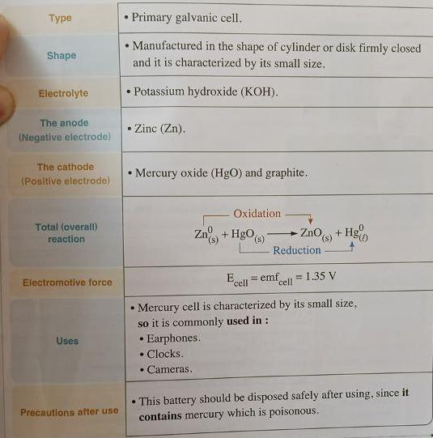
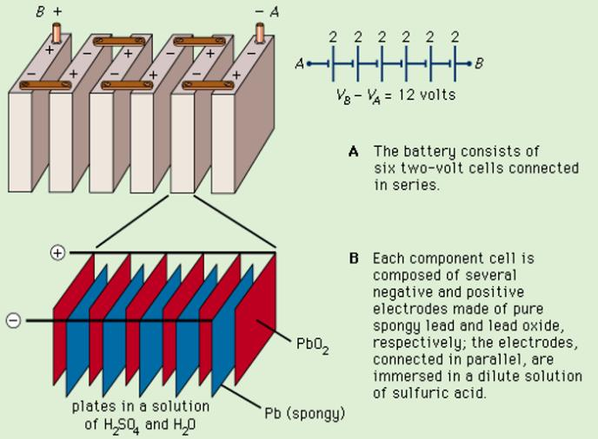
PRIMARY BATTERIES (Non-Rechargeable)
① DRY CELL (Zinc-Carbon / Alkaline)
• Anode: Zinc container | Cathode: Graphite rod | Electrolyte: NH₄Cl or KOH paste
• Alkaline cells last longer (zinc corrodes slower in basic conditions)
② MERCURY BATTERY (Mercuric Oxide)
• Anode: Zinc (oxidized → ZnO) | Cathode: HgO (reduced → elemental Hg)
• Electrolyte: NaOH or KOH (alkaline) | Excess HgO prevents H₂ buildup
③ FUEL CELL
• Continuous operation as long as fuel is supplied (e.g., H₂ + O₂ → H₂O + electricity)
• Anode: H₂ → 2H⁺ + 2e⁻ | Cathode: O₂ + 4H⁺ + 4e⁻ → 2H₂O
• Efficiency: ~75% vs conventional combustion (~35%)
• Used in: Spacecraft, electric vehicles, stationary power generation

Slide 15
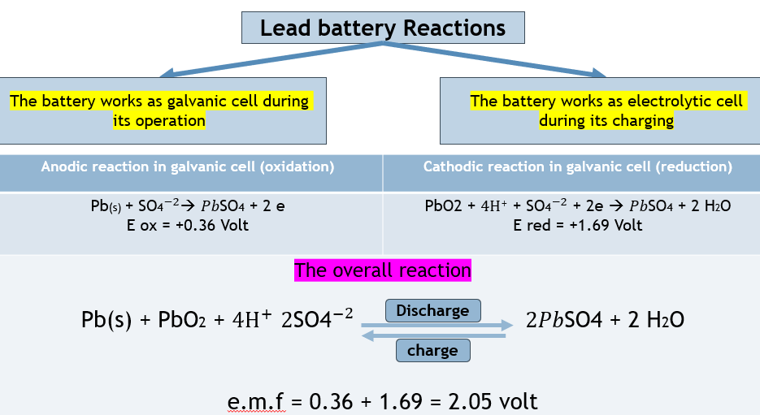
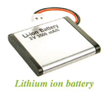
SECONDARY BATTERIES (Rechargeable)
① LEAD-ACID BATTERY (Car Battery)
• Electrolyte: Dilute sulfuric acid (H₂SO₄) – acidic battery
• DISCHARGING (Galvanic): Chemical → Electrical energy
Anode: Pb → Pb²⁺ + 2e⁻ | Cathode: PbO₂ + 4H⁺ + 2e⁻ → Pb²⁺ + 2H₂O
• CHARGING (Electrolytic): Electrical → Chemical energy (reactions reversed)
• 6 cells in series = 12V | Reversible cell
② LITHIUM-ION BATTERY
• Why Lithium? → Lightest metal + most negative E° value
• Anode: Lithium graphite (LiC)
• Cathode: Lithium cobalt oxide (LiCoO₂)
• Electrolyte: Anhydrous LiPF₆ in organic solvent
• Isolator: Thin plastic layer (allows ion flow only)
• Advantages: Light, high energy density, small, rechargeable
• Applications: Mobile phones, laptops, electric vehicles

Slide 16
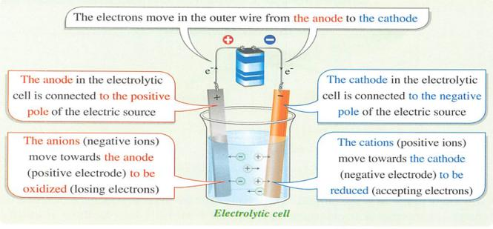
ELECTROLYTIC CELL – BASICS
DEFINITION:
Uses ELECTRICAL energy to drive a NON-SPONTANEOUS redox reaction
ANODE (+):
Connected to POSITIVE terminal → Oxidation occurs here
CATHODE (−):
Connected to NEGATIVE terminal → Reduction occurs here
ANIONS (−):
Move TOWARD anode (+) → get oxidized
CATIONS (+):
Move TOWARD cathode (−) → get reduced
ELECTROLYTE:
Aqueous salt/acid/base solution OR molten salt
INITIATION:
Voltage applied must exceed the reversible cell potential
KEY LAW:
Faraday's Laws → relates charge to mass deposited

Slide 17
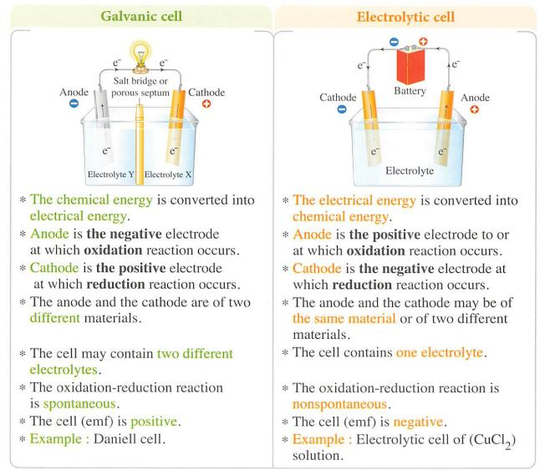
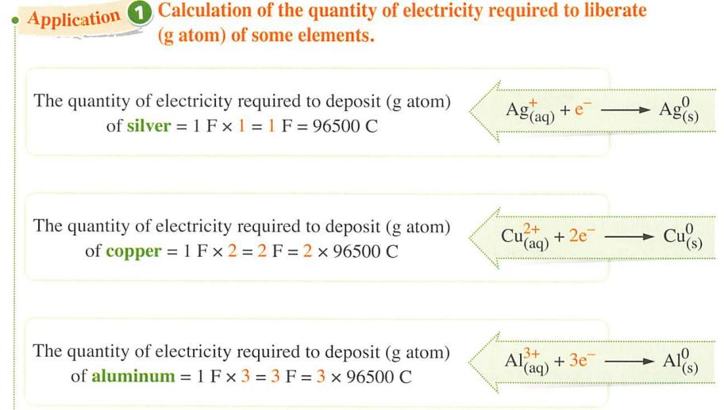
ELECTROLYSIS – EXAMPLES
① CuCl₂ (Copper Chloride)
Anode (+): 2Cl⁻ → Cl₂(g) + 2e⁻ [Oxidation]
Cathode (−): Cu²⁺ + 2e⁻ → Cu(s) [Reduction]
Overall: CuCl₂ → Cu(s) + Cl₂(g) | E° < 0 → Non-spontaneous
② Molten NaCl
Anode: 2Cl⁻ → Cl₂(g) + 2e⁻ | Cathode: 2Na⁺ + 2e⁻ → 2Na(l)
Products: Sodium metal (liquid) + Chlorine gas
③ NaCl Aqueous Solution
CONCENTRATED NaCl: (Cl⁻ conc. > OH⁻)
Cathode: 2H⁺ + 2e⁻ → H₂(g) | Anode: 2Cl⁻ → Cl₂(g) + 2e⁻
Products: H₂ + Cl₂ + NaOH | pH increases
DILUTE NaCl: (OH⁻ conc. > Cl⁻)
Cathode: 4H⁺ + 4e⁻ → 2H₂(g) | Anode: 4OH⁻ → O₂(g) + 2H₂O
Products: H₂ + O₂ | pH remains constant

Slide 18
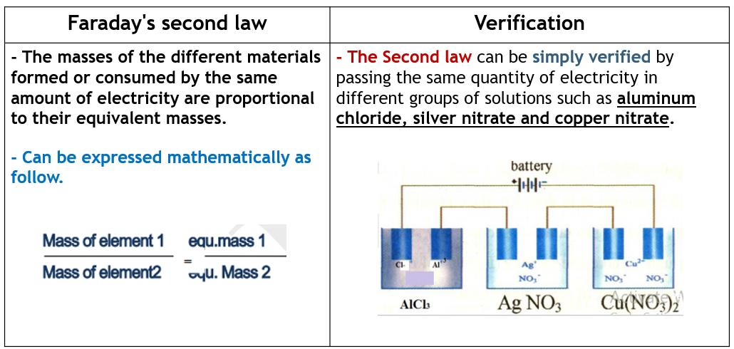
FARADAY'S LAWS OF ELECTROLYSIS
ELECTROLYSIS OF WATER:
Anode: 2H₂O → O₂ + 4H⁺ + 4e⁻ [Oxidation]
Cathode: 4H⁺ + 4e⁻ → 2H₂ [Reduction]
Overall: 2H₂O → 2H₂ + O₂ [Non-spontaneous → needs energy]
FARADAY'S FIRST LAW:
Mass deposited ∝ Charge passed → m ∝ Q = I × t
FARADAY'S SECOND LAW:
Equal charges → masses deposited ∝ equivalent weight (Mm / n)
KEY FORMULA:
Q = 96,500 × V × m / Mm
Q = charge (C) | V = valence | m = mass (g) | Mm = molar mass
F = Faraday's constant = 96,500 C/mol e⁻
Q = I × t (current × time)

Slide 19
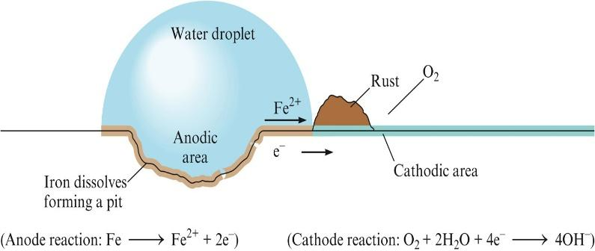
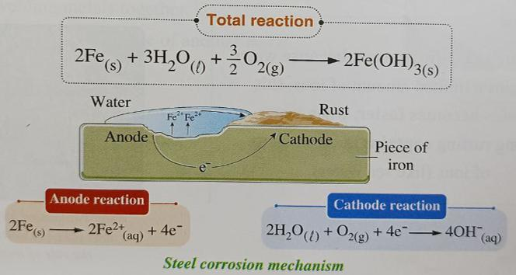
CORROSION – DEFINITION & PROCESS
DEFINITION: Gradual destruction of metals via chemical/electrochemical reactions with environment. Returns refined metals back to their natural stable state (oxides, hydroxides, sulfides).
IRON CORROSION – ELECTROCHEMICAL MECHANISM:
1. Exposure
Iron surface scratched/cracked; water + dissolved ions act as electrolyte
2. Anode Reaction
Fe → Fe²⁺ + 2e⁻ [Oxidation at crack/surface]
3. Cathode Reaction
O₂ + 2H₂O + 4e⁻ → 4OH⁻ [Reduction]
4. Precipitation
Fe²⁺ + 2OH⁻ → Fe(OH)₂ [White precipitate]
5. Further Oxidation
Fe(OH)₂ + ½O₂ + H₂O → Fe(OH)₃
6. Rust Formation
Rust = Fe₂O₃·nH₂O (reddish-brown hydrated iron oxide)
KEY FACTORS:
Moisture (essential electrolyte) | Salt (accelerates corrosion) | Dry air (NO rusting)
Impurities (create local galvanic cells) | Seawater (much faster than pure water)

Slide 20
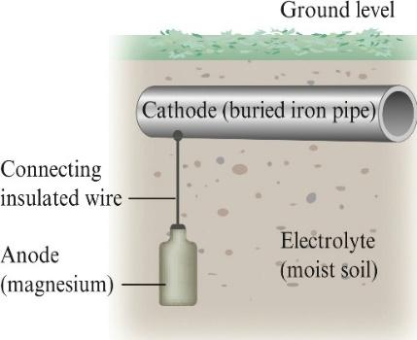
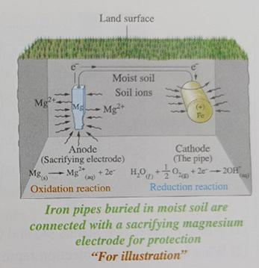
CORROSION PREVENTION METHODS
PAINTING / COATING
Organic/mineral coating creates barrier between metal and environment (short-term)
CATHODIC PROTECTION
Metal becomes CATHODE using less active coating (e.g., tin on iron cans). Active metal corrodes instead.
GALVANIZING (Anodic)
Dipping iron in molten zinc. Zinc = MORE ACTIVE metal (anode) protects base metal until consumed.
SACRIFICIAL ANODES
Attach highly active metal (Zn or Mg) to structure. Active metal corrodes, base metal protected. Applications: Buried pipes, ship hulls (Mg/Ti bars in seawater)
ALLOYING
Stainless steel (Fe + Cr + Ni) → Cr forms protective Cr₂O₃ oxide layer → behaves like noble metal

Slide 21
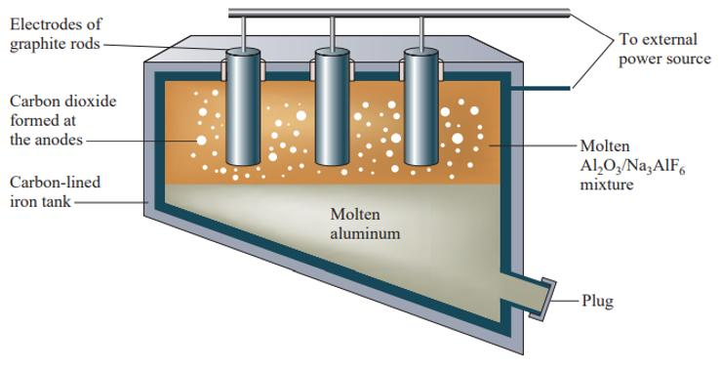
INDUSTRIAL APPLICATION: ALUMINUM PRODUCTION
HALL-HÉROULT PROCESS:
• Aluminum: 3rd most abundant element on Earth
• Found mainly as bauxite (Al₂O₃ – aluminum oxide)
• Problem: Alumina melts at 2050°C – impractical
• Solution: Cryolite (Na₃AlF₆) lowers melting point to ~1000°C
• Large electrolytic cells lined with carbon (anode material)
REACTIONS:
Cathode (−): AlF₃ + 3e⁻ → Al + 6F⁻
Anode (+): 2Al₂OF + 12F⁻ + 3C → 4AlF₃ + 3CO₂ + 4e⁻
Overall: 2Al₂O₃ + 3C → 4Al + 3CO₂
Output: 99.5% pure aluminum
Alloys: + Zinc → aircraft | + Manganese → utensils
Cost: Consumes ~5% of total US electricity
BAYER PROCESS (Alumina Purification):
① Al₂O₃ + 2OH⁻ → 2AlO₂⁻ + H₂O [Dissolution] → ② CO₂ + AlO₂⁻ + H₂O → Al₂O₃·nH₂O [Precipitation] → ③ Purified alumina + cryolite → Electrolysis → Al metal

Slide 22
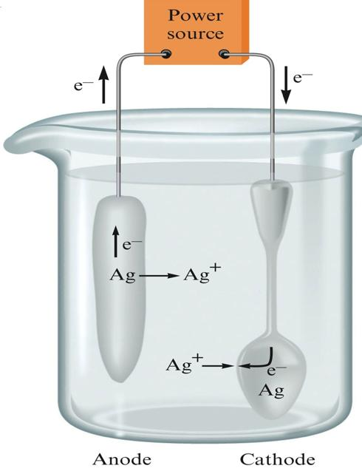
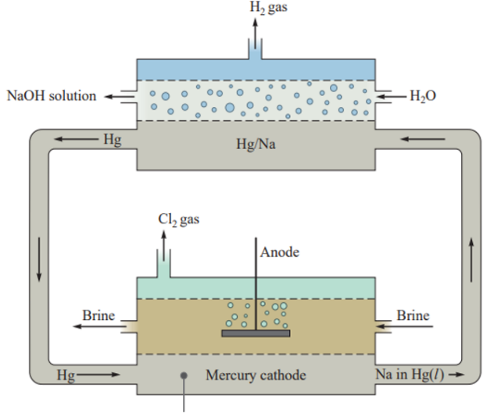
ELECTROPLATING & ELECTROREFINING
① ELECTROREFINING OF COPPER
Purpose: Purify impure copper to 99.95% purity
Anode: IMPURE copper slab (dissolves)
Cathode: PURE copper sheet (grows)
Electrolyte: CuSO₄ solution
Anode: Cu → Cu²⁺ + 2e⁻ | Fe → Fe²⁺ + 2e⁻ | Zn → Zn²⁺ + 2e⁻
Noble metals (Ag, Au) fall as sludge → recovered separately
Cathode: Cu²⁺ + 2e⁻ → Cu → 99.95% pure!
② ELECTROPLATING
Definition: Coating one metal onto another by electrolysis
Purpose: Decoration, corrosion resistance, conductivity
Setup: Anode = Metal to deposit | Cathode = Object to coat
Electrolyte = Solution of metal salt
Silver Plating Example:
Anode: Ag → Ag⁺ + e⁻ | Cathode: Ag⁺ + e⁻ → Ag
Applications: Jewelry, cutlery, electronics, anti-corrosion coatings

Slide 23
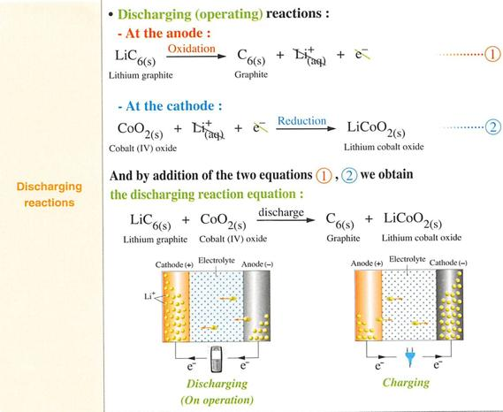
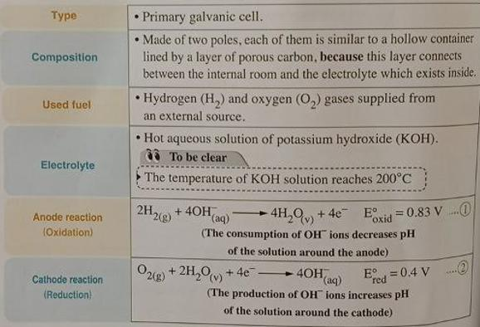
PRIMARY vs. SECONDARY CELLS
Feature
Primary Cell
Secondary Cell
Reversibility
Irreversible reaction
Reversible reaction
Rechargeable
NO ✗
YES ✓
Electrolyte
Paste or liquid
Usually liquid (H₂SO₄ / organic)
Usage
Single use only
Multiple recharge cycles
Examples
Dry cell, Mercury, Fuel cell
Lead-acid, Lithium-ion
Applications
Flashlights, remotes, watches
Cars, laptops, phones, EVs
Environment
Disposal issues (Hg toxicity)
Recyclable with proper handling

Slide 24
GALVANIC vs. ELECTROLYTIC CELLS – FULL COMPARISON
Feature
Galvanic Cell
Electrolytic Cell
Energy Conversion
Chemical → Electrical
Electrical → Chemical
Spontaneity
Spontaneous (E° > 0)
Non-spontaneous (E° < 0)
External Power
NOT required
REQUIRED
Anode Charge
Negative (−)
Positive (+)
Cathode Charge
Positive (+)
Negative (−)
Anode Reaction
Oxidation
Oxidation
Cathode Reaction
Reduction
Reduction
Ion Movement
Anions→anode | Cations→cathode
Same (Anions→anode | Cations→cathode)
Examples
Batteries, fuel cells
Electroplating, Al extraction, NaCl electrolysis
Key Equation
E°cell = E°cat − E°an
Faraday: m = QMm/(nF)

Slide 25
KEY FORMULAS & SUMMARY REFERENCE
EMF Formula
E°cell = E°cathode − E°anode
Free Energy
ΔG = −nFE°cell
Max Work
W_max = −nFE_cell
K & E°cell
E°cell = (0.0592 / n) × log K
Nernst (25°C)
E = E° − (0.0592/n) × log Q
Charge
Q = I × t
Faraday Mass
m = (Q × Mm) / (n × F)
Faraday Const.
F = 96,500 C/mol e⁻
SUMMARY
⚡ Galvanic Cell: SPONTANEOUS | Chemical → Electrical | Anode(−), Cathode(+) | E°cell > 0
🔌 Electrolytic Cell: NON-SPONTANEOUS | Electrical → Chemical | Anode(+), Cathode(−) | Needs power
⚗ Anode = OXIDATION (always) | ⚗ Cathode = REDUCTION (always)
📊 Positive E°cell → Spontaneous | Negative E°cell → Non-spontaneous | F = 96,500 C/mol
🔋 Primary = Non-rechargeable | Secondary = Rechargeable | Corrosion = Electrochemical process

