Slide 1
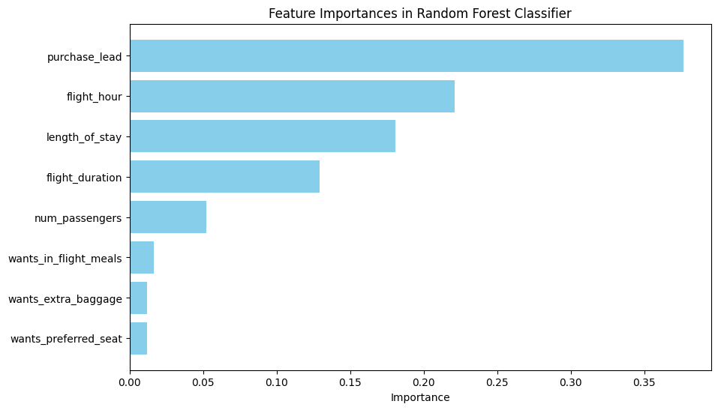
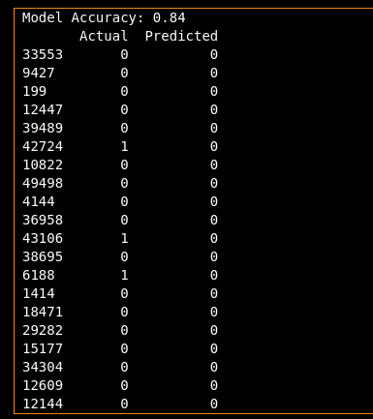
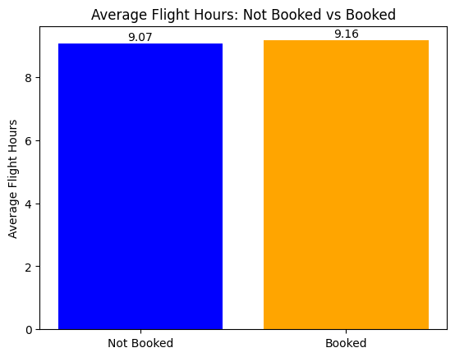
Task 2 Findings
Purchase lead was the most influential feature followed by flight hours. From the figure below, we observe a slight difference in the average flight hours between bookings that were completed and those that were not. Specifically, the average flight duration for confirmed bookings is approximately 9.16 hours, while for unconfirmed bookings it is about 9.07 hours. This suggests that customers who complete their bookings tend to prefer slightly longer flights.
One possible explanation for this trend is that longer flights may be associated with more significant travel plans, such as international trips or vacations, where customers are more committed to finalizing their bookings. Additionally, longer flights often offer more amenities and comfort, which could be particularly appealing to higher-tier customers, such as business or first-class passengers. These travellers may be more likely to complete their bookings to take advantage of these benefits.
The model achieved an accuracy of 0.84, which indicates strong overall performance in predicting confirmed bookings. This means that the model correctly classified approximately 84% of the test data, showing that it was able to identify most booking outcomes effectively.
We used a Random Forest Classifier to build the model, as it combines multiple decision trees to improve prediction accuracy and reduce the risk of overfitting. This ensemble approach allows the model to capture complex relationships in the data while maintaining robustness across different samples.
To evaluate the model’s performance, we used the accuracy score function from scikit-learn, which compares the model’s predictions with the actual outcomes in the test set. While accuracy alone gives a strong indication of success, further metrics such as precision, recall, and the confusion matrix could provide deeper insights into how the model performs on different booking categories or classes.

