Slide 1
Tutorial 3: Quasielastic Neutron Scattering (QENS)
Chi Y. Cheng, Maciej Bartkowiak, Sanghamitra Mukhopadhyay
MDANSE Workshop 2026
04/11/2026

Slide 2



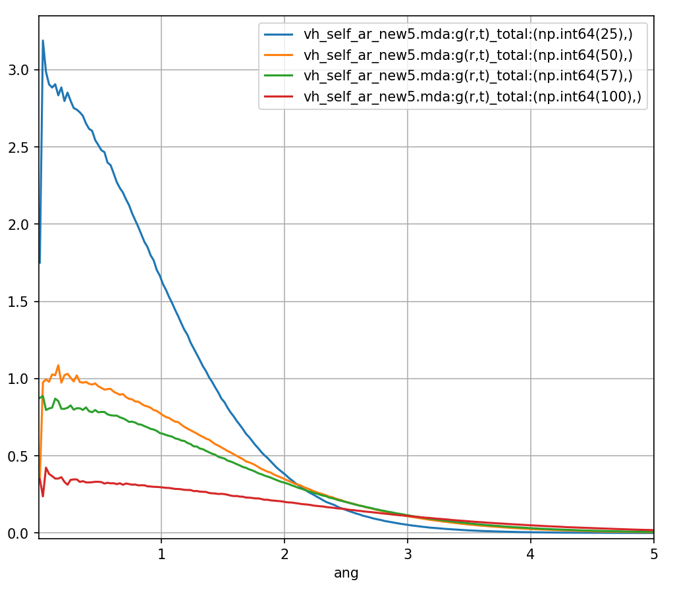
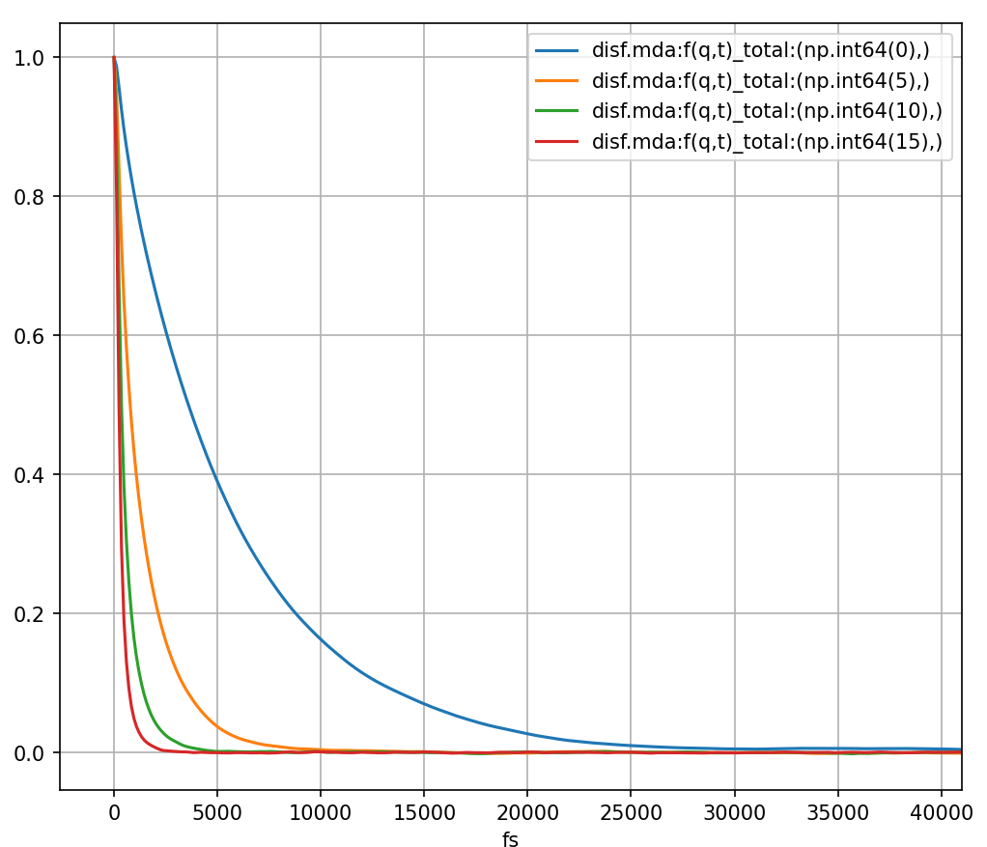
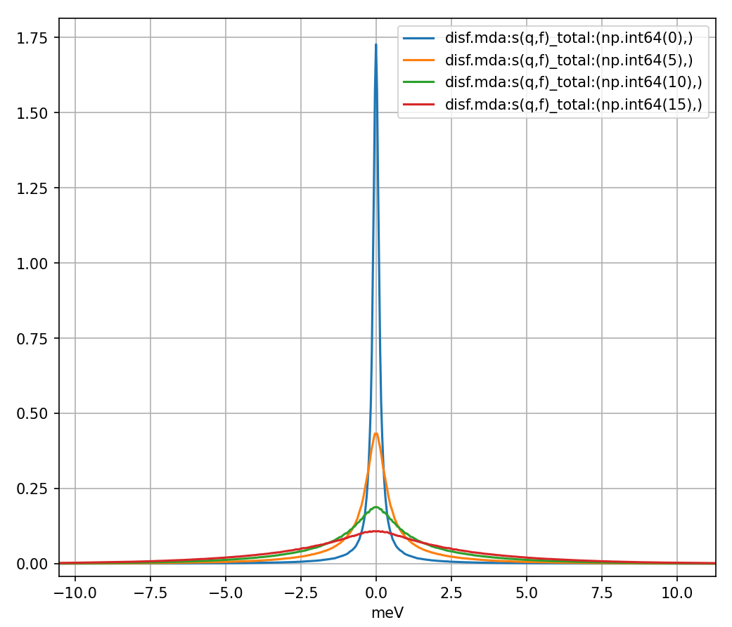
Tutorial 3: Quasielastic Neutron Scattering (QENS)
The van Hove function (and therefore the PDF) are closely related to the dynamics structure factor via Fourier transforms. Here we show the self-part and its Fourier transforms.

Slide 3
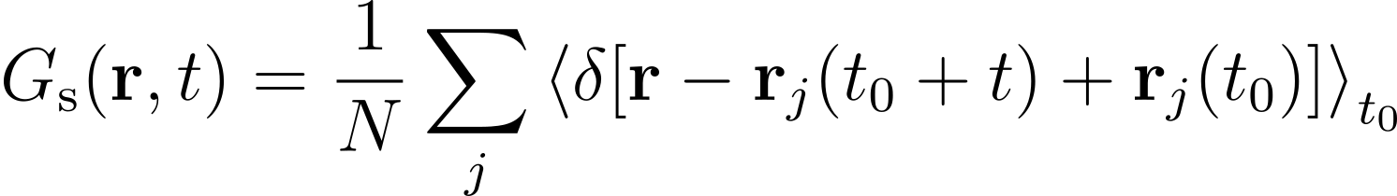
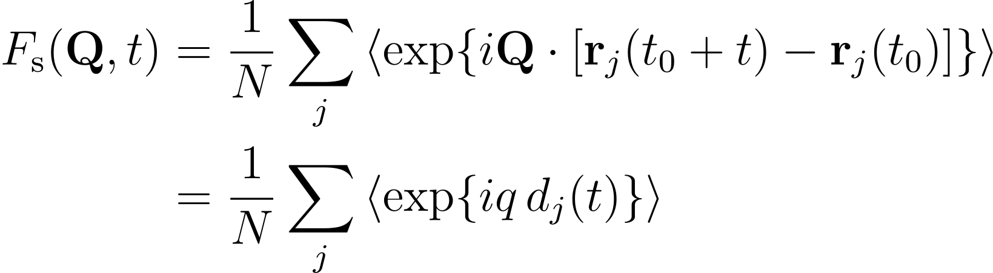
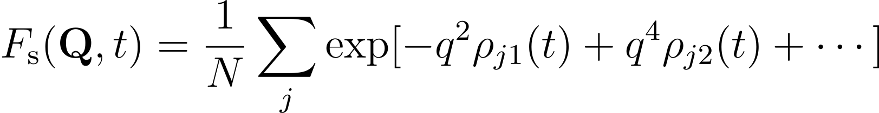
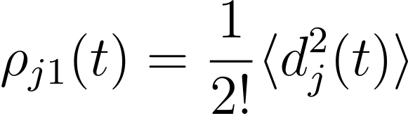
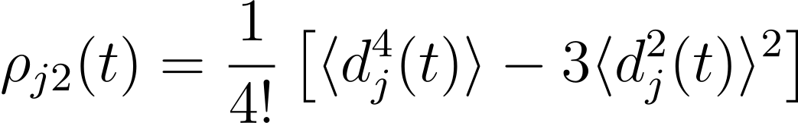
Tutorial 3: Quasielastic Neutron Scattering (QENS)
From the previous slides, we can see that the self-part of the van Hove function (and therefore the self intermediate scattering function and the incoherent scattering) is closely related to the diffusion of a particle.
We can rewrite the self intermediate scattering function as the exponential of a power-series in terms of the cumulants of d(t).

Slide 4
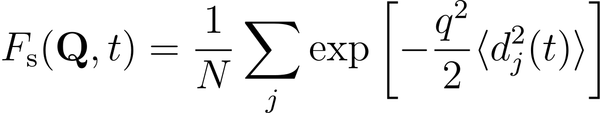
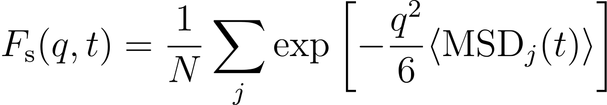

Self Intermediate Scattering Function
Taking the leading term, the self intermediate scattering function is simply a Gaussian, this is known as the Gaussian approximation.
When the system is isotropic, <d^2(t)> is related the MSD of the particle.
The MSD of a particle is related to the to the diffusion constant via MSD = 6D|t|. Here I drop the summation as I assume a monoatomic system.

Slide 5
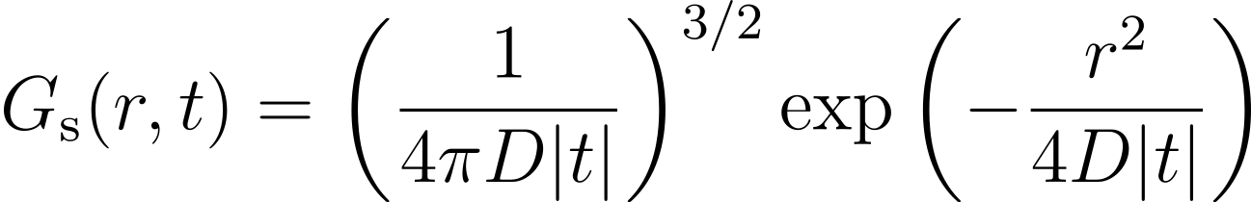
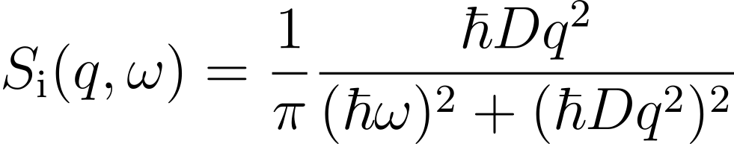
Van Hove Function (relation to diffusion)
For an isotropic system which follows the Gaussian approximation, we can see that van Hove function simply depends on the diffusion constant of the system.

Slide 6
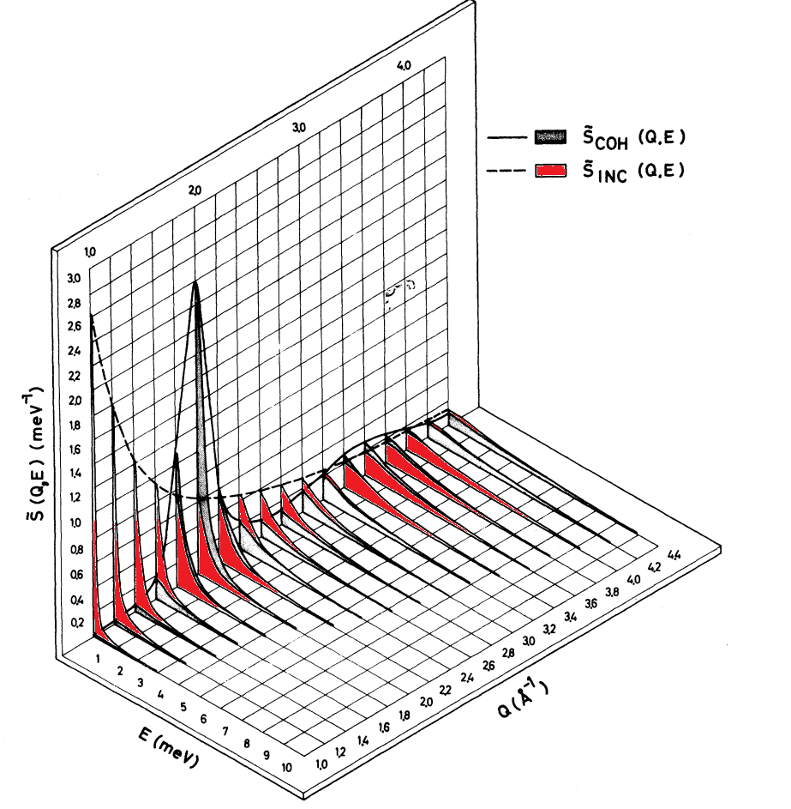
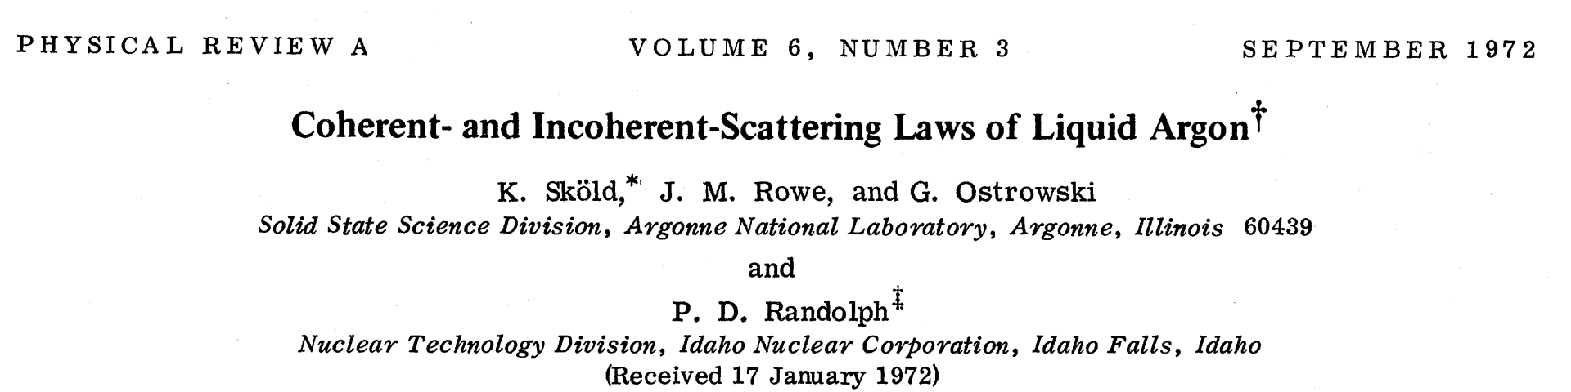
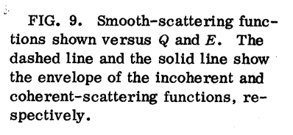
Tutorial 3: Quasielastic Neutron Scattering (QENS)
Elastically scattered neutron have the same energy before and after scattering. This leads to a sharp peak at ω=0.
Quasielastic scattering is a special case of inelastic scattering and leads to a broad peak around ω=0. QENS that can be used to determine diffusion constant of liquids and solids.
We'll be looking at a paper by Sköld et al.
Phys. Rev. A 6, 1107 – 1972
DOI: https://doi.org/10.1103/PhysRevA.6.1107

Slide 7
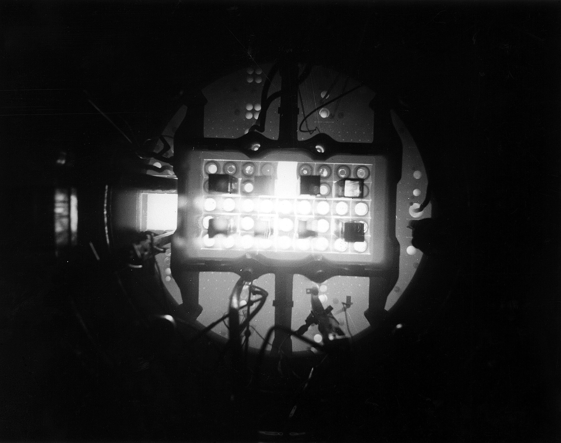
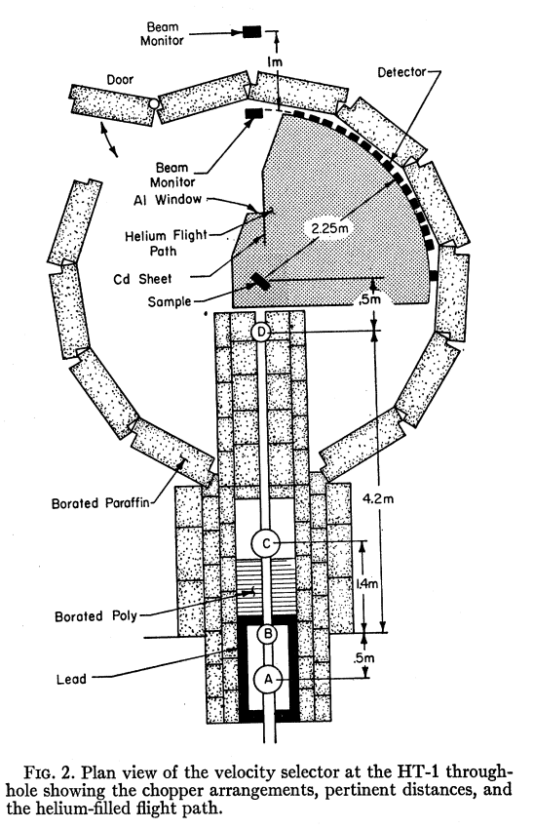
Tutorial 3: Quasielastic Neutron Scattering (QENS)
Image: View down through 20 feet of water into the tank of Materials Testing Reactor 1955
In this paper, neutrons were obtained from a reactor source (Materials Testing Reactor - Idaho National Laboratory – decommissioned 2011).
Experimental setup:
• Neutron instrument with a velocity selector (chopper-based)
• Time of flight inelastic instrument using thermal neutrons

Slide 8
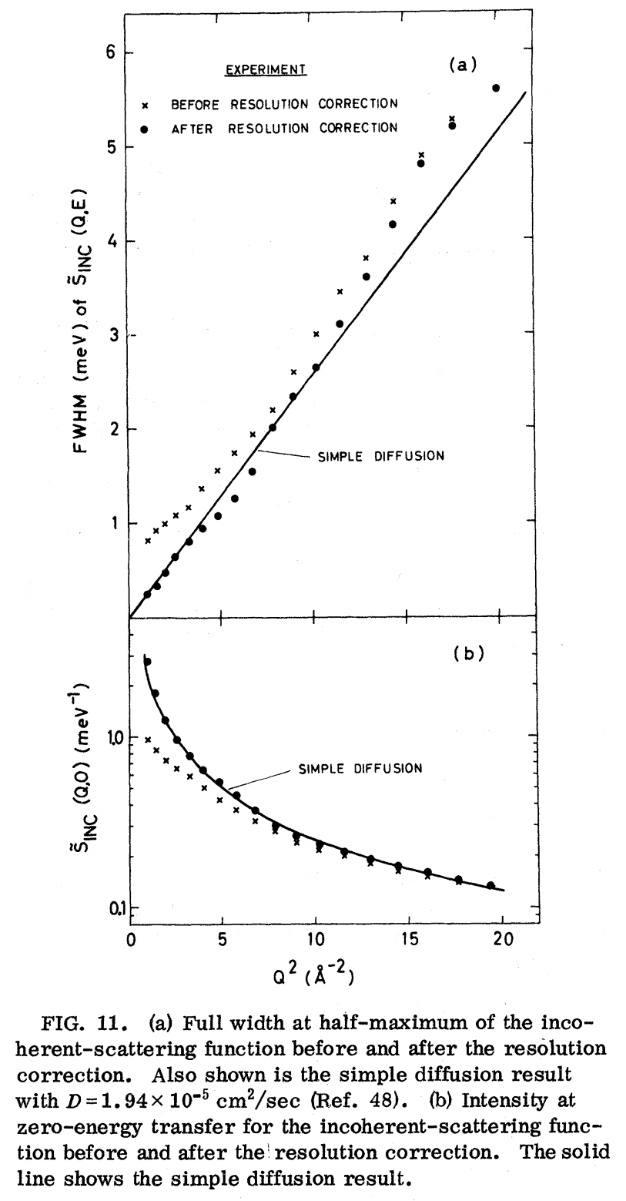
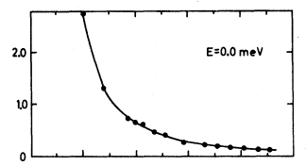

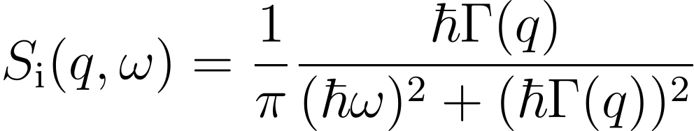

Tutorial 3: Quasielastic Neutron Scattering (QENS)
The QENS peak is a Lorentz function.
By measuring the half-width at half-maximum of the QENS peak for a number of values of q the diffusion constant (D) of the system can be determined.

Slide 9
Tutorial 3: Quasielastic Neutron Scattering (QENS)
Let's calculate the QENS peaks and determine the diffusion constant from it following the paper from Sköld et at.
Load up the Argon MDT trajectory ar36_120fs_8_f64.mdt.
First, we will save the scattering parameters as an instrument profile.
Then, we will calculate the Dynamic Incoherent Structure Factor (DISF) and determine the diffusion constant by fitting the results.

Slide 10
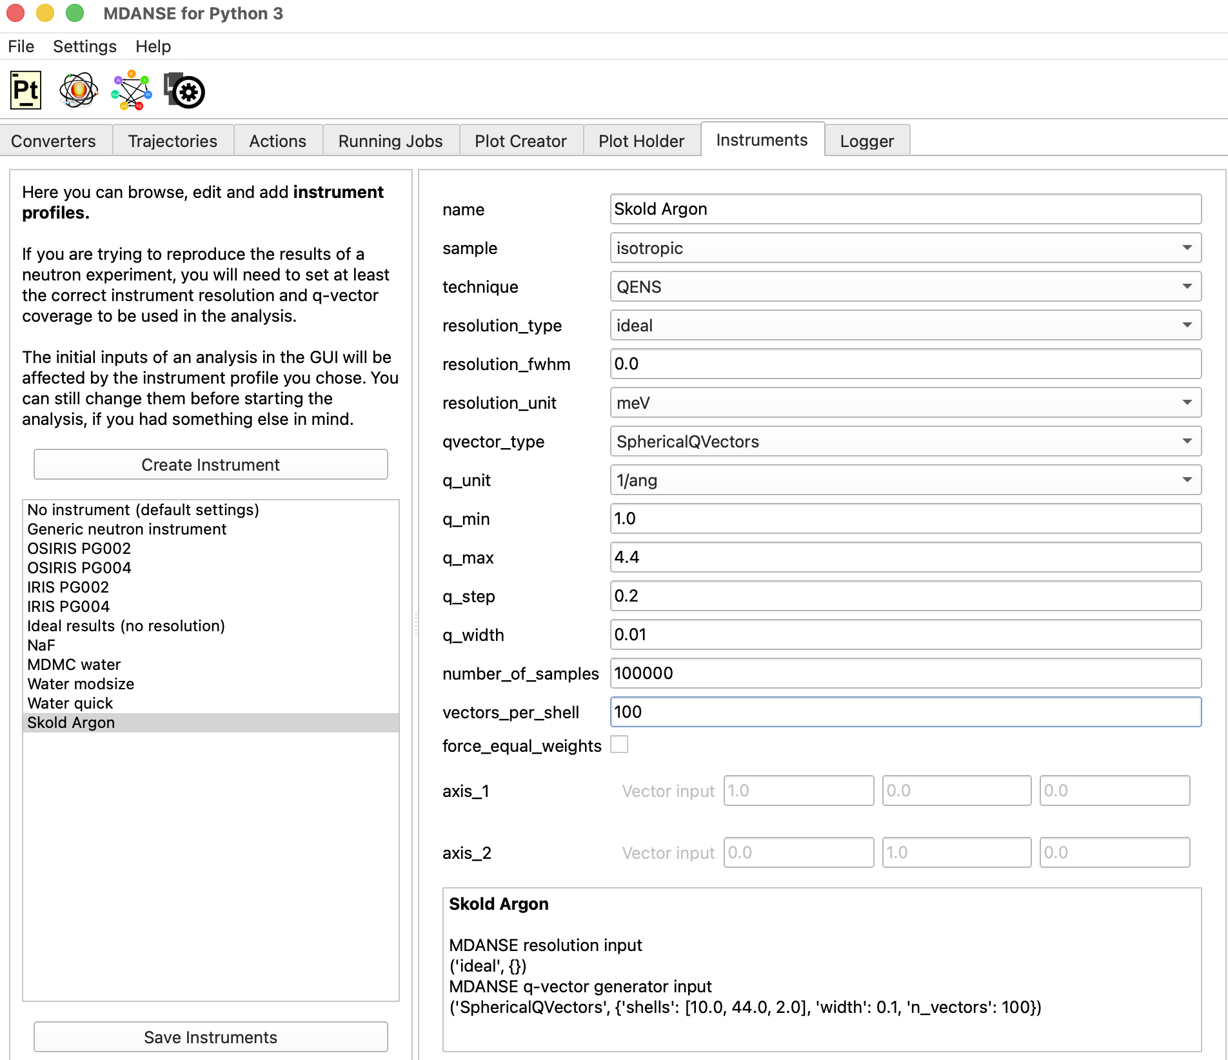
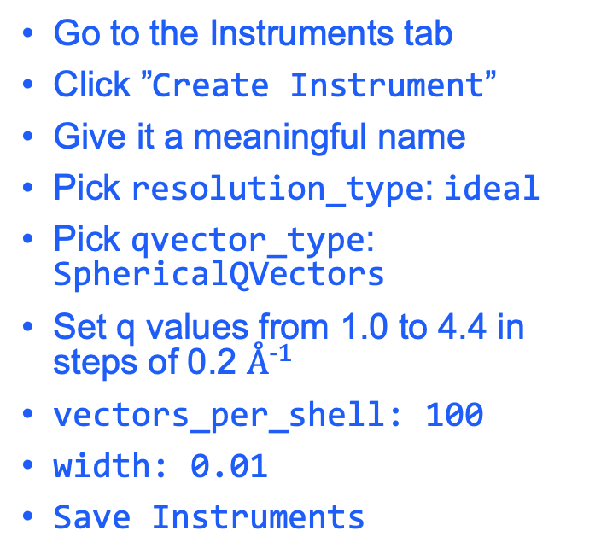
Tutorial 3: Save your scattering parameters
Go to the Instruments tab
Click ”Create Instrument”
Give it a meaningful name
Pick resolution_type: ideal
Pick qvector_type: SphericalQVectors
Set q values from 1.0 to 4.4 in steps of 0.2 $Å^{−1}$
vectors_per_shell: 100
width: 0.01
Save Instruments

Slide 11
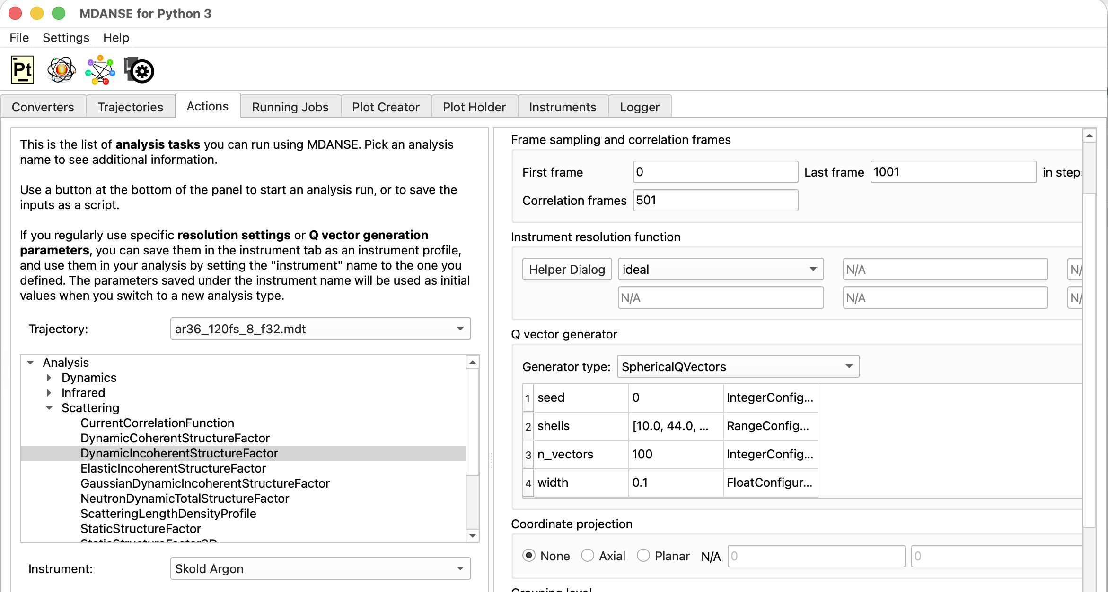
Tutorial 3: Quasielastic Neutron Scattering (QENS)
Go to the Actions tab.
Set the instrument to the one you just created.
Choose:
Analysis ->
Scattering ->
DynamicIncoherent
StructureFactor

Slide 12
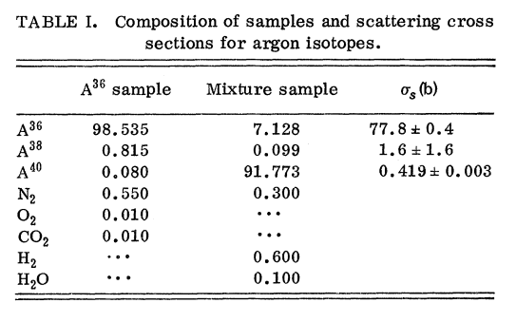
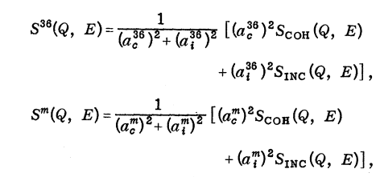
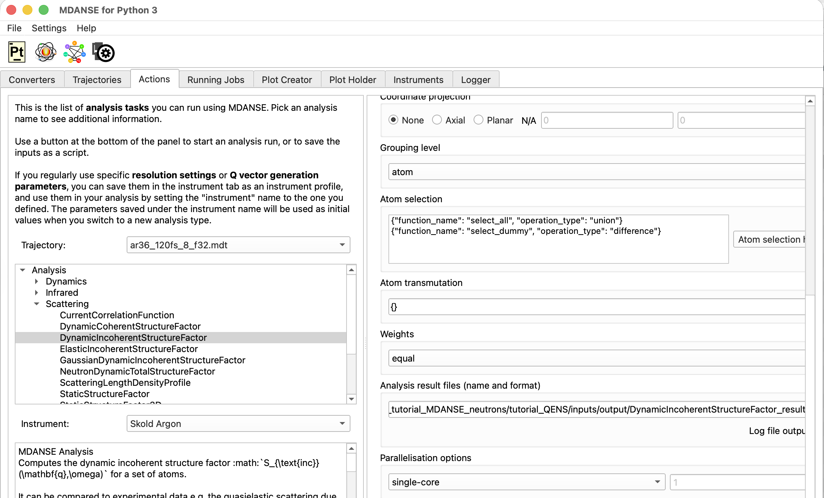
Tutorial 3: Quasielastic Neutron Scattering (QENS)
Set the weight to equal.
Our trajectory is pure Ar36 which does not scatter incoherently – we set equal to get an unweighted S_inc(q,f).
Experimentally Sköld et al. obtained S_inc(q,f) by running scattering experiments on two different Argon samples and solving for S_inc(q,f).

Slide 13
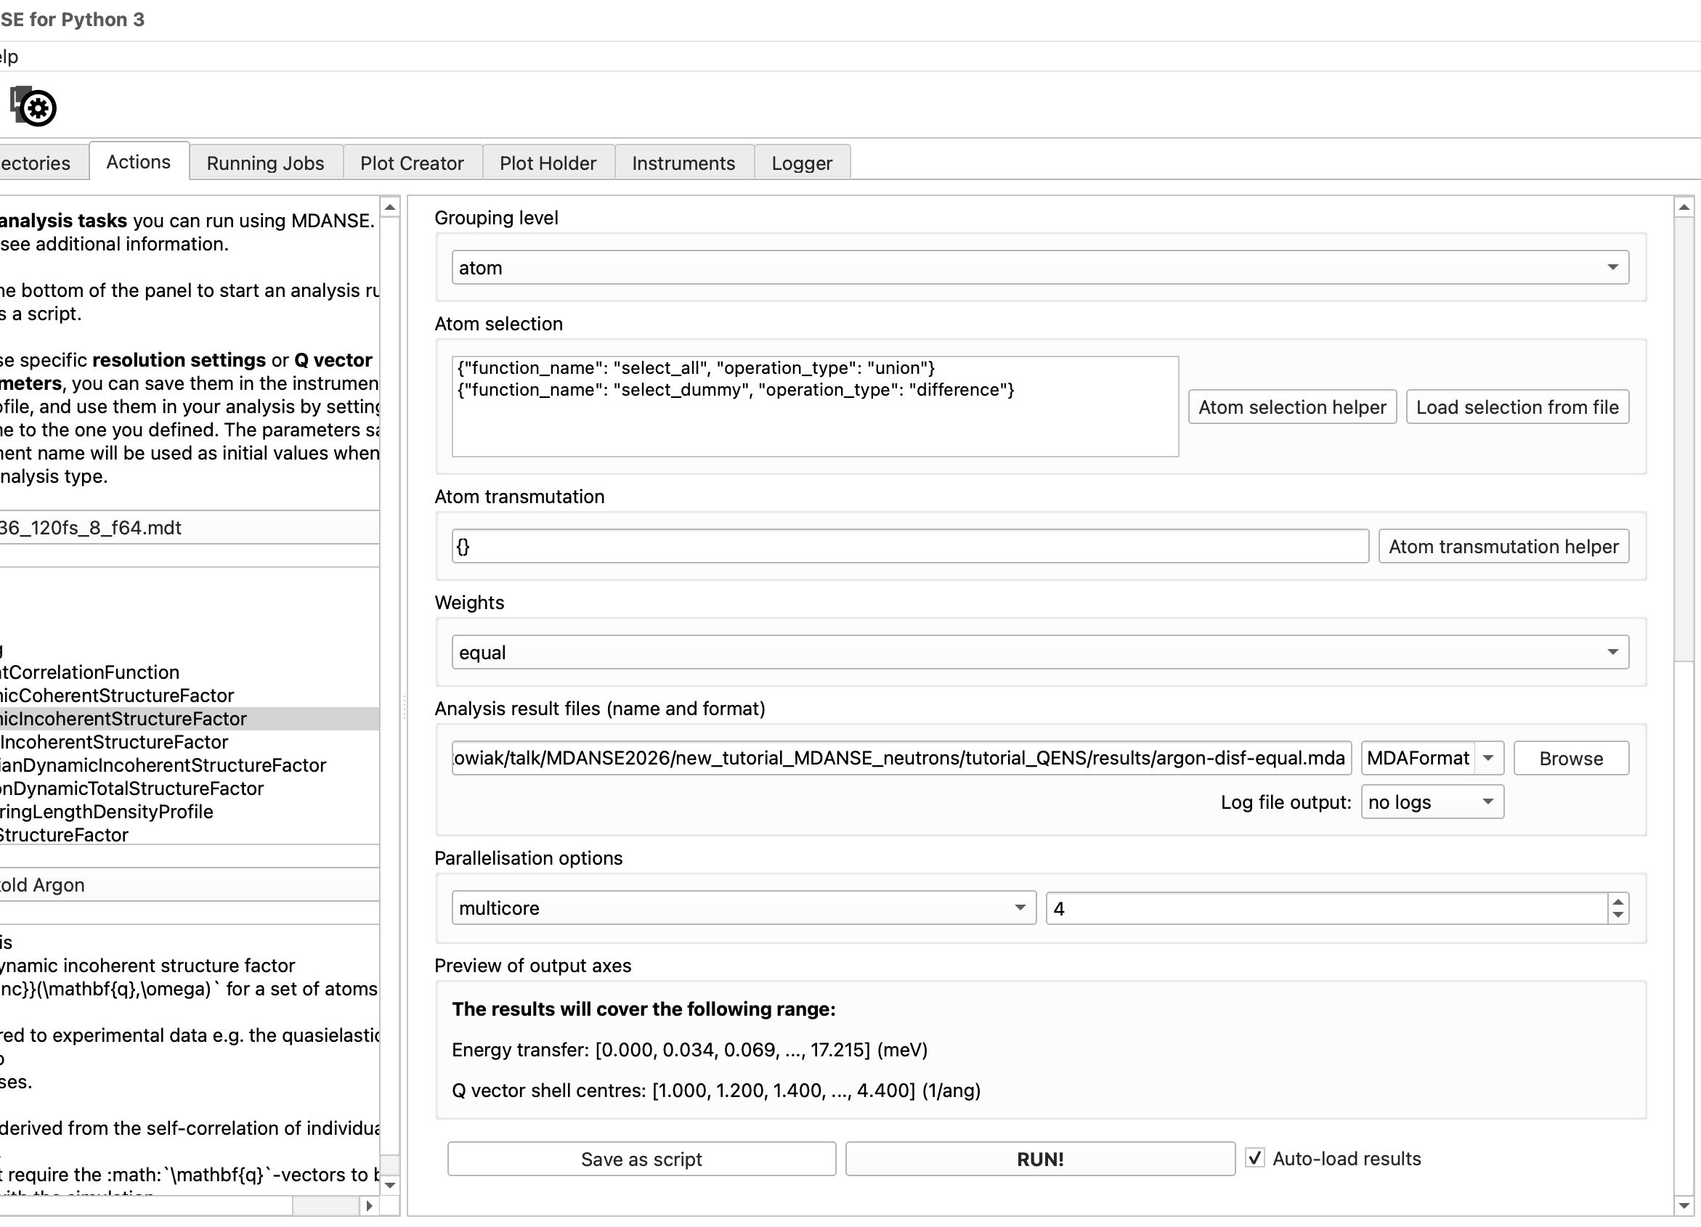
Tutorial 3: Quasielastic Neutron Scattering (QENS)
Set the output file, set multicore with 2 or more cores and hit “RUN!”
Check the “Running Jobs” tab - this should take less than 3 minutes.

Slide 14
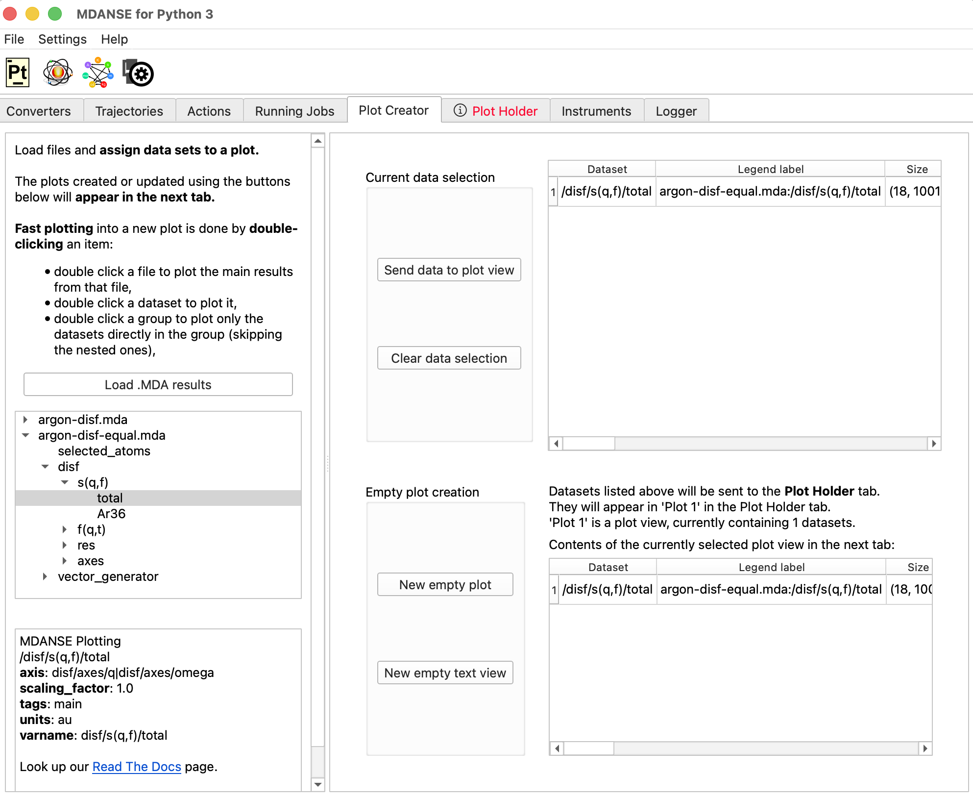
Tutorial 3: Quasielastic Neutron Scattering (QENS)
Once complete, go to the Plot Creator and create a plot of S(q,f)_total.

Slide 15
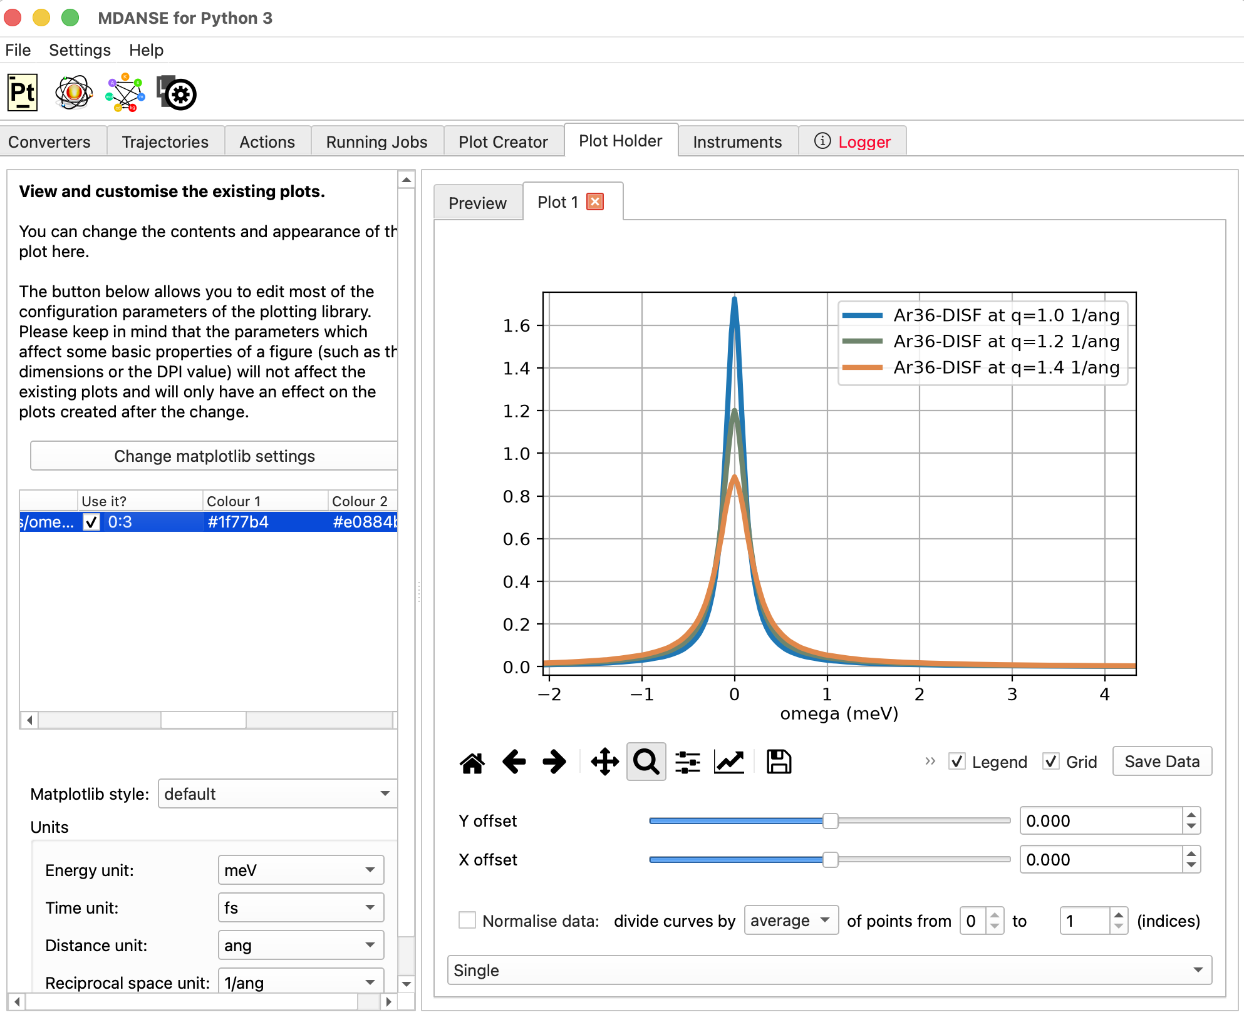
Tutorial 3: Quasielastic Neutron Scattering (QENS)
Using your cursor determine the half width at half maximum for each plot.
The first plot is |Q|=1.0 Å⁻¹, the next is |Q|=1.2 Å⁻¹, and etc.
You can enter a number:
4
or a range:
0:3
in the "Use it?" column to select curves corresponding to specific q_vector magnitudes.

Slide 16
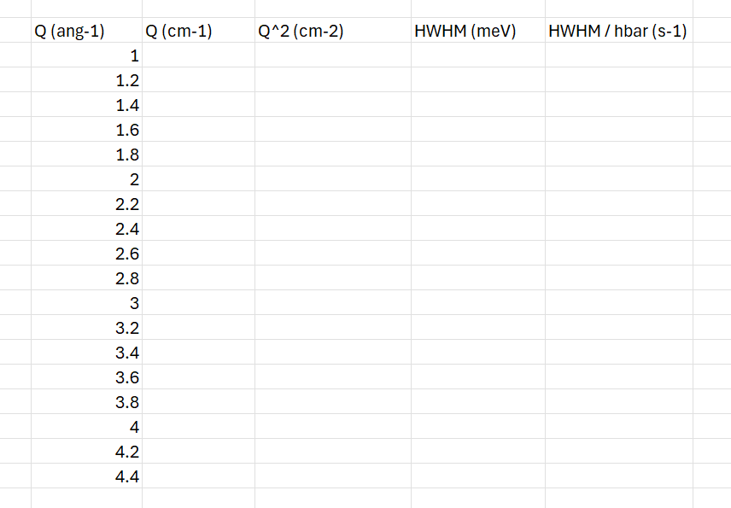
Tutorial 3: Quasielastic Neutron Scattering (QENS)
Using a spreadsheet to create a plot to determine the diffusions constant.
HINT: see FIG. 11 in the paper by Sköld et al.

Slide 17
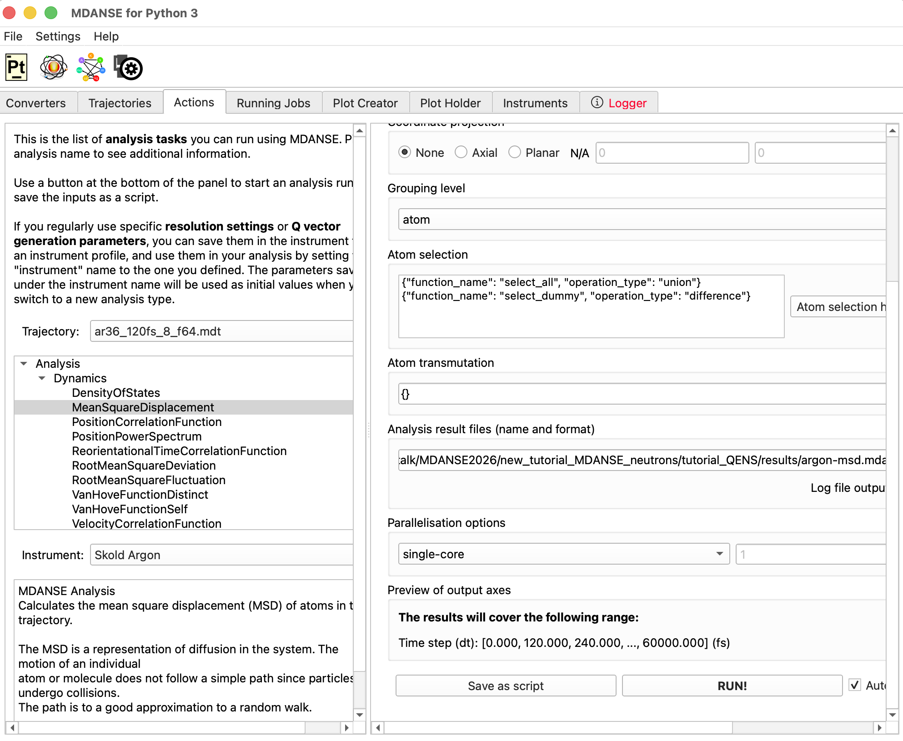
Tutorial 3: Quasielastic Neutron Scattering (QENS)
Now let's calculate the diffusion constant directly from the mean square displacement and compare results.
Using the ar36_120fs_8_f64.mdt run the mean square displacement calculation.
Default settings are fine. Just set the output path and run it

Slide 18
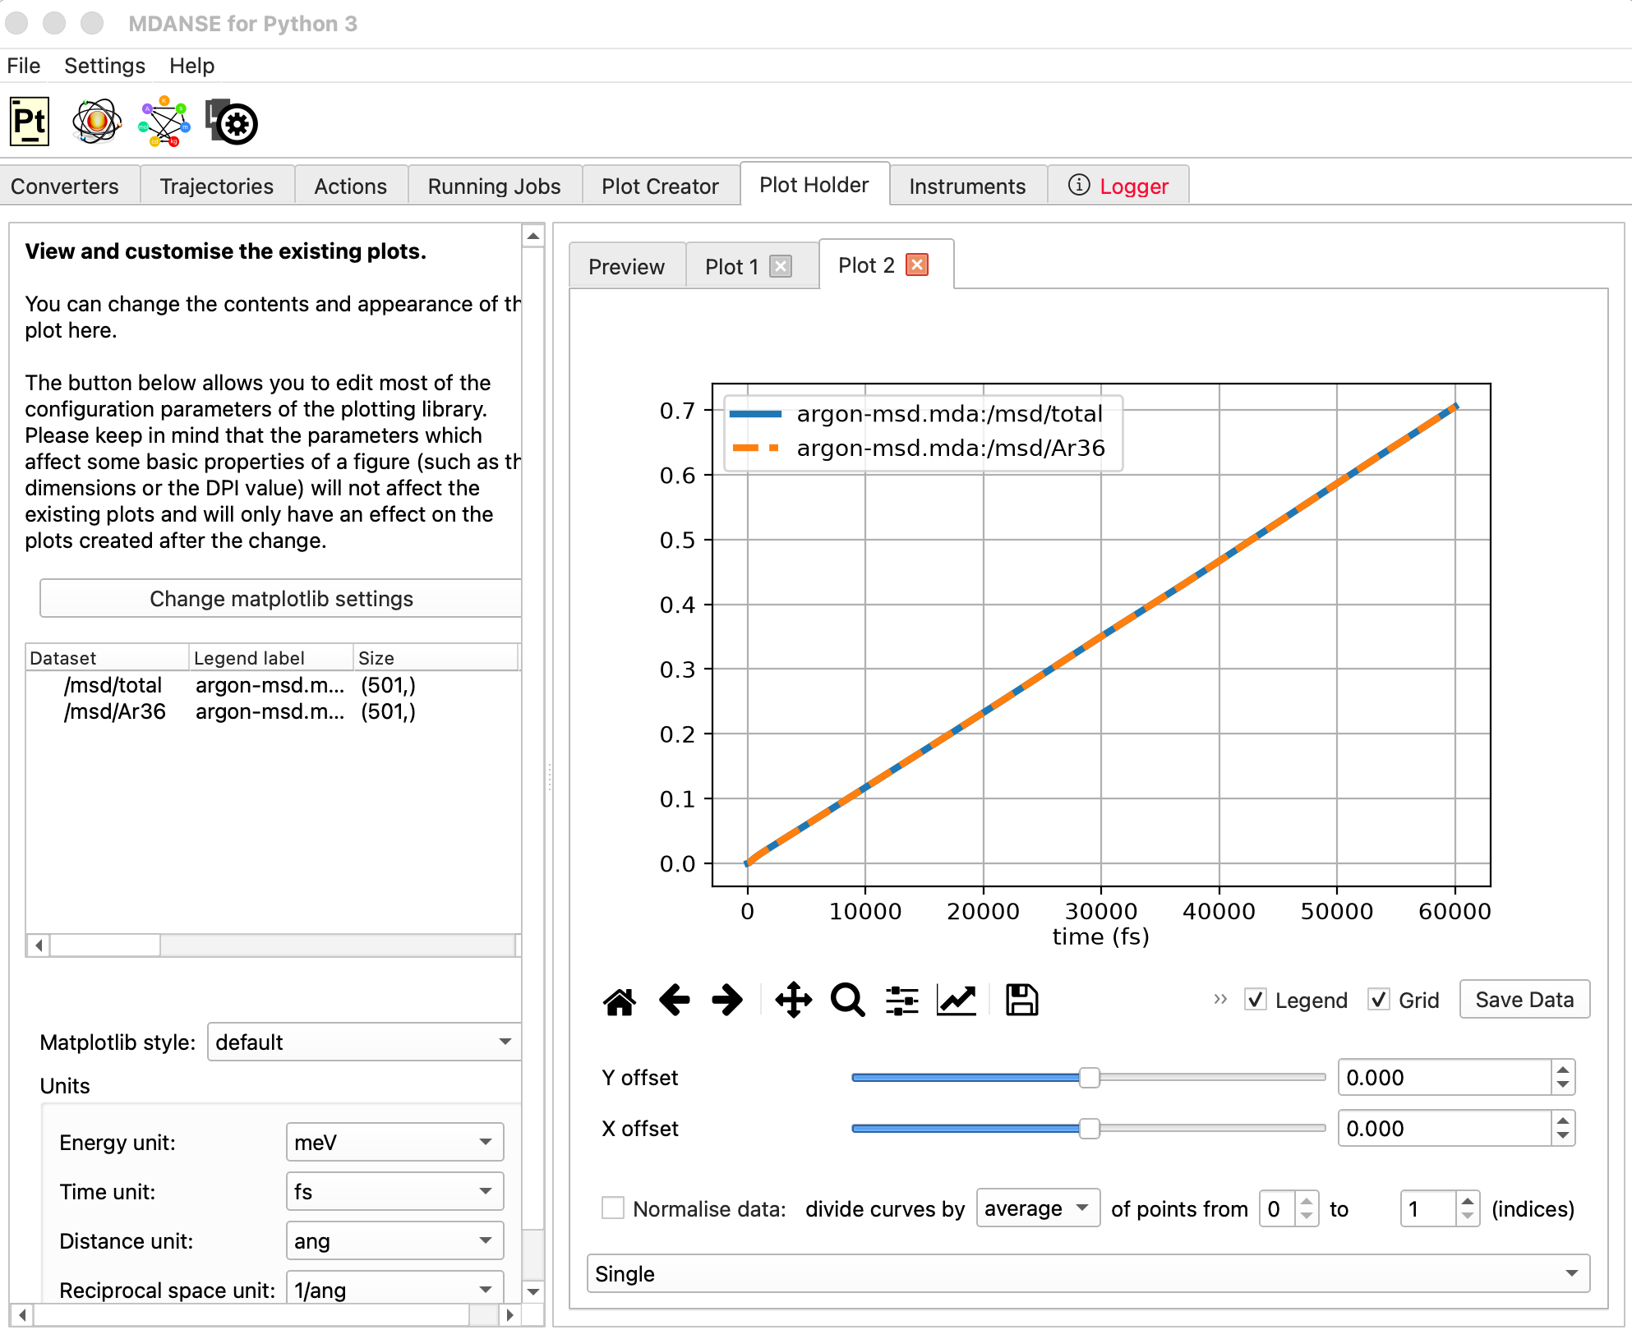
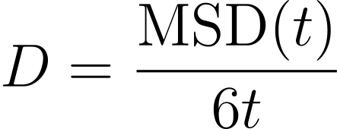
Tutorial 3: Quasielastic Neutron Scattering (QENS)
The Argon MSD is essentially linear for long times, we can calculate the diffusion constant with.
Calculate the diffusion constant using the last time step t=60000 fs.
Did your results from QENS and MSD agree with the experimental?

