Slide 1
MDANSE for neutron scattering analysis
Maciej Bartkowiak, Chi Y. Cheng, Sanghamitra Mukhopadhyay
MDANSE Workshop 2026
03/11/2026

Slide 2
Presentation plan
Applications of molecular dynamics to neutron scattering techniques.
Simulation time and experiment energy.
Dynamic structure factor (coherent and incoherent).
Q-vector sampling.
Examples of neutron instrument resolution.
Neutron scattering length in static structure factor calculations.

Slide 3
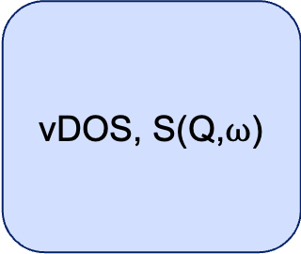
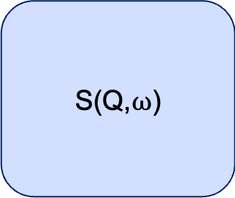
Which neutron scattering techniques can benefit from MD?
Diffraction
Reflectometry
Inelastic Neutron Scattering
(INS)
Small Angle Neutron Scattering (SANS)
Quasielastic Neutron Scattering (QENS)
Diffuse scattering
Time-averaged scattering length density profile
vDOS, S(Q,$ω$)
S(Q), but you may need a large simulation
S(Q,$ω$)

Slide 4
Do you really need MD?
Diffraction
Reflectometry
Inelastic Neutron Scattering
(INS)
Small Angle Neutron Scattering (SANS)
Quasielastic Neutron Scattering (QENS)
Use average structure and thermal factors
You can model a scattering length density profile
For many systems you have: AbINS, Euphonic, SpinW
SasView, SASfit, etc. can model your system with fewer parameters
Very likely, yes.

Slide 5
Molecular Dynamics: the boundary conditions
There are limits of what you can get from a specific MD trajectory.
Time limits:
Step size
Total number of steps
Space limits:
- Size of the simulation box (assuming there is one)

Slide 6
Molecular Dynamics: the boundary conditions
Time step vs. vibrational frequencies
Time limits:
Step size
At the limit
Enough
Not enough

Slide 7
Molecular Dynamics: the boundary conditions
Time step defines the maximum energy you can access.
Time limits:
Step size
At the limit
Enough
Not enough

Slide 8
Molecular Dynamics: the boundary conditions
What about the total number of steps?
Time limits:
Step size
Number of steps

Slide 9
Molecular Dynamics: the boundary conditions
Time limits:
Step size
Number of steps

Slide 10
Molecular Dynamics: the boundary conditions
Adding more steps improves the sampling of the energy axis.
Time limits:
Step size
Number of steps

Slide 11
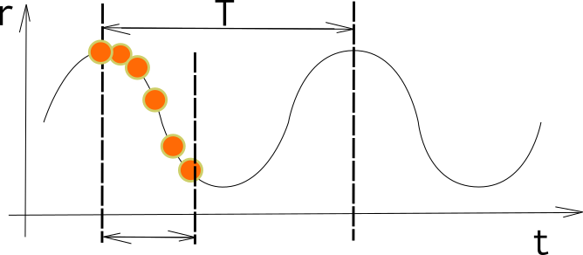
Molecular Dynamics: the boundary conditions
Slow oscillations:
Try to cover one full period or more.

Slide 12
Molecular Dynamics: the boundary conditions
The time axis of the trajectory defines the time axis of the result.
Examples:
5 fs step x 100 frames = 500 fs total time => up to 412 meV in 4.1 meV steps
10 fs step x 50 frames = 500 fs total time => up to 206 meV in 4.1 meV steps
5 fs step x 10000 frames = 50 ps total time => up to 412 meV in 0.041 meV steps
1 ps step x 50 frames = 50 ps total time => up to 2.05 meV in 0.041 meV steps

Slide 13
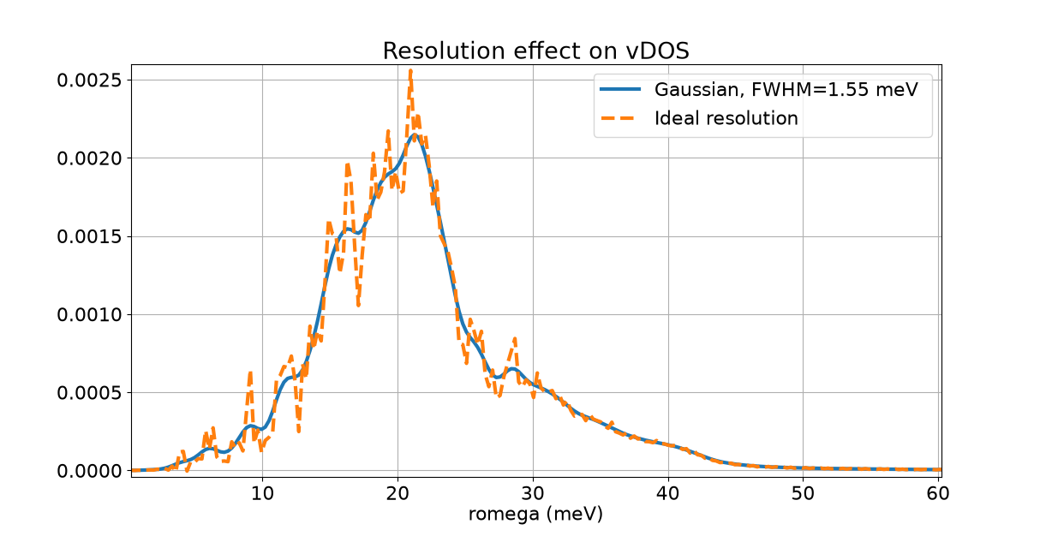
Energy resolution

Slide 14
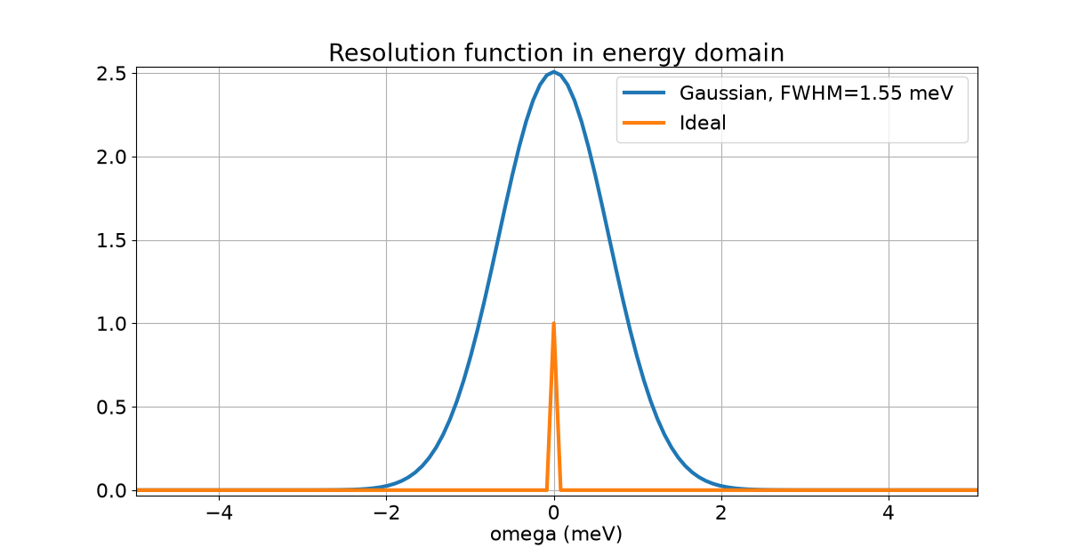
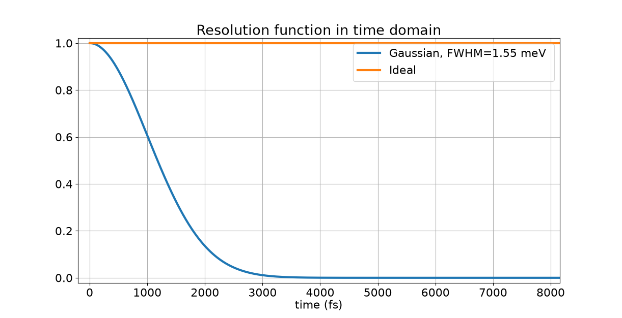
Energy resolution as a time window

Slide 15
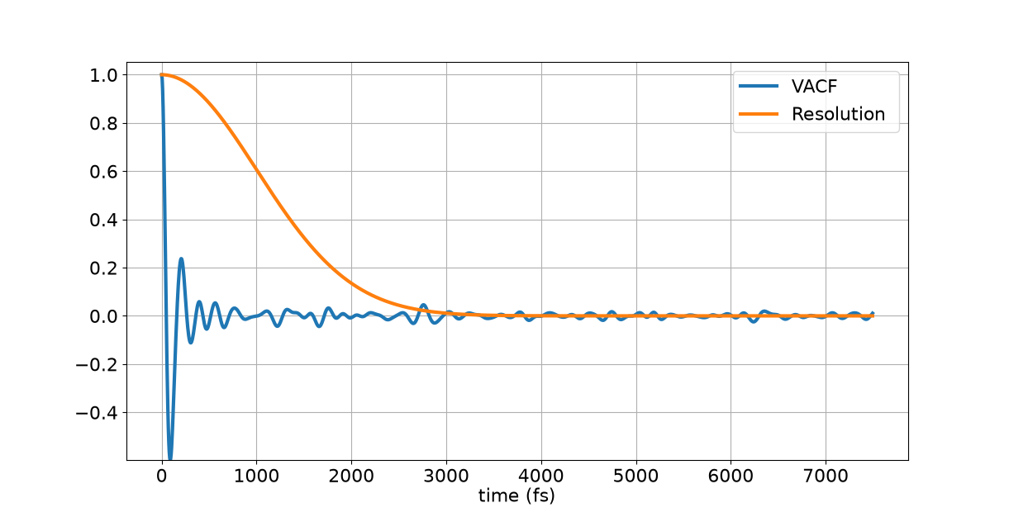
Energy resolution as a time window

Slide 16
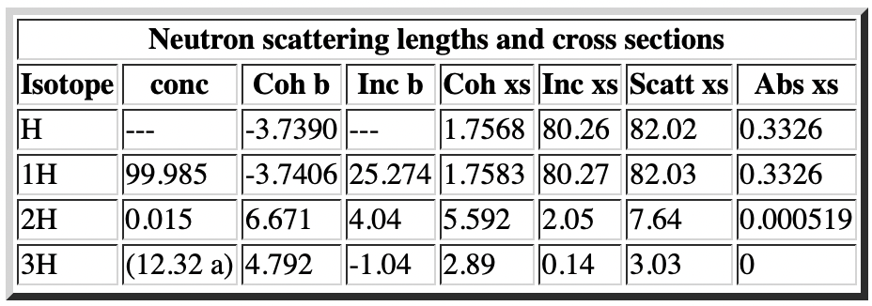
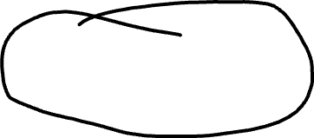
Neutrons: how are neutron results different?
https://www.ncnr.nist.gov/resources/n-lengths/
We will talk more about coherent and incoherent scattering lengths in the tutorials on Wednesday.
Neutron scattering lengths can be used as weights when combining partial calculation results.

Slide 17

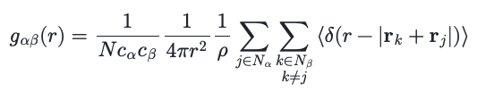
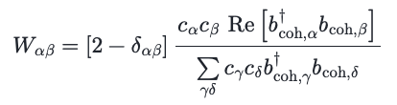
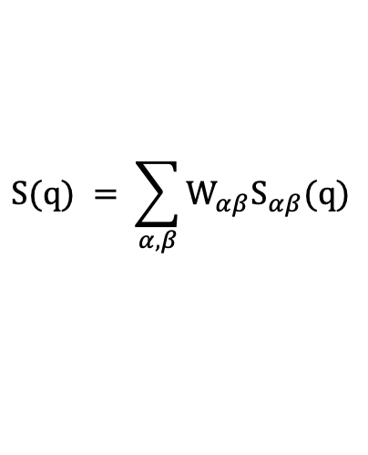
Neutrons: isotopes and contrast matching
MDANSE calculates Static Structure Factor as:
This is where scattering lengths become part of the calculation.
$$S(q) = \sum_{α,β}{W_{αβ}S_{αβ}(q)}$$

Slide 18
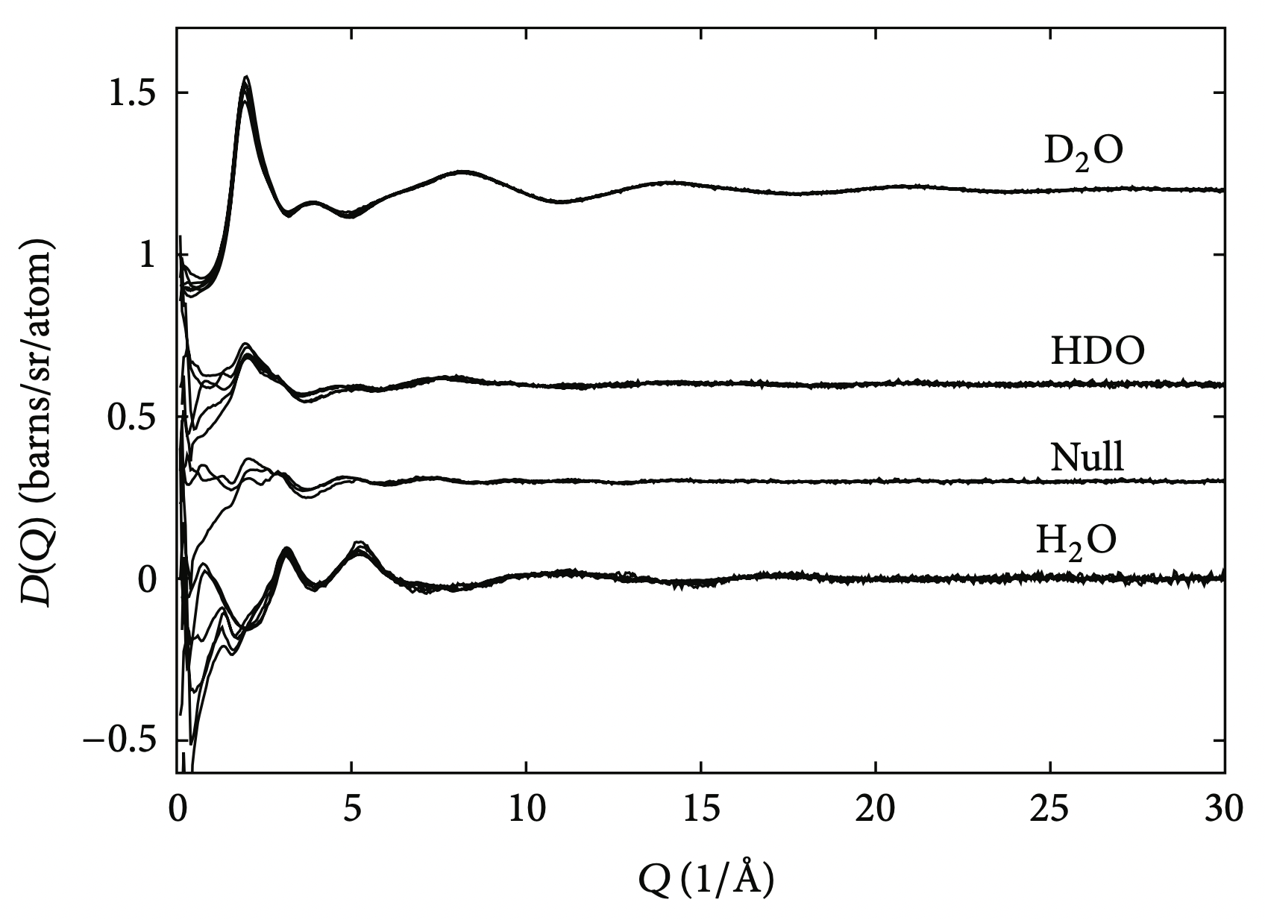
Neutrons: isotopes and contrast matching
The Radial Distribution Functions of Water as Derived from Radiation Total Scattering Experiments:
Is There Anything We Can Say for Sure?
A. K. Soper
http://dx.doi.org/10.1155/2013/279463

Slide 19
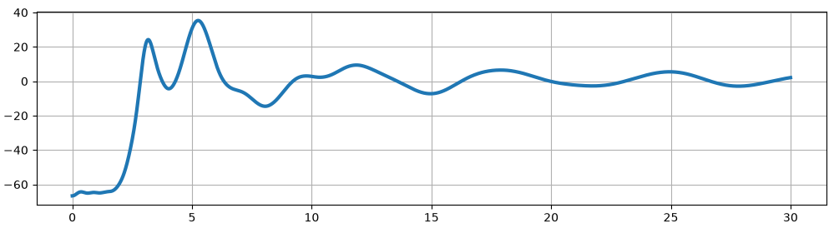
Neutrons: isotopes and contrast matching
Static structure factor.
Coherent scattering length is the weight in the calculation.
Isotopically normal water.

Slide 20
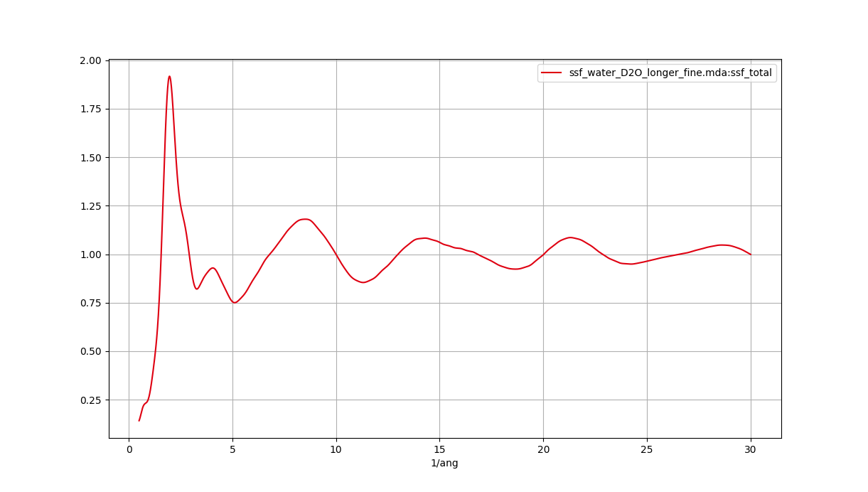
Neutrons: isotopes and contrast matching
Static structure factor.
Coherent scattering length is the weight in the calculation.
Fully deuterated water.

Slide 21
QENS: Dynamic Structure Factor
Typically, we calculate two components of the Dynamic Structure Factor:
Dynamic Incoherent Structure Factor
proportional to the incoherent scattering cross section of contributing atoms,
calculated from correlations of individual atom positions over time.
2. Dynamic Coherent Structure Factor
proportional to the coherent scattering cross section of contributing atoms,
calculated from correlations between different atoms over time,
calculation on vectors commensurate with the reciprocal unit cell.

Slide 22

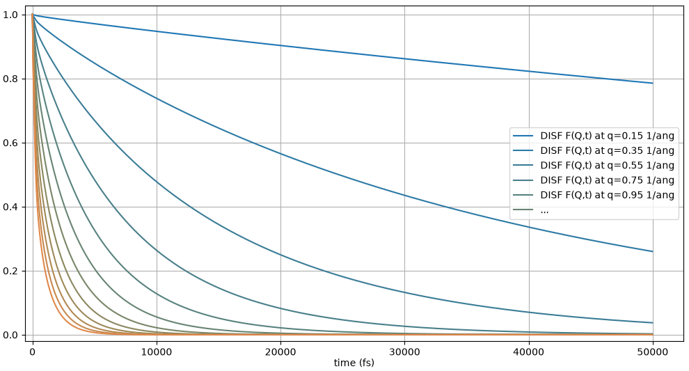



QENS: Dynamic Incoherent Structure Factor

Slide 23
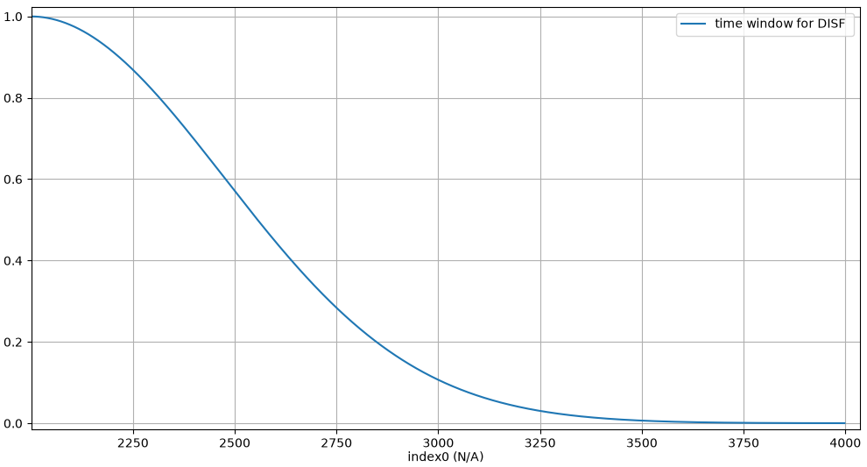
QENS: Dynamic Incoherent Structure Factor

Slide 24
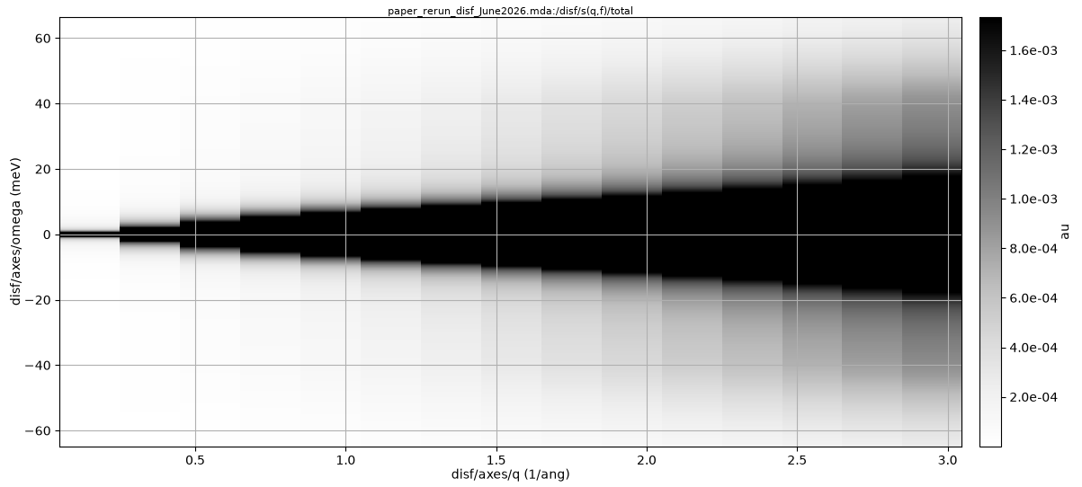
QENS: Dynamic Incoherent Structure Factor

Slide 25
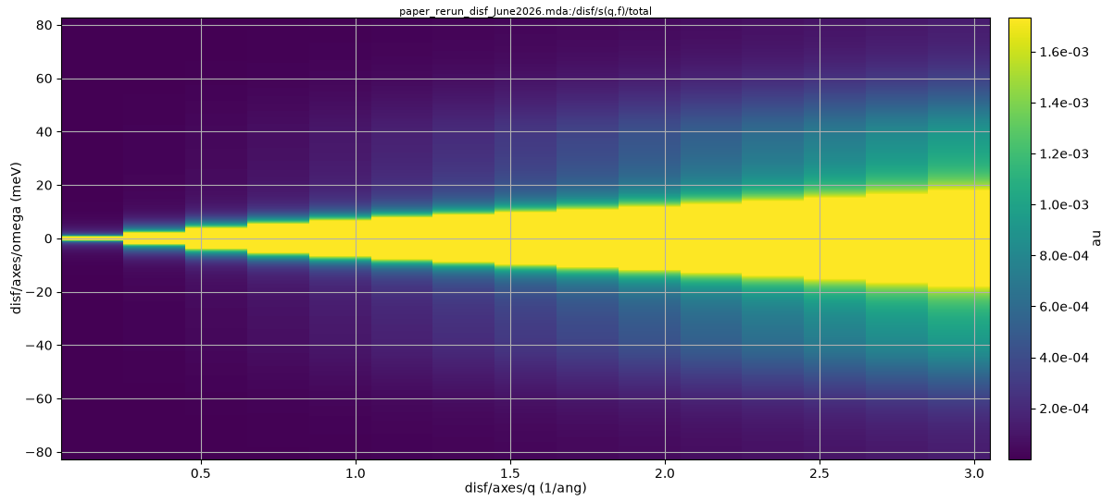
QENS: Dynamic Incoherent Structure Factor

Slide 26

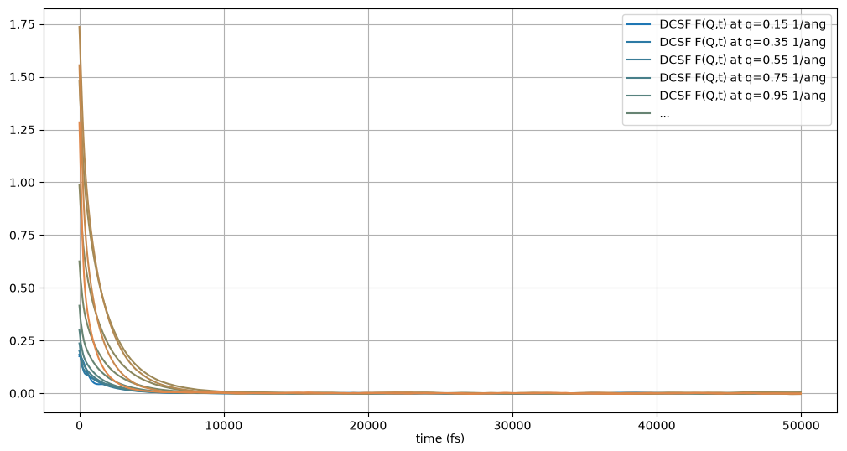



QENS: Dynamic Coherent Structure Factor

Slide 27
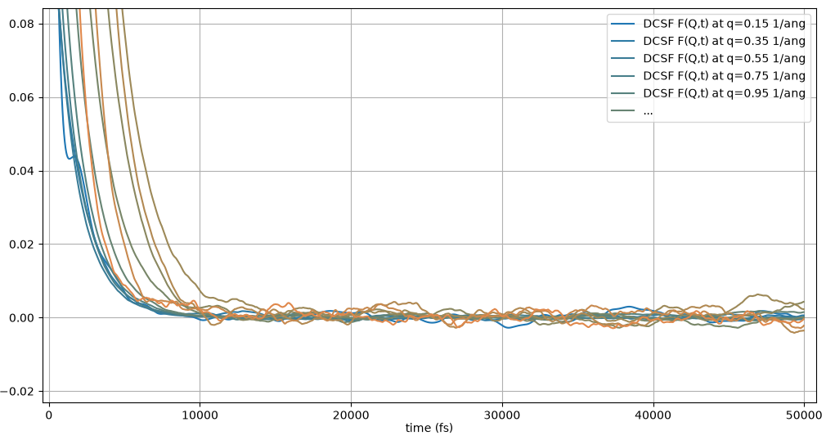
QENS: Dynamic Coherent Structure Factor

Slide 28
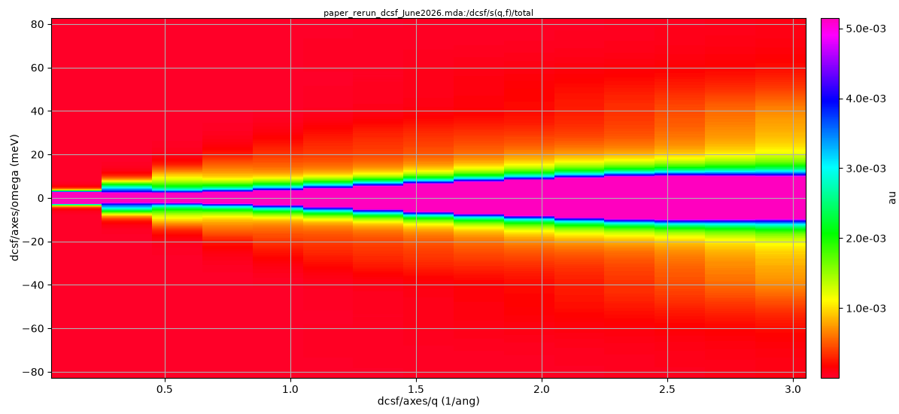
QENS: Dynamic Coherent Structure Factor

Slide 29
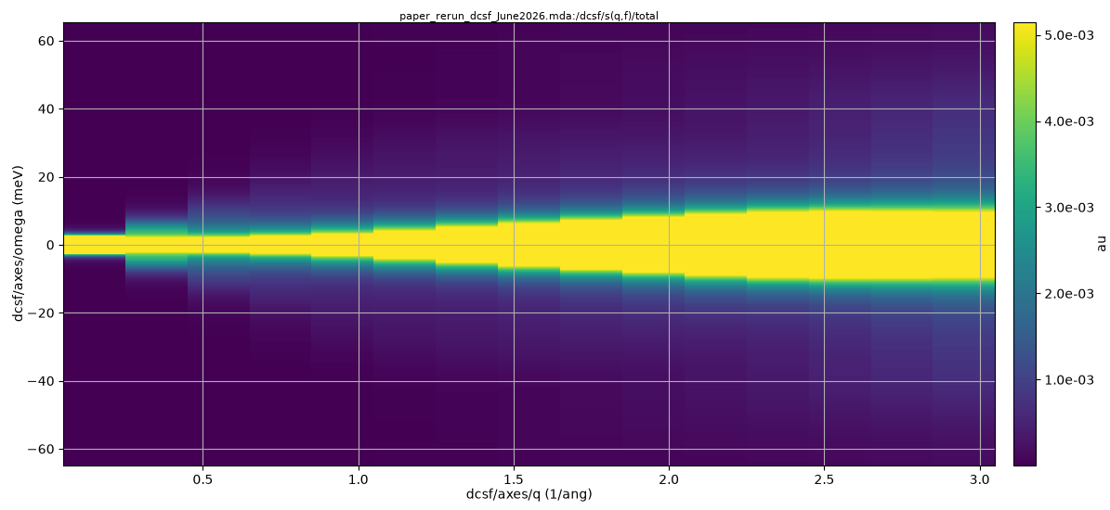
QENS: Dynamic Coherent Structure Factor

Slide 30
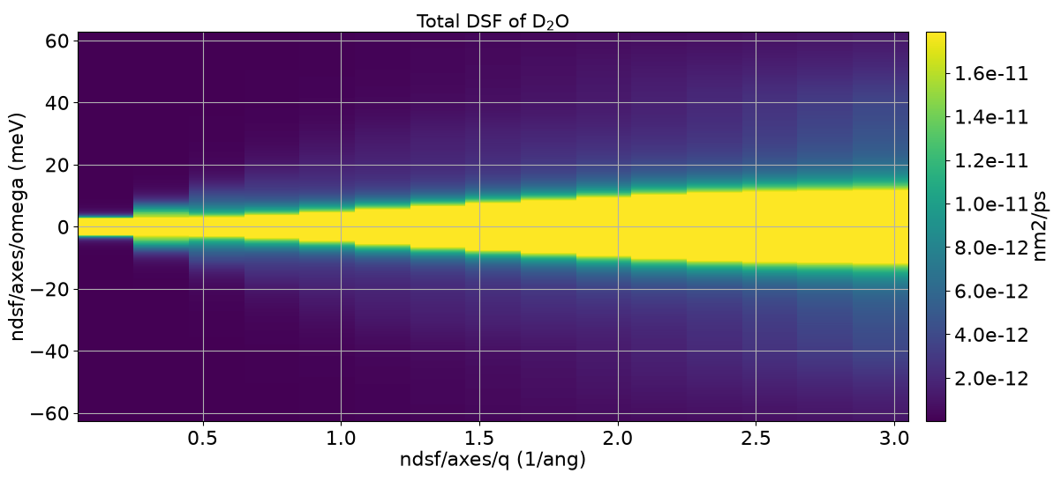
QENS: Total Dynamic Structure Factor

Slide 31
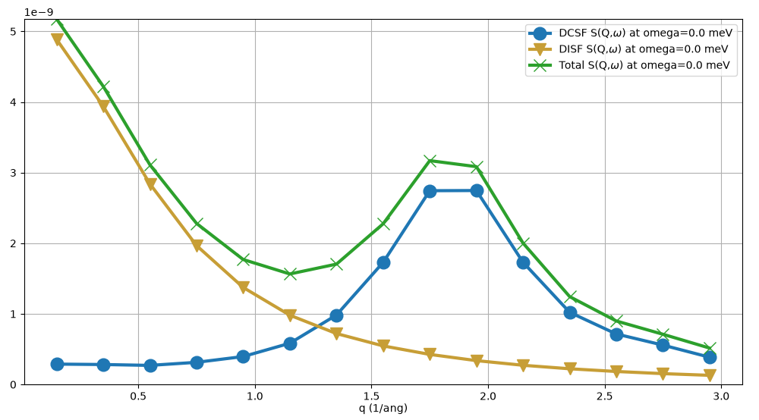
QENS: Total Dynamic Structure Factor

Slide 32
Interlude: neutron properties
Energy
Momentum
E
k
0

Slide 33
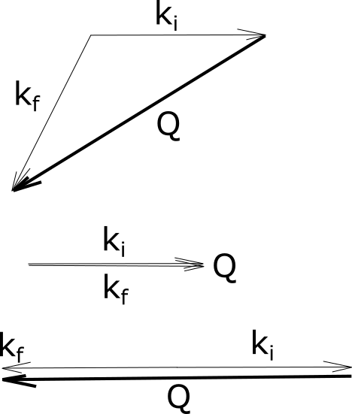

Neutrons: what is a Q vector?
Elastic scattering
$$\left|k_{i}\right|=|k_{f}|$$
For a single incoming neutron wavelength/energy/k vector
change of scattering direction changes the direction and length of Q

Slide 34
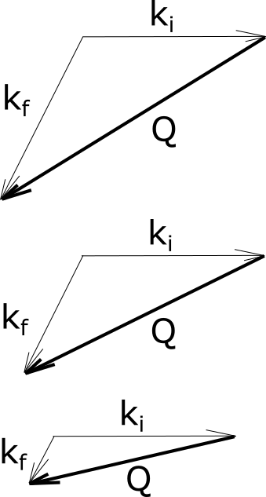

Neutrons: what is a Q vector?
Inelastic scattering
$$|k_{i}|≠|k_{f}|$$
For a single incoming neutron wavelength/energy/k vector
a single scattering direction covers many directions and lengths of Q

Slide 35
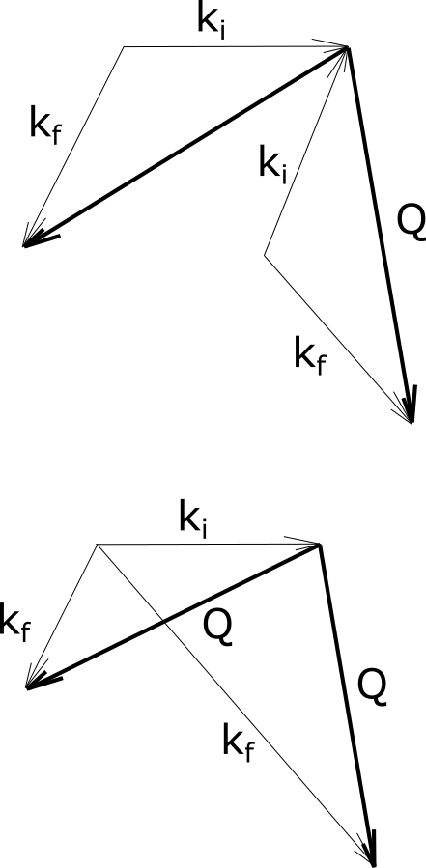
Neutrons: what is Q vector sampling?
Elastic
scattering
In MDANSE:
We generate Q-vector shells,
Results are averaged over all the vectors in a shell,
For each shell, the entire energy transfer range is covered.
In real life:
The k_{i} direction is fixed,
Not all k_{f} directions are possible,
Not for every |Q| value the entire energy range can be covered.
Inelastic
scattering

Slide 36
Neutrons: what is Q vector sampling?
Elastic
scattering
The QENS picture:
Energy range is small, so even for short Q vectors we should be able to cover it,
Energy range is small, so the resolution will be close to constant in the covered range.
Why do we generate multiple Q vectors with one |Q|?
Inelastic
scattering

Slide 37
Neutrons: what is Q vector sampling?
Why do we generate multiple Q vectors with one |Q|?
Imagine you have a 0.01 mL sample of water.
The number of water molecules in this sample will be of the order of 10²⁰.
How does your trajectory compare to this?

Slide 38
Neutrons: what is Q vector sampling?
Why do we generate multiple Q vectors with one |Q|?
Imagine you have a 0.01 mL sample of water.
The number of water molecules in this sample will be of the order of 10²⁰.
How does your trajectory compare to this?
We don’t sample all that many configurations in an MD trajectory.
Spherical sampling helps us re-use the same configurations in different orientations.

Slide 39
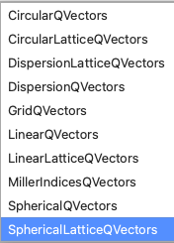
Do we need spherical averaging?
Or, what are all the other vector generators for?
System order
none (isotropic)
1D (nematic)
2D (layered)
3D (crystal)
Q vectors symmetry
spherical
circular
linear
individual points

Slide 40
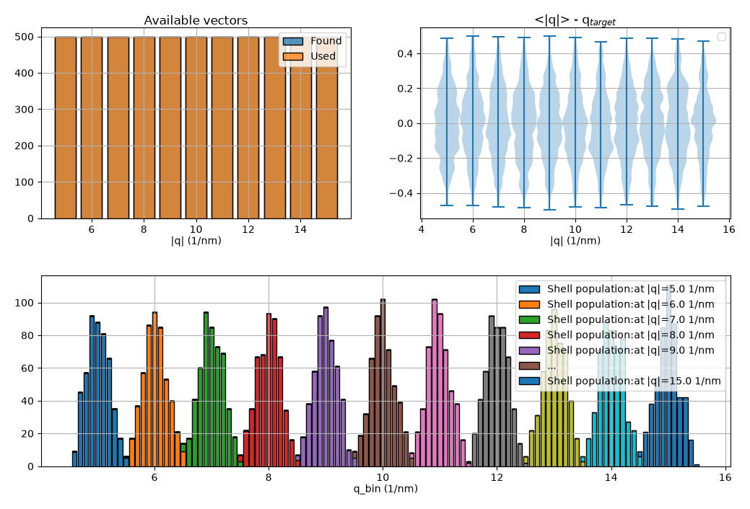
How we use Q vectors for isotropic systems

Slide 41


Molecular Dynamics: the boundary conditions
Space limits: size of the simulation box
Lattice
constant
$$a$$
$$\frac{2π}{a}$$

Slide 42

Molecular Dynamics: the boundary conditions
Increasing the size of the system gives access to lower Q values.
Space limits:
Size of the simulation box
supercell
$$Q→0$$

Slide 43
How we use Q vectors for isotropic systems

Slide 44
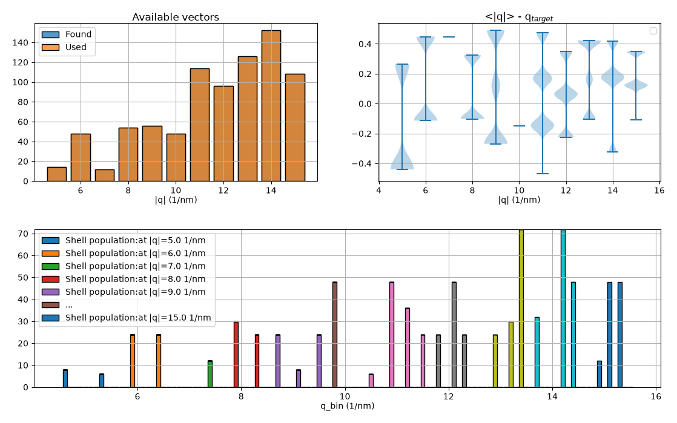
How we use Q vectors for isotropic systems, using only lattice vectors

Slide 45
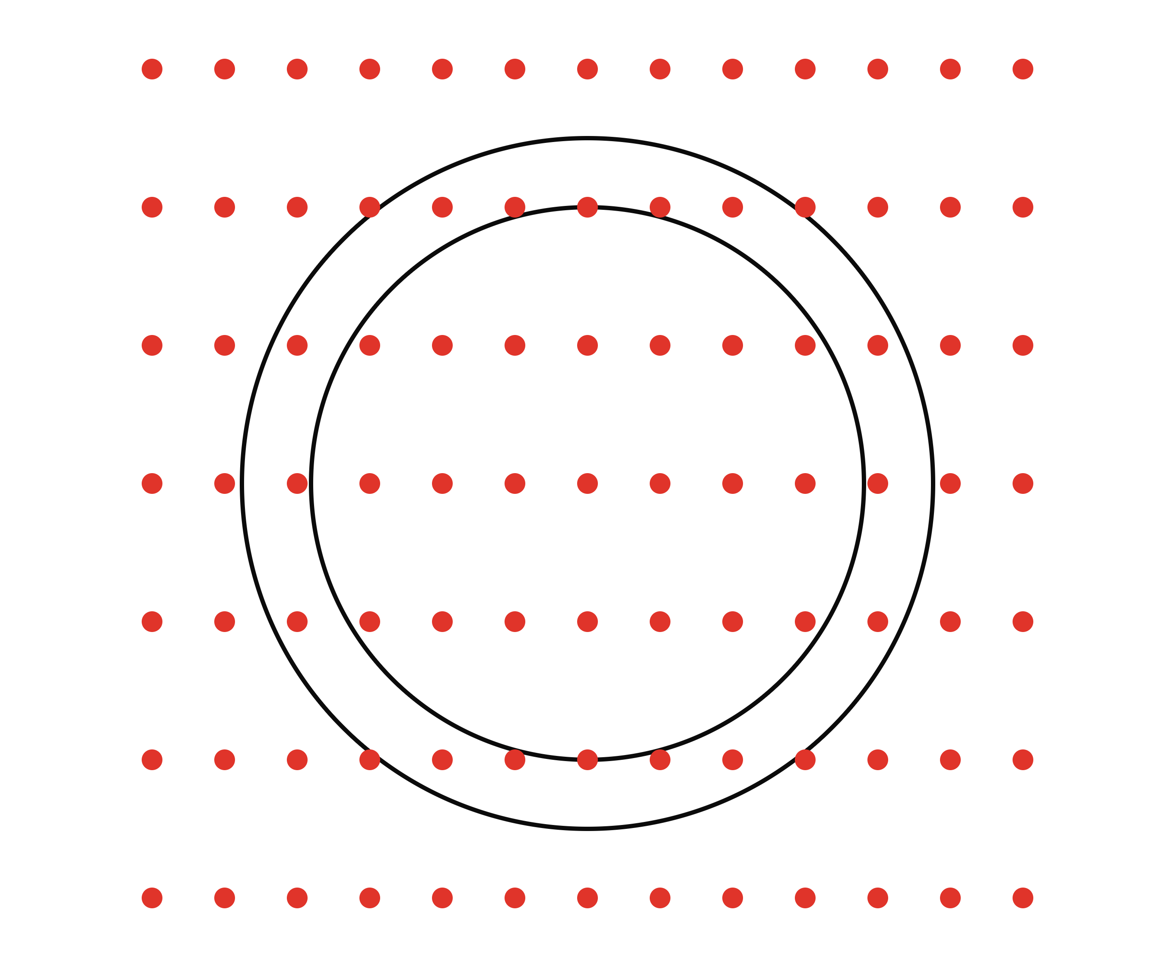
Lattice vectors vs. spherical averaging
Generate reciprocal lattice points
MDANSE was originally designed for liquid or powdered systems, usually q-vectors will be generated in a spherical shell and results are averaged.
A new mechanism to improve the spherical averaging has been added.
Non-cubic lattice

Slide 46
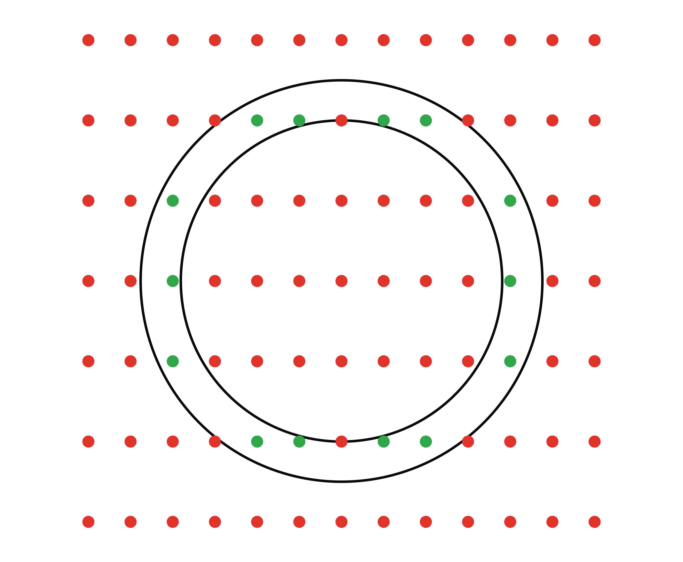
Lattice vectors vs. spherical averaging
Select reciprocal lattice points in a shell.
MDANSE was originally designed for liquid or powdered systems, usually q-vectors will be generated in a spherical shell and results are averaged.
A new mechanism to improve the spherical averaging has been added.

Slide 47
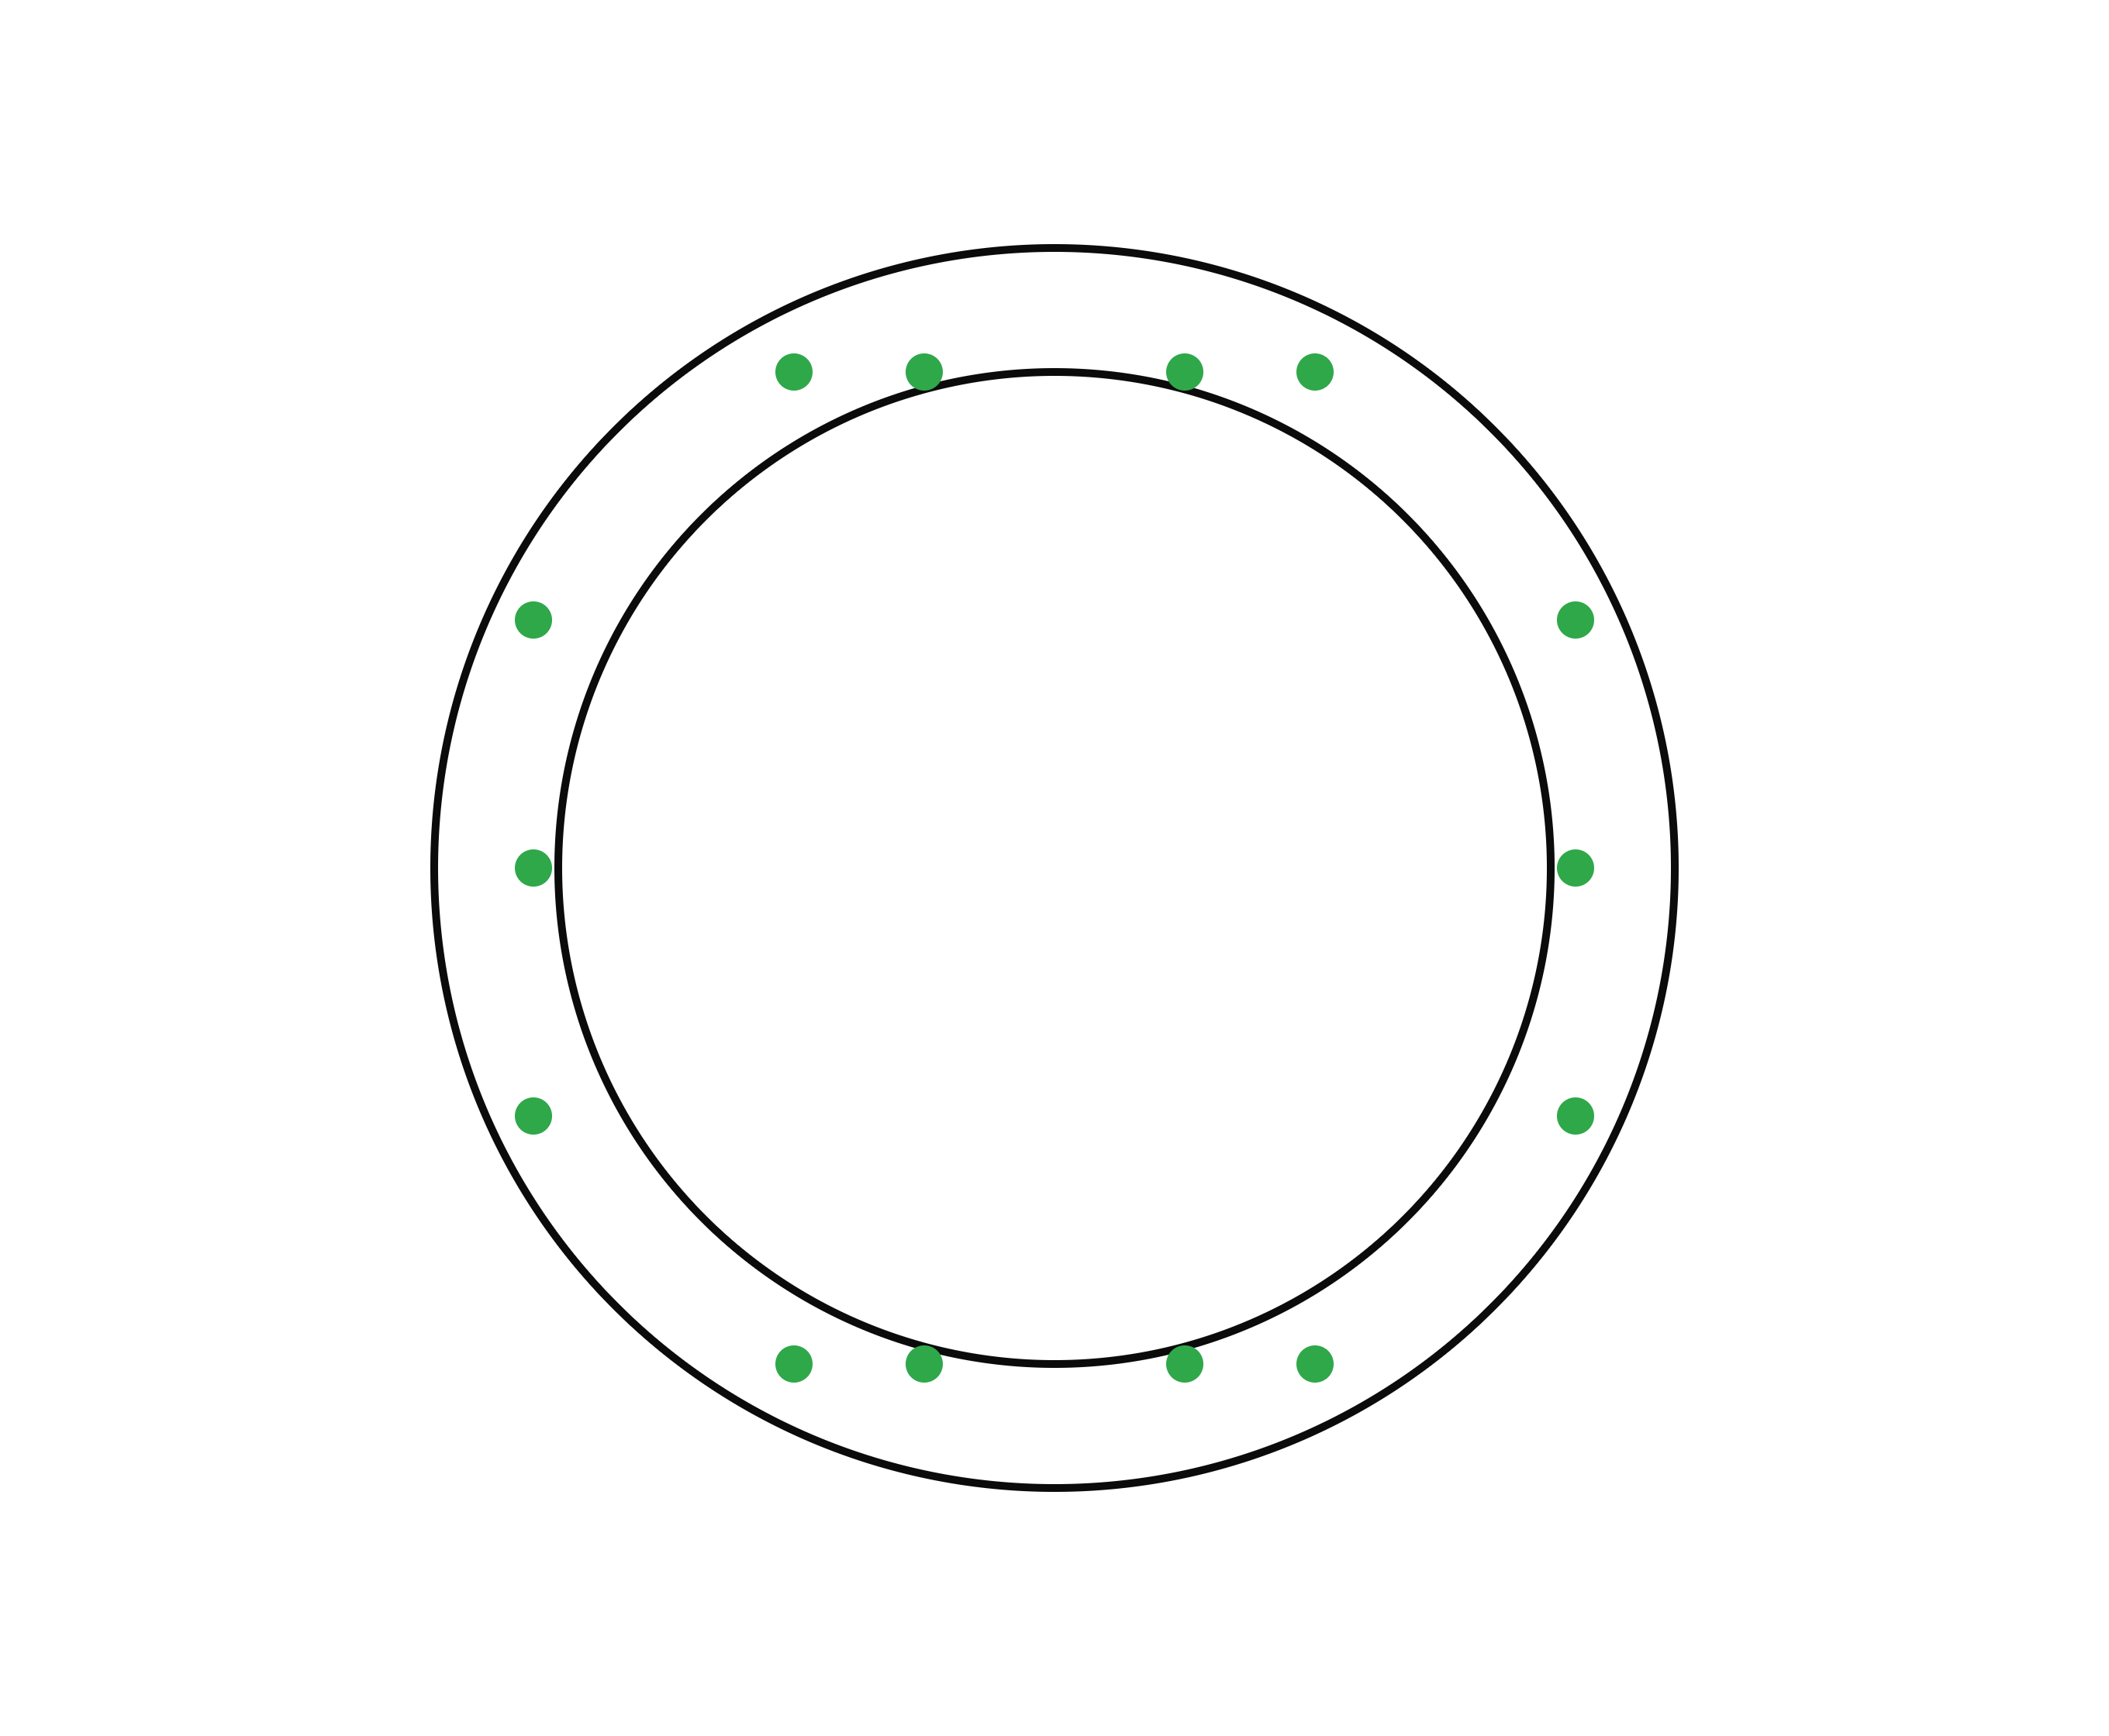
Lattice vectors vs. spherical averaging
Calculate S(q, w) averaged over the q-vectors in the shell.
MDANSE was originally designed for liquid or powdered systems, usually q-vectors will be generated in a spherical shell and results are averaged.
A new mechanism to improve the spherical averaging has been added.
Old scheme can still be used by setting equal weights.
Old scheme

Slide 48
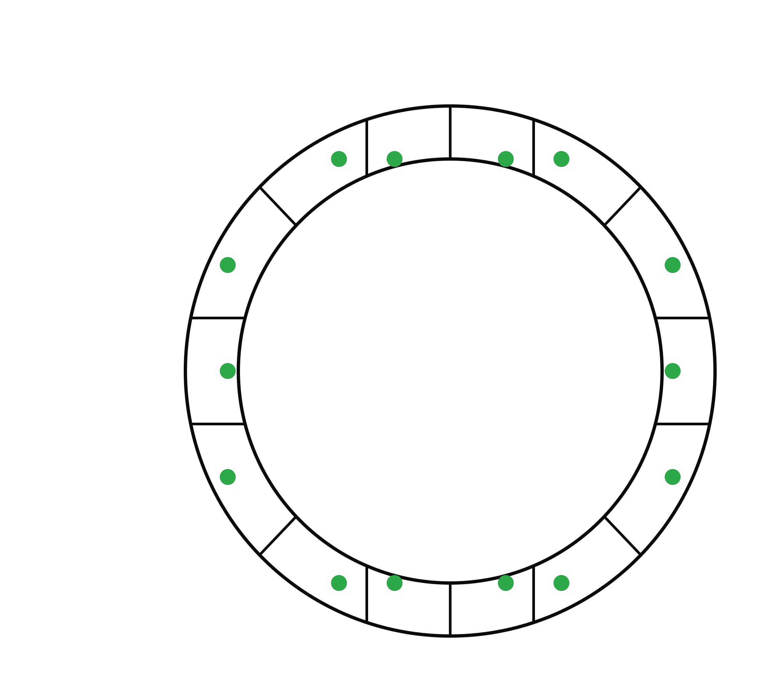
Lattice vectors vs. spherical averaging
Calculate S(q, w) with a weighted averaged over the q-vectors in the shell.
MDANSE was originally designed for liquid or powdered systems, usually q-vectors will be generated in a spherical shell and results are averaged.
A new mechanism to improve the spherical averaging has been added.
Old scheme can still be used by setting equal weights.
New scheme weights q-vectors based on its shell Voronoi cell volume.
New scheme
Larger weight
Smaller weight

Slide 49
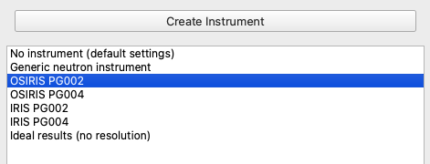
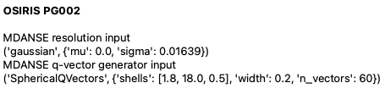
MDANSE implementation of a “neutron instrument”
Basic features of a neutron instrument:
Resolution (constant, energy independent)
Coverage (evenly spaced in Q, finite width)

Slide 50
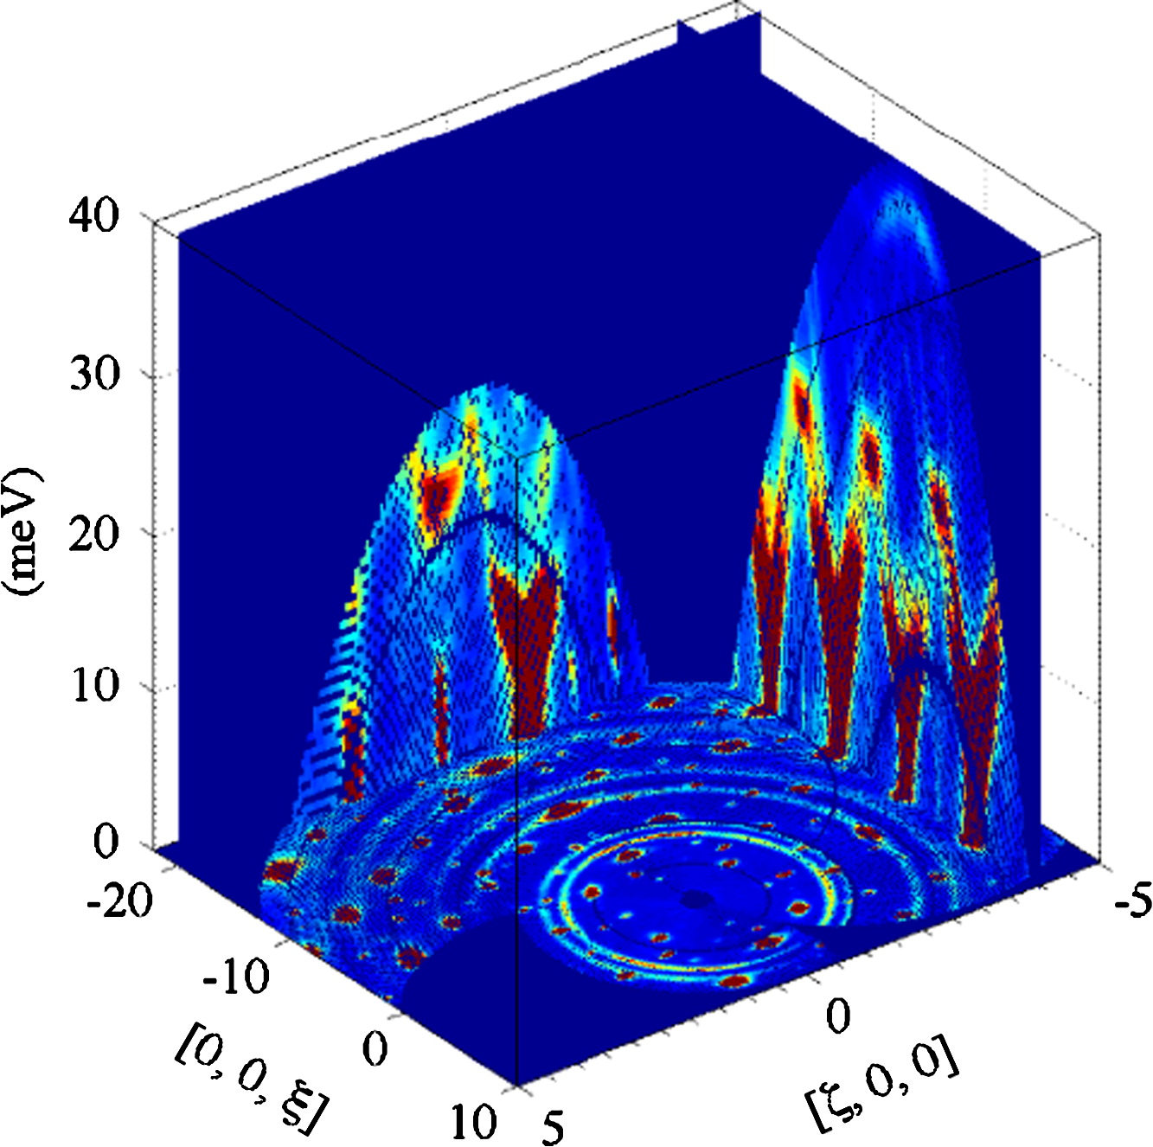
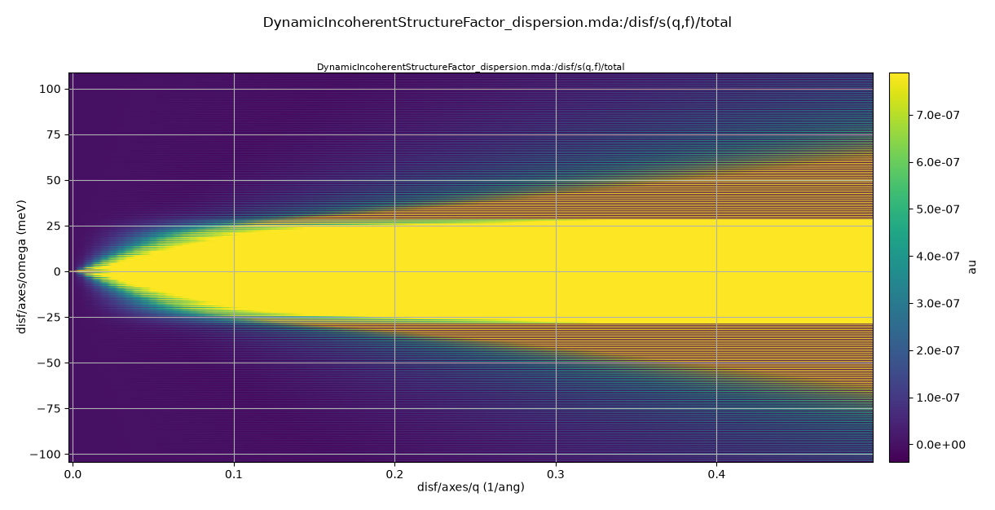
MDANSE implementation of a “neutron instrument”
In real life, at different Q we get different energy coverage.
In MDANSE, we get full energy range at every Q.
https://doi.org/10.1016/j.nima.2011.01.173
R.I. Bewley et al., Nuclear Instruments and Methods A, Volume 637, Issue 1, (2011) 128-134

Slide 51
Interlude: neutron properties
Time of flight
10 m distance
(ms)
Wavelength
(Ang)
Energy (meV)
Momentum
(1/Ang)
Velocity (m/s)
1
2
3
10
81.787
20.447
9.087
0.82
6.283
3.142
2.094
0.628
3955
1978
1318
396
2.53
5.01
7.6
25.3

Slide 52
Neutron time of flight
Main principle:
We determine the neutron wavelength (and therefore energy) based on the
time needed to cover a distance.
This is all fine, but:
do we know how much time the neutron spent between the two points?
do we know how long the distance was?

Slide 53
Neutron time of flight
detector
(tubes)
Do we know how long the distance was?
These two trajectories
have different lengths,
but will show up in the same detector pixel.
sample
neutron guide

Slide 54
Neutron time of flight
detector
(tubes)
Do we know how long the distance was?
These two trajectories
have different scattering angles,
but will show up in the same detector pixel.
sample
neutron guide

Slide 55
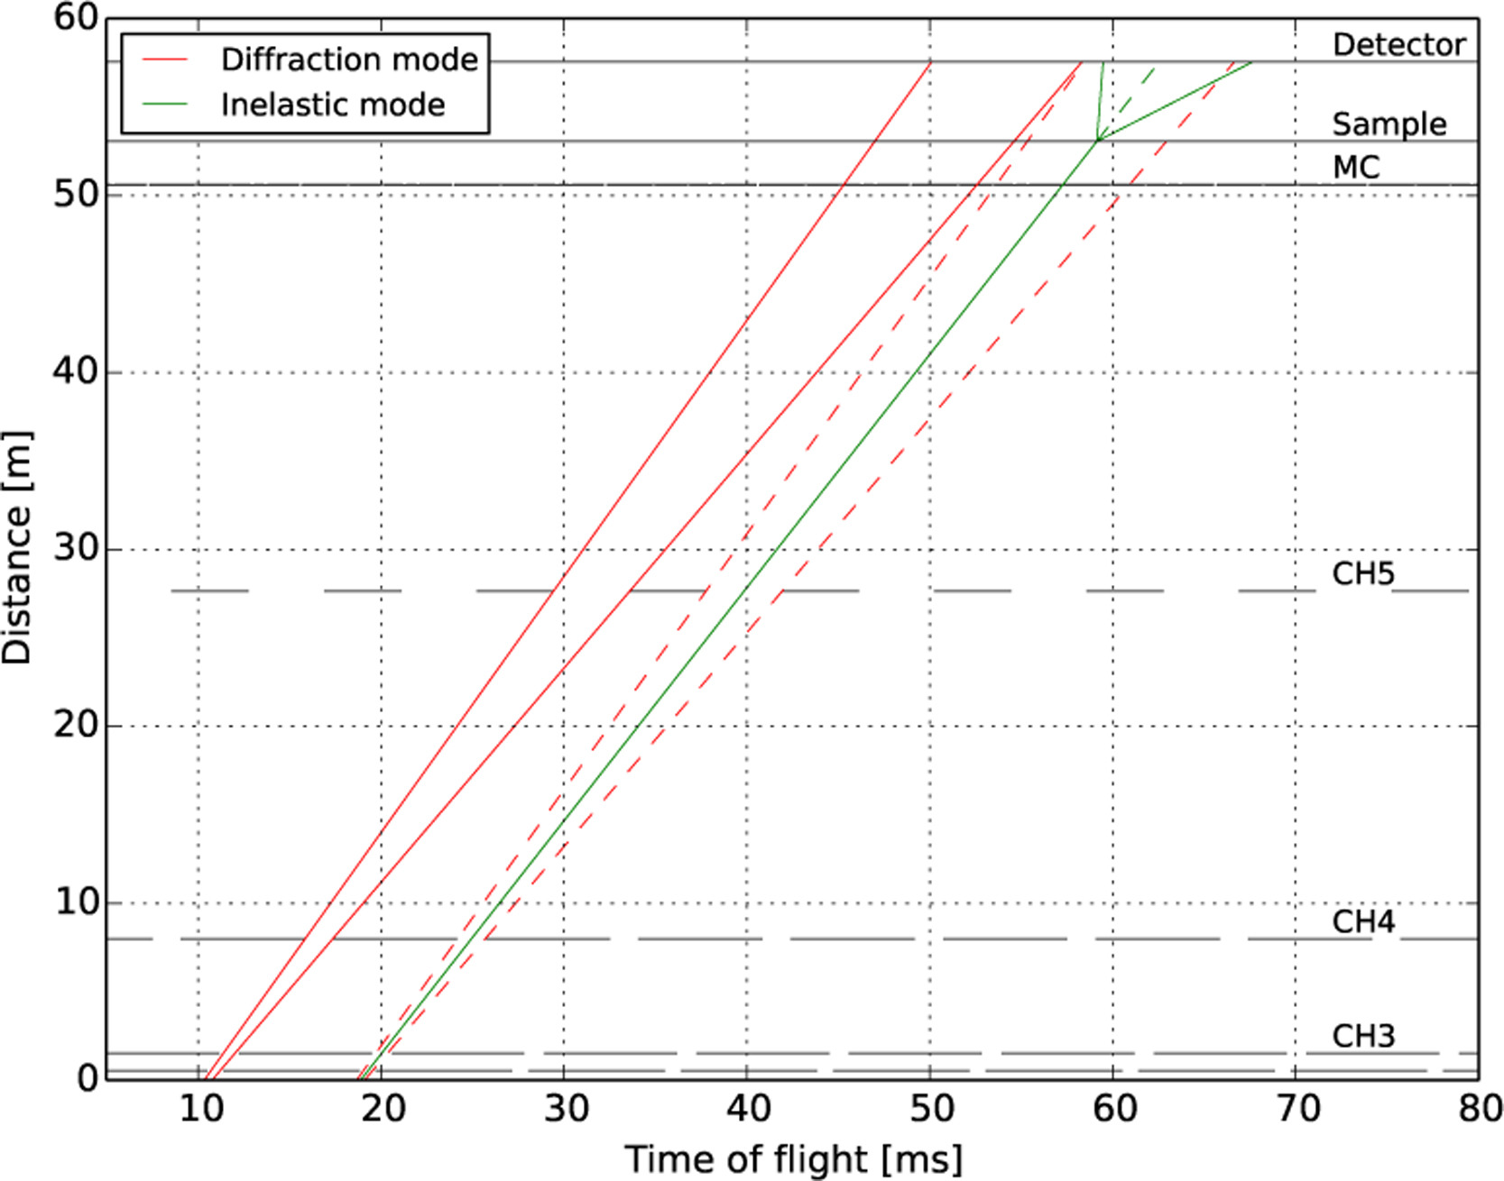
Neutron time of flight
Do we know how much time the neutron spent between the two points?
Faster choppers with smaller windows
reduce the time uncertainty.
Turn your TOF diffractometer into a direct TOF spectrometer with this one extra double-disc chopper!

Slide 56
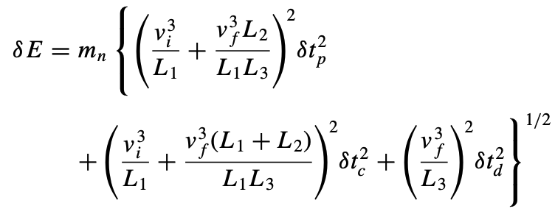



Neutron time of flight
First chopper
Last chopper
Sample
Detector
L₃
L₂
L₁
$$δt_{p}$$
pulse width of the first chopper
$$δt_{c}$$
pulse width of the last chopper
$$δt_{d}$$
TOF uncertainty due to sample size and detection volume
CNCS design by G. Ehlers et al. https://doi.org/10.1063/1.3626935

Slide 57
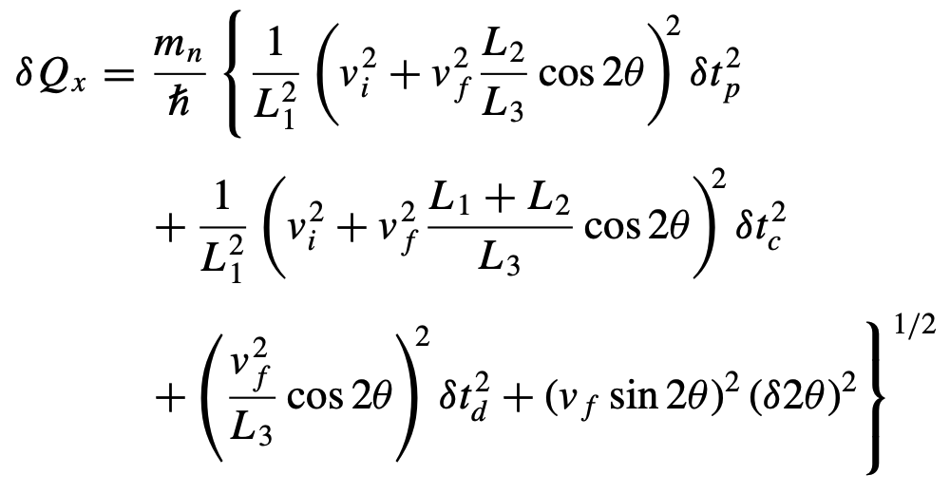
Neutron time of flight: direct spectrometer
First chopper
Last chopper
Sample
Detector
L₃
L₂
L₁
$$δt_{p}$$
pulse width of the first chopper
$$δt_{c}$$
pulse width of the last chopper
$$δt_{d}$$
TOF uncertainty due to sample size and detection volume
CNCS design by G. Ehlers et al. https://doi.org/10.1063/1.3626935

Slide 58
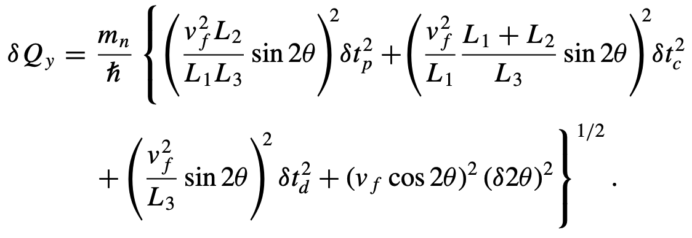



Neutron time of flight: direct spectrometer
First chopper
Last chopper
Sample
Detector
L₃
L₂
L₁
$$δt_{p}$$
pulse width of the first chopper
$$δt_{c}$$
pulse width of the last chopper
$$δt_{d}$$
TOF uncertainty due to sample size and detection volume
CNCS design by G. Ehlers et al. https://doi.org/10.1063/1.3626935

Slide 59
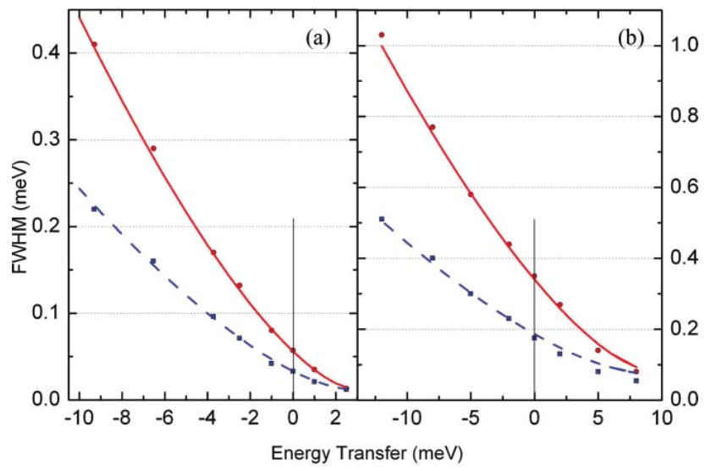
Neutron time of flight: direct spectrometer
CNCS design by G. Ehlers et al. https://doi.org/10.1063/1.3626935

Slide 60
Neutron time of flight: direct spectrometer
Using a constant peak width for the entire energy range works only for QENS, where the energy range is small.
MDANSE: ongoing work to start using ResIns for resolution calculations.
CNCS design by G. Ehlers et al. https://doi.org/10.1063/1.3626935

Slide 61
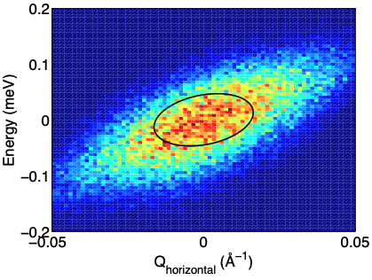
How can we observe inelastic neutron scattering?
Time of flight instruments:
direct TOF spectrometer (one wavelength going in)
indirect TOF spectrometer (one wavelength going out)
triple axis spectrometer resolution volume
Monochromatic instruments:
triple-axis spectrometers
from https://doi.org/10.1016/j.nima.2013.07.007
(M.D. Le et al., 2013)

