Slide 1
Tutorial: Neutron Scattering Lengths
Chi Y. Cheng, Maciej Bartkowiak, Sanghamitra Mukhopadhyay
MDANSE Workshop 2026
04/11/2026

Slide 2
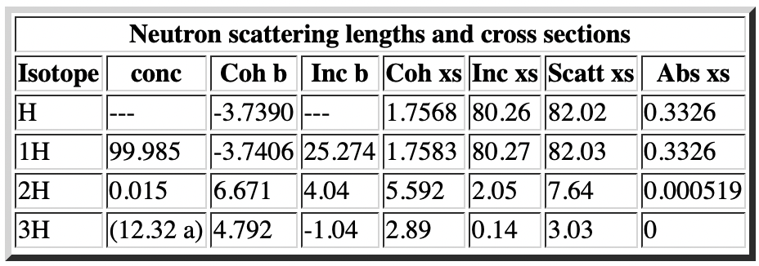
Tutorial: Neutron Scattering Lengths
In MDANSE, we use the values of `b_coherent` and `b_incoherent` (neutron scattering lengths) to determine the contribution of atoms to the total neutron scattering result.
Let’s consider hydrogen: H1, H2 and H3 are labels for specific hydrogen isotopes: ¹H, ²H and ³H.
The fourth one, H, is an averaged atom type with scattering lengths which depend on the natural abundances of the three isotopes.
https://www.ncnr.nist.gov/resources/n-lengths/

Slide 3
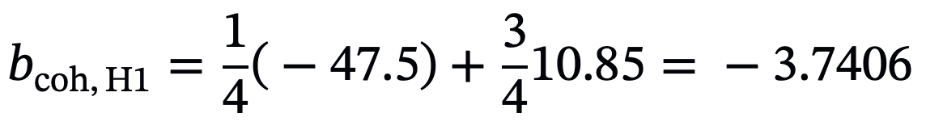
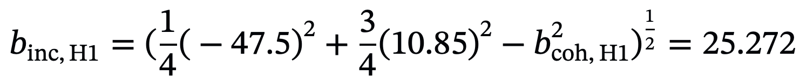
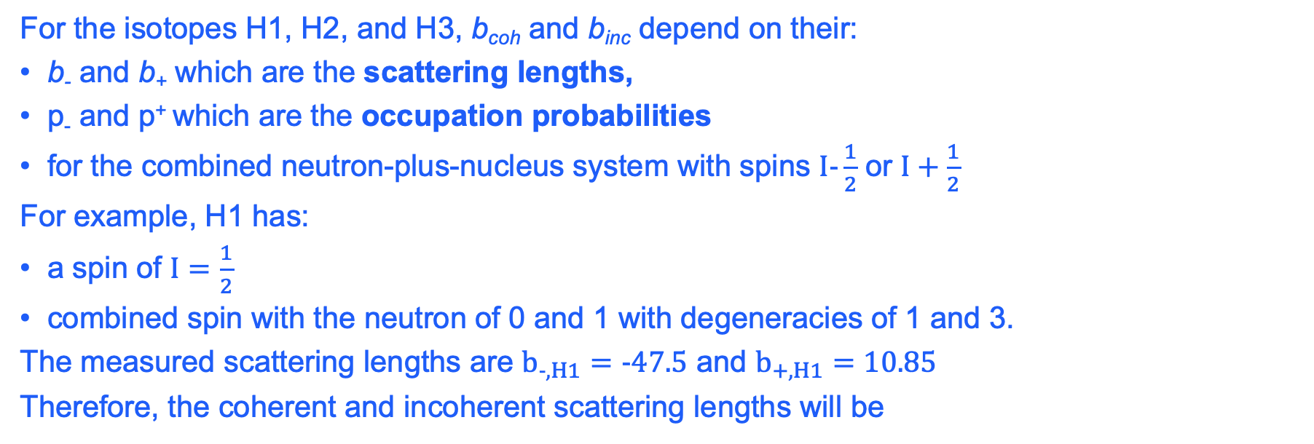
Spin Incoherence
For the isotopes H1, H2, and H3, b_{coh} and b_{inc} depend on their:
b₋ and b₊ which are the scattering lengths,
p₋ and p⁺ which are the occupation probabilities
for the combined neutron-plus-nucleus system with spins $I-\frac{1}{2}$ or $I+\frac{1}{2}$
For example, H1 has:
a spin of $I=\frac{1}{2}$
combined spin with the neutron of 0 and 1 with degeneracies of 1 and 3.
The measured scattering lengths are $b_{-,H1}=-47.5$ and $b_{+,H1}=10.85$
Therefore, the coherent and incoherent scattering lengths will be

Slide 4
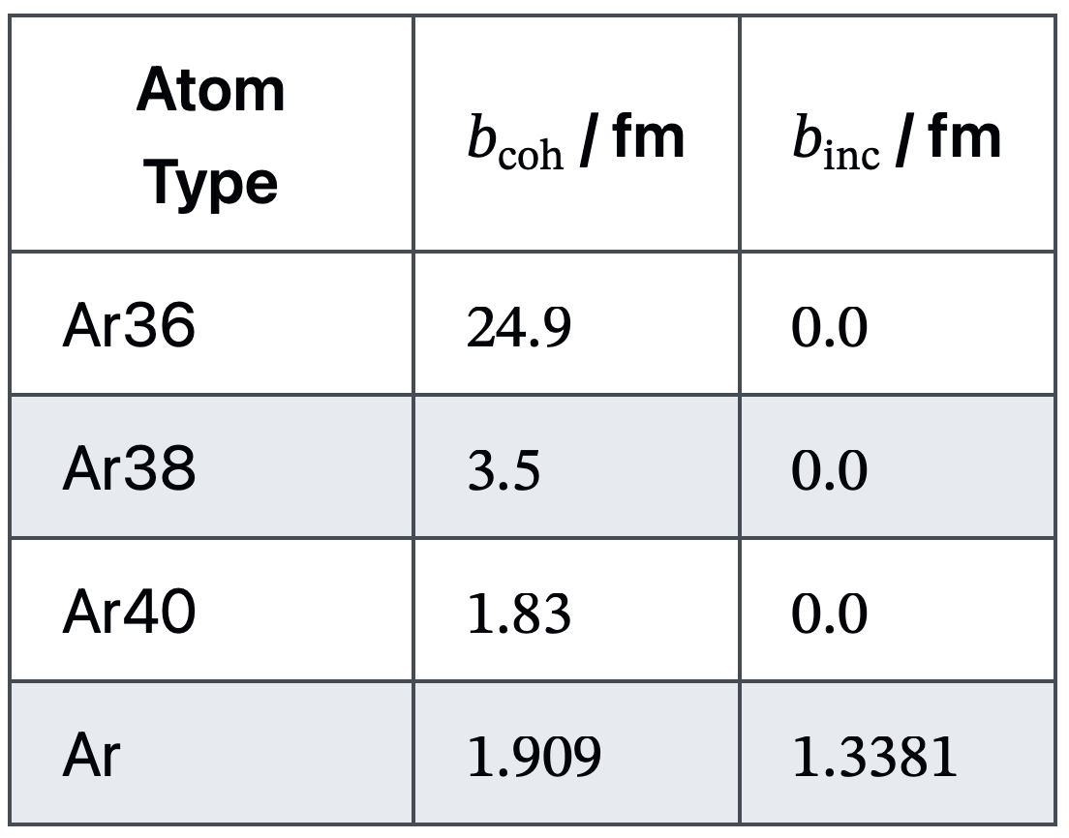
Isotopic incoherence
Argon isotopes are all zero spin nuclei which lead to zero b_{inc} values. Unlike for the hydrogen atoms, there will be no contribution to the incoherent scattering from spin incoherence.
The b_{inc} for the Ar atom type arises from isotopic incoherence.
The natural abundances of the argon isotopes are 0.337%, 0.063%, and 99.6% for the Ar36, Ar38, and Ar40 isotopes, respectively.
The coherent and incoherent scattering lengths of argon are:

Slide 5
Isotopic incoherence
When we use the Ar atom type in MDANSE, we assume that the isotopes of argon in our system are randomly distributed and follow their natural abundances.
In the case of the atom types which are not specific isotopes
(e.g. H and Ar) the b_{inc} contains contributions from only spin and isotopic incoherence.

Slide 6
Chemical incoherence
Incoherent scattering can arise from a system where two or more atom types with different scattering lengths share similar trajectories and distributions across the system.
Incoherent scattering from this source of randomness is known as chemical incoherence.
Chemical incoherence is included in MDANSE but will turn up in the coherent signal, (dynamic coherent structure factor) rather than the incoherent (dynamic incoherent structure factor).

Slide 7
Scenario of the tutorial
We will create three new atom types, `Atm1`, `Atm2`, and `Atm1Atm2`.
`Atm1Atm2` will be a combined atom type, representing a mixture of Atm1 and Atm2.
We will calculate the dynamic coherent structure factor (DCSF) and dynamic incoherent structure factor (DISF) for:
a 50/50 mixture of `Atm1` and `Atm2`
a system of 100% `Atm1Atm2`.
We will then combine the DCSF and DISF results using the neutron total dynamic structure factor (NTDSF) job.
We will compare the coherent and incoherent signal between the two systems.

Slide 8
The trajectories
We have already generated a trajectory of argon in another exercise.
We are going to re-use it and change the chemical elements assigned to atoms.
NOTE:
You may want to start the MDANSE GUI in the directory of this tutorial, using
mdanse_gui --local
This will keep the changes to the atom database within the working directory, not affecting the central settings in the home directory.
At the same time, you will not have access to the settings and definitions you already created in the previous tutorials.

Slide 9
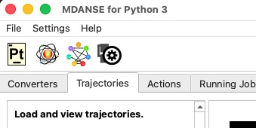
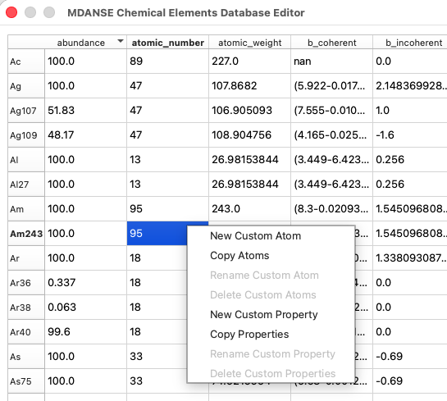
Adding new chemical elements
In the MDANSE GUI, open the chemical elements editor.
Right-click the table to open the context menu.
Choose “New Custom Atom”.

Slide 10
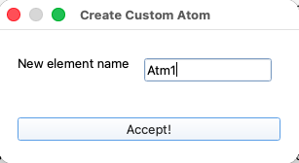
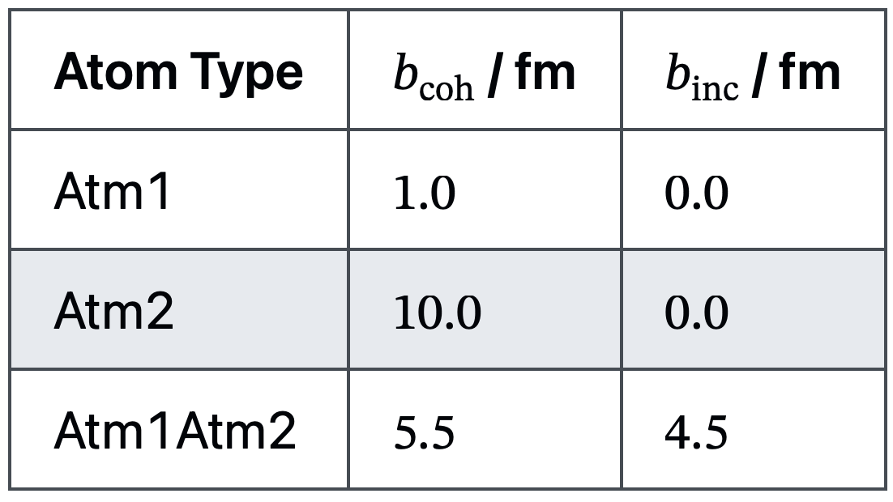
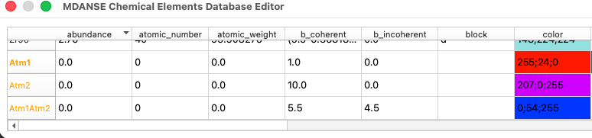
Adding new chemical elements
Create new atoms called “Atm1”, ”Atm2” and “Atm1Atm2”.
Set their scattering lengths to the values in the table.
Assign different colours to the elements.
Set their van der Waals radius to 0.188 to make them visible in the 3D view. Or give them different radii to tell them apart?
You should expect the new entries to look like this:

Slide 11
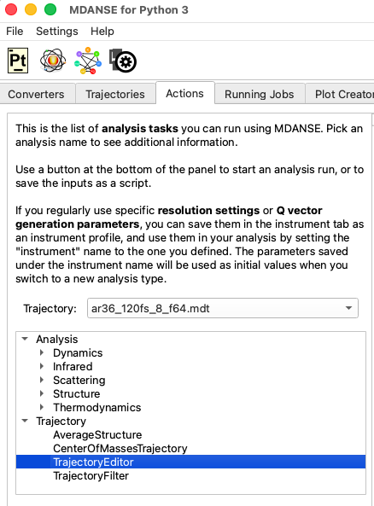
Replacing atoms in the trajectory
Load the argon trajectory and select TrajectoryEditor.
The input field you will need is Atom transmutation.
To replace all atoms with “Atm1Atm2, open the Atom transmutation helper.

Slide 12
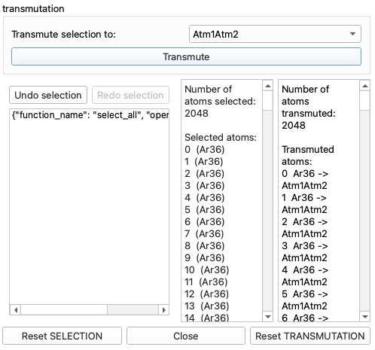
Replacing atoms in the trajectory
To replace all atoms with “Atm1Atm2”, open the Atom transmutation helper.
Since all the atoms are selected by default, you need to set the atom type to Atm1Atm2, then click “Transmute”.
The bottom-right text field should now contain the list of transmuted atoms.
All that’s left to do is:
close the dialog,
change the output file name,
click “run”.

Slide 13
Replacing atoms in the trajectory
In the second trajectory, we want assign Atm1 and Atm2 types to 50% of the atom each, randomly.
There is no option of doing it automatically in the GUI, so instead we will run the script “mdanse_inputs/script2_random.py”
The script will output a text string that can be pasted directly into the Atom transmutation text field, without even opening the helper dialog.
In the end, that part of the GUI will look similar to this:
Again, you can now change the output file name and click “run”.

Slide 14
Replacing atoms in the trajectory
In the second trajectory, we want assign Atm1 and Atm2 types to 50% of the atom each, randomly.
There is no option of doing it automatically in the GUI, so instead we will run the script “mdanse_inputs/script2_random.py”
The script will output a text string that can be pasted directly into the Atom transmutation text field, without even opening the helper dialog.
In the end, that part of the GUI will look similar to this:
Again, you can now change the output file name and click “run”.

Slide 15
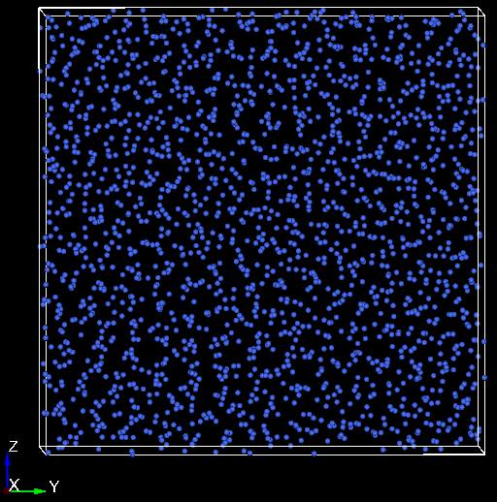
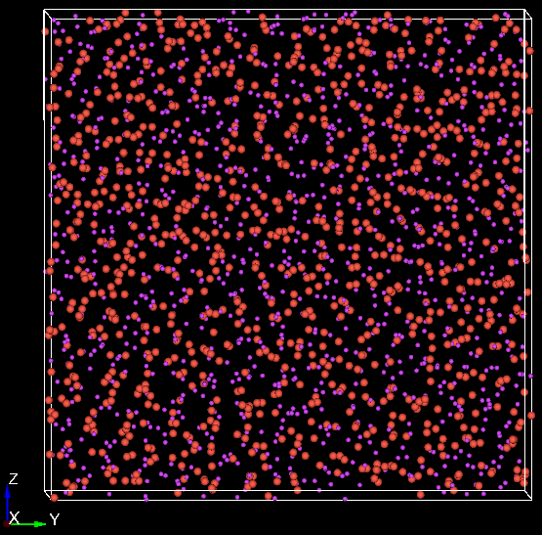
Replacing atoms in the trajectory
Now, you should have two trajectories, looking like this:

Slide 16
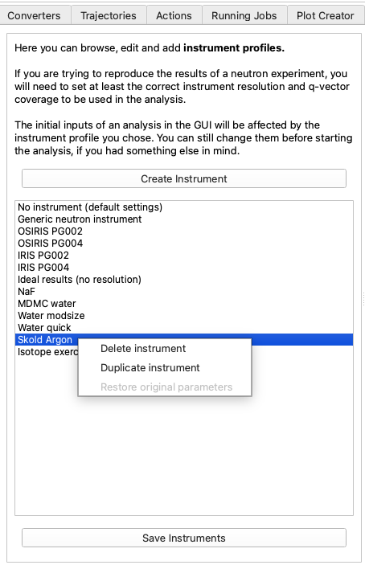
DCSF, DISF and NDTSF calculations
We can start calculating the neutron observables for both trajectories.
In the Instruments tab, create a new instrument.
(Do you still have the instrument profile you created in the previous tutorial? You can use it as the starting point.
In the instrument tab, right-click the previous instrument definition you created and click “Duplicate instrument”. Then edit the new instrument.)

Slide 17
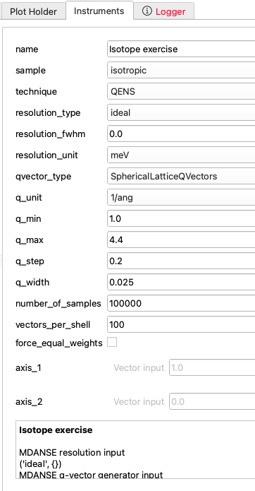
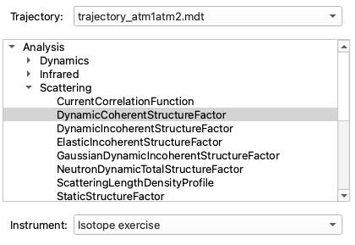
DCSF, DISF and NDTSF calculations
Set the instrument parameters as shown here:
In the Actions tab, select the new instrument and the first calculation type: DynamicCoherentStructureFactor.

Slide 18
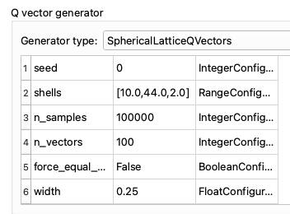
DCSF, DISF and NDTSF calculations
In the Actions tab, select the new instrument and the first calculation type: DynamicCoherentStructureFactor.
The Q-vector generator parameters should be the same as here:

Slide 19
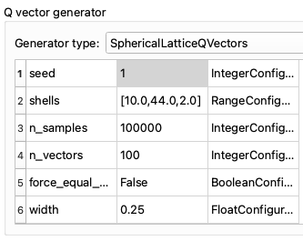
DCSF, DISF and NDTSF calculations
In the Actions tab, select the new instrument and the first calculation type: DynamicCoherentStructureFactor.
The Q-vector generator parameters should be the same as here:
NOTE:
We set the random seed to 1 to make sure that the results are reproducible between repeated calculations.

Slide 20
DCSF, DISF and NDTSF calculations
In the Actions tab, select the new instrument and the first calculation type: DynamicCoherentStructureFactor.
The Q-vector generator parameters should be the same as here:
NOTE:
We set the random seed to 1 to make sure that the results are reproducible between repeated calculations.

Slide 21
DCSF, DISF and NDTSF calculations
Run the DCSF and DISF calculations, for both trajectories, while giving the output files meaningful names, such as:
mdanse_outputs/disf_atm1atm2.mda
mdanse_outputs/dcsf_atm1atm2.mda
mdanse_outputs/disf_atm1_atm2.mda
mdanse_outputs/dcsf_atm1_atm2.mda
NOTE:
We set the random seed to 1 to make sure that the results are reproducible between repeated calculations.

Slide 22
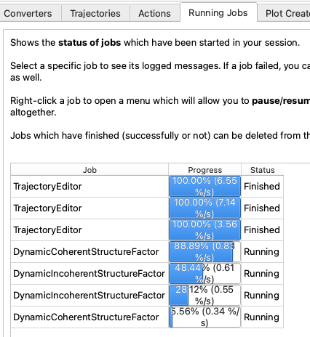
DCSF, DISF and NDTSF calculations
You can check on the progress of your analysis in the “Running Jobs” tab.
It is fine to run multiple analysis tasks at the same time, as long as you have enough CPU cores and memory to spare.

Slide 23
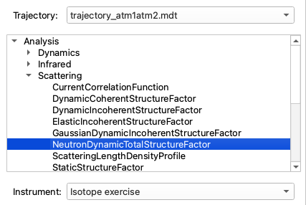
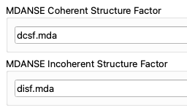


DCSF, DISF and NDTSF calculations
Run the NeutronDynamicTotalStructureFactor.
Match the trajectory name to the input file names.
mdanse_outputs/disf_atm1atm2.mda
mdanse_outputs/dcsf_atm1atm2.mda

Slide 24
DCSF, DISF and NDTSF calculations
Run the NeutronDynamicTotalStructureFactor.
Match the trajectory name to the input file names.
Here, we assume that you used output file names:
mdanse_outputs/ndtsf_atm1atm2.mda
mdanse_outputs/ndtsf_atm1_atm2.mda

Slide 25
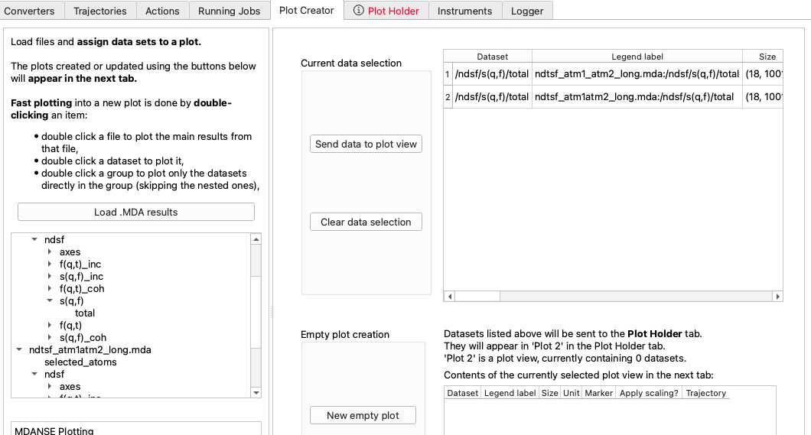
DCSF, DISF and NDTSF calculations
In the Plot Creator tab, create plots to compare the results.
Here, we compare
the total S(Q, ω)
from each trajectory.

Slide 26
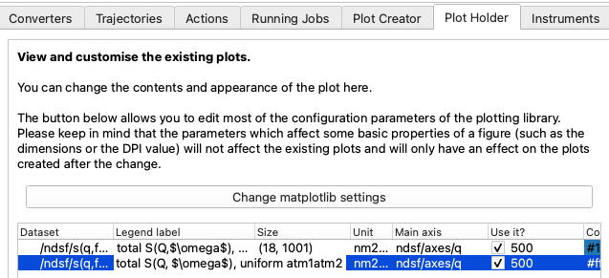
DCSF, DISF and NDTSF calculations
In the Plot Creator tab, create plots to compare the results.
Here, we compare
the total S(Q, ω)
from each trajectory.
Plot the results as a function of Q,
and pick the data row in the middle of
the range (which is E=0).
check size
Range centre
Edit
labels
Set to Q

Slide 27
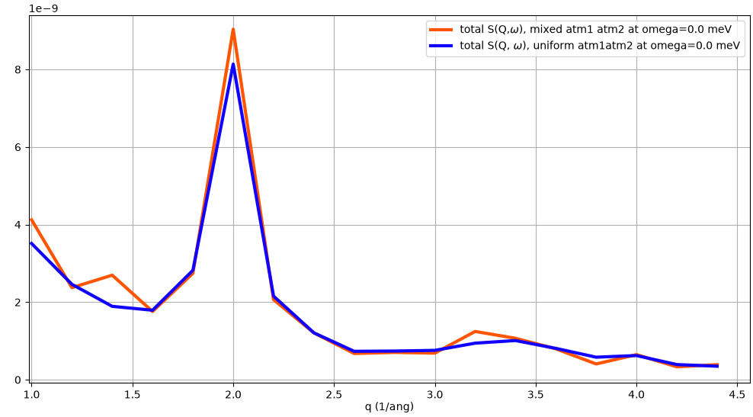
DCSF, DISF and NDTSF calculations
In the Plot Creator tab, create plots to compare the results.
Here, we compare
the total S(Q, ω)
from each trajectory.

Slide 28
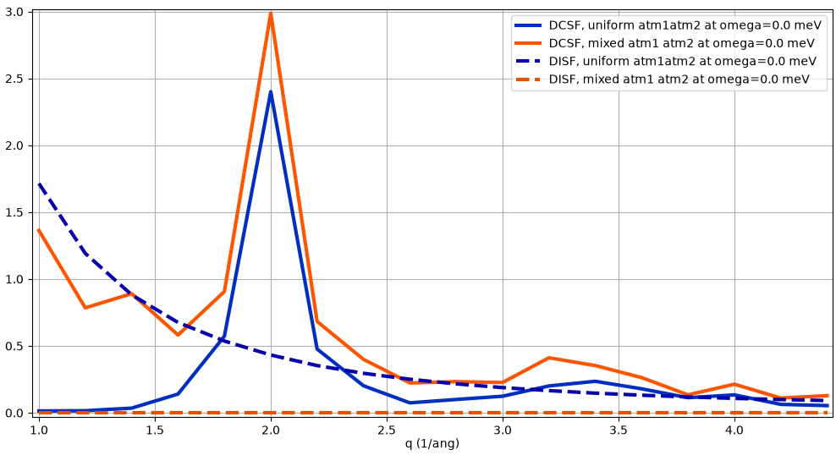
DCSF, DISF and NDTSF calculations
In the Plot Creator tab, create plots to compare the results.
Here, we compare
the coherent and
incoherent components
of S(Q, ω)
from each trajectory.

Slide 29
Interpretation of the results
There is a difference between a trajectory where every atom is of an exactly known, specific type,
and a trajectory which uses the averaged atom type.
The trajectory with a mix of Atm1 and Atm2 does not show the isotopic incoherence contribution to the incoherent signal.
A longer trajectory would have produced a less noisy result.
Overall, the total scattering produced by the two trajectories converges to the same result.

