Slide 1
Section 1-1
Data-Driven Society and
Data Science
The University of Tokyo
Center for Research and Development on Transition to Modern Education
April 30, 2021
Ryohei Hisano, The University of Tokyo 2021 CC BY-NC-SA
1

Slide 2
Overview
In this section, we aim to achieve the following goals:
01
Significance of Data Science
Understand the core importance and impact of learning data science in our modern, data-driven society.
02
Data Utilization Process
Experience sequential data processes and master workflows (e.g., hypothesis testing, knowledge discovery, root cause analysis, and decision support).
03
The Future Society
Deepen understanding of upcoming paradigm shifts and infrastructural changes in future human society.
Ryohei Hisano, The University of Tokyo 2021 CC BY-NC-SA
2

Slide 3
Table of Contents
I.
Case Studies of Data Science Applications
pp. 4-7
II.
New Business Models Leveraging Data
pp. 8-11
III.
Social Implementation of AI and Data-Driven Society
pp. 12-15
IV.
Society 5.0 and Super Cities
pp. 16-24
Ryohei Hisano, The University of Tokyo 2021 CC BY-NC-SA
3

Slide 4

Research & Development: Process Steps
Five Core Pillars of R&D
The lifecycle of data-driven research and development is strictly classified into five sequential operations: Hypothesis Verification, Knowledge Discovery, Cause Investigation, Planning, and Decision Support.
The Recommendation Ecosystem
Global streaming giants like Netflix utilize viewing history to provide hyper-personalized recommendation matrices.
Engineering Challenge
How are these systems engineered behind the scenes, and what exact data validation processes power their persistent optimization loops?
YouTube Reference (Timestamp 2:47)
Ryohei Hisano, The University of Tokyo 2021 CC BY-NC-SA
4

Slide 5
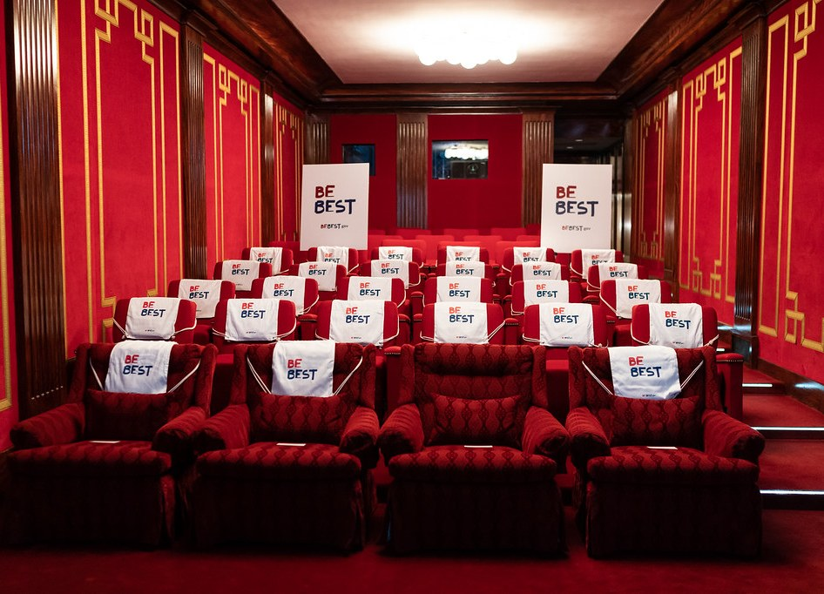
Knowledge Discovery (Niche Tagging)
Beyond Broad Classifications
Media content cannot always be simplified into generic genres like "Action" or "Horror". Real audience preferences are far more nuanced.
Analyzing Viewing Behaviors
Evaluating raw user telemetry allows data systems to construct refined, granular sub-clusters that discover latent features.
Micro-Tagging at Scale
Netflix extracts hyper-specific tags like "Character-driven Suspense" or "Children's Shows featuring Vehicles", optimizing the discovery interface.
Figure: Evolutionary shift from traditional taxonomy to multi-dimensional micro-tags. (Source: YouTube youtu.be/0CGQvdAbNcc t=9:13)
Ryohei Hisano, The University of Tokyo 2021 CC BY-NC-SA
6

Slide 6

R&D Planning and Decision Support
Operational Feedback Loops
Insights obtained from hypothesis testing and knowledge discovery directly feeds back into production plans and executive decision support.
1
Original Production Economics
The rising volume of "Original Series" across platforms (e.g., Netflix, Amazon Prime) heavily relies on historic data to model creative development.
2
Empirical Creative Decisions
3
Telemetry is used to optimize casting combinations, structural pacing, scene composition, and budget allocation, mitigating expensive creative risks.
Figure: Continuous integration of data insights into studio production decisions. (Source: YouTube youtu.be/0CGQvdAbNcc t=16:46)
Ryohei Hisano, The University of Tokyo 2021 CC BY-NC-SA
7

Slide 7
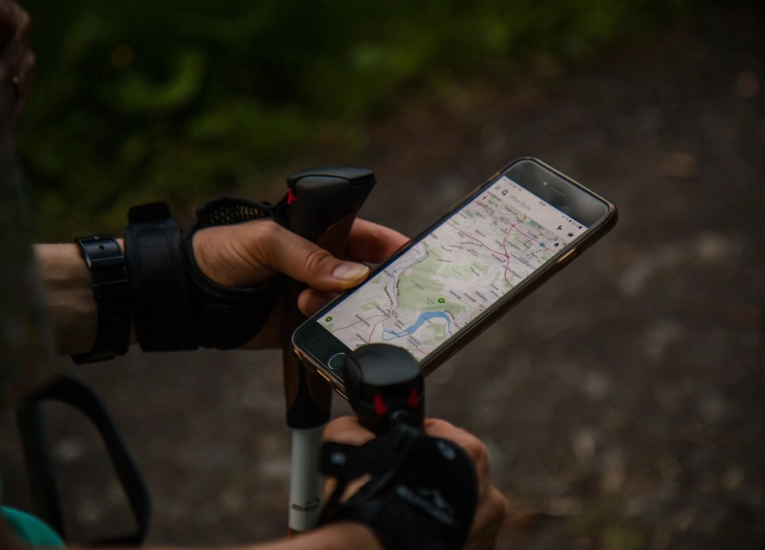
New Business Models: Marketing
Data-Driven Root Cause Analysis
Modern marketing utilizes telemetry to identify the precise underlying drivers behind purchasing behaviors rather than relying on correlation.
Behavioral Log Integration
Integrating search engine footprints and query telemetry yields unparalleled predictive capabilities on consumption waves.
Spatio-Temporal GPS Analysis
High-frequency geospatial coordinates from mobile devices are actively parsed to measure demographic density and municipal mobility index during critical social emergencies.
External References: mobaku.jp & valuesccg.com
Ryohei Hisano, The University of Tokyo 2021 CC BY-NC-SA
8

Slide 8

Activity Substitution: Smart Manufacturing
Automation on the Factory Floor
Applying artificial intelligence and advanced data science on manufacturing lines represents a major shift toward high-performance activity substitution.
Computer Vision Quality Control
Major food manufacturers (e.g., Kewpie) utilize AI computer vision systems directly within raw ingredient sorting processes to analyze quality in real time.
Automated Sorting
Deep learning models identify defects, anomalies, and foreign objects in raw materials (like potatoes), mimicking and replacing human visual sorting with 24/7 consistency.
Figure: Simulated conveyor-line computer vision defect detection dashboard. [BrainPad Case Study](https://ai.brainpad.co.jp/case-study/194/)
Ryohei Hisano, The University of Tokyo 2021 CC BY-NC-SA
9

Slide 9
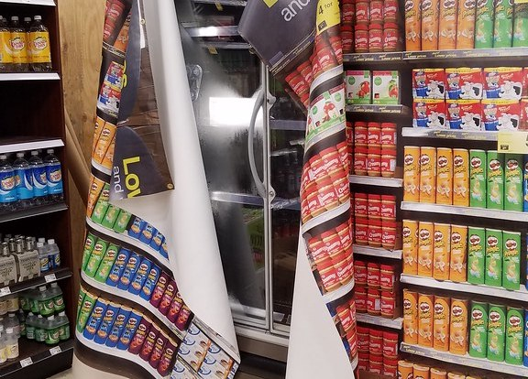
Activity Substitution: Inventory Management
Smart Stock Control
Analyzing real-time computer vision feeds in warehouse and store shelf environments completely automates standard physical inventory audits.
Demographic Profiling via Security Feeds
Security camera streams can be cross-analyzed to evaluate customer metrics such as age and gender demographics while strictly maintaining baseline data protection standards.
Synergistic Demand Forecasting
Combining shelf inventory levels with demographic purchasing patterns yields powerful, context-aware demand forecasting models that drastically optimize supply chains.
Figure: Synergistic integration of visual monitoring and behavioral metrics. [Case Study: Arts & Crafts](https://www.arts-crafts.co.jp/post-1997/)
Ryohei Hisano, The University of Tokyo 2021 CC BY-NC-SA
10

Slide 10
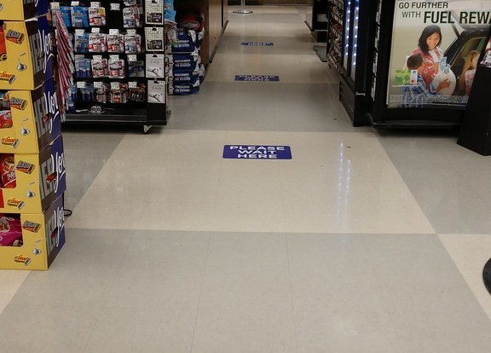
Activity Substitution: Unmanned Retail
Technological Convergence
Synergizing automated self-checkout technology with advanced, camera-based inventory and tracking processes enables completely unmanned retail operations.
Addressing Demographic Challenges
This paradigm represents a critical infrastructural solution for countries experiencing rapid demographic aging, severe labor shortages, and rural depopulation.
Pioneering Deployments
Early commercial deployments include automated pilot stores (e.g., Lawson, Monotaro AI stores), proving the viability of labor-minimized commerce models.
Figure: Unmanned store deployments and technological synergy. [Techfirm Retail Blog](https://www.techfirm.co.jp/blog/unmanned-stores-in-japan)
Ryohei Hisano, The University of Tokyo 2021 CC BY-NC-SA
11

Slide 11

AI Implementation: Autonomous Vehicles
Integration of Multi-AI Technologies
Autonomous driving technology serves as an easily understandable, comprehensive model for the societal implementation of modern AI.
Replacing Human Environmental Perception
To control a vehicle safely, simple execution of driving functions is not enough. The vehicle must accurately interpret video feeds from external camera inputs to perform advanced situations analysis.
Target Objects of Computer Vision
The core of safety hinges on the rapid, real-time recognition of obstacles, pedestrian movement, and international road traffic regulations.
Figure: Simulated recognition targets for computer vision models (e.g., STOP and NO ENTRY regulations).
Ryohei Hisano, The University of Tokyo 2021 CC BY-NC-SA
12

Slide 12
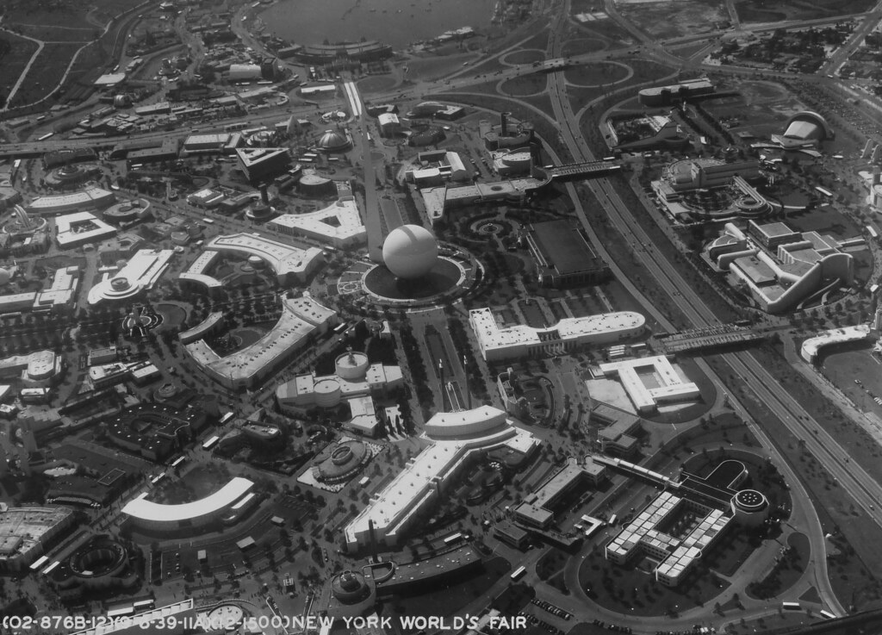
Connected Cars: Shared Network Telemetry
Real-Time Context Adjustments
To perform accurate situation analysis, autonomous vehicles must continuously parse changing environments (e.g., localized weather, accidents, and fuel/charging stations).
Collective Telemetry Over Isolation
Rather than operating in isolated computation loops, sharing telemetry across multiple vehicles creates far superior, crowd-sourced map precision.
The Connected Car Architecture
This strategic vision of inter-vehicular communication and centralized server telemetry aggregation is termed the "Connected Car" paradigm.
Figure: Connected Car data-exchange architecture. [Ministry of Internal Affairs and Communications](https://www.soumu.go.jp/main_content/000501374.pdf)
Ryohei Hisano, The University of Tokyo 2021 CC BY-NC-SA
13

Slide 13
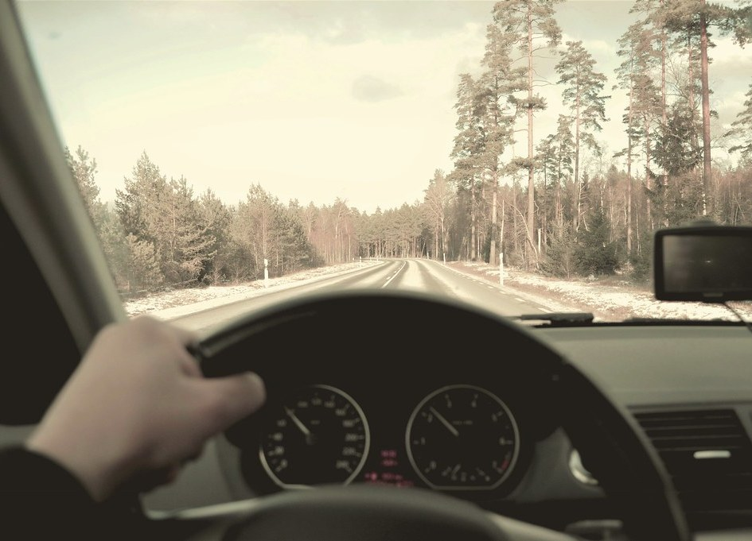
Connected Cars: NaviCon System
Real-Time Destination Recommendation
Connected vehicles open rich possibilities for localized, context-aware point-of-interest (POI) and destination recommendations while driving.
Seamless Smartphone Integration
Interfacing smartphone navigation directly with vehicle hardware allows dynamic route adjustments and on-the-fly spot recommendations based on live travel telemetry.
Industry Implementation: DENSO NaviCon
Developed by DENSO, the NaviCon application serves as a prime industry model, enabling seamless synchronization of smartphone-selected targets with vehicle infotainment units.
Figure: Dynamic POI transmission architecture. [DENSO NaviCon](https://navicon.com/user/support/howto/index.html)
Ryohei Hisano, The University of Tokyo 2021 CC BY-NC-SA
14

Slide 14
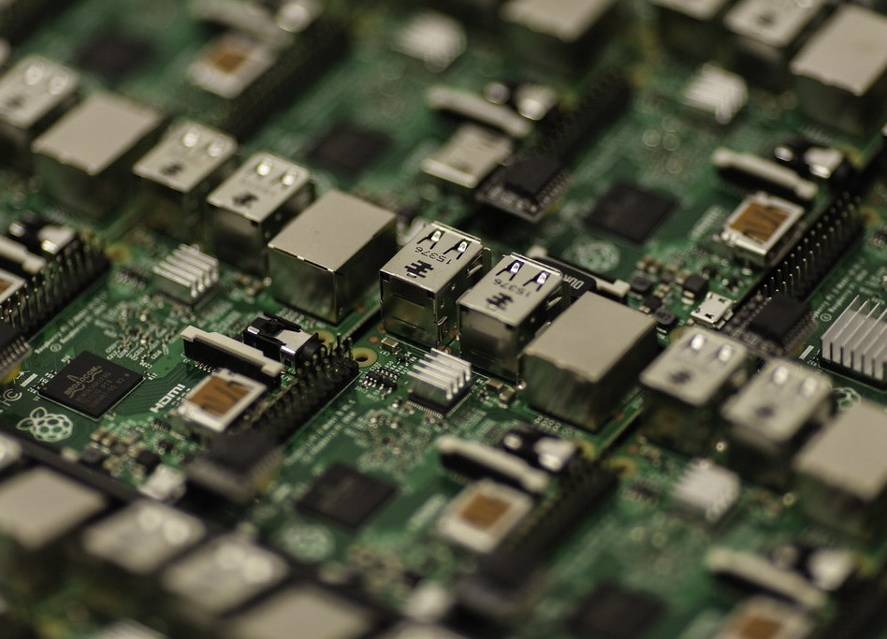
The Data-Driven Society Concept
Harnessing Big Data
As demonstrated by autonomous and connected vehicles, aggregating massive datasets via ubiquitous IoT devices serves as the primary engine for providing advanced AI-driven public services.
Definition of Data-Driven Society
A "Data-Driven Society" refers to a societal ecosystem where big data collection and algorithmic decision-making actively dictate resource allocation and social optimization.
Foundational Vision for the Future
This concept acts as the cornerstone for next-generation economic, industrial, and administrative strategies globally.
Figure: Systematic flow of continuous data leveraging. [Ministry of Economy, Trade and Industry (METI)](https://www.meti.go.jp/committee/sankoushin/shojo/johokeizai/report_001.html)
Ryohei Hisano, The University of Tokyo 2021 CC BY-NC-SA
15

Slide 15
Science & Technology Basic Plan
The Five-Year Legislative Cycle
In Japan, the Science and Technology Basic Law mandates the formulation of the Science and Technology Basic Plan every five years to anchor national research policies.
The 5th Basic Plan
Coherent Historical Phases
Fiscal Years 2016 – 2020
These strategic phases systematically dictate funding parameters and cross-institutional priorities across public, private, and academic sectors.
Introduction and Definition of Society 5.0
The 6th Basic Plan
Fiscal Years 2021 – 2025
The Birth of Society 5.0
Focus on rapid social implementation & innovation
First proposed as the ideal blueprint for Japan's future under the 5th Basic Plan (FY2016-FY2020), this vision sets the definitive tone for national innovation.
Source: [Cabinet Office, Government of Japan](https://www8.cao.go.jp/cstp/society5_0/)
Ryohei Hisano, The University of Tokyo 2021 CC BY-NC-SA
16

Slide 16
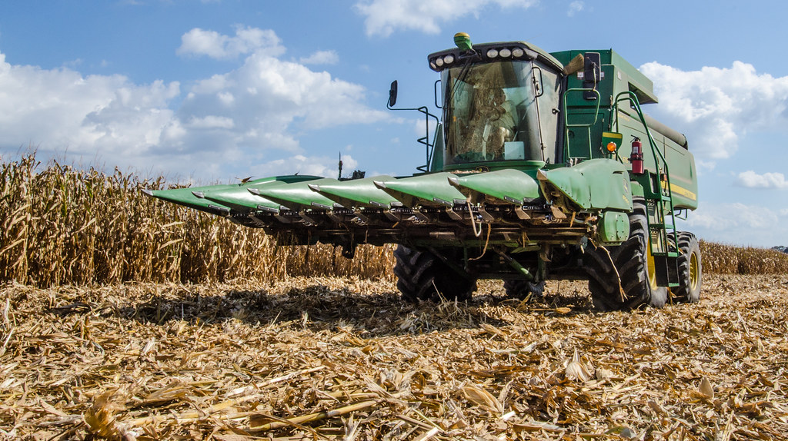
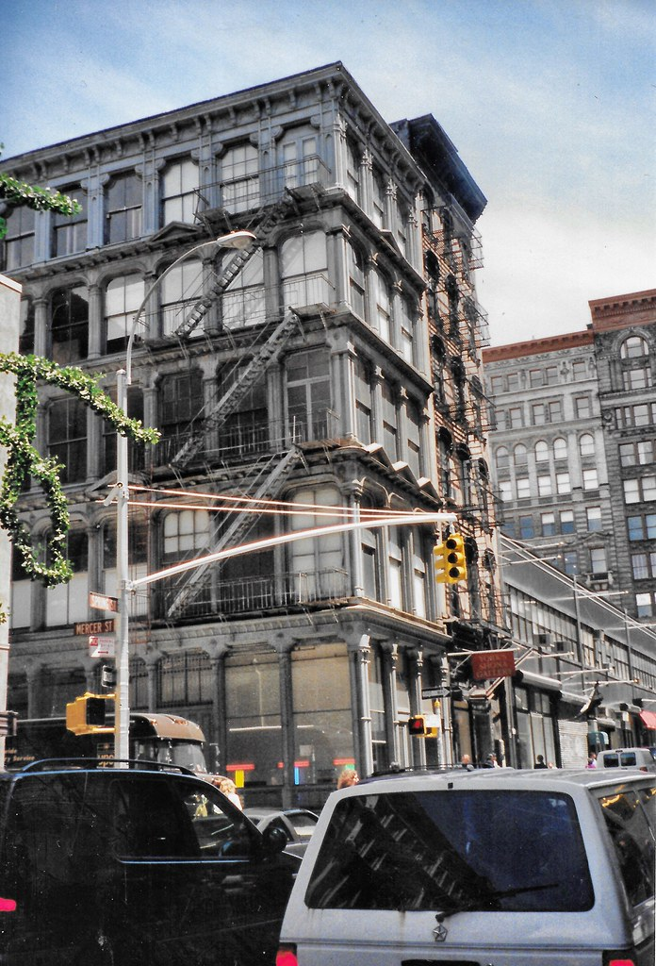
SOCIETY 1.0 - 3.0: Historical Transitions
Society 1.0: Hunting & Gathering
The primordial stage of human civilization, sustained entirely by direct collection of wild plants and cooperative hunting in nature.
Society 2.0: Agricultural Settlement
Triggered by the agricultural settlement revolution. Established permanent living and agricultural cultivation, dominant up to the late 18th century.
Society 3.0: Industrial Revolution
Initiated by the Industrial Revolution in the late 18th century. Shifted humanity toward factory mass production and fossil fuel energy utilization (18th to late 20th century).
Ryohei Hisano, The University of Tokyo 2021 CC BY-NC-SA
17

Slide 17
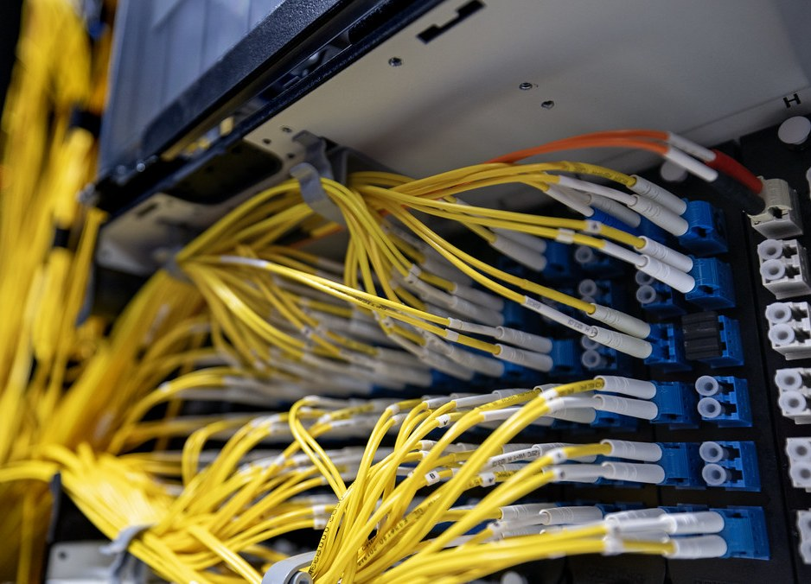
SOCIETY 4.0: The Information Society
SOCIETY 4.0 Definition
The "Information Society" (representing modern society) succeeded Industrial Society, defined fundamentally by computing and data networks.
The Proliferation of Web & Internet
The rapid adoption of computers and internet connectivity catalyzed a hyper-connected public landscape, yielding massive data growth.
The "Data Overflow" Trap
In this era, humanity has essentially become overwhelmed by big data, with information retrieval and manual synthesis posing heavy cognitive and structural burdens.
Source Material: [Cabinet Office, Government of Japan](https://www8.cao.go.jp/cstp/society5_0/)
Ryohei Hisano, The University of Tokyo 2021 CC BY-NC-SA
18

Slide 18

SOCIETY 5.0: The Cyber-Physical Concept
A New Structural Interface
Unlike Society 4.0, which relies on humans manually searching, analyzing, and acting upon cloud-sourced knowledge, Society 5.0 automates this loop.
Deep Cyber-Physical Fusion
In this paradigm, extensive IoT sensor arrays map physical-space dynamics into high-performance cyber-space computing environments instantly.
AI-Integrated Execution
Advanced artificial intelligence models parse this cyber representation to deliver automated optimizations directly back into physical reality, breaking previous structural limits.
Figure: Evolution of Cyber-Physical workflow orchestration. [Cabinet Office](https://www8.cao.go.jp/cstp/society5_0/)
Ryohei Hisano, The University of Tokyo 2021 CC BY-NC-SA
19

Slide 19
SOCIETY 5.0: The Four Strategic Pillars
01
02
Omni-Connected IoT Synergy
Demographic Innovation
Bridging isolated information spaces via unified IoT frameworks. Promotes massive data synergy and creates entirely new value streams.
Leveraging systematic technology and robotic automation to address the socioeconomic challenges of aging populations and regional depopulation.
03
04
Cognitive Offloading via AI
Physical Capability Expansion
Shifting the burden of data searching and curation onto autonomous AI models, providing contextual intelligence exactly when needed.
Drastically expanding human capabilities, transport logistics, and mechanical safety through autonomous driving fleets and assistive robotics.
Ryohei Hisano, The University of Tokyo 2021 CC BY-NC-SA
20

Slide 20
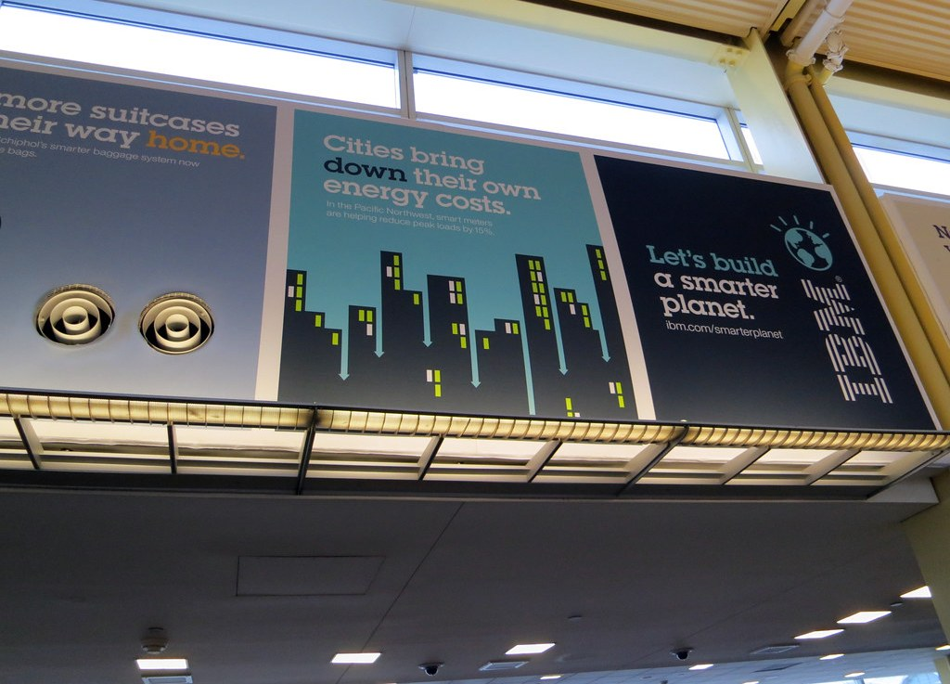
Implementation Platform: Smart Cities
Precursor to Society 5.0
Smart Cities serve as the pioneering sandbox, testbed environments, and baseline infrastructure for realizing the strategic objectives of Society 5.0.
Public-Private Partnerships (PPP)
In August 2018, the Government of Japan established the Smart City Public-Private Partnership Platform to coordinate administrative legislation and tech ecosystems.
Unified Technological Integration
These initiatives sync municipal transit, public administration, healthcare, and energy sectors into unified IoT structures.
Partnership Platform
Ryohei Hisano, The University of Tokyo 2021 CC BY-NC-SA
21

Slide 21
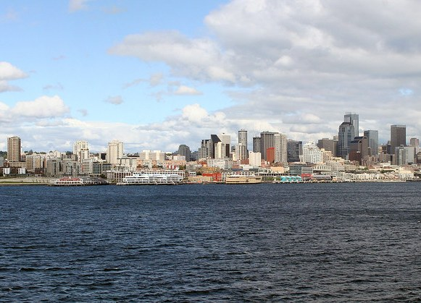
National Strategy: The Super City Law
Accelerating Societal Transition
To scale up smart cities into highly integrated "Super Cities" (Society 5.0), Japan passed landmark legislation to execute cross-cutting regulatory reforms.
Amendment Passage (May 2020)
The Diet passed the Bill to Partially Amend the National Strategic Special Zones Act (commonly referred to as the Super City Law), enabling localized regulatory bypasses.
Synergistic Multi-Domain Services
Rather than optimizing single verticals, the law coordinates data links across multiple life-supporting services (finance, medical, energy) to establish clear demographic value evaluated by local citizens.
Source: [National Strategic Special Zones Open Lab](https://www.kantei.go.jp/jp/singi/tiiki/kokusentoc/supercity/openlabo/supercitycontents.html)
Ryohei Hisano, The University of Tokyo 2021 CC BY-NC-SA
22

Slide 22
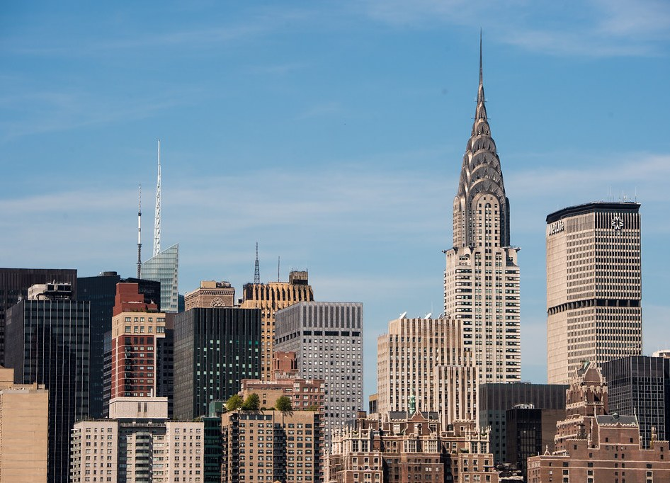
Smart City Model: Toyota Woven City
Human-Centered Living Laboratory
Toyota's Woven City represents a prime, privately-funded real-world testbed designed specifically to test emerging technologies in a real residential setting.
Three Core Philosophy Pillars
The project centers around three immutable core values: Human-Centered Design, A Living Laboratory for experimental technologies, and An Ever-Evolving, Unfinished City.
Demographic Scaling
Starting with 360 residents and expanding to over 2,000 (including researchers and engineers), the city constructs a live data framework to solve critical urban challenges.
Project Hub: [Woven City Global Portal](https://www.woven-city.global/jpn)
Ryohei Hisano, The University of Tokyo 2021 CC BY-NC-SA
23

Slide 23
The 6th Basic Plan (Innovation Strategy)
A Brand-New Nomenclature
Covering FY2021-FY2025, Japan renamed its legislative policy to the "Science, Technology, and Innovation Basic Plan" to emphasize social implementation.
Rapid Social Deployment
The core objective shifts from basic laboratory research toward rapid, crisis-aware social implementation loops to realize Society 5.0 immediately.
Concrete Materialization of Society 5.0
Crisis-Aware Speed in Social Implementation
Broad Structural Goals
Prioritizes robust R&D investment parameters, global talent cultivation, collaborative socio-technical dialogue, and resilient systems capable of tackling public health and national safety crises.
Cultivation of Global Research Talent
Enhanced Public-Private R&D Investment
Source: [CSTP Innovation Basic Plan](https://www8.cao.go.jp/cstp/kihonkeikaku/index6.html)
Ryohei Hisano, The University of Tokyo 2021 CC BY-NC-SA
24

