Slide 1
Section 2-1
Big Data and
Data Engineering
The University of Tokyo
Center for Research and Development on Transition to Modern Education
May 26, 2021
Hiroshi Saito, The University of Tokyo 2021 CC BY-NC-SA
1

Slide 2
Overview
Understanding the progress of ICT and Big Data Systems:
01
Socio-Technical Infrastructure Background
Understand the technological background and infrastructural advancements (e.g., broadband and cellular evolution) that made data engineering possible.
02
Multi-Domain Industrial Applications
Explore practical data-driven case studies across retail, manufacturing, logistics, and primary industries (agriculture & fishery).
Hiroshi Saito, The University of Tokyo 2021 CC BY-NC-SA
2

Slide 3
Table of Contents
I.
Conceptual Definition and Data Proliferation
pp. 4-5
II.
Four Key Challenges of Big Data Leverage
p. 6
III.
Enabling Background: ICT & Hardware Infrastructure
pp. 7-13
IV.
Multi-Domain Case Studies (Retail, Logistics, Industrial)
pp. 17-26
V.
Socio-Technical Data Classifications & Primary Sector
pp. 27-31
Hiroshi Saito, The University of Tokyo 2021 CC BY-NC-SA
3

Slide 4
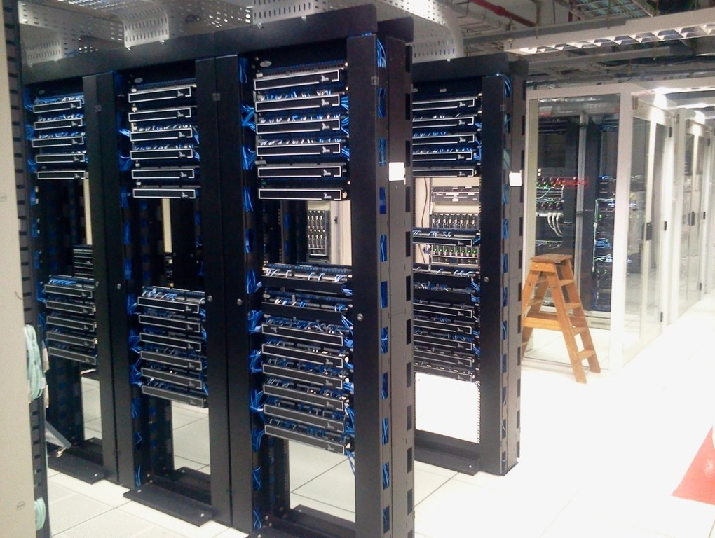
Defining Big Data
Massive Digital Telemetry
At its core, Big Data refers to massive volumes of digital information that are generated, formatted, and propagated seamlessly across the internet.
The Proliferation of Behavioral Logs
Typical examples include social network interactions (SNS), search histories, and purchase telemetry on e-commerce platforms or physical POS retail networks.
Natural & Experimental Observations
Big data extends to scientific and natural realms, such as high-frequency meteorological data, seismic wave sensors, and particle physics experiment outputs.
Source: [McKinsey Report (2011)](https://www.mckinsey.com/business-functions/mckinsey-digital/our-insights/big-data-the-next-frontier-for-innovation)
Hiroshi Saito, The University of Tokyo 2021 CC BY-NC-SA
4

Slide 5

The Proliferation of Data Volume
Ubiquitous Data Generation
Modern society is constantly surrounded by massive streams of continuous data. Every micro-action contributes directly to the expansion of the digital universe.
High-Frequency Micro-Actions (Per Minute)
Statistical studies reveal staggering levels of data creation every single minute: millions of media views, hundreds of millions of emails, and hundreds of thousands of uploads.
Accelerating Big Data Creation
This organic, user-driven behavior across smartphones, applications, and social platforms acts as the primary catalyst accelerating big data generation globally.
Every minute metrics based on 2019 census data. [Domo Data Blog](https://web-assets.domo.com/blog/wp-content/uploads/2019/07/data-never-sleeps-7-896kb.jpg)
Hiroshi Saito, The University of Tokyo 2021 CC BY-NC-SA
5

Slide 6
Four Key Challenges of Big Data Leverage
01
02
Massive Storage Capacity
High-Performance Processing
How to reliably and cost-effectively ingest, store, and partition petabyte-scale unstructured datasets over time.
Achieving low latency and high throughput when filtering, sorting, or joining massive datasets in distributed architectures.
03
04
High-Value Knowledge Extraction
Security & Privacy Protection
Leveraging statistical models, machine learning, and semantic pipelines to convert raw telemetry into valuable business insights.
Establishing robust cryptographic frameworks, anonymization, and access control models to safeguard sensitive user data.
Hiroshi Saito, The University of Tokyo 2021 CC BY-NC-SA
6

Slide 7

Enabling Background: ICT Progress
Rapid Progress of ICT
The rising prominence of Big Data and modern Data Engineering is unequivocally driven by the massive advancements in Information and Communications Technology (ICT).
Explosive Data Ingestion Capabilities
High-capacity telecommunication infrastructure has drastically boosted data collection pipelines. Simultaneously, user behaviors (e.g. SNS) have moved raw data production completely online.
Focus on Network Proliferation
To understand this evolution, we must analyze the rapid penetration of high-speed broadband and high-bandwidth wireless cellular networks globally.
Figure: Structural flow of modern network data ingestion.
Hiroshi Saito, The University of Tokyo 2021 CC BY-NC-SA
7

Slide 8
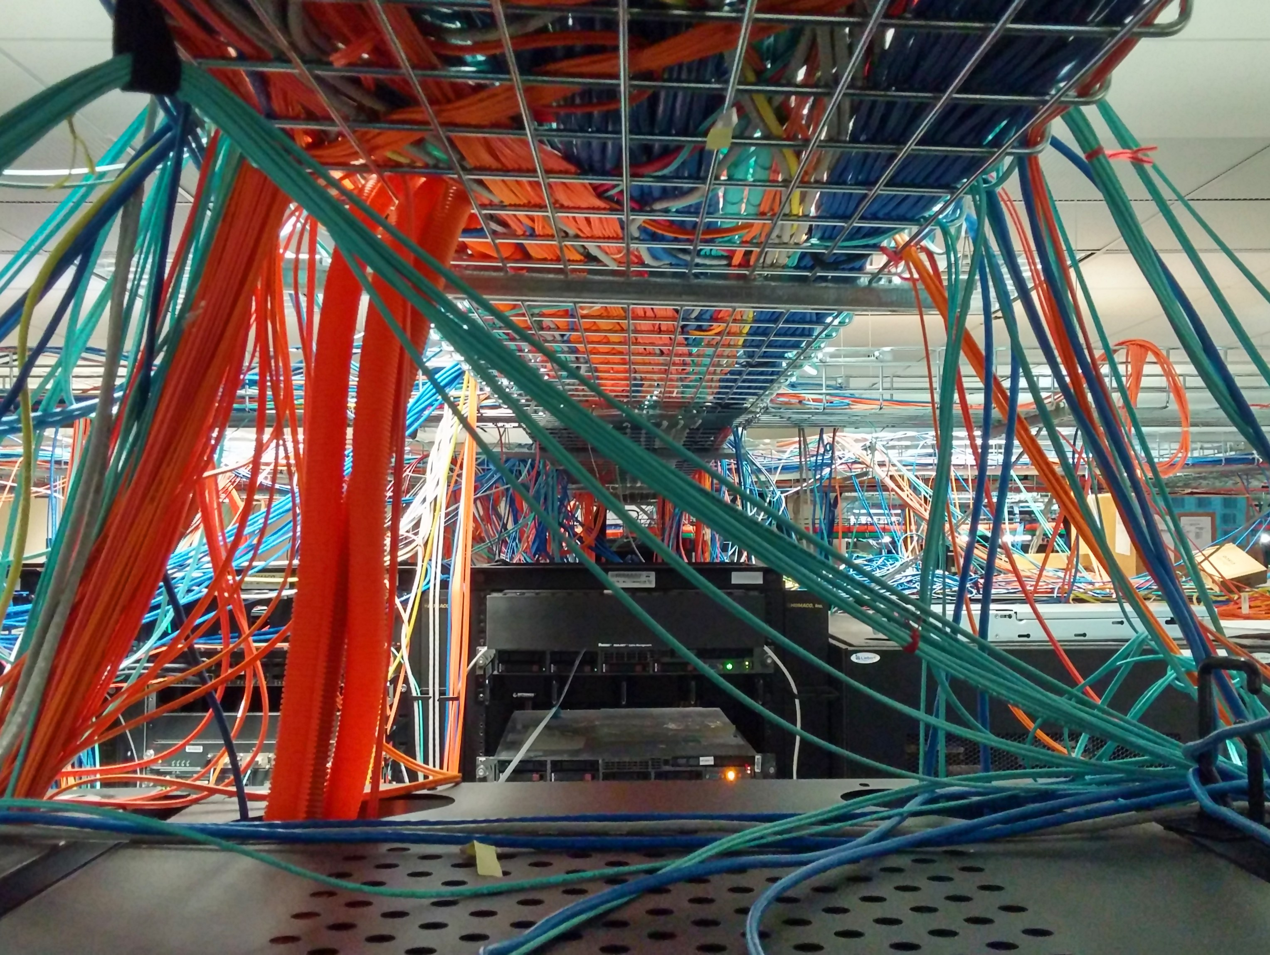
The Evolution of Broadband Contracts
Wired & Wireless Proliferation
The structural metrics show a rapid transition toward high-speed, high-performance bandwidth lines on both fixed and mobile networks.
Fixed Broadband Growth
Fixed-line infrastructure migrated rapidly from copper DSL models to ultra-fast fiber FTTH (Fiber-to-the-Home) networks, establishing Gbps-scale household access.
Explosive Mobile Ingestion
The adoption of broadband mobile contracts (such as LTE and BWA) surpassed fixed networks by orders of magnitude, cementing continuous, high-volume mobile telemetry.
Source: [Ministry of Internal Affairs and Communications (MIC) White Paper (2020)](https://www.soumu.go.jp/johotsusintokei/whitepaper/ja/r02/html/nd252210.html)
Hiroshi Saito, The University of Tokyo 2021 CC BY-NC-SA
8

Slide 9
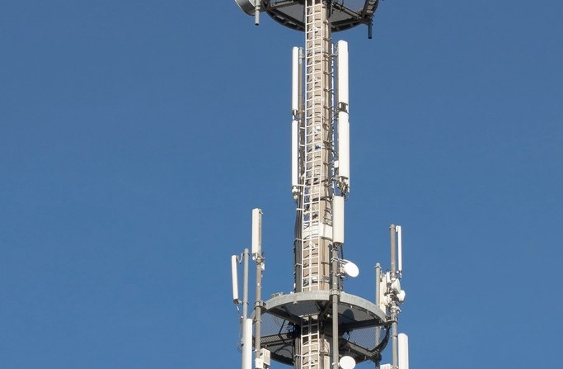
Mobile Network Traffic Explosion
Socio-Technical Traffic Growth
Paralleling the broadband contract proliferation is the exponential surge in actual mobile network traffic transiting through regional telecommunication cellular towers.
High-Frequency Mobile Adoption
The rising integration of high-definition streaming, cloud telemetry, app distribution, and continuous GPS location tracking has generated astronomical traffic growth.
The Data Engineering Mandate
Handling these soaring multi-terabit network loads made the development of highly scalable distributed computing frameworks and database engines an absolute necessity.
Figure: Rapid exponential growth curve of mobile communication traffic. [MIC Whitepaper](https://www.soumu.go.jp/johotsusintokei/field/data/gt010602.pdf)
Hiroshi Saito, The University of Tokyo 2021 CC BY-NC-SA
12

Slide 10

Storage Hardware Expansion Trends
Solving the Ingestion Bottleneck
The first primary challenge of big data leverage—retaining massive volumes of information—was systematically resolved by hardware innovations in storage density.
Magnetic & Solid State Evolution
Over recent decades, HDD (Hard Disk Drive) density and DRAM (Dynamic Random Access Memory) chip capacity have followed an aggressive exponential growth curve.
Foundations of Distributed Databases
This rapid, hardware-driven drop in cost-per-gigabyte laid the indispensable foundation for building modern, distributed database architectures.
Figure: Historical capacity expansion trends of HDD and DRAM hardware. [NHK Science & Technology Research Labs](https://www.nhk.or.jp/strl/publica/rd/181/2.html)
Hiroshi Saito, The University of Tokyo 2021 CC BY-NC-SA
13

Slide 11
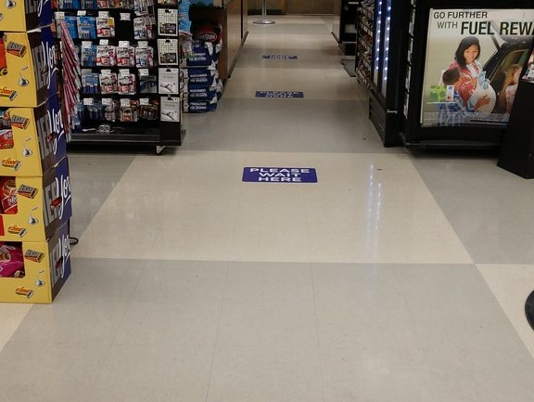
Big Data Case Studies: POS Analytics
Physical Point-of-Sale Telemetry
Recording transactions directly inside physical retail outlets (POS) captures rich behavioral metadata, acting as a crucial component of modern marketing analytics.
Market Basket & Supply Synergy
Analyzing co-occurrence probabilities of purchase items enables optimal shelf layouts. Modeling temporal variations allows adaptive supply chain planning based on weather or localized events.
Direct Campaign Measurement
Analyzing exact purchase reaction logs after marketing campaigns allows food & beverage enterprises to drastically trim wasteful advertising costs while expanding gross margins.
Case Study: One-to-One Marketing Campaign Efficiency. [Liskul Retail Analytics](https://liskul.com/one-to-onemarketing-13202)
Hiroshi Saito, The University of Tokyo 2021 CC BY-NC-SA
17

Slide 12

Big Data Case Studies: EC Marketing
Granular Behavioral Logs
Unlike physical stores, digital actions on e-commerce (EC) platforms generate continuous, granular clickstream logs and behavioral records per individual user.
Cookie-Based Identity Tracking
Utilizing client-side cookie identifiers and past purchase histories allows operators to run personalized, real-time campaign optimizations rather than mass marketing.
One-to-One Marketing Paradigm
This systematic strategy focuses on targeting users individually with tailored recommendations or related-product promotions, which boosts conversion rates.
Concepts: E-commerce behavioral telemetry and personalized targeting.
Hiroshi Saito, The University of Tokyo 2021 CC BY-NC-SA
18

Slide 13

Two Paradigms of Recommendation
Value of Recommendation Systems
Recommendation systems represent one of the most commercially successful implementations of big data, serving as a primary driver of digital platform engagement.
Collaborative Filtering
Models user preferences based entirely on aggregate purchase histories of other similar users. It requires no demographic metadata but suffers from cold-start problems with new items.
Content/Attribute-Based Filtering
Utilizes metadata profiles of users and product attributes directly. While highly effective at recommending brand-new releases, it cannot function if attribute profiles are missing.
Figure: Comparing collaborative filtering vs. attribute-based approaches.
Hiroshi Saito, The University of Tokyo 2021 CC BY-NC-SA
19

Slide 14

Amazon: Item-to-Item Collaborative Filtering
Personalization as the Core Strategy
Amazon.com leverages its recommendation engine not merely as an add-on, but as a central framework to completely personalize the user's web storefront experience.
Item-to-Item Collaborative Filtering
First implemented in 1998, this classic algorithm pairs purchased items with closely-related inventory. This approach scales seamlessly to millions of concurrent customers.
Hybrid Offline/Online Computation
Computes complex product similarity tables entirely offline. The online component performs simple key-value lookups based on a user's active cart, ensuring sub-second response times.
Source: [Linden, Smith, & York (2003)](https://ieeexplore.ieee.org/document/1167344) & [Smith & Linden (2017)](https://ieeexplore.ieee.org/document/7924241)
Hiroshi Saito, The University of Tokyo 2021 CC BY-NC-SA
21

Slide 15

YouTube: Co-viewing Recommendation Model
Defining Video Relatedness
YouTube maps video associations based on co-viewing patterns—identifying which subsequent videos are watched after viewing an initial Video A.
Precomputed Association Sets
The algorithm pre-calculates the Top-N related videos for each entry, forming a precomputed related video set R(A) to ensure instantaneous serving latency.
Recursive Recommendation Graph
The live system cross-references active user histories with these sets, expanding recommendations to include secondary degrees of association, such as related videos of R(A).
Source: [Davidson et al., ACM Recommender Systems (2010)](https://dl.acm.org/doi/10.1145/1864708.1864770)
Hiroshi Saito, The University of Tokyo 2021 CC BY-NC-SA
22

Slide 16

Netflix: Multi-Algorithm Recommendation Matrices
High CTR Conversion Drive
Approximately 80% of total viewing hours on Netflix are driven directly by personalized recommendations, underscoring the critical business value of algorithmic personalization.
The Unified Grid Interface
Rather than using a single algorithm, Netflix serves a matrixed interface where each horizontal row represents an entirely different specialized recommender model.
Multi-Dimensional Scoring
Separate algorithms run concurrently in real time, sorting specific categories, trending releases, and genre preferences adjusted to user demographic profiles.
Figure: Mock of row-based algorithm mapping in the Netflix interface. [Gomez-Uribe & Hunt (2016)](https://dl.acm.org/doi/10.1145/2843948)
Hiroshi Saito, The University of Tokyo 2021 CC BY-NC-SA
23

Slide 17

Big Data Case Studies: Human Mobility
Mapping Spatio-Temporal Flows
Measuring, predicting, and optimizing human movement dynamics in physical space represents a highly impactful area of big data application.
Optimizing Public Spaces
Commercial and public organizations capture visitor movement patterns within museums or retail layouts to dynamically restructure pathing, traffic signs, and exhibits.
Emergency Disaster Navigation
Connecting real-time crowding telemetry with digital signage systems allows authorities to dynamically route evacuation paths during catastrophic natural events.
Source: [AIST Artificial Intelligence Research Center](https://www.airc.aist.go.jp/achievements/ja/p-028.html) & [Nikkei XTech](https://xtech.nikkei.com/it/atcl/column/14/122600137/122600001/)
Hiroshi Saito, The University of Tokyo 2021 CC BY-NC-SA
24

Slide 18

Big Data Case Studies: Machine Telemetry
Industrial IoT Telemetry
Just as human behavioral logs are parsed as big data, high-frequency physical telemetry and machine operational logs represent an identical paradigm shift.
Global Fleet Ingestion: Komatsu KOMTRAX
As an industry pioneer, Komatsu equips standard machinery fleets with KOMTRAX sensors, centralizing real-time positioning and mechanical strain logs over wireless networks.
Predictive Failure Analysis
Turbine power plant operators (e.g., IHI) aggregate massive operational telemetry, modeling baseline dynamics to predict critical anomalies and prevent physical failure.
References: [Komatsu KOMTRAX](https://sanki.komatsu/komtrax/) & [IHI Lifecycle Operation Support](https://www.ihi.co.jp/powersystems/lifecycle/operation_support/index.html)
Hiroshi Saito, The University of Tokyo 2021 CC BY-NC-SA
25

Slide 19

Big Data Case Studies: Syslog Diagnostics
System-Level Event Logs
High-volume information system logs represent critical, unstructured big data, parsed extensively to model complex infrastructure health.
Failure of Simple Rule-Based Alerts
Standard networks rely on hardcoded thresholds for hardware failures. However, they struggle to capture latent, pre-failure anomalies, traditionally relying on veteran experience.
Mapping Co-occurrence (Syslog Analysis)
A single anomaly triggers cascading logs across multiple network elements. Modeling these co-occurrence events enables highly precise diagnostic mapping.
Source: [T. Kimura, Syslog Analysis for Large-scale Network Failures (2015)](https://search.ieice.org/bin/summary.php?id=j98-b_9_823)
Hiroshi Saito, The University of Tokyo 2021 CC BY-NC-SA
26

Slide 20
Socio-Technical Data Classifications
01
02
Image Telemetry
Voice & Audio Streams
Advanced image processing algorithms for automated piloting systems, vehicle identification, smart food sorting, and deep-learning cancer detection.
Continuous voice recognition (Apple Siri, Alexa) paired with advanced text-to-speech synthesis models used in automated news anchors.
03
04
Document & Natural Language
Sensor & Temporal Logs
Leveraging neural machine translation models (Google GNMT) and deep generative neural networks to automate comprehensive article writing.
High-frequency industrial IoT, syslog co-occurrence networks, GPS mobility tracks, and point-of-sale customer purchase history logs.
Hiroshi Saito, The University of Tokyo 2021 CC BY-NC-SA
27

Slide 21
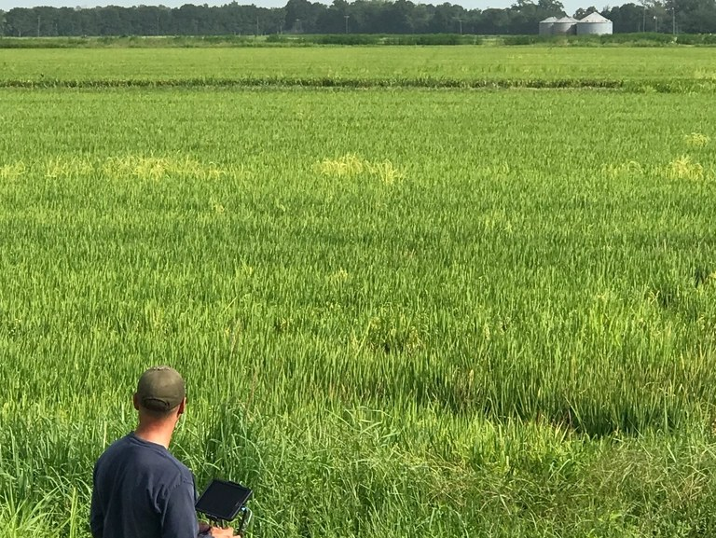
Industrial Innovations: Smart Agriculture
Spatio-Temporal Crop Monitoring
Analyzing farm conditions via multispectral satellite imagery and ground-level wireless sensor arrays enables highly efficient, localized crop management (e.g., viticulture).
Systematic Agricultural Collaboration
To scale productivity, national initiatives coordinate cross-industry databases, establishing unified data pipelines to sharing climate, soil, and yield metrics.
The WAGRI Integration Initiative
The establishment of the Agricultural Data Collaboration Platform (WAGRI) provides a highly unified API network that integrates public weather, geological, and agricultural telemetry.
Source: [Smart Agriculture Japan](https://smartagri-jp.com/smartagri/20) & [WAGRI Consortium Portal](https://wagri.net/ja-jp/)
Hiroshi Saito, The University of Tokyo 2021 CC BY-NC-SA
30

Slide 22

Industrial Innovations: Smart Fisheries
Predictive Harvest Modeling
Building predictive harvest models based on historical catch records, meteorological conditions, and real-time ocean current sensors optimizes set-net fishery yields.
Deep Sea Resource Forecasting
Pelagic fleets (e.g., skipjack and tuna fisheries) aggregate massive oceanographical datasets, using sea surface temperatures to model fish school movement and map maritime resources.
Smart Aquaculture & Efficiency
Integrating water quality telemetry with automated computer vision feeders optimizes fish growth and operational workflows in modern aquaculture facilities.
Source: [MIC Smart Fishery Initiative (2017)](https://www.soumu.go.jp/main_sosiki/joho_tsusin/top/local_support/ict/jirei/2017_013.html) & [Nissui Aquaculture Life-cycle](https://nissui.disclosure.site/ja/themes/144)
Hiroshi Saito, The University of Tokyo 2021 CC BY-NC-SA
31

Slide 23
Summary: Big Data & Data Engineering
Socio-Technical Co-evolution
The exponential growth of big data is deeply intertwined with high-speed telecommunications, drop in hardware cost-per-gigabyte, and the proliferation of IoT networks.
High-Value Knowledge Extraction
Practical business success across e-commerce (Amazon), streaming (Netflix, YouTube), and logistics hinges on shifting from mass-marketing to precise, one-to-one algorithmic models.
The Broad Industrial Landscape
The Engineering Paradigm
From high-frequency industrial IoT, Syslog anomaly mining, and GPS human mobility networks, to WAGRI agricultural APIs and predictive fisheries, data engineering actively optimizes our primary, secondary, and tertiary sectors.
Transitioning from passive data storage to automated, real-time context-aware decision systems that actively optimize human societal capabilities.
Hiroshi Saito, The University of Tokyo 2021 CC BY-NC-SA
35

