Slide 1
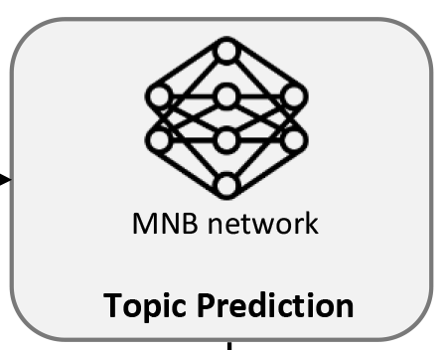
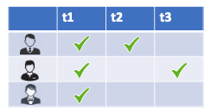

Featured topics
TopFilter-α
CTop topics
MNB network
GitHub repository
Mixed topics

